Slide 1
Controlling Home Moisture for
Indoor Air Quality
Kenneth Hellevang, Ph. D.
Professional Engineer, Professor
North Dakota State University
Notes:
Indoor air quality is important because we breath about 5,000 gallons of air daily and spend about 90% of our time indoors. Everyone’s health is affected by indoor air quality, but children and the elderly are at higher risk of adverse effects. Many indoor air quality problems are related to moisture problems in the home.

Slide 2
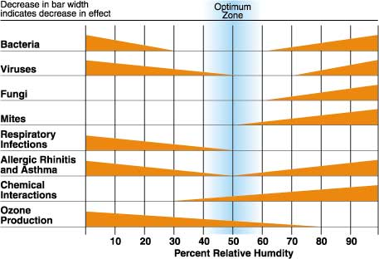
Notes:
The optimum relative humidity for minimizing adverse health effects is between 40% and 60%. Respiratory infections and allergic rhinitis, as well as diseases associated with viruses and bacteria, increase at relative humidity levels below about 30%. Humidity levels above about 70% increase the potential for bioaerosols such as bacteria and fungi or mold.

Slide 3
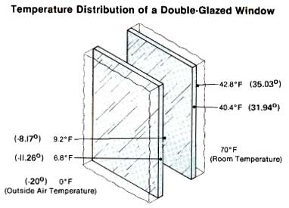
Notes:
Due to condensation problems on windows, we cannot generally maintain humidity levels of 40% to 60% during the winter. When it is 0º F outside, the temperature on the inside glass surface of a double-glazed window will be about 43º F. When room air at 70º F and 40% relative humidity is cooled to 43º F at the window surface, the air relative humidity near the glass surface will be about 100% and condensation will be forming on the glass surface.

Slide 4
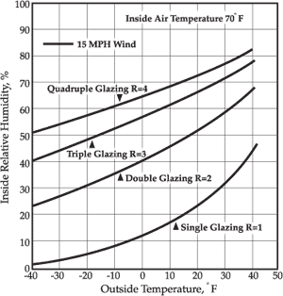
Notes:
A typical double glazed window will have condensation when the inside relative humidity is about 40% at outdoor temperatures of zero or colder. At 30% relative humidity, condensation does not form until outdoor temperatures are below about -20 degrees. Condensation can be controlled by reducing indoor relative humidity. This is normally achieved by increasing the amount of ventilation exchanging inside air with outside air during the winter. The recommended indoor winter relative humidity is about 30% to 40%.

Slide 5
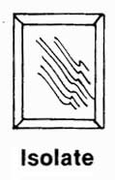
Notes:
The condensation can also be controlled by warming the window surface, by either adding a plastic window covering or using more energy efficient windows.

Slide 6
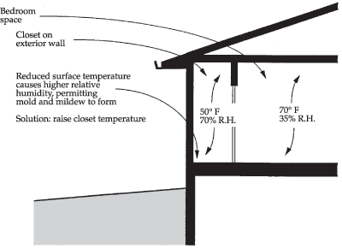
Notes:
Temperature variations in a home may lead to high humidity areas which will be susceptible to mold growth. A 20 degrees drop in temperature causes the relative humidity to double. For example, air at 70 degrees and 35% relative humidity will have a relative humidity of about 70% when cooled to 50 degrees. Mold growth normally occurs at relative humidity levels exceeding about 70%. This is a concern in closets on exterior walls, behind drapery and behind furniture for example. Keep the closet warm by storing things away from the outside wall to allow air circulation. Leave closet doors open during very cold weather. Keep furniture away from outside walls to permit air circulation.

Slide 7
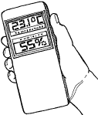
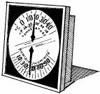

Notes:
A hygrometer is used to measure relative humidity. A hygrometer needs to be calibrated to ensure accuracy. The hygrometer should read about 75% after being placed in a plastic bag with a cup containing about ½ cup of water and 1/4 cup of salt for a period of at least 12 hours. The hygrometer should be calibrated annually, since hygrometers tend to drift. Digital hygrometers tend to be more accurate.

Slide 8
Moisture Production in a Home
Shower (excludes towels & spillage) 1.0 / 10 minute shower
Clothes drying (vented indoors) 5.0 / load
Combustion (unvented space heater) 7.6 / gallon of kerosene
Cooking dinner (family of four) 1.2 (1.6 if gas cooking)
Floor mopping 1.5 / 50 sq. ft.
Respiration (family of four) 0.4 / hour
Desorption of materials: seasonal 6 to 17 / day
New construction 10+/day
Ground moisture migration Up to 100 /day
1.0 pint will increase the relative humidity
by about 8% in a 1,500 sq. ft. single floor home
Notes:
Activities in a home produce moisture which needs to be removed. The addition of one pint of moisture will raise the relative humidity of a 1,500 sq. ft. home by about eight percentage points; 40% to 48%. A ten minute shower produces about 1 pint, an unvented combustion heater produces about 7.5 pints for each gallon of fuel burned, respiration by a family of four produces about 0.4 pint per hour, the desorption of housing materials in the fall will produce about 6 to 17 pints per day, and moisture coming from the ground through the basement concrete may produce up to 100 pints per day.

Slide 9
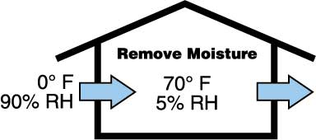
Notes:
This moisture can be removed during times when it is colder outdoors by ventilation, exchanging indoor air with outdoor air. Relative humidity is the relative amount of moisture in the air compared to the amount that the air can hold. Cold air can hold very little moisture. Outside air at 0º F and 90% relative humidity will have a relative humidity of only 5% when warmed to 70º F. The recommended ventilation rate is 0.35 air changes per hour, but not less than 15 cfm per person. This is to remove moisture and pollutants from the house.

Slide 10
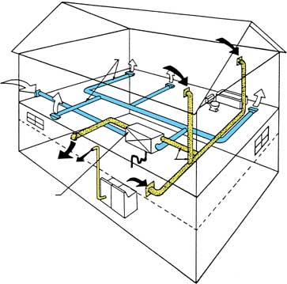
Notes:
An air-to-air heat exchanger is an energy efficient method of obtaining the desired ventilation. Heat in the air being exhausted from the house is used to warm the air being brought into the house. A heat exchanger is about 70 - 80% efficient. A heat exchanger requires maintenance to be effective and efficient.

Slide 11
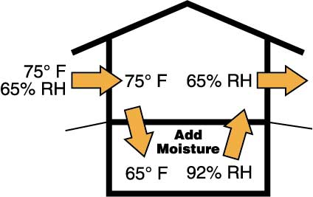
Notes:
During the summer, ventilation may increase the moisture in a basement where it is cooler than outdoor temperatures. Cooling air decreases it’s moisture holding ability and increases it’s relative humidity. Air at 75º F and 65% relative humidity will have a relative humidity of 92% when cooled to 65º F in a cool basement. Therefore, moisture should be removed by running a dehumidifier or an air conditioner.

Slide 12
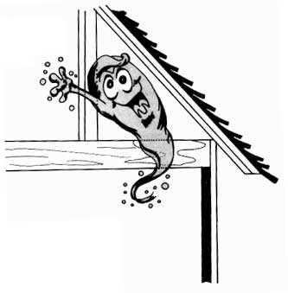
Notes:
Moisture that moves by convection (carried by airflow) through openings and through vapor transmission (moving through the material) into the attic must be removed by ventilation. Provide at least one square foot of vent opening in the attic for each 300 sq. ft of house area if there is a vapor retarder in the ceiling. Provide one-half of the vent area near the peak and one-quarter at each eave or soffit. Twice as much vent area is needed if there isn’t a vapor retarder in the ceiling. One square foot of attic vent area per 150 sq. ft. of house may be used to limit heat gain during hot summer months. Seal all openings around recessed lights and other openings in the ceiling and walls.

Slide 13
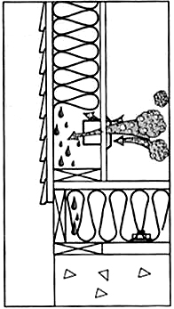
Notes:
All openings in the wall, such as around electrical outlets, or ceiling, such as around recessed light fixtures, need to be sealed to limit moisture transfer into the wall or ceiling. Large amounts of moisture can be transferred through an opening in the wall or ceiling.

Slide 14
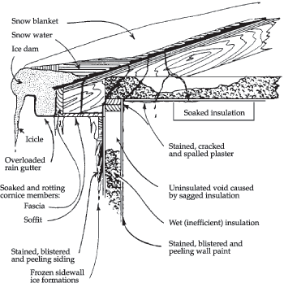
Notes:
Problems associated with ice dams include staining of inside sheeting, wet ineffective insulation, rotting wood, and mold. Ice dams occur when the roof is warm enough to melt snow, due to heat from the house, while the roof over the soffit is cold enough to freeze the water.

Slide 15
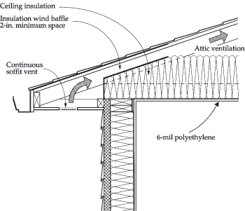
Notes:
The potential for ice dams can be reduced by putting more insulation in the ceiling, providing soffit venting into the attic, and blocking any airflow paths from the living space into the attic.

Slide 16
Water Control
1 inch of rain on 1,000 sq. ft. = 623 gallons
Extend down spouts
Slope ground 1 inch per foot away from the house
Notes:
Approximately 625 gallons of water drains from the roof of a 1,000 sq. ft. house during a one-inch rain. Extend down spouts for several feet from the house, and slope the ground about 1 inch per foot away from the house to minimize the potential for roof water causing water problems in the home.

Slide 17
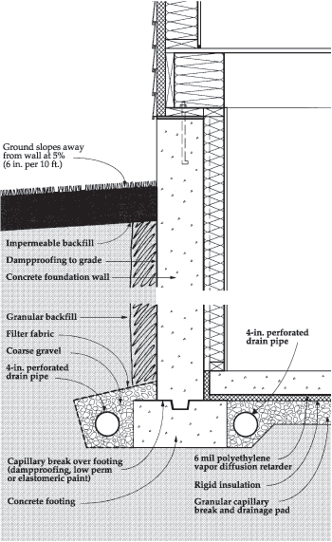
Notes:
Install at least 6 inches of gravel underneath the basement concrete floor. This forms a water drainage layer and radon removal layer. Place a vapor retarder between the concrete floor and the granular layer to minimize radon and moisture entry into the house. Place 4-inch drainage pipe along both the inside and outside of the concrete footing. The top of the drainage pipe should be below the top of the footing. Install a coarse gravel envelope around the outside drainage pipe. Place filter fabric around the coarse gravel to prevent soil particles from clogging the coarse gravel. Place gravel or a drainage mat next to the concrete foundation wall (basement wall) to allow water to drain to the drainage pipe and to keep wet soil away from the wall. Place a layer of impermeable soil, such as clay, near the surface to limit the amount of water soaking into the ground next to the wall. Slope the ground about 1 inch per foot away from the house.

Slide 18
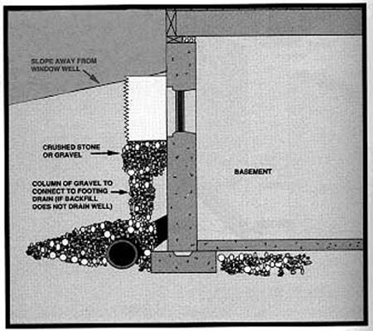
Notes:
There should also be a granular connection from the window well to the drain tile to assure drainage away from basement windows. Place a layer of crushed stone or gravel under the window well to aid in drainage. Keep leaves and other debris from clogging the crushed stone.

Slide 19
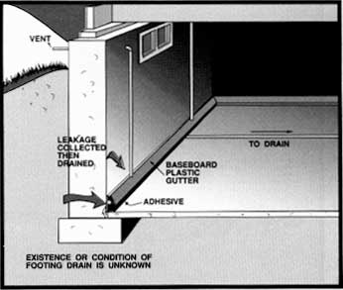
Notes:
The source of a water problem must be determined to select the appropriate solution. A baseboard gutter may intercept water coming from along the basement wall, but would not help the problem of water entering from cracks in the basement floor.

Slide 20
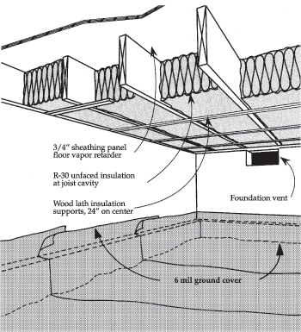
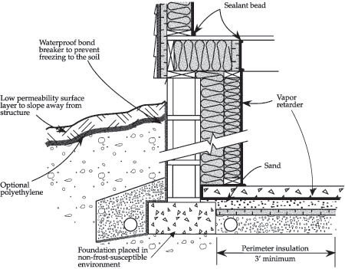
UNHEATED crawls space
HEATED crawl space
Notes:
Crawl spaces need moisture control similar to that used in a basement to keep the soil in the crawl space dry. There should be a vapor retarder covering the floor of the crawl space that is bonded to the footing wall. A vent should be available to remove moisture if it accumulates in the crawl space. The vent is normally closed to keep moisture from the outdoor air entering the crawl space.

