Slide 1

SPCC
Spill Prevention, Control, and Countermeasure
How This Rule May Affect You
Roxanne Johnson
NDSU Extension Water Quality Associate

Slide 2
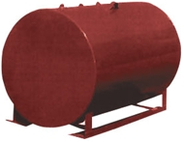
What’s Changed?
Farms vs. Facility:
    Farms defined since 2008!
Clean Water Act 1972
SPCC starts 1974
Goal of EPA
  Prevent oil spills into waters
  of the United States and
  adjoining shorelines.
Source: http://www.epa.gov/osweroe1/content/spcc
Notes:
The 2008 amendment changed the language to “farms” rather than “facility.” This change defined what a farm is….anyone who earns more than $1,000 from agricultural products during a year.
The owner has discretion in determining which contiguous or non-contiguous buildings, properties, parcels, leases, structures, installations, pipes, or pipelines make up the facility.
------------------------------------------------------------------------------------------------------------------------------------------------------------------------------------------------
So what is SPCC or Spill Prevention Control and Countermeasure? It is a regulation of the Environmental Protection Agency to prevent oil spills into waters of the United States and adjoining shorelines.
Key elements include a plan of how you will identify, prevent, control, and manage a spill.
The plan is to be written up and kept on-site. What you have written in the plan is to be implemented on your farm.

Slide 3
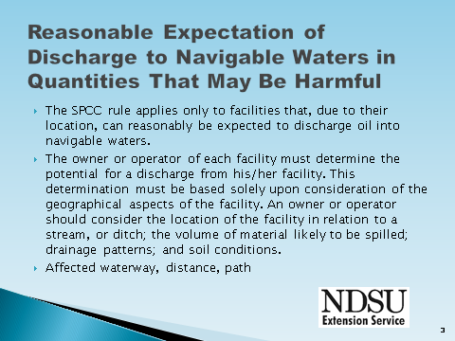

Slide 4

Navigable waters?
Interstate waters
Intrastate lakes, rivers, streams related to interstate commerce
  Interstate travelers for recreational or other purposes;
  From which fish is sold in interstate commerce;
  Used for industrial purposes by industries in interstate commerce;
Tributaries of these waters
That may affect natural resources under the exclusive management authority of the United States

Slide 5
SPCC applies to farms that:
Store, transfer, use, or consume oil or oil products; and
> 1,320 U.S. gallons in aboveground containers or more than 42,000 U.S. gallons buried; and
And due to its location could reasonably be expected to discharge oil to waters of the U.S.
  If your farm meets all of these,
  then your farm is covered by SPCC
Source: http://www.epa.gov/osweroe1/content/spcc
Notes:
SPCC applies to farms which:
Store, transfers, uses, or consumes oil or oil products….this includes diesel fuel, gasoline, lube oil, hydraulic oil, adjuvant oil, crop oil, vegetable oil, or animal fat. Oil can be liquid or semi-solid such as DDGs (dried distiller grains)…bottom line is oil of any kind and in any form.
If you have over 1,320 US gallons storage aboveground or 42,000 US gallons buried. This is shell capacity…they are not interested that you only fill a tank half full. Count all containers that have 55 gallon capacity or more.
This next line is very controversial. It says, “Could reasonably be expected to discharge oil to waters of the US or adjoining shorelines.” EPA recommends that adverse weather conditions be considered in this determination. This means that in a worse case scenario, the spill could go from a ditch into a stream and into a river. This is not based on a quantity of oil discharged. EPA looks at the “Sheen Rule” … if it causes a film or sheen on the water’s surface or leaves sludge or emulsion beneath the surface it violates state water quality standards.
If your farm meets all of these, you need to have a plan and secondary containment.
LEADERS: More information from the EPA: To determine if you could impact water quality you must consider the geography and location of your facility relative to nearby navigable waters (such as streams, creeks and other waterways). Additionally, you should determine if ditches, gullies, storm sewers or other drainage systems may transport an oil spill to nearby streams. Estimate the volume of oil that could be spilled in an incident and how that oil might drain or flow from your facility and the soil conditions or geographic features that might affect the flow toward waterways. Also you may want to consider whether precipitation runoff could transport oil into navigable waters or adjoining shorelines.

Slide 6
Total Gallons Include:
Gas tanks
Diesel tanks
Oil Drums
Milk – if not regulated under PMO
Anything 55 gallons and greater…
      Anything that will leave a sheen
Shell capacity
Source: http://www.epa.gov/osweroe1/content/spcc/
Notes:
What you do need to count in the total.
PMO is the pasteurized milk order…………. Most dairies fall under this regulation and therefore don’t have to include this in the SPCC total.
However, raw milk containers don’t fall under PMO so must be included in SPCC total.

Slide 7
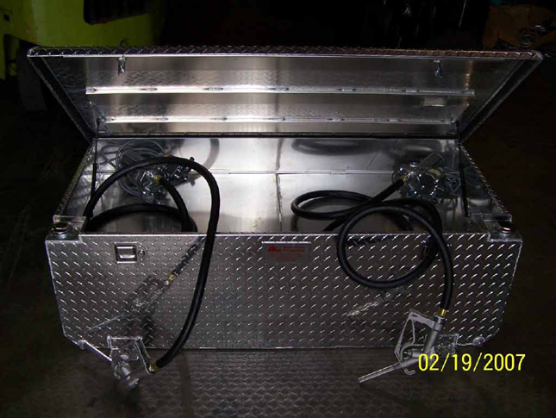
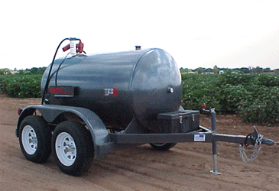
Total Gallons Include:
Farm Nurse Tank – Mobile Refuelers
  Mobile/portable containers to store & transport fuel
  - to and from farm equipment
  - to and from other bulk storage containers
  Used only for transfer of fuel
Source: http://www.epa.gov/osweroe1/content/spcc/
Photo Credit: http://www.aerotanks.com/veh/diamondplates.htm
Notes:
What you do need to count in the total.
This relates to transporting fuel, using a truck or a nurse tank. You will need to include this in your total but they no longer have to have sized secondary containment….this means they don’t need to stay inside a berm. This includes mobile tanks that are parked and not used for transporting.
They must have some form of secondary containment such as a spill kit or drip pan, and a plan of what you will do to contain the spill if that should happen. You will need to specify where these tanks are parked and where the sorbent materials are, if that is what your plan states you will do.
Tanks in the back of your pickup. This has been a very controversial area as some people believe that although the pickup has a fuel tank in the back, it also is the same pickup that you drive to the grocery store or to get parts. It is not designed or used solely to store or transport fuel for transfer. To be on the safe-side include it in your total. Include a spill kit in the pickup to use as an active secondary containment.

Slide 8
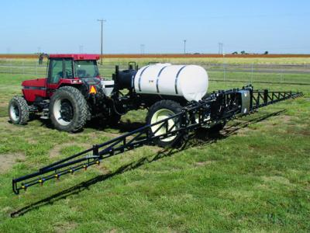
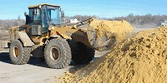

Exemptions to the Rule
Pesticide Application Equipment
  Includes
    Ground boom applicators
    Airblast sprayers
    Specialty aircraft that apply
    measured amounts of pesticides to crops and/or soils
    Related mix containers
Distillers grains
Source: http://www.epa.gov/osweroe1/content/spcc
Notes:
Exemptions include pesticide application equipment. This includes the containers you mix in and does not matter who owns them or where they are located.

Slide 9
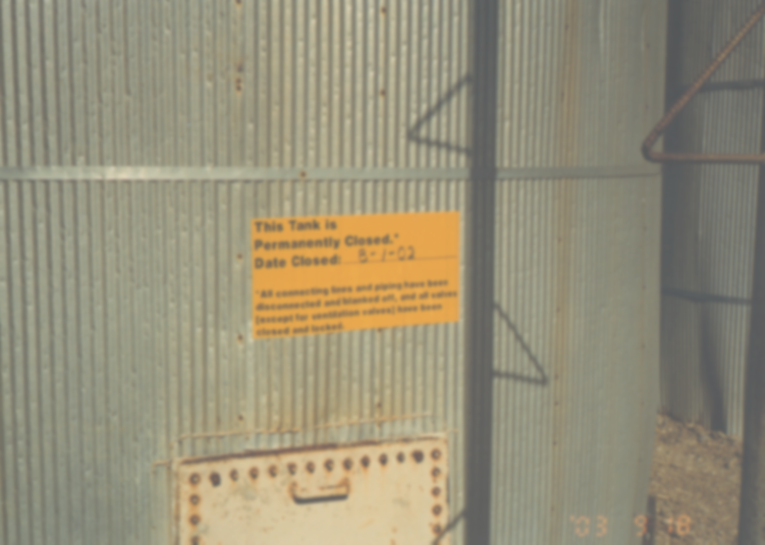
Exemptions to the Rule
  Buried Tanks
  State regs for >1,320 gallons
  Permanently Closed
  Remove all liquid & sludge
  Disconnect all connecting lines & piping
  Close & lock all valves (except ventilation valves)
  Conspicuous signage
Source: http://www.epa.gov/osweroe1/content/spcc
Notes:
Exemptions include buried tanks that must follow UST (Underground Storage Tank) rules. They must be completely buried or they need to be included in SPCC totals.
If you have a tank that you are not using you can permanently close it and not have it count in your total. All liquid and sludge must be removed and all connecting lines closed and blanked off. All valves, with the exception of ventilation valves, must be closed off and locked. And finally, a conspicuous sign must posted on each container stating that it is a permanently closed container and noting the date of closure. It does not need to be removed from the site.
You may bring a permanently closed container back into use as needed but it will then need to be added to the total storage number.

Slide 10
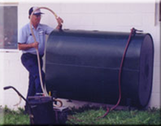
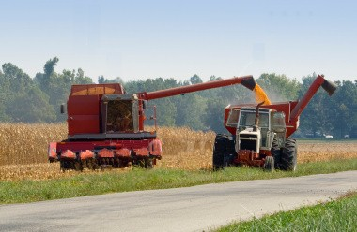
Exemptions to the Rule
Residential heating oil containers at single-family residences
Motive power containers
Source: http://www.epa.gov/osweroe1/content/spcc
Notes:
A heating oil container for your residence does not need to be included…..however the tank that is used to heat your shop DOES. If it is not your residence you must include it. This applies to containers that are above ground only.
Motive power containers are any onboard bulk storage container used primarily to power the movement of a motor vehicle, or ancillary onboard oil-filled operational equipment. This includes trucks, automobiles, bulldozers, and self-propelled equipment.

Slide 11
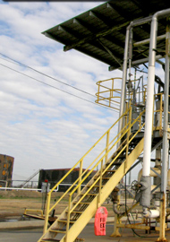
Exemptions to the Rule
Loading Rack Requirement
  Loading racks must comply with requirement
    Generally not seen on farms
    Any loading/unloading area
    needs to meet the general
    secondary containment requirements
Notes:
EPA is finalizing a definition Loading racks are typically not seen on farms. Any loading or unloading need to have general secondary containment…..with a focus on the most likely spill. The farmer is responsible for any spill when filling from a bulk dealer. He should address this by using overfill gauges, having spill kits available and documenting monitoring while filling.

Slide 12
When Should I Prepare A Plan?
A facility starting operation... | Must…
On or before August 16, 2002 | Maintain its existing SPCC Plan Amend and implement the amendments to the SPCC Plan no later than May 10, 2013
After August 16, 2002 through Nov. 10, 2011 | Prepare and implement the SPCC Plan no later than May 10, 2013
After Nov. 10, 2011 | Prepare and implement a SPCC Plan before beginning operations
Extensions only apply to farms that had a SPCC Plan in place prior to the 2002 SPCC Rule.
Source: http://www.epa.gov/osweroe1/content/spcc
Notes:
When should a plan be prepared? Now.
This is not a new ruling…..farms did not consider themselves a “facility” but EPA always has and therefore if you farmed prior to 2002 you are expected to have this plan in place now. Only changes in the 2008 rules need to be updated on your present plan.
For those who began farming after August 16, 2002 you have until the 2013 to complete your plan.

Slide 13
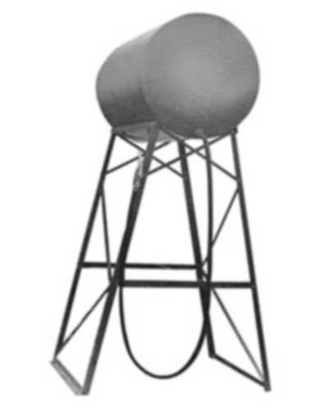
What Do I Do Next?
Prepare and Implement a SPCC Plan
  If you have a Plan, you must maintain it.
  If you do not have a Plan, you must prepare and implement one.
Can I Have More Than
One Plan?
  Yes
Notes:
How do you prepare for this? You prepare and implement a plan.
If you have a plan you must maintain it.
If you do not have a plan you must prepare and implement one.

Slide 14
General Requirements
Tier I
Tier II
Tier III
Must have management approval
to implement
Source: http://www.epa.gov/osweroe1/content/spcc
Notes:
If you have over 1,320 gallons of oil storage at your farm you must then decide where you fit….Tier I, II, or III.
I will review each of these but understand that all of these must be written with full approval of management to fund and implement.

Slide 15
Tier I – Self Certify
  - 10,000 U.S. gallons or less - aggregate
  - No container with a capacity of more than 5,000
  U.S. gallons (55 to 5,000 gallons)
  In the 3 year period prior to self-certification has
  not had
    one spill of more than 1,000 U.S. gallons; or
    two spills, each exceeding 42 U.S. gallons, within any 12-month period
    Does not need to be certified by an engineer
    http://www.epa.gov/osweroe1/content/spcc/tier1temp.htm
Source: http://www.epa.gov/osweroe1/content/spcc
Notes:
“Tier I” qualified facilities have less complicated operations and farm characteristics such as a few low capacity oil containers and some mobile/portable containers, few oil transfers, and little to no piping. You can self-certify by filling out a form that is available on the EPA website.
To meet the 2006 qualified facility eligibility criteria you must have 10,000 gallons or less in total aboveground oil storage capacity. Remember that storage capacity is the shell capacity. It does not matter that you may only fill the tank half full. A three thousand gallon tank must be included as a three thousand gallon tank.
You cannot have a container that is over 5,000 gallons and
You cannot have had a spill in the 3 years prior to the plan certification, or since becoming subject to the rule. So if you have operated for less than 3 years, the facility must not have had a single discharge of oil to navigable water exceeding 1,000 US gallons, or 2 discharges of oil to navigable waters each exceeding 42 US gallons within any 12-month period.
When you self-certify you are saying that you are certifying the information is correct. Does not involve an engineer.

Slide 16
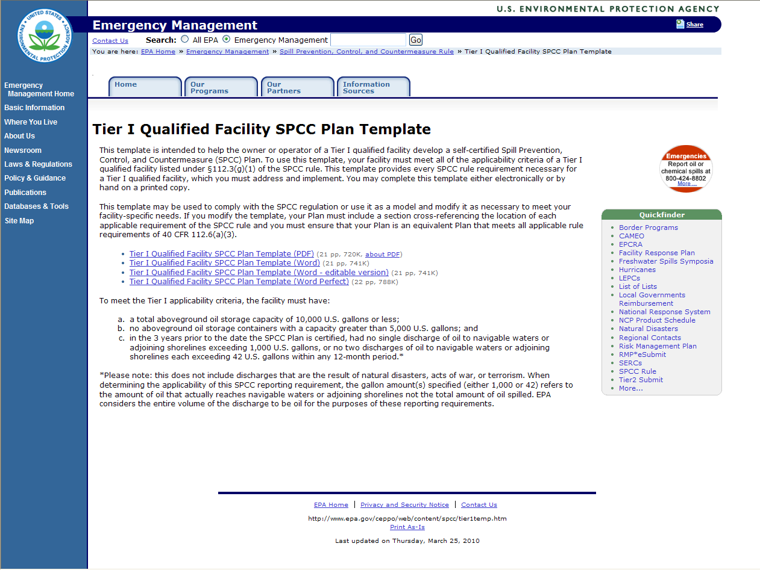
Self Certify http://www.epa.gov/ceppo/web/content/spcc/tier1temp.htm
Sample of completed Tier I Template
http://www.ndsu.edu/waterquality
Source: http://www.epa.gov/osweroe1/content/spcc
Notes:
For those of you who fall under Tier I you can self certify using the template on this EPA website. They offer it in pdf or word format.
Fill this form out and keep it handy so if you are inspected you can produce this document. If you have changes you must document those changes to this document.

Slide 17

Tier II
  -10,000 gallons or less total oil storage
  - Individual tank 5,001 gallons or more
  - Must follow the Federal Register design
  (Cannot use environmental equivalents without PE certification)
    - In the 3 year period prior to self-certification has not had
    one spill of more than 1,000 gallons; or
    two spills, each exceeding 42 gallons, within any 12-month period
Source: http://www.epa.gov/osweroe1/content/spcc
Notes:
To use Tier II you must have less than 10,000 gallons but may have a tank over 5,001 gallons.
The environmental equivalence provision, contained in §112.7(a)(2), allows for deviations from specific requirements of the SPCC rule, as long as the alternative measures provide equivalent environmental protection. It must achieve the same desired outcome, though not necessarily through the same mode of operation.
Examples:
Rather than posting signs or giving verbal warnings you would protect the equipment from the possibility of a collision by installing fencing, barriers, curbing or other physical obstacles to provide equivalent environmental protection.
Using preventive measures such as a predetermined, written filling procedure rather than an audible/visual alarm for overspill protection.
Using alternative technologies specifically engineered to prevent oil from escaping the facility containment and drainage control system, while normally allowing drainage of uncontaminated water. This would be used rather than a manual open-and closed-design.
Can be based on various considerations, such as:
Safety
Cost
Geographical constraints
Appropriateness of a particular requirement based on site-specific considerations
Other factors consistent with engineering principles

Slide 18
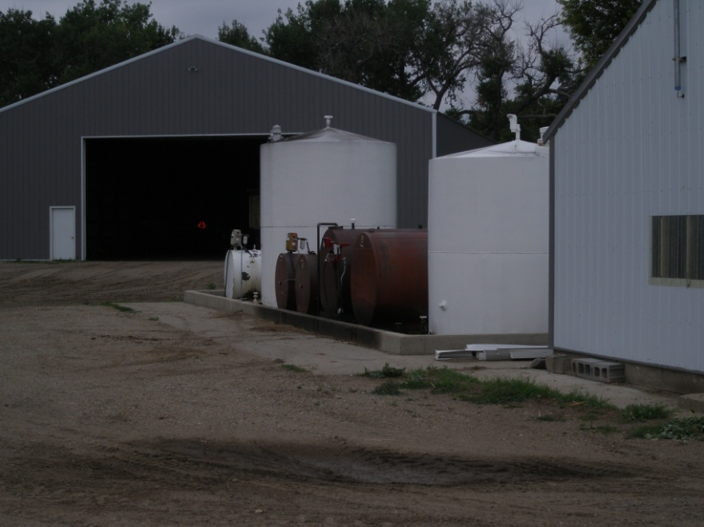
Tier III
- Over 10,000 U.S. gallons
- Must be certified by a professional engineer
  Licensed in any state
  Be familiar with 40 CFR Part 112
  PE or agent visited site
Source: http://www.epa.gov/osweroe1/content/spcc
Notes:
This is for anyone with over 10,000 gallons. Your plan must be certified by a professional engineer.

Slide 19
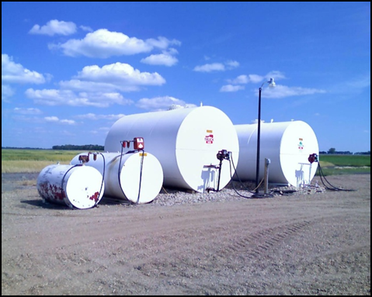
SPCC PLAN
KEY ELEMENTS

Slide 20
Facility Diagram Requirements
Description of the physical layout of the facility … include a diagram…TIER III only
  Location of storage tanks
  Size and contents of storage tanks
  Completely buried tanks that are otherwise exempted from the SPCC regulation
  Flow expected if spill occurs
  Mobile and portable containers
    Show the area where these are parked
Not required for Tier I
Source: http://www.epa.gov/osweroe1/content/spcc
Notes:
Note: A diagram is not required for a Tier I plan but I would include one because it is a great way to assist recovery personnel if you should have a spill on your farm.
The facility diagram can be a hand-drawn map but must have sufficient detail for responders to take effective measures in the event of a spill, or EPA to carry out an inspection. It must include where the tanks are, what is in them, their size, and direction of flow if there was a spill and any underground tanks.
For mobile or portable containers, the diagram must show
The location where you store the containers…where are they parked?
The number of containers, the contents, and capacity of each container.

Slide 21
Training, Inspections, and Records
Follow your plan
  Five-year review
Have a training program annually for oil handlers
Inspection of Tanks
  Inspections are dictated by the size of tank and your secondary containment
Document training and inspections
Designate Leadership
Management Approval
Source: American Petroleum Institute

Slide 22
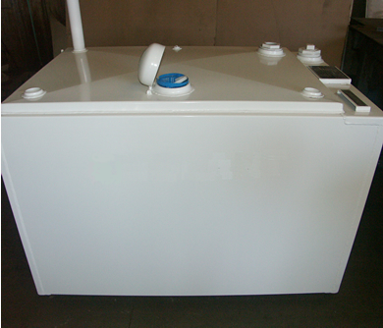
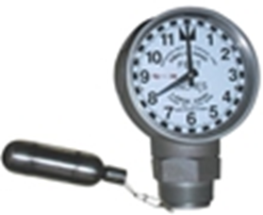
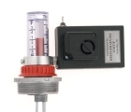
Storage Containers
Use containers suitable for the product that is stored in the container
Provide overfill protection for your storage containers

Slide 23
Inspection Schedules
  P - Periodic Inspections by owner
  E - Formal external inspection by certified inspector
  I - Formal interior inspection by certified inspector
  L - Leak test
  (frequency of inspection in years)
Above Ground Storage Tank Size (US gallons) | Category I (Elevated tanks with CRDS* and those with an impermeable barrier such as concrete, steel, or synthetic liner) | Category 2 (Tanks sit on the ground without impermeable layer)
0 – 1,100 | P | P
1,101 - 5,000 | P | P, E (10), L(10)
5,100 – 30,000 | P, E (20) | P, E(10), I(20) Or P, E(5), L(10)
30,100 – 50,000 | P, E(20) | P, E (5) & L(5)
*CRDS – Continuous Release Detection System
Source: American Petroleum Institute
Notes:
This slide shows you what the Steel Tank Institute requires for inspections.
By Kenneth J. Hellevang, Professor and PE, NDSU Agricultural and Biosystems Engineering
Tank inspections, including the length of time between inspections and the type of inspections, are determined by many factors. These include whether the fuel tank is elevated (so all sides of the tank can be inspected), if it is sitting on the ground, whether an impervious membrane is between the tank and the earth (with the earth sloped so leaks will be observed on the low end), and the type of secondary containment (earthen berm, concrete, liner, etc.). The cost of a system requires evaluating both the cost of the containment structure and the cost of inspections. A typically cited standard for steel tank inspections divides the containment structure into Category 1 and Category 2.
Category 1 – Includes secondary containment with a continuous release detection system (CRDS) where releases are visually detected. A CRDS includes methods that do not require sensors or power to operate, such as a liquid containment barrier that is sufficiently impervious to the liquid being stored (for example steel, concrete, and elastomeric liners) that is installed under the above ground storage tank. The liquid containment barrier diverts leaks toward the perimeter of the tank so they can be easily detected and prevents liquid from contaminating the environment until clean-up occurs.
Also included in Category 1 are elevated tanks, where all sides of the tank can be observed for leaks. It also requires a liner or a low permeability soil such as clay with a deep water table to minimize the risk of contamination of the environment until clean-up occurs.
Category 2 – Includes secondary containment such as an earth berm or dike without the release detection system, such as fuel tanks sitting on the
soil or a gravel layer, without an impervious material under the tank. Leaks cannot be visually observed in Category 2.
The entire secondary containment system, including walls and floor, must be capable of containing oil so that any discharge from a tank or pipe will not escape the containment system before cleanup occurs. Diked areas must be sufficiently impervious to prevent oil from reaching water before the spill is cleaned up.
Clay or other low permeability soil (at least 35% clay) should be used for earth berms or dikes. Normally, at least a width to height ratio of 3 to 1 is required for the berm to develop the dike strength and durability needed. Top soil should be removed and the clay compacted to form a stable berm. Earth berms or dikes will require more area for secondary containment than if vertical walls are used. The floor of an earth berm containment should consist of a low permeability soil such as clay.
Any synthetic or elastomeric liners need to be installed according to manufacturer’s recommendations. Frequently a layer of sand is required above and below the liner to minimize the potential for punctures in the liner. Concrete containment will need to be appropriately designed to carry the load of the fuel tanks and to seal joints or other openings.
If the secondary containment is impervious to water, water will need to be removed by pumps; however, you must manually activate these pumps and must inspect the condition of the accumulation before starting, to ensure no oil will be discharged. Pipes through the wall may be used to drain the rainwater, but sealing around the pipe may be difficult and the pipe must have a manually operated value that is normally closed.
Secondary containment must hold fuel from the largest tank and rain from a 25-year 24-hour rainfall event. A 25-year 24-hour rainfall event ranges from 3.5 inches in western North Dakota to 4.2 inches in the southeast corner of the state. The volume of the largest tank is its maximum capacity. The volume displaced by other storage containers within the containment area must be considered when calculating containment volume required.
Fuel tanks must be 10 ft. from property lines, 5 ft. from occupied buildings, and the tanks must be separated by at least 3 ft., according to North Dakota Guidelines included in “Farm Fuel Tank Safety Guide” from the North Dakota Department of Emergency Services. http://www.nd.gov/des/uploads%5Cresources%5C510%5Cfarmfueltanksafetyguide.pdf
It is also recommended that there be three feet between the tank and containment wall to permit movement for inspection or working with the tanks.
Helpful information on planning secondary containment including tables for tank volumes is included in chapter 7 of MWPS-37 “Designing Facilities for Pesticide and Fertilizer Containment.”
Calculations of volumes can be simplified by assuming a circular or rectangular shape for all tanks and containment structures.
Rectangle Volume (cu. ft.) = length (ft.) x width (ft.) x height (ft.)
Rectangular Area (sq. ft.) = length (ft.) x width (ft.)
Circular Volume (cu. ft.) = 0.785 x diameter (ft.) x diameter (ft.) x height
Circular Area (sq. ft.) = 0.785 x diameter (ft.) x diameter (ft.)
Conversions: 1 cu. ft. = 7.48 gallons
Example:
Design earthen secondary containment to hold a 5,000 gallon 8 ft. diameter vertical tank and a 3,000 gallon 8 ft. diameter and 8 ft. long horizontal tank in central North Dakota.
The containment must hold the fuel from the largest tank, so must contain 5,000 gallons of fuel.
It must also hold rainwater from a 24-hour 25-year event, which for this example will be 4 inches. The volume required for the 5,000 gallons of fuel is 5,000 / 7.48 gal per cu. ft. = 669 cu. ft. The required area with a 2 ft. containment wall would be 669 / 2 = 334 sq. ft.
The additional volume required for the rainfall is 334 sq. ft. plus the area of the two tanks.
Area of the vertical tank is A = 0.785 x 8 x 8 = 50 sq. ft. Area of horizontal tank is A= 8 x 8 = 64 sq. ft. The volume for rainfall is (334+50+64) x (4 inch rain /12 inches per foot) = 149 cu ft. For a two-foot wall this increases the required area by 149 / 2 = 75 sq. ft.
To simplify the calculation for the displacement of the horizontal tank, a rectangular area 8 ft. by 8 ft. is assumed. This would be an area of 8 x 8 = 64 sq. ft. This over estimates the volume required. Referring to Table 7 on page 29 of MWPS-29 shows that the displaced volume is 79 cu. ft. The volume using the 64 sq. ft. area with a two foot depth is 128 cu. ft. The calculations of displaced volume of a round horizontal tank are cumbersome, so refer to a table or use the simple calculations knowing it will over estimate the value. (79 cu. ft. from table for horizontal tank vs. 128 cu. ft. from rectangle.)
The total area required is 334 + 75 + 64 = 473 sq. ft. This might be an area 25 ft. x 19 ft.
The earthen dike requires a height to width ratio of 3 to 1, so it would be 2 ft. tall and with a base at least 6 ft. wide. To permit some freeboard, the secondary containment area would be within the base of the dike. The dike and containment floor would be constructed of clay, with top soil removed from the containment area to minimize permeability.
Rainwater would soak into the containment area, so a means of removing water from within the containment area would not be required.
This would be classified as a Category 2 containment because the tank sits on the ground, so inspection by a certified inspector would be required every ten years.

Slide 24
Elevated Tanks
Notes:
Do not elevate your tank if the tank is not built for it!

Slide 25
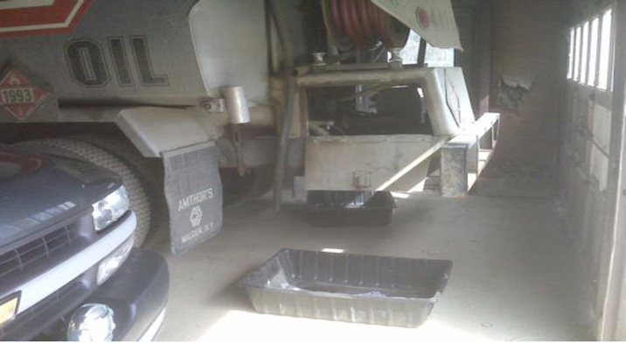
General
Secondary Containment Requirements
Intended to address the most likely oil discharge from any part of a facility
        Active
        Passive
Source: http://www.epa.gov/osweroe1/content/spcc
Notes:
Secondary containment addresses the most likely discharge.
There are 2 types of secondary containment. They are active or passive.
Active containment is put in place prior to, or immediately upon discovery, of a spill. This will stop the spill from reaching a navigable water. Examples are covering a storm drain prior to transfer activity or before a spill reaches the drain. Using spill kits or a spill response team if you have a spill would also fall under the active secondary containment. Make sure you can follow through with any of these prior to putting them in your plan.
Passive secondary containment would be anything that is in place whether you are there or not, such as a berm or alarm system.
NOTE: EPA personnel say do not “over-engineer” these! Look at your soils. You may want to check with a soil scientist at NRCS to see if your soils are tight enough to hold a spill until you can clean it up. Look at the lay of your farmstead. The berm does not have to be directly around the tanks. The idea is to keep it from entering a ditch or stream…. keeping it from getting to the water.
Your shop can be a secondary containment. If your building slopes to the center and that is where the oil stays, then it is contained and should be written up as such in your plan. If it can run out of the building you will have to take measures to seal up the outer walls so it stays contained. This may meaning adding a lip across doorways so it cannot leave through a door.

Slide 26
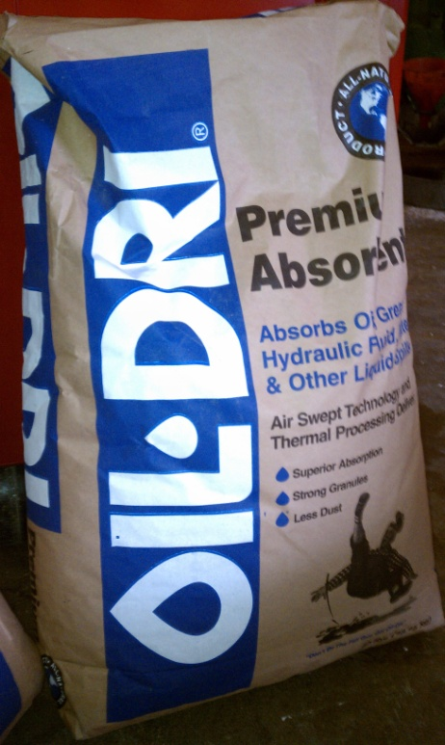
General Secondary Containment Requirements
Use any of these or its equivalent:
  Dikes, berms or retaining walls sufficiently impervious to contain oil;
  Curbing or drip pans;
  Sump or collection systems;
  Culverts, gutters or other drainage systems;
  Weirs, booms, or other barriers;
  Spill diversion ponds;
  Retention ponds; or
  Sorbent materials (spill kits, floor dry, cat litter)
Source: http://www.epa.gov/osweroe1/content/spcc
Notes:
NOTE: EPA personnel say do not “over-engineer” these! Look at your soils. You may want to check with a soil scientist at NRCS to see if your soils are tight enough to hold a spill until you can clean it up. Look at the lay of your farmstead. The berm does not have to be directly around the tanks. The idea is to keep it from entering a ditch or stream…. keeping it from getting to the water.
Your shop can be a secondary containment. If your building slopes to the center and that is where the oil stays, then it is contained and should be written up as such in your plan. If it can run out of the building you will have to take measures to seal up the outer walls so it stays contained. This may meaning adding a lip across doorways so it cannot leave through a door.

Slide 27

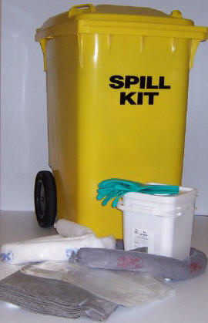
Mobile Refuelers
Do not need sized secondary containment (berm)
Remain subject to secondary containment (spill kit)
Source: http://www.epa.gov/osweroe1/content/spcc/
Notes:
Mobile Refuelers or tanks in the back of your pickup.
Do not need to be in a bermed area but do need to be addressed. What is the most likely oil loss, how much, and how will you clean it up.

Slide 28
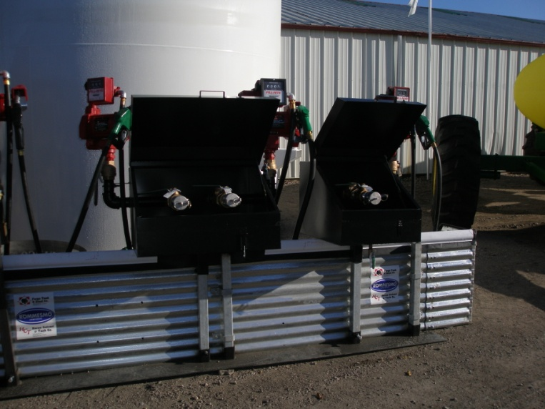
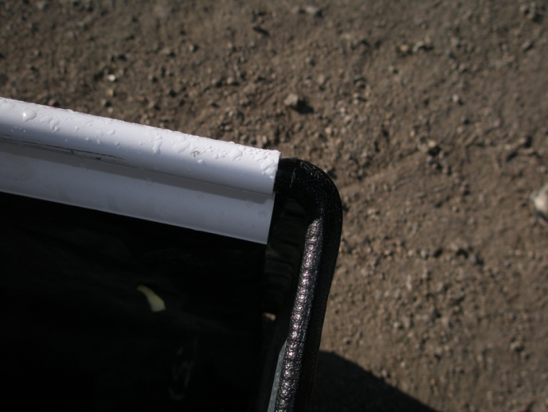
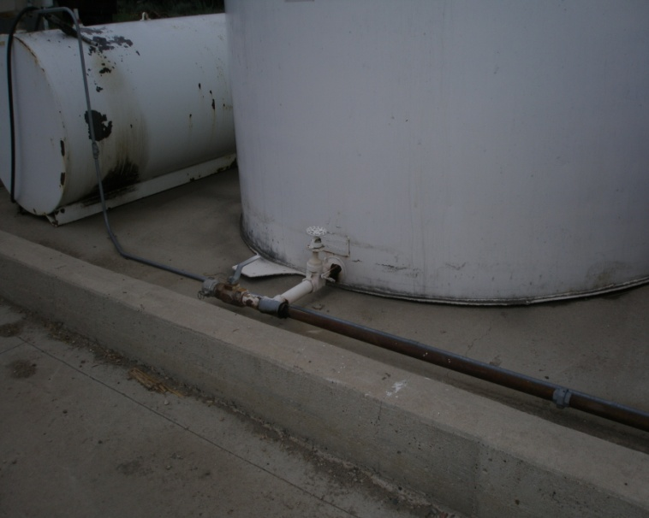
Secondary Containment
Notes:
These are examples of secondary containment. They include steel siding, concrete, and double walled tanks.

Slide 29
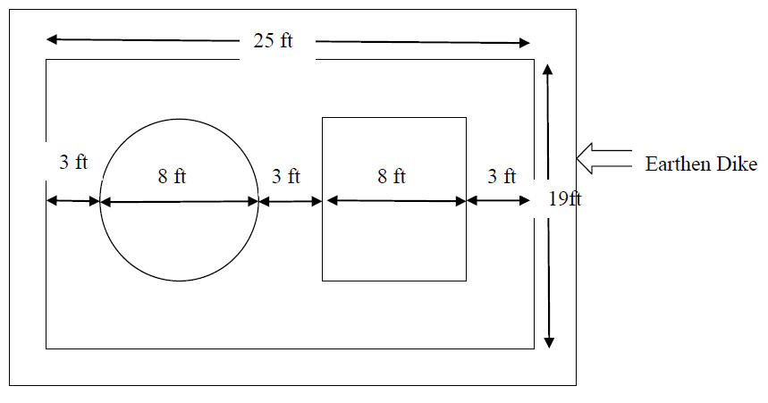
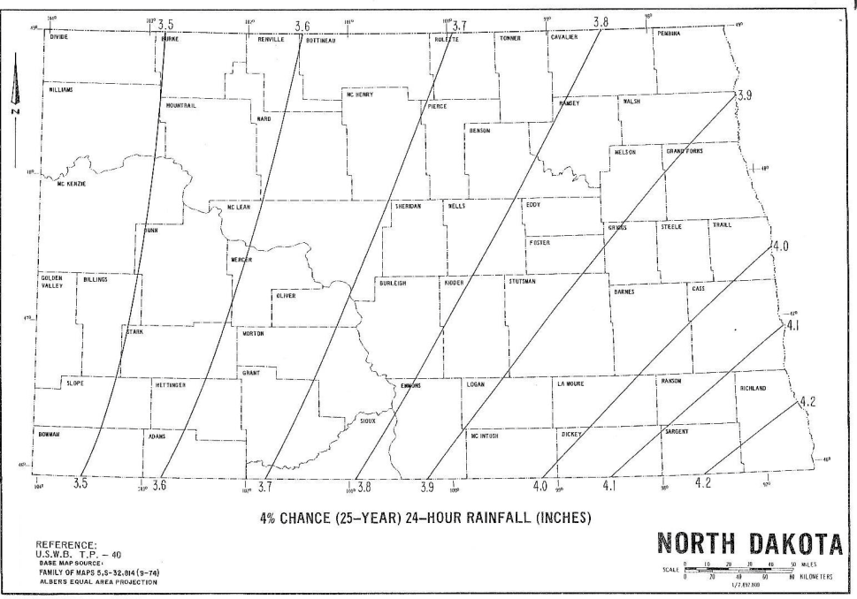
Calculating Your Secondary Containment Area
www.ndsu.edu/waterquality
Notes:
Figuring the size of the container has to include the volume of the largest tank + a 25-year, 24-hour rainfall event + displacement of the tanks. Rainfall amounts are shown on this map. A handout has been developed by Ken Hellevang, a PE in the Ag & Biosystems Engineering Department at NDSU, to explain how to calculate sizing your secondary containment. This is available at www.ndsu.edu/waterquality and is also in the notes of slide # 23.

Slide 30

Manmade Structures
Certain manmade features may be used to comply with SPCC requirements.
Source: http://www.mortonbuildings.com/gallery-of-photos-farm_shop.aspx
Notes:
Manmade structures refer to using your shop as a containment unit. The SPCC plan can consider using the building walls and or the drainage system of your shop as a secondary container. Most shops drain to the center whether there is a drain or not and this could be defined as your secondary containment in some instances.
If your containers are indoor you do not need to add freeboard for precipitation.

Slide 31
Site Security
2002 Amendment
  Changed from “should” to “must” have
FLEXIBILITY……Tailored to the facility’s specific characteristics and location
Photos: EPA
Notes:
Site Security – This is an important part of the plan.
The 2002 Amendment changed wording from should to must have, but it also said you could tailor the security to suit your site specific location.
The plan use to say you had to have fencing but now if you live at the site, that is your security. You should install locks on gas pumps and doors to the shop that holds your oil. This should all be documented in your plan.
You must also include in your plan how you will secure and control access to the master flow and drain valve, starter controls on oil pumps. Lighting is suggested to prevent vandalism and assist with discovery of a spill.

Slide 32
Site Security
Must include:
  How you will secure and control access
    Locks – YES, I LOCK ALL TANKS
    Lighting – NOT REQUIRED ON REMOTE LOCATIONS
    Fencing – NOT REQUIRED
Photos: EPA
Notes:
If you live on the site, you are the security for your farm. You need to say in your plan how you will turn off the power to the pumps and how the general public are denied access to the controls.
YOUR FARM: I LIVE THERE AND HAVE LIGHTING TO OBSERVE SPILLS. I HAVE A BERM AROUND THE TANKS TO CONTROL A SPILL.
OFFSITE LOCATION: I USE MY HEADLIGHTS TO OBSERVE A SPILL. I LOCK ALL TANKS AND HAVE A BERM AROUND THE TANK TO CONTROL A SPILL.

Slide 33
Maintaining Your Plan
Amend and update your SPCC Plan whenever changes are made to your farm tank system.
Plans must be amended within 60 days of the change.
Plans must be reviewed every 5 years to insure no changes have been made to the facility.

Slide 34

Spill Response
List who is in charge at your facility
What will you do first?
  Shut off valves
  Contain spill
Who to Contact
  Appropriate Federal, State, and local agencies
    Call ND Dept of Emergency Services Duty Officer
    1-800-472-2121 (they will contact the Health Dept.)
    Email – Incident Report to Health Department
    IF spill reaches water call National Response Center (NRC) at 1-800-424-8802 or 202-426-2675
  Local Emergency Responders
Source: http://www.ndhealth.gov/wm/
Notes:
What will you do if you have a spill?
Whoever your plan has designated as being in charge of this will make sure the following happens:
1. Shut off all valves. Stop flow from reaching water if out of containment area..
2. Contact the ND Dept. of Emergency Services Duty Officer at this number or email the information using a form I will show you how to get.
Either way you contact them, they will contact the Health Department.
If you have a spill you will need to call the number posted here. You also need the following information:
Name or type of substance
Actions taken to contain the spill/leak
Estimated quantity released
Time and duration of release
Area affected. Ground, water, wetlands, river, etc.
Noticeable health effects as a result of the spill/leak
Your name and contact information
If the spill reaches water you must call the National Response Center (NRC) at 1-800-424-8802 or 202-426-2675.

Slide 35
Removal and Cleanup
Case-by-case basis
  Chemical
  Quantity
  Location
  Geology/Hydrology
  Climatic conditions
Source: http://www.ndhealth.gov/wm
Notes:
Removal and Cleanup Actions.
The required cleanup is determined on a case-by-case basis depending on the type of chemical
spilled, quantity of chemical spilled, location of the spill, geology/hydrology of the area, and any
other factors such as climatic conditions. This could be as simple as removing a few shovels of soil
and spreading it thinly, to hiring an emergency response contractor for an extensive cleanup.
The Department should be contacted for guidance on appropriate remediation which address the
protection of public health and the environment and compliance with state laws and rules.

Slide 36
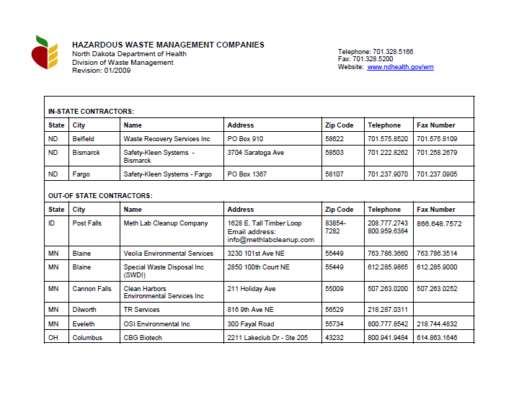
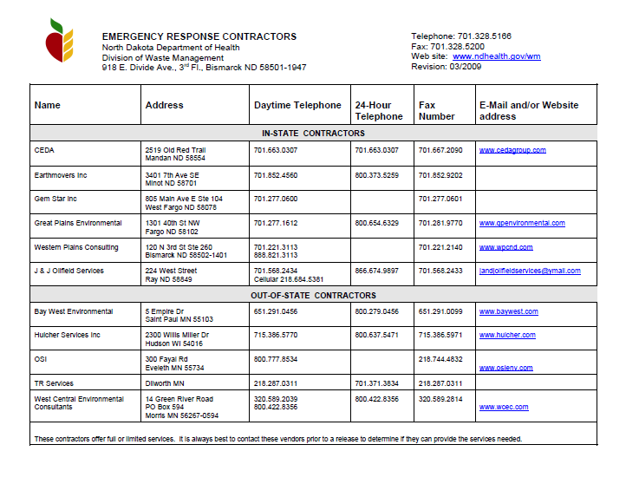
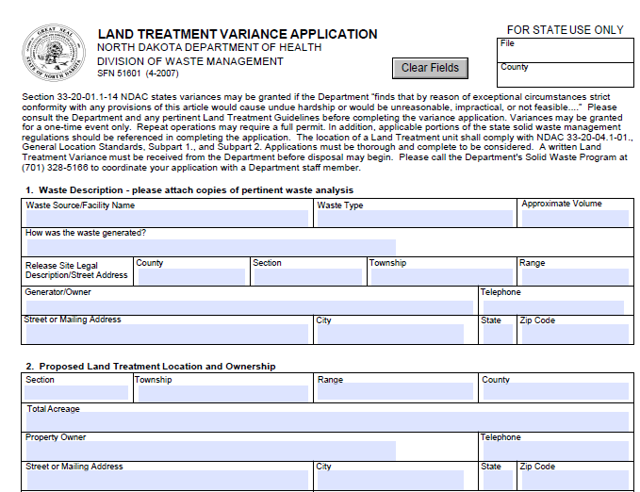
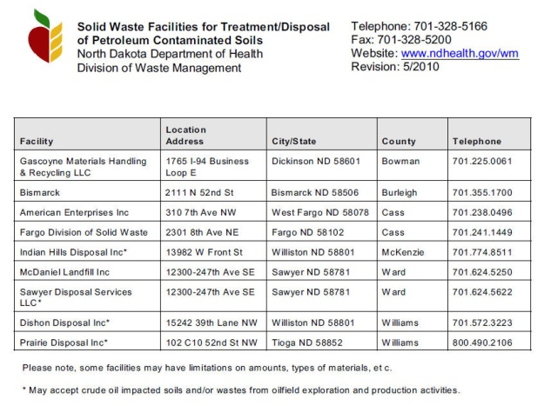
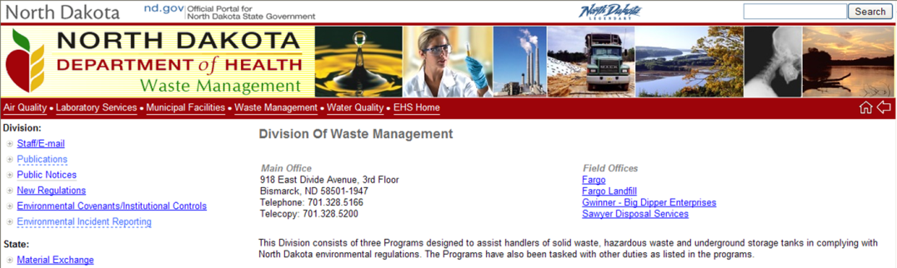
North Dakota Department of Health
Guideline 7 – Land Treatment of Petroleum Contaminated
Soil: Single Application
Sites Solid Waste Facilities for
Treatment/Disposal of Petroleum
Contaminated Soils
Emergency
Response
Contractors
Environmental
Incident Report
Land Treatment Variance Application
Hazardous Waste Disposal Sites
Source: http://www.ndhealth.gov/wm
Notes:
The Department of Emergency Services Duty Officer will contact the Waste Management Division.
This website has very important information. It includes (next slide)

Slide 37
Financial Assistance - NRCS
Conservation Protection Activity (CAP)
Environmental Quality Incentives Program (EQIP)
  Batching periods end Jan. 28th and June 3rd 2011
  Ranking and funding determined as money is available
  First round of contracts to be approved in March 2011
  450/550 signed up for first batching period
  CHECK WITH YOUR NRCS OFFICE TO
  SEE IF ANOTHER FUNDING PERIOD
  WAS INITIATED.
Notes:
Financial Assistance is available through EQIP during fiscal year 2011 to provide assistance for both the SPCC Conservation Activity Plan (CAP) and the supporting implementation practice. Approximately $1 million will be made available to States to support development of the SPCC CAP and approximately $2 million will be made available for the Agricultural Secondary Containment Facility (710) interim practice to be made available in the Conservation Practice Standards (CPS) database.
An initial allocation of $150,000 per State will be distributed to each State piloting this effort. The agency has established that the maximum amount paid for the development of the SPCC CAP will be $2,500. Moreover, the agency has established a maximum payment of $10,000 for the interim practice 710 to be applied at the time of payment in ProTracts

Slide 38
Financial Assistance - NRCS
Waivers
  Does not guarantee financial assistance but would honor the application if approved.
  Sign up now.
  Must have the request in writing.
  Based on the merit of the request.
Notes:
Financial Assistance is available through EQIP during fiscal year 2011 to provide assistance for both the SPCC Conservation Activity Plan (CAP) and the supporting implementation practice. Approximately $1 million will be made available to States to support development of the SPCC CAP and approximately $2 million will be made available for the Agricultural Secondary Containment Facility (710) interim practice to be made available in the Conservation Practice Standards (CPS) database.
An initial allocation of $150,000 per State will be distributed to each State piloting this effort. The agency has established that the maximum amount paid for the development of the SPCC CAP will be $2,500. Moreover, the agency has established a maximum payment of $10,000 for the interim practice 710 to be applied at the time of payment in ProTracts

Slide 39
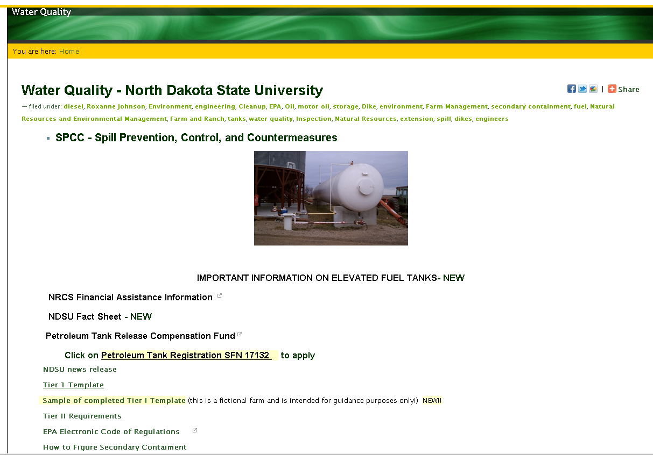
Resources Online
www.ndsu.edu/waterquality

Slide 40
More Information
Environmental Protection Agency www.epa.gov
  SPCC – http://www.epa.gov/osweroe1/content/spcc
North Dakota Department of Health
  www.ndhealth.gov/wm/publications
NDSU
  www.ndsu.edu/waterquality
  701-429-3756
  Roxanne Johnson

Slide 41
Region 8 Contacts
Donna Inman
      303-312-6201
      inman.donnak@epa.gov
Melissa Payan
    - 303-312-6511
    - payan.melissa@epa.gov

Slide 42
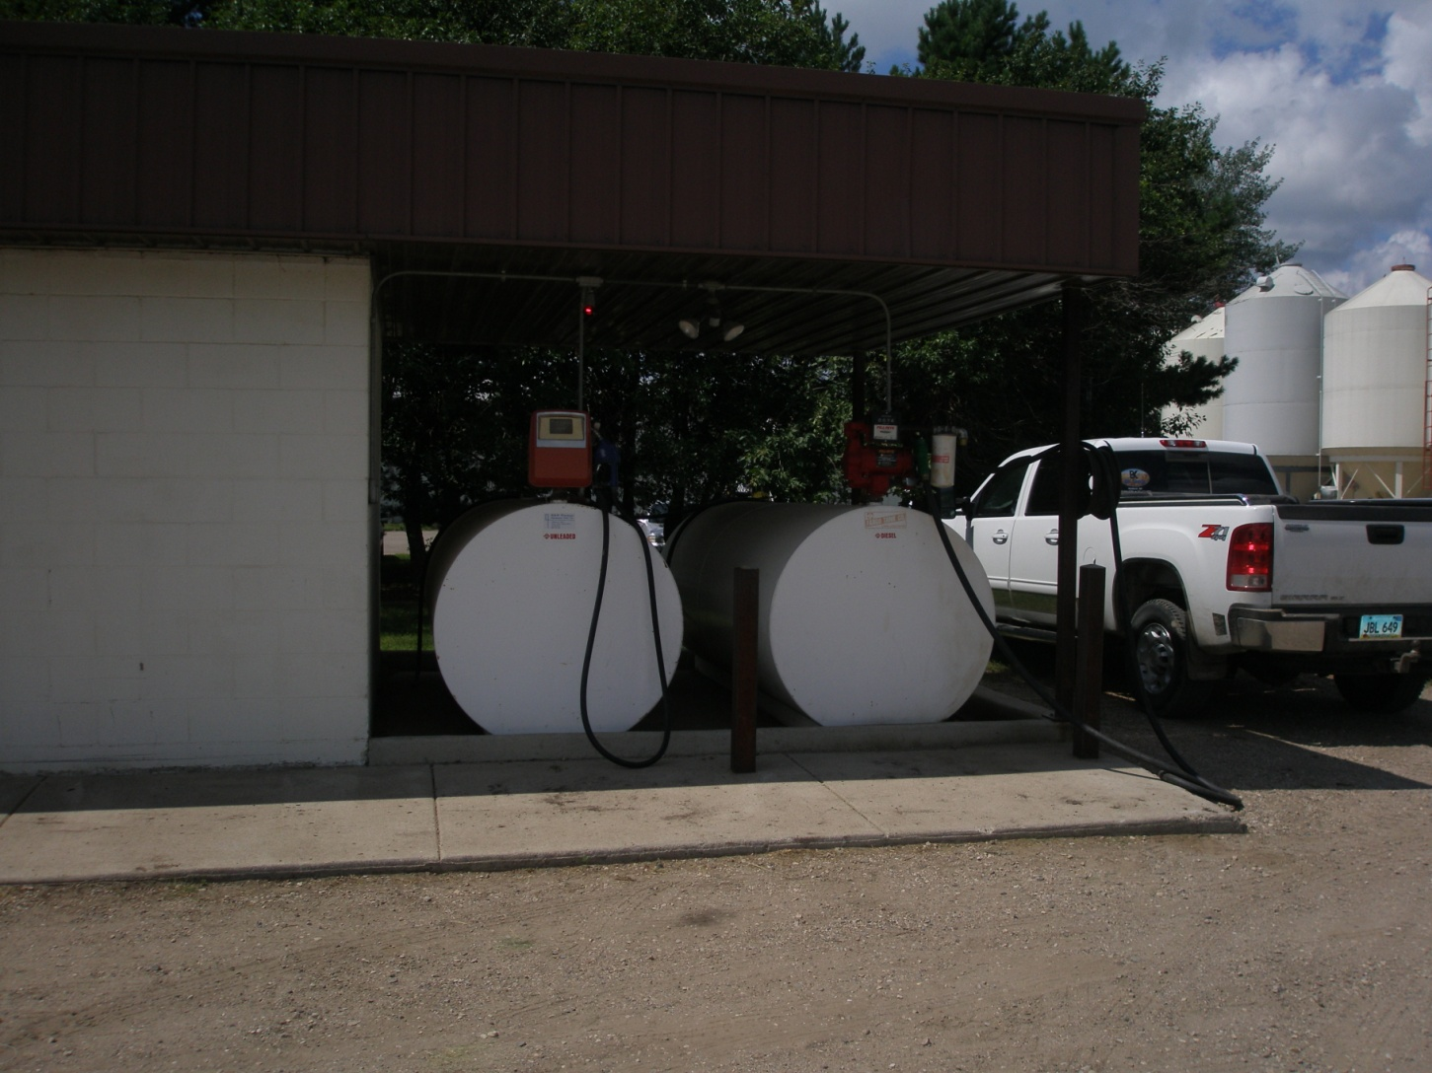
Questions?
www.ndsu.edu/waterquality

