Slide 2


Potato Production in North Dakota and Minnesota
Andy Robinson
Extension Potato Agronomist
NDSU & U of M
Andrew.p.robinson@ndsu.edu
701.231.8732

Slide 3
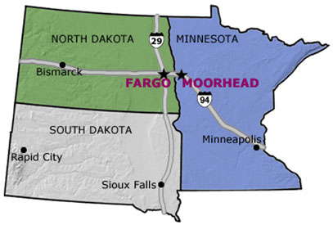

Slide 4
US Potato Acres 2011
Ranking | State | Acres planted
1 | Idaho | 320,000
2 | Washington | 160,000
3 | North Dakota | 84,000
4 | Wisconsin | 63,000
5 | Colorado | 58,500
6 | Maine | 57,000
7 | Minnesota | 49,000
ND and MN planted 133,000 acres of potatoes in 2011.
http://quickstats.nass.usda.gov

Slide 5
US Potato Production 2011
Ranking | State | Production (CWT)
1 | Idaho | 127,070,000
2 | Washington | 98,400,000
3 | Wisconsin | 25,000,000
4 | Oregon | 23,342,000
5 | Colorado | 22,919,000
6 | North Dakota | 18,865,000
7 | Minnesota | 16,685,000
ND and MN produced 35,550,000 CWT
http://quickstats.nass.usda.gov

Slide 6
ND and MN Potato Acres Planted
Potato acres are decreasing by 2,777 and 3,490 acres/year for MN and ND non-irrigated potatoes, respectively.
http://quickstats.nass.usda.gov

Slide 7
ND and MN Potato Yield
Potato yield has increasing steadily for MN and irrigated fields in ND.
http://quickstats.nass.usda.gov

Slide 8
Potato Production
Potato yield is decreasing in MN and in non-irrigated fields in ND.
http://quickstats.nass.usda.gov

Slide 9
Glyphosate
Drift
Misapplications
Sprayer contamination
Aerial malfunctions

Slide 10
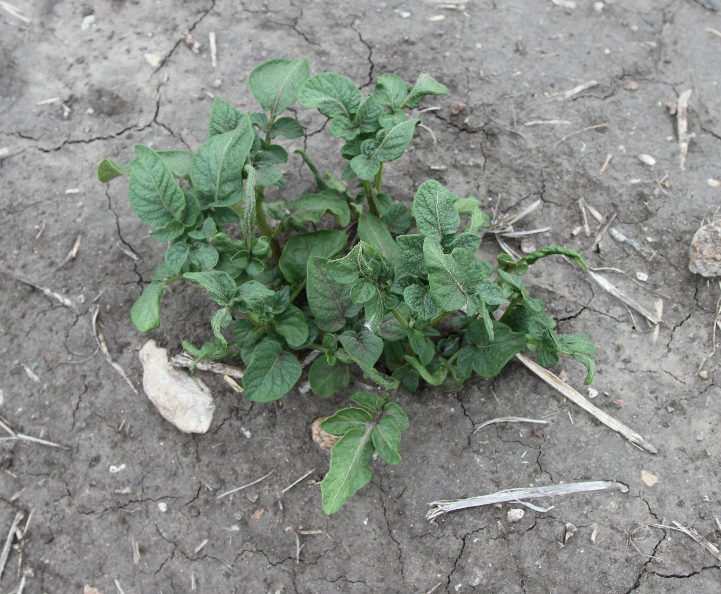

Slide 11
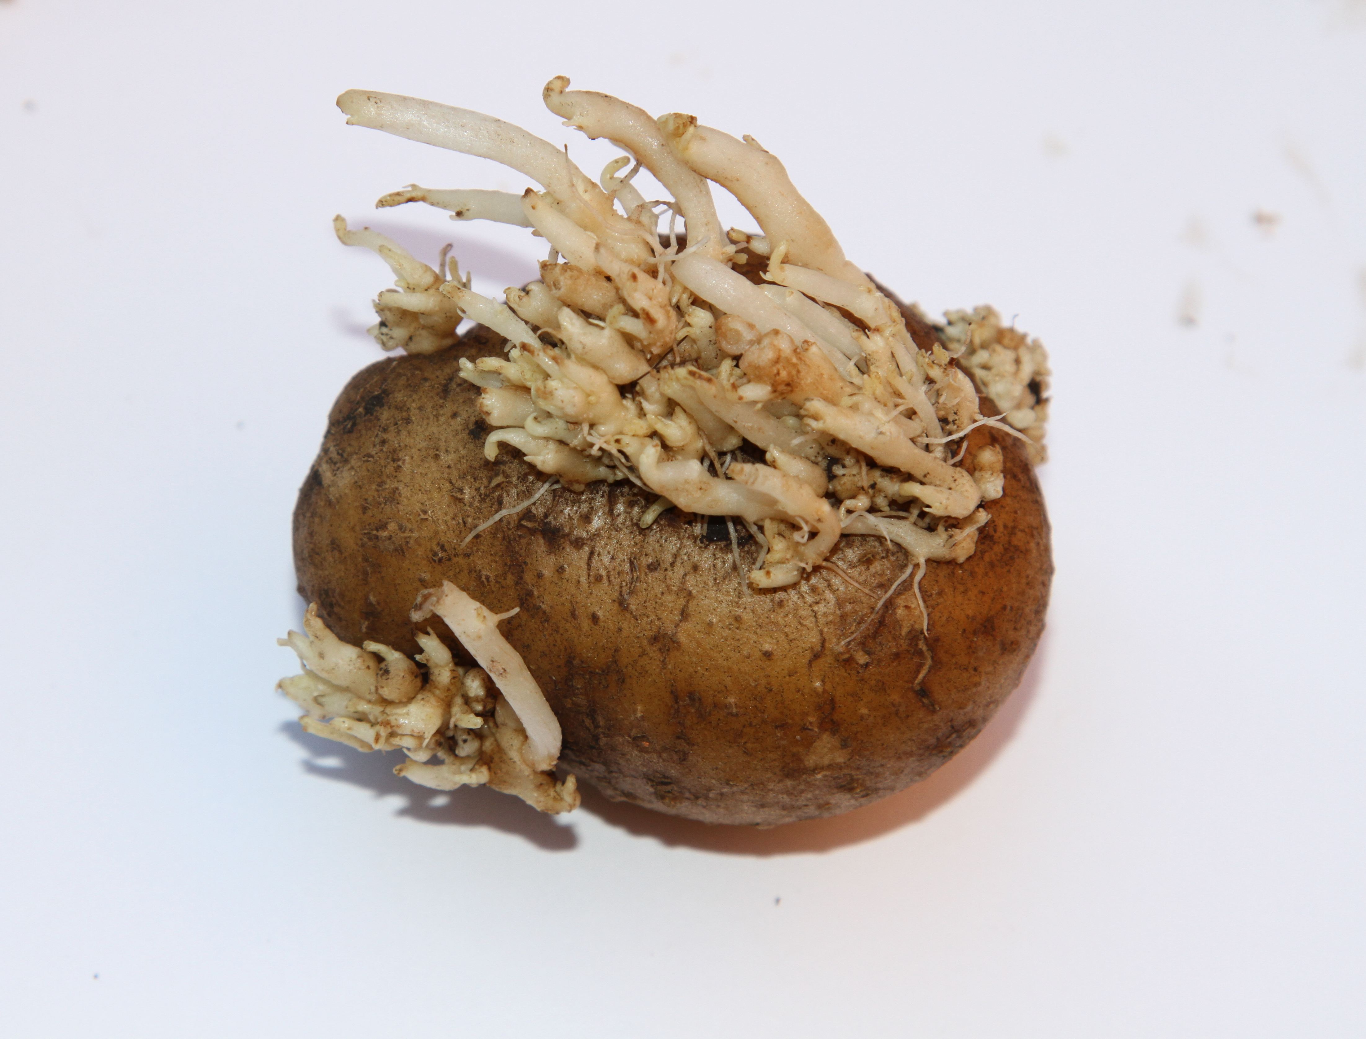

Slide 12
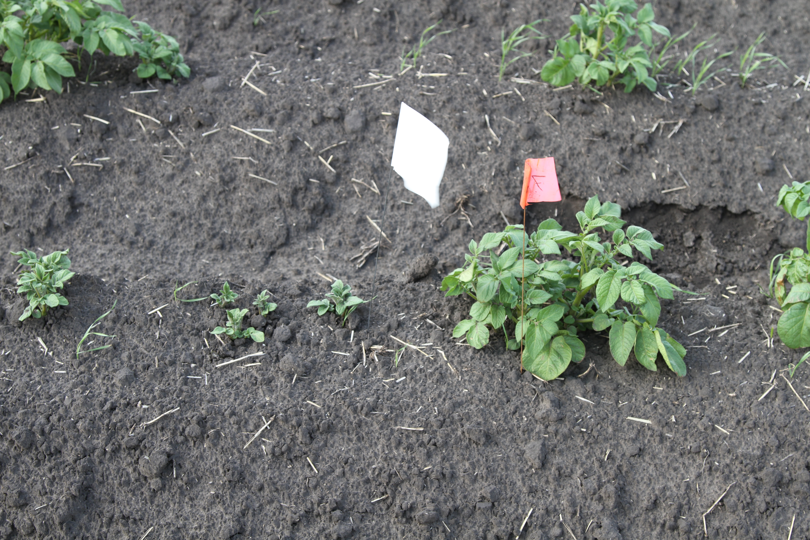

Slide 13
Glyphosate
Weight | Tuber (no.) | Weight per tuber (g) | Hill weight (g)
No glyphosate | 10.5 | 87 | 907
Glyphosate | 6.2 | 66 | 417

Slide 14
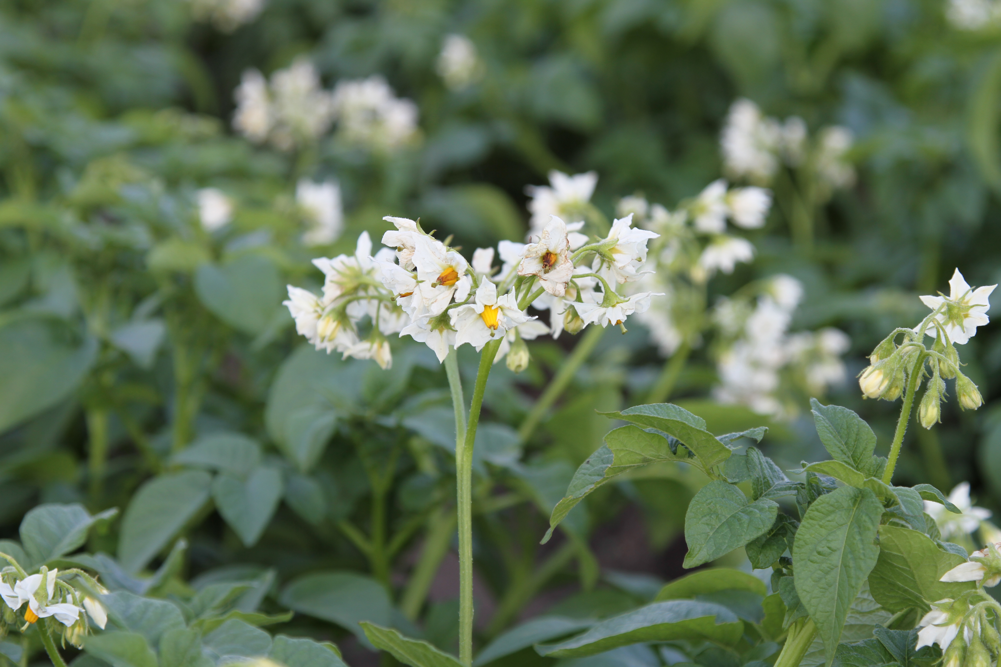
Questions?

