Slide 1
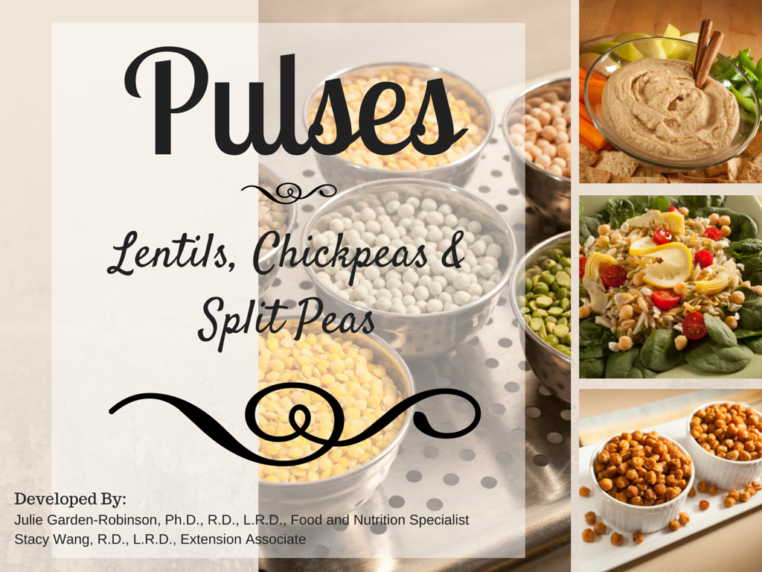

Notes:
Objectives:
Participants will be able to identify pulse crops (lentils, chickpeas and split peas).
Participants will know what counts as a serving of lentils, chickpeas and split peas.
Participants will know MyPlate recommendations for lentils, chickpeas and split peas.
Participants will know how to prepare pulse crops.
Suggested handouts:
“Pulses: The Perfect Food” (FN1508); http://www.ag.ndsu.edu/publications/landing-pages/food-and-nutrition/pulses-the-perfect-food-fn-1508
“Using More Pulse Foods in Your Diet” (FN1714) http://www.ag.ndsu.edu/publications/landing-pages/food-and-nutrition/pulse-foods-in-your-diet-fn-1714
A survey tool is available for evaluation purposes.
Optional: Demonstrate and taste-test one of the featured recipes in either of the handouts. The hummus recipes are very easy to prepare as a demonstration.
Talking points:
Pulses, which include lentils, chickpeas and dry peas, are increasingly being recognized for their role in promoting good health. Making pulses a regular part of your diet may reduce your risk of heart disease, diabetes and certain cancers.

Slide 2
Which of these are considered pulse crops?
Lentils
Oats
Chickpeas
Corn
Dry Peas
Wheat
Barley
Rye
Green Beans
Notes:
Answers:
Lentils
Dry peas (whole and split)
Chickpeas

Slide 3
Pulses are legumes,
(seeds that grow in their pods)
Today’s focus
Lentils
Dry Peas
Chickpeas
Notes:
Pulses are a type of legume (seeds that grow within pods). There are many varieties grown all over the world.
Today we will be focusing on these pulses: lentils, chickpeas (also known as garbanzo beans) and dry peas.

Slide 4
What Health Benefits are associated with Pulse Crops?
Skin health
Reduce risk of birth defects
Bone health
Heart health
Eye health
Reduce risk of certain cancers

Slide 5
Nutritional Characteristics
Pulses
Protein
Fiber
Minerals
Vitamins
Notes:
Pulses provide protein, fiber (complex carbohydrates), and several vitamins and minerals. They contain no cholesterol and little to no fat. Addition of pulses to a healthy diet will help in maintaining good health.

Slide 6
Nutrient (unit) | Reference Diet (used on food labels) | Chickpeas/garbanzo beans (per cup, cooked, without added salt) | Lentils (per cup, cooked, without added salt) | Split peas (per cup, cooked, without added salt)
Calories (kcal) | 2,000 | 269 | 230 | 231
Total Fat (g) | Less than 65 | 4.3 | 0.8 | 0.8
Saturated Fat (g) | Less than 20 | 0.4 | 0.1 | 0.1
Trans Fat (g) | (No value set; minimize in diet) | 0 | 0 | 0
Cholesterol (mg) | Less than 300 | 0 | 0 | 0
Sodium (mg) | Less than 2,400 | 11 | 4 | 4
Total Carbohydrate (g) | 300 | 45 | 39.9 | 41.3
Fiber (g) | 25 | 12.5 | 15.6 | 16.3
Protein (g) | 50 | 14.5 | 17.9 | 16.4
Vitamin A (IU) | 5,000 | 44 | 16 | 14
Vitamin C (mg) | 60 | 2.1 | 3.0 | 0.8
Calcium (mg) | 1,000 | 80 | 38 | 27
Iron (mg) | 18 | 4.7 | 6.6 | 2.5
Folate (mcg) | 400 | 282 | 358 | 127
Notes:
Nutritional analysis of selected pulses compared with a reference diet.
Source: U.S. Department of Agriculture, Agriculture Research Service. National Nutrient Database for Standard Reference, available at www.nal.usda.gov/fnic/foodcomp
Experts recommend adults consume at least 25 grams of fiber per day.
U.S. Public Health Service recommends women of child-bearing age consume at least 400 micrograms of folic acid/folate daily to help prevent birth defects.

Slide 7
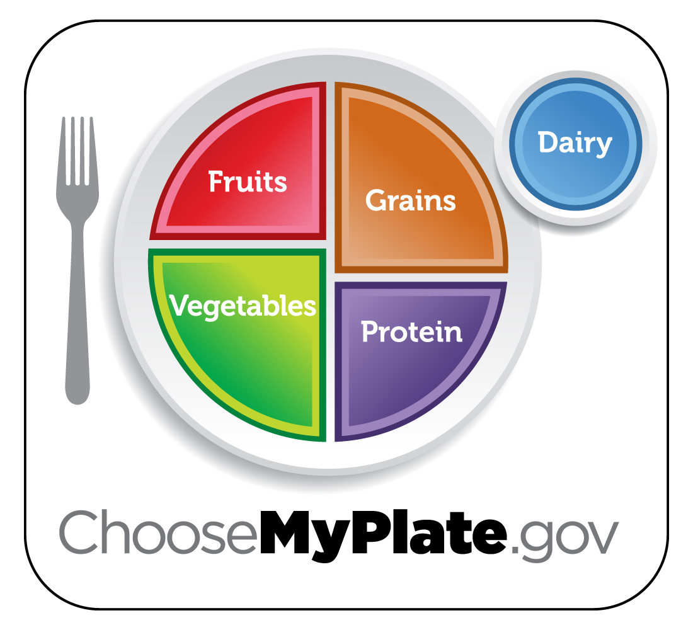
MyPlate

Slide 8
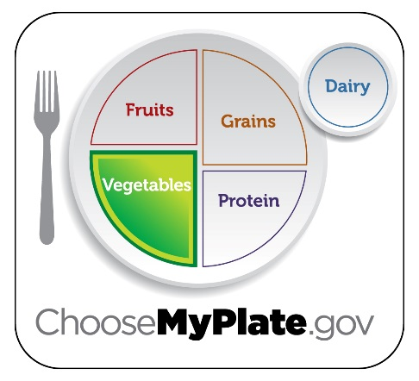
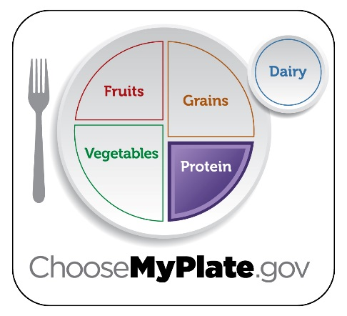
MyPlate Recommendations
Vegetable Group
Protein
Group
1 cup whole or mashed peas or lentils = 1 cup of vegetables
¼ cup of cooked chickpeas, lentils or peas
= 1 ounce equivalent
Notes:
Pulses can count toward either the Vegetable Group or the Protein Foods Group total. The amount of food you need from each group varies depending on gender, age, and physical activity level. To find out what’s right for you visit www.choosemyplate.gov and print out your daily food guide.
On average, adults need about 2.5 cups to 3 cups of vegetables per day and 5 to 6 ounce equivalents of meat and beans per day.

Slide 9
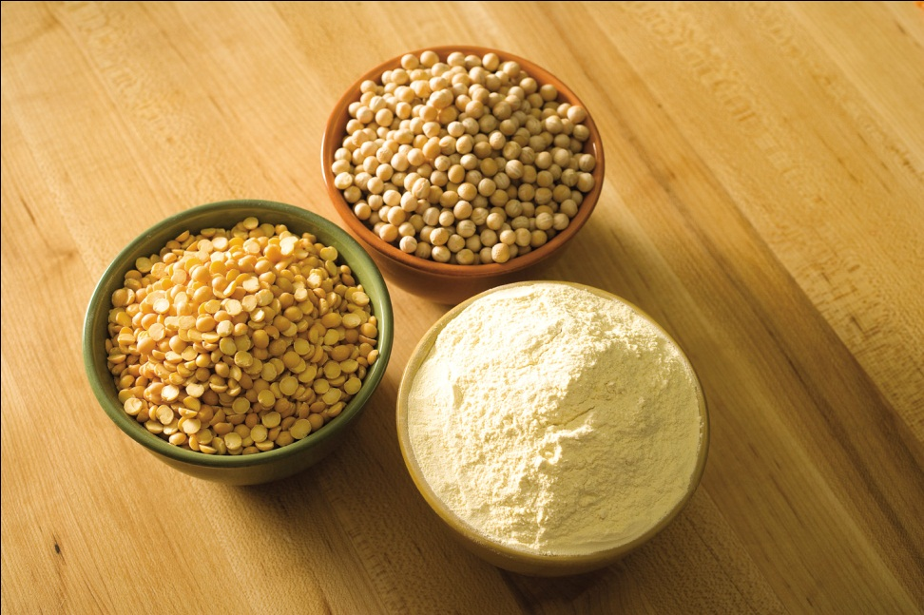
MyPlate recommendations
Add more lentils, chickpeas, split peas to your diet

Slide 10
Role in special diets
Gluten-free diet
Diabetic Diet
Weight Management Diet
Vegetarian Diet
Notes:
Gluten-free diet: Pulses contain no gluten(protein found in wheat and some other cereal grains) so therefore people with gluten intolerances (Celiac disease) can use lentils, chickpeas, and peas in their recipes.
Diabetic diet: Pulses may help with blood glucose management because of their low glycemic index (measure of how fast carbohydrate-containing foods raise blood sugar levels.) A low glycemic index means pulses raise blood sugar slowly compared with foods having a high glycemic index.
Vegetarian diet: Pulses are a good source of protein an essential part of the vegetarian diet.
Weight management diet: Pulses are high in fiber and protein leading to a feeling of fullness. They are also low in fat.
*When consuming extra fiber be sure to drink plenty of water.

Slide 11
Preparing lentils
No soaking required
Add 2.5 cups water for every 1 cup of lentils
Remove stones and rinse lentils
Yield:
1 cup lentils
+ 2.5 cups water =
About 2.5 cups cooked
lentils
Heat water to boiling, simmer lentils for 15 to 20 minutes
Notes:
In the grocery store, lentils are available dry, in several varieties ranging from a red color to a greyish color.

Slide 12
Preparing Chickpeas
Add 2 cups water for every 1 cup of chickpeas
Remove stones and rinse chickpeas
Yield:
1 cup chickpeas + 2 cups water =
About 2 cups cooked chickpeas
Must soak using one of the following methods: slow soak, hot soak, or quick soak
Simmer for 1.5 to 2 hours
Notes:
Chickpeas can either be found dry or canned in the grocery store.
Soaking methods:
Slow soak: Cover 1 pound of dry chickpeas with 10 cups of water and refrigerate 6-8 hours or overnight.
Hot soak: Bring 10 cups of water to a boil, add 1 pound dry chickpeas and return to a boil. Allow to stand at room temperature for 1 hour.
Quick soak: Bring 10 cups of water to a boil, then add 1 pound of dry chickpeas. Boil 2 to 3 minutes. Allow to stand at room temperature for 1 hour.

Slide 13
Preparing Split peas
No soaking required
Add 2 cups water for every 1 cup of split peas
Remove stones and rinse
split peas
Yield:
1 cup split peas + 2 cups water =
About 2 cups cooked
split peas
Heat water to boiling, simmer
split peas for 30 minutes
Notes:
Dry peas (whole and split) can be found dry in the store.
When preparing whole peas:
Soak overnight or use one of the methods mentioned under chickpeas.
Cook peas 35 to 40 minutes or until desired tenderness is reached.

Slide 14
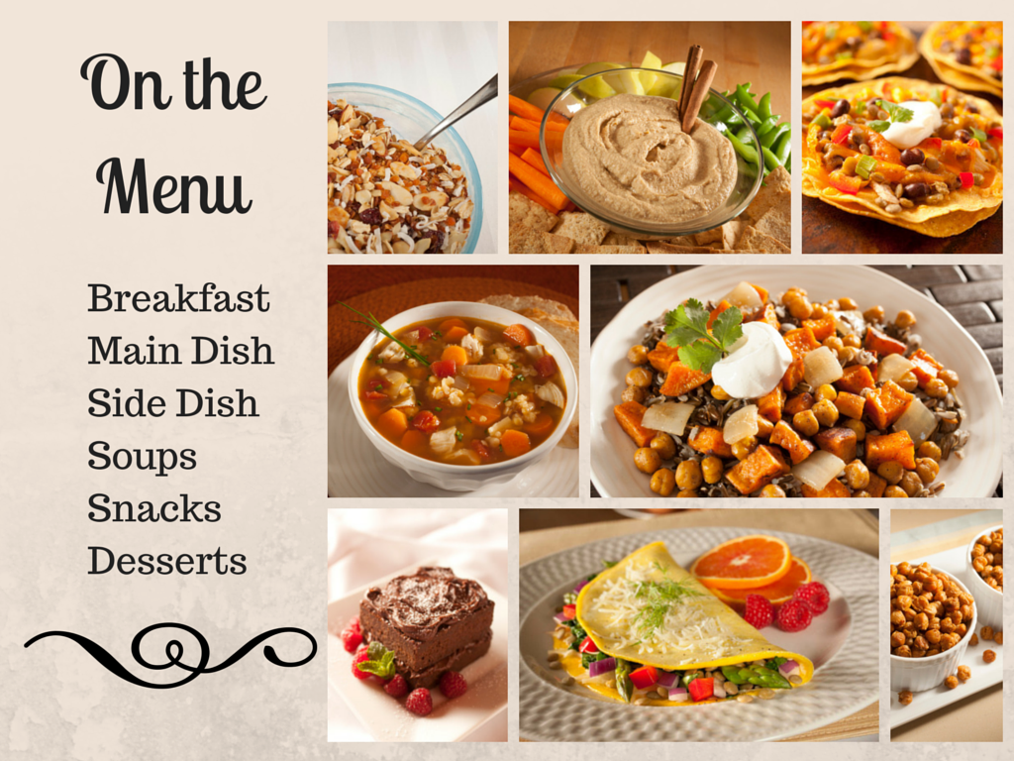

Slide 15
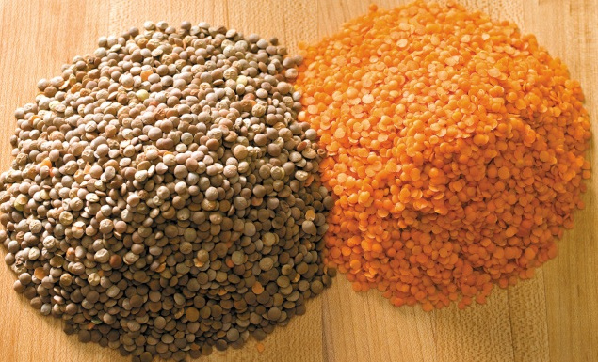
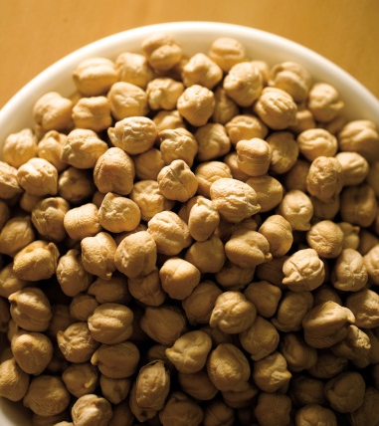
Storing pulses
Uncooked
Cooked
Store dry, uncooked pulses in a sealed container in a cool, dry place.
Refrigerate leftovers at 40 degrees F
and use within three days.

Slide 16
Top 10 Reasons to Use Pulses
Excellent source of fiber
Good source of protein
Low fat
Low sodium
Good source of iron
Excellent source of folate
Good source of potassium
Low glycemic index
Gluten-free
Cholesterol-free

Slide 17

ADDITIONAL INFORMATION
NDSU Extension Service
www.ag.ndsu.edu/food
Northern Pulse Growers Association
www.northernpulse.com
MyPlate Website
www.choosemyplate.gov

