Slide 1
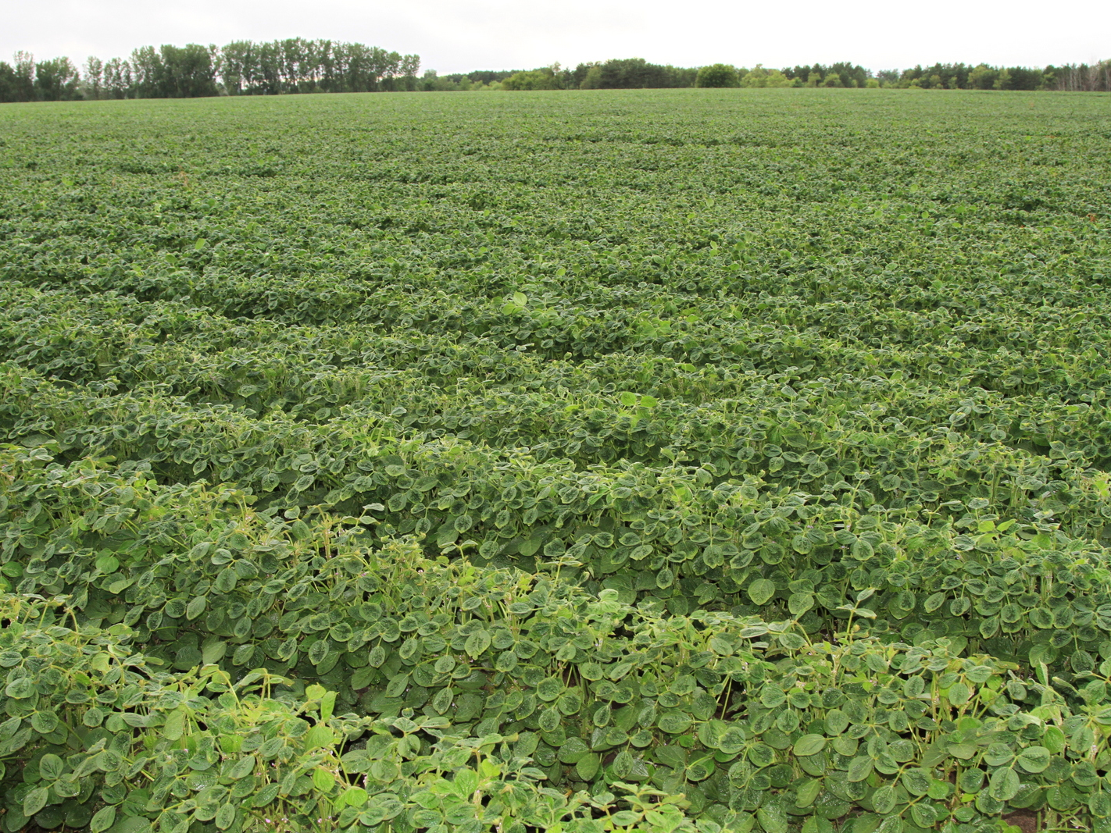
Reducing Spray Drift and Its Effects
Andy Robinson NDSU & U of M
www.ag.ndsu.edu/potatoextension

Slide 2
Today’s Presentation
New technology
Off-site movement of herbicides
Response of soybean to 2,4-D
Response of soybean to Dicamba
Effect of glyphosate on potatoes

Slide 3
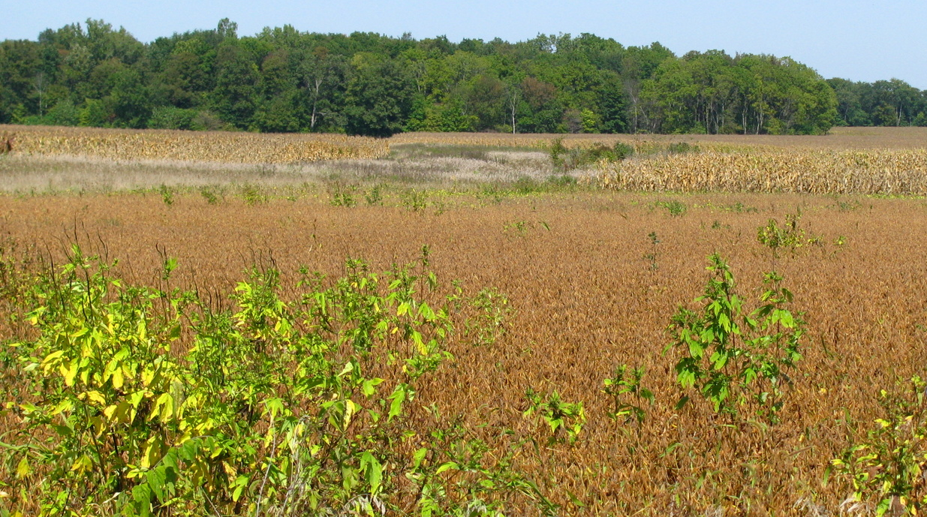
Glyphosate-Resistant Weeds
Glyphosate-resistant soybean became commercially available in 1996.
Since 1996, 24 weeds have been documented to be glyphosate resistant (www.weedscience.org).

Slide 4
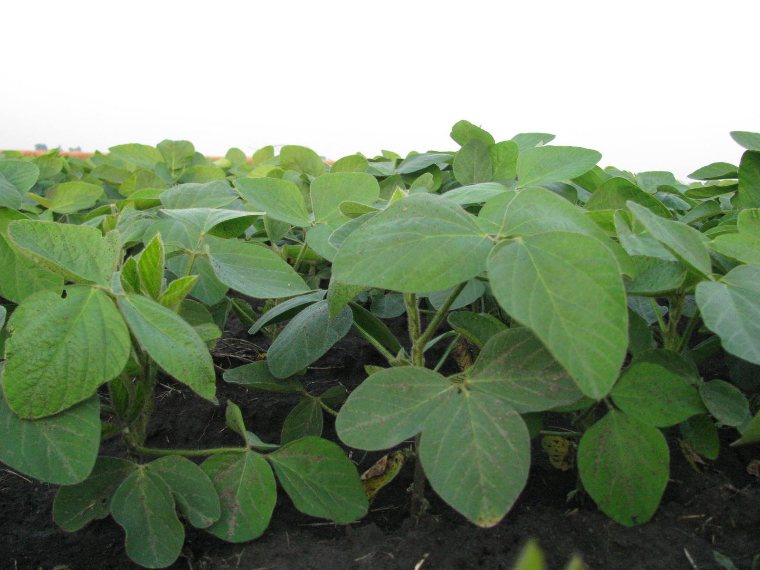
New Genetically Engineered Technology
Resistance to:
2,4-D (+ triclopyr, fluroxypyr, and fops - ACCase inhibitors)
Dicamba
ALS
HPPD

Slide 5
Synthetic Auxin Herbicides
2,4-D and dicamba resistant soybean will be available in the next few years.
Low amounts of auxin mimic herbicides can cause epinasty.
  Epinasty: leaf crinkling, bubbling, strapping, and/or twisting and bending of petioles, branches, and stems.

Slide 6
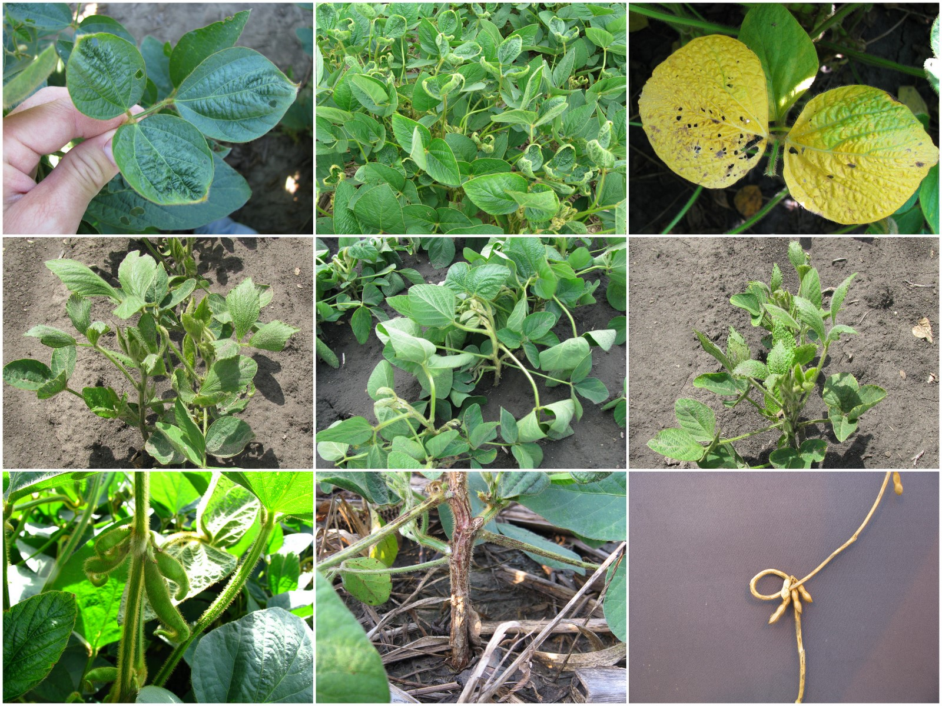

Slide 7
Epinasty
Epinasty can lead to reduced leaf area, changed leaf angle, and malformed growth.
The greater the amount of epinasty is often associated with a reduction in yield potential.

Slide 8
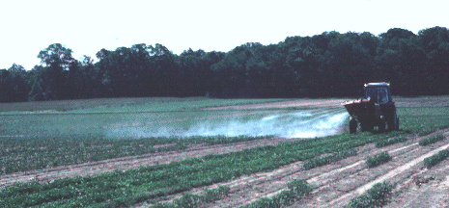
Inadvertent Exposure to Herbicides
Particle drift (including inversions)
Volatilization
Contamination of spraying equipment
Misapplication
www.state.me.us

Slide 9
Drift – Particle Size
Influence of droplet size on potential distance of drift
Droplet diameter (microns) | Type of droplet | Time required to fall 10 feet | Lateral distance droplets travel in falling 10 feet in a 3 mph wind
5 | Fog | 66 minutes | 3 miles
20 | Very fine spray | 4.2 minutes | 1,100 feet
100 | Fine spray | 10 seconds | 44 feet
240 | Medium spray | 6 seconds | 28 feet
400 | Coarse spray | 2 seconds | 8.5 feet
1,000 | Fine rain | 1 second | 4.7 feet

Slide 10
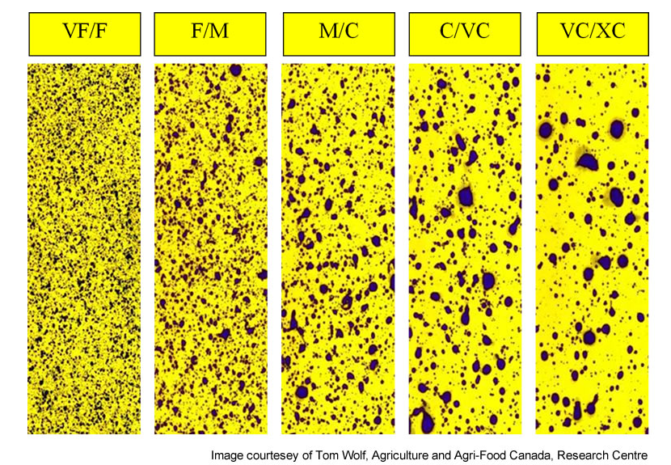
Coverage of Droplets
http://www.wilger.net/Drop%20cat%20drop%20sizes.jpg

Slide 11
What’s the Trade-Off?

Slide 12
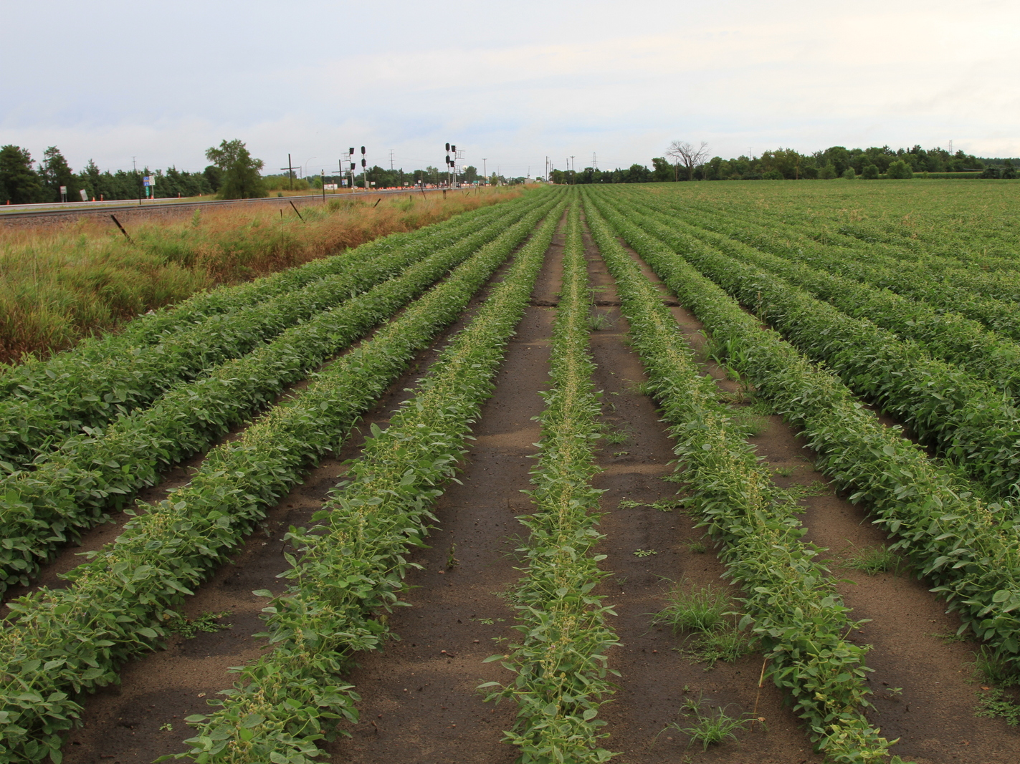
Herbicide Volatilization

Slide 13
Tank Contamination
Tank Contamination
  Soybean injury can occur from 0.01% of 8 fl oz/A dicamba
Incomplete clean-out
  0.01% = 6.4 oz left after 16 fl oz/A Clarity in 500 gallon spray tank
  0.1% = 2 quarts left after 16 fl oz/A Clarity in 500 gallon spray tank
Contaminated jugs or equipment
  0.01% = 0.05 oz or 1.5 mL Clarity in 500-gallon load

Slide 14
Tank Residue Case Study
Water source | Dicamba (ppb) | Use rate (%)
Spray tank | 945 | 0.024%
Spray tank after overnight | 822 | 0.021%
Spray boom | 24,800 | 0.63%
Based on 1 pt/A Clarity applied in 15 gal/A. Spray tank cleaned out prior to test.
(Boerboom, 2004)

Slide 15
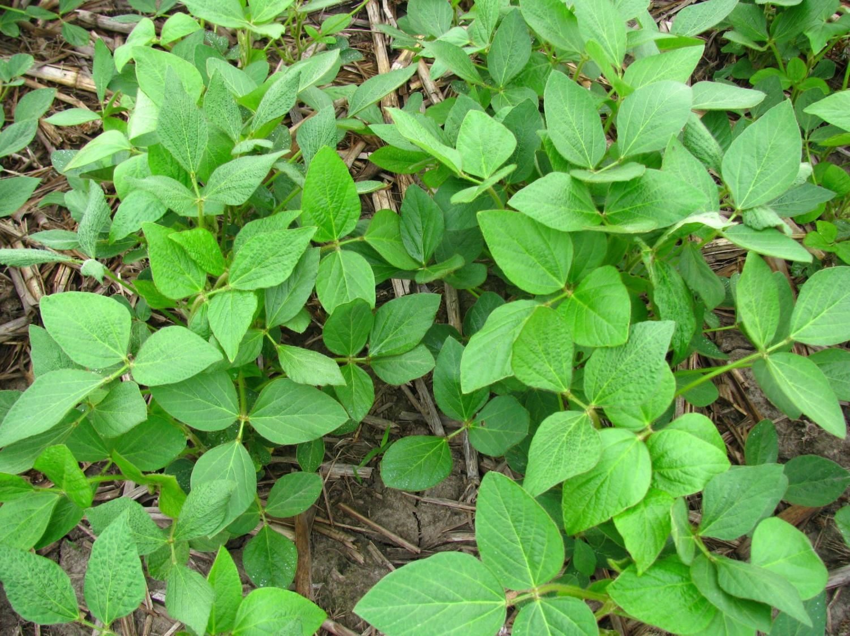
Response of Glyphosate-resistant Soybean to 2,4-D

Slide 16
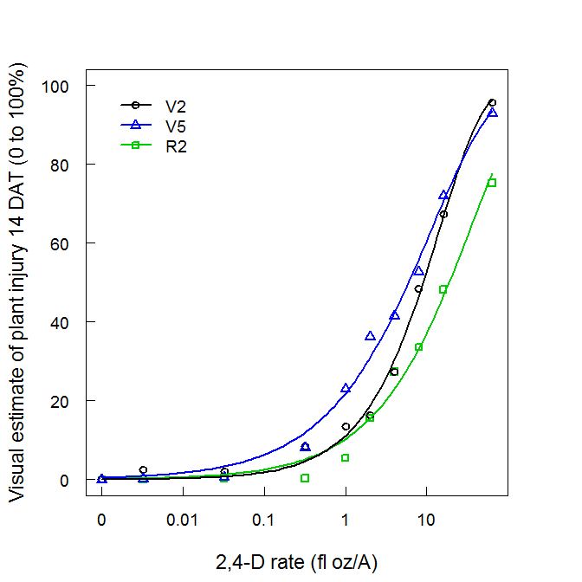
Soybean Injury from 2,4-D at 14 DAT
Estimated 2,4-D dose that caused soybean injury (ED) at 14 DAT.
 | Soybean growth stage
ED % | V2 | V5 | R2
 | ------------- fl oz/A -------------
ED₂₀ | 2.19 | 0.84 | 3.11
ED₅₀ | 9.02 | 5.97 | 18.8
Soybean injury of 20% would need 3 to 10% of 32 fl oz/A 2,4-D solution drifting.

Slide 17
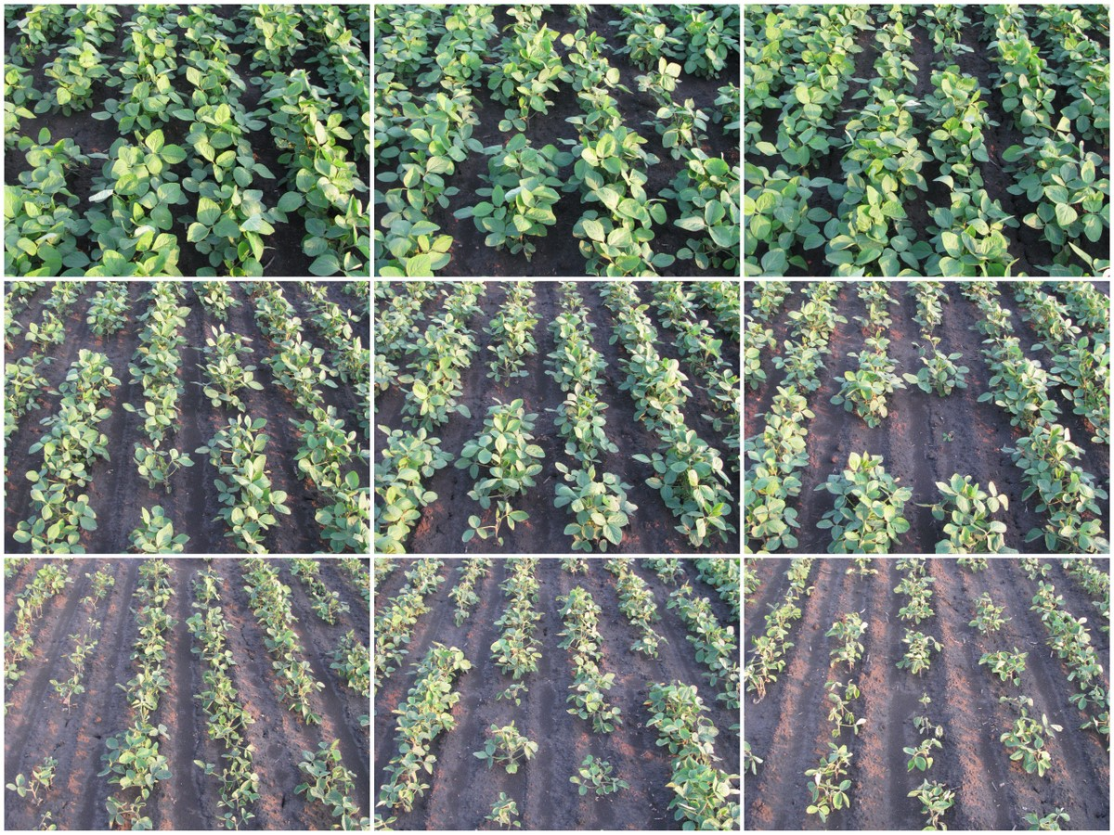
14 DAT V2
0 fl oz/A
0.003 fl oz/A
0.03 fl oz/A
0.3 fl oz/A
1 fl oz/A
2 fl oz/A
4 fl oz/A
8 fl oz/A
16 fl oz/A

Slide 18
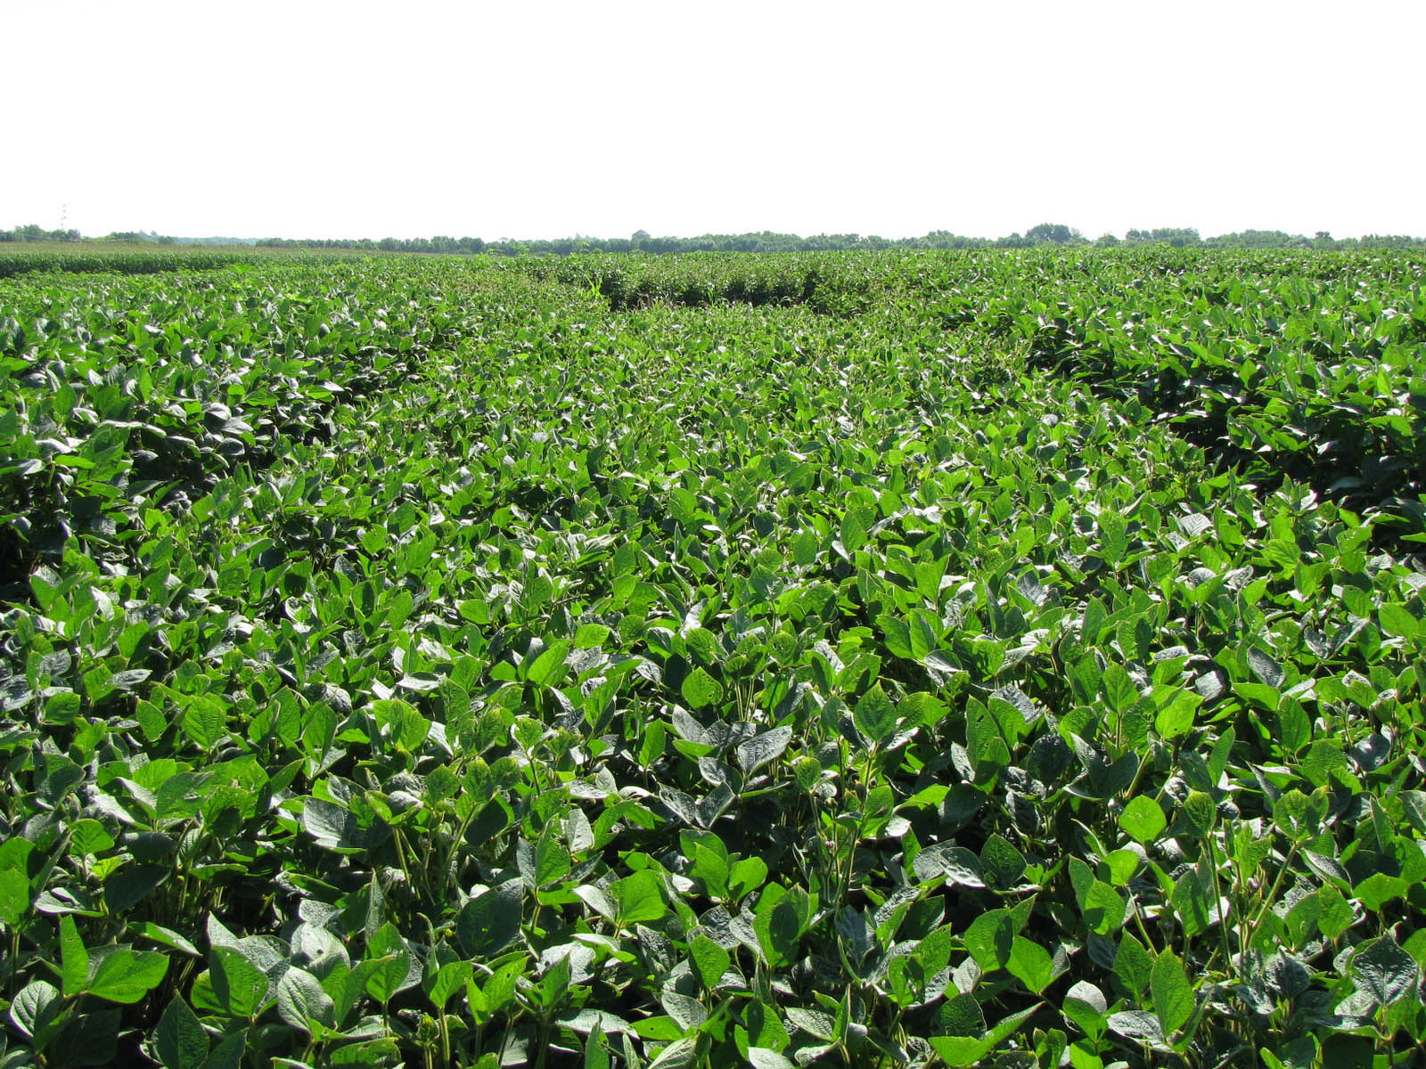
Reduction in Plant Height from 2,4-D

Slide 19
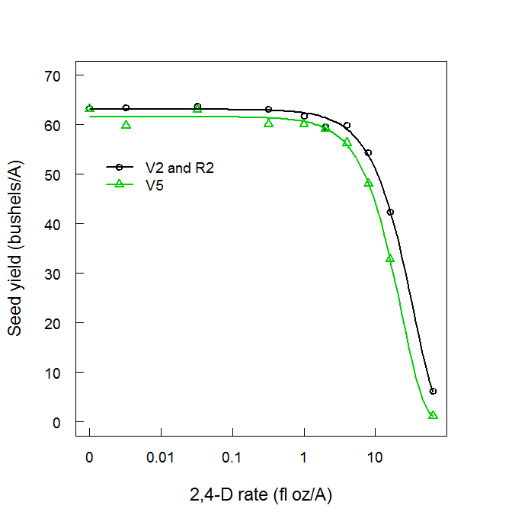
Yield Reduction
Estimated 2,4-D dose (ED) resulting in yield reduction.
 | Soybean growth stage
ED % | V2 and R2 | V5
 | ------------- fl oz/A -------------
ED₁₀ | 5.8 (0.36 pt) | 4.2 (0.26 pt)
ED₂₀ | 10.4 (0.65 pt) | 7.4 (0.46 pt)
A 10% reduction in seed yield would need 13 to 18% solution drift of 32 fl oz/A 2,4-D.

Slide 20
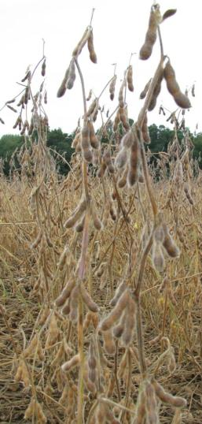
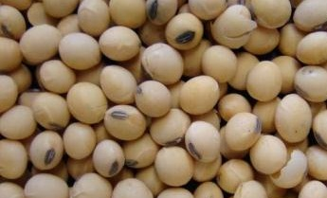
Yield Reduction
Reduction in the number of:
  Main stem nodes
  Reproductive nodes
  Pods
  Seeds

Slide 21
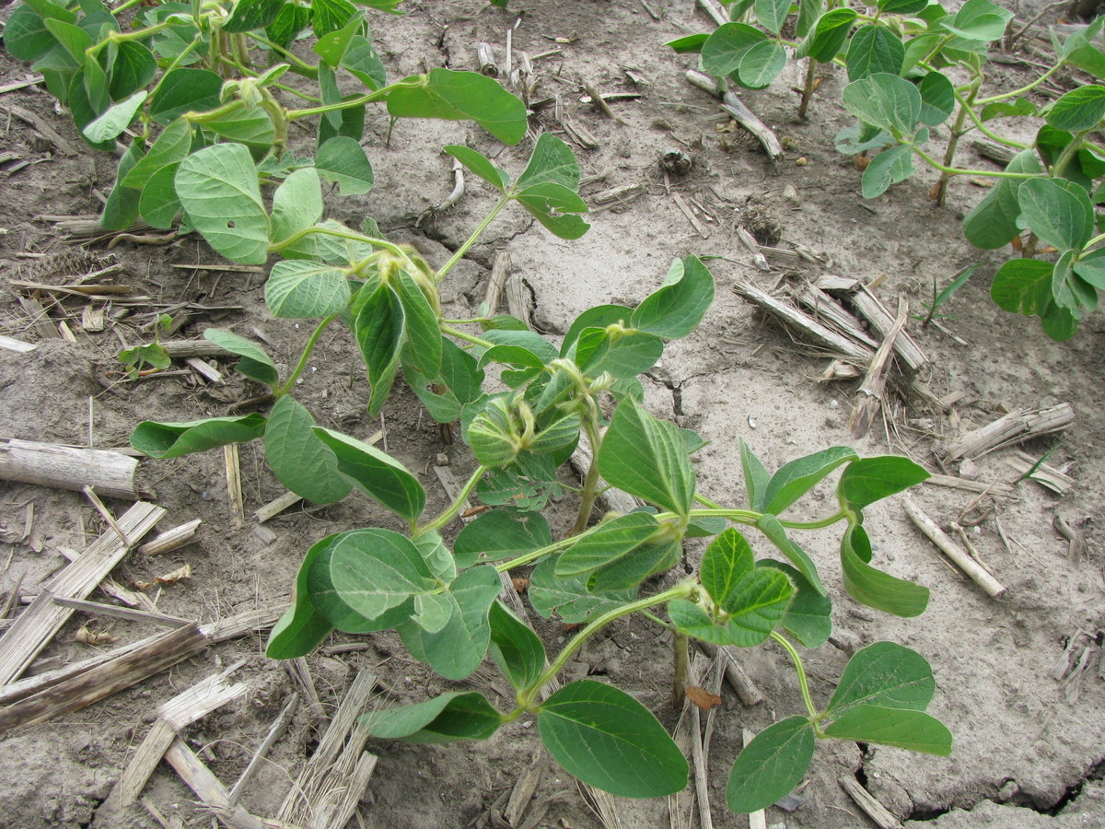
Can Yield Loss be Estimated from Injury Symptomology?

Slide 22
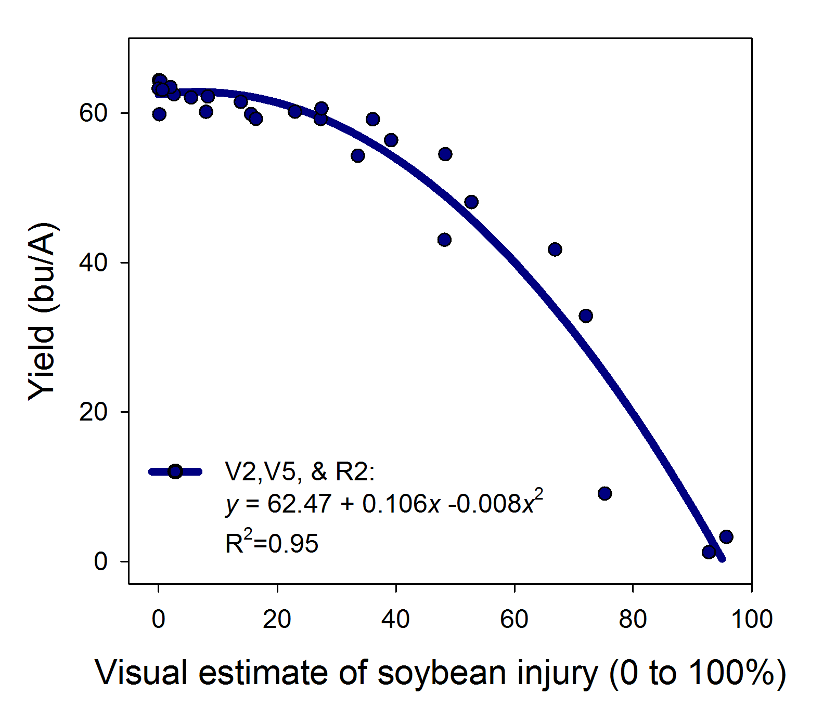
Soybean Yield Loss and Injury
Soybean injury from 2,4-D causing soybean yield loss (YL).
 | Soybean growth stage
YL% | V2, V5, & R2
 | ---- % injury ----
YL₁₀ | 35
YL₂₀ | 47

Slide 23
Implications of 2,4-D Drift
Injury symptoms can be difficult to detect.
Soybean was most sensitive to 2,4-D at the V5 growth stage.
Crop injury and yield loss take a fairly high amount of 2,4-D (13 to 18%) to cause yield loss.
Greatest injury from 2,4-D will likely occur as a result of misapplication or tank contamination, but cultivars may vary is sensitivity.
Soybean injury can be used as a quick and easy method to estimate yield loss, but environment and human error can result in variable estimates.

Slide 24
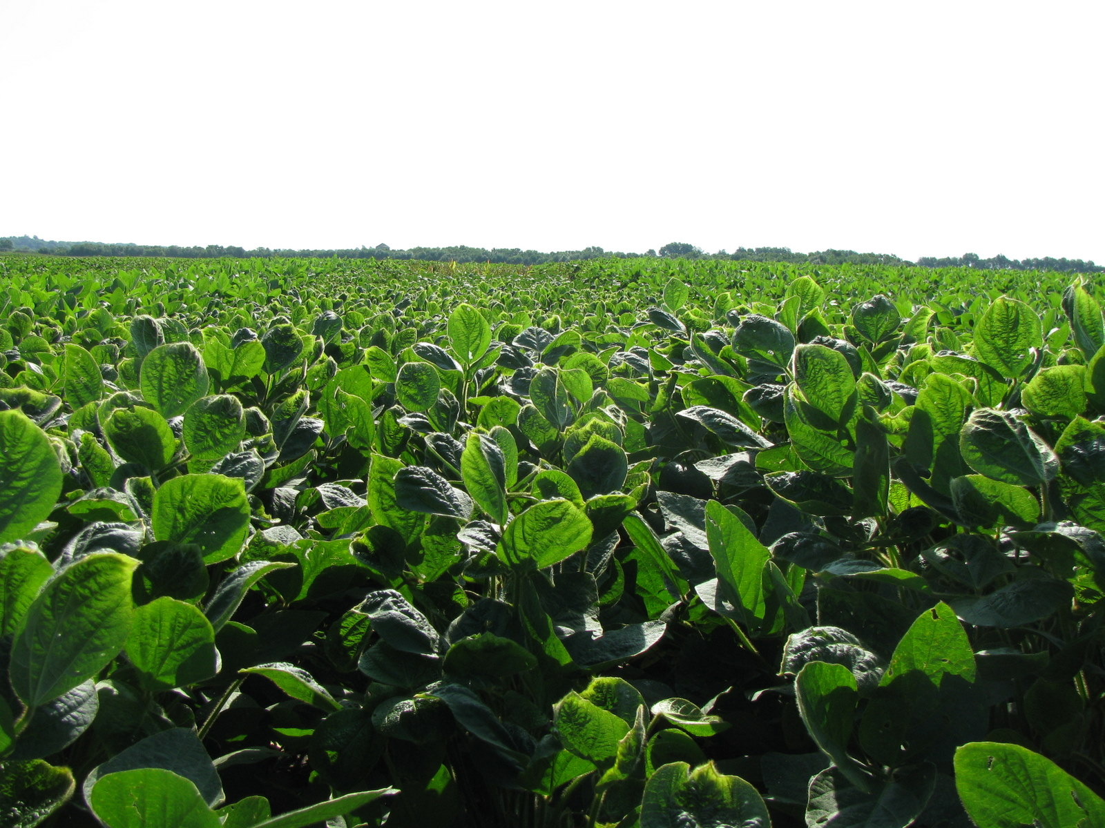
Response of Glyphosate-resistant Soybean to Dicamba Exposure

Slide 25
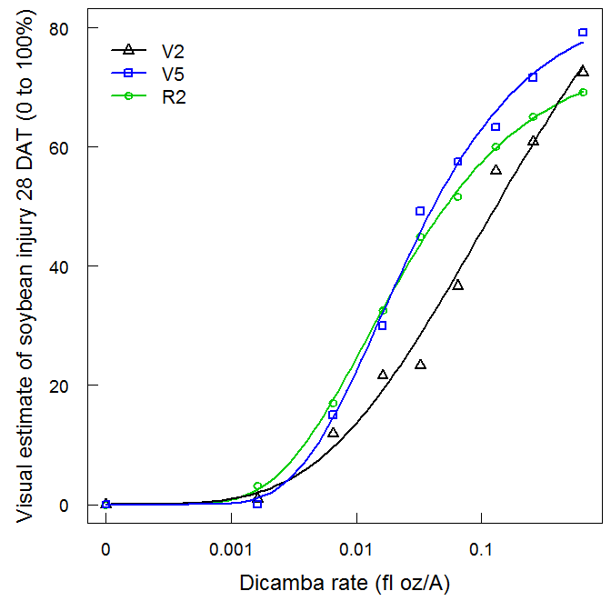
Soybean Injury from Dicamba at 28 DAT
Estimated dicamba dose that caused soybean injury (ED) at 28 DAT in 2009.
 | Soybean growth stage
ED % | V2 | V5 | R2
 | ------------- fl oz/A -------------
ED₂₀ | 0.03 | 0.01 | 0.01
ED₅₀ | 0.13 | 0.04 | 0.05
Soybean injury of 20% would need 0.06 to 0.2% of 16 fl oz/A dicamba solution drifting.

Slide 26
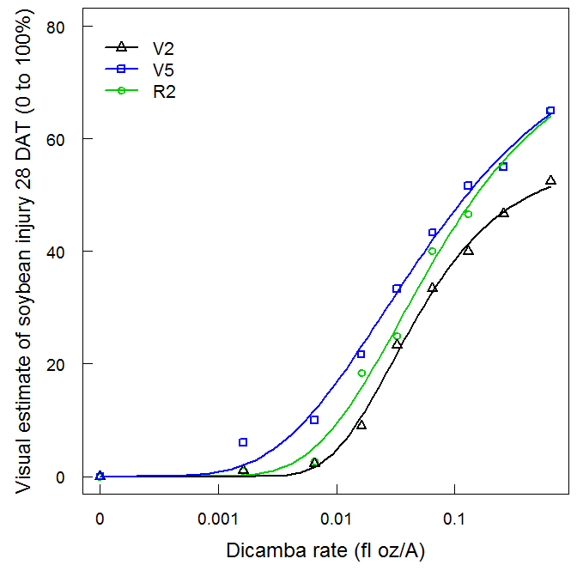
Soybean Injury from Dicamba at 28 DAT
Estimated dicamba dose that caused soybean injury (ED) at 28 DAT in 2010.
 | Soybean growth stage
ED % | V2 | V5 | R2
 | ------------- fl oz/A -------------
ED₂₀ | 0.04 | 0.02 | 0.03
ED₅₀ | 0.45 | 0.13 | 0.15
Soybean injury of 20% would need 0.1 to 0.3% of 16 fl oz/A dicamba solution drifting.

Slide 27
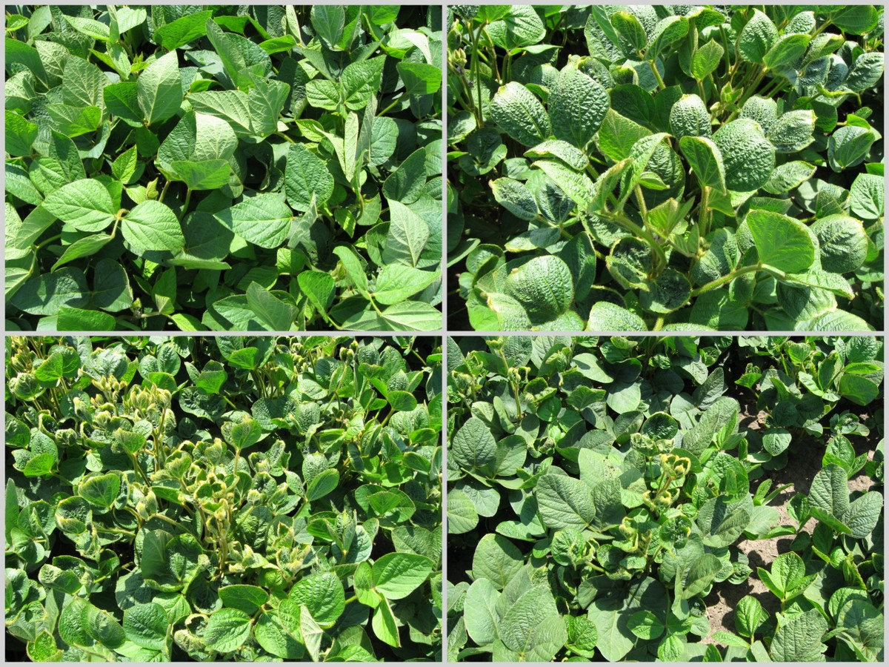
0% drift
0.1% drift
0.2% drift
1.6% drift

Slide 28
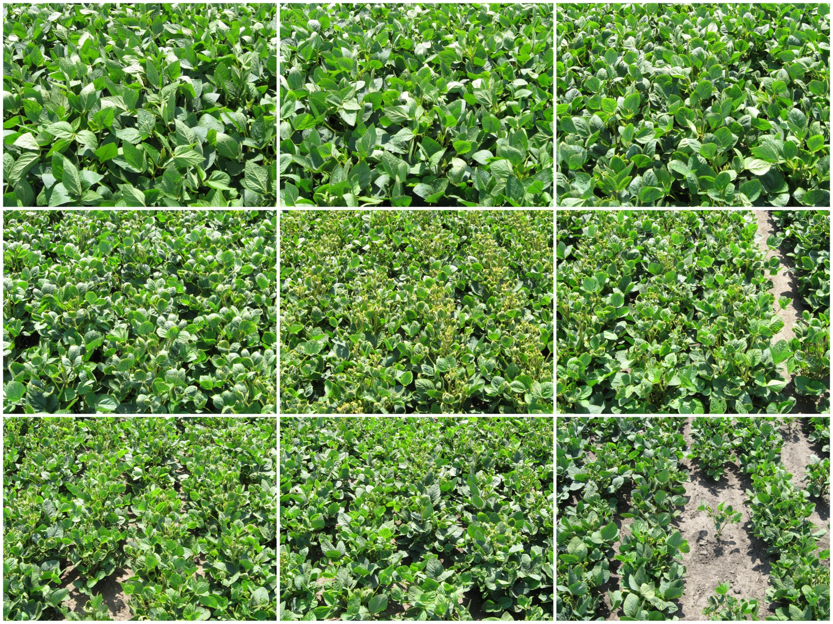
28 DAT V5
0 fl oz/A
0.002 fl oz/A
0.007 fl oz/A
0.02 fl oz/A
0.03 fl oz/A
0.07 fl oz/A
0.13 fl oz/A
0.26 fl oz/A
0.65 fl oz/A

Slide 29
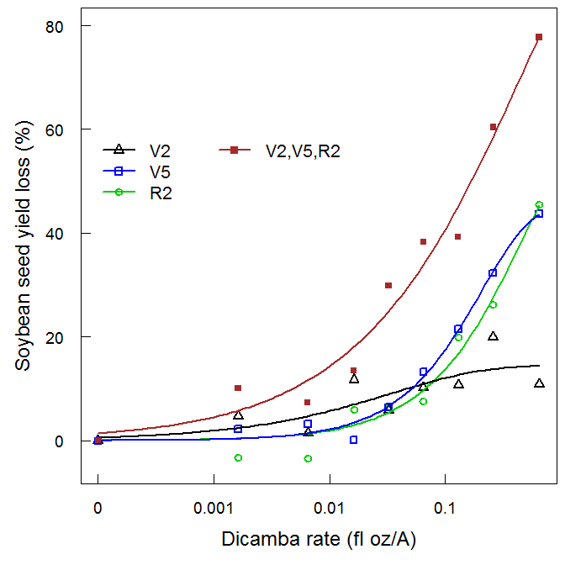
Soybean Yield Loss from Dicamba
Estimated dicamba dose that caused soybean yield loss.
 | Soybean growth stage
 | MRC 2009 & TAPC 2010 |  |  | TPAC 2009
ED % | V2 | V5 | R2 | V2, V5, R2
 | ------------- fl oz/A -------------
ED₁₀ | 0.02 | 0.31 | 0.02 | 0.005
ED₂₀ | - | 0.07 | 0.03 | 0.02
MRC 2009 &
TPAC 2010
TPAC 2009
Soybean yield loss of 10% would need 0.03 to 1.9% of 16 fl oz/A dicamba solution drifting.

Slide 30
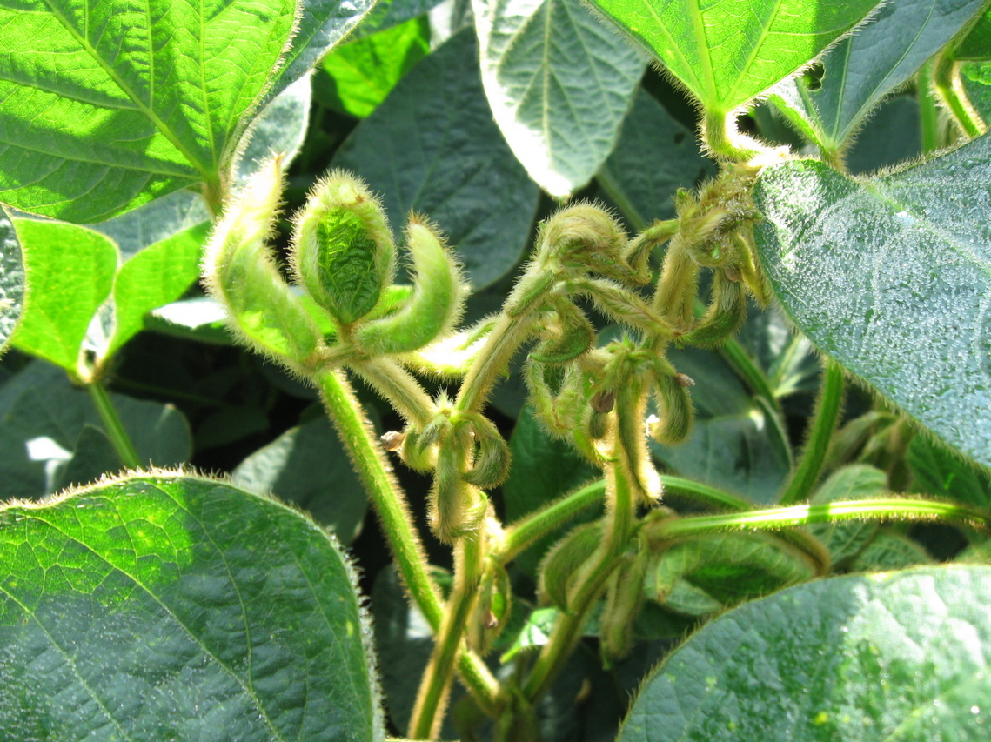
Can Yield Loss be Estimated from Injury Symptomology?

Slide 31
Soybean Yield Loss and Injury
Soybean injury from dicamba causing soybean yield loss (YL).
 | Soybean growth stage
YL% | V2 | V5 & R2
 | ------ % injury ------
YL₁₀ | 16 | 29
YL₂₀ | 42 | 42

Slide 32
Implications of Dicamba Drift
Injury symptoms are easy to identify with dicamba. Leaf puckering is a predominate symptom.
Soybean are sensitive to dicamba, and a small amount of drift (0.06 to 1.9% dicamba) can cause injury and yield loss.
Soybean plants under drought stress are more sensitive to dicamba exposure.
Soybean injury can be used as a quick and easy method to estimate yield loss, but environment and human error can result in variable estimates.

Slide 33
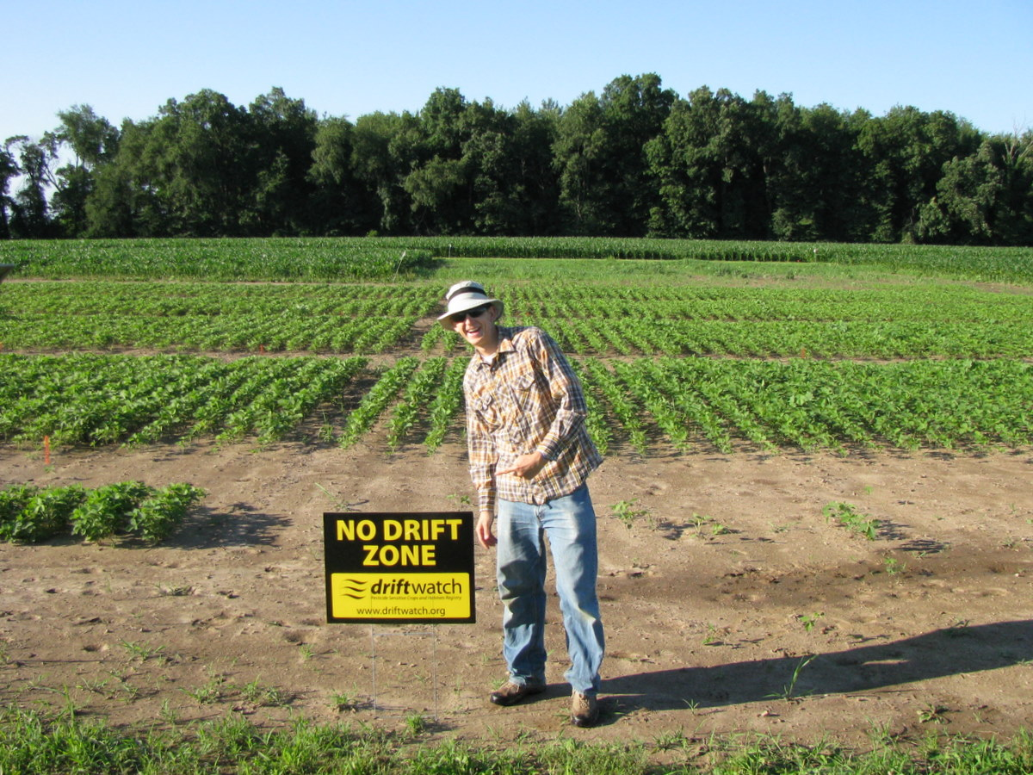
Effects of Dicamba & 2,4-D Drift
Many other plants and crops are sensitive to dicamba and 2,4-D.
Because a low amount causes epinasty, concerns will likely arise when a small amount of product drifts.
To avoid drift follow the label and any recommended practices recommended by NDSU Extension and chemical companies.
If a drift incident occurs follow the instructions in “Documentation for Suspected Herbicide Drift Damage” (http://www.ag.ndsu.edu/pubs/plantsci/weeds/wc751.pdf)

Slide 34
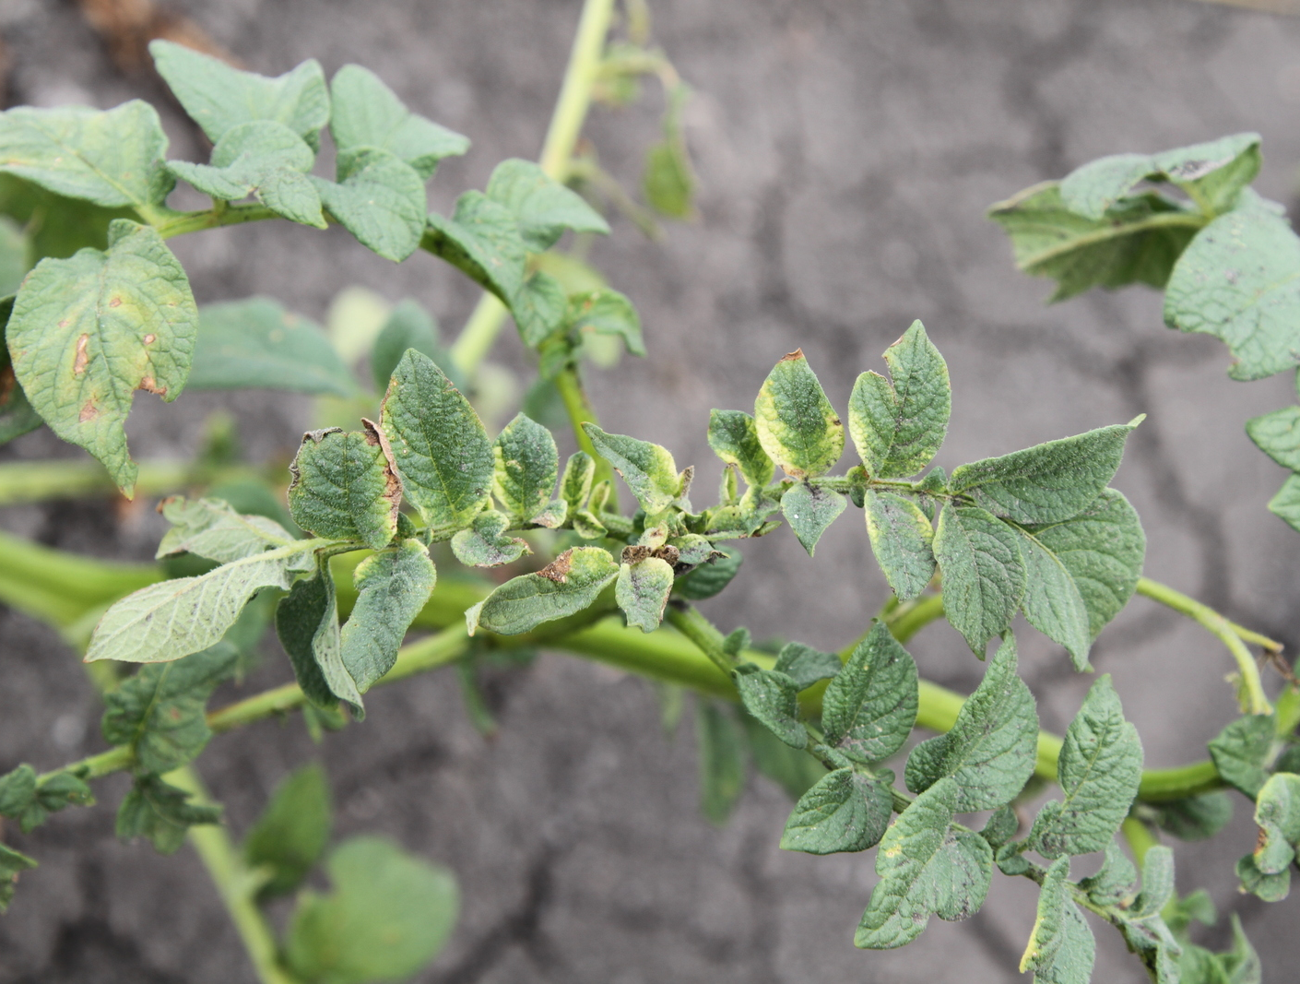
Glyphosate and Potatoes

Slide 35
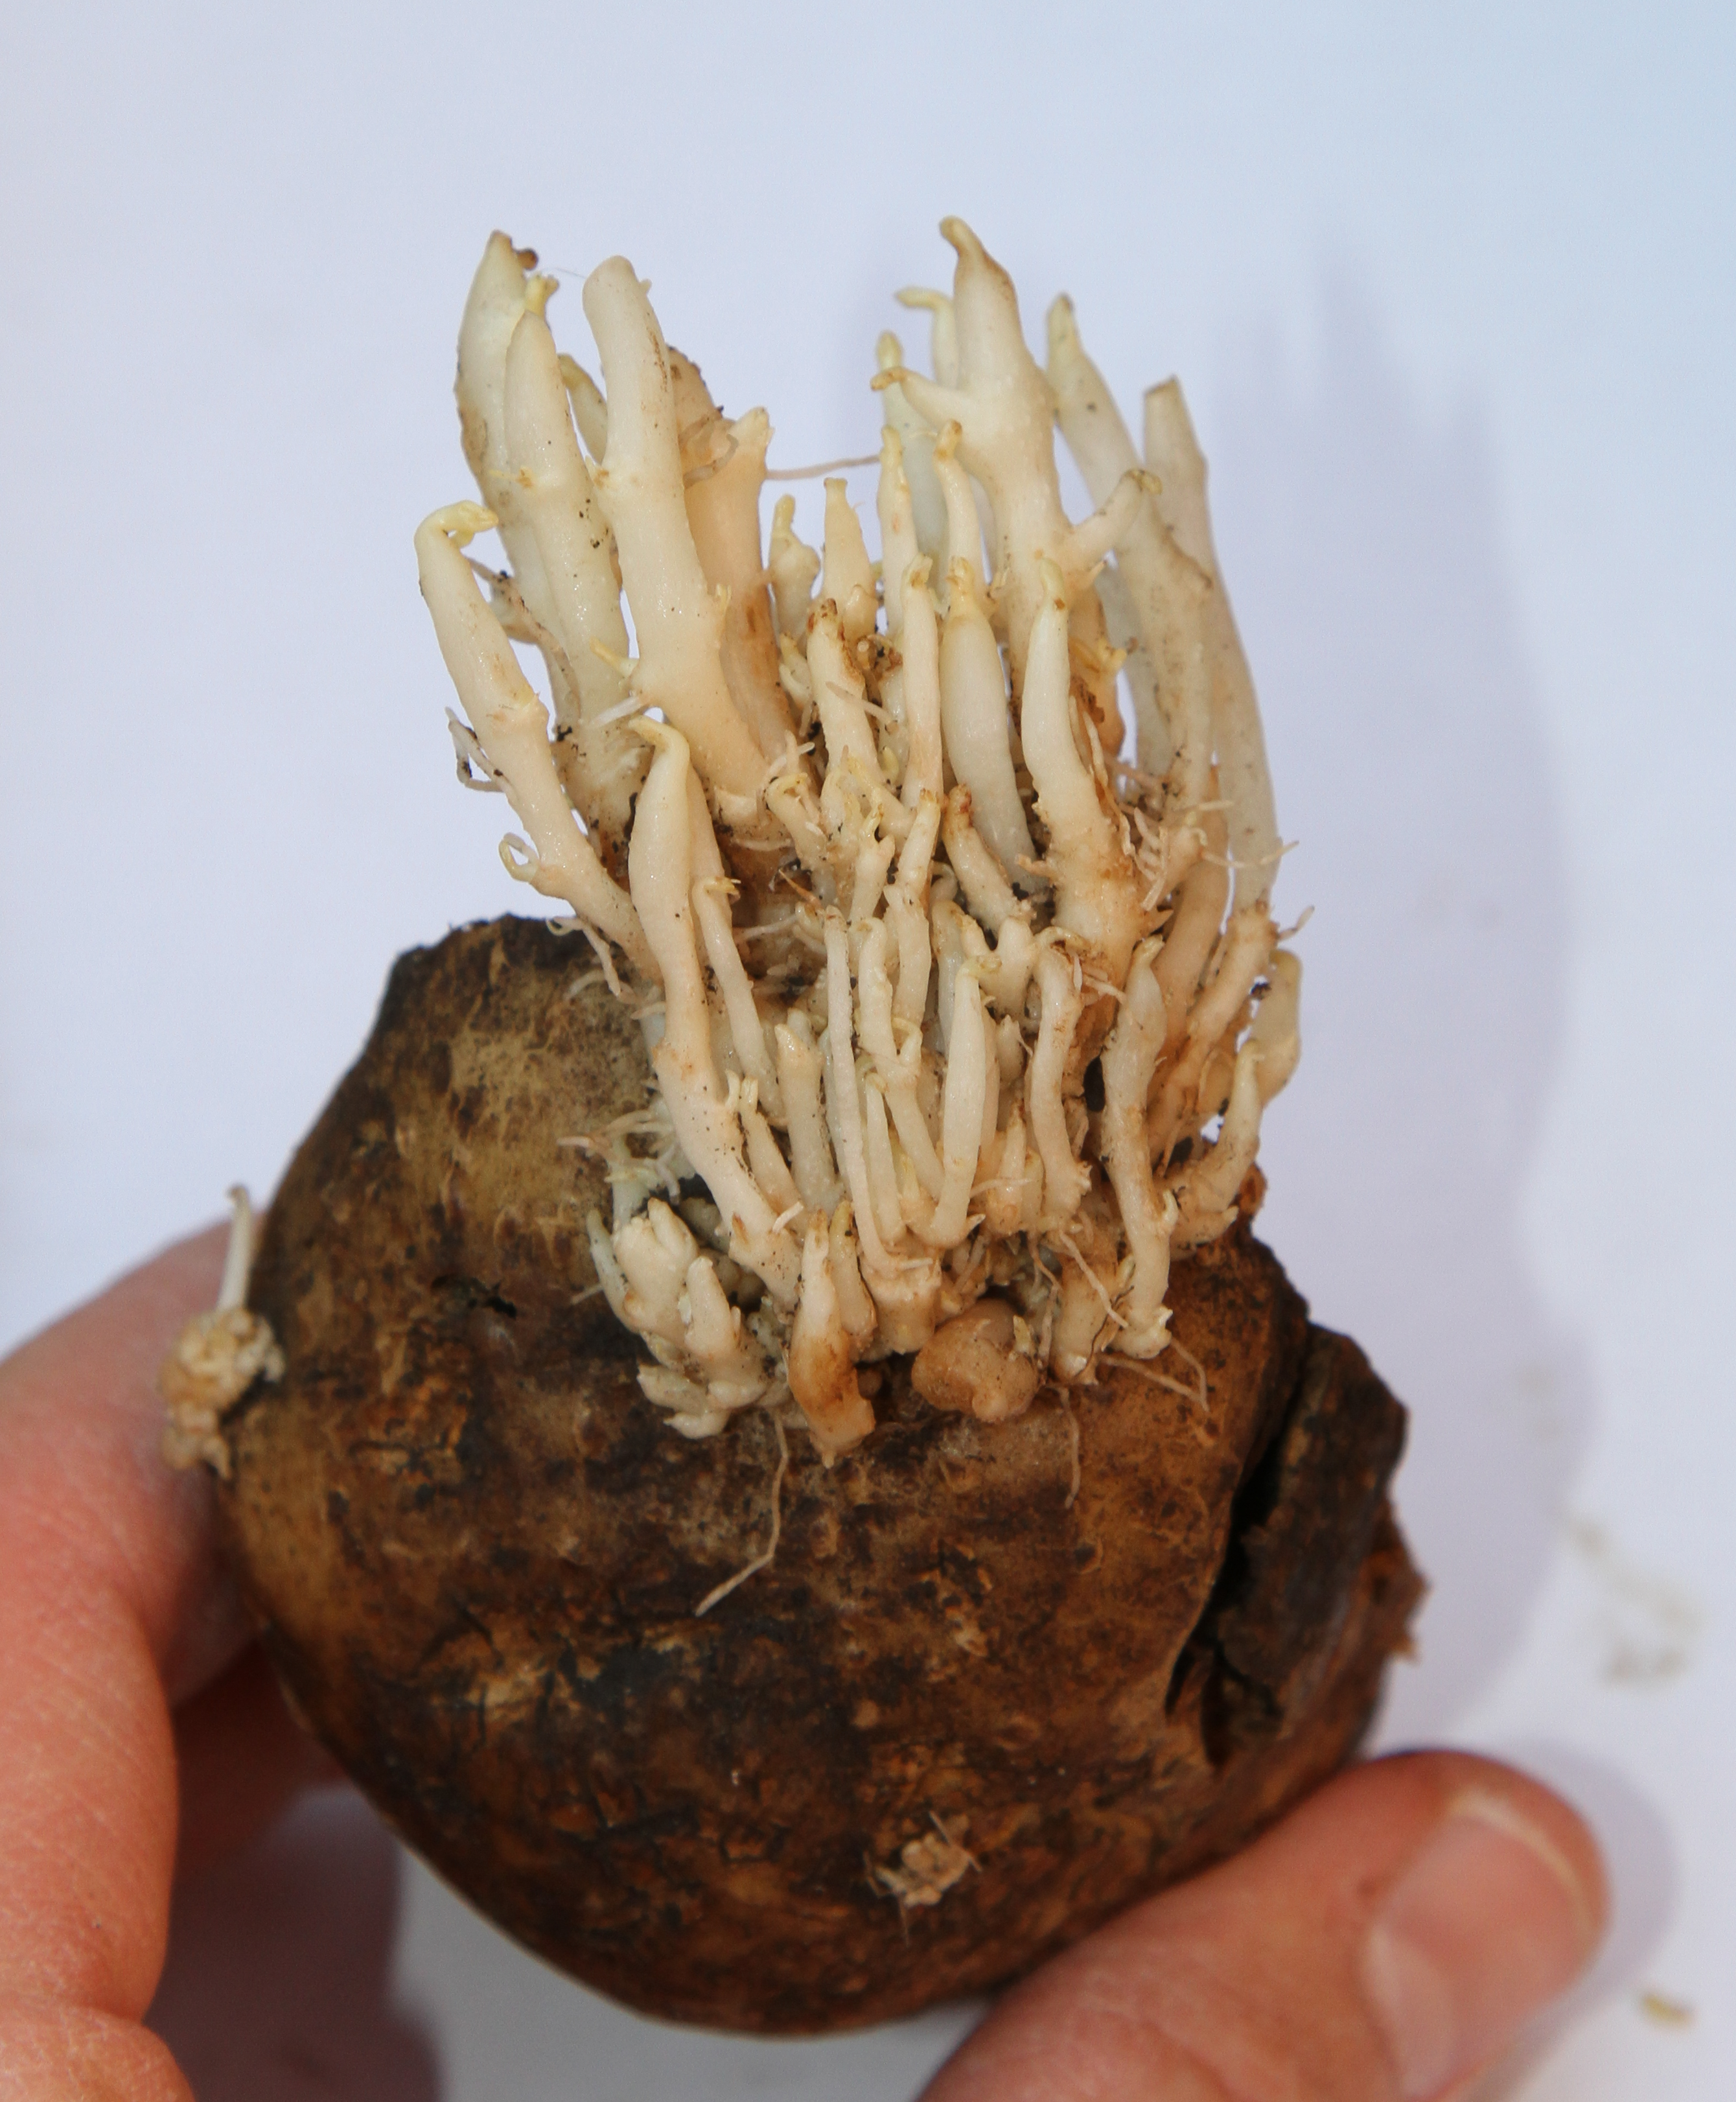
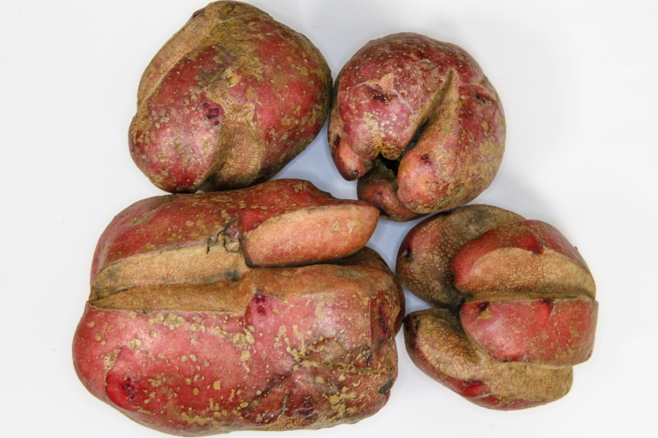
Glyphosate on Potatoes
Potatoes are sensitive to low concentrations of glyphosate.
In seed potatoes, glyphosate will move to tubers and the residues accumulate in the eyes causing sprouting problems the next year.
Commercial potatoes can become malformed and unmarketable.

Slide 36
Symptoms of Glyphosate Carryover in Seed Potatoes
Erratic and slow emergence pattern
Bending, twisting, and yellowing of leaves
Multiple shoots from an eye
Cauliflower or candelabra formation of shoots
Enlarged shoots
Prolific roots or reduced rooting

Slide 37
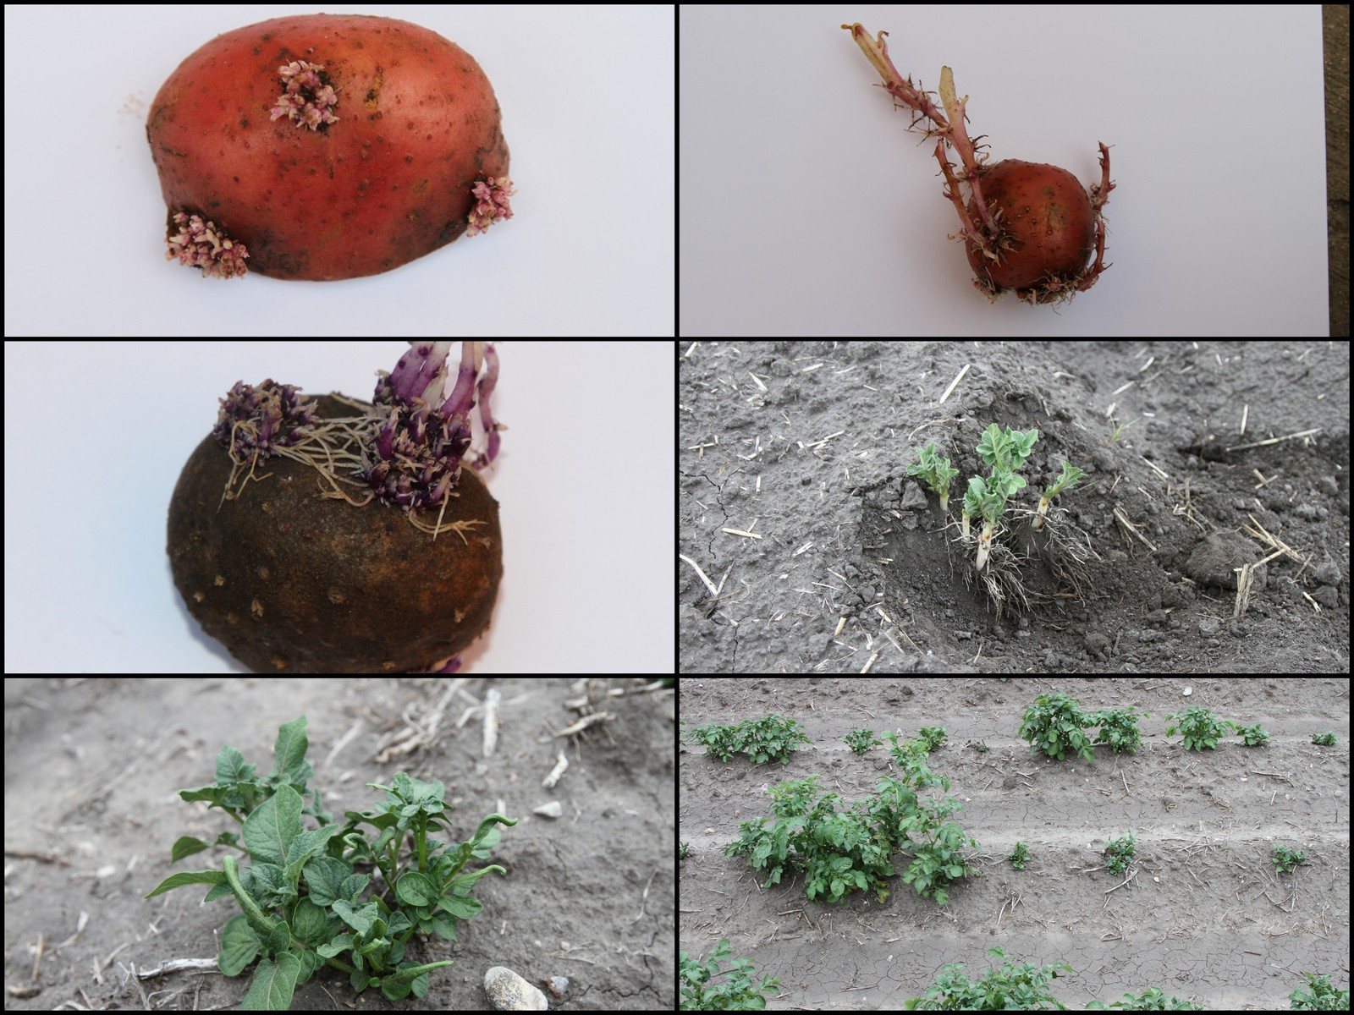

Slide 38
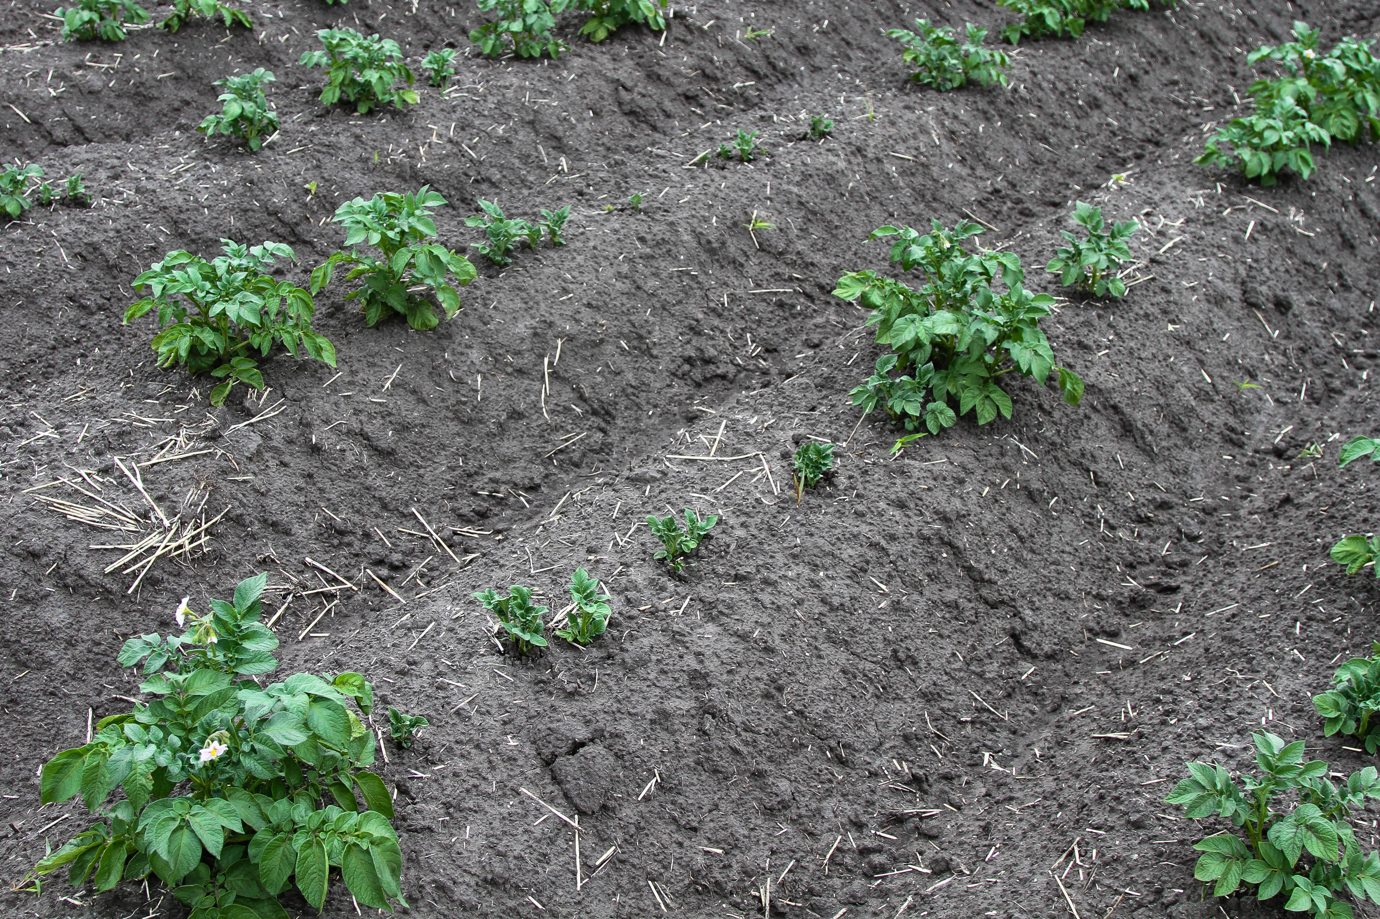
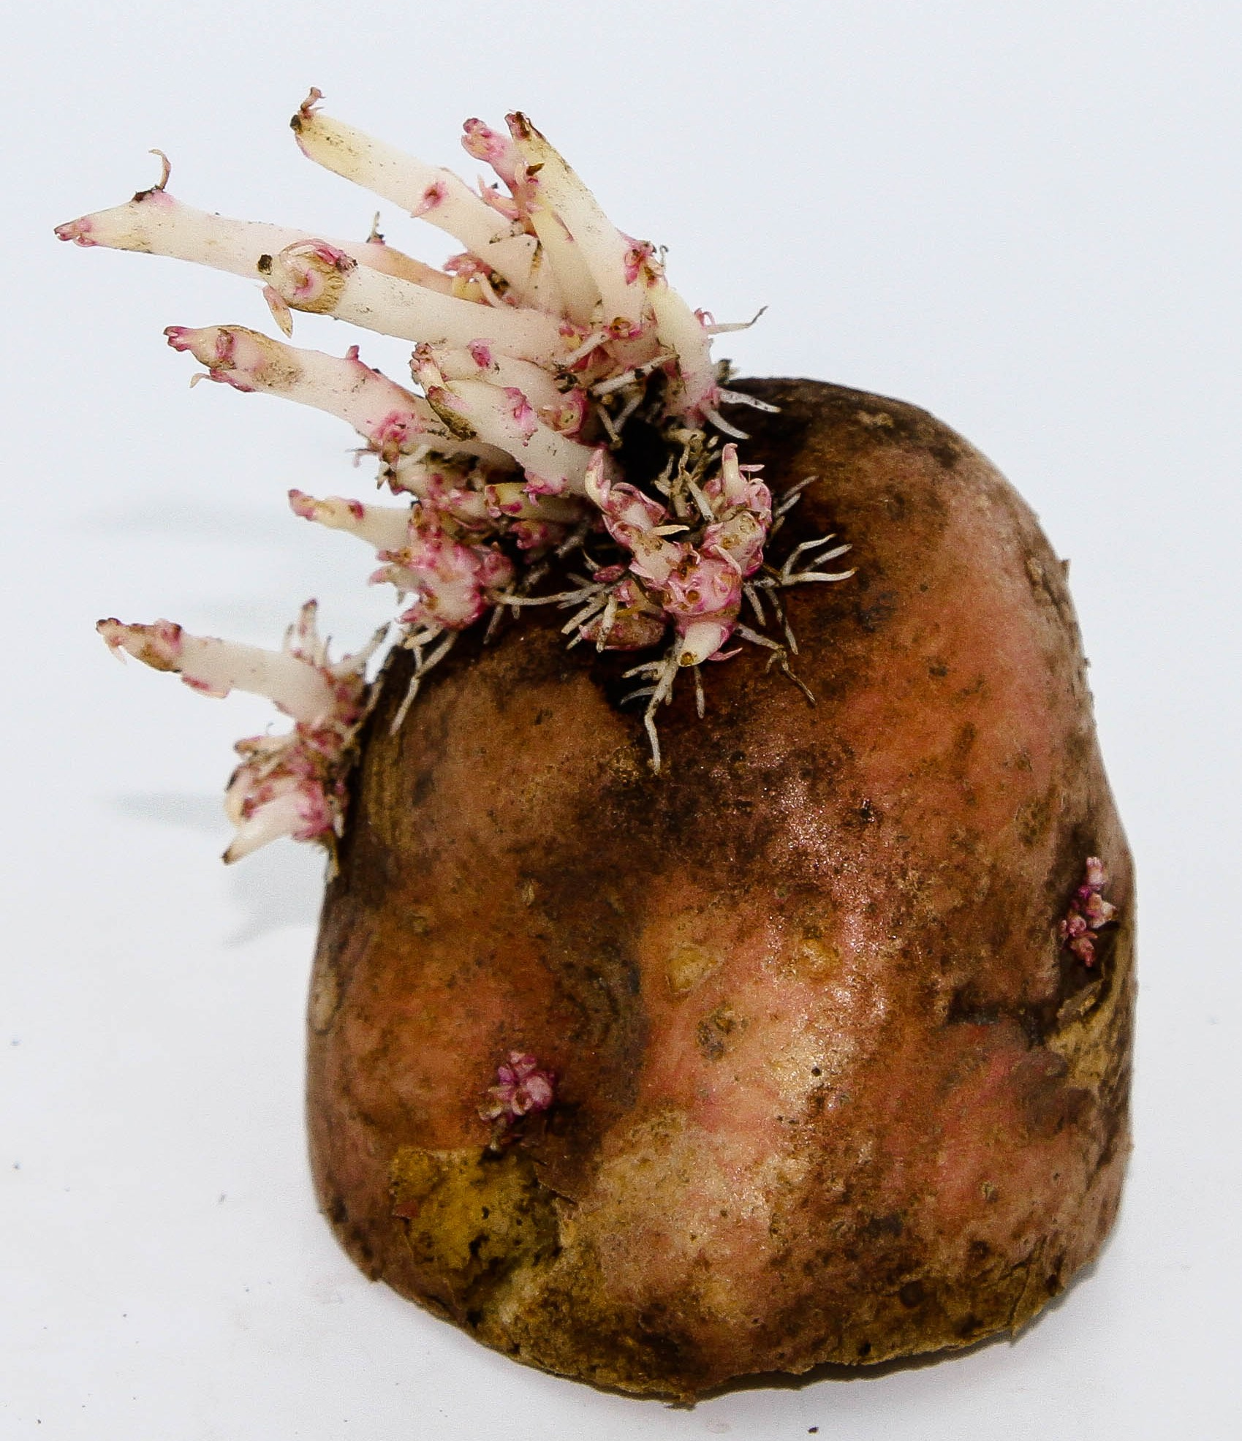
Glyphosate Levels
Amount: 0.007 to 0.036 ppm glyphosate

Slide 39
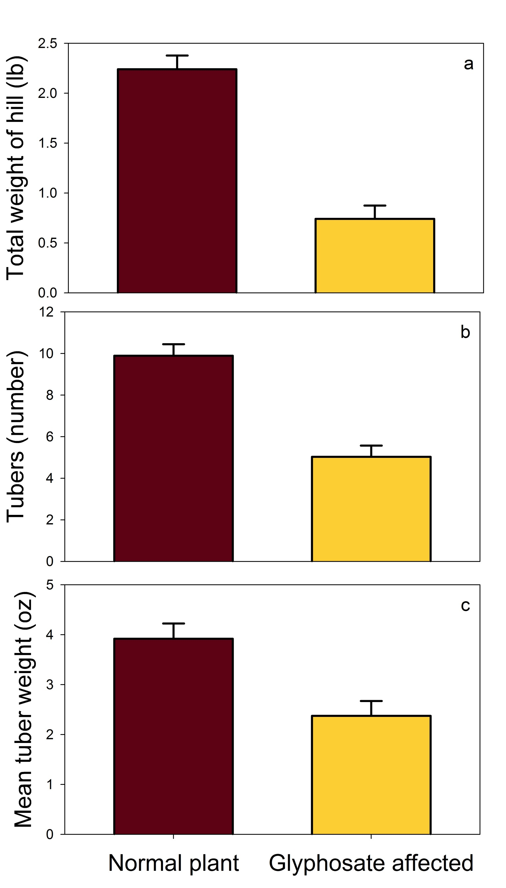
Glyphosate Residues in Seed Potato
Seed pieces with glyphosate residues had a:
67% reduction in total yield (from 2.25 to 0.75 lb/hill)
50% reduction in tuber number (10 to 5 tubers/hill)
38% reduction in mean tuber weight (3.92 to 2.40 oz/tuber)

Slide 40
Cost of Production
Total operating and overhead costs per acre in 2013
Corn | Soybean | Wheat | Barley | Potatoes
$648 | $421 | $300 | $447 | $3,000
100 acres of potatoes is worth $300,000.
Damaging a potato crop is EXPENSIVE!

Slide 42
2,4-D and Dicamba Drift Studies
Studies conducted in Indiana and Illinois in 2009 and 2010.
Rates
  2,4-D: 0, 0.003, 0.03, 0.3, 1, 2, 4, 8, 16, 64 fl oz/A (dimethylamine salt)
  Dicamba: 0, 0.002, 0.007, 0.02, 0.03, 0.07 0.13, 0.26, 0.65 fl oz/A (diglycolamine salt)
Application timings: V2, V5, R2
Maturity Group 3.4 (Becks brand 342NRR)
Notes:
Convert rates to lbs ae/acre for my notes to I can talk both

Slide 43
Rating Injury
Rating scale for visual estimate of soybean injury affected by synthetic auxin herbicides.
Rating (%) | Description
0 | No injury, plant growth is normal.
10 | Slight reduction in height or canopy volume, cupped or bubbled leaves on ≤ upper 10% of the plant, bent petioles, and chlorosis or necrosis.
20 | Moderately crinkled leaflets (extended across ≤ upper 20% of the plant), curled petioles, reduced height and canopy volume, cupped terminal leaflets.
30 | Moderate to high reduction of height and canopy, compacted internodes and plants begin to have an abnormal appearance, malformation with drawstring, fiddleneck, or cupped effects on ≤ upper 30% of the plant, many petioles curled and main stems may be bent.
40 | Highly stunted plants (≤ 40% of the plant), petioles curled and main stems bent and/or starting to curl upper leaves exhibit severe malformation and expansion of new leaves suppressed, plant may have patches of necrotic tissue.
50 | Very high reduction of plant height (≤ 50% of the plant) with little likelihood of recovery from the apical meristem, new growth suppressed, formation of pods reduced or malformed, some leaf and stem tissue becomes necrotic, petioles, and stems show severe twisting.
60 | Severe height and canopy reduction, including any new growth from axillary buds, leaves severely cupped or fiddlenecked on ≤ 60% of the plant, petioles and stems twisted, swollen, and splitting, more extensive die back of tissue.
70 | Severe to very severe reduction of plants, new growth callused and inhibited, most leaves severely deformed and mostly necrotic, extensive petiole bending.
80 | Very severe soybean injury, ≤ 80% of the plants mainly prostrate, petioles twisted with leaves drooping, leaves are chlorotic or necrotic, stems severely twisted, swollen, and split.
90 | Plant dying, ≤ 90% of the plants mainly prostrate, leaves and stems mostly chlorotic or necrotic, all petioles severely twisted, swollen, or split.
100 | All plants dead.

Slide 44
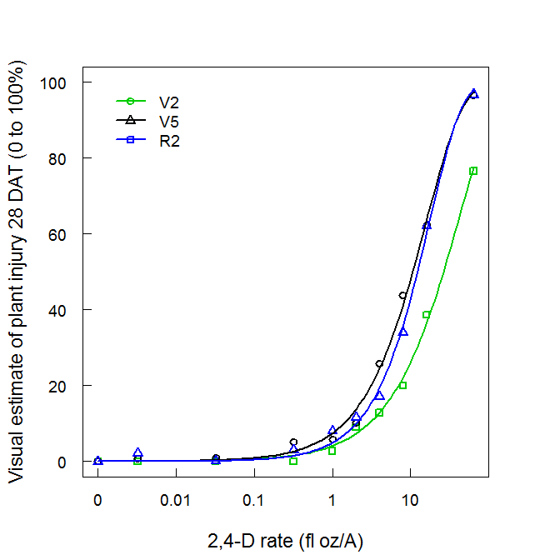
Soybean Injury from 2,4-D at 28 DAT
Estimated 2,4-D dose that caused soybean injury (ED) at 28 DAT.
 | Soybean growth stage
ED % | V2 | V5 | R2
 | ------------- fl oz/A -------------
ED₂₀ | 3.12 | 4.13 | 6.99
ED₅₀ | 10.6 | 12.2 | 26.3
Soybean injury of 20% would need 10 to 22% of 16 fl oz/A 2,4-D solution drifting.

Slide 45
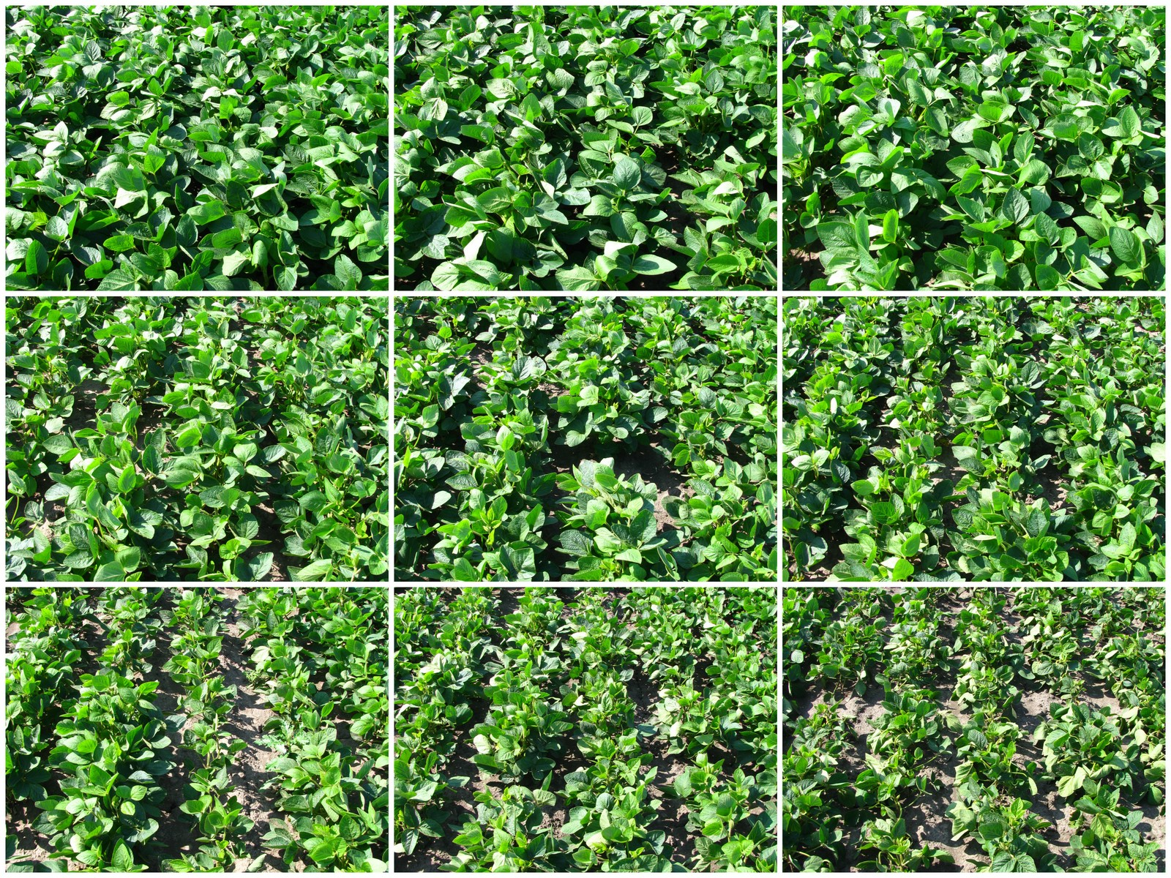
14 DAT V5
0 fl oz/A
0.003 fl oz/A
0.03 fl oz/A
0.3 fl oz/A
1 fl oz/A
2 fl oz/A
4 fl oz/A
8 fl oz/A
16 fl oz/A
Notes:
14 DAT V5

Slide 46
Symptoms of Soybean Injury from 2,4-D
Reduction in growth and plant height.
  Primarily seen at V5 growth stage when plants were growing rapidly.
Rates ≥ 8 fl oz/A (0.5 pt/A) caused bending of petioles and callusing of stem.
Potential yield loss from off-site movement of 2,4-D may be difficult to detect.

Slide 47
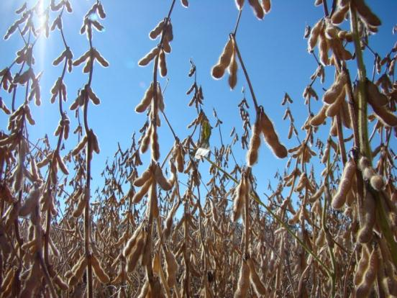
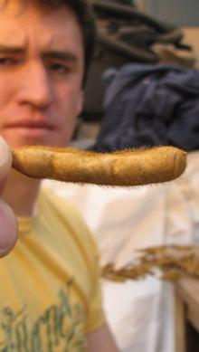
Yield Components
Primary
Secondary
Tertiary
Quaternary
Percent reproductive nodes
Reproductive node number
Pod number
Node number
Pod per reproductive node
Seed number
Yield
Seed per pod
Seed mass

Slide 48
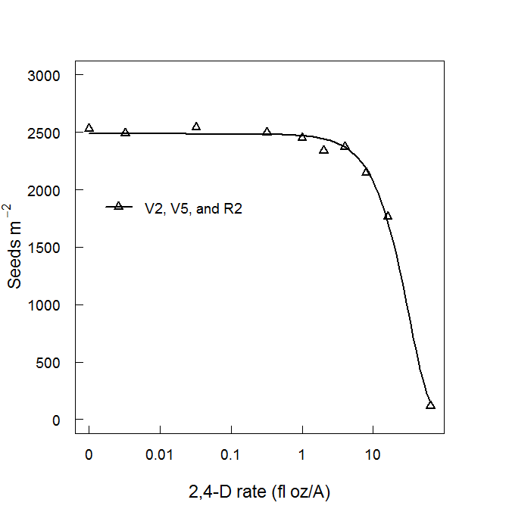
Seed Number Affected by 2,4-D
Estimated 2,4-D dose that caused soybean seed loss.
 | Soybean growth stage
ED % | V2, V5 & R2
 | ------- fl oz/A -------
ED₁₀ | 6.88
ED₂₀ | 11.4
Soybean seed loss of 10% would need 43% of 16 fl oz/A 2,4-D solution drifting.

Slide 49
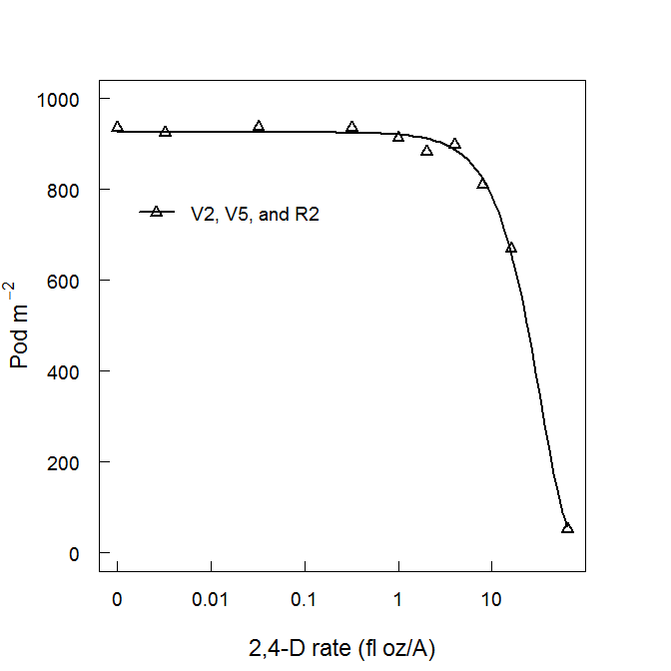
Pod Number Affected by 2,4-D
Estimated 2,4-D dose that caused soybean pod loss.
 | Soybean growth stage
ED % | V2, V5 & R2
 | ------ fl oz/A ------
ED₁₀ | 7.44
ED₂₀ | 12.2
Soybean pod loss of 10% would need 47% of 16 fl oz/A 2,4-D solution drifting.

Slide 50
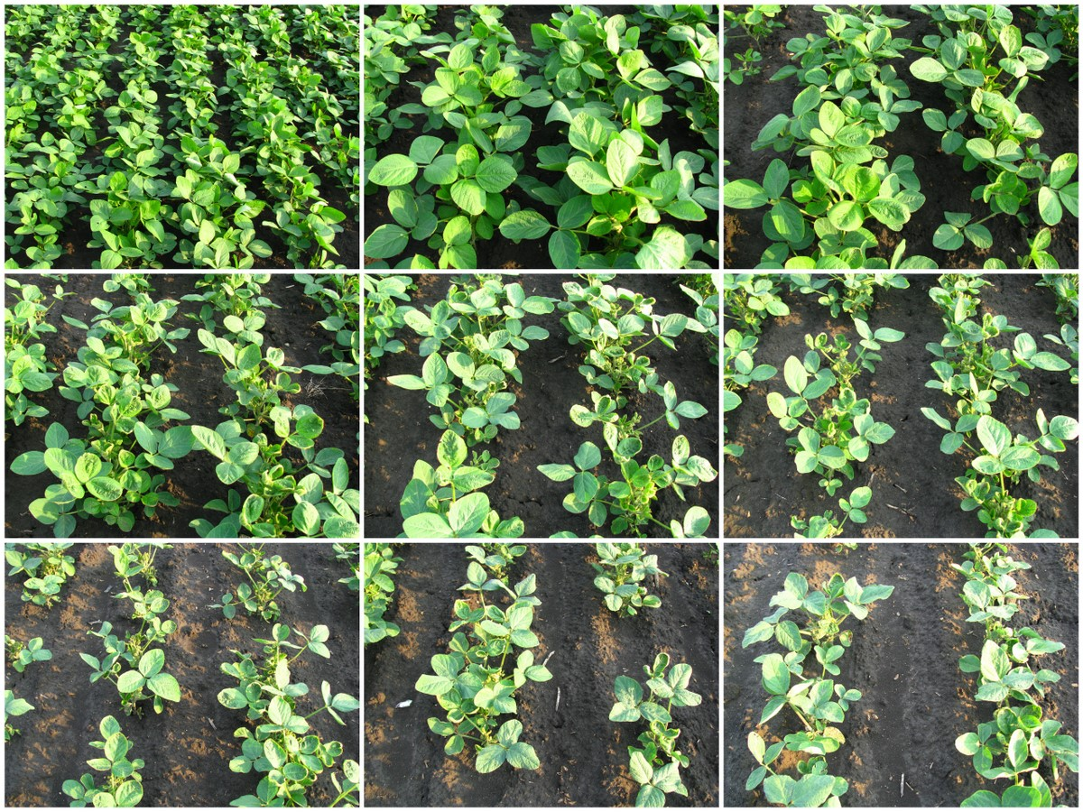
14 DAT V2
0 fl oz/A
0.002 fl oz/A
0.007 fl oz/A
0.02 fl oz/A
0.03 fl oz/A
0.07 fl oz/A
0.13 fl oz/A
0.26 fl oz/A
0.65 fl oz/A

Slide 51
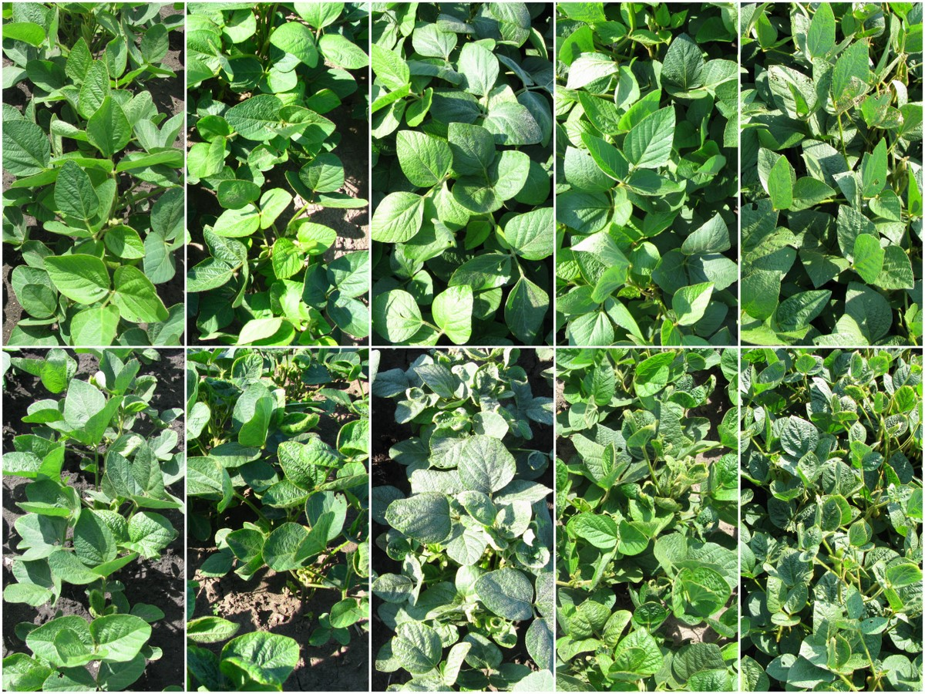
V5 application
2,4-D: 0.02 fl oz/A
7 DAT
14 DAT
21 DAT
28 DAT
56 DAT
V5 application
dicamba: 0.13 fl oz/A
7 DAT
14 DAT
21 DAT
28 DAT
56 DAT

Slide 52
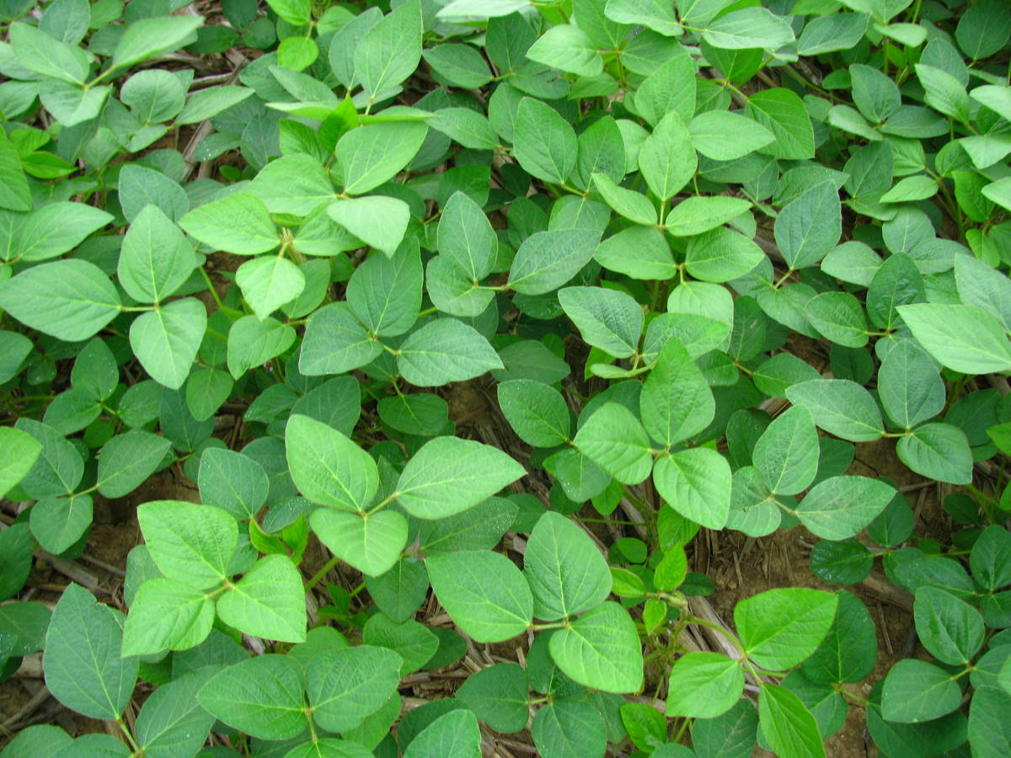
Measuring Soybean Injury
0% = No injury, plant growth is normal.

Slide 53
10% Soybean Injury
10% = Slight reduction in height or canopy volume, cupped or bubbled leaves on ≤ upper 10% of the plant, bent petioles, and chlorosis or necrosis.

Slide 54
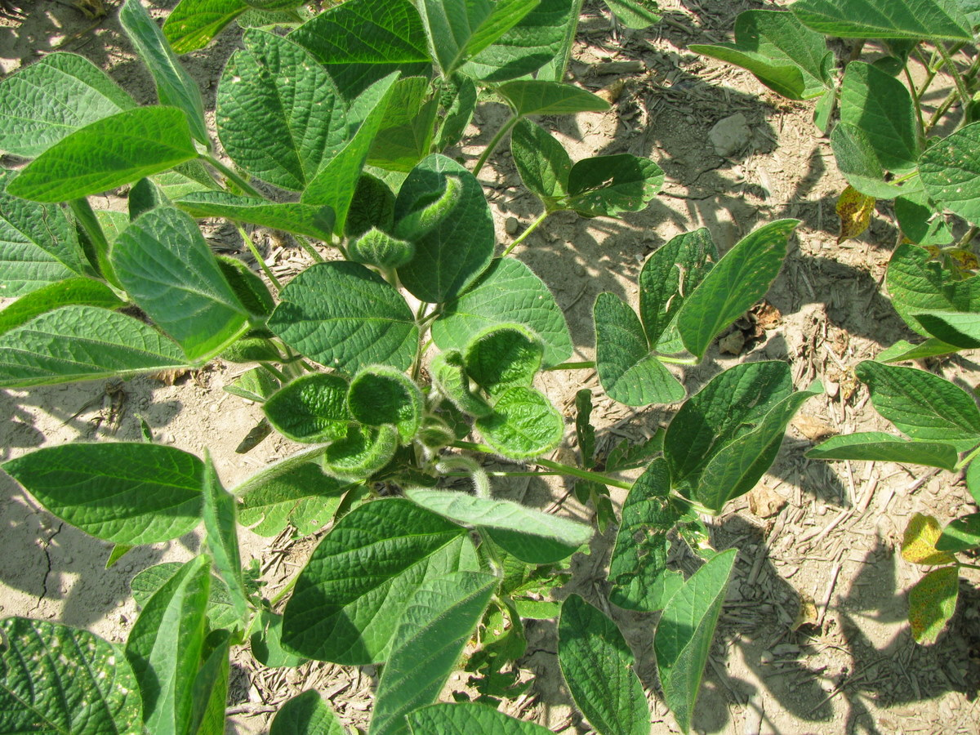
10% Soybean Injury
10% injury

Slide 55
20% Soybean Injury
Moderately crinkled leaflets (extended across ≤ upper 20% of the plant), curled petioles, reduced height and canopy volume, cupped terminal leaflets.

Slide 56
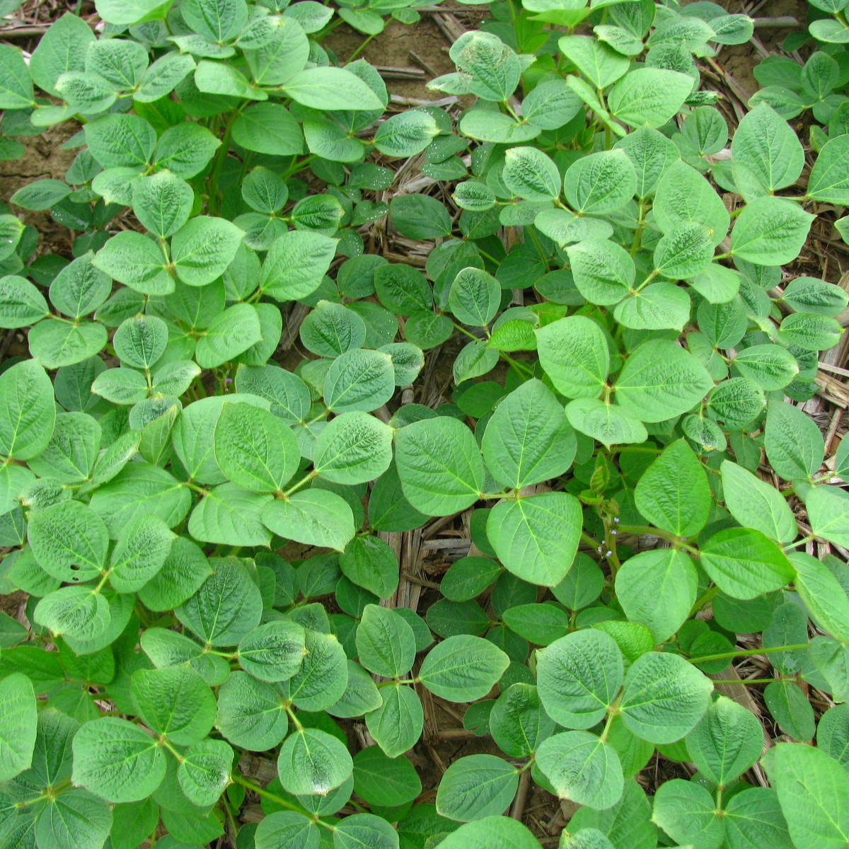
15 – 20% Soybean Injury
20% injury

Slide 57
30% Soybean Injury
Moderate to high reduction of height and canopy, compacted internodes and plants begin to have an abnormal appearance, malformation with drawstring, fiddleneck, or cupped effects on ≤ upper 30% of the plant, many petioles curled and main stems may be bent.

Slide 58
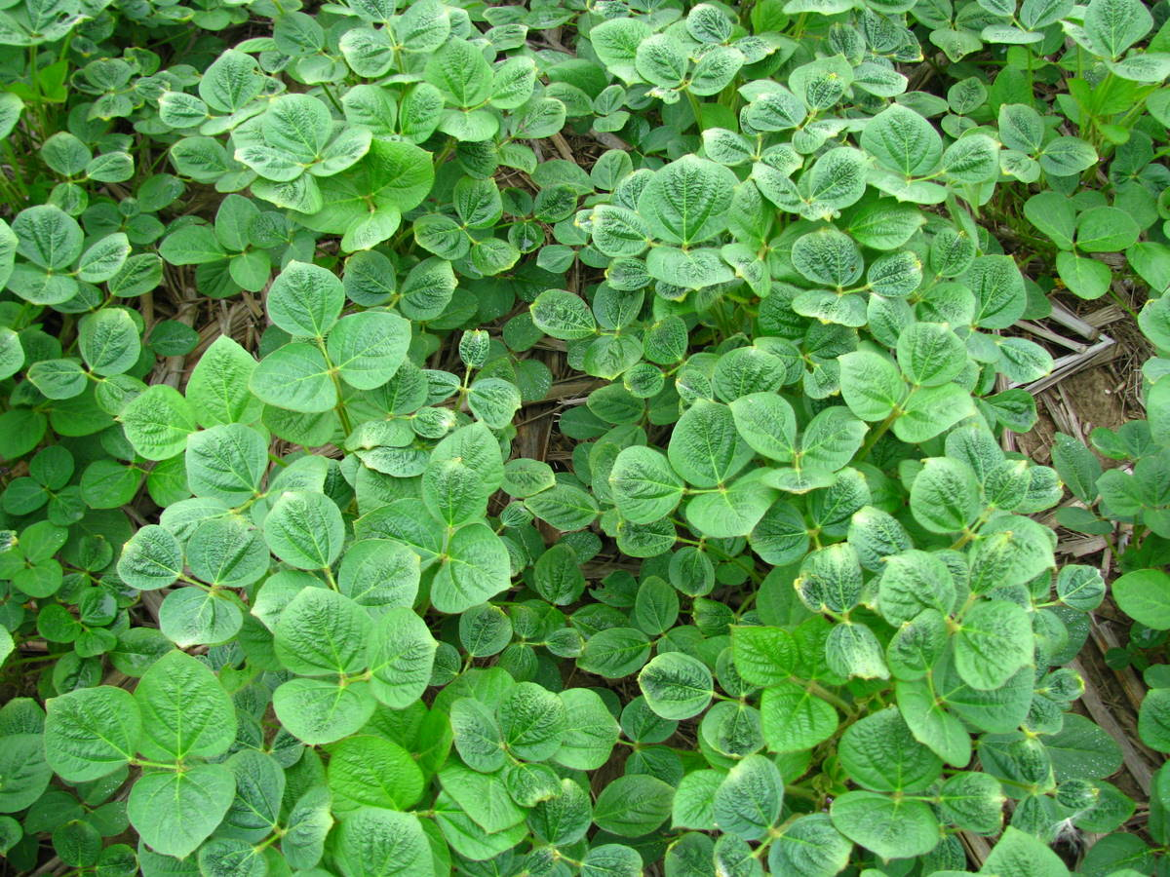
25 – 30% Soybean Injury
30% injury

Slide 59
40% Soybean Injury
Highly stunted plants (≤ 40% of the plant), petioles curled and main stems bent and/or starting to curl upper leaves exhibit severe malformation and expansion of new leaves suppressed, plant may have patches of necrotic tissue.

Slide 60
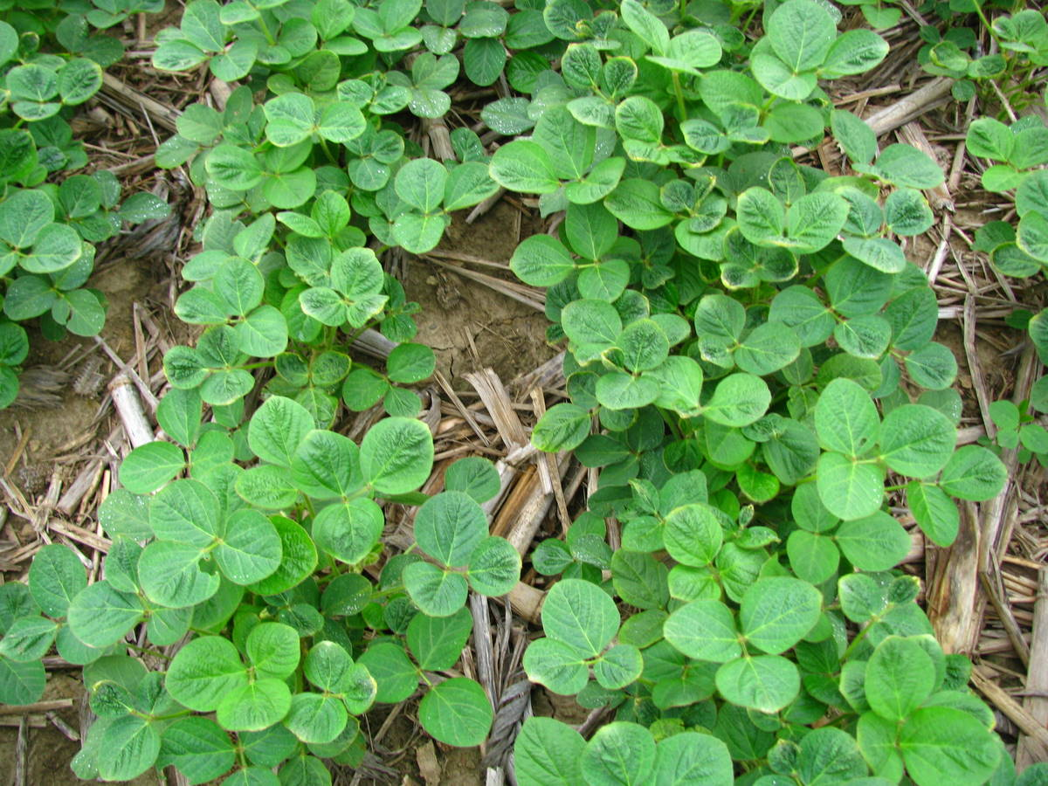
35 – 40% Soybean Injury
40% injury

Slide 61
50% Soybean Injury
Very high reduction of plant height (≤ 50% of the plant) with little likelihood of recovery from the apical meristem, new growth suppressed, formation of pods reduced or malformed, some leaf and stem tissue becomes necrotic, petioles, and stems show severe twisting.

Slide 62
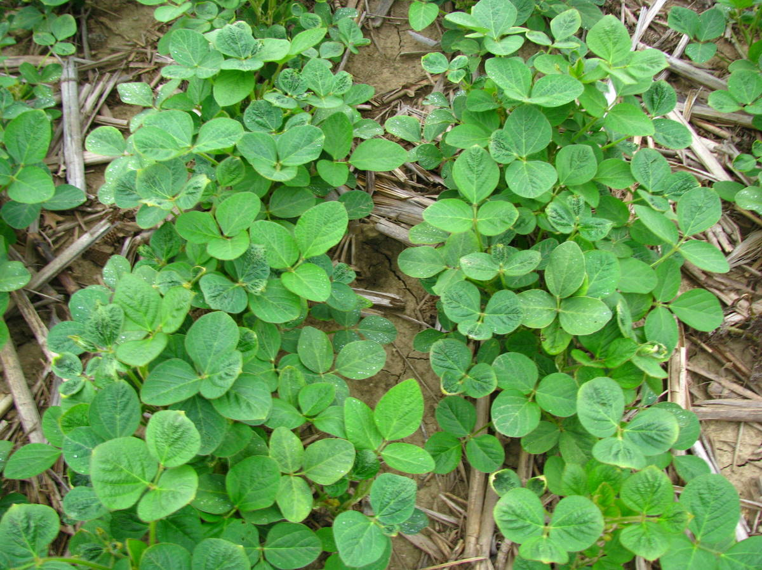
45 – 50% Soybean Injury
50% injury

Slide 63
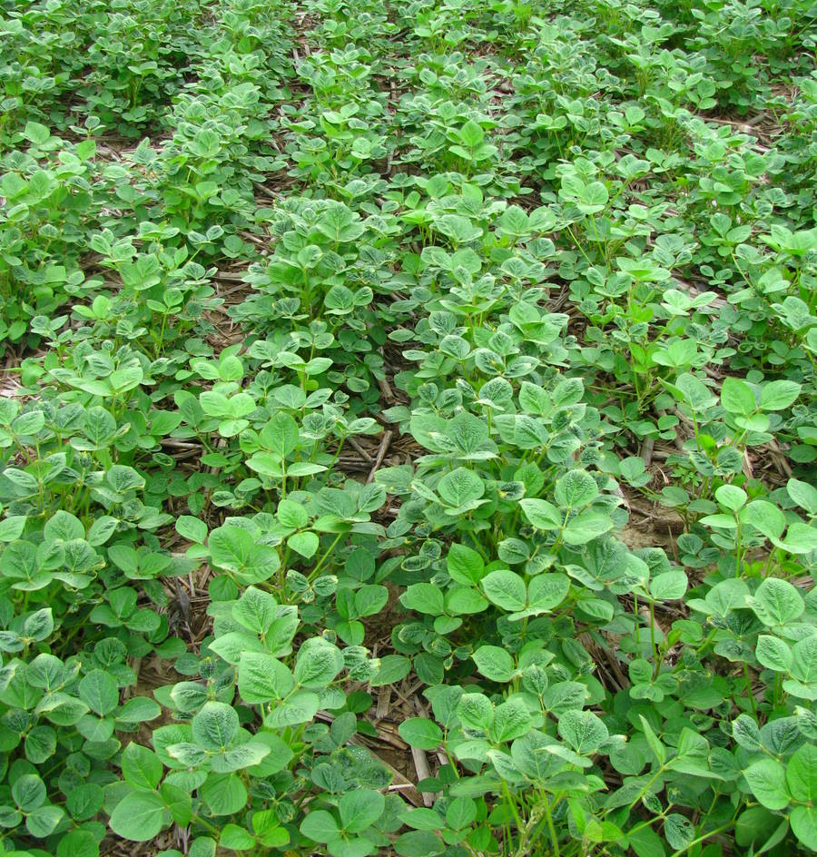
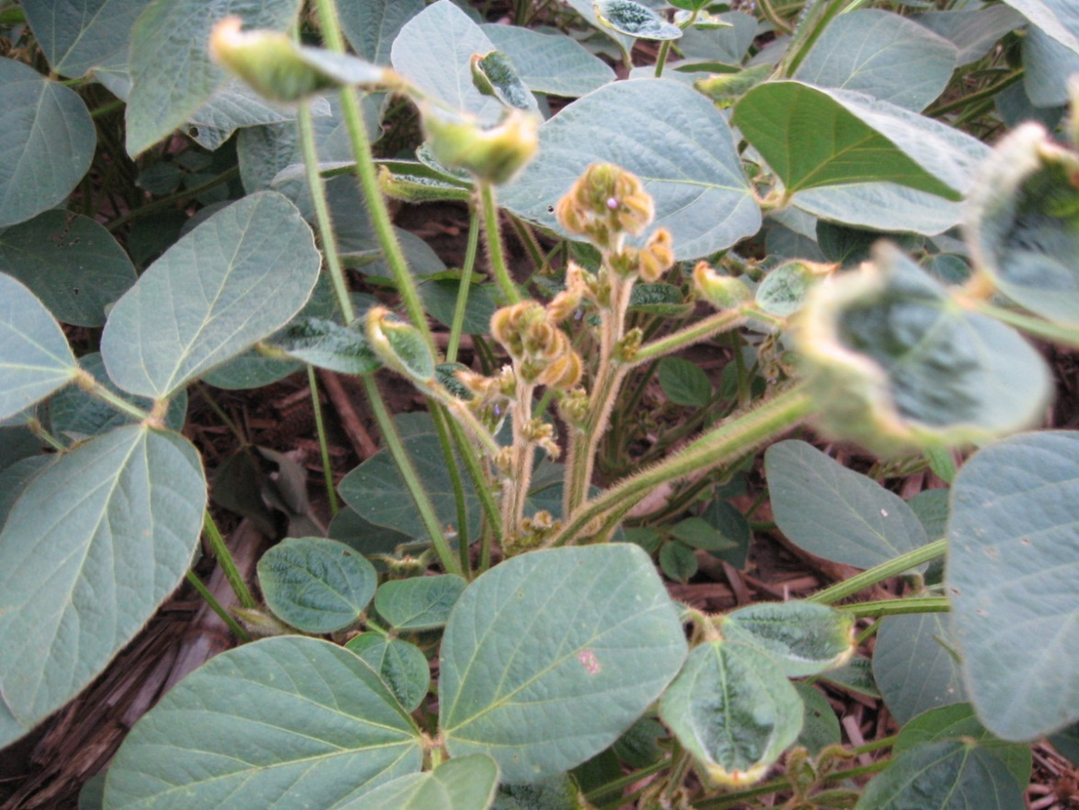
50% Soybean Injury

Slide 64
60% Soybean Injury
Severe height and canopy reduction, including any new growth from axillary buds, leaves severely cupped or fiddlenecked on ≤ 60% of the plant, petioles and stems twisted, swollen, and splitting, more extensive die back of tissue.

Slide 65
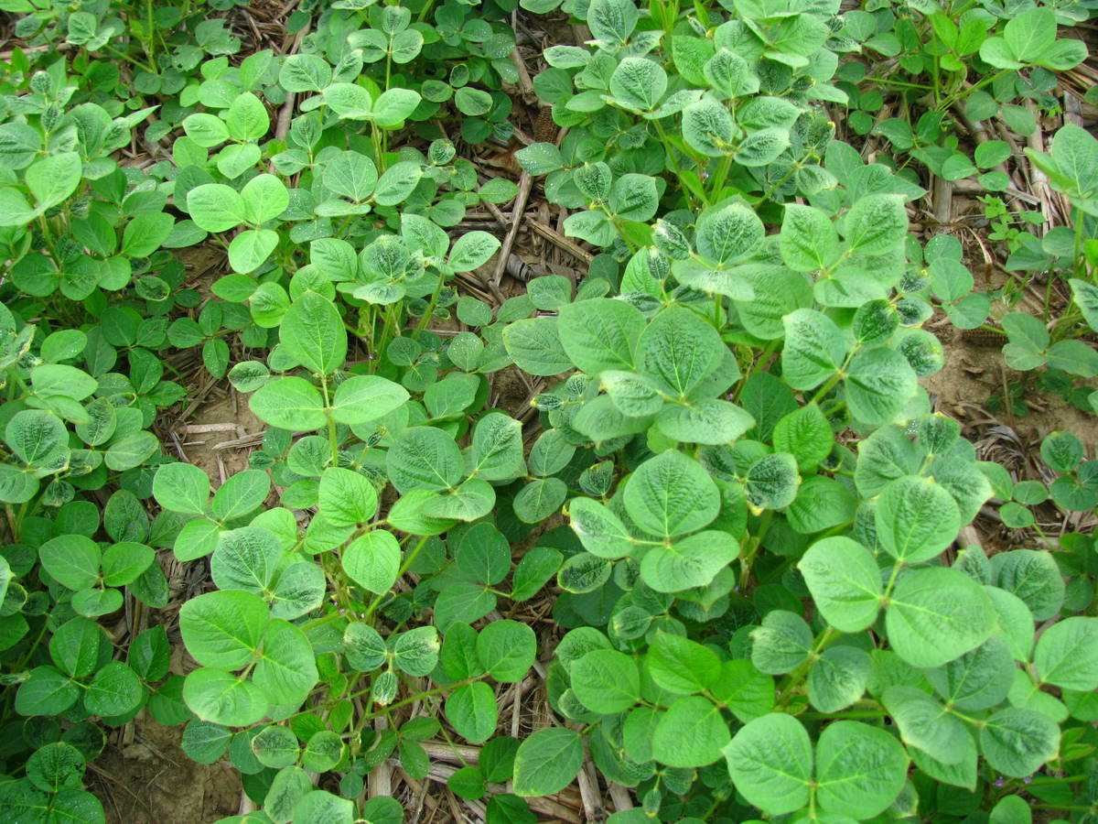
55 – 60% Soybean Injury
60% injury

Slide 66
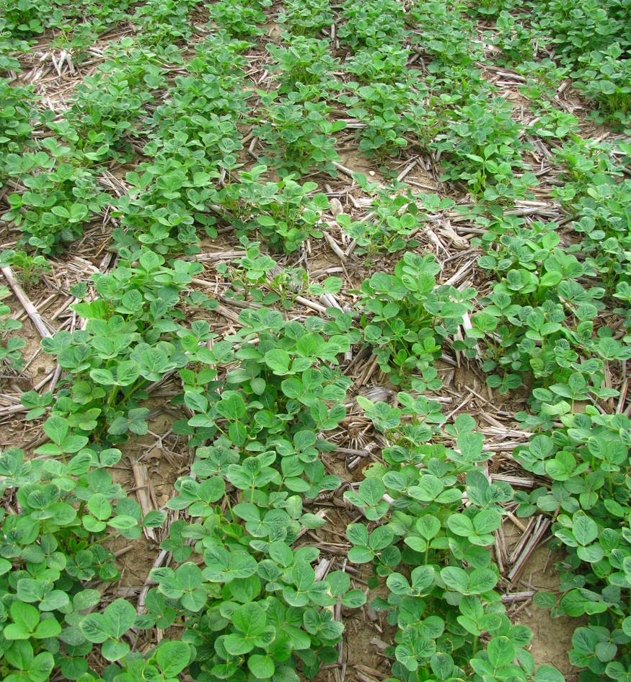
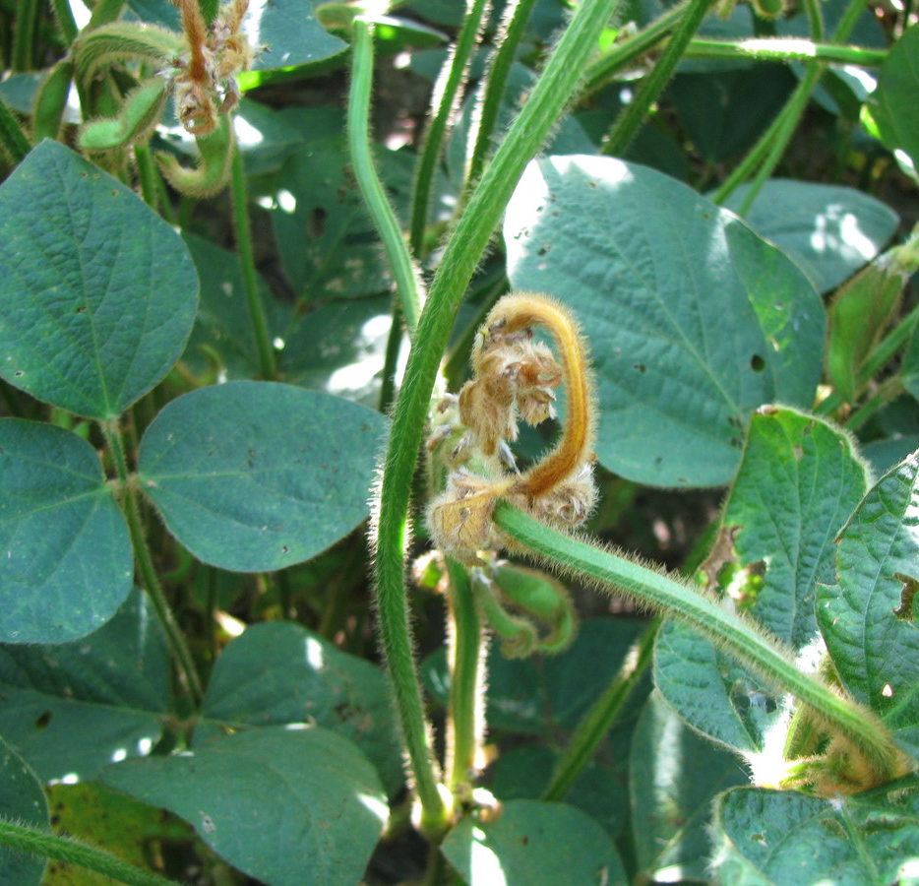
60% Soybean Injury

Slide 67
70% Soybean Injury
Severe to very severe reduction of plants, new growth callused and inhibited, most leaves severely deformed and mostly necrotic, extensive petiole bending.

Slide 68

70% Soybean Injury
70% injury

Slide 69


70% Soybean Injury

Slide 70
80% Soybean Injury
Very severe soybean injury, ≤ 80% of the plants mainly prostrate, petioles twisted with leaves drooping, leaves are chlorotic or necrotic, stems severely twisted, swollen, and split.

Slide 71

80% Soybean Injury
80% injury

Slide 72
90% Soybean Injury
Plant dying, ≤ 90% of the plants mainly prostrate, leaves and stems mostly chlorotic or necrotic, all petioles severely twisted, swollen, or split.

Slide 73

90 – 95% Soybean Injury
90% injury

Slide 74

100% Soybean Injury
All plants dead.

Slide 75


Slide 76


Slide 77
Total Tuber Weight

Slide 78
Tuber Number

Slide 79
Average Tuber Weight

