Slide 1
Preparing to Plant Potatoes
Andy Robinson, PhD
Extension Potato Agronomist
NDSU / U of M @spudology

Slide 2
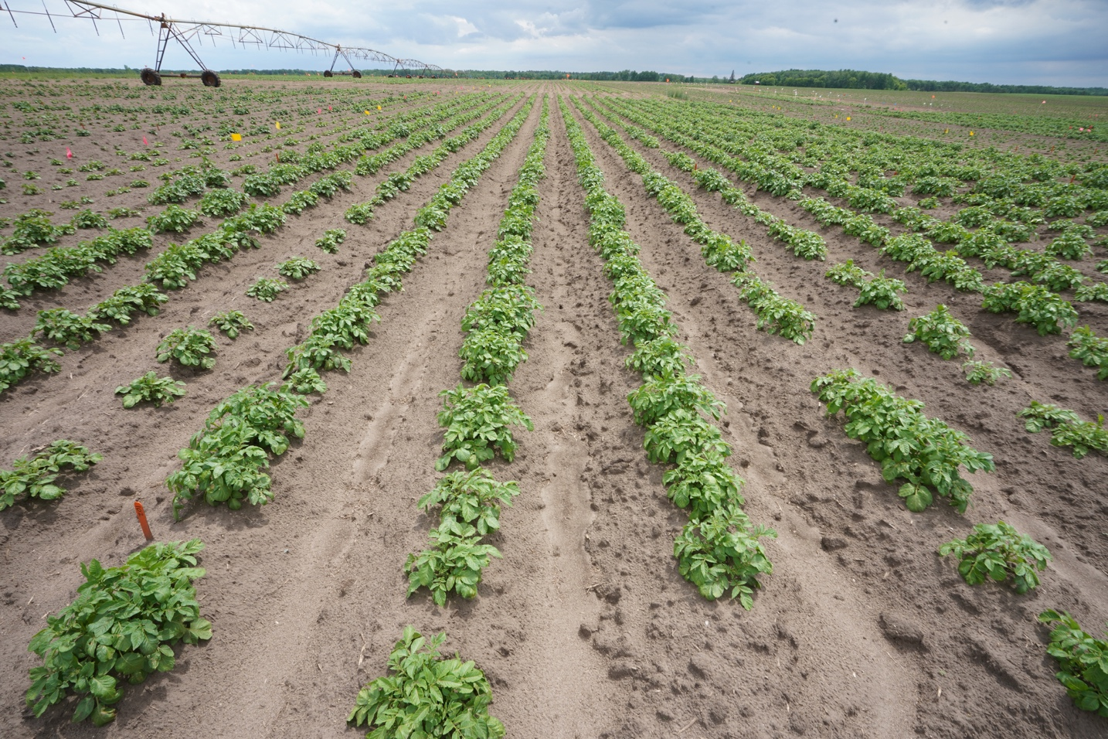
Successful potato production
Build the factory quicker
Run the factory longer
Run it more efficiently
Potato plant is basically a starch factory
  Over 90% of tuber dry matter comes from photosynthesis
(Mike Thornton, 2014)

Slide 3
Purchasing Seed
A good crop starts with good seed.
  Why? The same amount of fertilizer and pesticides will be used on poor or good seed.
Choose seed that is physiologically and physically healthy.
  Free from diseases, herbicide residues, virus (winter grow out results and lab tests)

Slide 4
The first ~40 days the seed piece is the primary source of energy
(M. Thornton; Iritani and Thornton, 1984)

Slide 5
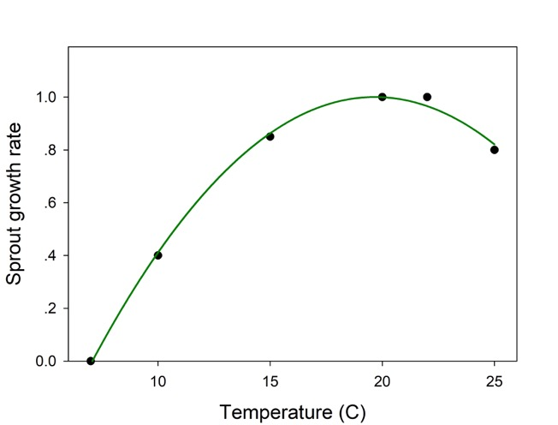
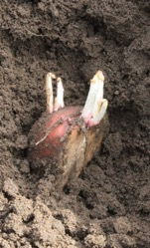
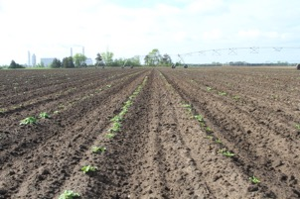
Sprout growth rate is related to soil temperature
(Kelmke and Moll, 1990)

Slide 6
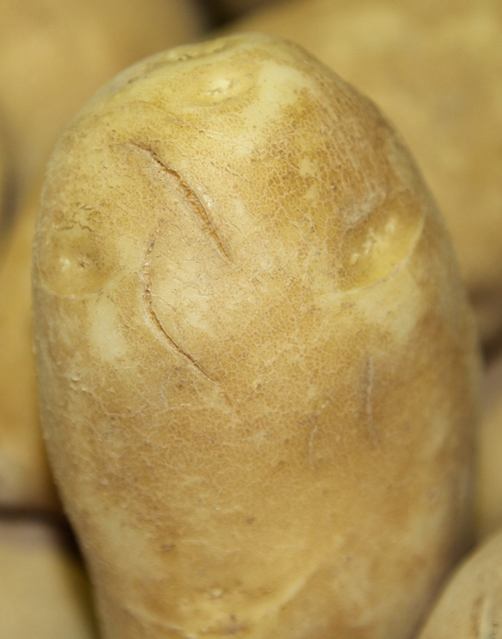
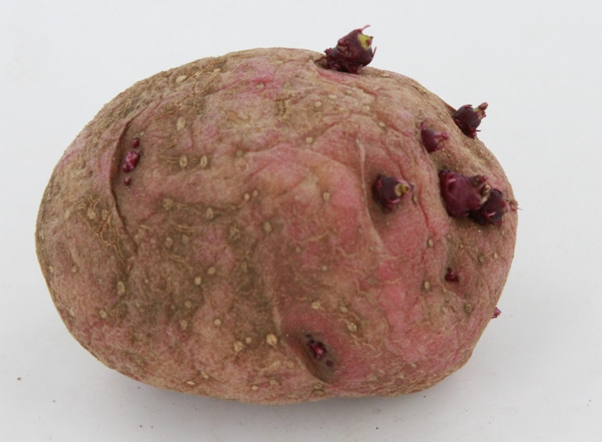
Seed Age
Chronological age: number of days that have passed since harvest
Physiological age: internal age of the seed resulting from biochemical changes taking place in within the tuber

Slide 7
Physiological aging
Increased over time and by stress
  Hot temperature
  Drought stress
  Fertility stress
  Disease pressure
  Poor storage conditions
  Bruising
Scale
  Dormant
  Young
  Middle age
  Old
  Potato no top / little tuber
Notes:
Potato seed is aged in two ways, chronologically and physiologically. The chronological age is the number of days that have passed since the tubers were harvested. The physiological age refers to the internal age of the seed as affected by biochemical changes that take place within the tuber. Potato tubers age at a greater rate when grown in stressful environments such as temperature stress, moisture stress, fertility stress, disease pressure, when stored under fluctuating temperatures or warm temperatures, and are bruised.
Growing conditions last year included warmer than normal temperatures and less precipitation, which increased the bruising of potatoes during harvest. These stresses increased the physiological age of potato seed, or reduced the typical number of days of dormancy. Physiological old seed that was not properly stored is easily recognizable. It has sprouts, sprout tubers or second growth, and/or it can be soft or dehydrated. Planting seed with these symptomologies can result in missing plants, slow emergence, multiple stems, and a non-uniform stand in the field. This ultimately will affect yield and tuber size distribution. To ensure uniform emergence, use certified potato seed that do not exhibit long sprouts or sprout tubers.

Slide 8
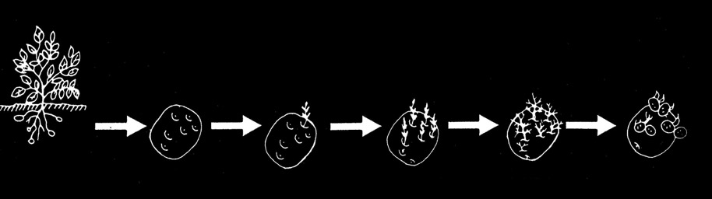
Physiologic age and stages of sprouting
Young
Apical dominance
high
low
Tuber
Initiation
Dormant
Tuber
Apical
Sprouting
Multiple
Sprouting
Hairy
Sprout
Little
Tuber
No Plant
Single Stem
Plant
Multi-Stem
Plant
Weak, Bushy
Plant
No Plant
Produces
A Few
Large Tubers
Large Set
of Smaller
Tubers
Low Yield

Slide 9
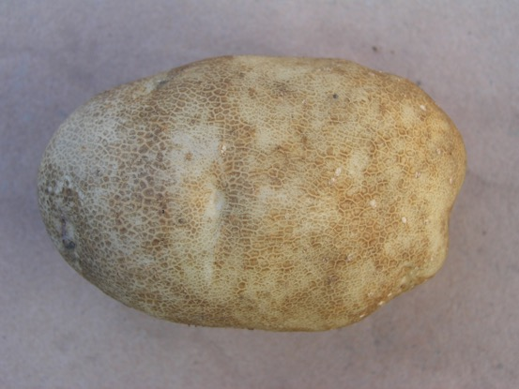
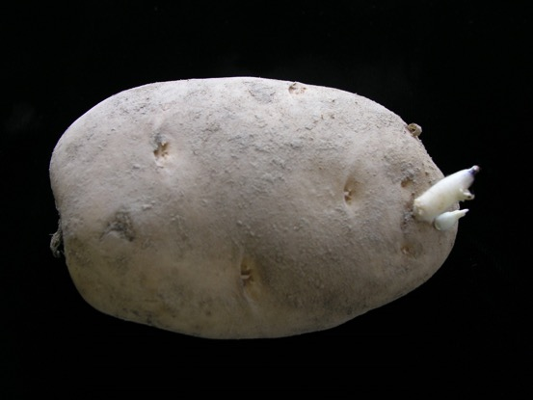
Physiological age
Dormant
Young seed
SB Johnson
UMCE
SB Johnson
UMCE

Slide 10
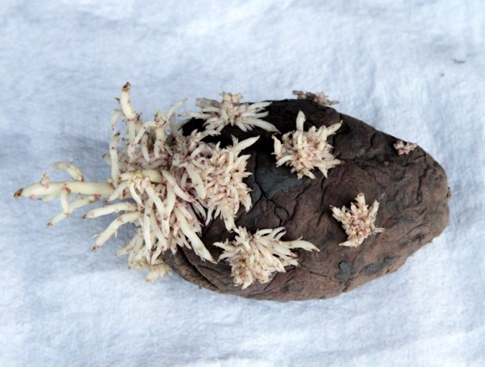
Physiological age
Middle aged seed
SB Johnson
UMCE

Slide 11
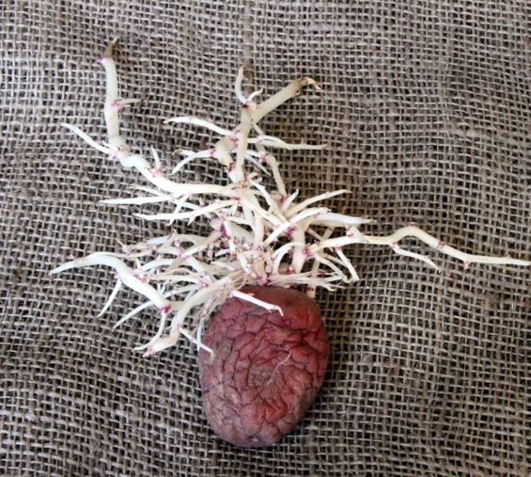
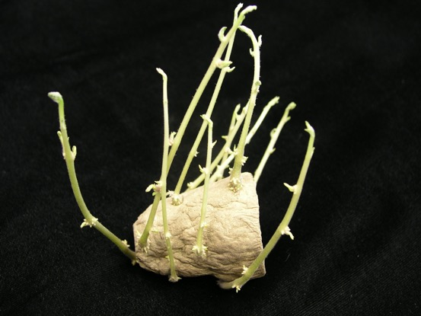
Physiological age
Old seed
SB Johnson
UMCE

Slide 12
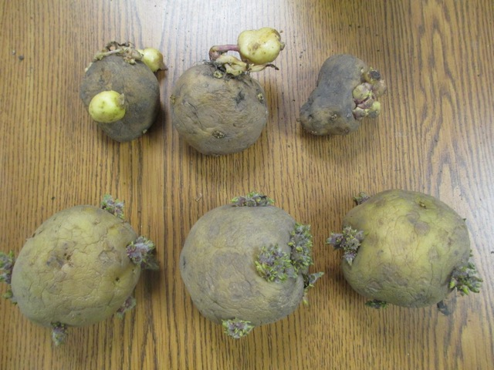
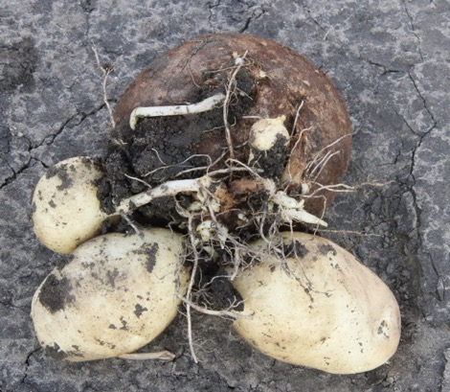
Physiological age
Potato no top

Slide 13
Characteristics of Young vs. Old Seed
Young Seed | Old Seed
Slow emergence | Rapid emergence
Fewer stems per hill | More stems per hill
Low tuber set | Higher tuber set
Longer tuber bulking period | Shorter tuber bulking period
Long tuberization period | Uniform tuber set
Larger tubers at harvest | Smaller tubers at harvest
(Iritani and Thornton, 1984)

Slide 14
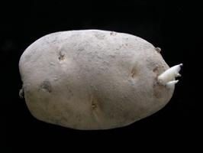

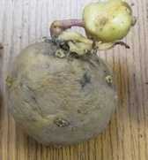
Hypothetical scheme
(Struik and Wiersema, 1999)

Slide 15
Seed age effects
Younger seed
Older seed
Slower emergence
Fewer stems
More foliar production
Later tuber initiation
Fewer tubers per plant
Larger tuber size
Later plant senescence
Faster emergence
Multiple stems
Less foliar production
Earlier tuber initiation (at lower leaf index)
More tubers per plant
Smaller sized tubers
Earlier plant senescence

Slide 16
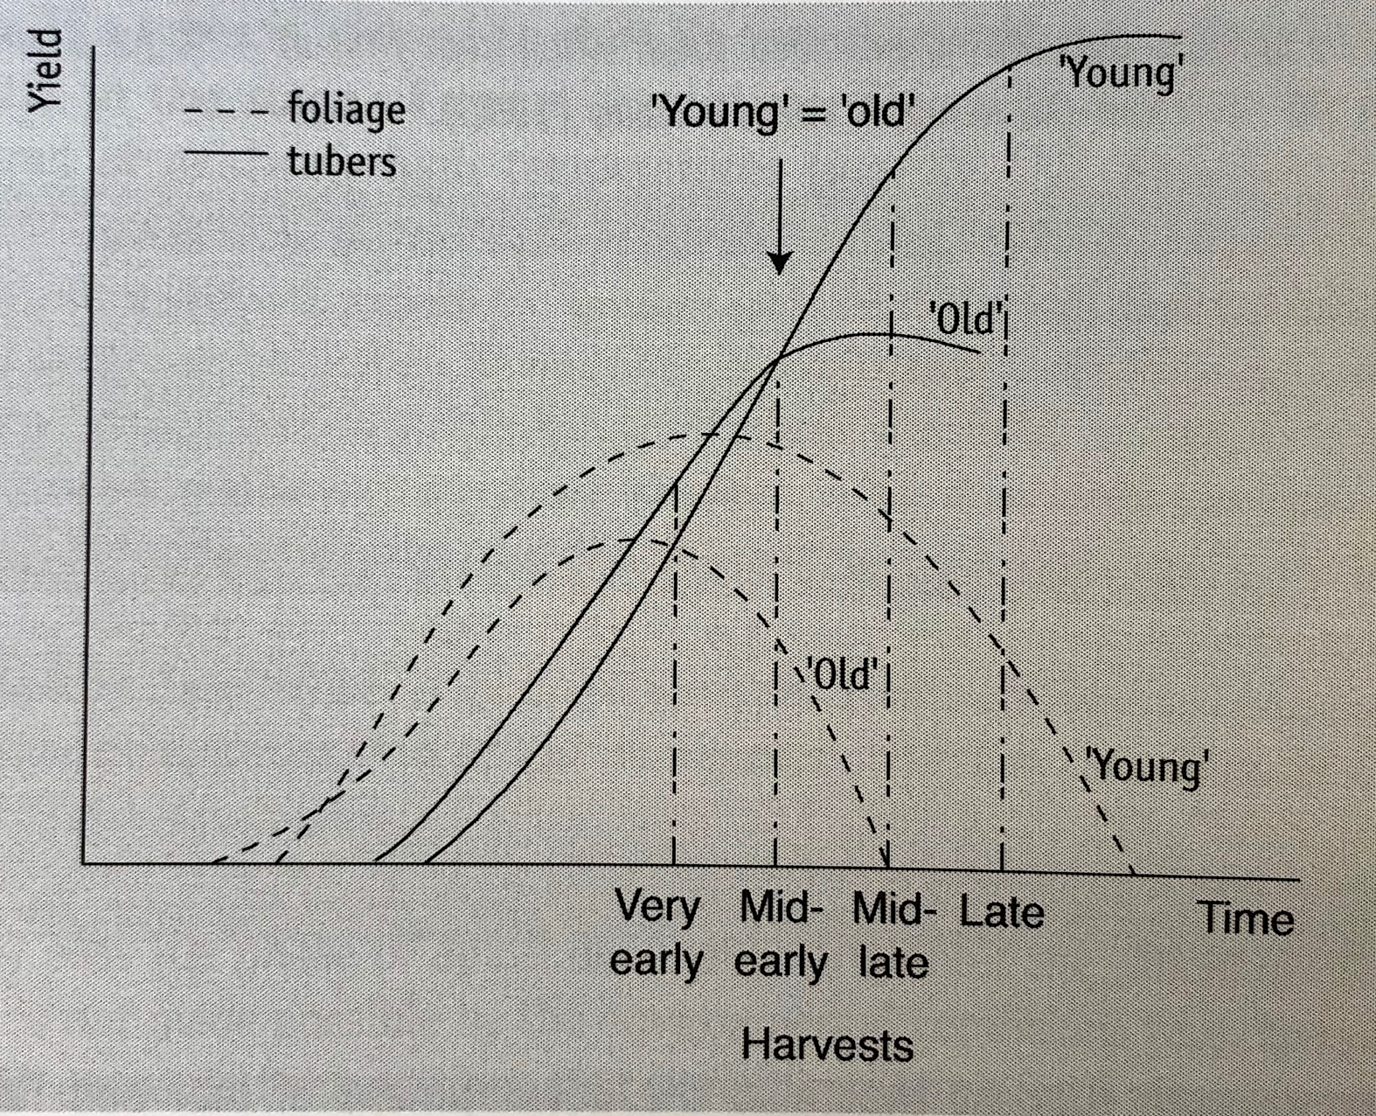
Effects of old seed
Old seed can lead to:
Early emergence
Earlier tuberization
Reduced foliage
Reduced yield
Earlier maturity
(Struik and Wiersema, 1999)

Slide 17
Where do you want to be at?
Young
Apical dominance
high
low
Tuber
Initiation
Dormant
Tuber
Apical
Sprouting
Multiple
Sprouting
Hairy
Sprout
Little
Tuber

Slide 18
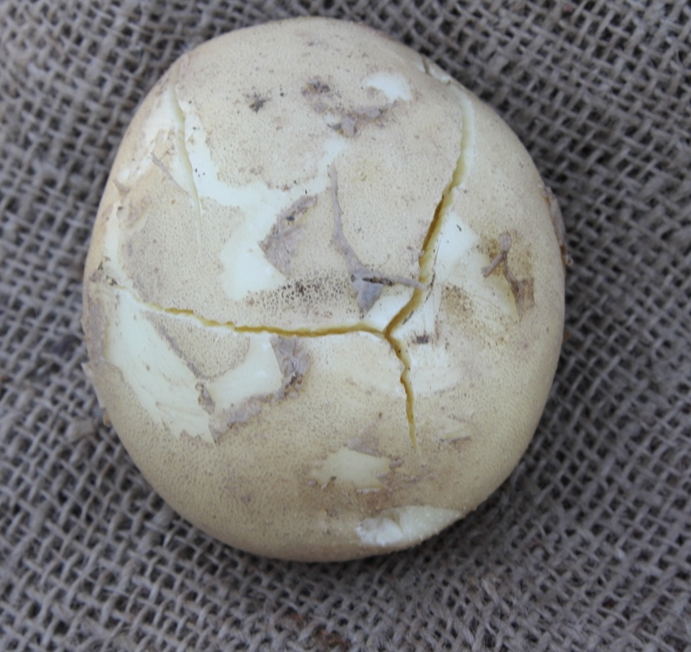
Physiological Age Influencers
Growing conditions of the seed crop
  Stresses cause aging of the seed
Bruising of seed tubers
  Increases respiration rate, accelerating aging
Seed storage temperature
  Seed held at 38 – 40 F ages slower than seed held at higher temperatures
Cutting operation
  Respiration rates increases after cutting (like bruising, but smooth cuts require less energy)

Slide 19
Storage Prior to Planting
Physiologically young seed
  Emerges slower and increases risk of seed piece decay and Rhizoctonia
  Hold at warm storage temperature (50 F) until 2-3 eyes per seed piece have begun to grow
Physiologically old seed
  Hold at 38 F prior to planting, then warm seed to 45 F prior to cutting and planting

Slide 20
Storage temperature on stem number
Seed aged at beginning of storage
Warmer the storage = increase in stem number
Know how well your seed is stored.
(Knowles and Knowles, 2006)

Slide 21
Stem numbers effects
Aged seed = more stems = higher tuber count
Increased tuber competition = smaller tubers
(Knowles and Knowles, 2006)

Slide 22
Stem numbers effects
Ranger Russet (Knowles and Knowles, 2006)

Slide 23
Stem number x tuber number
Russet Burbank (Bussan et al., 2007)

Slide 24
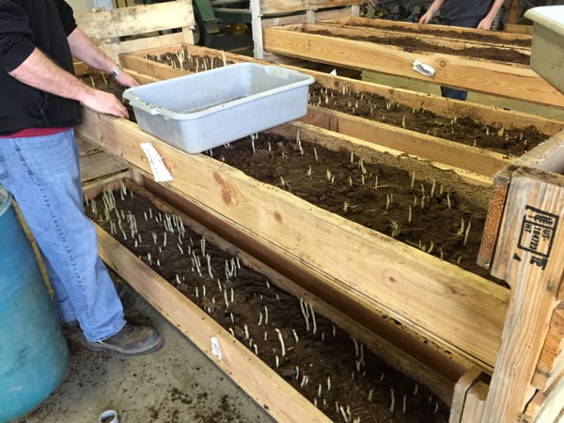
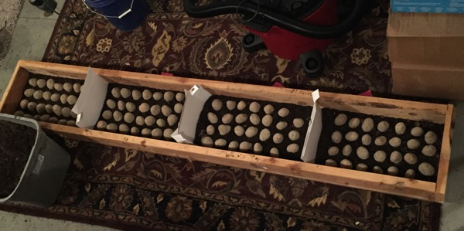
Determine stem number

Slide 25
Seed Piece Size & Physiological Age on Stem Number
Treatment | Spacing (in) | Seed cwt/acre | Stems/hill | Stems/acre
2 oz | 9 | 24 | 3.1 | 60,016
2 oz aged | 12 | 18 | 4.1 | 59,532
3 oz | 12 | 27 | 3.9 | 56,628
3 oz aged | 15 | 22 | 5.1 | 59,160
4 oz | 12 | 36 | 4.2 | 60,980
4 oz aged | 18 | 24 | 6.2 | 60,016
(Kleinkopf and Barta, 1991)

Slide 26

Determining planting density
$$\frac{Desired stems/acre}{Stem number/seed}=Seed number/acre$$

Slide 27
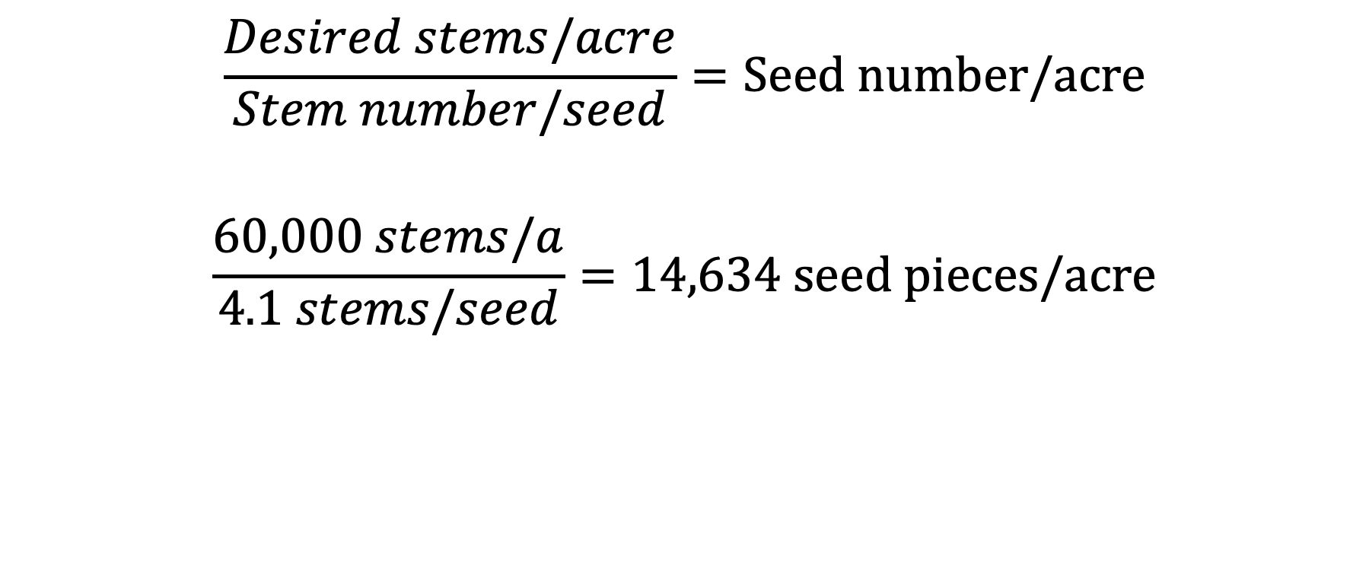
Determining planting density
$$\frac{Desired stems/acre}{Stem number/seed}=Seed number/acre$$
$$\frac{60,000 stems/a}{4.1 stems/seed}=14,634 seed pieces/acre$$

Slide 28
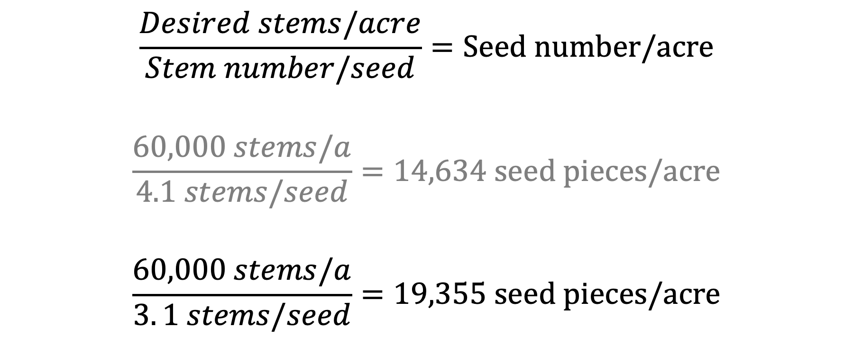
Determining planting density
$$\frac{Desired stems/acre}{Stem number/seed}=Seed number/acre$$
$$\frac{60,000 stems/a}{4.1 stems/seed}=14,634 seed pieces/acre$$
$$\frac{60,000 stems/a}{3. 1 stems/seed}=19,355 seed pieces/acre$$

Slide 29
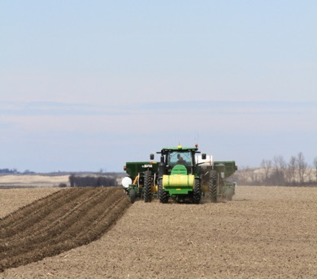
Seed planting rate calculator
Download sheet: z.umn.edu/seed

Slide 30
Other options for physiologically old seed
NAA – naphthaleneacetic acid
It is a rooting agent, often used for stem and leaf cuttings.
  Induces root formation
Causes growth inhibition
  Prevents premature dropping of fruits (apples, olives, oranges)
NAA producing potato plants will have larger root systems and stolons than run longer.

Slide 31
Effect of NAA on emergence
(Knowles and Knowles, 2016)

Slide 32
Effects of NAA seed treatment
NAA seed treatment can decrease stem number.
  Works better on old seed
Stem number decreased as did tubers per plant.
(Knowles and Knowles, 2016)

Slide 33
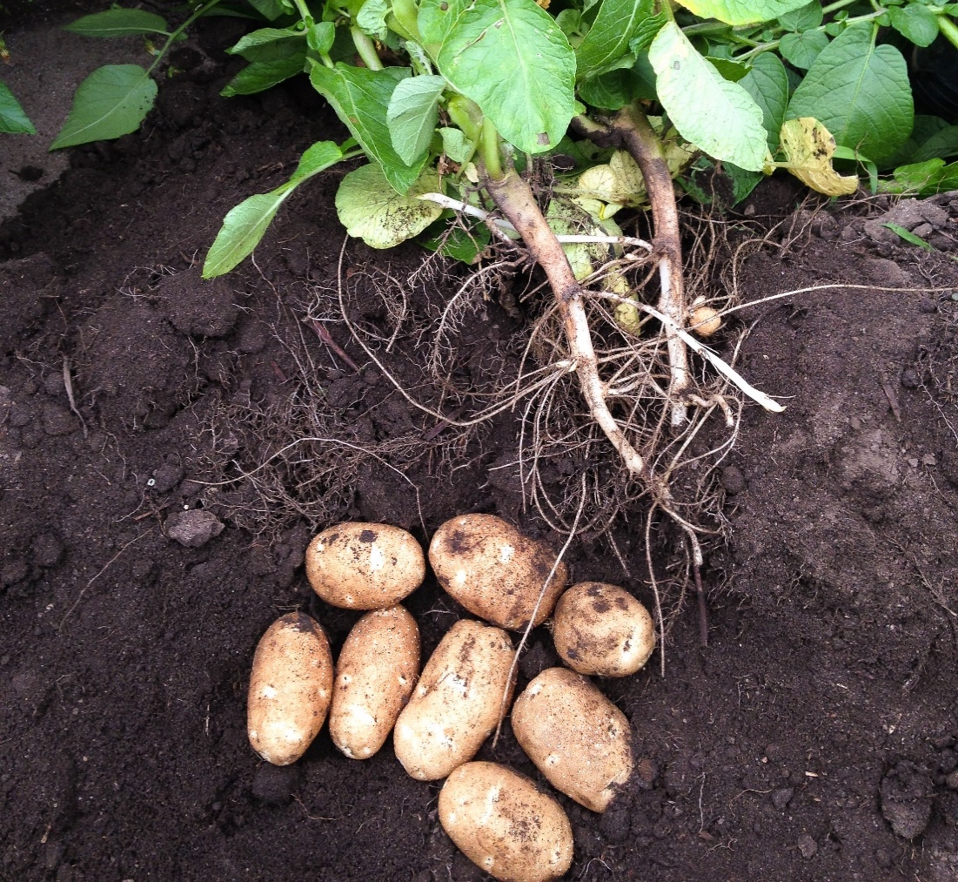
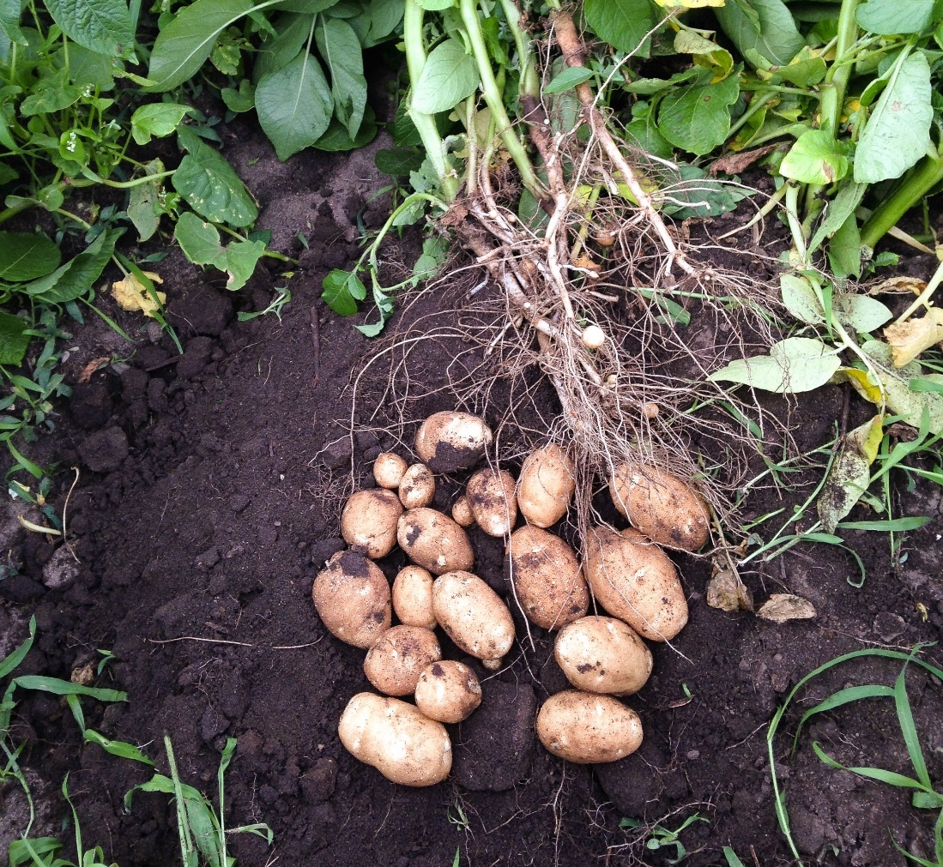
Stem number x tuber number & size

Slide 34
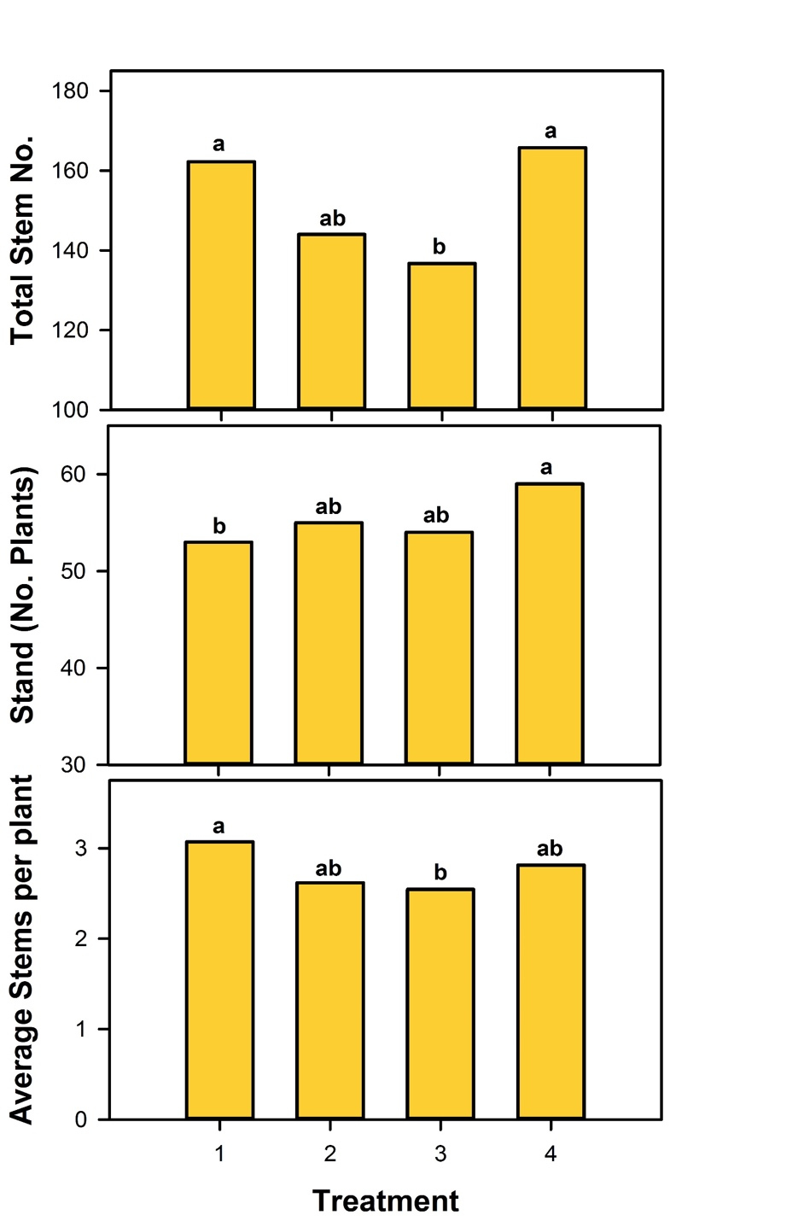
NAA on seed
NAA can reduce stem number on physiologically old seed.
RB treated with 1) non-treated, 2) 0.16 oz/ton seed at 12 in within-row spacing, 3) 0.30 oz/ton seed at 12 in within-row spacing and 4) 0.30 oz/ton seed at 10 in within-row spacing

Slide 35
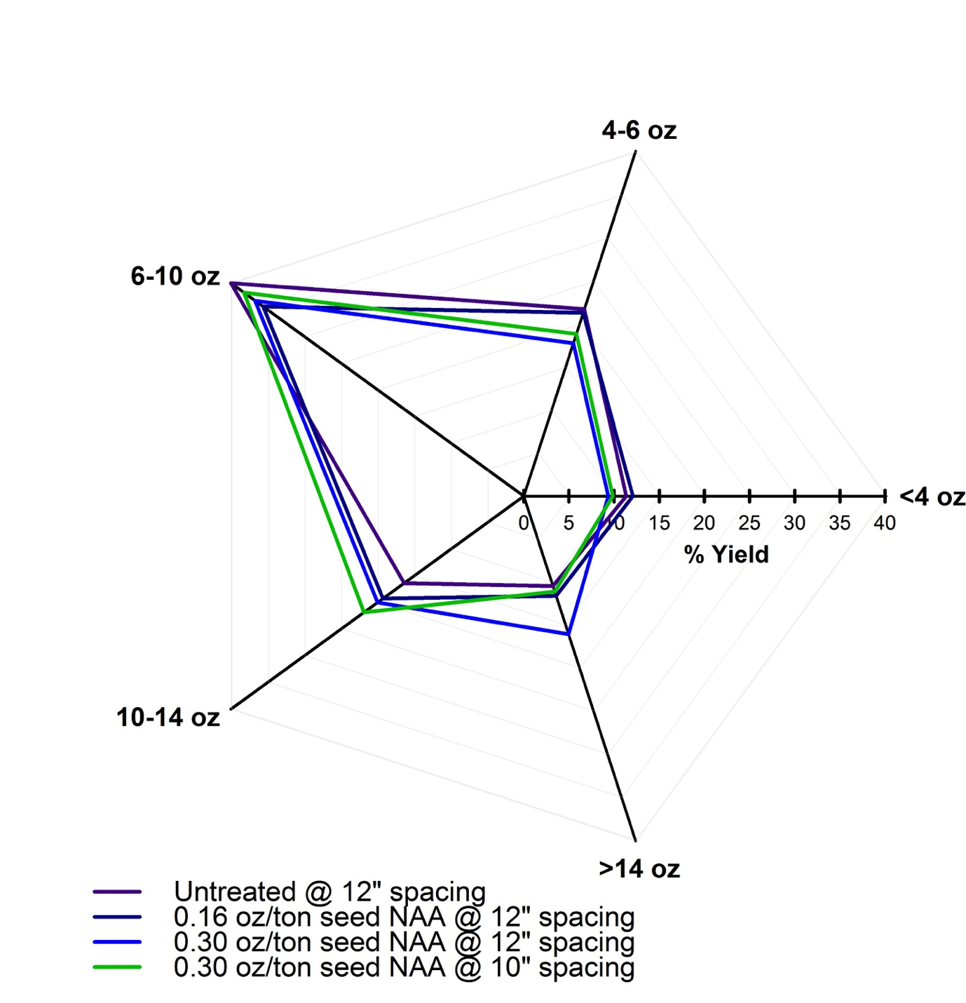
NAA on yield
NAA did not have a significant effect on US #1 yield.
Tuber size profile changed when 0.30 oz/ton seed NAA was applied at 10 or 12” spacing.
NAA did manipulate tuber size profile.

Slide 36
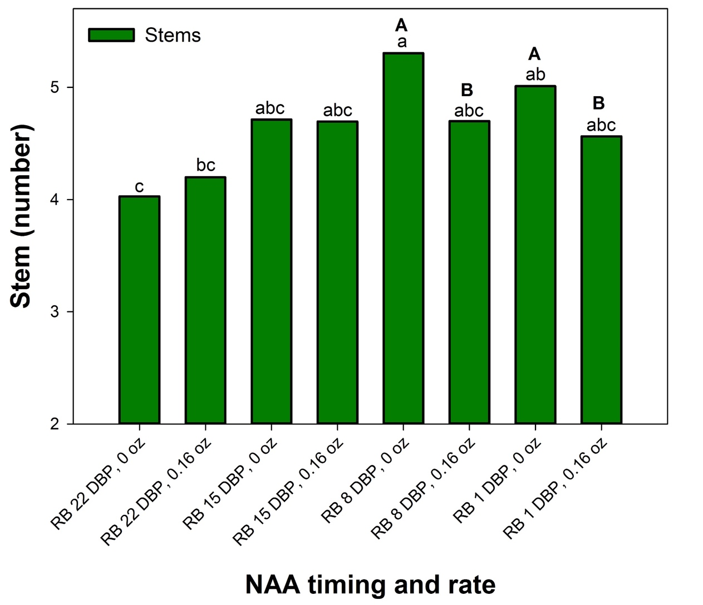
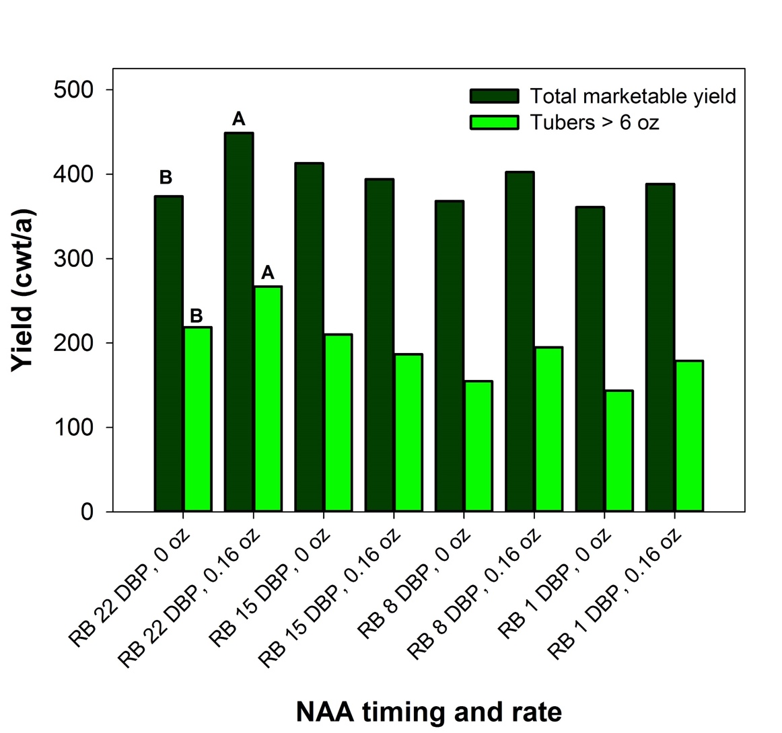
NAA timing on Russet Burbank

Slide 37
What to do if seed is physiologically old
Ensure seed is stored properly.
Increase spacing between seed pieces.
  Determine average stem number and calculate seed/acre based on this information.
Treat seed with NAA to reduce stem number
  If using NAA only applied as seed treatment closing to planting.

Slide 38
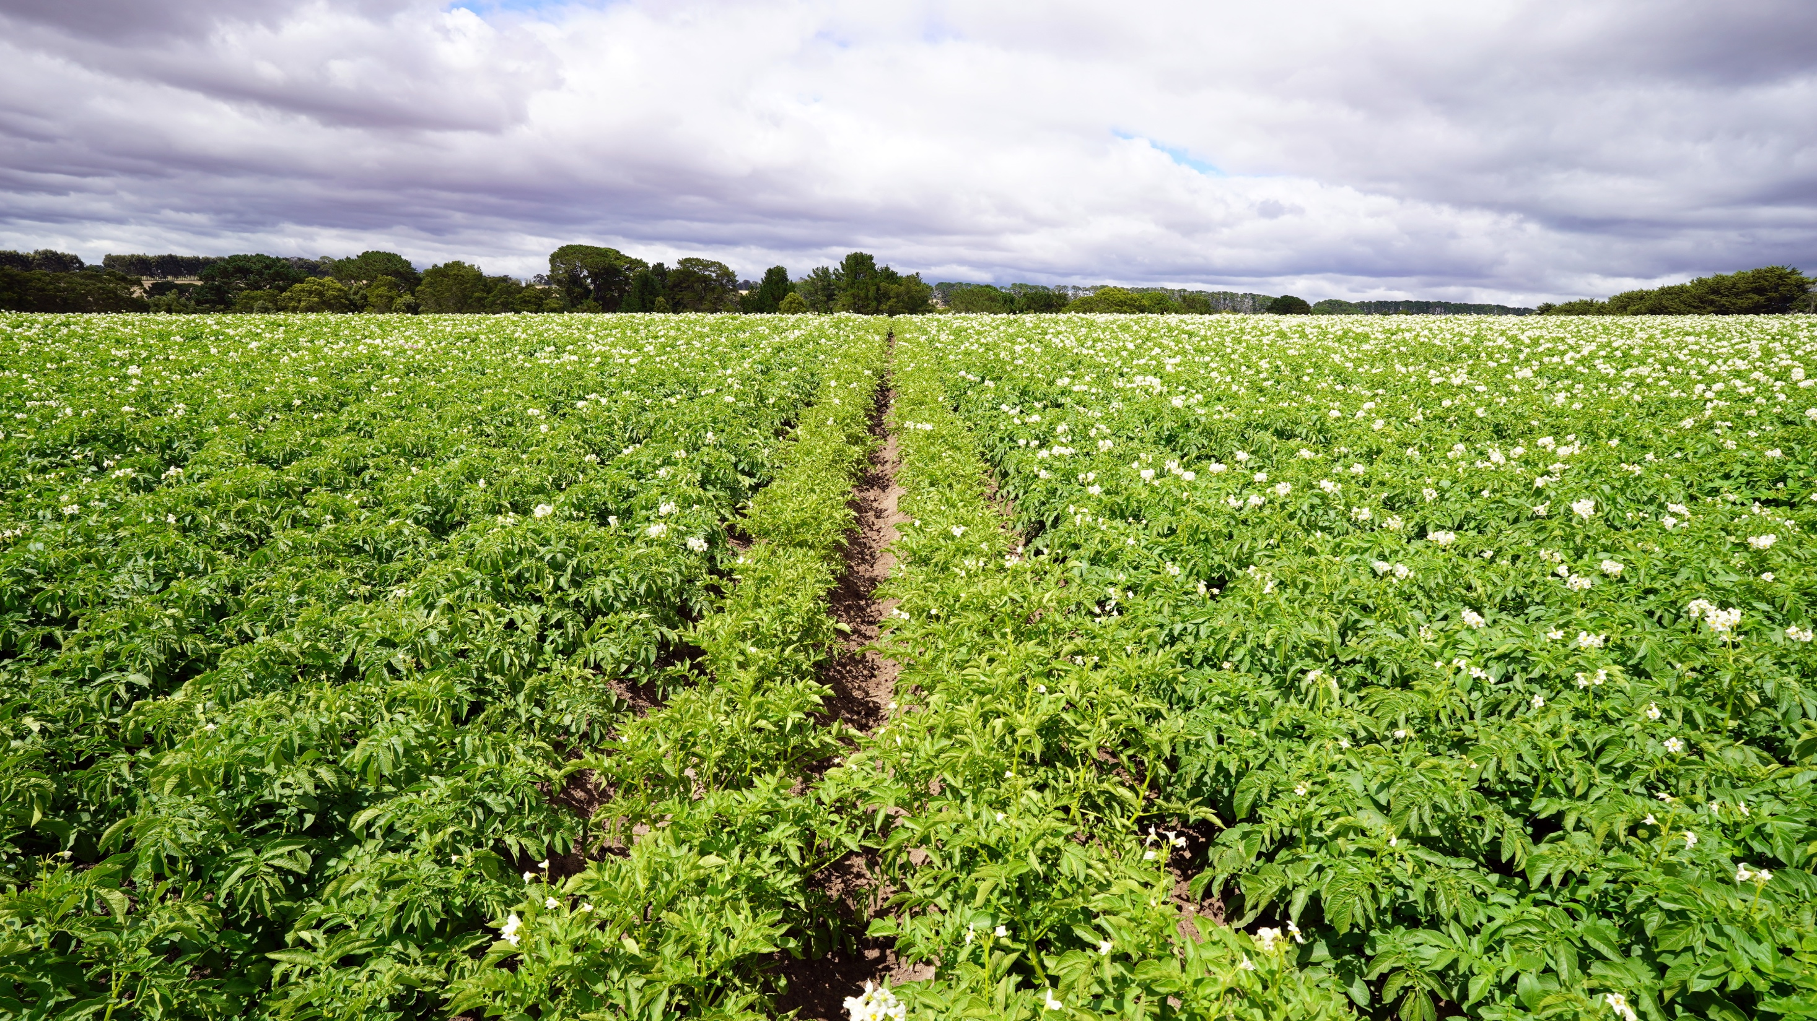
Thank you

Slide 40
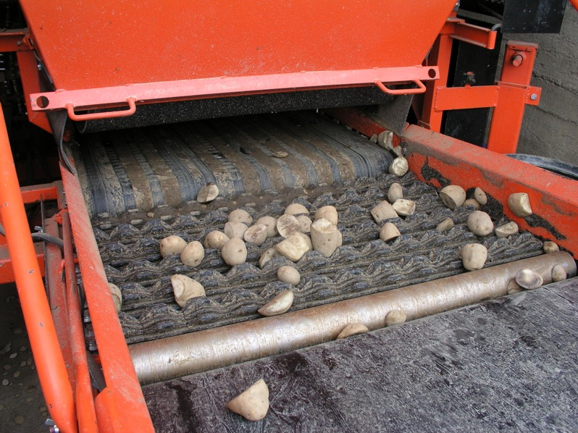

Seed cutting
Size
Shape
Distribution
Whole seed
SB Johnson
UMCE

Slide 41
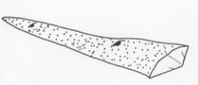
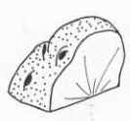

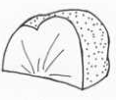
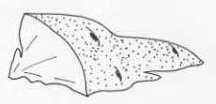
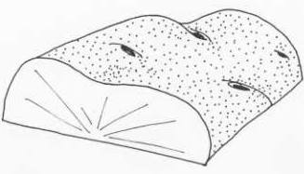
Potato seed basics
Undersize Seed Piece
Sliver Seed Piece
Slab Seed Piece
Ripped Seed Piece
Blind Seed Piece
Good Seed Piece
SB Johnson
UMCE

Slide 42
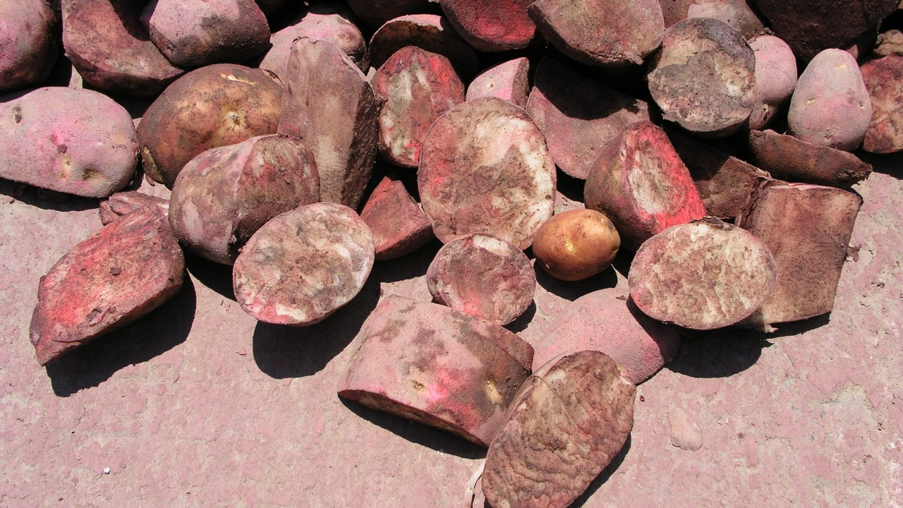
slab seed piece
undersize seed piece
sliver seed piece
SB Johnson
UMCE
ripped seed piece

Slide 43
Poor seed cutting distribution
SB Johnson
UMCE

Slide 44
Good seed cutting distribution
SB Johnson
UMCE

Slide 45
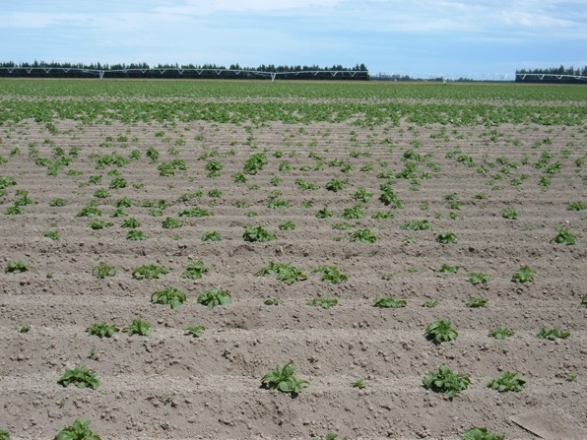
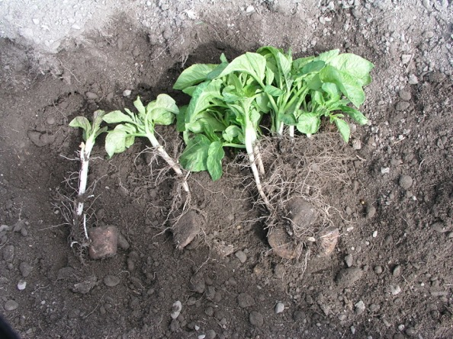
Poor seed or bad planting = uneven stand
SB Johnson
UMCE
SB Johnson
UMCE

