Slide 1
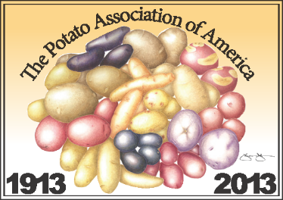
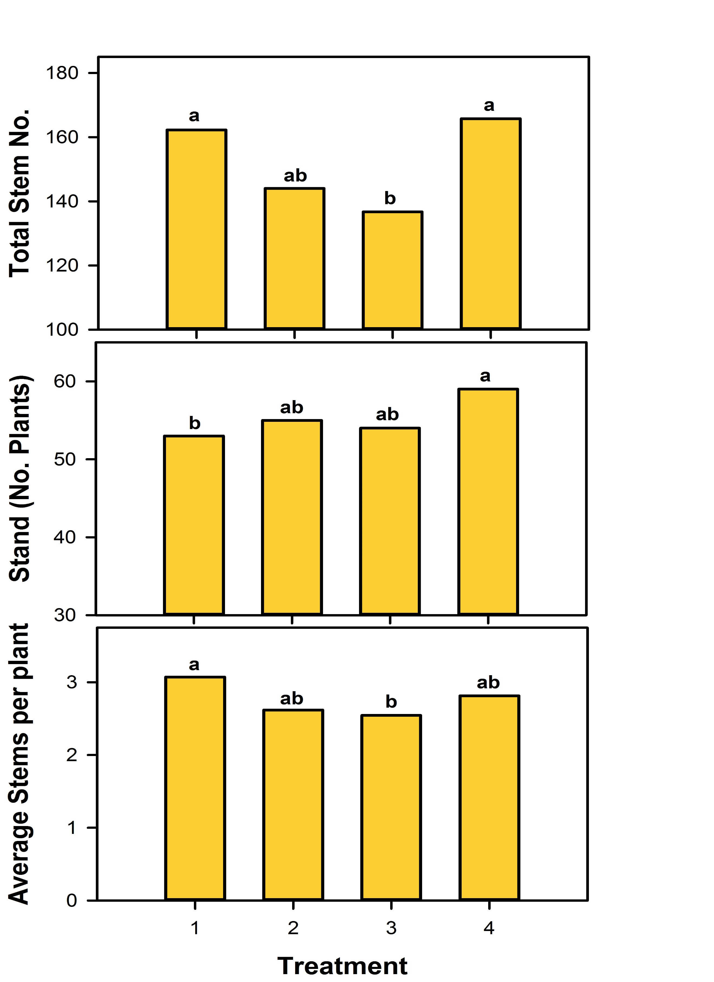
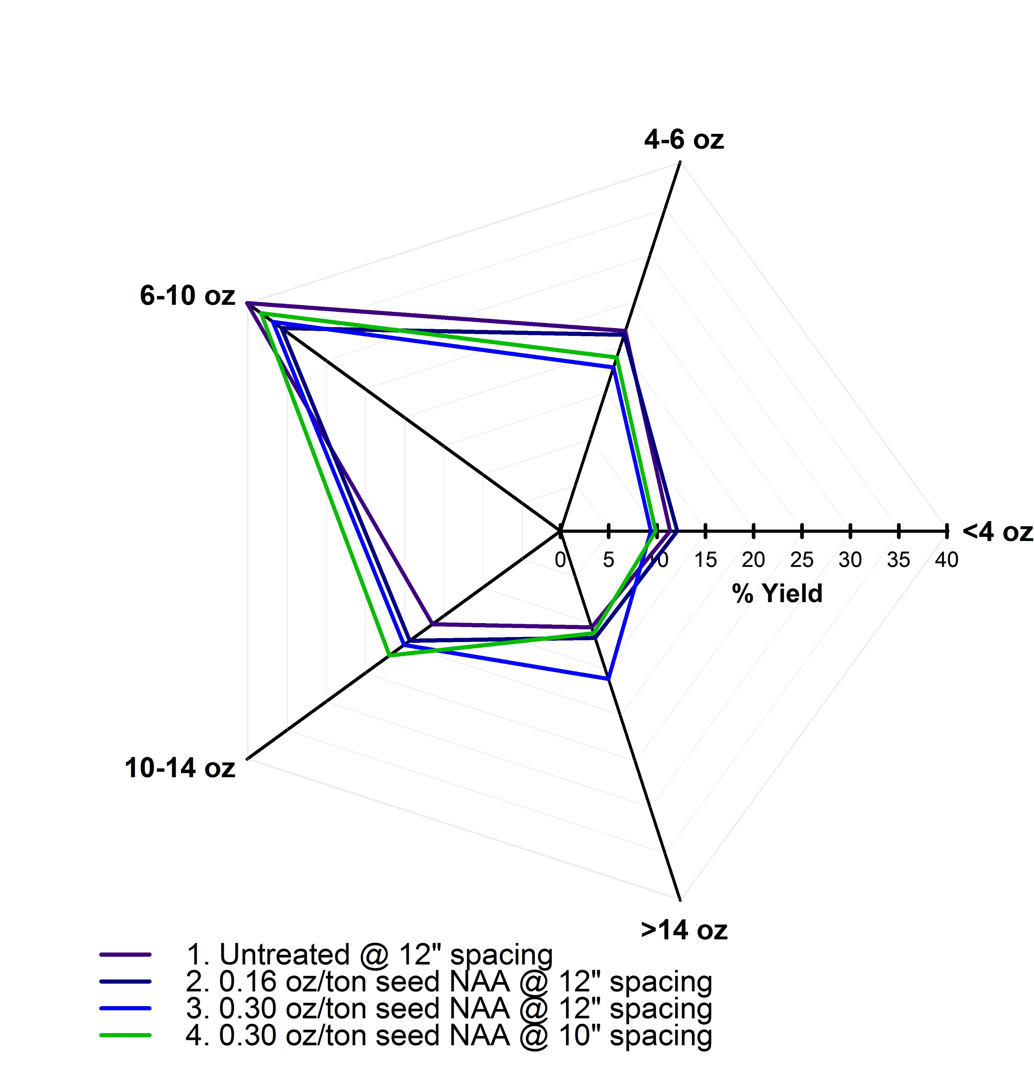
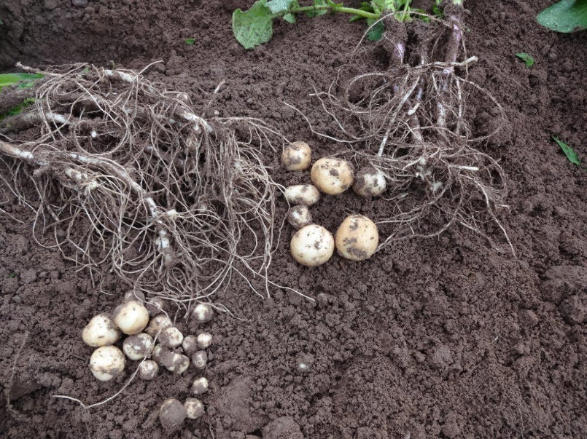
Utilization of NAA as a Seed Treatment to Control
Stem Number in Russet Burbank
Andrew P. Robinson, North Dakota State University / University of Minnesota
Email: andrew.p.robinson@ndsu.edu, website: www.ag.ndsu.edu/potatoextension
What Was Found
Introduction of the Problem
Background: Altering the number of stems can be an effective way to control tuber set and size of physiologically old seed. Russet Norkotah tubers that averaged 2.2 stems/seed piece compared to tubers that averaged 4.2 stems/seed piece had similar marketable yield. However, when comparing 2.2 to 4.2 stems/seed piece the number of tubers/plant increased from 7.6 to 11.0, tuber number/acre increased from 140,304 to 199,643 while the average tuber size decreased from 9.2 to 6.8 g/tuber, respectively (Knowles, 2012). The greater the stem count the more tubers/hill and the smaller tubers become and this can directly affect the value of the crop. Managing stem number not only affects size profile, but may also be combined with other cultural practices such as seed size, planting date, and in-row spacing to alter size profile and total marketable yield. There is little information on the combination of controlling stem number and reducing the in-row spacing.
Purpose of the Project: Examine the effect of 1-naphtheneacetic acid (NAA) treatments on seed in combination with in-row seed spacing on stem number, total yield, and graded yield.
What Was Found
Stem Number
NAA reduced the number of stems/plant by 0.26 to 0.52 stems (Figure 1).
Reducing in-row spacing by 2 inches and applying 0.30 oz/ton of seed NAA caused a similar number of stems/acre as the untreated.
Yield
NAA did not have a significant effect on US #1 yield (Figure 2).
NAA treatment of 0.30 oz/ton of seed and in-row spacing reduced by two inches increased the 10-14 oz tubers by 30 cwt/a when compared to the untreated.
NAA treatment of 0.30 oz/ton of seed and in-row spacing reduced by two inches increased the number of 10-14 oz tuber by 16 when compared to the untreated.
What Was Done
Experimental Procedures:
Location: Inkster, ND
Cultivar: Russet Burbank
Planting: 13 June 2013
Plots: 4 rows (3 ft/row) × 30 ft long, replicated 4 times
Treatments:
The field was irrigated with a linear sectional to maintain proper soil moisture. All other production practices were conducted according to recommended NDSU potato production practices.
Measurements
Stand and stem counts when plants were 8-10 inches tall
Harvested the two center rows on 18 October 2013
Potatoes graded on 4 November 2013
Data Analysis
Proc Mixed model with a Tukey pairwise separation at P<0.10 with SAS v. 9.3.
Table 1. NAA (trade name Rejuvenate) treatments used in 2013 trial at Inkster, ND.
Treatment | NAA rate (oz/ton of seed) | Row spacing (inches)
1 | 0 | 12
2 | 0.16 (labelled rate) | 12
3 | 0.30 (2x label) | 12
4 | 0.30 (2x label) | 10
Figure 1. Stem number, stand, and average stems per plant affected by NAA seed treatment and in-row spacing.
Figure 2. Tuber size distribution affected by NAA seed treatment and in-row spacing.
What Does This Mean
NAA was an effective treatment to reduced stem number.
When in-row spacing was reduced the average size was reduced because of a higher density of plants/acre.
Average stem number for untreated plants was relatively low for this seed, likely limiting the effect of NAA. As stem number increases, or as NAA rate increases, a stronger response would be anticipated.
Reducing in-row spacing by less than 2 inches needs to be tested to determine if this reduction in spacing will provide a more profitable size profile and yield increase.
Figure 3. Comparison of potato plants with 6 stems 3 stems. Tuber number and size can be directly affected by the number of stems/seed piece.

