Slide 1
Agricultural Market Situation and Outlook
April 17, 2020
WEBINAR BEGINS AT 12:30 P.M. CST

Slide 2
Agricultural Market Situation and Outlook
April 17, 2020
WELCOME!

Slide 3
Agricultural Market Situation and Outlook
Microphone & camera off
Use Chat for questions

Slide 4
At the End
Q&A: Please use Chat
Feedback: 3 quick questions
https://bit.ly/AgEconCOVID

Slide 5

Current Economic Conditions and Industry Exposure
Bryon Parman
701-231-8248
Bryon.Parman@ndsu.edu

Slide 6
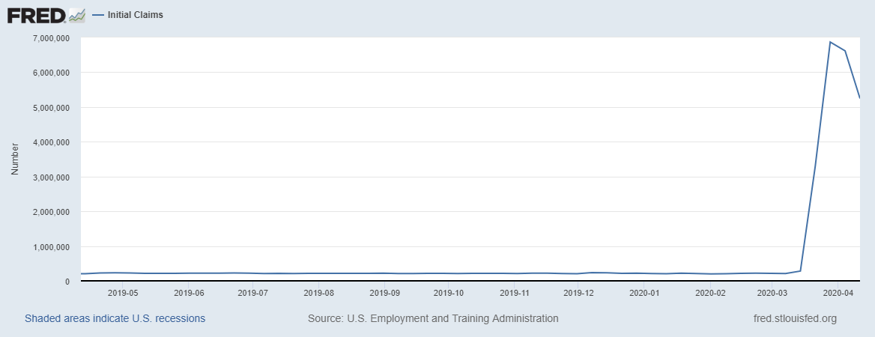
Weekly U.S. New Jobless Claims Since April 2019
5.24 Million for the week ending April 11th
6.6 Million for the week ending April 4th
6.87 Million for the week ending March 28th
3.28 Million for the week ending March 21st

Slide 7
Unemployment: The Numbers
Week Ending March 21th
  New Unemployment 3.28 Million
Week Ending March 28th
  New Unemployment revised up to 6.87 Million
Week ending April 4th
  New Unemployment 6.6 Million
Week ending April 11th
  New Unemployment 5.25 Million
U.S. Labor Force in February approximately 164.5 million
  Estimated unemployment rate of about 16.5%, up from 3.5% a month ago.
Unemployment rate peaks: 2009 – 9.9% / 1982 10.8% /
1933 – 25% /

Slide 8
Credit Tightening
JPMorgan Chase
  “From Tuesday, customers applying for a new mortgage will need a credit score of at least 700, and will be required to make a down payment equal to 20% of the home’s value”- CNBC
Across the Country
  “The availability of conventional loans dropped 24.2% in March, while jumbo loan availability dipped 36.9%. Government loans, which include USDA, VA and FHA mortgages, fell 6.6%.” - Forbes

Slide 9
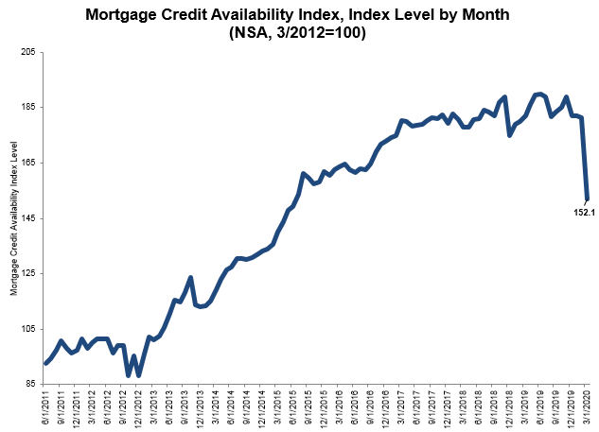
March 2020 Mortgage credit availability index
Note, this is through March.
April NOT included
Chart from Mortgage bankers Association, Online at:
https://www.mba.org/2020-press-releases/april/mortgage-credit-availability-decreased-in-march

Slide 10
Financial Institution Fallout
Financial Institutions (Banks)
  Bank of America, Goldman Sachs and Citi had 1st quarter profits fall by at least 40%
  JP Morgan and Wells had drops of 69% and 89% each
Banks anticipating a large spike in bad loans
  Goldman Sachs set aside $20 billion
  B of A set aside another $4.67 billion
  Citi set aside $7.03 billion

Slide 11
Direct Payments to Farmers
$16 Billion dollars in direct payments
$2-$3 Billion in Milk and other protein purchases such as pork, beef etc. sent to food banks
Specific mention to cattle, pork, specialty corps, and commodities hurt by COVID-19.
The plan to be submitted this week or early next week
Will re-evaluate the necessity/efficacy of the 1st round of payments later in the year to see if more is needed.

Slide 12

Crop Market Situation & Outlook
Frayne Olson
Crop Economist/ Marketing Specialist
frayne.olson@ndsu.edu
701-231-7377 (o)
701-715-3673 (c)

Slide 13
Definition of Basis
Mathematical:
  Basis = Cash – Futures
  Specific to location and delivery time period
Theoretical:
  Difference between national supply & demand (futures market) and local supply & demand (local cash market), for a given time period.
Operational:
  Basis is the local cash market regulating the flow of grain, over time and space.

Slide 14
Corn Basis
(09/01/2015 – 04/16/2020)
DTN ProphetX

Slide 15
Corn Shipments 2018-19
Annual North Dakota Elevator Marketing Report, 2018-19 - UGPTI

Slide 16
Soybean Basis
(09/01/2015 – 04/16/2020)
DTN ProphetX

Slide 17
Soybean Shipments 2018-19
Annual North Dakota Elevator Marketing Report, 2018-19 - UGPTI

Slide 18
Hard Red Spring Wheat Basis
(07/01/2015 – 04/16/2020)
DTN ProphetX

Slide 19
Hard Red Spring Wheat Shipments
2018-19
Annual North Dakota Elevator Marketing Report, 2018-19 - UGPTI

Slide 20

Livestock Price Situation and Outlook
Tim Petry
Extension Livestock Marketing Economist
Tim.Petry@ndsu.edu
www.ndsu.edu/
livestockeconomics

Slide 21






LIVESTOCK COMMODITY GROUP COVID-19 LOSSES

Slide 22
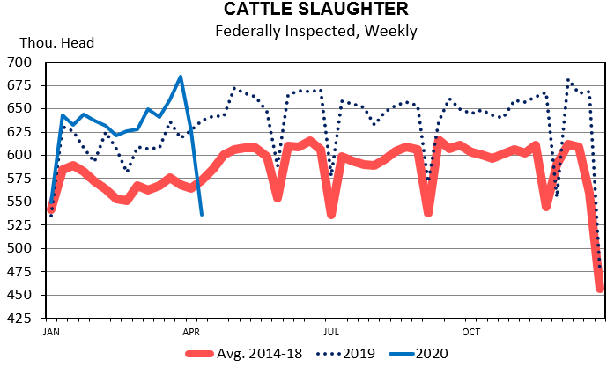
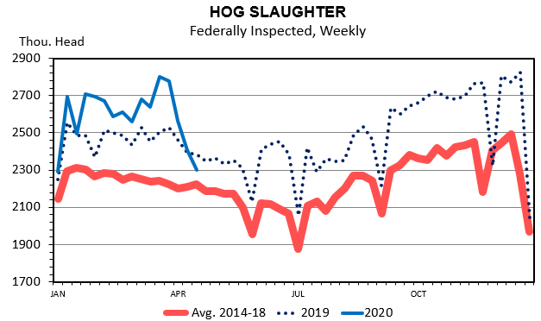
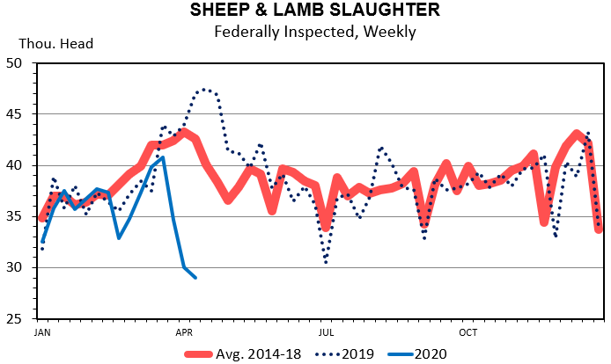
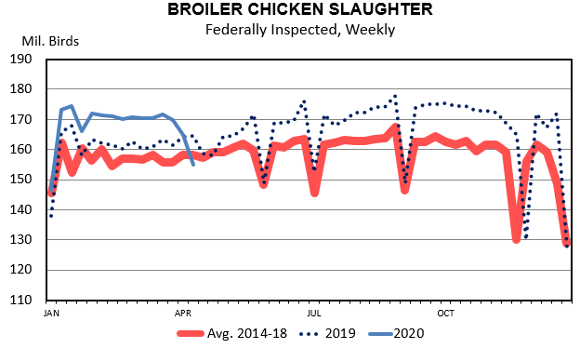

Slide 23
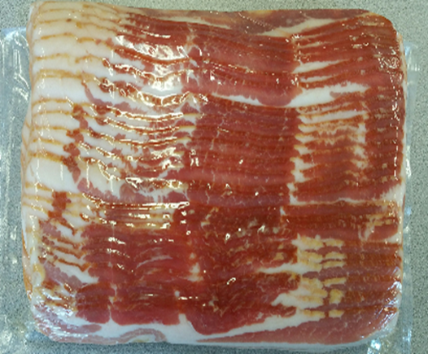

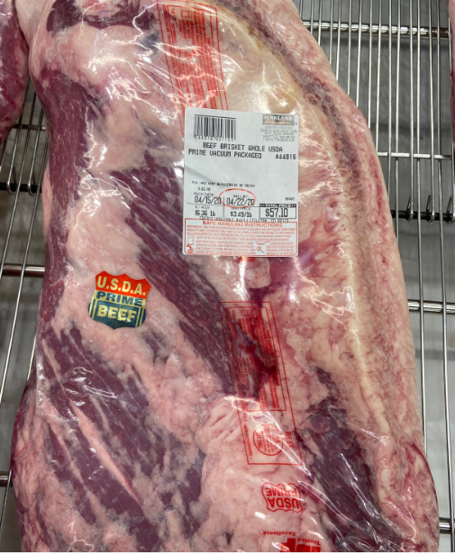
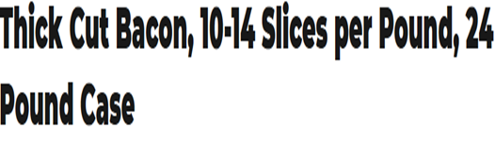
RETAIL MEAT MARKETING CHANGING
COSTCO-16.36lb Prime brisket $3.49=$57.10

Slide 24


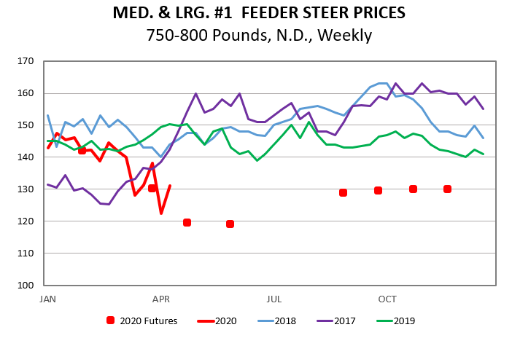
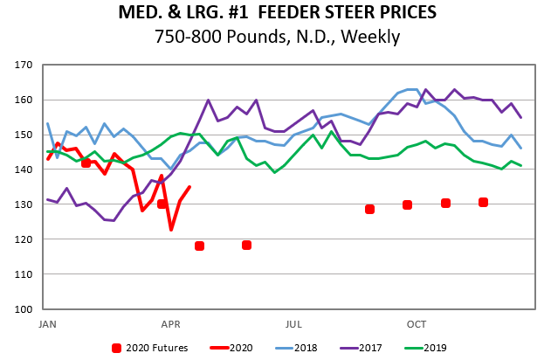

Slide 25

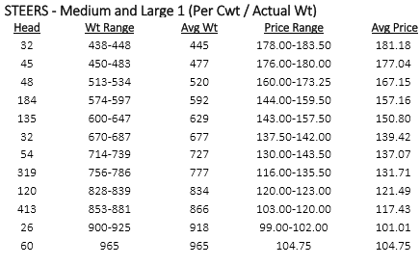
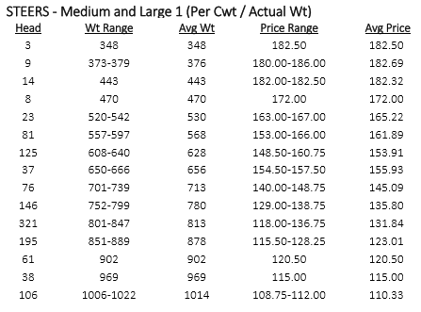


Slide 26

Payroll Protection Program
Ron Haugen
Extension Farm Management Specialist
701-231-8103
ronald.haugen@ndsu.edu

Slide 27
Payroll Protection Program
Updates
PPP: part of CARES Act to help keep people employed
$349B appropriated ALL USED UP
$250B replenishment is being considered by Congress
1.66M loans by almost 5K lenders
SBA 14 years of loans in 14 days
“Interim Final Rule”: farmers, self-employed
Normally SBA loans do not apply for agriculture, however, the CARES act specifically states all businesses qualify including agricultural enterprises

Slide 28
Payroll Protection Program
Eligibility
Eligibility: Must have been in operation on February 15, 2020 and meet one of the following criteria:
Small business with fewer than 500 employees
A 501(c) (3) with fewer than 500 employees
An individual who operates as a sole proprietor
An individual who operates as an independent contractor
An individual who is self-employed
Other SBA definitions

Slide 29
Payroll Protection Program
Details
Authorization: banks w/SBA affiliation, other banks, FCS
Justification for loan: “current economic uncertainty”
Max amount is lesser of 2.5 x average month payroll costs or $10M capped at $100K per employee
Terms: 2 year 1% ,Gov’t guarantee, No collateral, Fees waived
Allowable uses: payroll, health care benefits, mortgage interest, rent, utilities, interest on other debt obligations before Feb 15
Use Sch C (Sch F) profit as self-employed payroll, $100K limit “owner compensation replacement”

Slide 30
Payroll Protection Program
Forgiveness
Must be used in eight-week period after loan origination
75 percent must be used for payroll for forgiveness
Forgiveness will be prorated on percentage of employees reduced compared to 2019.
If rehire by June 30 will not be penalized
Self-employed payroll calculation, "owner compensation replacement” use 8/52 weeks of Sch C (Sch F) profit
Loans forgiven are not taxable

Slide 31
Payroll Protection Program
Take Away Points
Need a justification
Communicate with lender
DOCUMENT! Recommended to keep a separate account
Not a guarantee of a low interest loan
Not a guarantee of forgiveness
Up to $250K fine and 5 years in prison for false statements

Slide 32

Ag-Energy
Situation and Outlook
David Ripplinger
Bioproducts/Bioenergy Economics Specialist
david.ripplinger@ndsu.edu

Slide 33
Situation
Ethanol
  Continued decline in production
  At least 30 refineries are closed, 80 running at less than 50% capacity
  Nearing equilibrium
  Margins are improving, but negative
Oil
  Wells beginning to be shut-in
  Storage crisis continues to loom

Slide 34
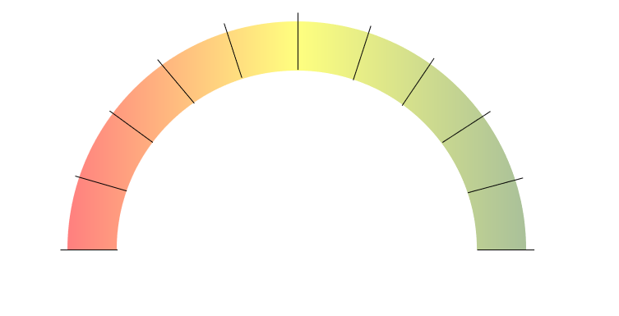
US Ethanol Production
April 10th 8.7 billion gallons
April 3rd 10.3 billion gallons
March 27th
12.8 billion gallons
March 20th
15.4 billion gallons per year
Data: EIA
Animation: NDSU Extension

Slide 35
Stocks – Days in Storage
 | 3/20/20 | 4/17/20 | 4 Year Average
Crude | 28.9 | 35.3 | 27.9
Gasoline | 25.8 | 40.9 | 25.4
Ethanol | 27.6 | 54.3 | 24.2
Data: EIA
Calculations: NDSU Extension

Slide 36
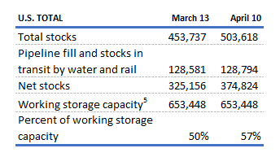
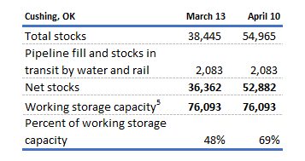
US Crude Oil Storage
US Total
Cushing, Oklahoma
Total Working Storage:
76 MMBBLS
4 Week Change:
+16.5 MMBBLS (21%)
March 13th Level:
36.3 MMBBLS
Data: EIA
Graphic: NDSU Extension

Slide 37
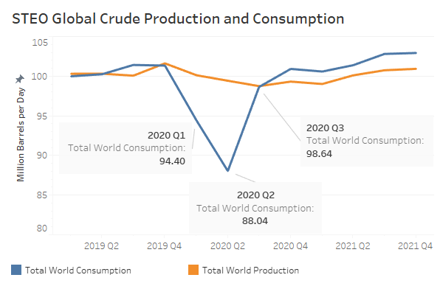
Data: EIA
Data: EIA

Slide 38
Recording & More Info:
Q&A: Please use Chat
Feedback: 3 quick questions
https://bit.ly/AgEconCOVID
www.ag.ndsu.edu/extension/economics
www.ag.ndsu.edu/alerts/coronavirus

