Slide 1
Agricultural Market Situation and Outlook
April 10, 2020
WEBINAR BEGINS AT 12:30 P.M. CST

Slide 2
Agricultural Market Situation and Outlook
April 10, 2020
WELCOME!

Slide 3
Agricultural Market Situation and Outlook
Microphone & camera off
Use Chat for questions

Slide 4
At the End
Q&A: Please use Chat
Feedback: 3 quick questions
https://bit.ly/AgEconCOVID

Slide 5
Current Economic Conditions and Industry Exposure
Bryon Parman
701-231-8248
Bryon.Parman@ndsu.edu

Slide 6
University of Michigan Index of Consumer Sentiment

Slide 7
FED Announces Another 2.3 Trillion in Rescue/Stimulus
More Liquidity via $2.3 Trillion in Loans
That is $2,300,000,000,000
$600 billion “Main Street Lending Fund” for small to mid-sized businesses.
$500 billion for short-term notes directly purchased from states, counties and cities
Will buy corporate “junk” rated bonds provided they were investment grade before March 23rd
Will buy highly rated new issues of CLO’s and mortgage backed securities

Slide 8
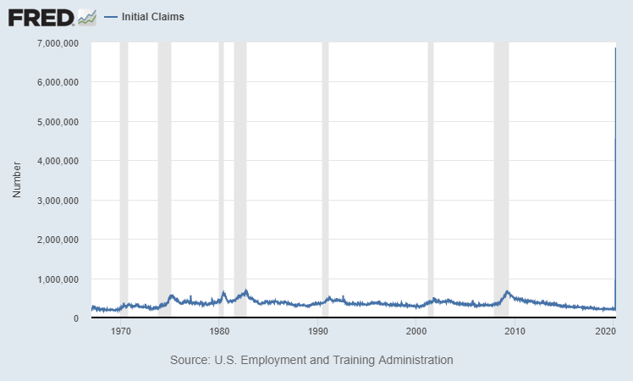
Weekly Initial Jobless Claims 1975 – Week Ending April 4th 2020
Adjusted for Population growth about 900,000
900k in 1982

Slide 9
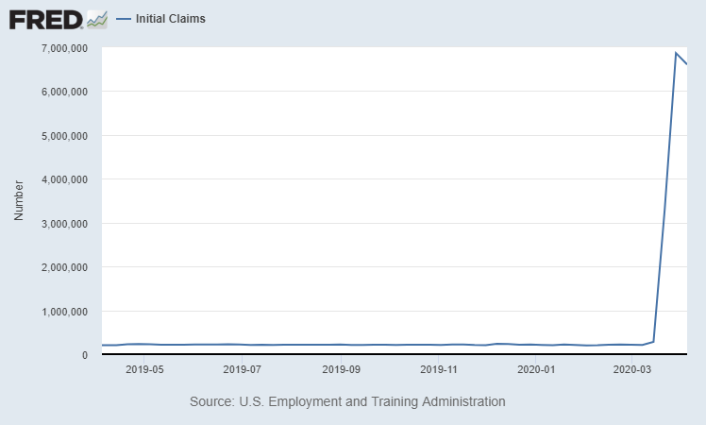
Weekly U.S. New Jobless Claims Since April 2019
6.6 Million for the week ending April 4th
6.87 Million for the week ending March 28th
3.28 Million for the week ending March 21st

Slide 10
Unemployment: The Numbers
Week Ending March 21th
New Unemployment 3.28 Million
Week Ending March 28th
New Unemployment revised up to 6.87 Million
Week ending April 4th
New Unemployment 6.6 Million
Previously Unemployed (before Covid-19) 5.8 million
That yields a total of approximately 22-22.5 million unemployed
U.S. Labor Force in February approximately 164.5 million
Estimated unemployment rate of about 13.7%, up from 3.5% a month ago.
Unemployment rate peaks: 2009 – 9.9% / 1982 10.8% /
1933 – 25% /

Slide 11
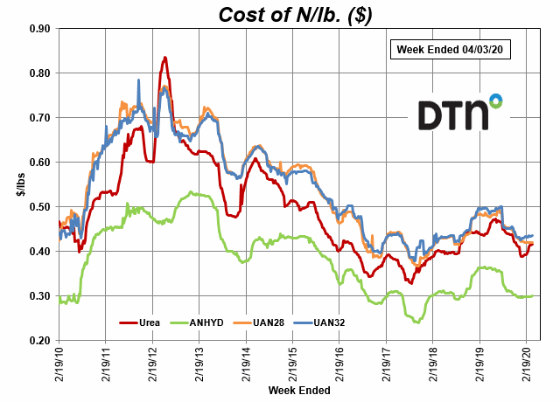

Slide 12
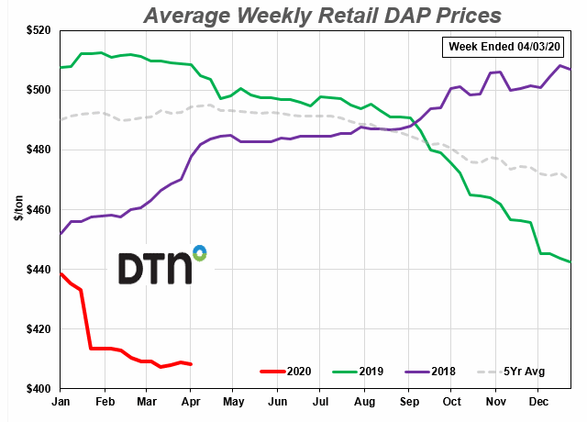

Slide 13
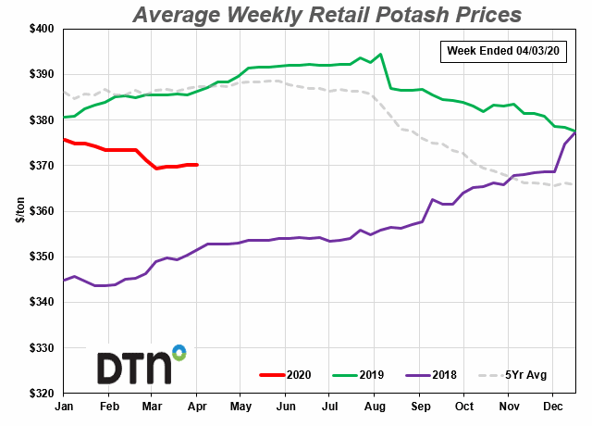

Slide 14
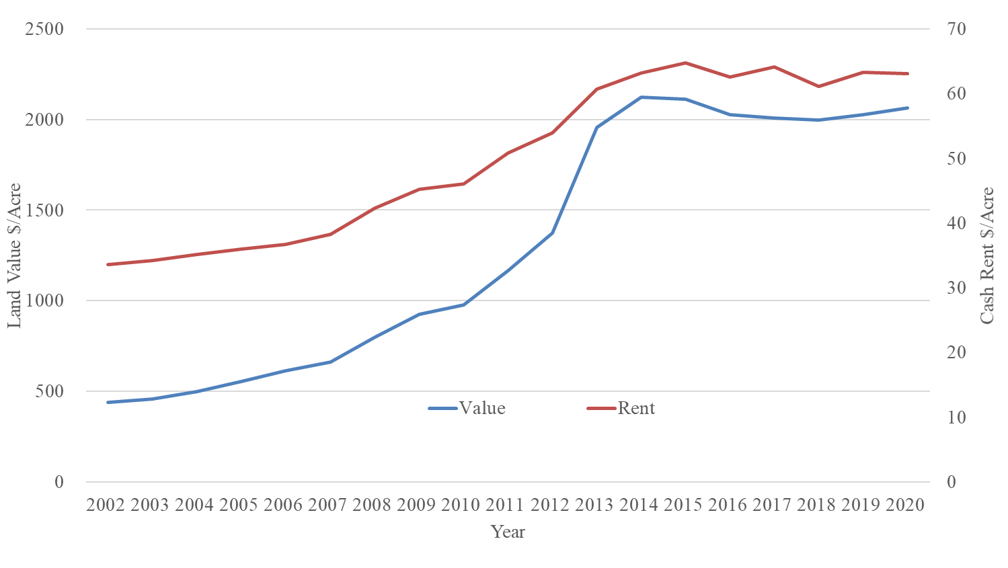
North Dakota Crop Land Values and Rents 2002-2020

Slide 15
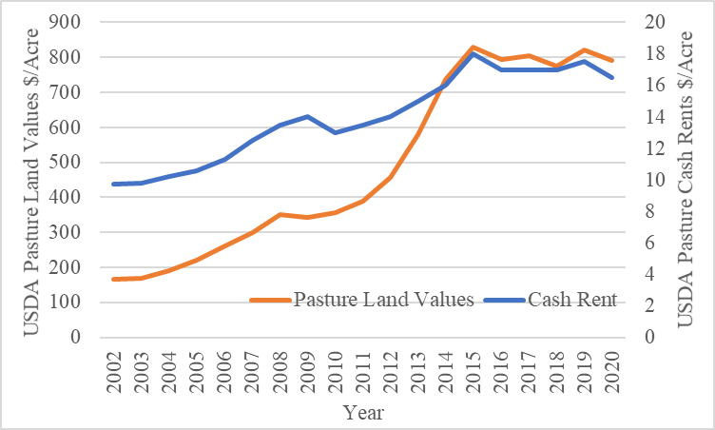
ND Pasture Land Values and Rents 2002 - 2020

Slide 16
Land Outlook
Interest rates to remain low for the foreseeable future
Governmental support programs for ag. will help prop up land values / rents
Production and demand conditions will also play a role heading into the 2020-2021 marketing year
Consumer confidence may lag considerably

Slide 17
Crop Market Situation & Outlook
Frayne Olson
Crop Economist/ Marketing Specialist
frayne.olson@ndsu.edu
701-231-7377 (o)
701-715-3673 (c)

Slide 18
Historic Corn Usage
Apr. 9, 2020 WASDE Report & USDA – Feed Grains Data Base Table 4

Slide 19
Weekly U.S. Corn Export Sales (09/03/2015 – 04/02/2020)
USDA-FSA Weekly Export Sales Report

Slide 20
Historic Soybean Usage
Apr. 9, 2020 WASDE Report & Oil Yearbook Table 3

Slide 21
Weekly U.S. Soybean Exports (09/01/2013 – 04/02/2020)
USDA-FAS Weekly Export Sales Report

Slide 22
Weekly U.S. Soybean Export Sales to China (09/01/2014 – 04/02/2020)
USDA-FAS Weekly Export Sales Report

Slide 23
Weekly U.S. Soybean Total Commitments by China (09/01/2014 – 04/02/2020)
USDA-FAS Weekly Export Sales Report

Slide 24
Historic All Wheat Usage
USDA WASDE – Apr. 9, 2020 & USDA Wheat Yearbook -Table 5

Slide 25
Weekly U.S. All Wheat Export Sales (06/04/2015 – 04/02/2020)
USDA-FSA Weekly Export Sales Report

Slide 26
Weekly U.S. HRSW Export Sales (06/04/2015 – 04/02/2020)
USDA-FSA Weekly Export Sales Report

Slide 27
Top 3 U.S. Export Destinations in 2018/19 MY (1,000 Metric Tons)
 | Corn | Soybean | All Wheat | Hard Red Spring Wheat
Largest Buyer | Mexico (15,461) | China (13,370) | Philippines (3,047) | Philippines (1,760)
Second Largest Buyer | Japan (12,632) | Mexico (4,918) | Mexico (3,034) | Japan (864)
Third Largest Buyer | Columbia (4,672) | Egypt (2,705) | Japan (2,695) | Taiwan (624)
Total 2018/19 Sales | 49,202 | 46,770 | 24,232 | 6,778
Market Concentration of Top 3 Buyers | 66% | 45% | 36% | 48%
USDA – FAS 2018 Exports by Country

Slide 28
Livestock Price Situation and Outlook
Tim Petry
Extension Livestock Marketing Economist
Tim.Petry@ndsu.edu
www.ndsu.edu/
livestockeconomics

Slide 29
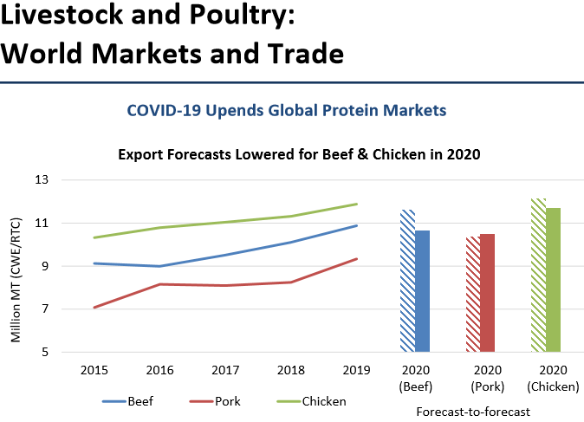

Slide 31
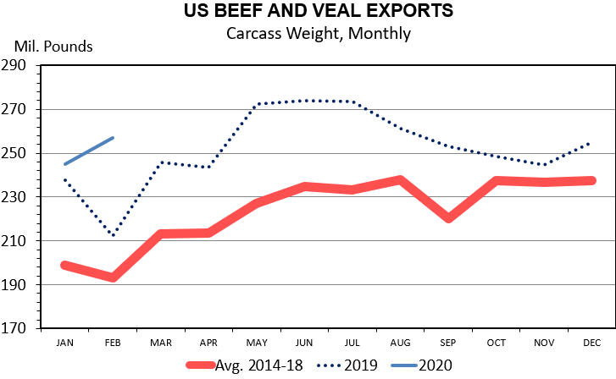
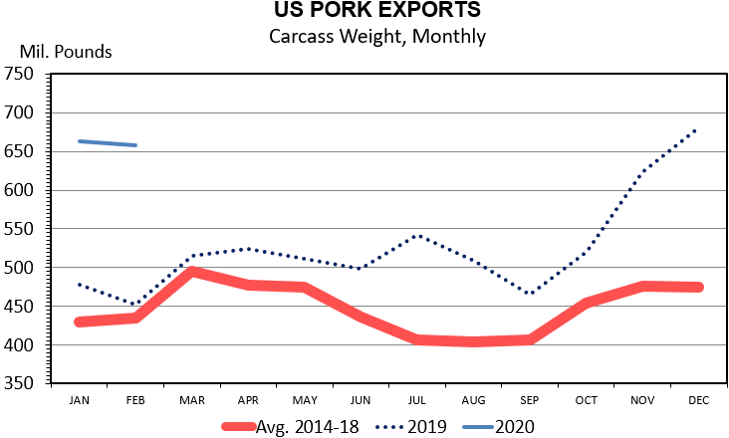
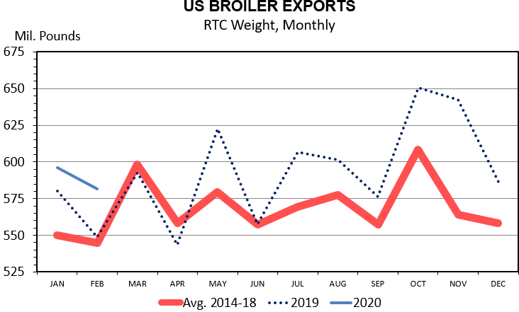

Slide 32
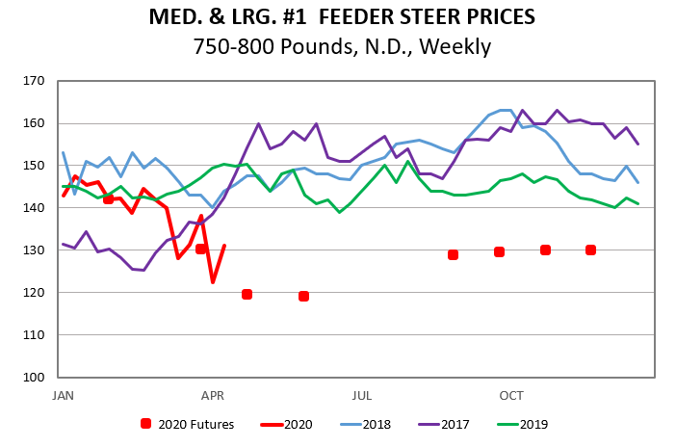

Slide 33
Ag-Energy Situation and Outlook
David Ripplinger
Bioproducts/Bioenergy Economics Specialist
david.ripplinger@ndsu.edu

Slide 34
Situation
Rapid decline in gasoline use, ethanol use, and ethanol reduction
Additional reductions are needed
40% reduction in 2Q gasoline use (EIA)
Storage crisis looms
Notes:
EiA

Slide 35
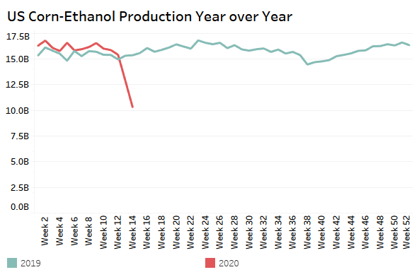
Ethanol production declined has 33% in last two weeks
SD Ethanol Prices | 4/9/20 | 4/17/19 | Change
Corn | 2.65-2.90 | 3.32-3.46 | -18%
Ethanol | .68 | 1.18 | -42%
Distillers Grains | 195 | 137.50 | +42%
Data: EIA, USDA/AMS
Calculations: NDSU Extension

Slide 36
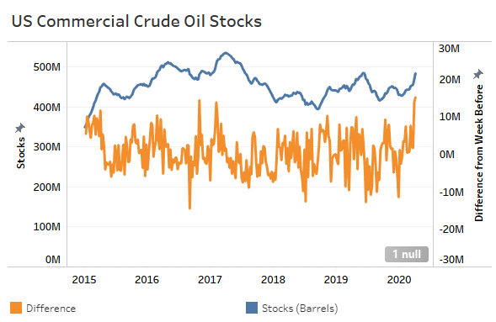
Data: EIA
Calculations: NDSU Extension

Slide 37
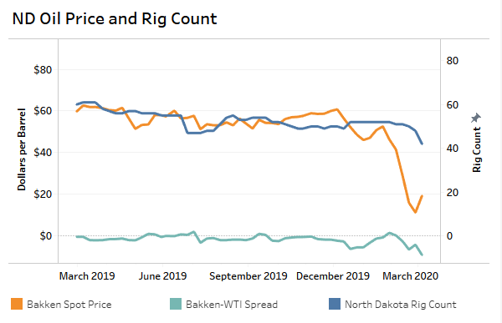
Data: EIA, Flint Hils Resources, Baker Hughes
Calculations: NDSU Extension

Slide 38
Recording & More Info:
Q&A: Please use Chat
Feedback: 3 quick questions
https://bit.ly/AgEconCOVID
www.ag.ndsu.edu/extension/economics
www.ag.ndsu.edu/alerts/coronavirus

