Slide 1
Agricultural Market Situation and Outlook
Microphone & camera off
Use Chat for questions

Slide 2
At the End
Q&A: Please use Chat
Feedback: 3 quick questions
https://bit.ly/AgEconCOVID

Slide 3

Current Economic Conditions and Industry Exposure
Bryon Parman
701-231-8248
Bryon.Parman@ndsu.edu

Slide 4
Over 85% of all Americans are under a stay at home order
Map From: https://www.businessinsider.com/us-map-stay-at-home-orders-lockdowns-2020-3
281,000,000 Americans

Slide 5
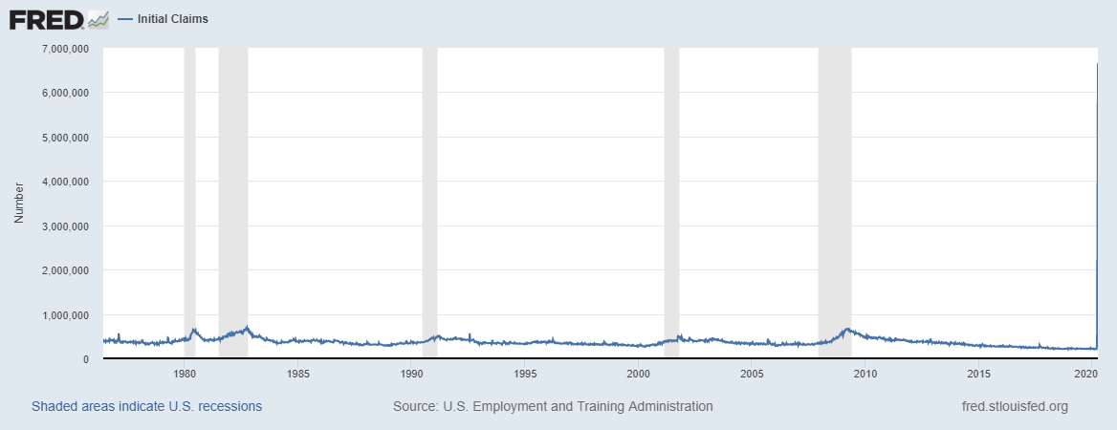
Weekly Initial Jobless Claims
1975 – Week Ending March 28th 2020
6.64 Million for the week ending March 28th
Adjusted for Population growth about 900,000
900k in 1982
3.28 Million for the week ending
March 21st
Unemployment increasing from 3.5% - Approximately 9.5% in a few weeks:
(from about 5.8 million in mid-March to nearly 16 million as of last Saturday

Slide 6
Key Federal Reserve Actions
Rate Cuts
  Fed cut rate for overnight borrowing to nearly 0%
QE
  Large-scale purchases of various bonds such as U.S. Treasuries and Mortgage-backed securities: Ensures longer-term consumer interest rates stay low
Discount Window
    Banks can now borrow for 90 days rather than just 1 day
Term Asset-Backed Securities Loan Facility
  Fed buys auto/credit card/ student loan and SBA loans to encourage lending in these areas
Corporate Paper/Corporate Credit Actions
  Ensuring very large businesses have access to cover expenses or losses

Slide 7
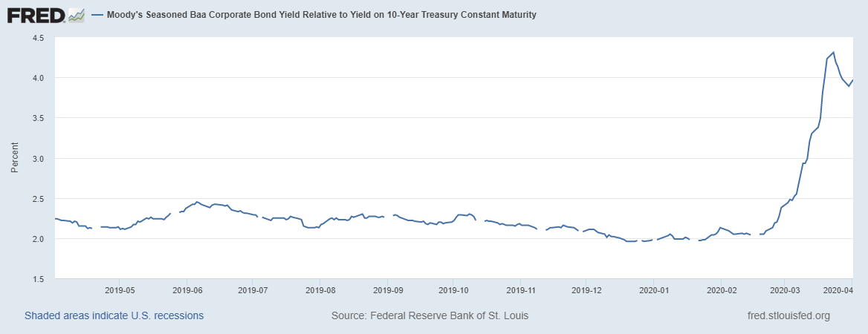
10 Year Treasury Note and Baa Corporate Bond Yield Spread
Fed to buy investment
grade corporate bonds

Slide 8
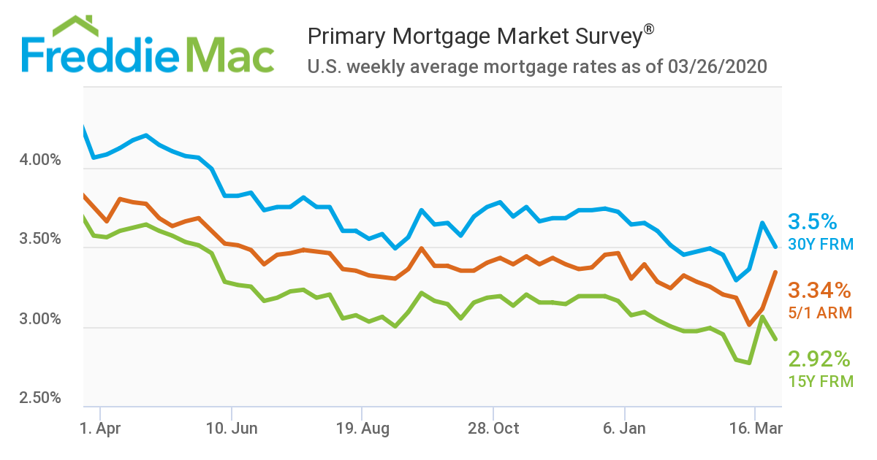
Mortgage/Interest Beginning to Decrease due to FED actions

Slide 9
Income and Substitution
Short – Intermediate shifts in food consumption as consumers substitute one product for another
  An income shock such as high unemployment for some, and low consumer confidence for others, may lead to changes in spending habits
  Individuals will look for calories at the lowest cost
    Especially those who remain unemployed for a long period of time or lack confidence in a rapid recovery

Slide 10
Food | Price | Servings | Calories/serving | Protein | Calories Per Dollar
Flour | 1.68 | 75 | 100 | 3 | 4,464
White Bread | 0.78 | 20 | 130 | 4 | 3,333
Sugar | 2.98 | 15 | 567 | 0 | 2,854
Rice | 6.53 | 101 | 150 | 3 | 2,320
Plain Oats | 7.89 | 113 | 150 | 5 | 2,148
Ramen | 2.34 | 24 | 190 | 4 | 1,949
Angel Hair | 1 | 8 | 200 | 7 | 1,600
White Pasta | 1 | 8 | 200 | 7 | 1,600
Bread Crumbs | 1.08 | 14 | 120 | 4 | 1,556
Peanut Butter | 10.99 | 86 | 190 | 7 | 1,487
Whole Wheat Pasta | 1 | 7 | 210 | 7 | 1,470
Pearled Barley | 0.98 | 10 | 140 | 4 | 1,429
Cheez-its | 5.49 | 45 | 150 | 3 | 1,230
Instant Rice | 2.44 | 14 | 200 | 5 | 1,148
Pinto Beans (10lbs) | 9.12 | 104 | 90 | 7 | 1,026
Whole Wheat Bread | 1.48 | 20 | 70 | 3 | 946
Lentils | 1.12 | 13 | 80 | 10 | 929
Olive Oil (Costco) | 25.99 | 200 | 120 | 0 | 923
Whole Milk | 2.59 | 16 | 146 | 8 | 902
Flour Large Taco Shells | 2.38 | 10 | 210 | 5 | 882
Bagels | 1.48 | 6 | 210 | 8 | 851
Large Heavy Whipping Cream | 3.78 | 64 | 50 | 0 | 847
Eggs (Costco) | 3.59 | 36 | 80 | 7 | 802
Frozen Breakfast Sausages | 3.98 | 13 | 180 | 7 | 588
72/27 Ground Beef | 12.7 | 16 | 350 | 17 | 439
Chart data from Efficiency is Everything LLC: https://efficiencyiseverything.com/calorie-per-dollar-list/

Slide 11
The Shape of Recovery
2: A 2nd spike in COVID-19
Causing a double dip
1: The Rapid Recovery
(majority of businesses recover
w/employment and demand rapidly
returning)
4: A short-run rapid GDP growth
Followed by a slow recovery to
Previous levels
3: The Slow Recovery
i.e. 2008 financial crisis

Slide 12

CARES Act
Ron Haugen
Extension Farm Management Specialist
701-231-8103
ronald.haugen@ndsu.edu

Slide 13
CARES Act
Stimulus: $1200/$2400 $500/child
Unemployment Benefits: extra $600/week to July 31, can’t double dip
Student Loans: waives 2 months payment, extends repayment to September 30
Retirement Accounts: 10% penalty for early withdrawal waived, can withdraw up to $100K (coronavirus related requirement)

Slide 14
CARES Act
Small Business Loans
Retroactive to Feb 15 through June 30
Max amount lesser of 2.5 x average month payroll costs or $10M
Gov’t guarantee on 7(a) loans to 100% through Dec 31
Allowable uses: payroll, health care benefits, mortgage interest, rent, utility payments, interest on other debt obligations before Feb 15
Terms: 10-year max, 4% max
Waives: borrower and lender fees, banks get a reimbursement
$349B appropriated
Normally SBA loans do not apply for agriculture, however, the CARES act specifically states all businesses qualify. Guidance forthcoming.

Slide 15
CARES Act
Forgiveness of Small Business Loans
Eight-week period after loan origination
Act in good faith
No collateral
Forgiveness will be prorated on percentage of employees reduced compared to 2019.
If rehire by June 30 will not be penalized
Payroll documentation required
Banks have 60 days to act

Slide 16
CARES Act
Income Tax Changes
Tax day July 15th
Charitable Contributions: deduct up to $300 with documentation
NOL Carryback rules changed to 5 years
Business Loss Limitations removed for 2020
Increased limit on interest deductibility for large firms 30% to 50%
Defer payroll taxes deposits (incl SE tax)

Slide 17

Crop Market Situation & Outlook
Frayne Olson
Crop Economist/ Marketing Specialist
frayne.olson@ndsu.edu
701-231-7377 (o)
701-715-3673 (c)

Slide 18
USDA Prospective Plantings
Prospective Plantings (million acres)
 | Corn | Soybean | All Wheat | Winter Wheat | Other Spring | Durum
Average Trade Estimate | 94.10 | 85.00 | 45.00 | 30.80 | 12.70 | 1.50
Highest Trade Estimate | 96.40 | 87.50 | 46.00 | 31.70 | 13.50 | 2.40
Lowest Trade Estimate | 92.00 | 82.70 | 44.00 | 30.10 | 12.00 | 1.10
USDA 2020 Planting Intentions | 96.99 | 83.51 | 44.66 | 30.78 | 12.59 | 1.29
USDA 2020 Outlook | 94.00 | 85.00 | 45.00 | N.A. | N.A. | N.A.
USDA 2019 Planted | 89.70 | 76.10 | 45.16 | 31.16 | 12.66 | 1.34
USDA 2018 Planted | 88.87 | 89.17 | 47.82 | 32.54 | 13.20 | 2.07
USDA Prospective Plantings – 03-31-20

Slide 19
North Dakota Prospective Plantings
Crop | Actual Planted Acres (1,000 a.) |  |  | Prospective Planting (1,000 a.)
 | 2018 | 2019 |  | 2020
Corn | 3,150 | 3,500 |  | 3,200
Oat | 300 | 355 |  | 320
Barley | 470 | 580 |  | 640
All Wheat | 7,735 | 7,505 |  | 6,800
Winter | 85 | 85 |  | 60
Durum | 1,100 | 720 |  | 640
Spring | 6,550 | 6,700 |  | 6,100
Canola | 1,590 | 1,700 |  | 1,660
Soybean | 6,900 | 5,600 |  | 6,600
USDA Prospective Plantings – 03-31-20

Slide 20
North Dakota Prospective Plantings
Crop | Actual Planted Acres (1,000 a.) |  |  | Prospective Planting (1,000 a.)
 | 2018 | 2019 |  | 2020
Sunflower-All | 436 | 535 |  | 570
Oil | 395 | 470 |  | 500
Non-Oil | 41 | 65 |  | 70
Flax | 165 | 275 |  | 190
Sugarbeet | 202 | 212 |  | 214
Dry Bean | 635 | 615 |  | 650
Chickpea | 114 | 41 |  | 17
Lentil | 185 | 95 |  | 85
Field Pea | 375 | 425 |  | 325
USDA Prospective Plantings – 03-31-20

Slide 21
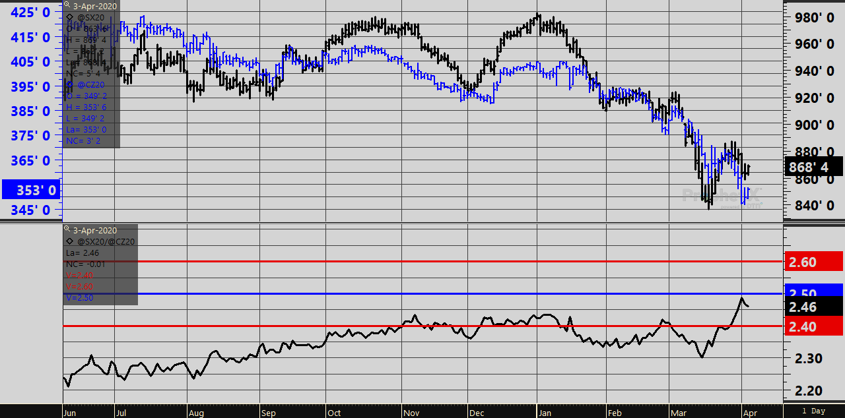
Soybean/Corn Ratio
DTN ProphetX – 04-03-20 am

Slide 22
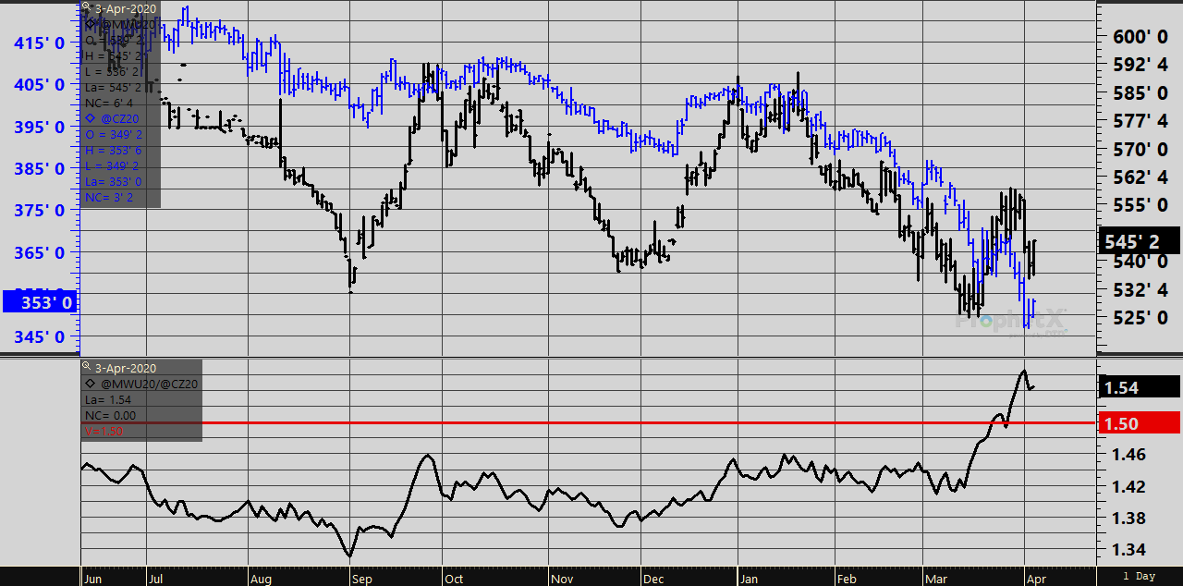
Spring Wheat/Corn Ratio
DTN ProphetX – 04-03-20 am

Slide 23

Livestock Price Situation and Outlook
Tim Petry
Extension Livestock Marketing Economist
Tim.Petry@ndsu.edu
www.ndsu.edu/
livestockeconomics

Slide 24
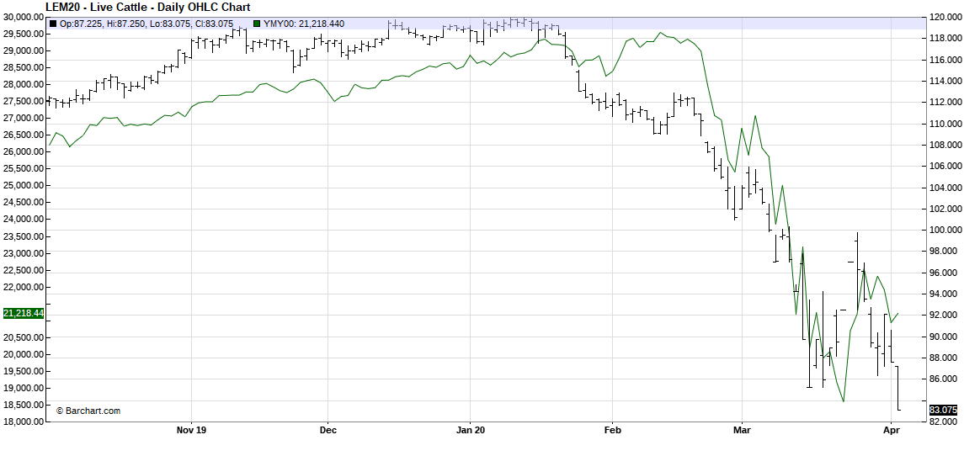
JUN LV CAT & DJIA

Slide 25
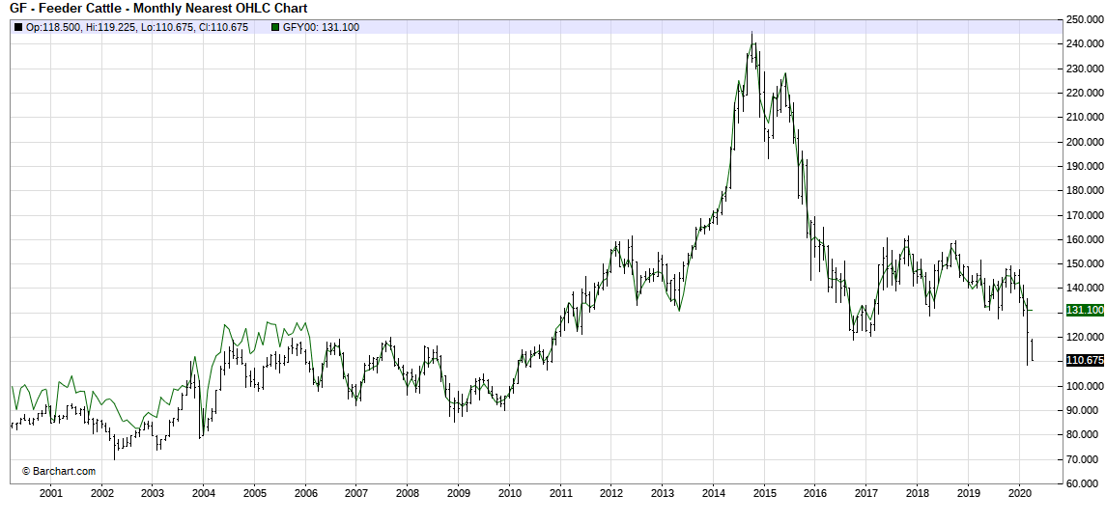
20 YEAR FEEDER CAT FUTURES

Slide 26
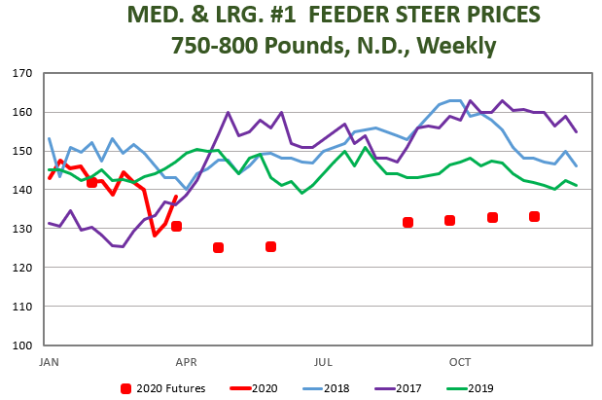
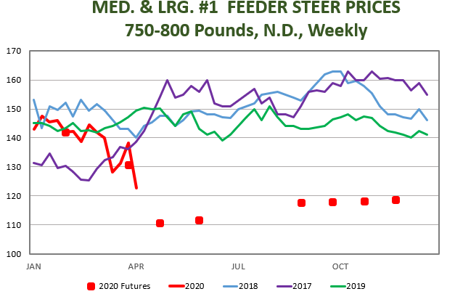

Slide 27

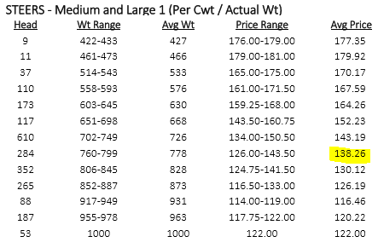
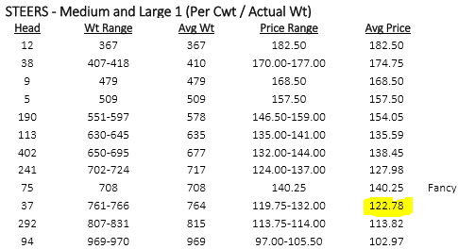

Slide 28
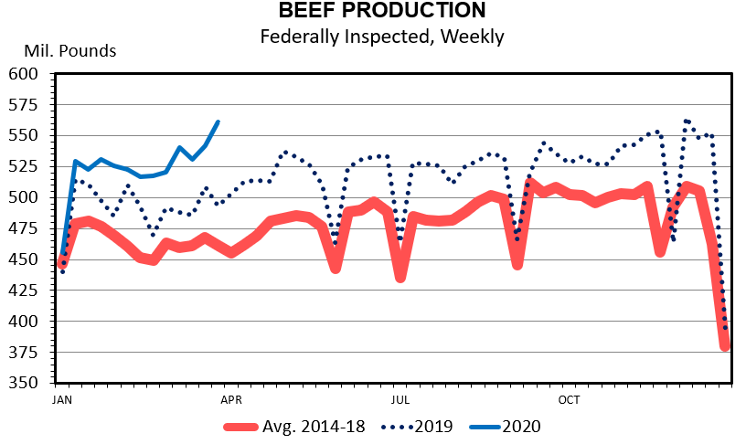
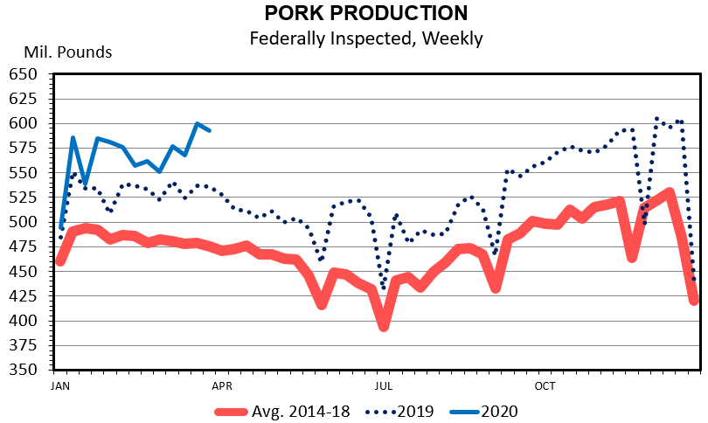

Slide 29
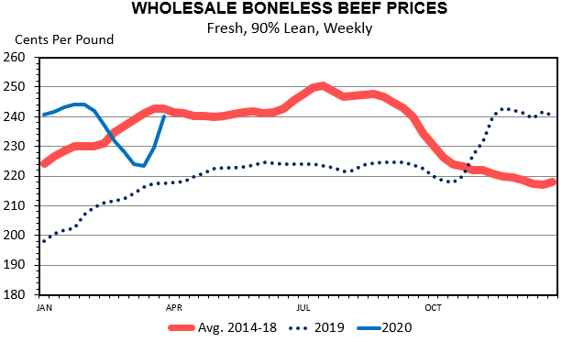
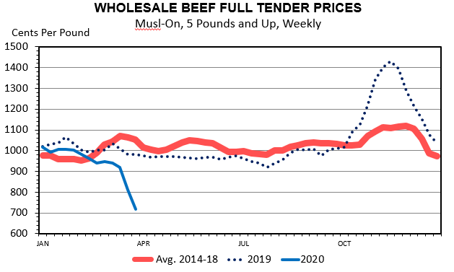

Slide 30
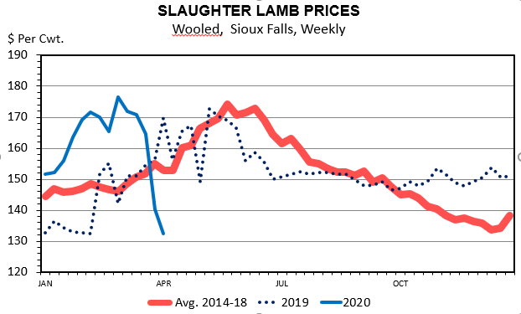

Slide 31

Ag-Energy
Situation and Outlook
David Ripplinger
Bioproducts/Bioenergy Economics Specialist
david.ripplinger@ndsu.edu

Slide 32
Situation
Rapid, large decline in US gasoline and ethanol use
Slower decline in gas and ethanol production
No change in US oil production
Dramatic increase in stocks
Notes:
Storage & something else.
Unemployment
Corn oil
What else…
Ethanol
Oil
Gasoline prices

Slide 33
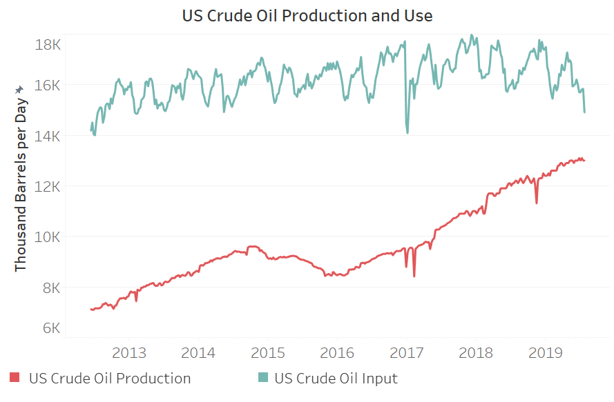
Source: EIA

Slide 34
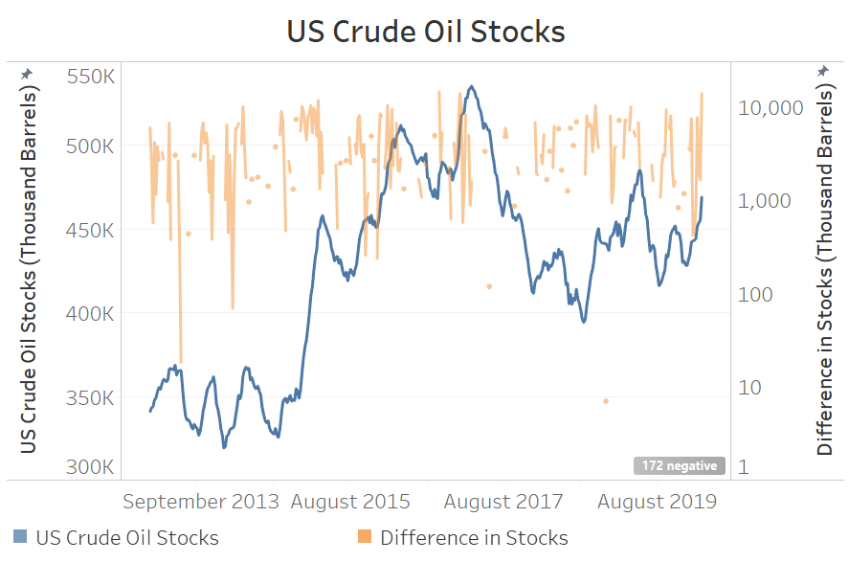

Source: EIA, NDSU Extension Calculations

Slide 35
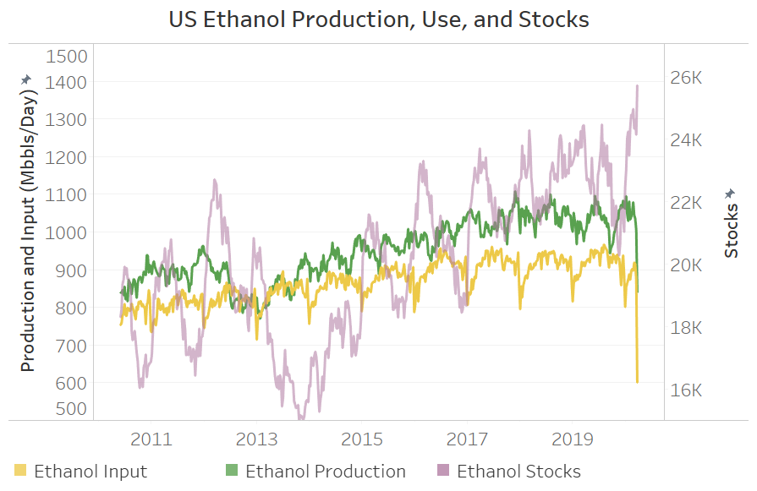
Source: EIA

Slide 36
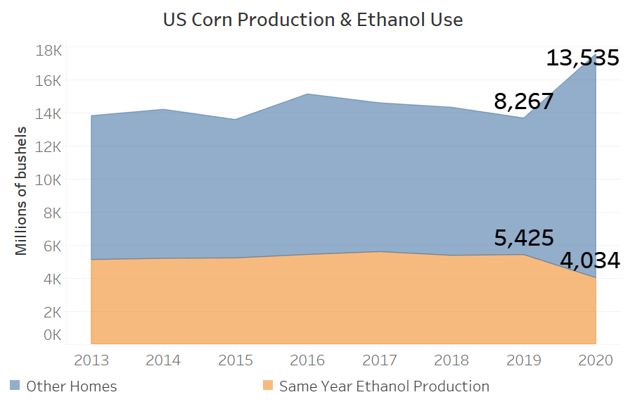
Source: USDA, NDSU Extension Calculations

Slide 37
Recording & More Info:
Q&A: Please use Chat
Feedback: 3 quick questions
https://bit.ly/AgEconCOVID
www.ag.ndsu.edu/extension/economics
www.ag.ndsu.edu/alerts/coronavirus

