Slide 1
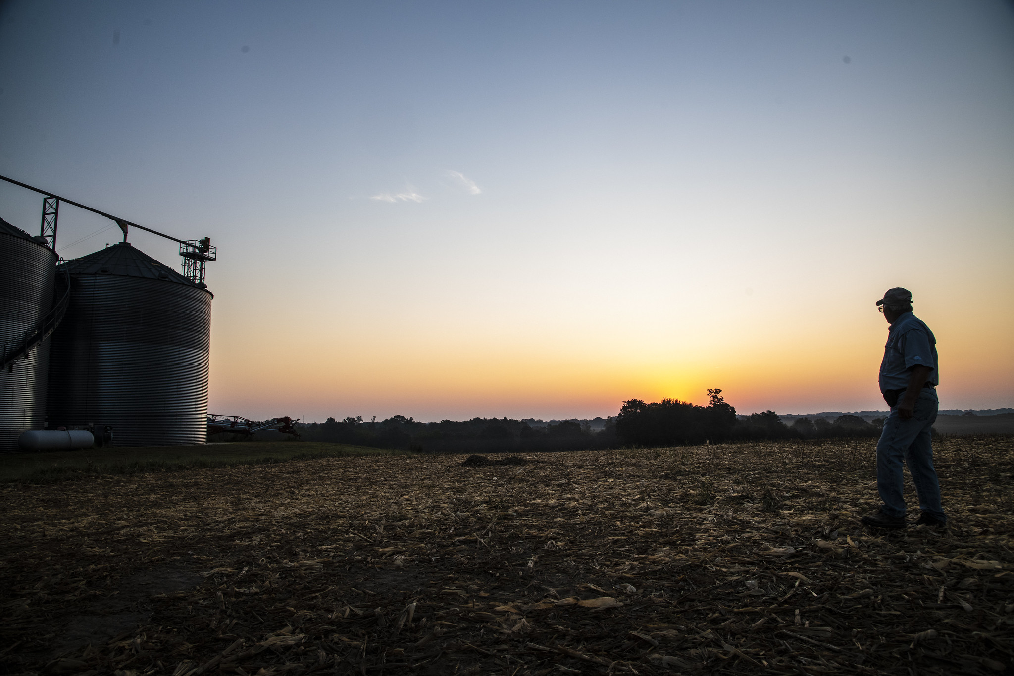
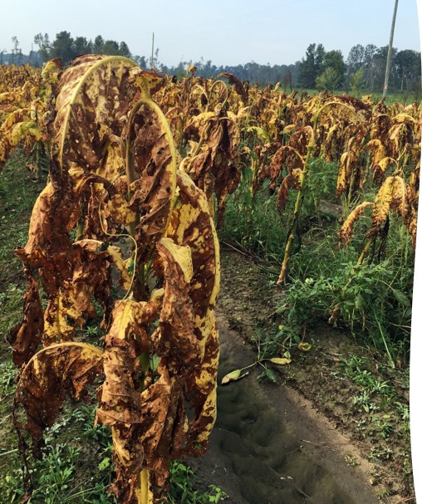
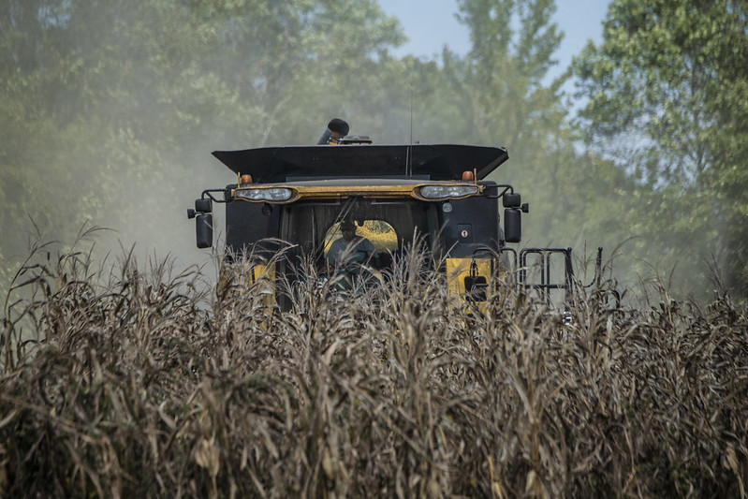
Quality Loss Adjustment Program

Slide 2
Introduction
Laura Heinrich
ND Farm Service Agency
Farm Program Director
laura.heinrich@usda.gov
Notes:
Intro/Housekeeping slide

Slide 3
Agenda
Today’s Discussion
What is the Quality Loss adjustment Program?
Who is eligible and how to apply?
Eligible Crops
  Forage Use
  Non-forage use

Slide 4
Authority and Funding
Quality Loss Adjustment (QLA)
Statutory
The Additional Supplemental Appropriations for Disaster Relief Act of 2019 (Pub. L. 116-20), as amended by the Further Consolidated Appropriations Act of 2020 (Pub. L. 116-94)
Regulatory
7 CFR Part 760, subpart R
Notes:
The authority and funding are authorized under The Additional Supplemental Appropriations for Disaster Relief Act of 2019 as amended by the Further Consolidated Appropriations Act of 2020. Regulations can be found in 7 CFR Part 760, subpart R.
This program differs from others in that payments will not be issued until after the end of the sign-up period. March 5, 2021

Slide 5
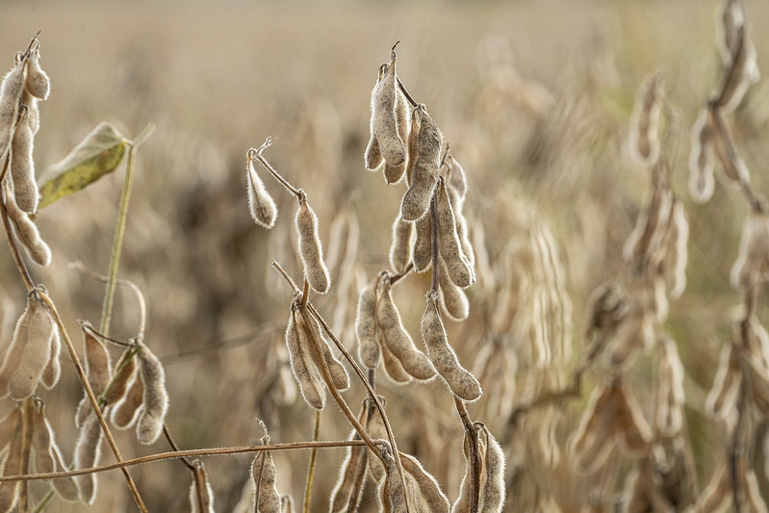
Quality Loss Adjustment (QLA)
Program Goal: Provide assistance for crop quality losses that were a consequence of hurricanes, excessive moisture, floods, qualifying drought, tornadoes, typhoons, volcanic activity, snowstorms, or wildfires occurring in calendar years 2018 and 2019.
Sign up deadline:
March 5, 2021
Notes:
Signup began January 6 continues through March 5, 2021
The goal of QLA is to provide assistance for crop quality losses that were a consequence of eligible disaster events that occurred during calendar years 2018 and 2019.

Slide 6
Eligible Crops
Quality Loss Adjustment (QLA)
Crops for which Federal crop insurance is available or
Crops eligible for coverage in the Noninsured Crop Disaster Assistance Program (NAP), excluding:
  value loss crops
  honey
  maple sap.
Crops that suffered a quality loss due to qualifying disaster event
Crops that incurred a five percent or greater quality discount due to the qualifying disaster event
Crops that incurred a nutrient loss (forage crops)
Crops that may have been sold, fed on-farm to livestock, or may be in storage at the time of application.
Notes:
Eligible crops include:
Crops for which Federal crop insurance or Noninsured Crop Disaster Assistance Program (NAP) is available. This excludes value loss crops such as ginseng, floriculture, Christmas trees, honey, and maple sap.
Crops that suffered a quality loss due to a qualifying disaster event
Crops that incurred a five percent loss due to qualifying disaster event(s)
Forage crops that incurred a nutrient loss
Crops that may have been sold, fed, or stored.

Slide 7
Ineligible Crops
Quality Loss Adjustment (QLA)
Ineligible crops include:
crops not grown commercially
crops intended for grazing
crops not intended for harvest
subsequent crops that do not meet double cropping provisions
volunteer crops
Notes:
Now let's look at what crops are ineligible:
Crops not grown commercially
Crops intended for grazing
Crops not intended for harvest or not harvested
Subsequent crops that do not meet double cropping provisions
volunteer crops

Slide 8
Ineligible Crops (continued)
Quality Loss Adjustment (QLA)
Ineligible crops include:
prevented planting crops
first-year seeding of forage crops
crops that were destroyed, other than by an eligible cause of loss
immature fruit crops
Notes:
Additionally, prevented planted crops, first-year forage seedings, crops that were destroyed other than by an eligible cause of loss and immature fruit crops.

Slide 9
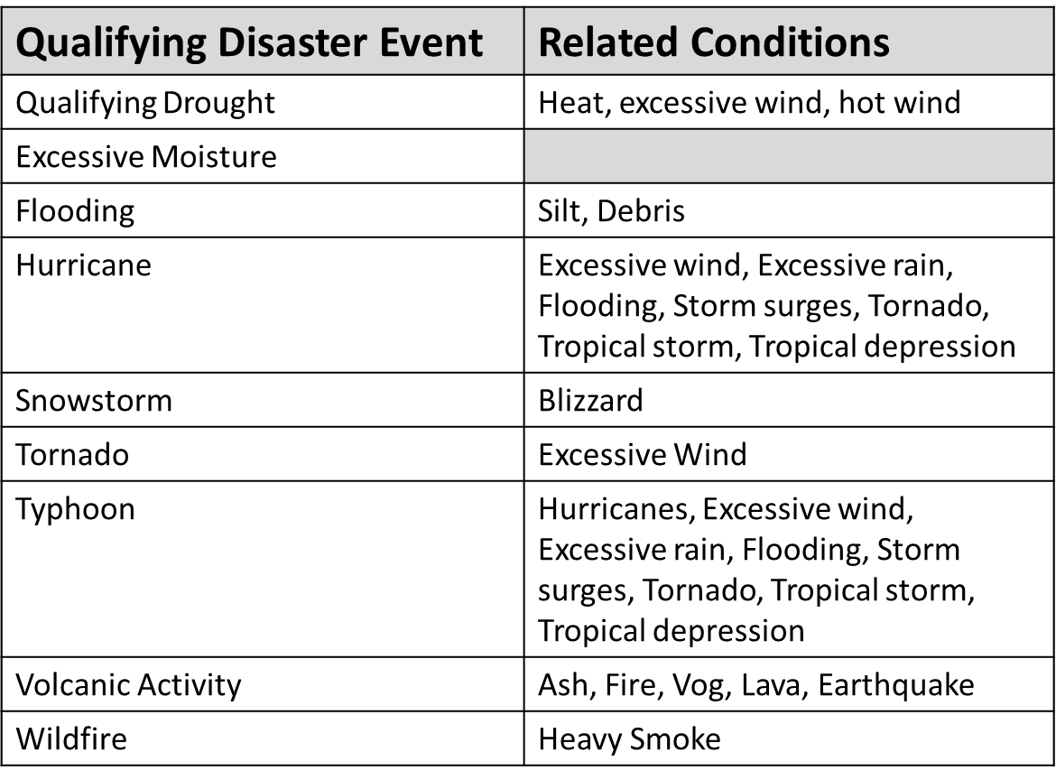
Qualifying Disaster Events
Quality Loss Adjustment (QLA)
Notes:
COCs are responsible for determining whether qualifying disaster event caused the loss based on weather data and knowledge of weather-related losses.
In North Dakota, qualifying disaster events are Qualifying Drought (D3), Excessive Moisture, Flooding, Snowstorm, Tornado and Wildfire.

Slide 10
Qualifying Disaster Events
Quality Loss Adjustment (QLA)
Eligible counties with:
D3 and D4 extreme Drought designations
Presidential Emergency Disaster Declarations or Secretarial Disaster Designations in 2018 and 2019
Listed under the Qualifying Disaster events section of: www.farmers.gov/quality-loss
Note: If a county is not listed the County FSA Committee will require evidence of the qualifying disaster event that affected the crops.
Notes:
Minnesota doesn’t have any counties that met the D3 or D4 extreme drought designations in 2018 or 2019.
North Dakota counties meeting the D3 or D4 designations include, for the 2018 crop year only, Eddy, Foster, McHenry, Nelson, Renville, Ward and Wells. ND doesn’t have any counties that met the D3 or D4 extreme drought designations in 2019.
The list of counties with Presidential or Secretarial disaster designations may be found at the website shown on the slide. If a county is not listed the COC will require evidence of the qualifying disaster event that affected the crops.

Slide 11
Ineligible Causes of Loss
Quality Loss Adjustment (QLA)
Losses:
NOT due to a qualifying disaster event
occurring after harvest
occurring in storage
due to insect infestation
drifting herbicide
failure to follow good farming practices
Notes:
Read slide.

Slide 12
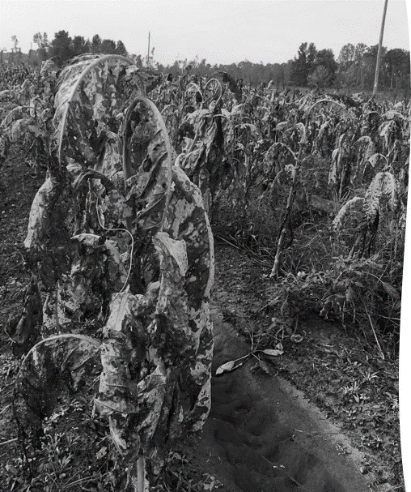
Example:
Quality Loss Adjustment (QLA)
Producer suffered a quality loss on 10,000 bushels of corn for grain due to excessive moisture. The grain suffered additional quality losses prior to harvest from a subsequent hailstorm.
All 10,000 bushels are eligible.
Notes:
Let’s walk through an example: A producer suffered a quality loss on 10,000 bushels of corn for grain due to excessive moisture. The grain suffered additional quality losses prior to harvest from a subsequent hailstorm. In this example all 10,000 bushels are eligible because they suffered a loss due to a qualifying disaster event.
Now let’s look at another example.

Slide 13
Example:
Quality Loss Adjustment (QLA)
Producer suffered a quality loss on 10,000 bushels of corn for grain. Only 1,000 bushels were affected by a qualifying disaster event (excessive moisture). The remaining 9,000 bushels only suffered a loss from hail.
Only the 1,000 bushels affected by a qualifying disaster event are eligible for QLA.
Notes:
A producer suffered a quality loss on 10,000 bushels of corn for grain. Only 1,000 bushels were affected by excessive moisture which is a qualifying disaster event. The remaining 9,000 bushels only suffered a loss from hail.
In this example only 1,000 bushels affected by a qualifying disaster event are eligible for QLA and would be included in the application.

Slide 14
Producer Eligibility
Quality Loss Adjustment (QLA)
An Eligible Producer is a:
US Citizen
Resident alien, also known as “lawful alien”
Partnership consisting solely of citizens of the U.S. or resident aliens
Corporation, Limited Liability Company or other organizational structure organized under State law consisting solely of citizens of the U.S. or resident aliens
Defined as a person or legal entity that is entitled to an ownership share and is at risk in the crop production and marketing associated with the agricultural production of crops on the farm.
.
Notes:
Let’s discuss eligibility
Individuals and entities also must:
• commercially produce the eligible commodities;
• be in the business of farming at the time of application;
• comply with the provisions of the “Highly Erodible Land and Wetland Conservation” regulations, often called the conservation compliance provisions;
comply with the $900,000 AGI provisions which will be explained in a later slide
• if a foreign person, they provides land, capital, and a substantial amount of active personal labor to the farming operation; and
• not have a controlled substance violation.
.

Slide 15
Verifying Producer Eligibility
Quality Loss Adjustment (QLA)
Applicants must be able to show, with verifiable evidence:
they have a valid ownership share and risk in the crop produced; and
control of the crop acreage on which the commodity was grown at the time of the disaster.
Notes:
Applicants must be able to show, with verifiable evidence that they have a valid ownership share and risk in the crop produced; and control of the crop acreage on which the commodity was grown at the time of the disaster.
Producers with crops sold under a contract or a Community Supported Agricultural (CSA) Agreement must provide a copy of the contract or agreement.

Slide 16
Eligibility
Quality Loss Adjustment (QLA)
Adjusted Gross Income and Farm Adjusted Gross Income:
A person or legal entity is ineligible for QLA Program benefits if their AGI exceeds $900,000, unless at least 75 percent of the AGI is derived from farming, ranching or forestry activities.
Notes:
Adjusted Gross Income and Farm AGI rules apply. CCC-941 and CCC-942 (if applicable) are required to be filed if not already on file for the year the application is filed for.
Producers (persons or legal entities) of specified agricultural commodities
• have an average adjusted gross income of less than $900,000; or
• derive at least 75 percent of their adjusted gross income from farming, ranching or forestry-related activities.
For the 2018 application the AGI is calculated using the 3 year average of 2014-2016; for the 2019 application the AGI is calculated using the 3 year average of 2015-2017.
Applicants that sell a crop under a contract or a Community Supported Agricultural (CSA) Agreement must provide a copy of the contract or agreement.
Applicants must also complete form AD 1026, if not already on file, certifying compliance with HELC and WC provisions
Deadline to file the AGI forms, Entity form and Conservation compliance form is within 60 days of signing the application form – form 898 which we’ll discuss shortly.

Slide 17
Payment Limitations
Quality Loss Adjustment (QLA)
$125,000 per person and legal entity
  Limitation applies to each of the program years applied for, 2018 and/or 2019.
Rules for Legal Entities:
Notification of interest
Substantive Changes
Notes:
Now, when it comes to payment limitations for this program:
QLA payments are subject to a per person and legal entity payment limitation of $125,000. This limitation applies to the each of the program years applied.
There are rules that apply for entities.
One of those rules is Notification of interest: Each legal entity must disclose names and tax id numbers of each person or legal entity holding an ownership interest in the payment entity.
Another is Attribution: payments will be attributed down to each member of the payment entity. If at the 4th level ownership the member is another legal entity payments will be reduced for that share.
Substantive change rules apply to QLA payments. Meaning, changes in the farming operation that resulted in the increase in the number of persons to which payment limitation applies must have occurred prior to June 1 of the applicable program year.
Payments made to a joint operation, including a general partnership or joint venture, will not exceed the total of $125,000 multiplied by the number of persons and legal entities included in the ownership of the joint operation.

Slide 18
Linkage Requirement
Quality Loss Adjustment (QLA)
As a condition for QLA benefits, producers are required to purchase crop insurance, or obtain NAP coverage, on the crop for the 2022 and 2023 crop years.
coverage must be purchased at the 60/100 level or equivalent.
linkage applies to all crops receiving a QLA payment.
Notes:
Read slide.
If a producer obtained sufficient coverage in prior years, they may request an exception to the 2022 and 2023 crop years. Requests for exceptions will be reviewed on a case-by-case basis. The following are possible exceptions to the 2022 and 2023 linkage requirement:
Exception Example: A producer received QLA payment for 2019 quality losses on corn. The producer purchased insurance at the 60/100 coverage level for corn in 2021 and 2022. The producer may request an exception to the requirement to purchase crop insurance in 2022 and 2023 based on obtaining coverage in 2021 and 2022.

Slide 19
Linkage Requirement
Quality Loss Adjustment (QLA)
Producers who agreed to obtain crop insurance or NAP coverage for the crop in accordance with the requirements for WHIP+ are considered to have met the requirement to purchase crop insurance or obtain NAP coverage for the QLA Program.
Notes:
Did you sign up for WHIP+ and agreed to meeting linkage at that time? Then you’ve met the linkage requirement if you received a Whip+ benefit on the crop you are applying for. If you are submitting a QLA application for a crop you did not receive a WHIP+ payment for then you are required to agree to meet linkage for QLA for that crop.
If the linkage requirement is not met in the 2022 and 2023 crop years, the producer will receive a letter requesting a refund of QLA Program benefits, plus interest.
If a producer obtained sufficient coverage in prior years, they may request an exception to the 2022 and 2023 crop years. Requests for exceptions will be reviewed on a case-by-case basis. The following are possible exceptions to the 2022 and 2023 linkage requirement:
Exception Example: A producer received QLA payment for 2019 quality losses on corn. The producer purchased insurance at the 60/100 coverage level for corn in 2021 and 2022. The producer may request an exception to the requirement to purchase crop insurance in 2022 and 2023 based on obtaining coverage in 2021 and 2022.

Slide 20
Forms
Quality Loss Adjustment (QLA)
FSA-898- QLA Program Application
FSA 895 – Crop Insurance/NAP Coverage Agreement Form
FSA-899 – Historical Nutritional Value Weighted Average Worksheet (if applicable)
CCC 902- Farm Operating Plan for Payment Eligibility
CCC 941 – Average Adjusted Gross Income (AGI) Certification and Consent to Disclosure of Tax
CCC 942- Certification of Income from Farming, Ranching and Forestry Operations (if applicable)
AD 1026 – HEL and Wetland Determination
FSA- 578 Acreage Report
AD-2106 – Race, Ethnicity and Gender Form (optional)
Notes:
New to USDA, no problem! Ask for help in filling out your application!
If you are a new customer to USDA, your local FSA staff will work with you to establish a record for you which will include asking for this type of information:
Name and address
Personal information, including your Tax Identification Number
Farm operating structure
Adjusted Gross Income compliance certification to ensure eligibility
Direct deposit information to enable payment
The local FSA staff will also be available to answer any questions you may have about completing the QLA application.
Applicants are required to file all eligibility documents (CCC-902, CCC-941, CCC-942, if applicable, and AD-1026) within 60 calendar days from the date of signing FSA-898.
Failure to timely provide the eligibility forms may result in no payment or a reduced payment.

Slide 21
Ways to Apply for QLA
Quality Loss Adjustment (QLA)
Apply online or in the office:
Forms and Online QLA Application Portal available at www.farmers.gov/quality-loss .
Locate your nearest service center here: www.farmers.gov/service-center-locator
Notes:
We offer multiple options to apply for QLA including an online portal. You can submit your application via mail, fax, hand delivery, or electronically. FSA staff at your local USDA Service Center are happy to work with you and here to help!
All USDA Service Centers are open for business by phone, some are open to visitors to conduct business in person by appointment only.
All producers wishing to conduct business with FSA should call ahead and schedule an appointment. Service Centers that are open for appointments will pre-screen visitors based on health concerns or recent travel, and visitors must adhere to social distancing guidelines. Visitors are also required to wear a face covering during their appointment.
The application and needed forms are available on our website: farmers.gov/quality-loss
If you are unfamiliar with where your nearest service center is located, you can find out here: www.farmers.gov/service-center-locator

Slide 22
QLA Payments
Quality Loss Adjustment (QLA)
Crop Categories
Crops intended for forage
Crops other than forage (non-forage)
Notes:
QLA payments will be calculated based on the type of crop – forage or non-forage – and the type of documentation submitted by the producer. Crops intended for forage will not be covered in great detail during this training.

Slide 23
Quality Discounts
Quality Loss Adjustment (QLA)
Quality discounts that are associated with a loss that could have been mitigated, such as high moisture and insect infestation, are NOT eligible.
FSA’s County Committees (COCs) are responsible for determining whether a loss could have been mitigated.
Notes:
The QLA program will consider all quality discounts recognized by the industry - However, quality discounts associated with a loss that could have been mitigated, by following normal farming practices are not eligible.
Since COCs have knowledge of the resources available in the county for producers to use to protect and maintain the crop, the COC is responsible for making the determination as to whether a loss could have been mitigated.

Slide 24
Example:
Quality Loss Adjustment (QLA)
A producer’s corn crop received a quality discount due to high moisture content. Is this producer eligible for the QLA Program?
Losses due to high moisture (for crops that can be dried down) are NOT eligible. The producer could have mitigated that quality loss by using best practices for drying and storing the crop.
Notes:
Read slide

Slide 25
Verifying Quality Loss
Quality Loss Adjustment (QLA)
Verifiable documentation includes records that:
can be verified by FSA through an independent source
will be used to substantiate the amount of quality loss.
be dated
show final disposition
be seasonal or crop-specific for the commodities produced more than once in a calendar year.
Notes:
Quality losses need to be supported by verifiable documentation which may include:
sales receipts from buyers
settlement sheets
truck or warehouse scale tickets
actual measurements or appraisals by FSA, RMA or reinsured companies, loss adjuster’s, or other USDA employees, if performed as part of their work duties, feed company representatives, or State Committee-approved consultants
written sales contracts
similar records that represent actual and specific quality loss information
forage tests for nutrient values.
All affected forage production and historical forage production must be supported by verifiable documentation of the nutritional value.

Slide 26
Verifying Quality Loss
Quality Loss Adjustment (QLA)
Crops other than Forage:
Verifiable documentation must come from tests/analyses conducted within 30 days of harvest.
Exception:
For grain crops that were sold, verifiable documentation at time of sale is acceptable, provided the crop was maintained using best management practices.
Notes:
Verifiable documentation must be dated within 30 days of harvest. There is an exception for grain crops that were sold, verifiable documentation at time of sale is acceptable, provided the crop was maintained using best management practices.
For grain crops, the COC may consider quality documentation tests that are dated beyond 30 days as verifiable if the COC determines the record is representative of the condition of the affected production at the time of harvest

Slide 27
Verifying Quality Loss
Quality Loss Adjustment (QLA)
Forage Crops – Nutritional Value
Forage quality tests, or analysis of nutritional value, must have been completed within 30 days of harvest.
Quality losses for hay and forage crops must be documented with an analysis from either of the following:
    a State University laboratory
    other laboratories approved by State FSA Committee (STC)
Notes:
To be eligible for the QLA Program, the forage test or laboratory analysis must have been completed by a state university laboratory within 30 days of harvest of the forage crop. Other labs may be approved by state committee.
Eligible forage will be broken into high and low nutritional value categories, based on the expected quality for the timing of harvest within the crop year.

Slide 28
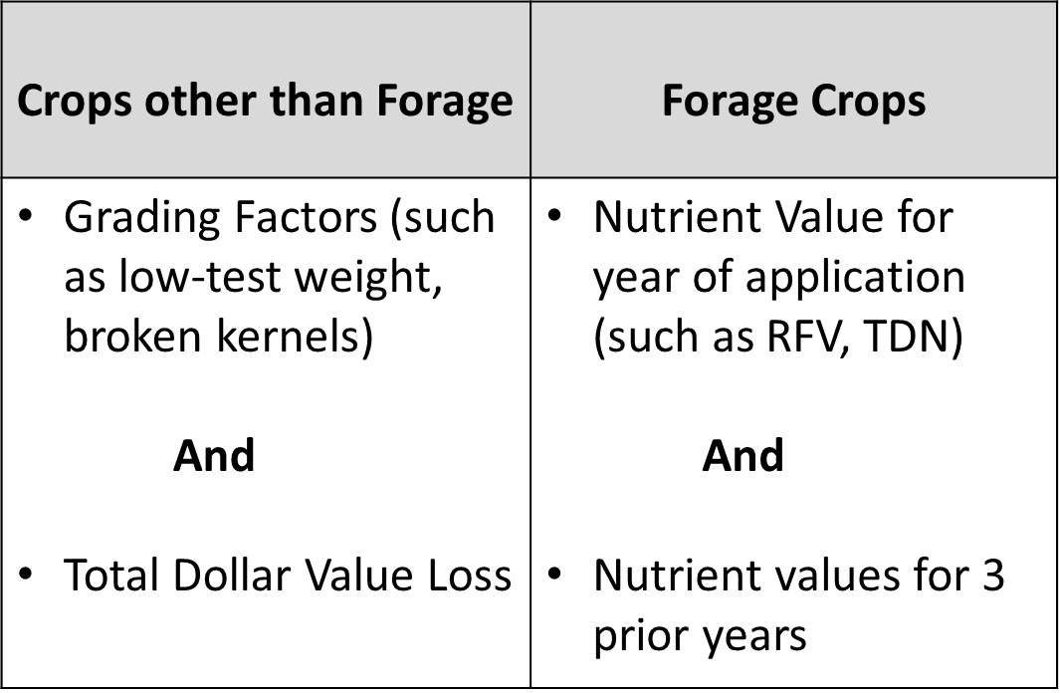
Payment Based on Producer Loss
Quality Loss Adjustment (QLA)
Notes:
In order for the payment to be based on the producer’s individual loss they need to have verifiable documentation of both the grading factors and total dollar value loss.

Slide 29
Example:
Quality Loss Adjustment (QLA)
A producer sold 10,000 bushels of corn. The settlement sheet shows the producer received a reduced price of $2.00 per bushel due to low test weight.
The producer’s verifiable evidence shows both a quality loss (low test weight) and a total dollar value loss of $20,000 (discounted price of $2.00 per bushel x 10,000 bushels of affected production).
Notes:
Let’s look at an example where the payment would be based on the producer’s loss.
A producer sold 10,000 bushels of corn. The settlement sheet shows the price before discount and the reduced price of $2.00/bushel due to low test weight.
The producer’s verifiable evidence shows both a quality loss (low test weight) and a total dollar value loss of $20,000 calculated taking the net number of affected bushels multiplied by the discounted price.

Slide 30
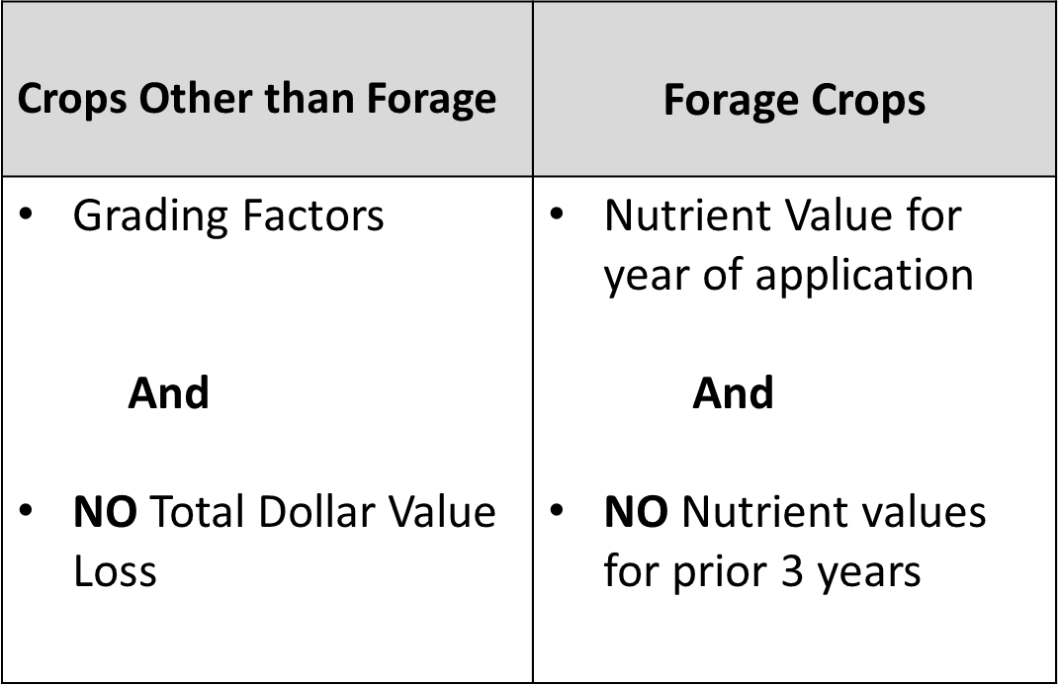
Payment Based on County Average
Quality Loss Adjustment (QLA)
Notes:
For producer’s that have verifiable evidence of grading factors, but no total dollar value loss payments are calculated differently. An example may be stored or fed grain.
Payments will be calculated using the county average percentage of loss based on producers in the county with verifiable evidence of both a quality loss and total dollar loss or percentage of loss due to quality for the same:
physical location
crop
type
intended use and
organic status.
If there are less than 5 producers in the county that applied for QLA benefits for the same crop, type, intended use, and organic status FSA may:
use data from a contiguous county, if available
determine the loss is ineligible.
Let’s look at an example.

Slide 31
Example:
Quality Loss Adjustment (QLA)
A producer delivered 10,000 bushels of corn. The scale ticket shows the corn had a quality discount due to broken kernels. The producer did not sell the corn but stored it for feed.
The producer’s verifiable evidence shows a quality loss (broken kernels) but no total dollar loss due to quality.
Notes:
A producer delivered 10,000 bushels of corn. The scale ticket shows the corn had a quality discount due to broken kernels, however the producer did not sell the corn but stored it for feed.
The producer has grading factor but no total dollar value loss. This payment would be based on the county average loss.

Slide 32
Crops Other than Forage –
Non-Forage Crops
Quality Loss Adjustment (QLA)
These crops will include:
All crops not intended for Forage
Any crop with an intended use other than Forage
Producers must have suffered a loss due to quality with verifiable grading factors directly related to a qualifying disaster event.
Notes:
Examples of crops other than forage include Corn intended for Grain, Soybeans intended for Grain, or Pumpkins intended for Fresh harvest.

Slide 33
Non-Forage Crops
Quality Loss Adjustment (QLA)
Affected production is the producer’s ownership share of harvested production, adjusted to standard moisture, of an eligible crop that experienced both:
a quality loss due to a qualifying disaster event
at least a 5 percent quality loss due to all eligible disaster events combined.
Affected production must have suffered a loss due to quality and have verifiable quality factors (grading factors).
Notes:
Affected production is the producer’s ownership share of harvested production, adjusted to standard moisture, of an eligible crop that experienced both a quality loss due to a qualifying disaster event and at a least a 5 percent quality loss due to all eligible disaster events combined.
Affected production includes all production that had a quality loss regardless of percent of loss. The 5% threshold will be based on the overall affected average loss of a crop, crop type, intended use, and organic status by county. Affected production does not include production that had no quality loss.

Slide 34
Non-Forage Crops
Quality Loss Adjustment (QLA)
Verifiable Documentation Records:
sales receipts from buyers
settlement sheets
truck or warehouse scale tickets
actual measurements or appraisals by FSA, RMA or reinsured companies, LA’s, other USDA employees, if performed as part of their work duties, feed company representatives, or STC-approved consultants
Notes:
Verifiable records can include sales receipts from buyers, settlement sheets, truck or warehouse scale tickets, measurement services performed by FSA employees, crop insurance companies or RMA, Loss adjusters, and others listed on this slide. They can also include written sales contracts, or any records that represent the quality loss information

Slide 35
Non-Forage Crops – Acceptable Records
Quality Loss Adjustment (QLA)
The quantity of affected production claimed on the application must be supported with non-verifiable records of production, which may include:
Copies of receipts
Ledgers of income
Income statements of deposit slips
Cash register tapes
Invoices for custom harvesting
U-pick records
Notes:
Acceptable records can also include non-verifiable records. These are used to support the quantity of affected production claimed on the FSA-898 and are acceptable when verifiable records are not available.
The producer must provide any documentation available, including records such as copies of receipts, ledgers of income, bank deposit slips or income statements, cash register tapes, invoices, and u-pick records.
Non-verifiable documentation must identify the:
amount of production
date of harvest.

Slide 36
Non-Forage Crops – Acceptable Records
Quality Loss Adjustment (QLA)
Producers that suffered a quality loss will fall into two categories regarding verifiable documentation:
Grading factors and a total dollar value loss based on their own, individual loss.
Grading factors but no total dollar value loss amount of the discount they received.
Notes:
As we mentioned earlier, the FSA-898 will be completed based on what type of acceptable records the producer provides to support their claimed quality loss. This will also determine how their payment is calculated.
All producers that have crops other than forage, will either have verifiable records of their total dollar value loss and complete Part D of the FSA-898 , or they will have no verifiable records of their total dollar value loss and will complete Part E of the FSA-898.

Slide 37
Non-Forage Crops – Verifiable Documentation of Total Dollar Value Loss
Quality Loss Adjustment (QLA)
Example: Lucy certifies to 100,000 bushels of affected corn due to drought in 2019. Corn price before discount is $4/bushel. The discounted price received was $3/bushel due to low test weight ($1/bushel discount).
Therefore, Lucy’s total dollar value loss amount is $100,000 calculated as follows:
100,000 X $4 = $400,000
minus 100,000 X $3 = $300,000
$100,000
Notes:
So lets walk through a very simple example of the total dollar value loss amount or discount.
In our example above, Miss Lucy certifies that she has 100,000 bushels of affected corn due to drought conditions in 2019. The commodity price of corn on the date of sale was $4/bushel. Because of low test weight, Miss Lucy actually received $3/bushel, $1 dollar per bushel less than commodity price.
If Miss Lucy would have received full price for her 100,000 bushels of affected corn, she would have received $400,000. However, due to the grading factors that resulted in her discount she received $300,000. Therefore, Miss Lucy’s total dollar value loss amount is $100,000

Slide 38
Non-Forage Crops – Verifiable Documentation of Total Dollar Value Loss
Quality Loss Adjustment (QLA)
Payment will be based on producer’s loss if verifiable documentation has both Grading Factors (such as low-test weight, broken kernels) and Total Dollar Value Loss. The payment calculation will be:
Total dollar value loss x 70% (QLA program factor)
Example: To calculate Miss Lucy’s payment, we would multiply her total dollar value loss by 70% ($100,000 x 70%) to get a QLA program payment of $70,000.
Note: The payment may be further reduced if sufficient funds are not available.
Notes:
So lets walk through a very simple example of the total dollar value loss amount or discount.
In our example above, Miss Lucy certifies that she has 100,000 bushels of affected corn due to drought conditions in 2019. The commodity price of corn on the date of sale was $4/bushel. Because of low test weight, Miss Lucy actually received $3/bushel, $1 dollar per bushel less than commodity price. If Miss Lucy would have received full price for her 100,000 bushels of affected corn, she would have received $400,000. However, due to the grading factors that resulted in her discount she received $300,000. Therefore, Miss Lucy’s total dollar value loss amount is $100,000
Payment calculation will be Total dollar value loss x 70% (QLA program factor). Miss Lucy had a $100,000 total dollar value loss x 70% = $70,000 payment. The payment may be further reduced if sufficient funds are not available.

Slide 39
Non-Forage Crops – Without Verifiable Documentation of Total Dollar Value Loss
Quality Loss Adjustment (QLA)
Payments for Non-Forage Crops without Total Dollar Value Loss are determined using the following calculation:
Total Affected Production, multiplied by,
County Weighted Average Dollar Value on Affected Production,
Loss Amount, multiplied by
70% payment factor, multiplied by
50%

Slide 40
Non-Forage Crops – Without Verifiable Documentation of Total Dollar Value Loss
Quality Loss Adjustment (QLA)
Example - Producer Jimmy:
  Had 80 acres of wheat that yielded 65 bushels per acre for a total of 5,200 bushels of durum wheat.
  certified he had 1,200 bushels that had a quality loss due to falling numbers that was due to an eligible weather event.
  certified he had the wheat sampled and tested for quality, and he has the verifiable documentation that supports the quality loss; however, Jimmy did not have a price before the discount for the crop.

Slide 41
Non-Forage Crops – Without Verifiable Documentation of Total Dollar Value Loss
Quality Loss Adjustment (QLA)
Example (Continued):
After sign-up ended it was determined that the Average Dollar Value Loss on Affected Production for durum wheat intended for grain conventionally planted was $1.10. This was based on the applications filed with Crops Sold with Verifiable Total Dollar Value Loss.
It was further determined that Price for durum wheat intended for grain conventionally planted was $6.00. This was based on weighted average of applications filed with Crops Sold with Verifiable Total Dollar Value Loss.
$1.10 divided by $6.00 results in a calculated percentage of loss of 18.33 percent.

Slide 42
Non-Forage Crops – Without Verifiable Documentation of Total Dollar Value Loss
Quality Loss Adjustment (QLA)
Example (Continued):
Because the loss was calculated at 18.33 percent, which is greater than the 5 percent threshold, Jimmy qualifies for the following payment:
1,200 bushels (Total Affected Production), multiplied by
$1.10 (Average Dollar Value Loss on Affected Production), equals
$1,320.00 (Loss Amount), multiplied by
70 percent Payment Factor, multiplied by
50 percent, equals
$462 Gross Estimated Payment
Note: This amount may be factored based on availability of funds after sign-up ends.

Slide 43
Non-Forage Crops
Completing an Application - Example 1
Quality Loss Adjustment (QLA)
MacDonald Farm & Transport Inc has sold 1882.7 bushels of wheat for grain. 1082.84 bushels had a quality loss due to falling number, protein, and vomitoxin due to excessive moisture that occurred between May 1, 2019 and September 30, 2019.
MacDonald Farm & Transport Inc also has 1500 bushels in storage. They certified that these bushels also have quality losses due to falling numbers, protein, and vomitoxin resulting from excessive moisture.
Notes:
Read slide.

Slide 44
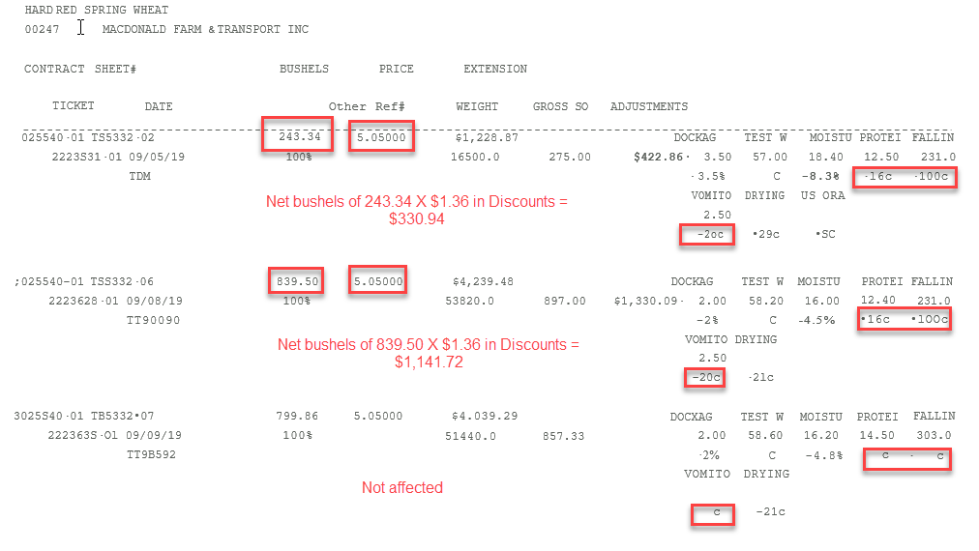
Quality Loss Adjustment (QLA)
Notes:
In reviewing the settlement sheet, the producer identified 2 loads of wheat that had qualifying quality losses due to protein, falling numbers, and vomitoxin.
Add the factors for those 3 factors together and multiply by the net bushels. For the first load there was a $1.36/bu discount resulting in a $330.94 quality deductions.
The second load had a $1,141.72 quality loss.
The third load was not affected so will not be included in the application.
Now let’s go to the application.

Slide 45
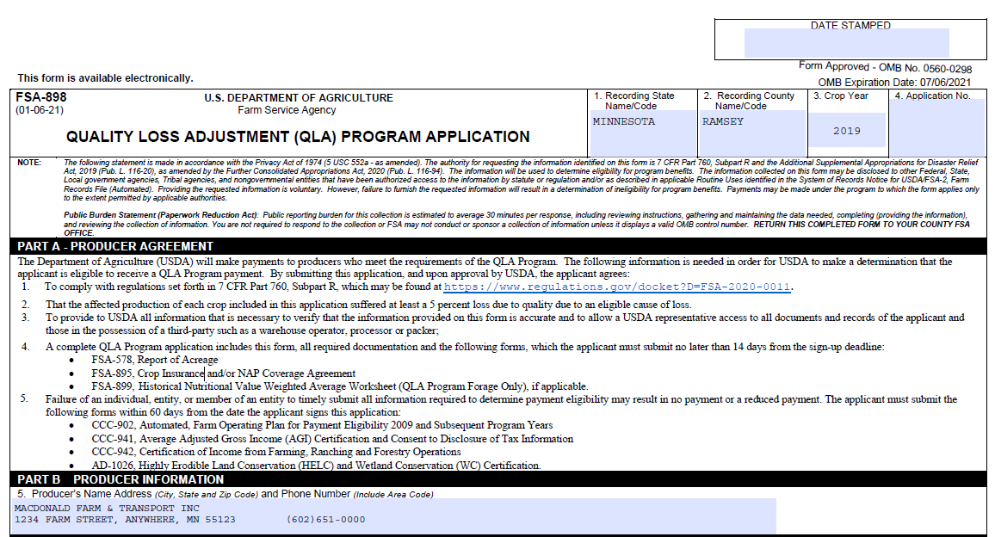
Quality Loss Adjustment (QLA)
Notes:
Complete Part B with name, address, and phone number.

Slide 46
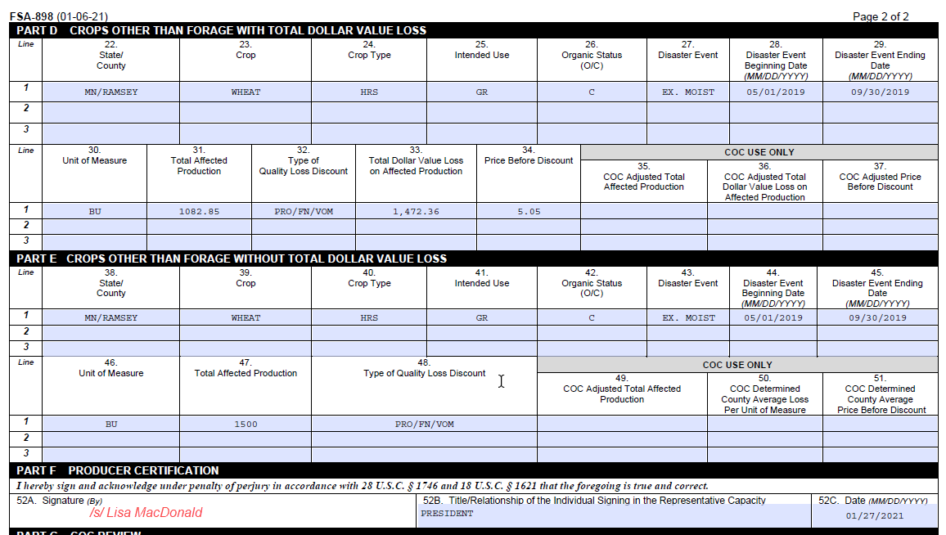
Quality Loss Adjustment (QLA)
Notes:
In Part D you are going to load the bushels that were sold and had a discount loss.
Box 22 - indicate the physical state/county where the affected crop was produced.
Box 23 – the crop – Wheat
Box 24 – crop type – HRS for Hard Red Spring
Box 25 – Intended use – grain
Box 26 – organic status – this crop was grown conventionally
Box 27 – indicate the disaster event – excessive moisture
Box 28 -29 – Disaster beginning and end dates 5/1-9/30/19
Box 30 – unit of measure – bushels
Box 31 – Total affected production – 1082.85 bushels that is the total net bushels of the 2 loads that were affected by quality
Box 32 – Type of Quality Loss/Discount – List discounts being claimed – protein, falling numbers, and vomitoxin.
Box 33 – Total Dollar Value Loss on Affected Production – total of the discounts we calculated on the assembly sheet$1472.66
Box 34 – the grain was priced at $5.05 as indicated on the settlement sheet
In Part E we are going to include production stored at home that had the same quality losses.
Box 38 – physical state/county where grown
Box 39 – crop – Wheat
Box 40 – crop type – HRS Hard Red Spring
Box 41 – Intended use – grain
Box 42 – Organic status – this crop was conventional
Box 43-45 – Disaster event and dates - Excessive moisture that occurred between May 1st and September 30th of 2019.
Box 46 – unit of measure – bushels
Box 47 – Total affected production – 1500 bushels
Box 48 – Type of quality discount – protein, falling numbers, and vomitoxin.
In Part F Producer Certification
Signature, representative capacity and date signed

Slide 47
Non-Forage Crops
Completing an Application - Example 2
Quality Loss Adjustment (QLA)
Farmer Joe has sold 19,546.43 bushels of corn for grain. All 19,546.43 bushels had a quality loss due to test weight and broken kernel/foreign matter due to excessive moisture that occurred between January 1, 2019 and December 31, 2019.
Notes:
Read slide.

Slide 48
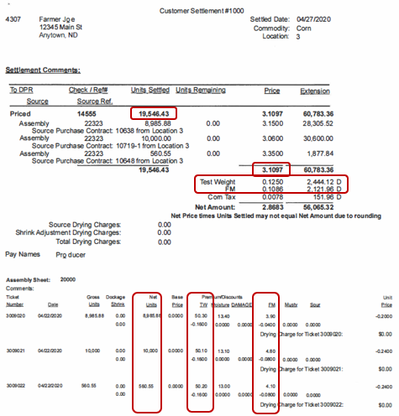
Quality Loss Adjustment (QLA)
Notes:
In reviewing the settlement sheet, the producer identified all loads of corn that had qualifying quality losses due to low test weight and foreign matter.
Add the total loss for each quality loss together for the total dollar value loss for the application - $4566.08.
Now let’s go to the application.

Slide 49
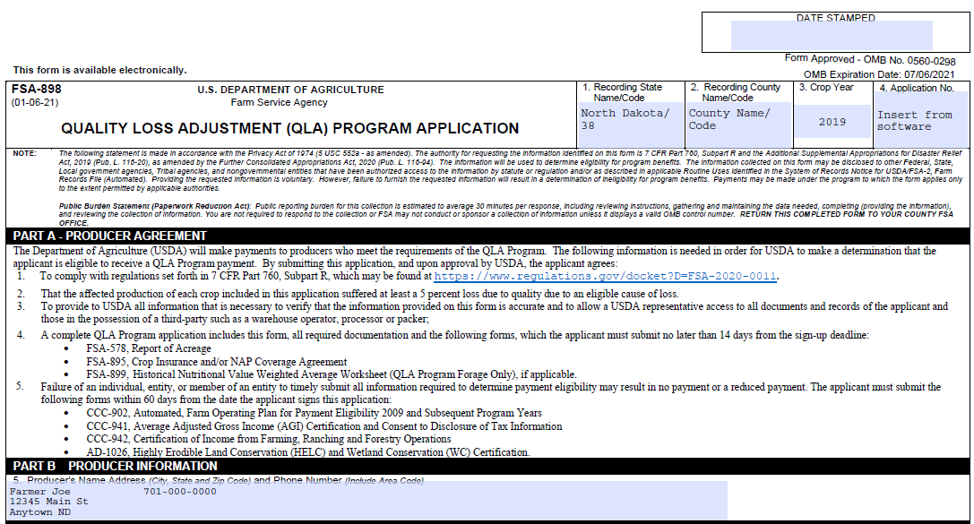
Quality Loss Adjustment (QLA)
Notes:
In Part D you are going to load the bushels that were sold and had a discount loss.
Box 22 - indicate the physical state/county where the affected crop was produced.
Box 23 – the crop – Wheat
Box 24 – crop type – HRS for Hard Red Spring
Box 25 – Intended use – grain
Box 26 – organic status – this crop was grown conventionally
Box 27 – indicate the disaster event – excessive moisture
Box 28 -29 – Disaster beginning and end dates 5/1-9/30/19
Box 30 – unit of measure – bushels
Box 31 – Total affected production – 1082.85 bushels that is the total net bushels of the 2 loads that were affected by quality
Box 32 – Type of Quality Loss/Discount – List discounts being claimed – protein, falling numbers, and vomitoxin.
Box 33 – Total Dollar Value Loss on Affected Production – total of the discounts we calculated on the assembly sheet$1472.36
Box 34 – the grain was priced at $5.05 as indicated on the settlement sheet
In Part E we are going to include production stored at home that had the same quality losses.
Box 38 – physical state/county where grown
Box 39 – crop – Wheat
Box 40 – crop type – HRS Hard Red Spring
Box 41 – Intended use – grain
Box 42 – Organic status – this crop was conventional
Box 43-45 – Disaster event and dates - Excessive moisture that occurred between May 1st and September 30th of 2019.
Box 46 – unit of measure – bushels
Box 47 – Total affected production – 1500 bushels
Box 48 – Type of quality discount – protein, falling numbers, and vomitoxin.
In Part F Producer Certification
Signature, representative capacity and date signed

Slide 50
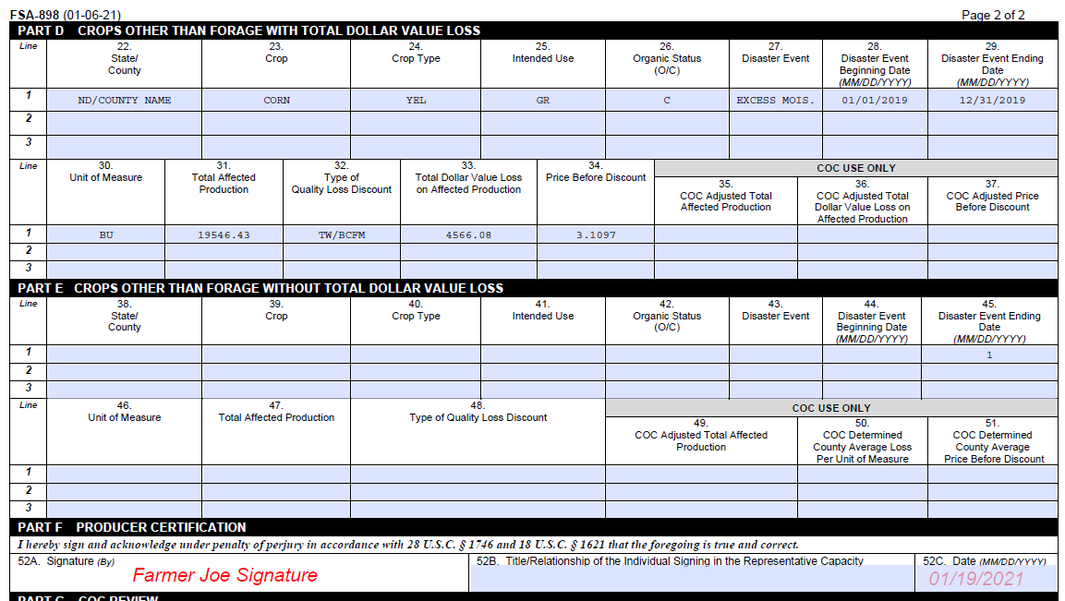
Quality Loss Adjustment (QLA)
Notes:
In Part D you are going to load the bushels that were sold and had a discount loss.
Box 22 - indicate the physical state/county where the affected crop was produced.
Box 23 – the crop – Corn
Box 24 – crop type – YEL for Yellow
Box 25 – Intended use – grain
Box 26 – organic status – this crop was grown conventionally
Box 27 – indicate the disaster event – excessive moisture
Box 28 -29 – Disaster beginning and end dates 1/1-12/31/19
Box 30 – unit of measure – bushels
Box 31 – Total affected production – 19,546.43 bushels that is the total net bushels of the settlement sheet that were affected by quality
Box 32 – Type of Quality Loss/Discount – List discounts being claimed – TW, broken kernels/foreign matter (BCFM).
Box 33 – Total Dollar Value Loss on Affected Production – total of the discounts we calculated on the settlement sheet $4,566.08
Box 34 – the grain was priced at $3.1097 as indicated on the settlement sheet
In Part F Producer Certification
Signature, representative capacity and date signed

Slide 51
Forage Crops – Nutritional Value
Quality Loss Adjustment (QLA)
Forage quality tests, or analysis of nutritional value, must have been completed within 30 days of harvest.
Quality losses for hay and forage crops must be documented with an analysis from either of the following:
    a State University laboratory
    other laboratories approved by State FSA Committee (STC)
Notes:
To be eligible for the QLA Program, the forage test or laboratory analysis must have been completed by a state university laboratory within 30 days of harvest of the forage crop. Other labs may be approved by state committee.
Eligible forage will be broken into high and low nutritional value categories, based on the expected quality for the timing of harvest within the crop year.

Slide 52
Forage Crops – Nutritional Value
Quality Loss Adjustment (QLA)
Eligible forage will be broken into high and low nutritional value categories, based on the expected quality for the timing of harvest within the crop year.
Notes:
To put this simply, it will be based on the cutting. This is a producer certification. Note: If there is typically only one harvest for the crop within the year, it will be categorized as high quality

Slide 53
Example:
Quality Loss Adjustment (QLA)
Producer Sumrall routinely harvests 5 cuttings of alfalfa each year. The first and last cuttings are generally lower in quality, while the second, third, and fourth cuttings are higher quality. Sumrall suffered a loss due to drought in 2018 at a time that a fourth cutting would typically be harvested. Sumrall would use the representative laboratory analyses for the second, third, and fourth cuttings to determine the nutritional values as high nutritional category.

Slide 54
Documenting Historical Nutritional Value
Quality Loss Adjustment (QLA)
A producer must have:
4 years of nutritional values representing either high or low nutritional value categories, 1 for the year of application and 3 historical years, AND
must provide both production and historical nutritional value of the specific crop, type, intended use, and organic status using the FSA-899.
Notes:
The comparison for determining quality loss can be made one of 3 ways. We will use the FSA-899 to document the producer’s own historical nutritional values by category, or for a new producer, the farm’s historical nutritional values by category with 3 years of historical data.
When the producer has verifiable documentation of the application year nutritional value, but no historical value, a weighted average of submitted applications in the county will be used to determine the percent of quality loss for the crop, type, intended use, organic status, and nutritional category.

Slide 55
Documenting Historical Nutritional Value
Quality Loss Adjustment (QLA)
The 3 years of historical values will be broken into high and low nutritional value categories to be placed on the FSA-899.
The producer will submit historical nutritional values that are representative of the application year based on the timing and number of harvests within the year.
Notes:
Read slide.
If there is typically only one harvest for the crop within the year, it will be categorized as high quality.

Slide 56
Example:
Quality Loss Adjustment (QLA)
Producer Lowe submitted an application for 2018 due to drought in an eligible county. Lowe will provide verifiable documentation of nutritional value and acceptable documentation of production for 2015, 2016, and 2017 to calculate the weighted average historical nutritional value, and 2018 verifiable documentation for the application year nutritional value and acceptable documentation of affected production.
Notes:
In this example we are comparing the same category of nutritional values, we need to specify that on the FSA-899, which I will show you next. If we refer back to our example once again, producer Lowe is going to provide the production and lab tests for 2015, 2016 and 2017 for the 2nd 3rd and 4th cuttings for the FSA-899.

Slide 57
Forage Crops with Application Year and Historical Nutritional Values
Quality Loss Adjustment (QLA)
QLA Payment = Total Affected Production x
Verifiable % Loss x Average Market Price x 0.7
Note: The payment may be further reduced if sufficient funds are not available.
Notes:
The QLA payment calculation for producers with historical nutritional values is calculated by taking the total affected production for the year of application multiplied by the verifiable % loss, then multiplied by the average market price, and factored by .7. This would calculate the estimated payment, but subject to funding could be factored again.
Note: The Average Market Price is set by the State FSA Committee and is the same price used for the Noninsured Assistance Program (NAP)

Slide 58
Example:
Quality Loss Adjustment (QLA)
Producer Jordan had 800 acres of alfalfa that yielded 4 tons per acre for a total of 3,200 tons of hay. Jordan certified 800 tons of alfalfa that had a quality loss due to excessive moisture occurring June 1, 2019, through August 31, 2019, that was fed to livestock. Jordan produces high quality alfalfa hay and tests for quality annually.
Notes:
Let’s look at a more detailed example. – Read slide.

Slide 59
Example:
Quality Loss Adjustment (QLA)
Example (Continued):
Jordan completed the Historical Nutritional Value Weighted Average Worksheet (FSA-899) for 2016, 2017, and 2018 to find the Weighted Historical Nutritional Value was 116. Jordan certified that in 2019 there was verifiable documentation that supported an application year Nutritional Value of 80.

Slide 60
Example:
Quality Loss Adjustment (QLA)
Example (Continued):
Jordan’s Calculated Verifiable Percentage of Nutrient Loss was determined to be 31.03 percent (1 minus [80 divided by 116]).
Because Jordan’s loss of 31.03 percent at least met the 5 percent loss threshold, Jordan qualifies for the following payment:

Slide 61
Example:
Quality Loss Adjustment (QLA)
800 tons (Total Affected Production), multiplied by
31.03 percent (Calculated Verifiable Percentage of Nutrient Loss), multiplied by
$125 (determined price for the commodity), equals
$31,030 (Loss Amount), multiplied by
70 percent Payment Factor, equals
$21,721.00 Gross Estimated Payment
Note: This amount may be factored based on availability of funds after sign-up ends

Slide 62
Forage Crops with only Application Year Nutritional Values (No historical nutrient values)
Quality Loss Adjustment (QLA)
The county average percent of loss for each crop, type, intended use, organic status and nutritional category will be computed after all applications within the county have been submitted and reviewed.
An additional reduction of 50 percent will apply to the producer’s computed benefit.
Notes:
For applications with year of application nutritional values only, and if less than 5 producers in the county receive a payment for the same crop, crop type, intended use, organic status, and nutritional value, DAFP may elect to determine the county average based on the best available data, or may elect not to issue payment.

Slide 63
Forage Crops Without Historical Nutritional Value Payment Calculations
Quality Loss Adjustment (QLA)
QLA Payment = Total Affected Production x
County Average % Loss x Average Market Price x 0.7 x 0.5
The average market price is determined by USDA’s Farm Service Agency.
Note: The payment may be further reduced if sufficient funds are not available.
Notes:
For forage crops with verifiable documentation of nutrient factors for the affected production for the year of application but no historical nutrient factors for the three preceding crop years, the following payment equation will be used.
Total affected production X county average % loss X average market price X .7 and reduced again by 50%.

Slide 64
Example:
Quality Loss Adjustment (QLA)
Producer Jody had 800 acres of legume/grass mixed forage conventionally grown for forage that yielded 4 tons per acre for a total of 3,200 tons hay. Jody certified to 400 tons of mixed forage that had a quality loss due to excessive moisture on July 1, 2019, that was fed to livestock. Jody had a quality test done on the 400 tons and had produced hay in the prior years but was unable to provide a verifiable forage test for the historical years.
Notes:
Now let’s look at an example of a producer with no historical forage test information. Read slide.

Slide 65
Example:
Quality Loss Adjustment (QLA)
After sign-up was finished, it was determined that the Weighted Average percent of loss for legume, grass mixed forage conventionally grown for forage in the high tier nutritional category was 25 percent, which was greater than the 5 percent threshold, so Jody qualifies for the following payment:

Slide 66
Example:
Quality Loss Adjustment (QLA)
400 tons (Total Affected Production), multiplied by
25 percent (Weighted Average Percentage of Loss), multiplied by
$90 (determined price for the commodity), equals
$9,000.00 (Loss Amount), multiplied by
70 percent Payment Factor, multiplied by
50 percent, equals
$3,150.00 Gross Estimated Payment
Note: This amount may be factored based on availability of funds after sign-up ends

Slide 67
Completing Application
Quality Loss Adjustment (QLA)
Sue submits an application for 2018 due to drought in an eligible county. Sue provides verifiable documentation of nutritional value and acceptable documentation of production for 2015, 2016, and 2017 to calculate the weighted average historical nutritional value, and 2018 verifiable documentation for the application year nutritional value and acceptable documentation of affected production.
Sue also provides records to show the quantity of production.

Slide 68
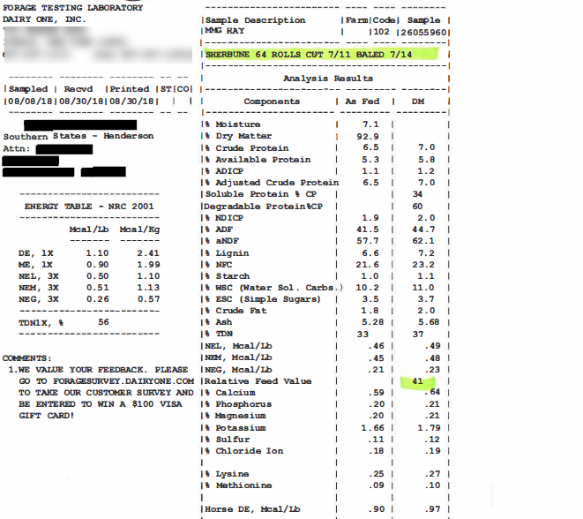
2018 RFV (Application Year Analysis - 2018 crop year)
Notes:
Assuming this laboratory test has all required data on it, for 2018 the Relative Feed Value (RFV) value is 41.
This example is using RFV as the standard nutritional value for measuring forage quality. Total Digestible Nutrients (TDN) can also be used as the standard nutritional value for measuring forage quality.

Slide 69
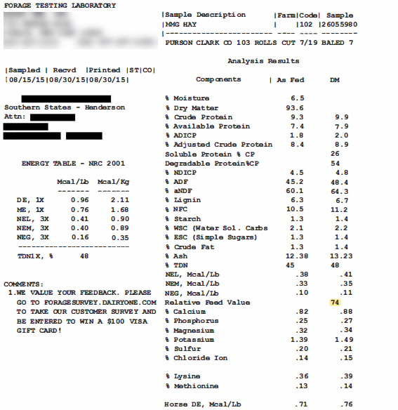
2015 RFV
Notes:
The RFV value for 2015 is 74

Slide 70
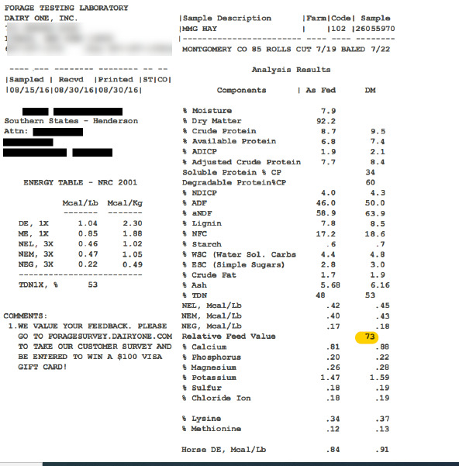
2016 RFV
Notes:
The RFV value for 2016 is 73

Slide 71
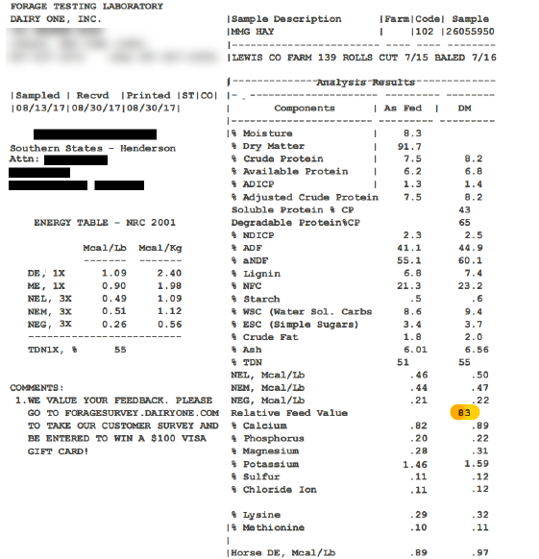
2017 RFV
Notes:
The 2017 RFV value is 83. So now Sue will complete the FSA-899 Historical Weighed Nutritional Value Weighted Average Worksheet using the data she has provided.

Slide 72
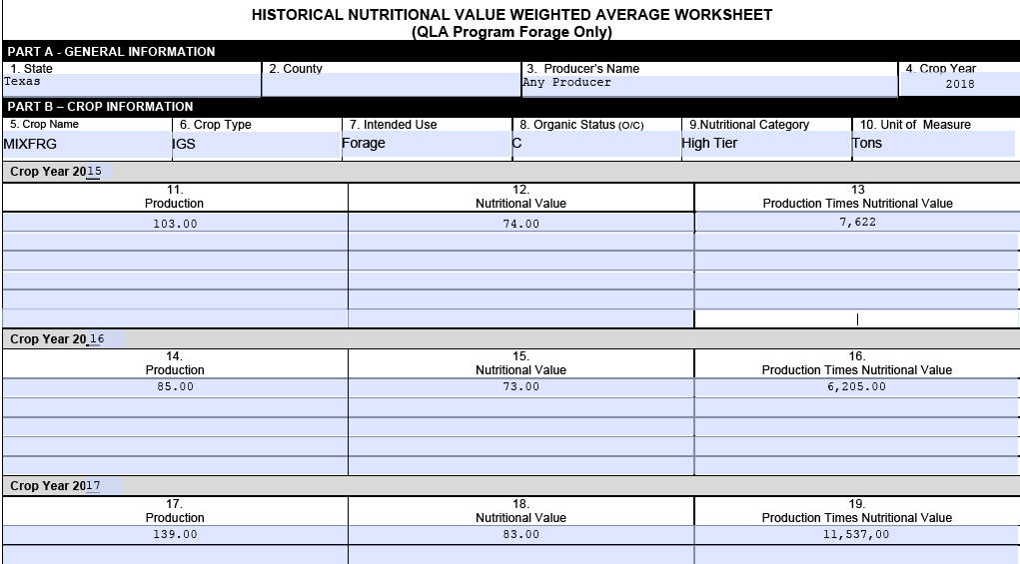
Example 3- FSA-899
Red River
Notes:
Part A – General Information
Box 1 – 2 – are the state and county the forage was produced in
Box 3 – is producer name
Box 4 – is the crop the producer is applying for
Boxes 5-8 – are the crop name, type, intended use, and organic status.
Box 9 – in this case the producer only takes 1 cutting, so High Tier is used, if the producer took multiple cuttings the first and last would be considered Low Tier, and middle cuttings High Tier.
Box 10 – Unit of Measure
Boxes 11-19 – will list the production, nutritional value, and production times the nutritional value for each historical year.

Slide 73
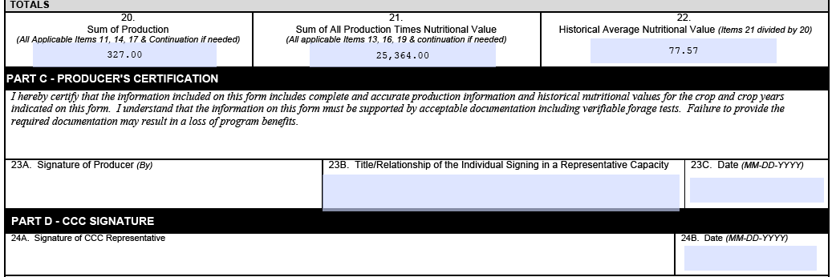
Example 3 - FSA-899
Notes:
Boxes 20-22 will equal the sums of the columns above.
Sue will need to sign in Box 23A, and date in 23C.

Slide 74
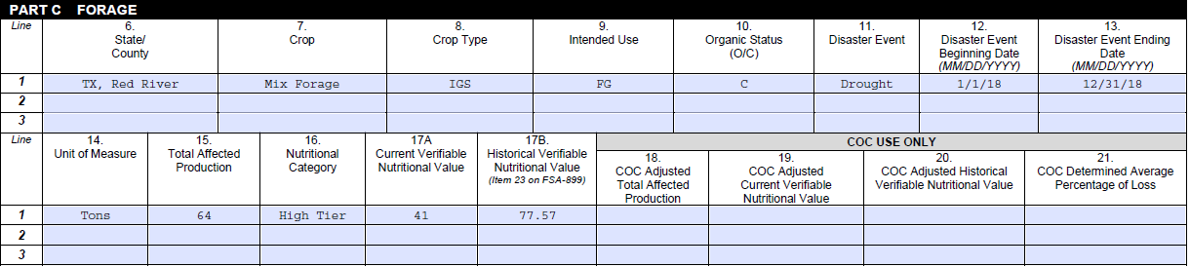
Example 3 - Application – FSA-898 Part C
TX, Red River
Notes:
Sue now completes the FSA-898 QLA application
For forage she will complete Part C
Boxes 6-10 the state/county the forage was produced in, crop, crop type, intended use, and organic status.
Boxes 11-13 list the disaster event, beginning and end date
Box 14 is the Unit of Measure which is tons
Box 15 is the total affected production produced in 2018 in Red River, TX
Box 16 is the nutritional category which is High in this example
Box 17A – is the current verifiable nutritional value for 2018 is 41. This was indicated on the first lab test Sue provided.
Box 17B – is the Historical Verifiable Nutritional Value from box 22 of the FSA-899. The FSA-899 Sue completed showed a historical value of 77.57.
Once completed Sue provides the completed FSA-899 Historical Value Worksheet, FSA-898 QLA Application, laboratory tests for 2015-2018, and proof of the quantity of production indicated on both the historical value worksheet and the application.

Slide 75
How do I apply?
Quality Loss Adjustment (QLA)
One application for entire operation nationwide in recording county office.
Application includes all eligible crops suffering a quality loss.
Losses sustained in more than one crop year require a separate application for each crop year.
Notes:
Producers will submit one application for their entire operation nationwide in the recording county office. The application will include all eligible crops suffering a quality loss broken down by physical county it was produced in. If a producer is applying for losses sustained in more than one crop year, a separate application is required for each crop year.
As with other programs recently, a blank application will be available through farmers.gov in addition to the more traditional methods of filing in the county office and available for producers with level 2 eAuthentication.

Slide 76
How do I apply?
Quality Loss Adjustment (QLA)
New to USDA, no problem! Ask for help in filling out your application! Local staff may also ask for:
  Name and address
  Personal information, including your Tax Identification Number
  Farm operating structure
  Adjusted Gross Income compliance certification to ensure eligibility
  Direct deposit information to enable payment
  Some producers may need to file an acreage report
Find the QLA application (FSA 878) and needed forms: www.farmers.gov/quality-loss
Find your nearest service center here: www.farmers.gov/service-center-locator
Notes:
If you are a new customer to USDA, your local FSA staff will work with you to establish a record for you which will include asking for this type of information:
Name and address
Personal information, including your Tax Identification Number
Farm operating structure
Adjusted Gross Income compliance certification to ensure eligibility
Direct deposit information to enable payment
The local FSA staff will also be available to answer any questions you may have about completing the QLA application.
All USDA Service Centers are open for business by phone, some are open to visitors to conduct business in person by appointment only. All producers wishing to conduct business with FSA should call ahead and schedule an appointment. Service Centers that are open for appointments will pre-screen visitors based on health concerns or recent travel, and visitors must adhere to social distancing guidelines. Visitors are also required to wear a face covering during their appointment.
The application and needed forms are available on our website: farmers.gov/quality-loss
If you are unfamiliar with where your nearest service center is located, you can find out here: www.farmers.gov/service-center-locator

Slide 77
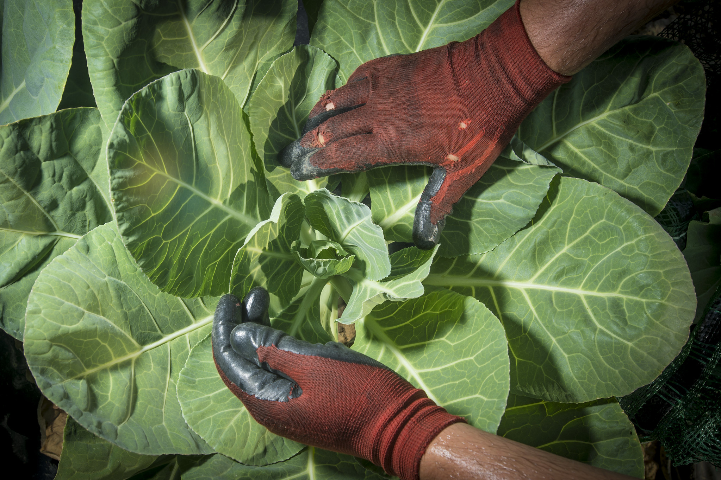
Utilizing the Customer Call Center
QLA applicants can call: 877-508-8364
Operating hours: 7 AM – 7 PM Central
Work one-on-one with an employee, get help filling out an application, and get a direct transfer to the applicable service center
Language interpretation: Call-center users press 1 for English or to identify the non-Spanish language they need. Spanish speakers press 2
Notes:
Producer’s who need or want one-on-one help are encouraged to reach out the customer call center for assistance in completing an application.
This is a phone number to make note of.

Slide 78
What happens after I sign my application?
Producers have 14 days from signing their QLA application to submit verifiable documentation to support their quality loss. They have 60 days to submit remaining producer eligibility forms.
QLA payments will not being to be issued to producers until after the application period ends March 5.
If the total amount of needed QLA payments exceeds the amount of funding available, FSA will prorate payments to all producers by a national factor.
Notes:
Producers have 14 days from signing their QLA application to submit verifiable documentation to support their quality loss.
Producers have 14 days from signing their QLA application to submit verifiable documentation to support their quality loss.
Producers have 60 days from signing an application to resolve any issues with their application.
Payments will not begin to be issued until after sign up ends. This will enable FSA to calculate county averages and the total scope of QLA payments requested.
If the total amount of needed QLA payments exceeds the amount of funding available, FSA will prorate payments to all producers by a national factor. For example, if the national factor is 75 percent, all producers participating in the program will receive 75 percent of their calculated payment.

Slide 79
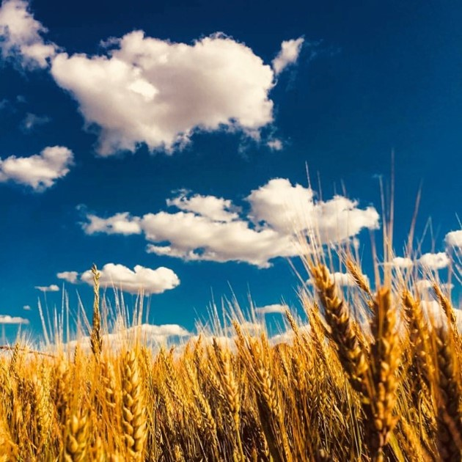
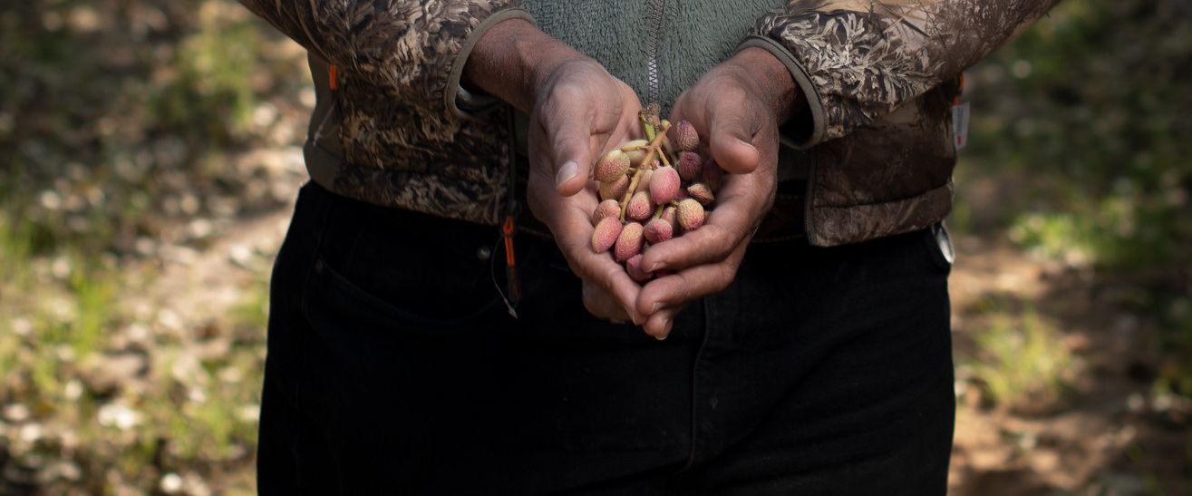
For more information on:
  QLA eligibility
  Eligible crops
  Qualifying Disaster events
  Payment limitations
  How to apply
  Program information in Spanish
Visit farmers.gov/quality-loss
Notes:
If you would like additional information about any of these areas please visit farmers.gov/quality-loss

Slide 80
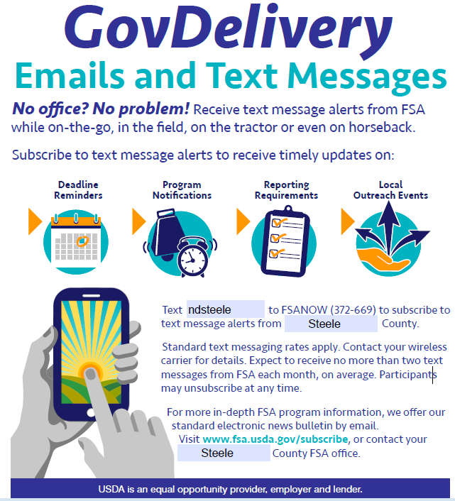
Stay Connected with the Latest Information

Slide 81
