Slide 1
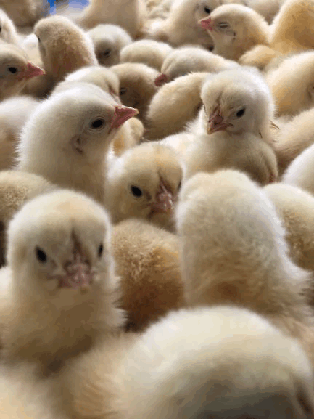
Coronavirus Food
Assistance Program 2
(CFAP 2)

Slide 2

Today’s discussion
What is CFAP 2.0?
Who is eligible and how to apply
Eligible commodities
Payment categories
  Price trigger commodities
  Flat-rate crops
  Sales commodities
Notes:
Today we’ll discuss updates for CFAP, including new eligible commodities for specialty and nonspecialty crop producers, egg, broiler, livestock, nursery crop and floriculture, and aquaculture producers

Slide 3
General Information

Slide 4
Coronavirus Food Assistance Program 2
Goal: Provide relief for producers that continue to be impacted by COVID-19
Operations impacted since April encouraged to apply
Many more commodities are eligible in CFAP 2 than CFAP
Participants will receive 100% of eligible payment now
Payments are not withheld to satisfy prior USDA debts, nor offset by Treasury
Sign up deadline: December 11, 2020
Notes:
Coronavirus has continued to impact agricultural producers across the country and has had significant impacts to market prices.
USDA is implementing Coronavirus Food Assistance Program 2 (or CAFP 2) for agricultural producers who continue to face market disruptions and associated costs because of COVID-19. Coronavirus Food Assistance Program 2, CFAP 2, will provide producers with financial assistance that gives them the ability to absorb some of the increased marketing costs associated with the COVID-19 pandemic.
Up to an additional $14 billion was announced in a second Coronavirus Food Assistance Program or CFAP 2 for agricultural producers who continue to face these market disruptions and associated marketing costs because of COVID-19.
USDA is implementing the second sign up of CFAP which builds on assistance provided through CFAP 1.
CFAP 2 will provide producers with financial assistance that gives them the ability to absorb increased marketing costs associated with the COVID-19 pandemic.
Agricultural operations impacted by the pandemic since April 2020, are encouraged to apply for CFAP 2.
During the first round of CFAP, USDA listened to feedback received from farmers, ranchers and agricultural organizations about the impact of the pandemic on agricultural commodities and producers.
As a result, CFAP 2 has been adapted to better address the impacts to farmers and ranchers. Many more commodities are eligible in CFAP 2 that weren’t eligible in the first CFAP.
Big changes include:
The 5-percent-or-greater national price decline is no longer the single determining factor for commodity eligibility for all commodities.
While there are a few exceptions, generally, marketable commodities are eligible.
Commodities that are now covered by CFAP 2 include: hemp, tobacco, broilers from non-contract poultry growers, shell and dried eggs, turkeys, bison, all classes of wheat and many more.
Participants will receive 100% of eligible payment now.
This program is designed to offset payment losses and the financial impacts of the pandemic. The funds do not have to be paid back nor are there stipulations on how they must be spent. Most of the producers applying have incurred significant costs to get a product ready for market and then could not sell or experienced a price decline. The payments are not expected to make producers whole or compensate them for all their losses but is designed to give producers some financial relief. If a producer has outstanding debts with USDA they should still apply for the program if they are eligible—their payments will not be withheld to satisfy USDA debts or Treasury debts.
Signup began September 21, 2020 and the deadline to apply for CFAP 2 is December 11, 2020

Slide 5
Who is Eligible?
Producers who:
Are in the business of farming at the time of application
Have risk in the production of eligible commodities that apply to any of the 3 categories:
  Price Trigger Commodities
  Flat Rate Crops
  Specialty (Sales-Based) Commodities
Notes:
Price trigger Crops - 5-percent-or-greater market price decline between the average for mid January 2020 in a comparison for the average of late July 2020. Commodities within this category are: barley, corn, sorghum, soybeans, sunflowers, upland cotton, wheat (all classes); broilers and eggs; Dairy (milk); Livestock (excluding breeding stock) : beef cattle, hogs and pigs, lambs and sheep
Flat-Rate Crops - are crops that either: do not meet the 5 percent price decline trigger, or do not have data available to calculate a price change.
Specialty (Sales-Based) Commodities) - sales-based approach, where producers are paid based on five payment gradations associated with their 2019 sales
Commodity sections will be gone over later in training.

Slide 6
Forms for CFAP 2
Applicable forms include:
AD-3117, “CFAP 2 Application”
CCC-902 (Parts A & B), “Farm Operating Plan for Payment Eligibility”
CCC-901, “Member Information for Legal Entities”, if applicable
Notes:
The payment limitation forms will be discussed later in training.

Slide 7
Forms for CFAP 2 (continued)
Applicable forms also include:
CCC-941, Average Adjusted Gross Income (AGI) Certification
CCC-942, Certification of Income Farming, Ranching, and Forestry Operations”, optional
AD-1026, HELC & WC Certification
Notes:
The payment limitation forms and conservation compliance will be discussed later in training.

Slide 8
AD-3117 – CFAP 2 Application
One application nationwide per producer
Producer Certification
  Documentation is only required upon spot check or when requested by COC.
Completed AD-3117 may be submitted to any USDA Service Center
Recording County responsible for acting on AD-3117.
Notes:
One application per producer who had ownership share interest in 1 or more eligible CFAP commodities can file a CFAP application.

Slide 9
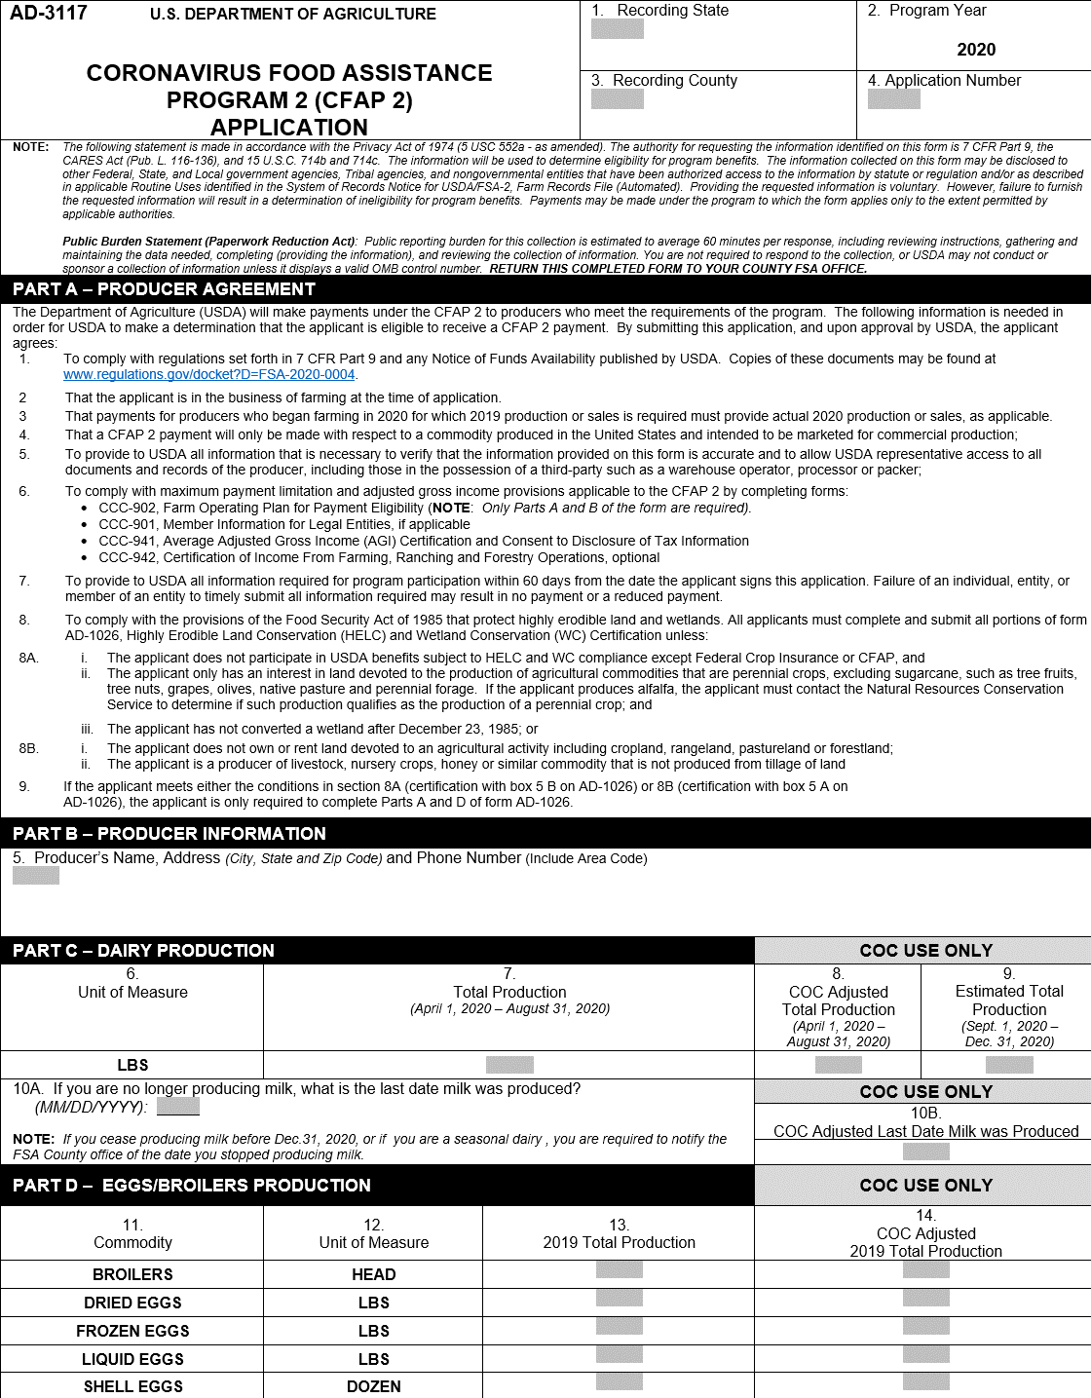
AD-3117 CFAP 2 Application
Page 1
Notes:
AD-3117 is a 2 page form. Page
Part A is the producer agreement which provides details to the producer similar to the producer certification just was put up front on the form so they producer sees it prior to filling out the application.
Part B is the producer information- the name of the person who had ownership risk and was affected by the covid-19 pandemic.
Part C and D will be discussed later in the training.

Slide 10
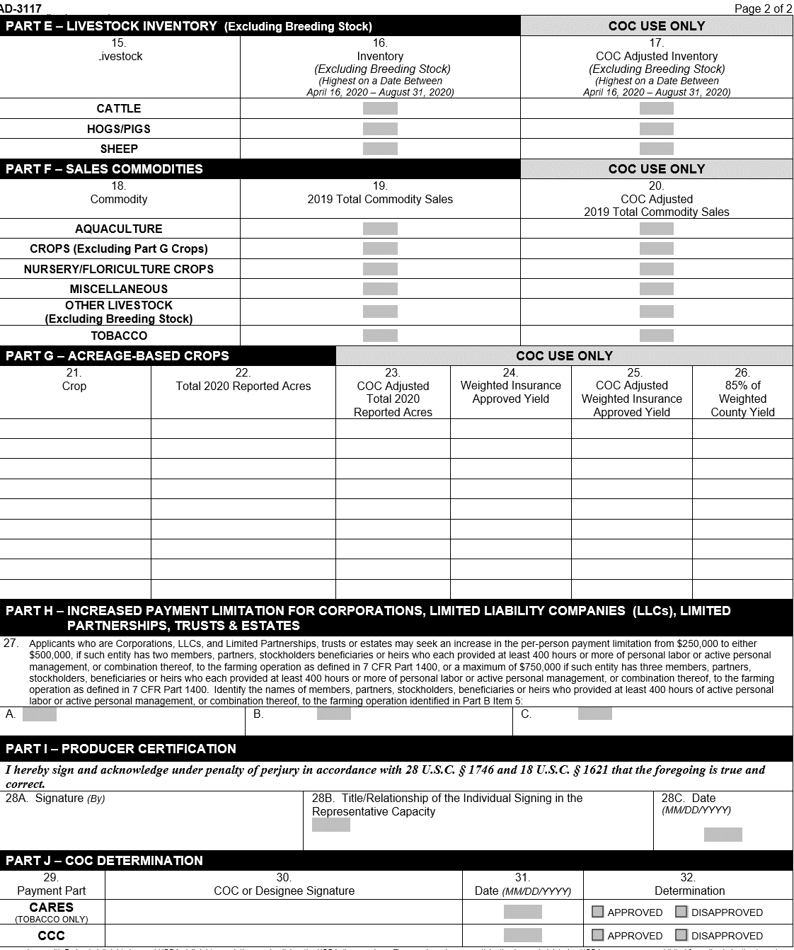
AD-3117 CFAP 2 Application
Page 2
Notes:
Parts of page 2 will be discussed through out the rest of the training.

Slide 11
Producer Eligibility
Payment Limitation &
Payment Eligibility

Slide 12
Who is eligible?
A person or legal entity sharing in the risk of producing and eligible commodity
Average adjusted gross income of less than $900,000 for tax years 2016, 2017, and 2018; or
derive at least 75 percent of their adjusted gross income from farming, ranching or forestry-related activities
Produce commercially
Be in business at the time of application
Note: Contract growers are not eligible for CFAP 2
Notes:
Let’s discuss eligibility and who can participate in CFAP2:
Producers (persons or legal entities) of specified agricultural commodities who face continuing market disruptions and significant marketing costs are eligible for CFAP 2 payments.
• have an average adjusted gross income of less than $900,000 for tax years 2016, 2017, and 2018; or
• derive at least 75 percent of their adjusted gross income from farming, ranching or forestry-related activities.
Individuals and entities also must:
• commercially produce the eligible commodities;
• be in the business of farming at the time of application;
• comply with the provisions of the “Highly Erodible Land and Wetland Conservation” regulations, often called the conservation compliance provisions;
• if a foreign person, provides land, capital, and a substantial amount of active personal labor to the farming operation; and
• not have a controlled substance violation.
Contract growers are not eligible for CFAP 2. A producer who has a marketing contract to sell a crop owned by the grower is NOT considered a contract grower.
Contract growers typically own the facility but don’t own the commodity, meaning that they don’t have the risk in the commodity. That’s different from someone who has a contract to sell a commodity they own to another party.

Slide 13
CFAP 2 Definition
Producer
Producer means a person or legal entity who shares in the risk of producing a commodity.
Does NOT include contract growers.
Does NOT include producers who are no longer in the business of farming at the time of application.

Slide 14
Eligibility clarifications
Participation in CFAP 1 does not make you ineligible for CFAP 2
If you didn’t apply for CFAP 1, you can still apply for CFAP 2
New producers who may not have historical sales records can still apply
Does not include producers no longer in the business of farming at the time of application
Notes:
If you previously applied for CFAP 1 and received a payment, this does not affect your eligibility for payment for CFAP 2.
If you never applied for CFAP 1, you can still apply for CFAP 2.
New producers that may not have historical sales records can still apply, we will discuss that more in depth as we proceed with our presentation and how payments will be calculated for new operations.
Does not include producers no longer in the business of farming at the time of application

Slide 15
Payment limitations
Limit of $250,000 per person and legal entity
  Applies to the total payment for all eligible commodities
Corporate entities, LLCs, LPS, trusts, and estates may receive up to:
  $500,000 (if 2 members each contribute at least 400 hours of active personal labor or management; or
  $750,000 (if 3 members each contribute at least 400 hours of active personal labor or management)
CFAP 2 payment limitations are separate from the CFAP 1 limitation
Notes:
Now, when it comes to payment limitations for this program:
CFAP 2 payments are subject to a per person and legal entity payment limitation of $250,000. This limitation applies to the total amount of CFAP 2 payments for all eligible commodities.
Unlike other FSA programs, special payment limitation rules apply to participants that are corporations, limited liability companies, limited partnerships (corporate entities), trusts, and estates. These legal entities may receive up to $500,000 (if 2 members each contribute at least 400 hours of active personal labor or management); or up to $750,000 (if 3 members each contribute at least 400 hours of active personal labor or active personal management).
For a legal entity: • With one such member, the payment limit for the entity is $250,000; • With two such members, the payment limit for the entity is $500,000 if at least two members contribute at least 400 hours of active personal labor or active personal management, or combination thereof, with respect to the operation of the corporate entity; and • With three such members, the limit is $750,000 if at least three members contribute at least 400 hours of active personal labor or active personal management, or combination thereof, with respect to the operation of the corporate entity.
CFAP 2 payment limitation is separate from the CFAP 1 payment limitation.

Slide 16
Payment Limitation
CFAP 2.0 Payment Limitation/Eligibility
$250,000 per person or legal entity.
Separate pay limit from CFAP 1.0.
Using FY2020 Business File and Subsidiary Records for determining eligibility.

Slide 17
Payment Limitation
Optional Increase in Payment Limitation is available to:
Corporations
LLCs
LPs
Trusts; and
Estates
Available when members, partners, stockholders, heirs or beneficiaries contributed 400+ hours of active personal labor or active personal management to the farming operation.
Notes:
Optional Increase in Payment Limitation is expanded to include Trusts and Estates.

Slide 18
Payment Limitation
Optional Increase Pay Limit Amounts:
$500,000 – when 2 entity members provided 400+ hours of active personal labor or active personal management.
$750,000 – when 3 entity members provided 400+ hours of active personal labor or active personal management.

Slide 19
Payment Limitation
Revocable Trusts using an SSN may seek an increase in payment limitation if the trust provides evidence, to the satisfaction of the COC, documenting there is more than one beneficiary of the trust, such as a husband and a wife. Evidence may include, but is not limited to, a copy of the executed trust agreement.

Slide 20
Payment Limitation
Changes in Attribution For CFAP 1.0 and CFAP 2.0:
Payments to persons and legal entities will be attributed and limited according to rules for attribution according to 7-CFR Part 1400.105.
- EXCEPTION -
Payments to legal entities qualifying for the optional increase in payment limitation will be limited to the lesser of $500,000 or $750,000; or the sum of the amount each eligible entity member may receive, regardless of ownership share.

Slide 21
Payment Limitation
“Previous” Pay Limit /Attribution Example 1 (for increased limitation):
ABC Corporation pay limit is increased to $500,000 based on 2 members contributing labor or management.
Member 1 (90% ownership share) Max Pay Limit = $250k
Member 2 (10% ownership share) Max Pay Limit = $250k
In this case, each eligible member would be attributed up to $250k based on their ownership share. Payments to ABC Corporation were determined by the amount each eligible member may receive. Member 1’s attributed amount is $250k ($500k x 90% = $450k - Not to Exceed $250k). Member 2’s attributed amount is $50k ($500k x 10%). Total payment to ABC Corporation was $300k ($250k + $50k).
NOTE: Payments were further reduced to ABC Corporation if any member received prior payments through another farming operation or is otherwise ineligible for CFAP benefits (i.e. AGI non-compliant)

Slide 22
Payment Limitation
“New” Pay Limit /Attribution Example 1 (for increased limitation):
ABC Corporation pay limit is increased to $500,000 based on 2 members contributing labor or management.
Member 1 (90% ownership share) Max Pay Limit = $250k
Member 2 (10% ownership share) Max Pay Limit = $250k
In this case, each eligible member may receive (directly or indirectly) up to $250k. The sum of payments each eligible member may receive is $500k ($250k + $250k), regardless of ownership share. Total payment to ABC Corporation would be $500k.
NOTE: Payments will be reduced to ABC Corporation if any member receives prior payments through another farming operation or is otherwise ineligible for CFAP benefits (i.e. AGI non-compliant)

Slide 23
Payment Limitation
“Previous” Pay Limit /Attribution Example 2 (for increased limitation):
ABC Corporation pay limit is increased to $500,000 based on 2 members contributing labor or management.
Member 1 LLC (100% ownership share) Max Pay Limit = $250k
  Producer A (90% ownership share) Max Pay Limit = $250k
  Producer B (10% ownership share) Max Pay Limit = $250k
In this case, Member 1 LLC pay limit is held to $250k. The maximum payment ABC Corporation could receive is $250k.
NOTE: Payments will be reduced to ABC Corporation if any member receives prior payments through another farming operation or is otherwise ineligible for CFAP benefits (i.e. AGI non-compliant)

Slide 24
Payment Limitation
“NEW” Pay Limit /Attribution Example 2 (for increased limitation):
ABC Corporation pay limit is increased to $500,000 based on 2 members contributing labor or management.
Member 1 LLC (100% ownership share) Max Pay Limit is increased to $500k
  Producer A (90% ownership share) Max Pay Limit = $250k
  Producer B (10% ownership share) Max Pay Limit = $250k
In this case, Member 1 LLC pay limit is increased to the maximum pay limit ABC Corporation may receive ($500k). The maximum payment ABC Corporation could receive is $500k and payments will be attributed accordingly down to the first level members of the embedded entity regardless of ownership shares.
NOTE: Payments will be reduced to ABC Corporation if any member receives prior payments through another farming operation or is otherwise ineligible for CFAP benefits (i.e. AGI non-compliant)

Slide 25
Payment Limitation
Attribution For CFAP 2.0:
CFAP payments to a legal entity will be tracked through 4 levels of ownership and will be reduced in an amount that represents the indirect ownership interest of the fourth level entity in the payment entity.

Slide 26
Commodity Categories

Slide 27
Commodity Categories
  Price trigger commodities
  Flat-rate row crops
  Sales commodities
27
Notes:
There are 3 major categories of payment calculations in the CFAP 2 program that we will discuss with you today. Those categories are:
Price Trigger commodities,
Flat-rate Row Crops
Sales commodities
We’ll cover the types of commodities that are eligible under each type of payment category.
Now, let’s dive deeper into what each of those mean and provide some examples.

Slide 28

Price Trigger Category
  Commodities within this category:
  dairy (cow milk)
  broilers and eggs
  beef cattle, hogs and pigs, lambs and sheep (excluding breeding stock)
  acre-based crops, including barley, corn, sorghum, soybeans sunflowers, upland cotton, wheat (all classes)
Notes:
What this covers:
Commodities that USDA determines have experienced a 5% or greater market price decline between the average for mid January 2020 in a comparison for the average of late July 2020. . Any crops shown as eligible on farmers.gov/cfap. Producers don’t have to justify price decline- if crop shows up as eligible on farmers.gov/cfap they can apply for payment
Commodities within this category are:
barley, corn, sorghum, soybeans, sunflowers, upland cotton, wheat (all classes)
broilers and eggs
Dairy (milk)
Livestock (excluding breeding stock) : beef cattle, hogs and pigs, lambs and sheep

Slide 29
Dairy Provisions

Slide 30
Eligible Dairy Operations
Dairy operations that commercially, market milk from cows in the United States at the time of application are eligible for CFAP 2.
Notes:
In order to be an eligible Dairy Operations, the dairy operation must be commercially marketing milk at time of application. If the dairy operation dissolved before applying for CFAP, they are ineligible for CFAP 2 under the Dairy Category.
Seasonal dairies are eligible and can apply!
For Seasonal dairy operations that stop producing milk before December 31, 2020, producers will need to report the date they stopped production of Milk, to FSA and refund any unearned CFAP payment according to the number of days in production

Slide 31
Dissolved Dairy Operations
Dairy operations that dissolve prior to enrollment are not eligible for CFAP 2
Dairy operations that dissolve after enrollment will use actual production and estimated production according to the prorated number of days of marketing milk.
Dissolved dairy operation are required to report to FSA the date of dissolution to FSA and refund any unearned CFAP payment.
Notes:
As we just stated, dairy operations that dissolve prior to applying for CFAP 2 are ineligible.
If a dairy dissolves after applying for CFAP 2, producer Must report the dissolution date to USDA, the actual production will be used to estimate the production according to the prorated number of days milk was produced.
Any unearned payments may need to be refunded to USDA if payment has already been issued.

Slide 32
Eligible Milk Production
CFAP Actual Milk production is:
  Milk commercially, marketed for the months of April, May, June, July, and August 2020 and
  Any dumped milk during that timeframe.
CFAP Estimated Milk production is:
  Milk expected to be commercially, marketed for the months of September, October, November, and December
  National adjustment to estimate expected milk production = Daily average of actual pounds produced in Apr.-Aug. 2020 multiplied by number of days milk was produced from Sep.–Dec. 2020.
Notes:
For CFAP 2, the eligible milk production is broken down into 2 categories:
Actual production, and
Estimated production.
Actual production is milk commercially marketed for the months of April through August 31st, 2020, along with any dumped milk during that same timeframe.
Estimated Milk production is milk expected to be commercially marketed for the months of September through December of 2020.
The estimated milk production is determined by the daily average of the actual milk production multiplied by the number of commercially marketing days the milk was produced in September through December 2020.

Slide 33
Price trigger for cow milk
What do producers receive:
$0.012 for:
  each pound of milk produced or dumped from April – August 2020
  An estimated amount of milk that will be produced September – December 2020
Producers report production in pounds for April – August 2020 in Part C of the CFAP 2 form, AD-3117. CFAP software will automatically calculate an estimated pounds of milk for September – December for payment
Notes:
So, how the price trigger category works for cow milk?
Producers will receive a little more than a penny for each pound of cow milk produced or dumped between April and August 2020, and on an estimated amount of milk that will be produced between September and December 2020.
The CFAP software will automatically calculate the estimated milk production in pounds for September to December.
Questions have been asked as to whether Goat milk is eligible for CFAP 2 and the answer is yes, however goat milk falls under the sales commodity payment category and not under the price trigger category.

Slide 34
Supporting Documentation
Dairy operations will self certify to their total milk production for the months of April-August 2020.
The following documents will assist the dairy operation in reporting actual production:
  Milk marketing statements for the months of April, May, June, July, and August 2020
  Any milk dumped not recorded on marketing statements.
Notes:
Producers will be required to self-certify to their total milk production for the months of April through August of 2020. Documentation such as milk marketing statements for April through August can help producers determine what the actual production is.

Slide 35
Egg and Broilers
Provisions

Slide 36
Eggs and Broilers Eligibility
Eggs and Broilers fall into the price trigger category for CFAP 2.
Price Triggered Commodity
  5-percent-or-greater market price decline between the average price for mid January 2020 in a comparison for the average price of late July 2020.
Notes:
Eggs and Broilers fall into the price trigger category for CFAP 2.
This means that Egg and broiler producers have experienced 5 percent or greater price declines in comparison of the average prices for the week of January 13-17, 2020 and the average prices for the week of July 27-31, 2020.

Slide 37
Eligible Producer
An eligible producer is a person or legal entity who shares in the risk of producing a commodity.
Egg and Broiler producers must be independent growers; contract growers are not considered eligible producers for CFAP 2.
Producers who are not in the business of egg or broiler production at the time of CFAP 2 application are not considered eligible producers.
Notes:
An eligible producer is a person or legal entity who shares in the risk of producing a commodity.
In order to be considered an eligible producer of eggs or broiler, the producer must:
be an independent grower. A contract grower is not eligible for CFAP 2, and.
The producers who are not in the business of egg or broiler production at the time of application are not considered an eligible producer.

Slide 38
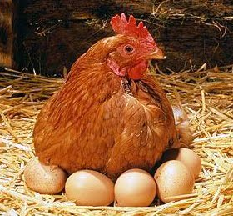
Eligible Egg Operations
Eligible egg operations who are commercially market shell, dried, frozen, or liquid eggs from chickens in the United States at the time of application are eligible for CFAP 2.
Egg operations with a risk in the egg sales may be eligible for CFAP 2 payments.
Egg operations with a guarantee price on their eggs are not eligible for CFAP 2.
Notes:
An eligible egg operation:
is one who commercially markets shell, dried, frozen or liquid eggs from chickens in the US at the time of application.
Who has a risk in the egg sales
Does not have a guaranteed price on the eggs sold.
If egg producers have a guaranteed price on their egg production, they would not be eligible for CFAP 2.

Slide 39
Reporting Egg Production
Egg producers will self-certify to their dried, liquid, and/or frozen egg production, in pounds, and in dozens for shell eggs, for the 2019 calendar year.
New egg producers, those who did not have any production in 2019, will use their actual 2020 production for payment.

Slide 40
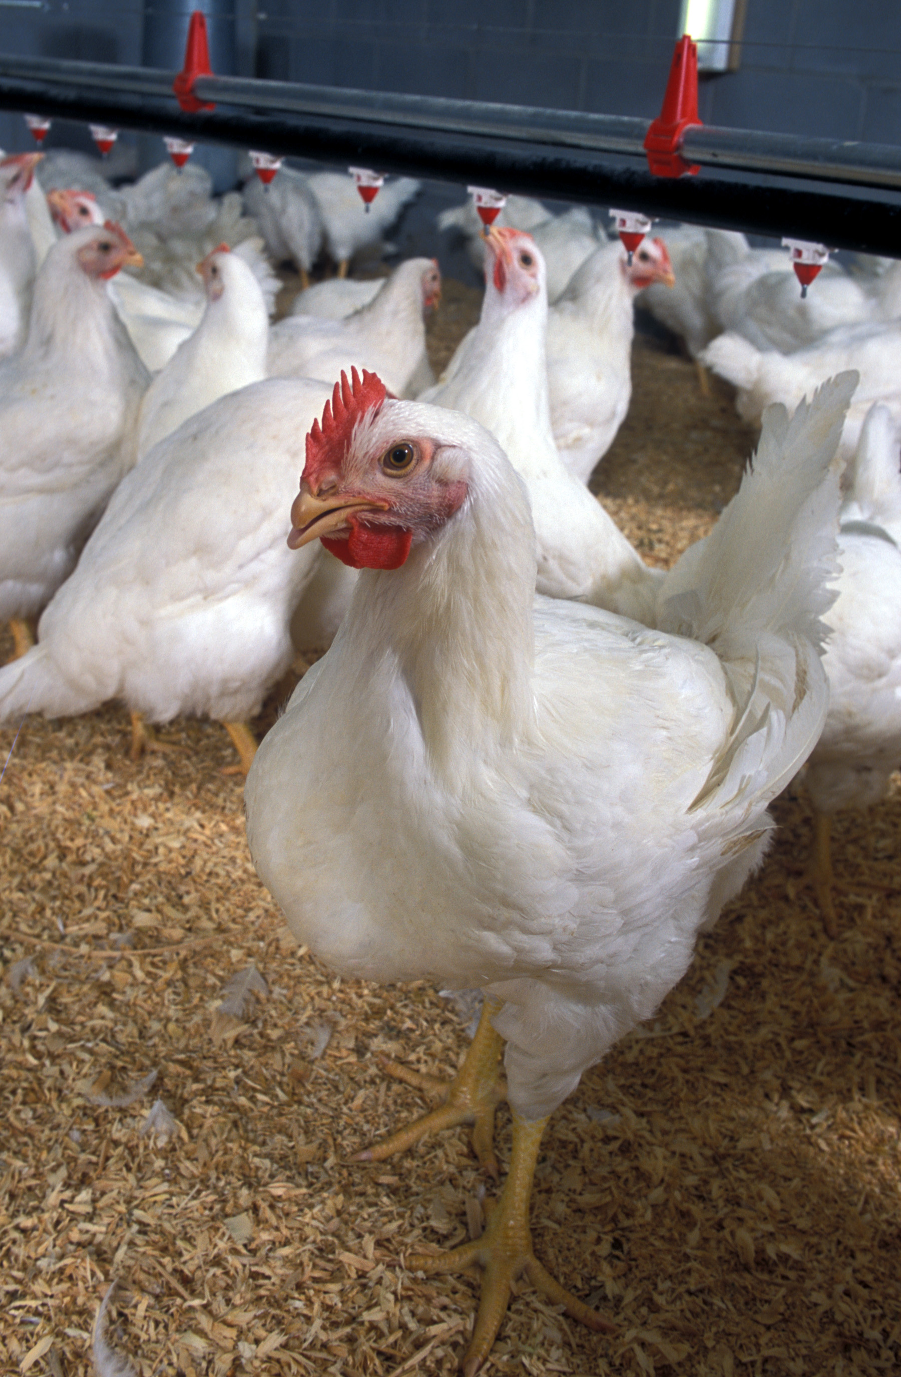
Broilers Definition
Broilers include any chicken that has been commercially produced for meat purposes that has left the farm for slaughter, and not used for laying or breeding purposes.
Notes:
The definition of a broiler is any chicken that has been commercially producer for meat purposes and not used for laying or breeding purposes.

Slide 41
Eligible Broiler Production
CFAP 2 eligible production for broilers is an eligible producer’s 2019 total broiler production
New broiler producers who began farming in 2020 and did not have production in 2019, can use their actual 2020 broiler production as of the date the producer submits an application for payment.
Notes:
Just like the eligible egg production, the eligible production for broilers is a producer’s self certification of the 2019 total broiler production
For new broiler producers who began farming in 2020 and did not have production in 2019, they can use their actual 2020 broiler production as of the date the producer submits a CFAP 2 application for payment.

Slide 42
Price trigger for eggs & broilers
What producers receive:
Type | Payment (75% of production)
Shell egg | $0.05 per dozen
Dried egg | $0.14 per pound
Liquid egg | $0.04 per pound
Frozen egg | $0.05 per pound
Broilers | $1.01 per head
Notes:
For eggs and broilers, payment is based on the producer’s 2019 production.
Producers report their egg production by dozen for shell eggs and in pounds for all other egg types. Broilers are reported by head.
EGGS
Conversion from eggs to pounds: Producers who sell frozen, liquid, or dried eggs in the shell to a processor can reach out to their local office or the CFAP call center for assistance in converting their production to pounds for their CFAP 2 application.
BROILERS
The definition for broilers are chickens commercially produced for meat purposes that have left the farm for slaughter and are not used for laying or breeding purposes.
Payment = 2019 Production x 75 Percent x Egg Type Payment Rate

Slide 43
Livestock Provisions

Slide 44
Eligible Livestock Producer
An eligible producer is a person or legal entity who shares in the risk of producing a commodity
Producers who are not in the business of livestock production at the time of CFAP 2 application are not considered eligible livestock producers
Notes:
An eligible producer is a person or legal entity who shares in the risk of producing a commodity.
Producers who are not in the business of livestock production at the time of application are not considered an eligible livestock producer.

Slide 45
Eligible Livestock
The following livestock, based on price declines, have been determined eligible for CFAP 2:
  Beef Cattle
  Hogs/Pigs
  Sheep
(EXCLUDES BREEDING STOCK)
Notes:
Eligible livestock for the CFAP 2 payment are
Beef cattle, including bred heifers
hogs and pigs
All breeds of sheet.
This does exclude breeding stock.

Slide 46
Ineligible Livestock
Ineligible livestock for CFAP 2 are:
Breeding Stock (including breeding livestock removed from the breeding operation)
  For Beef Cattle – cows and bulls
  For Hogs/Pigs – sows and boars
  For Sheep – ewes and rams
Livestock produced by contract growers
Livestock not meeting the definition of eligible commodity for CFAP 2
  Commodity means an agricultural commodity produced in the United States and intended for commercial production that has been designated as eligible for payments under CFAP 2.
Notes:
As we just mentioned, breeding stock are ineligible for CFAP 2, this includes
Cows and bulls
Sows and boars
Ewes and rams.
Basically if they have ever reproduced or been used for breeding, they are ineligible for CFAP 2.
Also Ineligible livestock include
Dairy cattle and equine
Companion animals
Animals raised for hunting or game
Contract growers are not eligible for CFAP 2. Keep in mind that a marketing contract to sell a crop owned by the grower is NOT considered a contract grower.
Any livestock not meeting the definition of an eligible commodity for CFAP 2 purposes.

Slide 47
Price trigger for livestock
What do producers receive:
Producers self-certify to their highest owned inventory on a date selected by the eligible producer from April 16, 2020 and August 31, 2020
Breeding stock is not eligible
Livestock | Payment rate
Beef Cattle | $55 per head
Hogs and pigs | $23 per head
Sheep and lambs | $27 per head
Notes:
CFAP 2 for livestock includes beef cattle, hogs, pigs, sheep, and lambs.
All ages and weight ranges are paid at the same rate.
Livestock must be produced in the U.S.
Payments for livestock will be equal to the highest inventory of the specific livestock on a date selected by the producer from April 16 to August 31, 2020, multiplied by the applicable payment rate per head.

Slide 48
Acreage-Based Crop Provisions
Price Trigger & Flat-Rate Crops

Slide 49
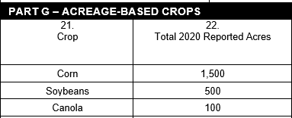
Acreage Based Crops –
AD-3117, Part G Acreage-Based Crops
For price trigger and flat-rate crops:
Items 21 & 22 are pre-populated; therefore, producer does not need to complete.
Eligible Crops & Reported Acres will be prefilled from CARS

Slide 50
Price Trigger Crops

Slide 51
Eligible Price Trigger Crops
Barley
Corn
Sorghum
Sorghum, dual purpose
Soybeans
Sunflowers
Upland cotton
Wheat (all classes)

Slide 52
Eligible Price Trigger Crops,
Types & Intended Uses
Crop Name | Type Name |  | Intended Use
Barley | All |  | FG, GR, SD
Corn | Amylose Blue Grainless Forage High Amylase Popcorn Red | Strawberry Popcorn Tropical Waxy White Yellow | FH, GR, PR, SD, SG
Sorghum | All |  | FG, GR, SD, SG
Sorghum, Dual Purpose | All |  | FG, GR, SD, SG
Soybeans | All |  | FG, FH, GR, SD, PR
Sunflowers | All |  | FG, GR, SD, PR
Upland Cotton
Wheat | All |  | FG, GR, SD

Slide 53
Price Trigger Crops
CFAP 2 benefits will be based on the producer’s:
2020 eligible acres for eligible crop(s) nationwide (CARS), and
weighted 2020 APH approved yield OR, if a weighted 2020 APH approved yield is not available, 85% of the weighted 2019 ARC-CO benchmark yield

Slide 54
Price Trigger Crops
Payment Calculation
CFAP 2 payment will be equal to the greater of producer’s eligible acres (FSA-578), times
(1) The result of multiplying:
  producer’s weighted 2020 APH approved yield, or if a weighted 2020 APH approved yield is not available, 85% of weighted 2019 ARC-CO benchmark yield, times
  applicable crop marketing percentage, times
  applicable crop payment rate.
  or (2)
  $15 payment rate per acre.
  Note: $15 per acre is the minimum payment a producer would receive for all price trigger crops.

Slide 55
Price Trigger Crops
Payment Example
Example - Producer A:
applies for CFAP 2 for corn
files 2020 FSA-578’s for 175 acres of corn nationwide
has an RMA insurance policy on corn in 5 counties nationwide for which a weighted 2020 APH approved yield of 140.16 bushels was calculated

Slide 56
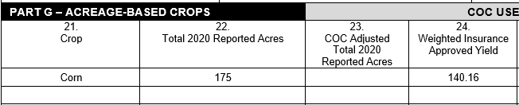
Price Trigger Crops
Payment Example
Producer A’s AD-3117:
Note: Total 2020 reported acres is based on
FSA-578, not from RMA records.

Slide 57
Flat Rate Crops

Slide 58
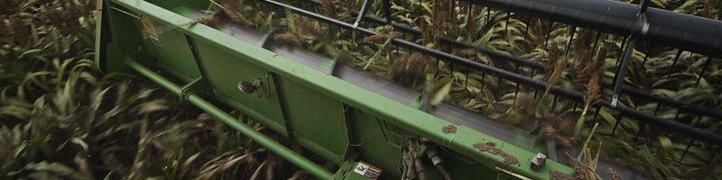
Flat rate crops basics
Eligible crops: All crops that are on the eligible acreage-based flat rate crops list at farmers.gov/cfap/row-crops. Failed acres are eligible
Ineligible: Crops intended for grazing, green manure, or left standing. Acres prevented from being planted
What producers receive: A flat $15 payment on each eligible acre for each eligible crop. Yield is not considered, only acreage
Notes:
These crops are those in our flat rate category. They all will receive $15 an acre.
As we take a deeper look into these, these are acreage based crops. We call these row crops because most of them are planted in a row.
We’re not looking at yield, only acreage.
Failed acres are eligible.
Ineligible:
Hay (except alfalfa)
Cover crops
Forage: soybeans, sorghum or mixed
Seed of ineligible crops
Acres that didn’t get planted are not eligible.

Slide 59
Eligible Flat Rate Crops
Alfalfa
Amaranth grain
Buckwheat
Canola
Cotton, (ELS)
Crambe
Einkorn
Emmer
Flax
Guar
Hemp
Indigo
Industrial rice
Kenaf
Khorasan
Millet
Mustard
Oats
Peanuts
Quinoa
Rapeseed
Rice
Rice, sweet
Rice, wild
Rye
Safflower
Sesame
Speltz
Sugar beets
Sugarcane
Teff
Triticale

Slide 60
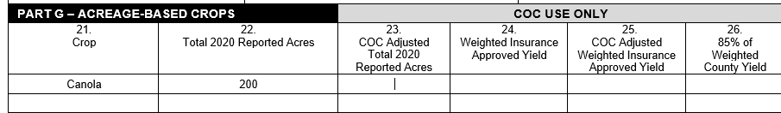
Flat Rate Crops –
AD-3117, Part G Acreage-Based Crops
Only items applicable to flat rate crops are:
Items 21
Items 22
Items 21 and 22 are prepopulated from CARS

Slide 61
Flat Rate Crops –
Payment Calculation
CFAP 2 payment will be calculated by multiplying:
eligible acres (578) of the crop, times
$15 payment rate per acre.

Slide 62
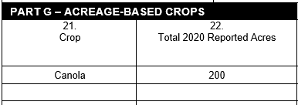
Flat Rate Crops –
Payment Example
Producer C, applies for CFAP 2 for Canola and files 2020 FSA-578’s for 200 acres of Canola nationwide.

Slide 63
Flat-Rate Crops Payment Calculation
Element | Instruction | Data
Eligible Acres | Taken from AD-3117, item 22 | 200 acres canola
Flat-Rate Formula | Multiply eligible acres, times payment rate | 200 acres, times $15 payment rate, equals $3,000 payment

Slide 64
Sales Commodities

Slide 65
Eligible Sales Commodities
Aquaculture, including mollusks
Specialty crops, including fruits, vegetables, and tree nuts
  This category includes honey, dry edible beans and peas, lentils, and chickpeas/garbanzo beans.
Nursery crops and floriculture
Livestock grown for food, fiber, fur or feathers including:
  Alpacas, Emus, Llamas
  Bison, Buffalo, Beefalo
  Deer, Elk, Reindeer
  Ducks, Geese, Pheasants, Quail, Turkeys
  Goats
  Guinea Pigs, Rabbits
  Ostriches
Notes:
The next category is the sales commodity category. This payment segment is for specialty crops, aquaculture, nursery crops and floriculture, and other commodities not included in the price trigger and flat-rate payment categories.
For those producers who participated in CFAP 1, there were a number of specialty crops eligible, but if a crop could be maintained in inventory or didn’t meet price loss requirements then it wasn’t eligible. Under CFAP 2, if you can grow it, it is probably eligible. What is eligible:
CFAP 2 Eligible Commodities Finder:
http://www.farmers.gov/cfap/tool
Specialty Crops: More than 230 fruit, vegetable, horticulture, and tree nut commodities are eligible for CFAP 2 along with honey and maple sap.
Aquaculture:
Any species of aquatic organisms grown as food for human consumption
Fish raised as feed for fish that are consumed by humans
Ornamental fish propagated and reared in an aquatic medium.
Eligible aquaculture species must be raised by a commercial operator and in water in a controlled environment. This includes molluscan shellfish and seaweed that was previously covered under the U.S. Department of Commerce program.
Floriculture and Nursery crops
Specialty livestock - raised for food, fur, fiber, or feathers (breeding stock is not eligible for CFAP 2). Contract growers are not eligible for CFAP 2. A marketing contract to sell a crop owned by the grower is NOT considered a contract grower.
Tobacco
Goat's milk
Mink
Mohair & Wool
Ineligible commodities: companion animals and animals raised for hunting or game, pelts (other than mink)

Slide 66
Eligible Sales Commodities (cont.)
Miscellaneous commodities including:
  Christmas Trees
  Goat Milk
  Mohair
  Mink
  Wool
Tobacco
Notes:
CFAP 2 Eligible Commodities Finder:
http://www.farmers.gov/cfap/tool

Slide 67
Ineligible Commodities
The following are NOT eligible for CFAP 2:
breeding stock
equine
companion or comfort animals/pets
commodities produced by contract growers
livestock raised for hunting or game purposes

Slide 68
Sales commodity category
To be eligible for sales commodities the producer must grow/produce a sales commodity in 2020.
  The sales commodity produced in 2020 does not need to be the same commodity that is certified to for 2019 sales on the application.
Notes:
What does it mean that it’s a sales commodity? That means FSA determines payment based on a producer’s reported total 2019 sales for eligible commodities.
Eligible sales include only sales of raw commodities grown by the producer
the portion of sales derived from adding value to the commodity, such as processing and packaging, and from sales of products purchased for resale is not included in the payment calculation.
That means producers will need to convert a processed commodity back to the raw form and report that raw commodity’s sales value.
For example, if you are a grower of grapes that are processed into wine, the amount of sales that you would claim on your CFAP 2 application would be the value of the grape, the raw product. What the value of the grapes would have been had you sold the grapes. If you sell the grapes to be processed into wine, you probably know that value. But if you process that into wine yourself, you would need to determine what that would be in order to report it on your CFAP 2 application. Your local FSA office might be able to help you with that, so please give them a call.
Another example: Maple syrup must be converted to the raw form maple sap. The additional sales value accrued between sap and syrup is not eligible.
Producers report their total commodity sales on Item 19, Part F of the CFAP 2 form, AD-3117.

Slide 69
Sales commodity category
Eligible sales include only sales of raw commodities grown by the producer, sales from adding value like processing and packaging are not included
Producers certify to their total 2019 commodity sales in dollars and cents on Item 19, Part F of the CFAP 2 form, AD-3117
  If the producer did not have 2019 sales of any sales commodities, they may qualify as a new producer.
Notes:
What does it mean that it’s a sales commodity? That means FSA determines payment based on a producer’s reported total 2019 sales for eligible commodities.
Eligible sales include only sales of raw commodities grown by the producer
the portion of sales derived from adding value to the commodity, such as processing and packaging, and from sales of products purchased for resale is not included in the payment calculation.
That means producers will need to convert a processed commodity back to the raw form and report that raw commodity’s sales value.
For example, if you are a grower of grapes that are processed into wine, the amount of sales that you would claim on your CFAP 2 application would be the value of the grape, the raw product. What the value of the grapes would have been had you sold the grapes. If you sell the grapes to be processed into wine, you probably know that value. But if you process that into wine yourself, you would need to determine what that would be in order to report it on your CFAP 2 application. Your local FSA office might be able to help you with that, so please give them a call.
Another example: Maple syrup must be converted to the raw form maple sap. The additional sales value accrued between sap and syrup is not eligible.
Producers report their total commodity sales on Item 19, Part F of the CFAP 2 form, AD-3117.

Slide 70
New Producer
Producers who began farming sales commodities in 2020 and had no 2019 sales will self-certify their actual 2020 sales, at the time of application, in lieu of 2019 sales.
The producer’s actual 2020 sales must be determined reasonable by the FSA county committee.
Notes:
Sales amount will be the sales to date at the time of the application.

Slide 71
New Producer Example 1
Producer B grew 100 acres of blueberries as an individual with 100% shares in 2019 with a total sales of $250,000.
In 2020 Producer B’s spouse, Producer C, began farming as a new producer, Producer B and Producer C now share the 100 acres of blueberries 50/50 and had a total of $200,000 in sales.
Producer B will certify to their 2019 sales of $250,000 for CFAP 2 and Producer C will certify to $100,000.
Notes:
Producer C qualifies as a new producer.

Slide 72
Example 2 – NOT New Producer
Producer A grew 120 acres of watermelons in 2018 but did not plant anything in 2019 due to disaster and did not sell any other sales commodities in 2019.
In 2020 the producer grew 120 acres of watermelons and had a total sales of $320,000.
Because the producer was farming prior to 2020, the 2019 sales will be $0.
Notes:
If the producer would have sold their 2018 watermelons in January and February of 2019, the producer may include their sales of watermelon in January and February of 2019 on their CFAP 2 application.

Slide 73
Sales Commodity Example
Sally breeds and grows buffalo for direct marketing of the meat and by-products to online customers. Sally’s sales records show several income streams from various products she sells including buffalo meat, hides and shoulder mounts.
Sally would certify the value of the live animal “delivered” to the point of harvest, whether on or off farm.
  After delivery there is value added by processing the animal into the various products sold. Sales of the by products such as meat, hides, and shoulder mounts should not be included, only the value of the live animal.
Notes:
Question:
If a producer raises buffalo or goats and sells the meat at Farmers Market, the cost would include processing, can they reduce their sales by the processing cost and apply on the 'raw commodity'?
Answer:
The sales value entered on the CFAP 2 application would be the value of the live animal “delivered” to the point of harvest, whether on or off farm. After delivery there is value added to the animal by processing the animal into the various products sold. Sales of the by-products such as meat, hides, and shoulder mounts should not be included, only the value of the live animal or delivered raw product.

Slide 74
Sales Commodity Example
Shawn grows grapes and owns a winery to process grapes into wine. Shawn also buys grapes from other growers.
For the CFAP 2 application Shawn should determine the value for his raw grapes at a price comparable to what was paid by the winery for similar quality, raw grapes.
  The sales of the value-added product, wine, would not be included on the CFAP 2 application.
Notes:
Question:
If a producer raises buffalo or goats and sells the meat at Farmers Market, the cost would include processing, can they reduce their sales by the processing cost and apply on the 'raw commodity'?
Answer:
The sales value entered on the CFAP 2 application would be the value of the live animal “delivered” to the point of harvest, whether on or off farm. After delivery there is value added to the animal by processing the animal into the various products sold. Sales of the by-products such as meat, hides, and shoulder mounts should not be included, only the value of the live animal or delivered raw product.

Slide 75
Sales Commodity Example
Sam raises cucumbers and sells raw cucumbers and cucumber pickles at a local farmer’s market directly to customers.
The 2019 sales would be the value of raw cucumbers sold at the market plus the raw value of the cucumber pickles.
Sam would use the quantity of cucumbers processed into pickles and the price of raw cucumbers sold at the market to calculate the raw value of the cucumber pickles.

Slide 76
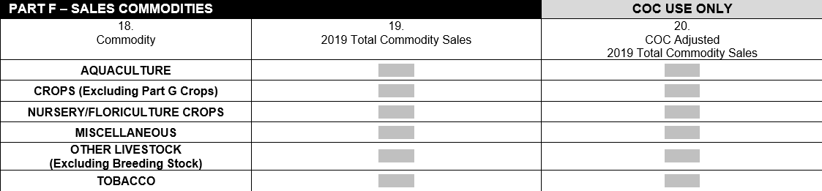
AD-3117, Part F
Sales Commodities

Slide 77
Sales commodity basics
2019 Sales Range | Percent Payment Factor for the Producer’s 2019 Sales of Eligible Commodities Falling in the Range
$0 to $49,999 | 10.6%
$50,000 to $99,999 | 9.9%
$100,000 to $499,999 | 9.7%
$500,000 to $999,999 | 9.0%
Sales over $1 million | 8.8%
New producers that do not have 2019 sales records will self-certify using 2020 actual sales at the time of application
Notes:
What happens once a producer reports their sales?
For the Payment Calculation for these crops, we will use a sales-based approach, where producers are paid based on five payment gradations associated with their 2019 sales of eligible sales-based commodities.
Payments are made based on the producer’s 2019 sales of eligible commodities in a declining block format using the payment rate factors as listed in this chart—this will make more sense in the example we’re about to show.
NOTE: Producers who began farming a category of sales commodity in 2020 and had no 2019 sales will self-certify their actual 2020 sales, at the time of application, in lieu of 2019 sales.

Slide 78
Payment Calculation Example
Farmer Joe has 2019 sales of $75,000; therefore, two payment factors apply:
10.6% (applied to $49,999)
9.9% (applied to $25,001; $75,000 minus $49,999).
Farmer Joe’s gross payment is the sum of:
$49,999 x 10.6% = $5,299.89
$25,001 x 9.9% = $2,475.10
$7,774.99

Slide 79
How do I apply?
New to USDA, no problem! Ask for help in filling out your application! Local staff may also ask for:
  Name and address
  Personal information, including your Tax Identification Number
  Farm operating structure
  Adjusted Gross Income compliance certification to ensure eligibility
  Direct deposit information to enable payment
  Some producers may need to file an acreage report
Find the CFAP 2 application (AD-3117) and needed forms: www.farmers.gov/cfap
Find your nearest service center here: www.farmers.gov/service-center-locator
Notes:
So, with all of that information – how do you apply?
If you are a new customer to USDA, your local FSA staff will work with you to fill out the application for the program, and will ask for this type of information:
Name and address
Personal information, including your Tax Identification Number
Farm operating structure
Adjusted Gross Income compliance certification to ensure eligibility
Direct deposit information to enable payment
If you received a payment under CFAP 1, your office likely has this information on file.
Note: You do not need to have a farm number to apply for CFAP 2, EXCEPT if you will be filing an application for commodities identified as “acreage-based crops”. The acreage and yield information must be provided by FSA through the annual acreage reporting process, either through an application initiated by USDA Service Center staff or by applying online.
We offer multiple options to apply for CFAP 2, including an online portal, payment calculator with downloadable application generator. You can submit your application via mail, fax, hand delivery, or electronically. FSA staff at your local USDA Service Center are happy to work with you and here to help!
All USDA Service Centers are open for business by phone, some are open to visitors to conduct business in person by appointment only. All producers wishing to conduct business with FSA should call ahead and schedule an appointment. Service Centers that are open for appointments will pre-screen visitors based on health concerns or recent travel, and visitors must adhere to social distancing guidelines. Visitors are also required to wear a face covering during their appointment.
The application and needed forms are available on our website: farmers.gov/cfap
If you are unfamiliar with where your nearest service center is located, you can find out here: www.farmers.gov/service-center-locator

Slide 80
FSA Operations: COVID-19 Impact
Status of County FSA Offices
Office status has been altered due to coronavirus but all Service Centers have remained open for business throughout the time period using phone, email and online tools.
Some offices currently are open for in-person, by-appointment-only business. All persons wanting FSA service should call ahead and schedule an appointment.
Program Flexibilities
Both farm loan and farm programs have created flexibilities for some programs in order to assist producers as we move through the COVID-19 impacts.
Notes:
We are open for business. It just looks a little different than normal.
As a government agency, we have to follow the protocols set by USDA in Washington DC, so we are working through a phased in approach to reopening to in-person traffic.
Looks at county-level metrics to determine status.
Our offices are open for in-person, by-appointment-only traffic. Producers should call the office for an appointment before going to the County Office.
CFAP 2 is easily completed by phone, email, or online tools.

Slide 81

Documentation reminders
When you sign your application, you certify that what you report on the CFAP 2 form is accurate
Keep your documentation for 3 years!
Be prepared for spot checks
A producer’s reported quantities may be adjusted upon review
Notes:
A few things we want to emphasize
Producers are self-certifying their info on their form that it is accurate.
However, keep your documentation because there may be spot checks.
A producer’s reported quantities may be adjusted upon review by USDA if the quantity is determined to be unreasonable or inaccurate based upon submitted evidence
For reference only (do not read but can reference a few as examples):
Commodity Source of Production Evidence
Dairy:
milk marketing statements for the months of April, May, June, July,
and August 2020
• records documenting milk that was dumped during April, May, June,
July, and August 2020
• other records determined acceptable by COC.
Eggs and Broilers:
• egg and broilers marketing statements for 2019
• contracts
• sales receipts
• other records determined acceptable by COC.
Note: If the applicant was a new producer after December 31, 2019,
provide 2020 documentation.
Sales Commodities:
• schedule F
• sales receipts
• ledgers of income
• income statements of deposit slips
• register tapes
• invoices for custom harvesting
• records to verify production costs
• contemporaneous measurements
• truck scale tickets
• contemporaneous diaries – determined acceptable by COC
• other records determined acceptable by COC.
Note: If the applicant was a new producer after December 31, 2019,
provide 2020 documentation.
Livestock:
Documentation that verifies the number of head claimed as owned
inventory, which includes but is not limited to:
• breeding records
• feeding records
• inventory records
• rendering receipts
• sales receipts
• veterinary records
• other records determined acceptable by COC.

Slide 82
What happens after I sign my application?
Producers have 60 days from signing their CFAP application to resolve any eligibility issues with their local office
Local office begins reviewing a producer’s application after the producer signs it, and will follow up with questions or missing information
Approved applications are processed for payment
Producers will be notified and provided opportunity to respond to adjustments by USDA that affect a producer's payment
Notes:
Producers have 60 days from signing an application to resolve any issues with their application.
Payments will be sent electronically through direct deposit.
Remember, producers do not need to have a farm number to apply – unless applying for acreage based commodity. Offices may follow up afterwards after the program to have some producers establish this info due to conservation compliance needs.

Slide 83
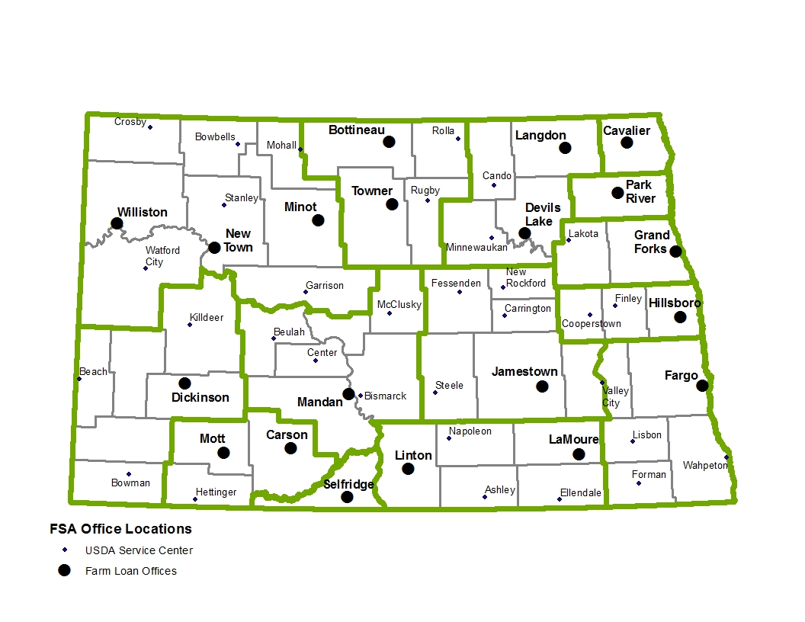
North Dakota
USDA Service Centers:

Slide 84
North Dakota USDA Service Center
Contact Information (Email & Phone)
County Office | Email Address (all staff) | Phone Number
County Name | County Group Email Address | Phone Number
Adams | ndhettinge-fsa@one.usda.gov | 701-567-2462
Barnes | ndvalleyci-fsa@one.usda.gov | 701-845-3083
Benson | ndminnewau-fsa@one.usda.gov | 701-473-5312
Bottineau | ndbottinea-fsa@one.usda.gov | 701-228-3611
Bowman /Slope | ndbowman-fsa@one.usda.gov | 701-523-5531
Burke | ndbowbells-fsa@one.usda.gov | 701-377-2983
Burleigh | ndbismarck-fsa@one.usda.gov | 701-250-4298
Cass | ndfargo-fsa@one.usda.gov | 701-282-2157
Cavalier | ndlangdon-fsa@one.usda.gov | 701-256-5521
Dickey | ndellendal-fsa@one.usda.gov | 701-349-3653
Divide | ndcrosby-fsa@one.usda.gov | 701-965-6001

Slide 85
North Dakota USDA Service Center
Contact Information (Email & Phone) Continued….
County Office | Email Address (all staff) | Phone Number
Dunn | ndkilldeer-fsa@one.usda.gov | 701-764-5991
Eddy | ndnewrockf-fsa@one.usda.gov | 701-947-2427
Emmons | ndlinton-fsa@one.usda.gov | 701-254-4791
Foster | ndcarringt-fsa@one.usda.gov | 701-652-2867
Golden Valley | ndbeach-fsa@one.usda.gov | 701-872-4313
Grand Forks | ndgrandfor-fsa@one.usda.gov | 701-775-5533
Grant | ndcarson-fsa@one.usda.gov | 701-622-3240
Griggs | ndcooperst-fsa@one.usda.gov | 701-797-2240
Hettinger | ndmott-fsa@one.usda.gov | 701-824-2691
Kidder | ndsteele-fsa@one.usda.gov | 701-475-2371
LaMoure | ndlamoure-fsa@one.usda.gov | 701-883-5268
Logan | ndnapoleon-fsa@one.usda.gov | 701-754-2251

Slide 86
North Dakota USDA Service Center
Contact Information (Email & Phone) Continued….
County Office | Email Address (all staff) | Phone Number
McHenry | ndtowner-fsa@one.usda.gov | 701-537-5471
McIntosh | ndashley-fsa@one.usda.gov | 701-288-3481
McKenzie | ndwatfordc-fsa@one.usda.gov | 701-842-3628
McLean | ndgarrison-fsa@one.usda.gov | 701-463-2267
Mercer | ndbeulah-fsa@one.usda.gov | 701-873-5290
Morton | ndmandan-fsa@one.usda.gov | 701-667-1163
Mountrail | ndstanley-fsa@one.usda.gov | 701-628-2446
Nelson | ndlakota-fsa@one.usda.gov | 701-247-2455
Oliver | ndcenter-fsa@one.usda.gov | 701-794-8725
Pembina | ndcavalier-fsa@one.usda.gov | 701-265-4333
Pierce | ndrugby-fsa@one.usda.gov | 701-776-5821
Ramsey | nddevilsla-fsa@one.usda.gov | 701-662-4987

Slide 87
North Dakota USDA Service Center
Contact Information (Email & Phone) Continued….
County Office | Email Address (all staff) | Phone Number
Ransom | ndlisbon-fsa@one.usda.gov | 701-683-5832
Renville | ndmohall-fsa@one.usda.gov | 701-756-6351
Richland | ndwahpeton-fsa@one.usda.gov | 701-642-9231
Rolette | ndrolla-fsa@one.usda.gov | 701-477-3167
Sargent | ndforman-fsa@one.usda.gov | 701-724-6226
Sheridan | ndmcclusky-fsa@one.usda.gov | 701-363-2237
Sioux | ndselfridg-fsa@one.usda.gov | 701-422-3331
Stark-Billings | nddickinso-fsa@one.usda.gov | 701-225-2931
Steele | ndfinley-fsa@one.usda.gov | 701-524-2840
Stutsman | ndjamestow-fsa@one.usda.gov | 701-252-1920
Towner | ndcando-fsa@one.usda.gov | 701-968-3514
Traill | ndhillsbor-fsa@one.usda.gov | 701- 436-5101

Slide 88
North Dakota USDA Service Center
Contact Information (Email & Phone) Continued….
County Office | Email Address (all staff) | Phone Number
Walsh | ndparkrive-fsa@one.usda.gov | 701-284-7771
Ward | ndminot-fsa@one.usda.gov | 701-852-5434
Wells | ndfessende-fsa@one.usda.gov | 701-547-3591
Williams | ndwillisto-fsa@one.usda.gov | 701-572-6729
Find Your Local Service Center
(including address information):
https://www.farmers.gov/service-center-locator

Slide 89
Communication Resources:
For more information visit: https://www.farmers.gov/cfap
CFAP 2 Eligible Commodities Finder:
http://www.farmers.gov/cfap/tool
Coronavirus and USDA Service Centers
https://www.farmers.gov/coronavirus

Slide 90
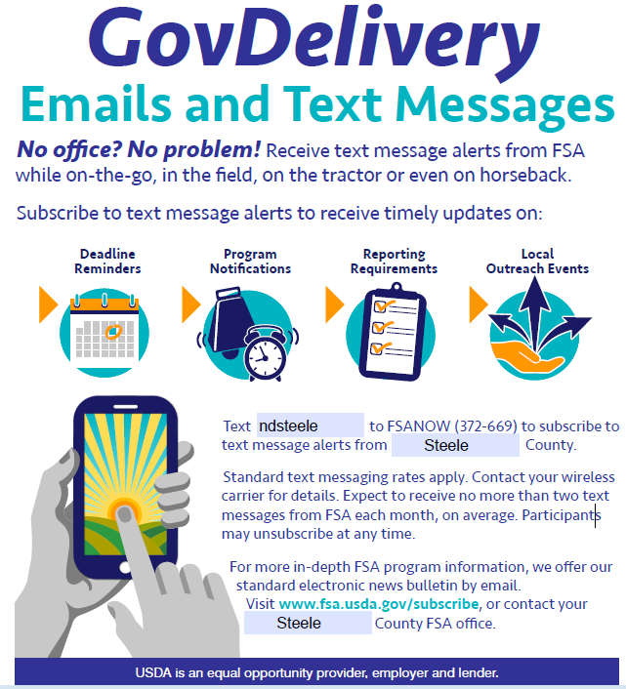
Stay Connected with the Latest Information

Slide 91
ND Farm Service Agency Contacts for information on this webinar:
General Program Information, Payment Limitation and Compliance | Laura Heinrich, laura.heinrich@usda.gov Farm Program Director Ronald Duvall, ronald.duvall@usda.gov Farm Program Director
Acreage Based Crops | Brian Haugen, brian.haugen@usda.gov Farm Program Director
Livestock, Dairy, Eggs & Broilers | Wanda Braton, wanda.braton@usda.gov Farm Program Director
Sales Commodities, Specialty Crops & Specialty Livestock | Laura Heinrich, laura.heinrich@usda.gov Farm Program Director
State Executive Director Communications/Outreach | Brad Thykeson, brad.thykeson@usda.gov Lindsey Abentroth, lindsey.Abentroth@usda.gov

Slide 92


