Slide 1
Agricultural Markets Situation and Outlook
June 10th, 2021

Slide 2
Use the Q&A Tool to ask Questions

Slide 3
ND Farm Income and Ratios
Bryon Parman
Cell – 701-261-5919
Bryon.Parman@ndsu.edu

Slide 4
Net Farm Income ND Farm Business Management, Excluding RRV
Notes:
Highlights the need for gov’t pmts 1997-2001.
Gov’t pmts have gone from 26% of NFI in 1995 to 110% of NFI in 2000.
Cash gov’t payments (LDP’s, AMTA, MLA, Disaster, Oilseed program
pmts, inundated acres, etc, but not including CRP) were $46,500 in 1999 and $62,500 in 2000, but dropped to $16,950 in 2002.
Nationally, gov’t payments as a % of cash income was higher in 1999 and 2000 than in any year during the 1930’s - a period known for reliance on gov’t support after the first major farm bill in 1933.

Slide 5
Rates of Return on Assets and Equity, per Farm ND Farm Business Management

Slide 6
Net Farm Income, Excluding Gov’t Pymts ND Farm Business Management
Notes:
Highlights the need for gov’t pmts 1997-2001.
Gov’t pmts have gone from 26% of NFI in 1995 to 110% of NFI in 2000.
Cash gov’t payments (LDP’s, AMTA, MLA, Disaster, Oilseed program
pmts, inundated acres, etc, but not including CRP) were $46,500 in 1999 and $62,500 in 2000, but dropped to $16,950 in 2002.
Nationally, gov’t payments as a % of cash income was higher in 1999 and 2000 than in any year during the 1930’s - a period known for reliance on gov’t support after the first major farm bill in 1933.

Slide 7
Net Farm Income, Excluding Govt & Ins. Pmts ND Farm Business Management
Notes:
Income from insurance has been unusually high in 1999 & 2000.
Cash insurance income averaged $27,000 in 1999 and $25,00 in 2000, $24,930
In 2001, $25,109 in 2002.
(In 1999, insurance made up nearly 2/3’s of the NFI of the high
20% profit farms.)

Slide 8
Crop Insurance and Government Payments State Averages

Slide 9
Money Borrowed and Principal Paid, per Farm ND Farm Business Management

Slide 10
ND Farm Business Management

Slide 11
Inflation
Latest report shows 5% inflation for may
3.8% core inflation
Highest since 2009
Many analysts think it is transitory and likely stemming from sections of the economy opening up
This implies it will be short lived and unlikely to affect FED policy

Slide 12
Implications of June WASDE
Frayne Olson
Crop Economist/ Marketing Specialist
frayne.olson@ndsu.edu
701-231-7377 (o)
701-715-3673 (c)

Slide 13
Pre-Report Industry Estimates vs. Reported Values
U.S. 2020-21 Ending Stocks (billion bushels)
 | All Wheat | Corn | Soybean
Average Trade Estimate | 0.869 bill. bu. | 1.207 bill. bu. | 0.122 bill. bu.
Highest Trade Estimate | 0.901 bill. bu. | 1.257 bill. bu. | 0.150 bill. bu.
Lowest Trade Estimate | 0.832 bill. bu. | 1.132 bill. bu. | 0.110 bill. bu.
USDA May 12, 2021 | 0.872 bill. bu. | 1.257 bill. bu. | 0.120 bill. bu.
USDA June 10, 2021 | 0.852 bill. bu. | 1.107 bill. bu. | 0.135 bill. bu.
Reuters News and June 10, 2021 USDA - WASDE

Slide 14
Pre-Report Industry Estimates vs. Reported Values
U.S. 2021-22 Ending Stocks (billion bushels)
 | All Wheat | Corn | Soybean
Average Trade Estimate | 0.783 bill. bu. | 1.423 bill. bu. | 0.146 bill. bu.
Highest Trade Estimate | 0.899 bill. bu. | 1.507 bill. bu. | 0.206 bill. bu.
Lowest Trade Estimate | 0.702 bill. bu. | 1.282 bill. bu. | 0.127 bill. bu.
USDA May 12, 2021 | 0.774 bill. bu. | 1.507 bill. bu. | 0.140 bill. bu.
USDA June 10, 2021 | 0.770 bill. bu. | 1.357 bill. bu. | 0.155 bill. bu.
Reuters News and June 10, 2021 USDA - WASDE

Slide 15
Next Major USDA Reports
Acreage report:
June 30, 2021, at 11:00 am CT.
Survey of approximately 70,900 farm operators in U.S. during first two weeks of June.
Update to the March Prospective Plantings report.
Note: WASDE is currently using 30-year trendline yields, adjusted for planting progress.

Slide 16
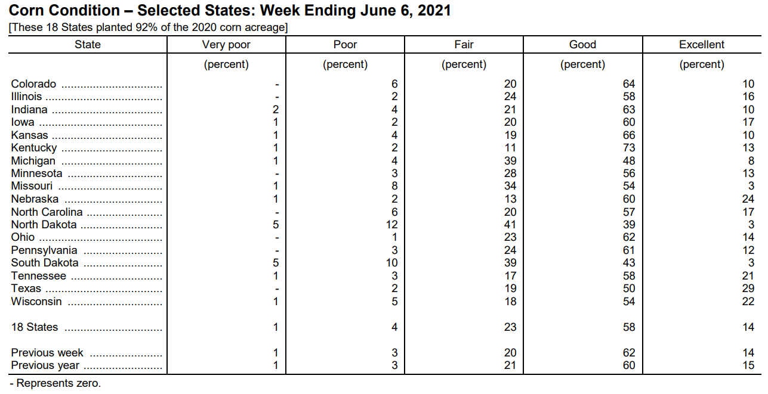
USDA Crop Progress Report - Corn
June 6, 2021 USDA – Crop Progress Report

Slide 17
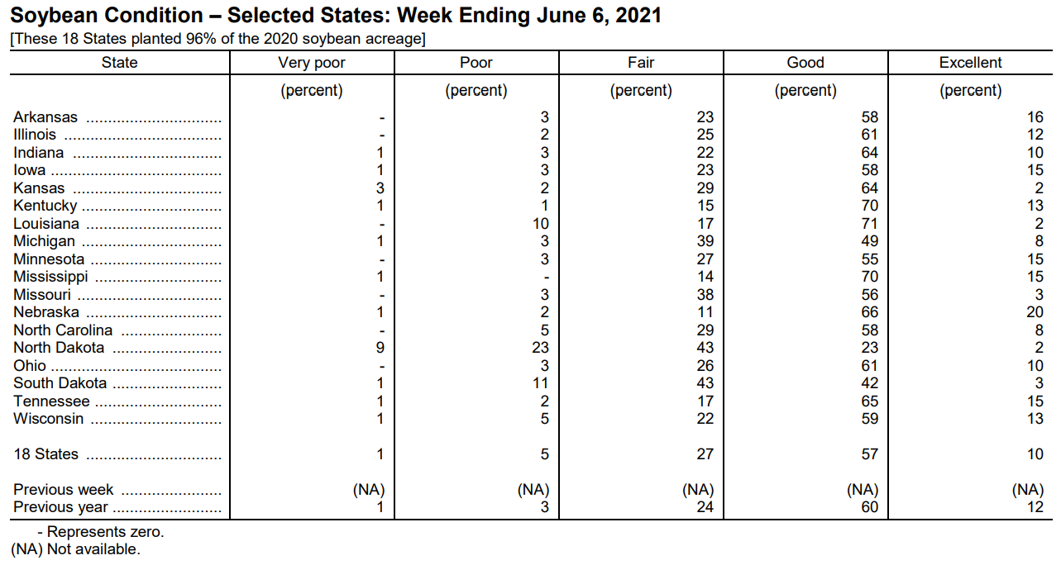
USDA Crop Progress Report - Soybean
June 6, 2021 USDA – Crop Progress Report

Slide 18
USDA Crop Progress Report – Spring Wheat
June 6, 2021 USDA – Crop Progress Report

Slide 19
U.S. Drought Monitor Comparison
June 8, 2021
June 1, 2021
National Drought Mitigation Center – University of Nebraska - Lincoln

Slide 20
Past 30-Day Total Rainfall
North Dakota Agricultural Weather Network (06-10-21 am)

Slide 21
Past 7-Day Total Rainfall
North Dakota Agricultural Weather Network (06-10-21 am)

Slide 22
Past 7-Day Accumulated Precipitation
National Weather Service – Climate Prediction Center (06-10-21 am)

Slide 23
0.0” - 3.9” Relative Soil Moisture
Short-term Prediction Research and Transition Center – NASA (06-10-21 am)

Slide 24
3.9” – 15.7” Relative Soil Moisture
Short-term Prediction Research and Transition Center – NASA (06-10-21 am)

Slide 25
Next 5-Day Precipitation Forecast
National Weather Service – Weather Prediction Center (06-10-21 am)

Slide 26
Next 3-7 Day Max. Temp. Anomaly
National Weather Service – Weather Prediction Center (06-10-21 am)

Slide 27
LIVESTOCK PRICE SITUATION AND OUTLOOK
Tim Petry
Extension Livestock Marketing Economist
Tim.Petry@ndsu.edu
www.ndsu.edu/livestockeconomics
701-231-7469

Slide 28
Markets do not like “unknown unknowns” which cause price volatility when they occur.
9/11/2001, BSE-2003, COVID-19
Many lately!
Now called “Black Swan” events.

Slide 29
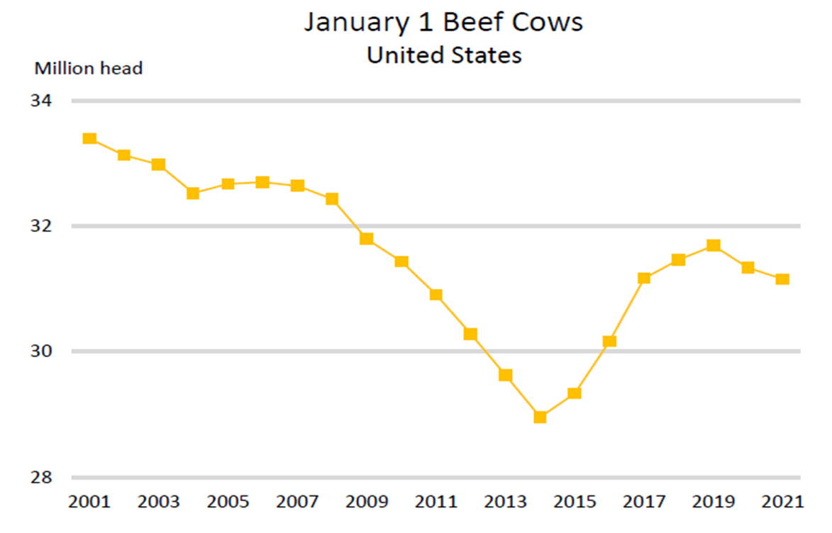

Slide 30
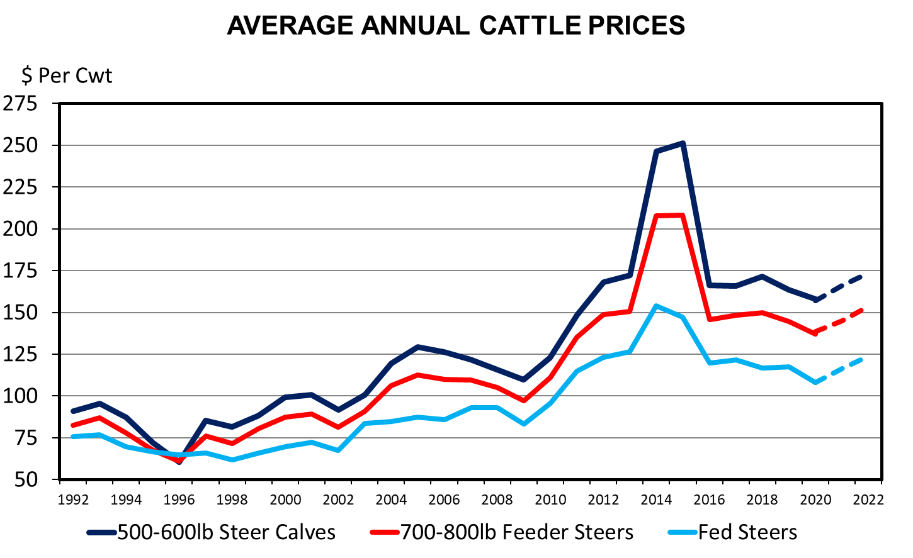

Slide 31
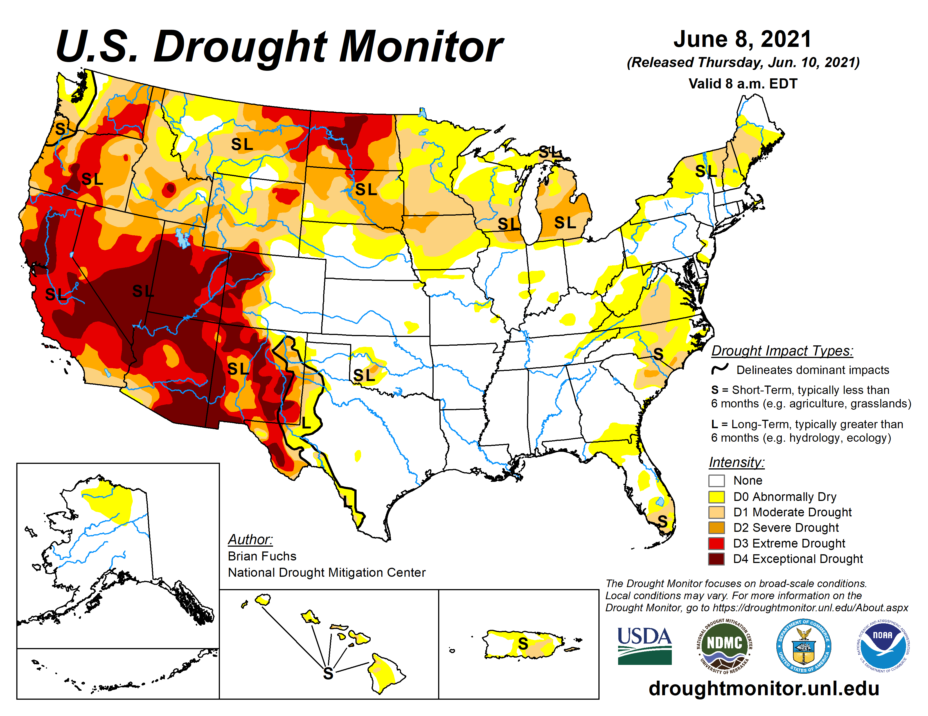
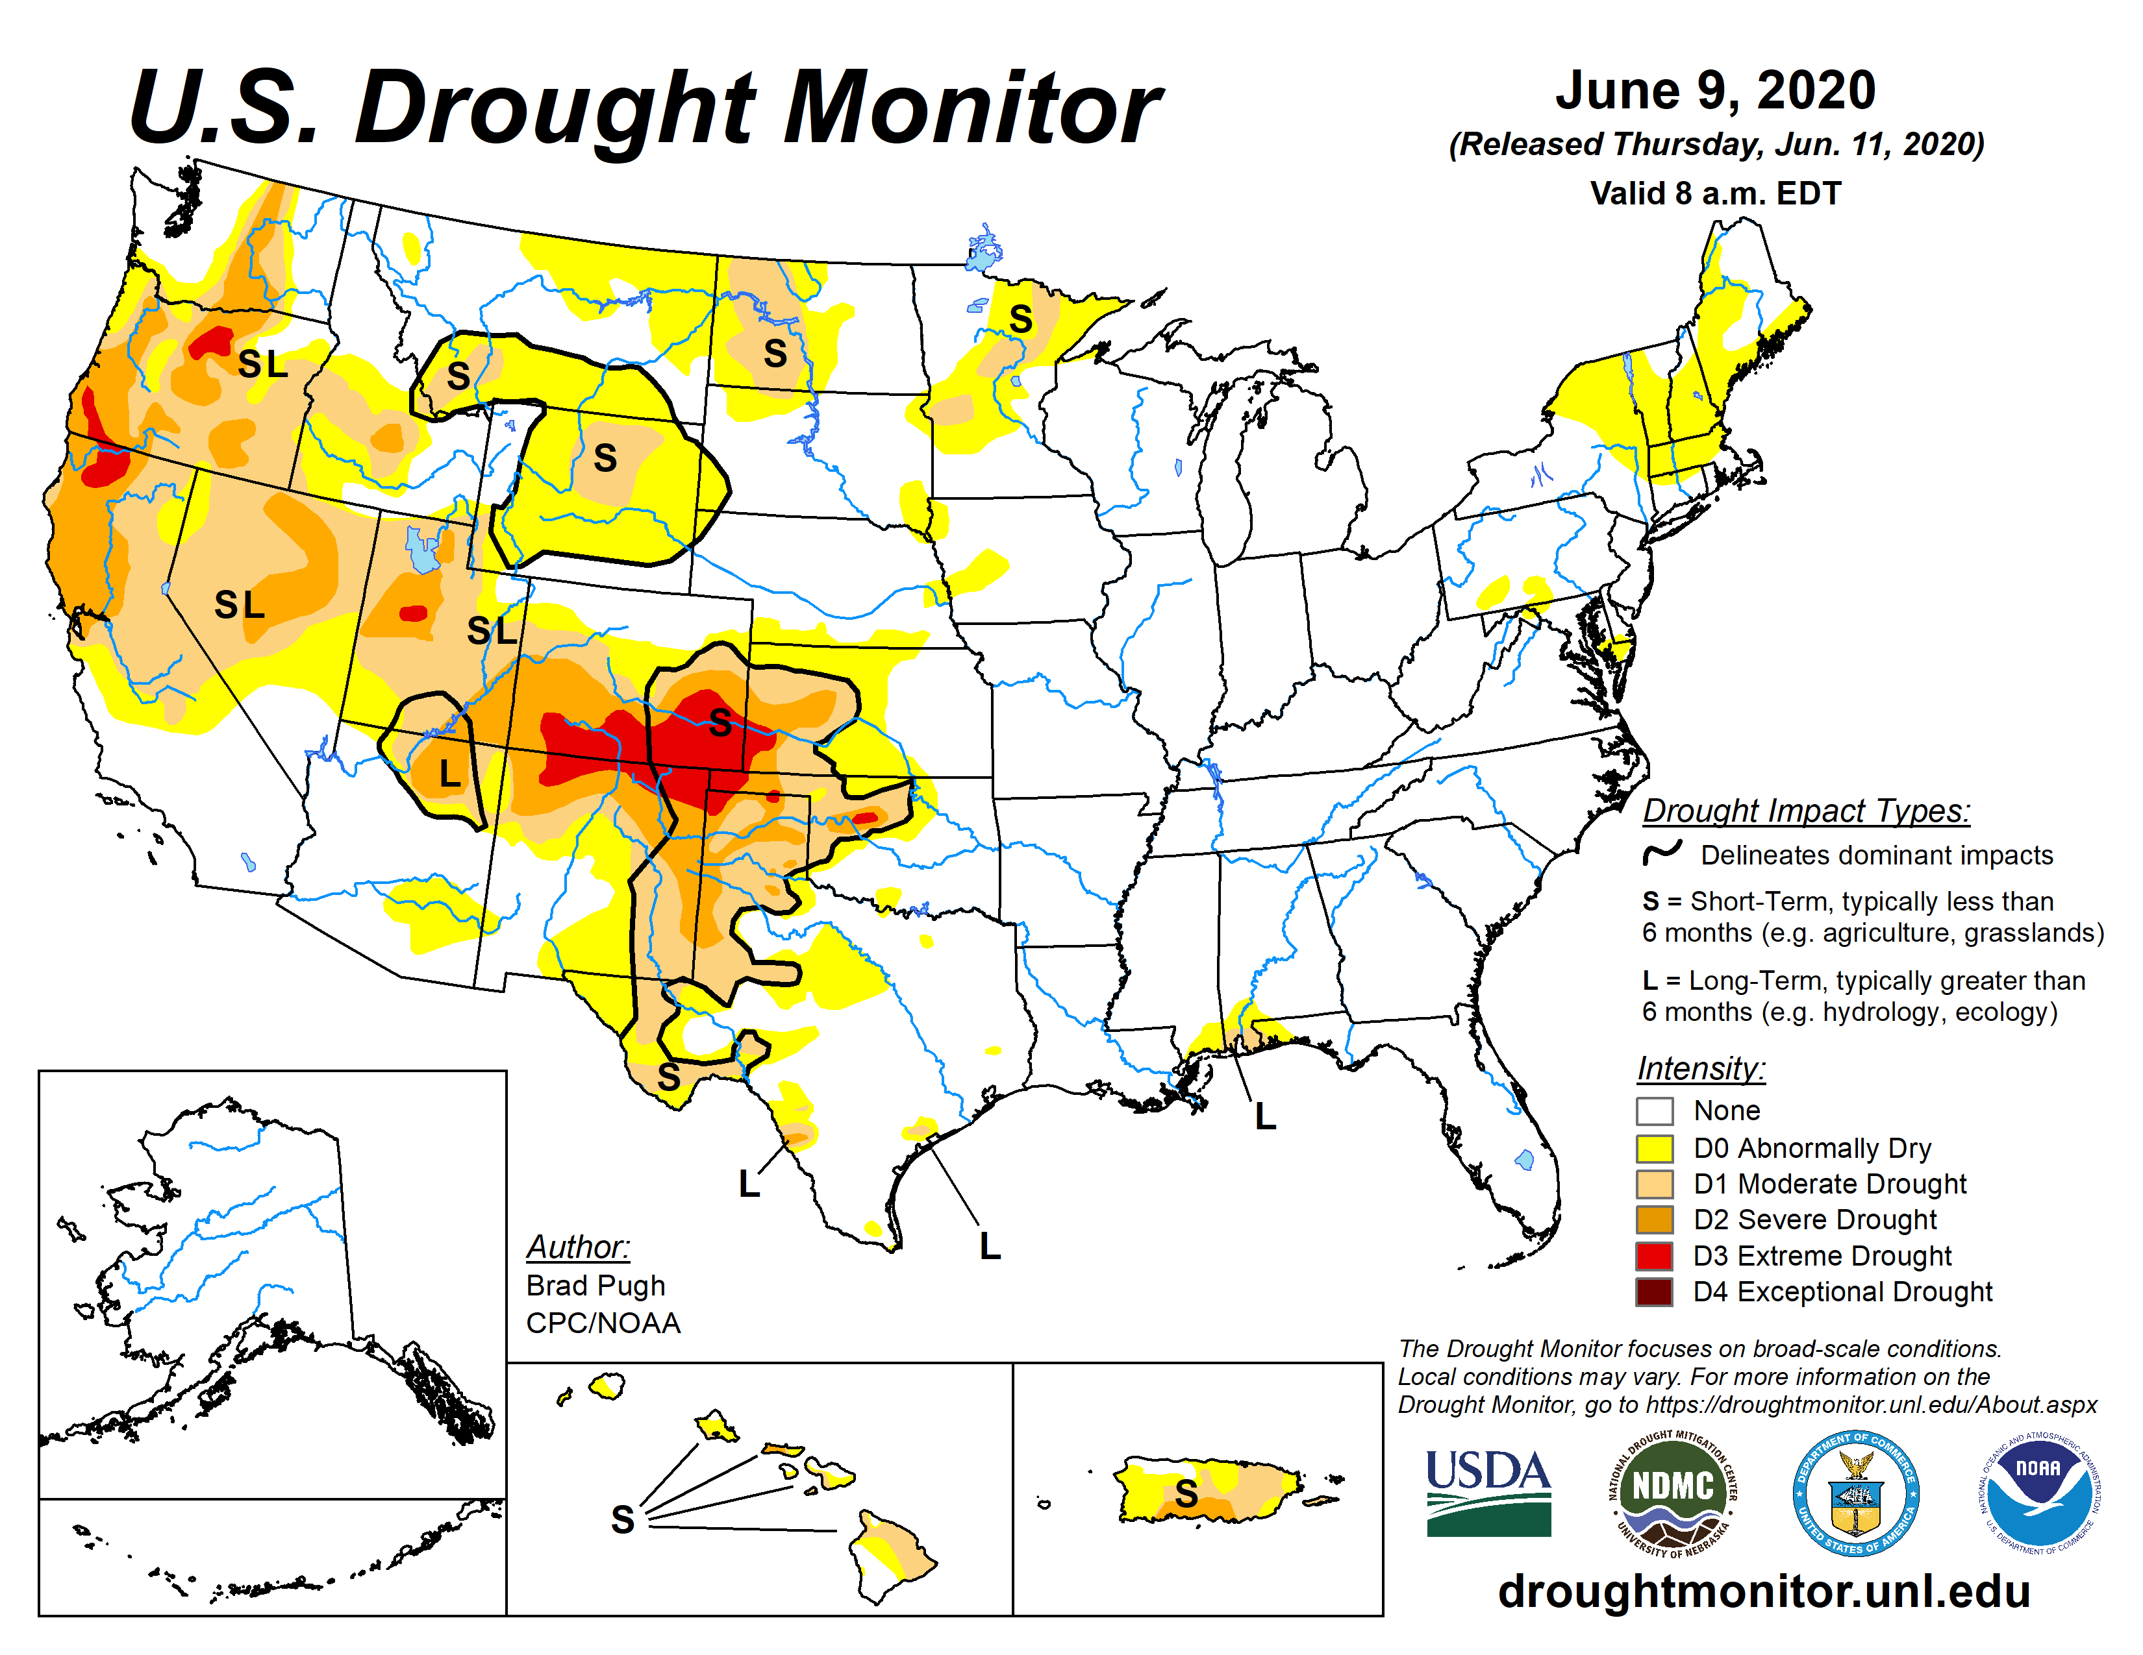

Slide 32
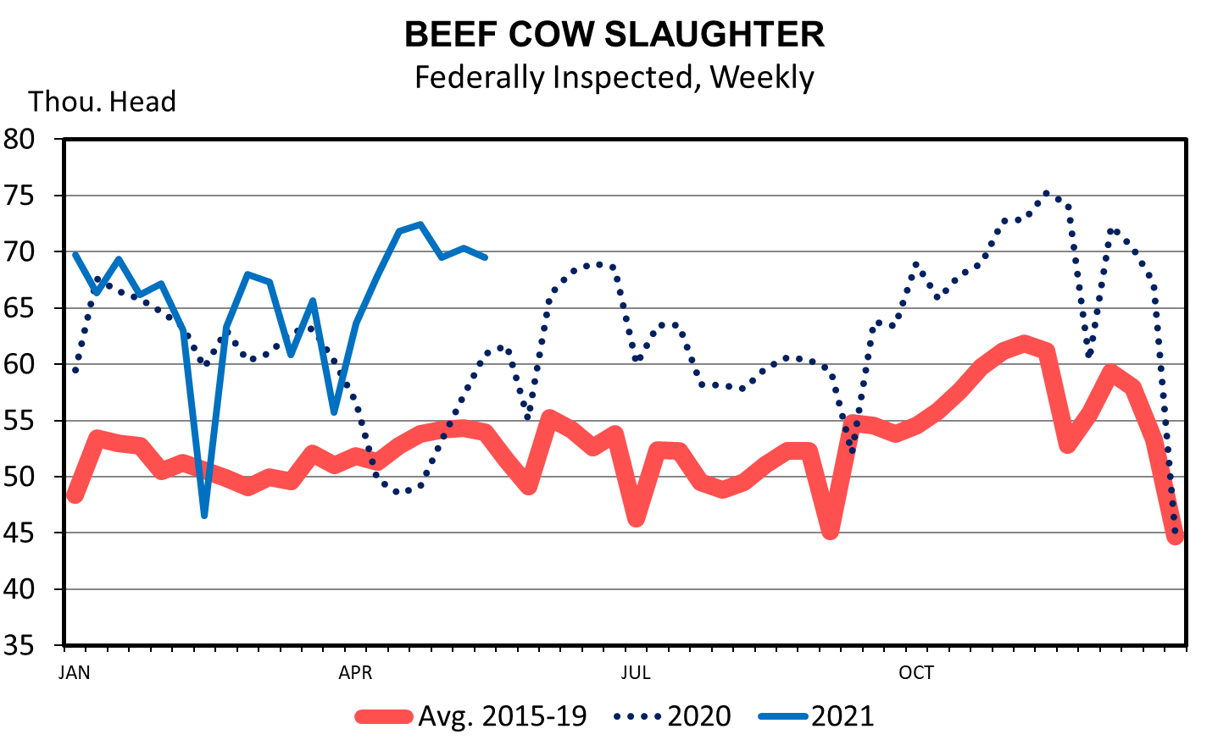
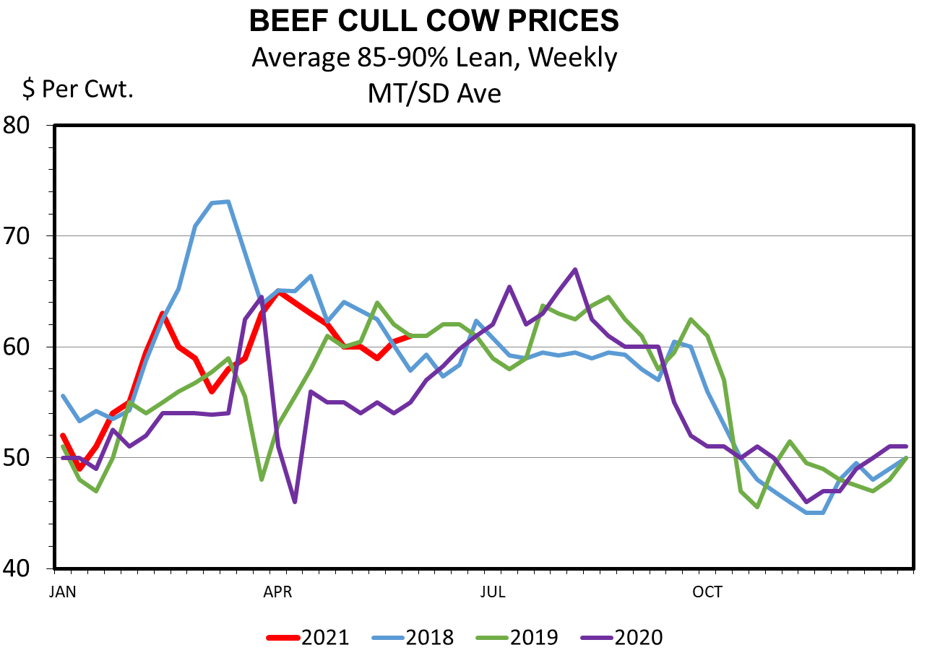

Slide 33
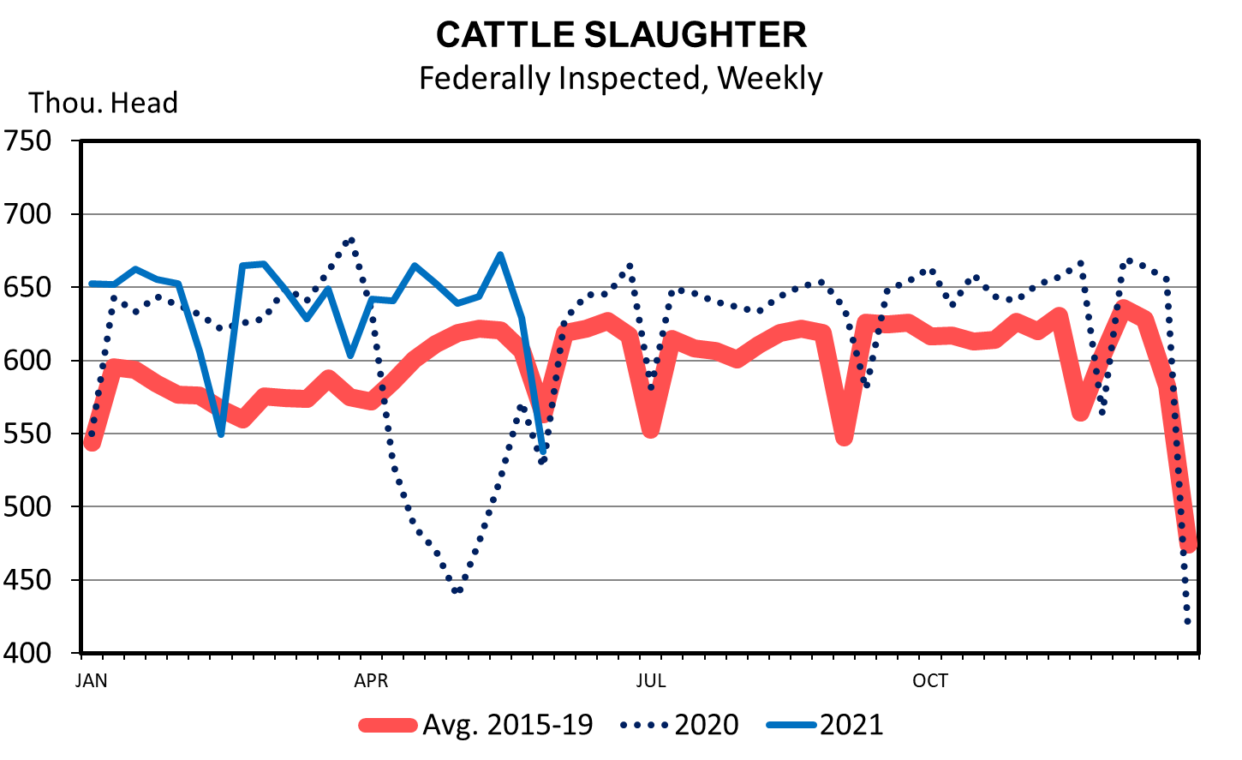

Slide 34
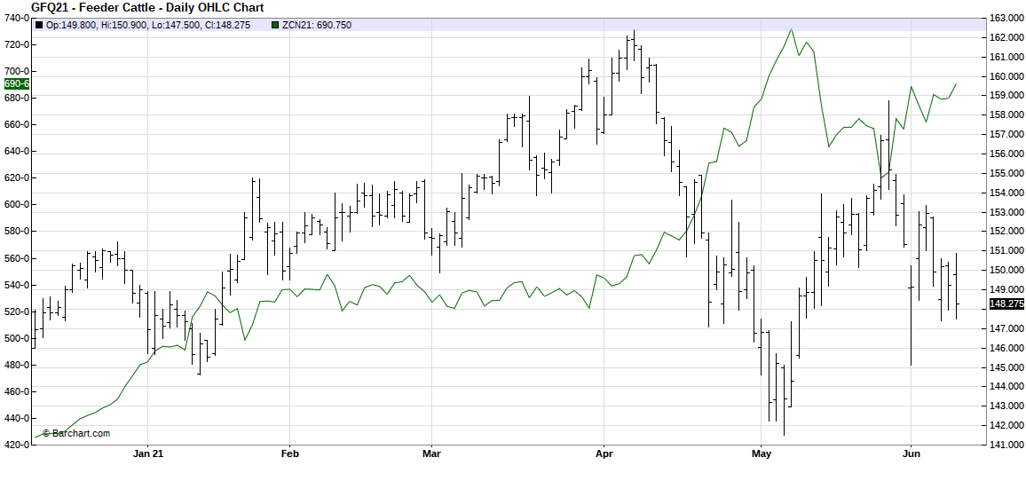
AUG FDR CAT and JUL CORN

Slide 36
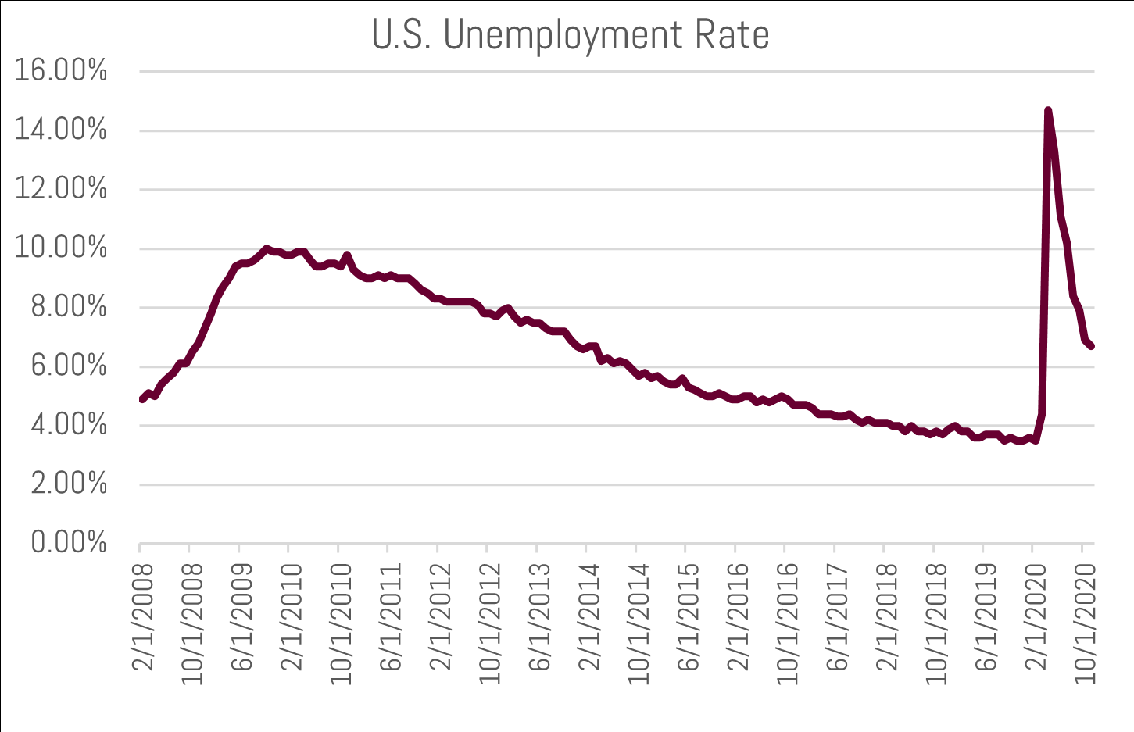
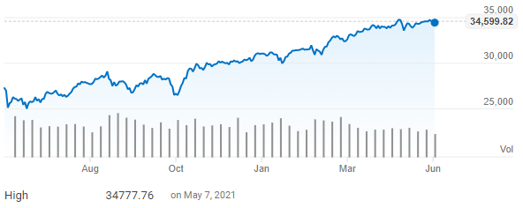
US ECONOMY?

Slide 37
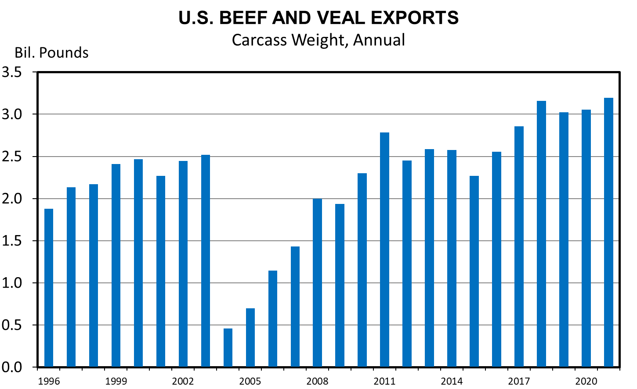
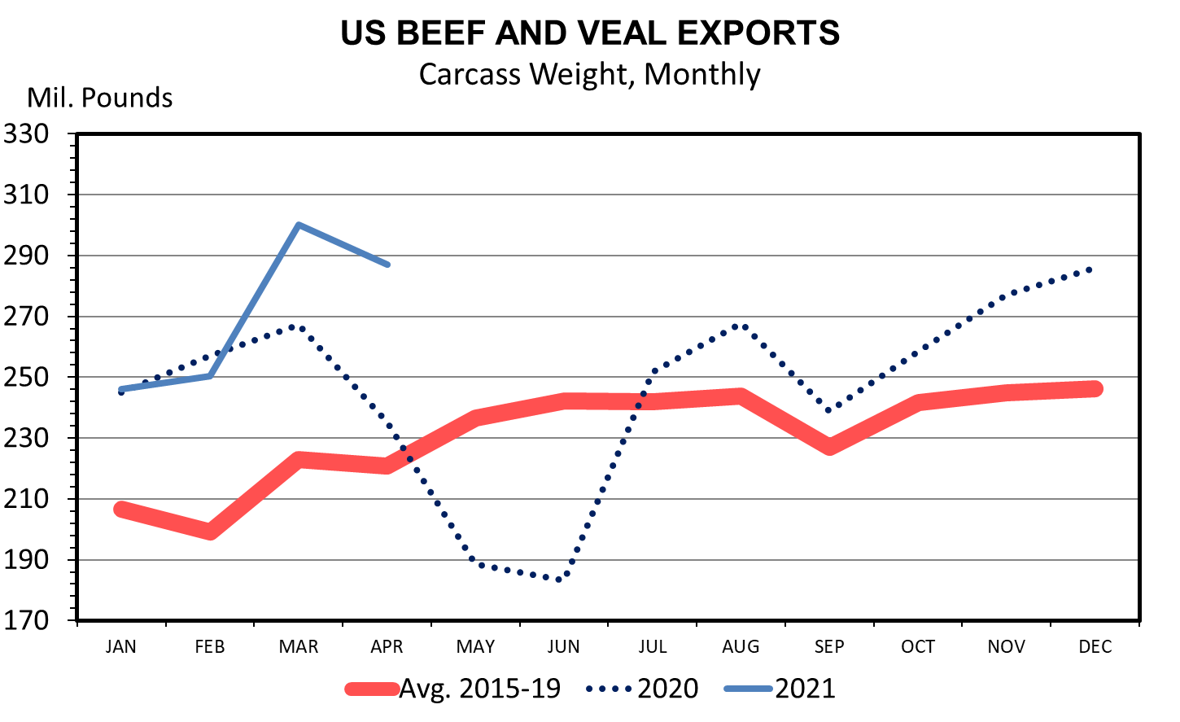

Slide 38
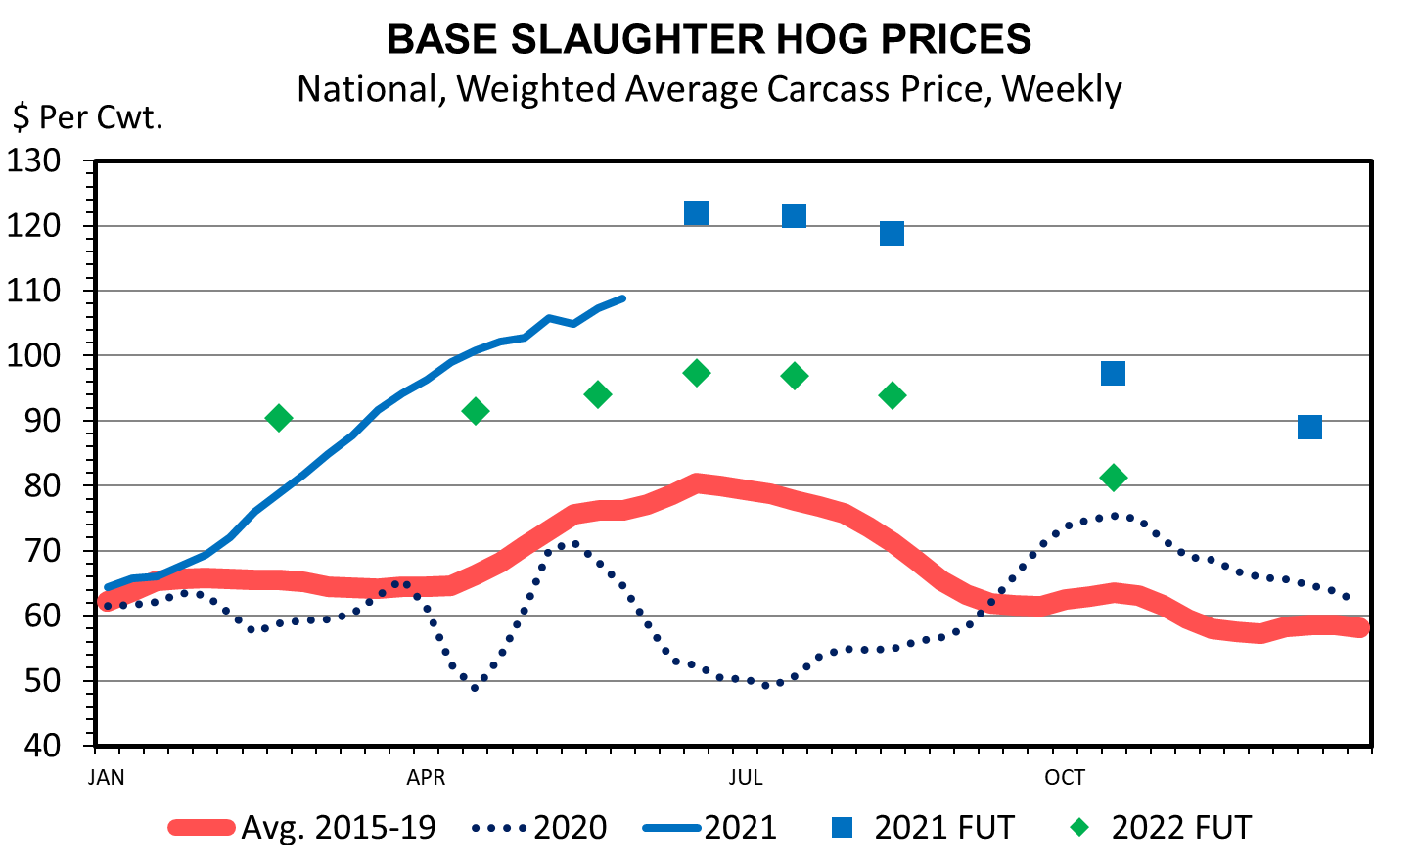
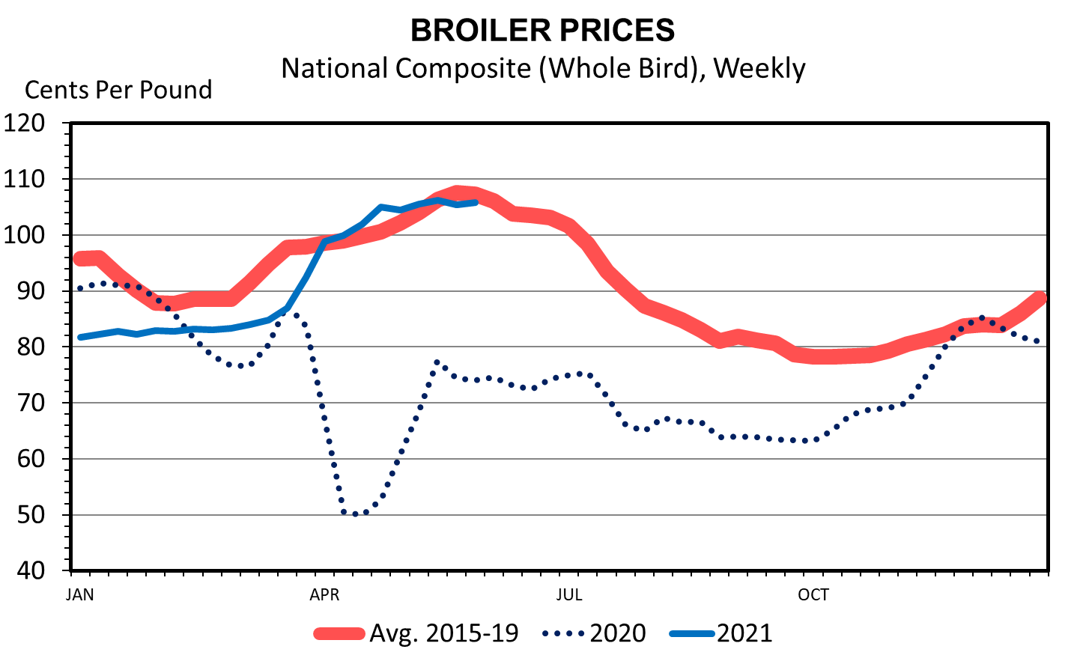
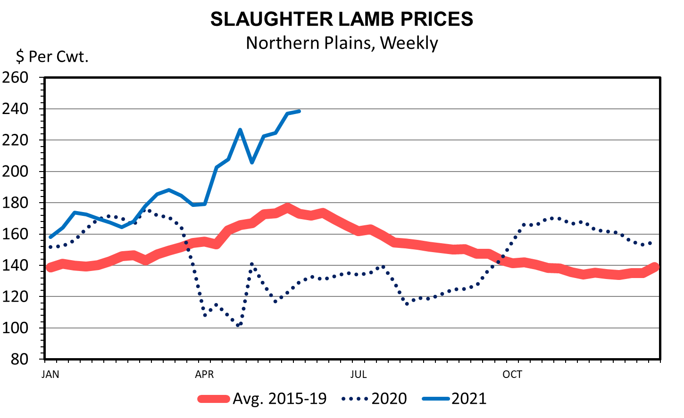
Other Livestock
Data Source: USDA-AMS; Livestock Marketing Information Center

Slide 39
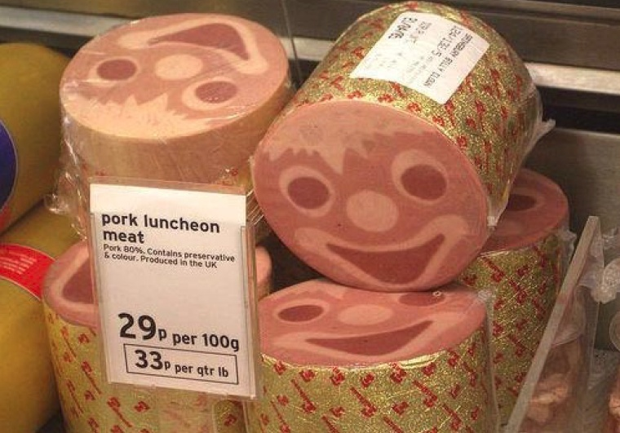
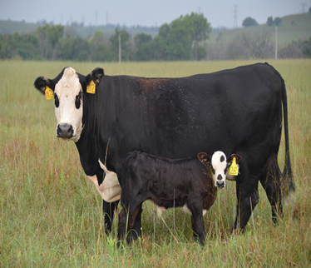
BETTER CATTLE PRICES AHEAD!
BUT VOLATILE
UNKNOWN UNKNOWNS?

Slide 40
Forced Livestock Sales/LFP
Ron Haugen
Extension Farm Management Specialist
701-231-8103
ronald.haugen@ndsu.edu

Slide 41
An eligible livestock owner or contract grower who, as a grazed forage crop producer, owns or leases grazing land or pastureland physically located in a county rated by the U.S. Drought Monitor as having a:
D2 (severe drought) intensity in any area of the county for at least eight consecutive weeks during the normal grazing period is eligible to receive assistance in an amount equal to one monthly payment
D3 (extreme drought) intensity in any area of the county at any time during the normal grazing period is eligible to receive assistance in an amount equal to three monthly payments
D3 (extreme drought) intensity in any area of the county for at least four weeks during the normal grazing period or is rated a D4 (exceptional drought) intensity at any time during the normal grazing period is eligible to receive assistance in an amount equal to four monthly payments
D4 (exceptional drought) in a county for four weeks (not necessarily four consecutive weeks) during the normal grazing period is eligible to receive assistance in an amount equal to five monthly payments

Slide 42
LFP Monthly payments 5-13-21
Divide
4
Burke
4
Renville
4
Bottineau
4
Rolette
4
Cavalier
4
Pembina
4
Towner
4
Williams
4
Pierce
4
Walsh
4
Mountrail
4
McHenry
4
Ramsey
4
Ward
4
Benson
4
Grand
Forks
3
Nelson
4
McKenzie
4
Eddy
4
McLean
4
Sheridan
4
Wells
4
Griggs
3
Steele
3
Foster
4
Traill
0
Dunn
4
Mercer
4
Billings
4
Oliver
4
Golden
Valley
4
Burleigh
4
Kidder
4
Stutsman
4
Barnes
3
Cass
0
Stark
4
Morton
4
Slope
4
Hettinger
4
Logan
4
LaMoure
4
Ransom
0
Grant
4
Emmons
4
Richland
0
Bowman
4
Adams
4
Sioux
4
McIntosh
4
Dickey
3
Sargent
0
0 1 3 4 5

Slide 43
LFP Monthly payments 6-3-21
Divide
4
Burke
4
Renville
4
Bottineau
4
Rolette
4
Cavalier
4
Pembina
4
Towner
4
Williams
4
Pierce
4
Walsh
4
Mountrail
4
McHenry
4
Ramsey
4
Ward
4
Benson
4
Grand
Forks
4
Nelson
4
McKenzie
4
Eddy
4
McLean
4
Sheridan
4
Wells
4
Steele
4
Foster
4
Griggs
4
Traill
1
Dunn
4
Mercer
4
Billings
4
Oliver
4
Golden
Valley
4
Burleigh
4
Kidder
4
Stutsman
4
Barnes
4
Cass
1
Stark
4
Morton
4
Slope
4
Hettinger
4
Logan
4
LaMoure
4
Ransom
0
Grant
4
Emmons
4
Richland
0
Bowman
4
Adams
4
Sioux
4
McIntosh
4
Dickey
4
Sargent
0
0 1 3 4 5

Slide 44
LFP Monthly payments 6-10-21
Towner County will go to five payments if in D4 for one more week
Divide
4
Burke
4
Renville
5
Bottineau
5
Rolette
5
Cavalier
4
Pembina
4
Towner
4
Williams
4
Pierce
5
Walsh
4
Mountrail
5
McHenry
5
Ramsey
4
Ward
5
Benson
5
Grand
Forks
4
Nelson
4
McKenzie
5
Eddy
4
McLean
5
Sheridan
5
Wells
5
Griggs
4
Steele
4
Foster
4
Traill
1
Dunn
5
Mercer
5
Billings
4
Oliver
5
Golden
Valley
4
Burleigh
5
Kidder
4
Stutsman
4
Barnes
4
Cass
1
Stark
4
Morton
5
Slope
4
Hettinger
4
Logan
4
LaMoure
4
Ransom
0
Grant
4
Emmons
4
Richland
0
Bowman
4
Adams
4
Sioux
4
McIntosh
4
Dickey
4
Sargent
0
0 1 3 4 5

Slide 45
Forced Livestock Sales
Two IRS provisions:
IRC 1033(e)
IRC 451(g)

Slide 46
Involuntary Conversion of Draft or Breeding Animal IRC Sec 1033(e)
A livestock producer who sells more draft, breeding, or dairy animals than normal due to weather-related conditions may defer recognition of the gains for up to two years.
The animals must be replaced within two years with other animals used for identical purposes.
This applies only to the number of animals sold in excess of normal business practices.
Declaration of a disaster area is not necessary, but the producer must be able to show that weather-related conditions forced the sale of more livestock than would normally be sold.
If there is a federal disaster declaration the replacement period is four years.
The Secretary of the Treasury can extend the period further if the drought persists three years or more.
Tax basis of the replacement livestock is equal to the basis in the livestock sold plus any additional amount invested in the replacement livestock that exceeds the proceeds from the sale.
If the animals are not replaced, or if replacement cost is less than the gain from their sale, the difference must be reported as a gain for the sale year by amending the tax return. The return will be subject to additional tax and interest.
It is a dollar for dollar replacement not head for head.

Slide 47
Making the Election 1033(e)
The producer makes this election by attaching a statement to his or her tax return. The election must include the following information:
• Name, address, and ID number.
• A declaration that the election is made under I.R.C. § 1033(e).
• Evidence of the weather-related conditions that forced the sale or exchange of animals.
• Explanation of how the sale is related to weather conditions.
• Number and kind of livestock sold or exchanged.
• Number of livestock of each kind that would have been sold or exchanged under normal business circumstances (generally, the average number of animals sold over the three preceding years).
• The amount of gain realized on the sale or exchange.
• The amount of income to be postponed

Slide 48
Deferral of Income for One Year of Sale of Market Animals IRC Sec 451(g)
Livestock producers using the cash method of accounting can elect to defer for one tax year the income of any qualified livestock sold due to weather-related conditions.
The area must be federally recognized and declared as eligible to receive federal assistance.
It is not necessary for the animals to be raised or sold in the declared disaster area, just that a weather-related event caused the area to receive federal disaster designation and caused the sale of the animals.
Only livestock sales in excess of normal business practice qualify for deferral.
The animals are not replaced and the elected gain is simply put off to the next year.

Slide 49
Making the Election 451(g)
The producer makes this election by attaching a statement to his or her tax return. The election must include the following information:
• Name, address, and ID number.
• A declaration that the election is made under I.R.C. § 451(g).
• Evidence of weather-related conditions that forced the sale or exchange of animals and federal disaster designation.
• Explanation of how the sale is related to weather conditions.
• Number of livestock of each kind that would have been sold or exchanged under normal business circumstances (generally the average number of animals sold over the three preceding years).
• Total number of animals sold in the current year and the number sold due to the weather-related circumstance.
• The amount of income to be deferred.

Slide 50
IRS Publication 225 “Farmers Tax Guide”
Contact your tax professional!

