Slide 1
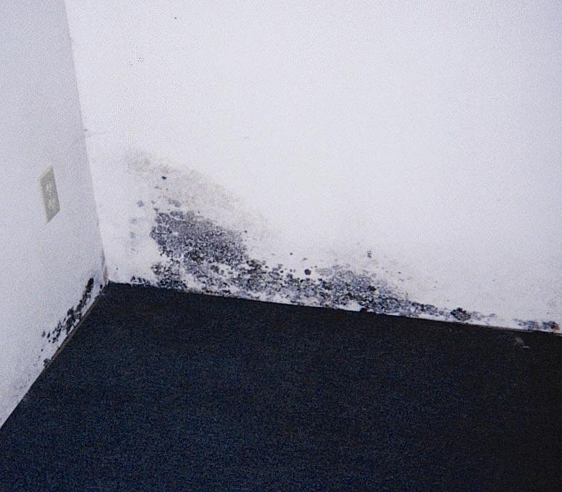

In Your Home
Mold
Photo courtesy of Paul Davis Systems
Notes:
Have you ever come upon a pile of old leaves and turned the leaves over to find a growth of mold? Mold is everywhere inside and outside. Can you name some places where mold is apt to grow? (Ask participants to name places where mold can grow. Answers may include greenhouses, farms, compost piles, wooded or shaded areas, lake areas, about anyplace since mold spores are everywhere and just need moisture to grow.)
Mold can grow anywhere there is moisture. For this lesson, we will talk about mold in the home and classify mildew as mold too. We will explore why some people are more at risk for allergies to mold, and we will learn that mold can be good but can also impact our health.

Slide 2
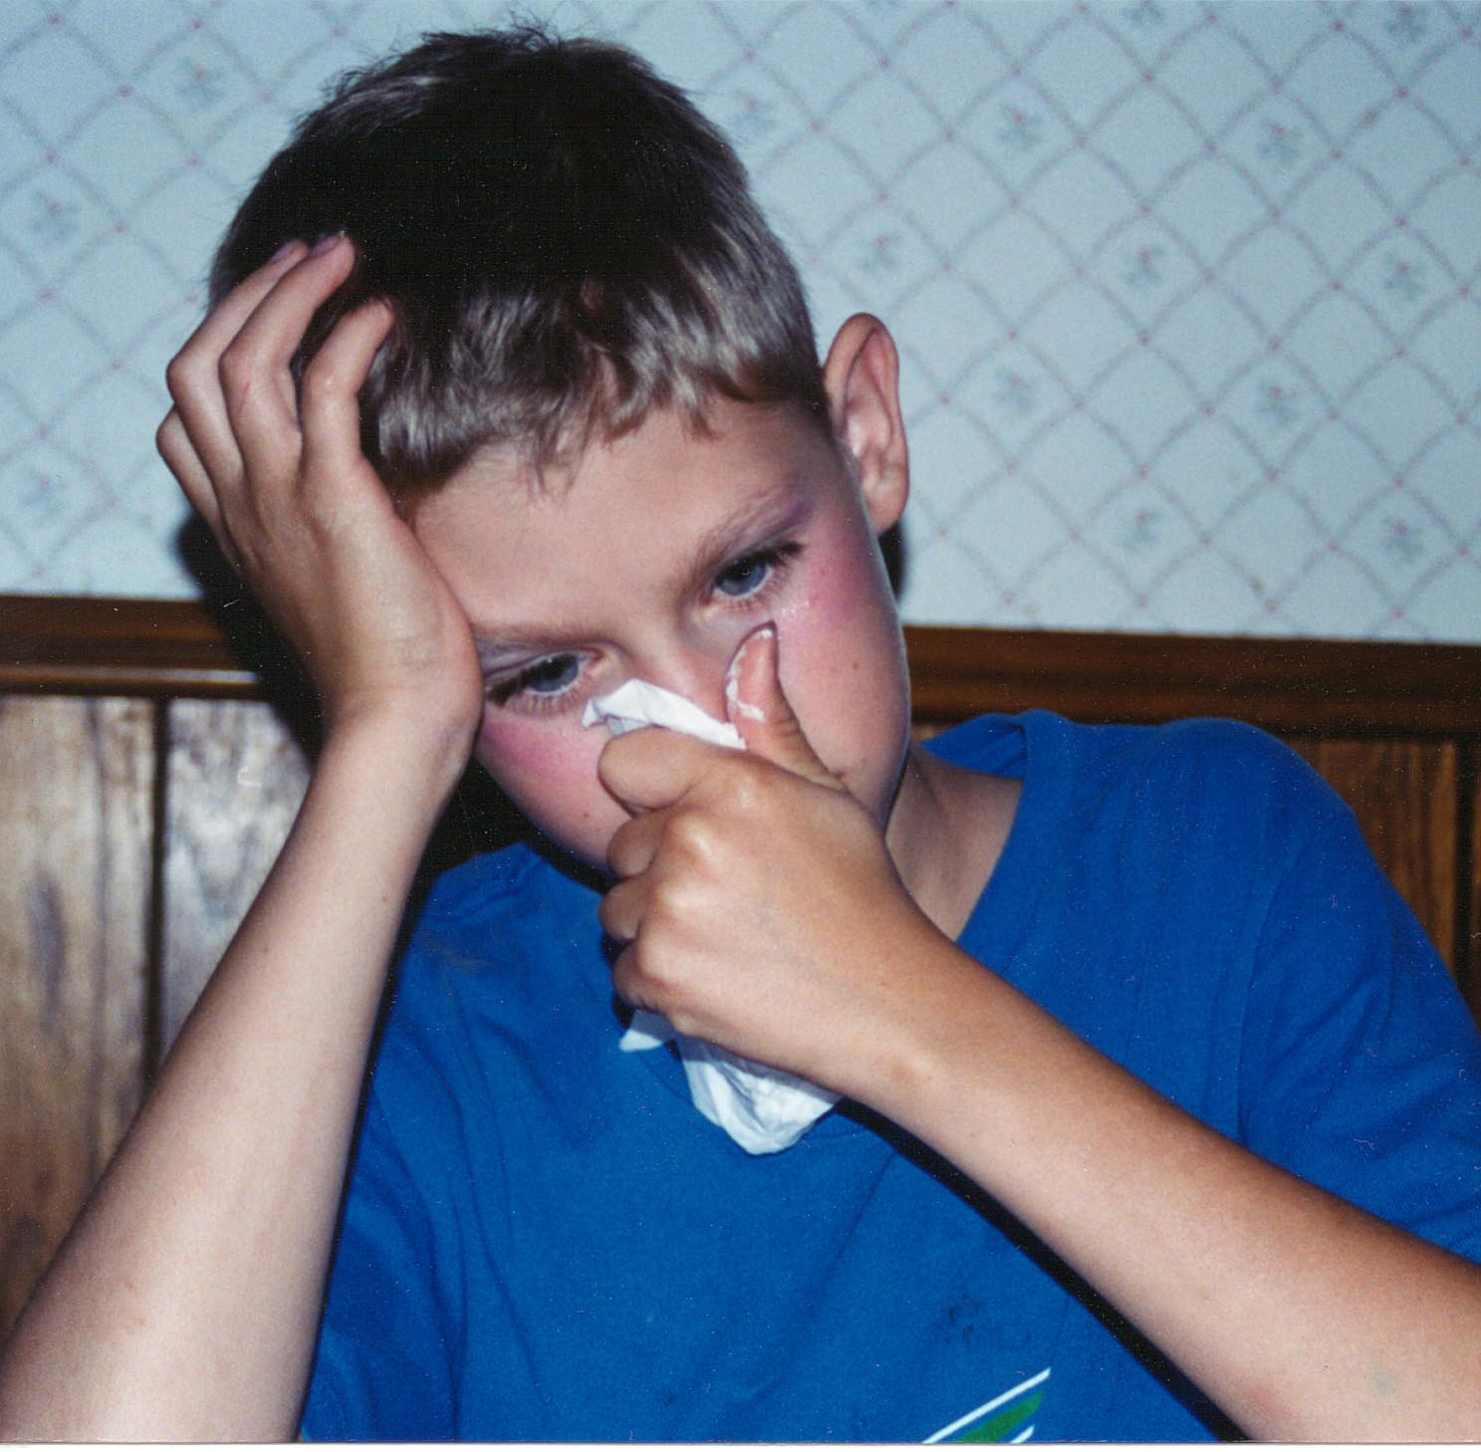
Health Effects of Mold
Watery or itchy eyes
Sore throat
Stuffed up nose
Coughing
Skin irritations
May trigger asthma attacks
Notes:
What are the health risks from exposure to mold? Some people are very sensitive to mold. A small amount can trigger reactions such as a sore throat, itchy eyes and nasal stuffiness. Severe reactions may be shortness of breath and fever. Mold may even trigger asthma attacks and cause respiratory problems.

Slide 3
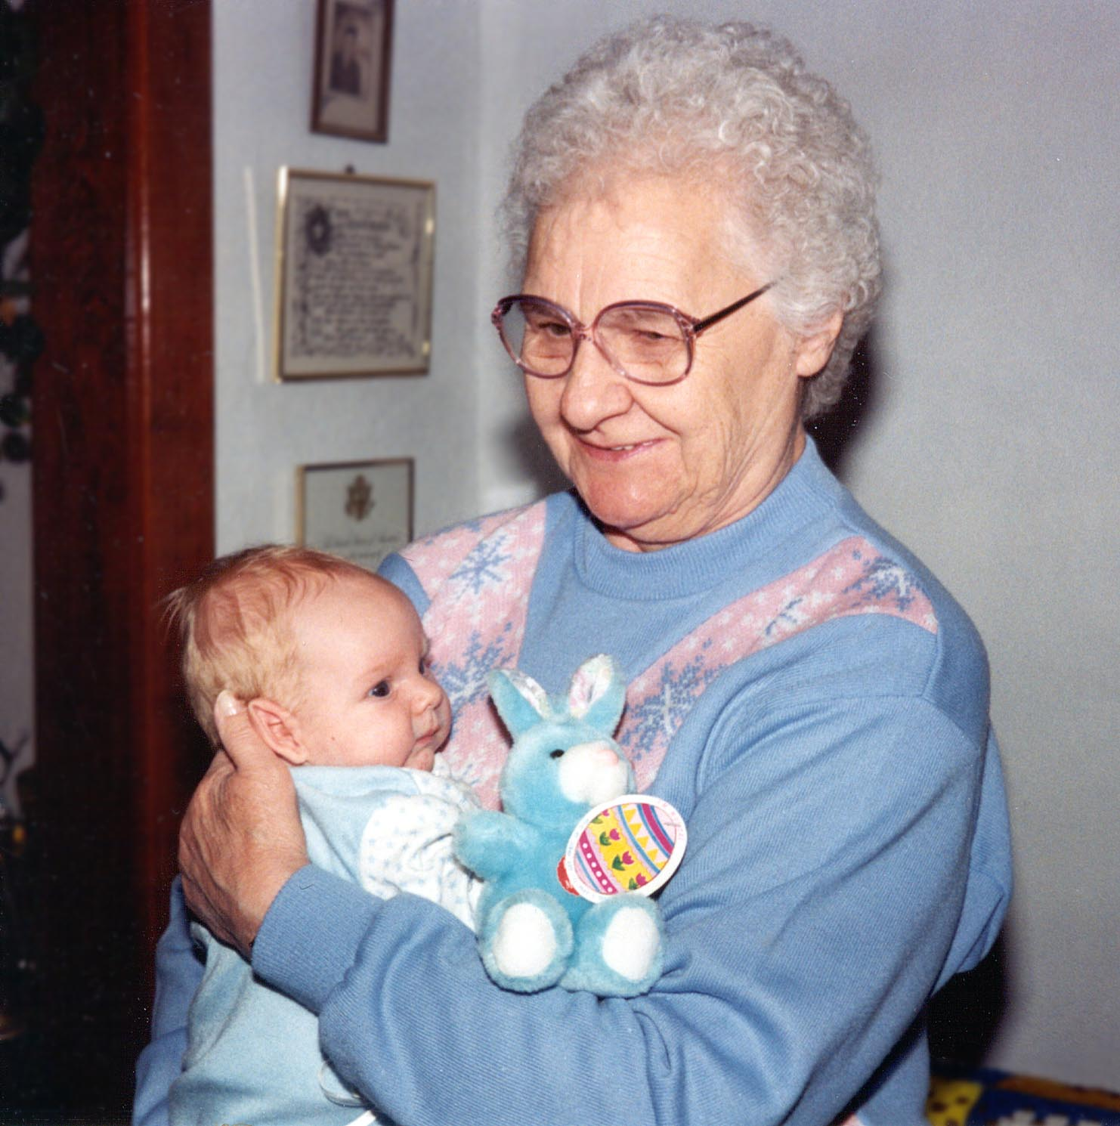
Who’s at Most Risk?
Infants and young children
Pregnant women
People with lower immunities
The elderly
Asthma sufferers
Notes:
Some people are at higher risk for adverse reactions to mold. Infants and young children, pregnant women, individuals who have lowered immunities, the elderly and asthma sufferers are at greater risk.
Infants and young children are at risk because their immune systems are still immature.
People whose immune systems aren't working at normal levels are susceptible to mold reactions. This group includes people who have had surgery recently and those with cancer, AIDS and other diseases.
Seniors may be at more risk due to chronic problems. As we age, our immune systems weaken.
Mold can trigger attacks in people with asthma.

Slide 4
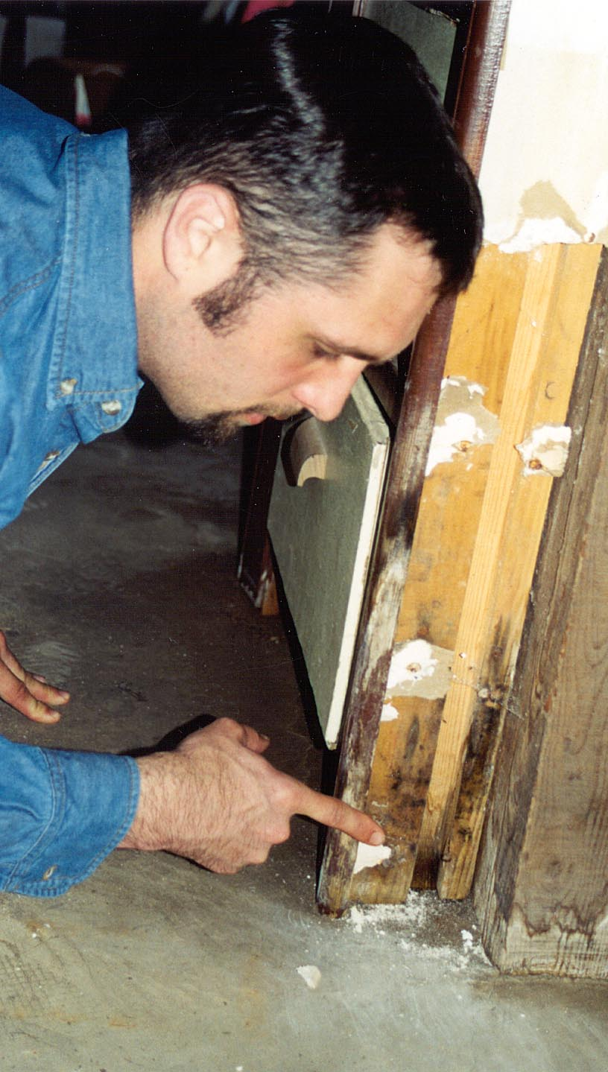
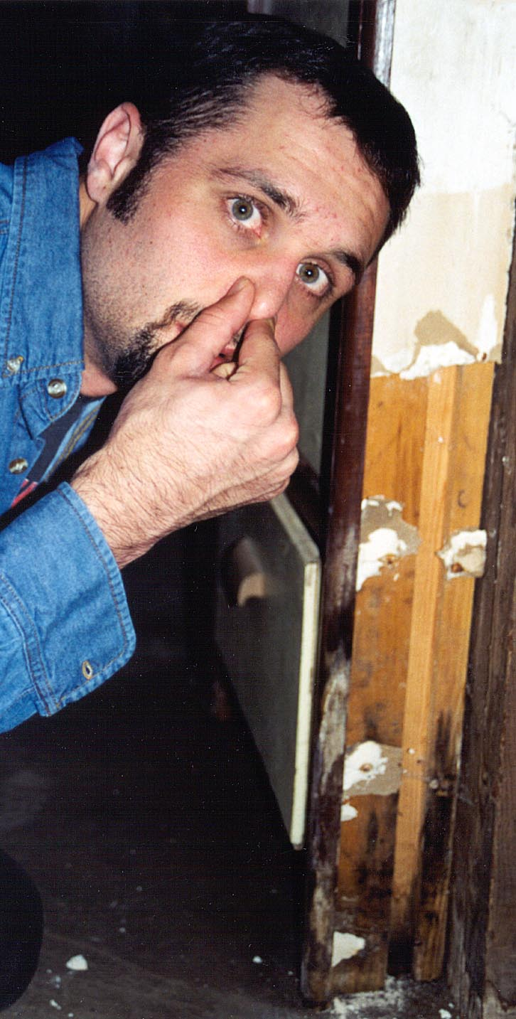
Recognizing Mold
Use your
eyes:
look for it
Use your nose: smell
for musty odors
Experiencing health effects of mold
Notes:
If you smell a musty odor or see mold, you have a problem. You can have your home tested for mold, but it is very expensive and generally is not necessary if you smell or see mold.
If you've ever walked into a closed-up home or entered an old building, you may have smelled a musty odor. Sometimes your nose tightens up, or you might even get a headache. If you re-enter your home or cabin after it's been locked up, you may smell a musty odor. This odor is caused by mold. Find where the odor is most intense to see if mold is present.
Since the sense of smell decreases rapidly, it is best to smell for mold after being away for a while.

Slide 5
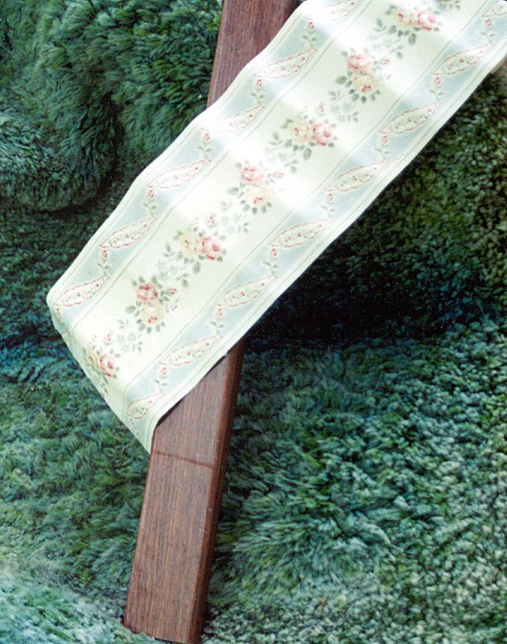
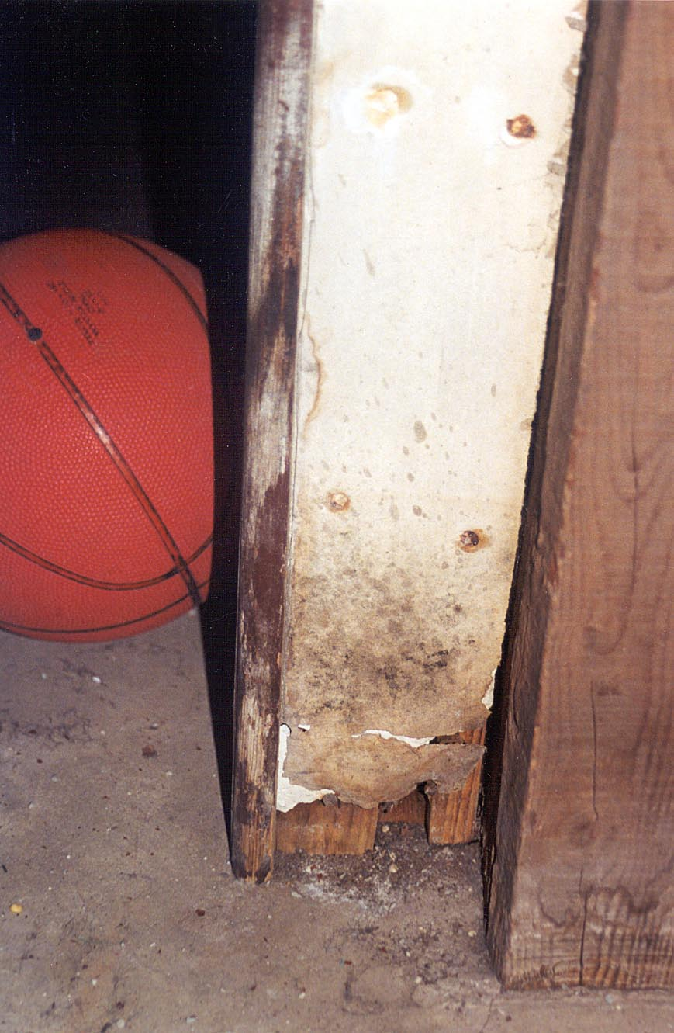
What is Required for
Mold to Grow?
Food source of organic material such as drywall, carpet, wallpaper
Moisture
Moderate temperature
Notes:
Mold needs a food source. It grows on organic materials, such as paper, dirt, wood and soap scum. Even materials that seem solid are often cellulose based so can be a food source for mold.

Slide 6

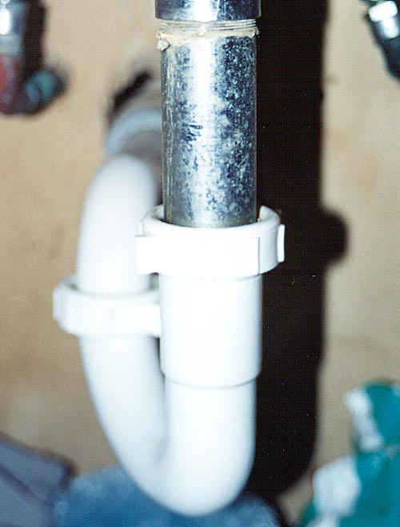
Moisture Sources
Water leaks
Flooded areas
Humidity levels above 65%–70%
Condensation
Notes:
The moisture required for mold to grow can come from water leaks, flooded areas, high humidity, condensation and other sources. What are some other moisture sources in the home?

Slide 7
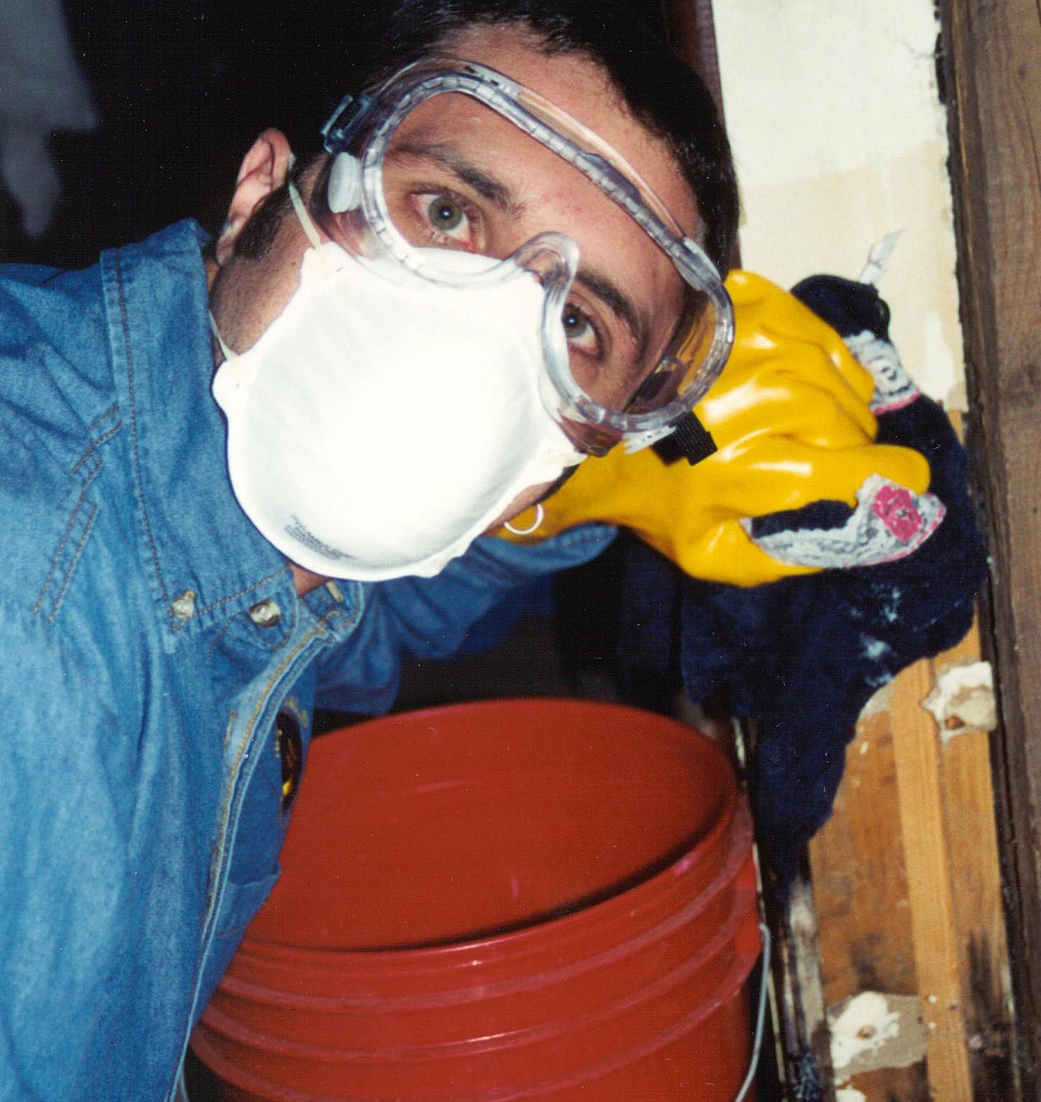
Protect Yourself When Removing
Mold
Respirator or mask to filter mold spores
Rubber gloves
Eye protection
Notes:
Some individuals react to mold whether it is living or dead. The mold must be removed either way. When removing mold, protect your health by using a respirator or two-strap mask to filter out mold spores, wearing eye protection and using rubber gloves. Suggested masks are N-95, 3M #1860 or TC-21C. Immediately wash clothes after completing removal of mold.

Slide 8
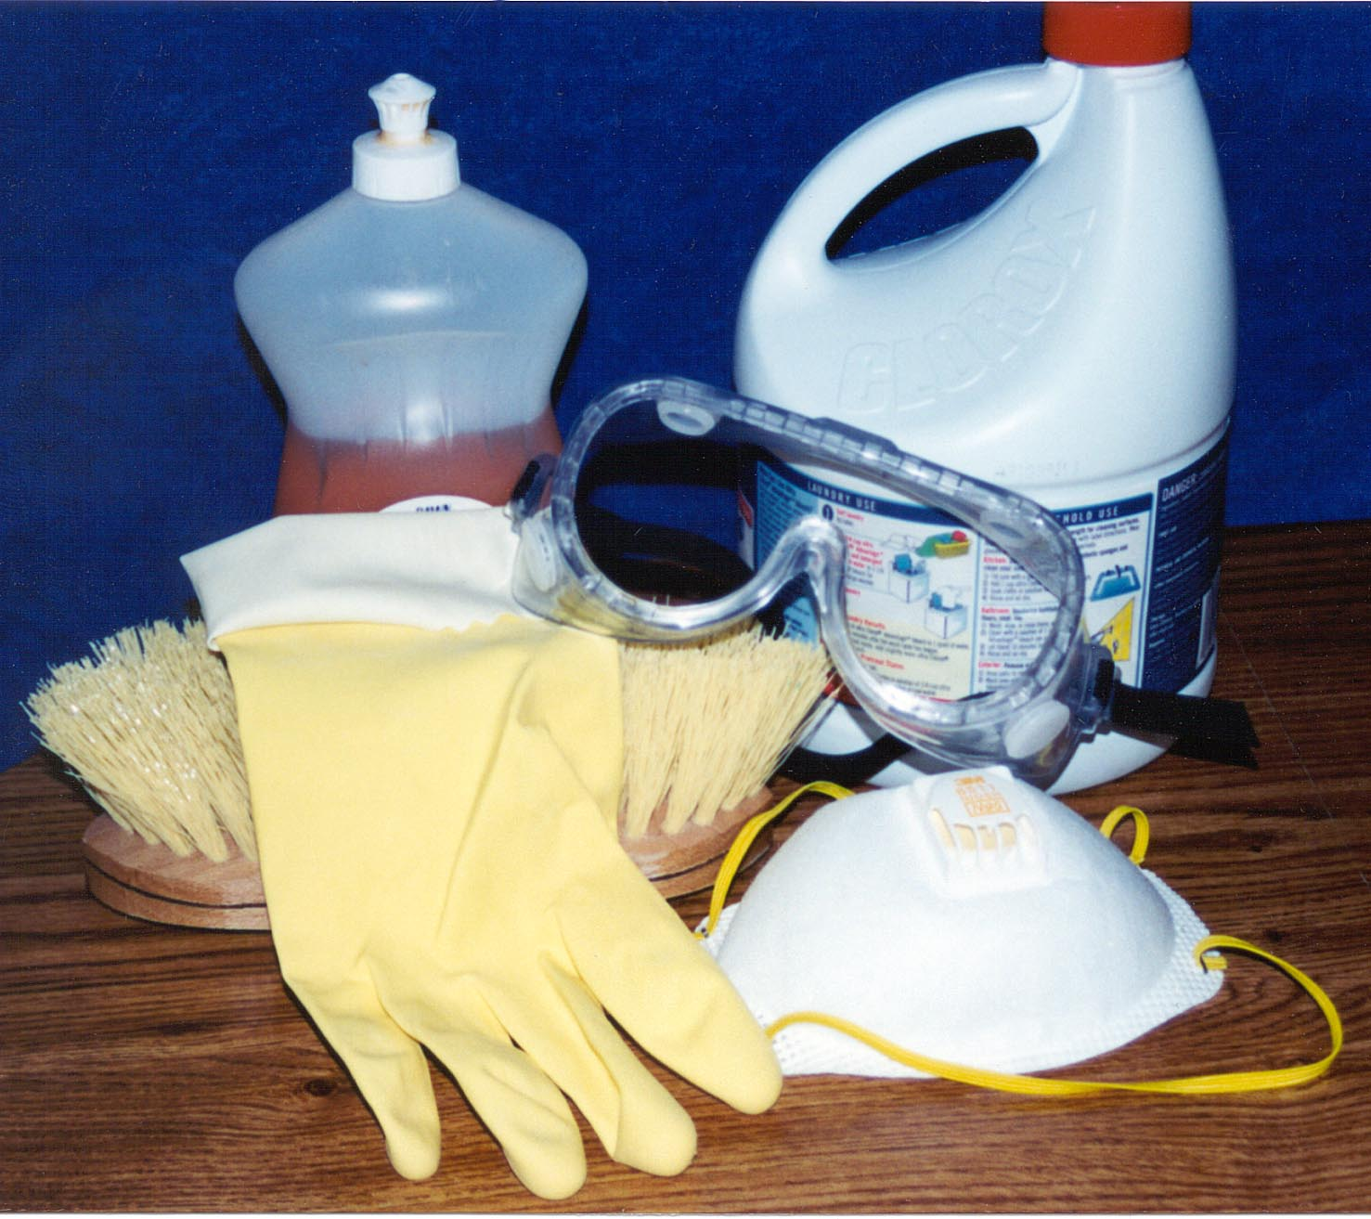
Remove Mold
Clean with detergent and brush
Disinfect with chlorine bleach solution
Rinse with water and dry quickly
Notes:
It is impossible to completely remove mold from porous surfaces such as paper, drywall and carpet padding, so these materials should be removed and discarded.
To remove mold from the surface of non-porous materials, first scrub with a brush and detergent solution. Ventilate the work area well. Then disinfect with a chlorine bleach solution. A clean surface requires less bleach than a dirty surface. A solution of ¼ cup chlorine bleach (sodium hypochlorite) to 1 gallon of water should be adequate for clean surfaces. Leave the bleach solution on the surface for 15 minutes, then rinse with water and dry quickly. Just splashing full-strength bleach on mold is not effective. It must be cleaned.
Air cleaners and ozone machines will not solve a mold problem. A high-efficiency air filter that removes mold spores may reduce the number of spores in the air, but the spores rapidly settle onto surfaces where air filters cannot remove them.

Slide 9
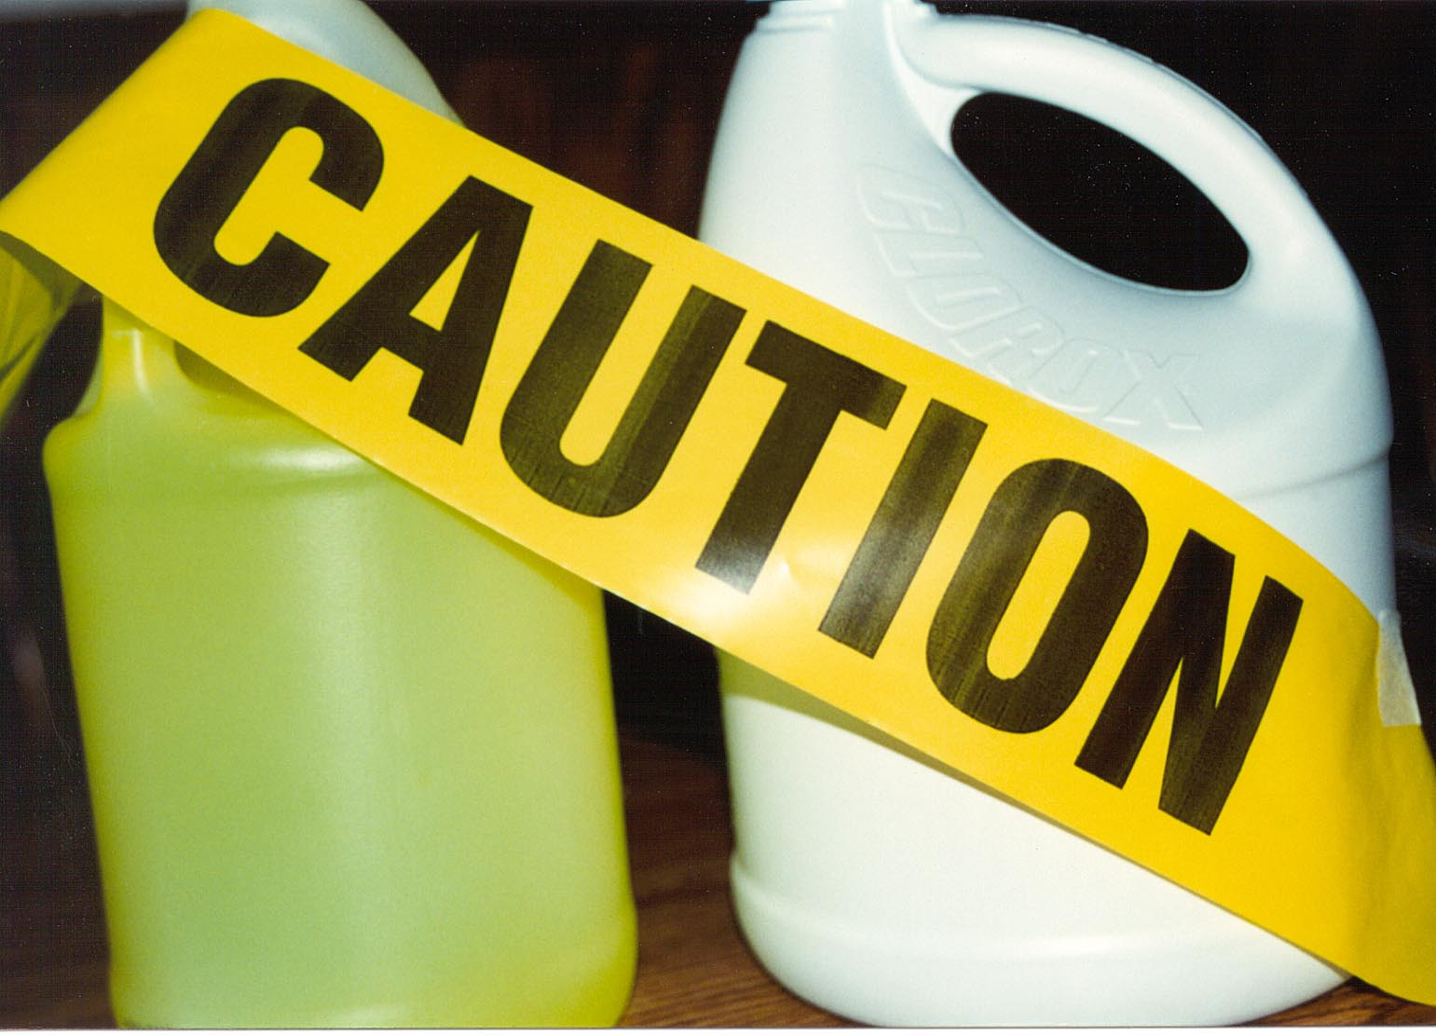
Never Mix Chlorine Bleach and Ammonia
The
fumes
are toxic
Notes:
Don't mix ammonia with chlorine bleach. The fumes of this mixture can quickly overcome you and can be deadly. Check the ingredient list to verify the cleaner does not contain ammonia.

Slide 10
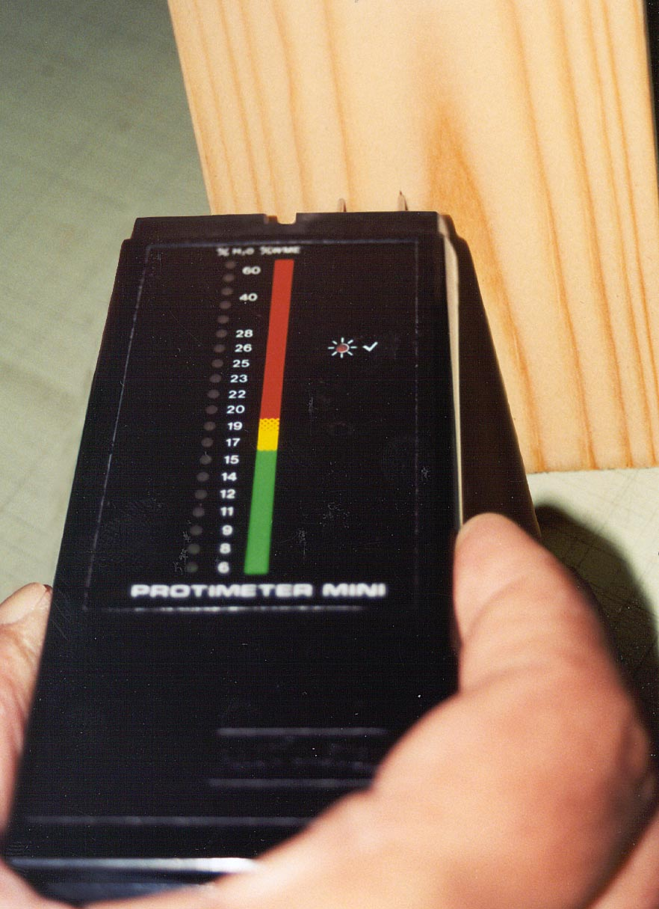
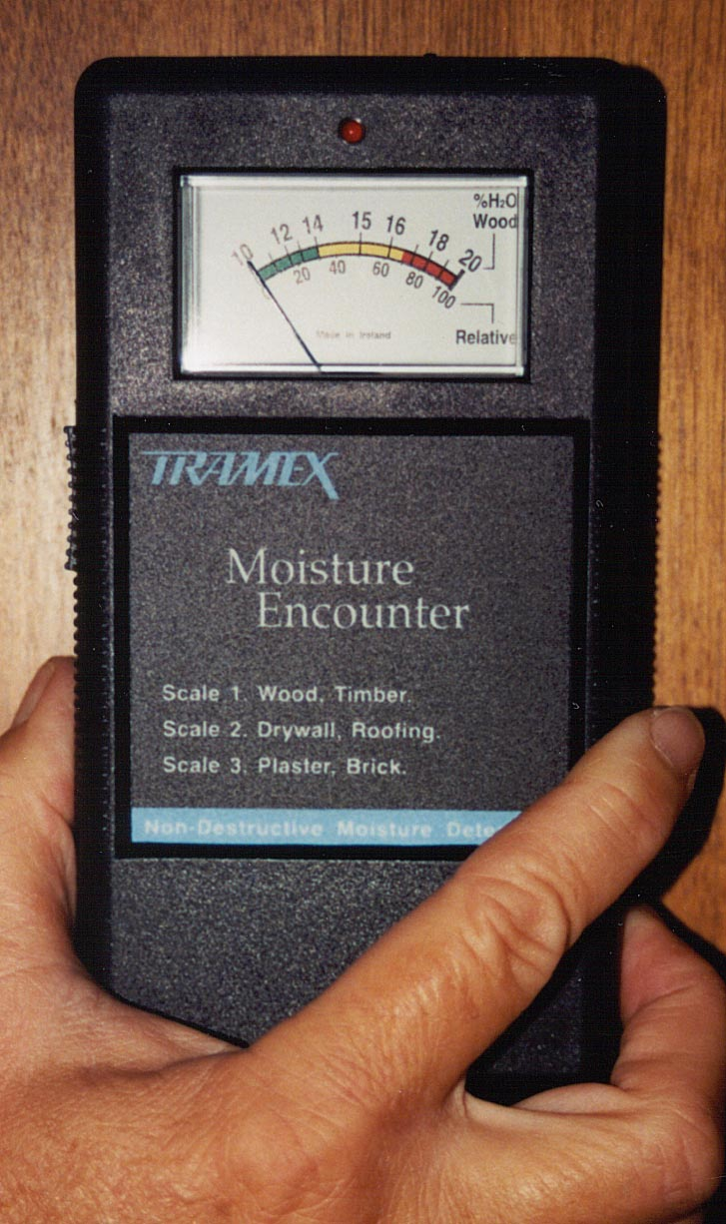
Dry Out Before Rebuilding
Wood should be less than 15% moisture
Notes:
If structural wood pieces, like studs, have stood in water, they need time to dry out. Moisture meters are available for free checkout from county Extension offices. These meters will show if the wood is below 15 percent moisture. If it is, you can replace drywall and similar materials. Even if the wood feels dry, it may still be too wet for rebuilding.
Moisture problems must be fixed to prevent future mold growth. Since there are some mold spores everywhere and since mold grows on any wet organic surface, the only way to prevent mold growth is to keep things dry.

