Slide 1


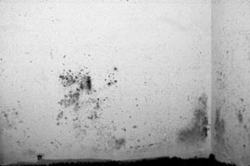
Mold Ecology
Kenneth Hellevang, Ph.D., P.E.
North Dakota State University
Fargo, ND

Slide 2

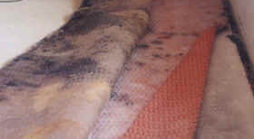
Mold Growth
Organic Materials - cellulose (paper, wood, etc.)
Mold Spores (seeds) Everywhere
Moisture: Water or high humidity (~70% RH)
Time: 24 to 48 hrs (cumulative)
Notes:
Mold grows on organic materials which includes the things that we use to make our homes and buildings. Mold spores, which might be referred to as mold seeds, are almost everywhere.
Mold will grow if moisture is present. Generally, if the relative humidity is above about 70 percent, there will be enough moisture for mold to grow. Keeping materials dry is the only practical method to prevent mold growth.
It only takes about 24 to 48 hours for a mold infestation to develop. Mold growth occurs slowly at first, and then multiplies rapidly. For example, at the beginning is goes from 2 to 4 to 8, 16, 32 and after a while is going from 400 to 800 to 1600, 3200, 6400. Frequently, the material will get wet, mold growth will start, then the surface dries and the mold goes dormant without a problem ever being observed. The next time the surface gets wet, the mold growth continues from its previous stage, appearing to multiply very rapidly.

Slide 3
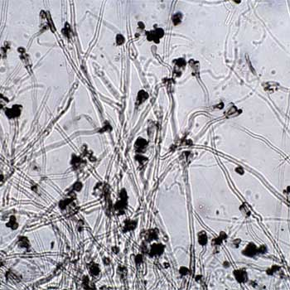
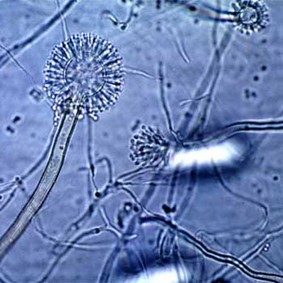
Moisture Characteristics
Stachybotrys spp. Continuously wet materials
Alternaria, Cladosporium spp.,
Aspergillus versicolor Continuously damp materials
Aspergillus glaucus group,
Some penicillium Relatively dry materials
Notes:
The type of mold growth will vary depending on the moisture condition. Stachybotrys (the black mold) grows when the materials are wet continuously. Alternaria, Cladosporium spp., and Aspergillus versicolor grow when materials are continuously damp. Aspergillus glaucus group and some penicillium can grow on relatively dry materials.

Slide 4
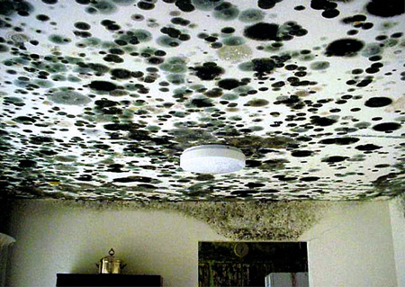
Temperature & Light
Optimum for most between 60 to 85°F
Do not grow better in the dark
Notes:
The optimum temperature for mold growth is between 60 and 85°F. These are the same temperatures that normally occur in our homes and other buildings. Many molds can grow at very warm and cold temperatures.
It is a myth that mold grows better in the dark. Mold is frequently found growing in dark places, but it is because these areas are usually damp, not because they are dark.

Slide 5

Types of Fungi
http://www.dehs.umn.edu/iaq/fungus/glossary.html
Fungal Glossary
Comes in every color
Notes:
A good resource on the types of mold or fungi is the fungal glossary at the University of Minnesota Environmental Health and Safety web site. It includes pictures of the molds, conditions where they grow, and further information on the types of fungi commonly found indoors. Molds come in every color.

Slide 6
Carpet
Notes:
Mold frequently grows on wet carpet and many times it is not visible on the top carpet surface. The top surface of this carpet shows no sign of mold growth even though there is extensive mold growth on the back surface. It is suggested to look at the back of the carpet if it has been wet or mold growth is suspected. Mold will frequently grow on carpet placed on a basement concrete floor. Moisture will come through the concrete as a vapor and accumulate in the the pad, creating an environment for mold growth. It is recommended to not use a carpet pad if carpet is placed on a basement concrete floor that may be prone to moisture problems.

Slide 7
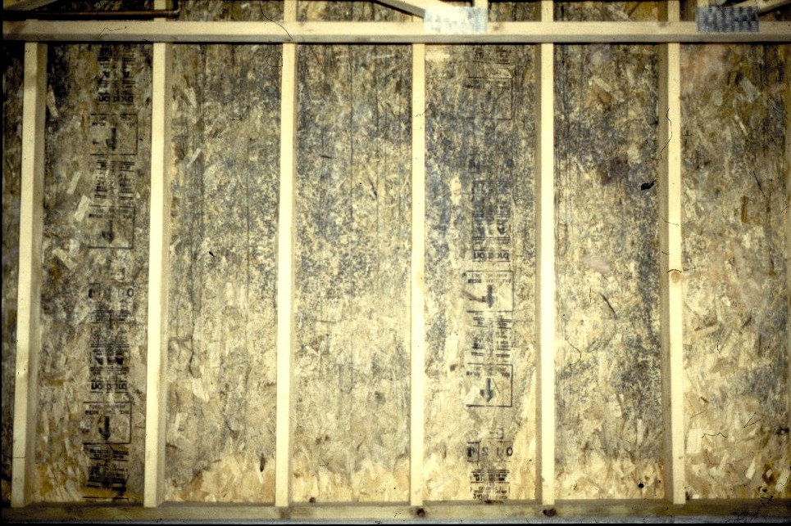
Vapor Retarder Problem
Notes:
This shows mold growing on the oriented strand board in a wall. This view is looking at the wall from inside the house after the wall was opened and the insulation was removed. The polyethylene vapor retarder was improperly installed, which permitted air from within the house to enter the wall cavity near the ceiling. Moisture condensed on the exterior wall surface creating a wet environment that permitted mold growth.
The more processed the building material, the more susceptible it is to mold growth. It seems that the more exposed the cellulose material the more prone it is to mold growth. There was extensive mold growth on the oriented strand board in the wall, but there was no mold growth on the structural 2x4 lumber. Mold growth is much more likely on the paper on wallboard than on structural wood. Oriented strand board is more prone to mold growth than plywood.

Slide 8
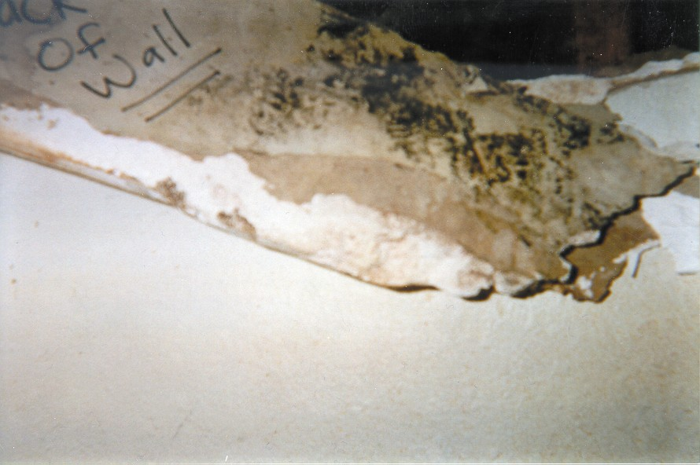
Mold on Back of Wallboard
Notes:
This mold was growing on the back of the wallboard inside the wall cavity. There was no mold growth visible on the wall surface in the living space. An ice-dam on the roof caused water to run into the wall cavity creating the moist environment that lead to the mold growth. Air pressure from wind blowing on the exterior of the building or other pressure gradients will move air from the wall cavity into the living space through openings in the wall such as electrical outlets, carrying mold spores, fragments, and odors.

Slide 9
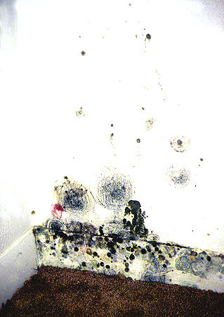
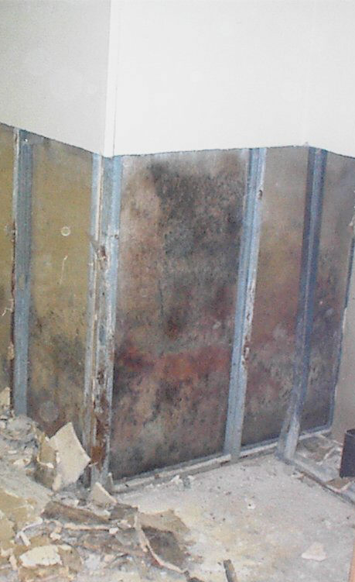
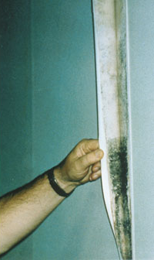
Mold
Notes:
Mold will grow any place that moisture is present. Sometimes the mold growth is visible and many times it is not. The mold in the left picture was growing in the back of a closet where a damp environment existed. The mold in the middle was inside a wall cavity. The picture on the right shows mold growing on the back side of wall paper. Molds will readily grow on glue on the back of wall paper. Again, the mold was not visible when looking at the paper surface.

Slide 10
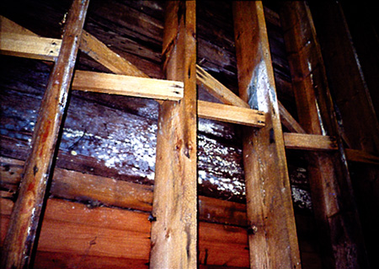
Mold in Crawlspace
Notes:
Damp environments in crawl spaces create an environment for mold growth. This picture shows mold growing on the underside of flooring boards. Air pressure in the crawl space will move air from a moldy crawl space through any openings into the living space. The crawl space must be kept dry.

Slide 11
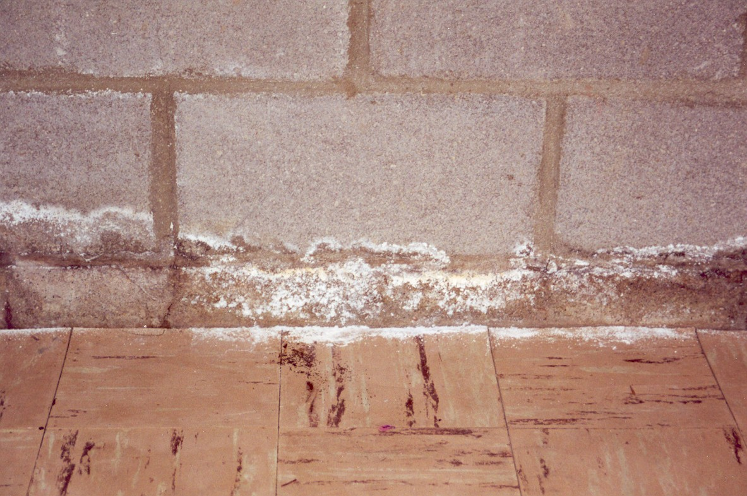
Mold or Salt
Notes:
Is this mold? Frequently a fluffy white material in a basement is a salt rather than mold. Water vapor carrying salt moves from moist soil on the outside to the inside of the basement. When it evaporates on the inside, the salt is deposited. It will frequently accumulate along cracks in the concrete, but can occur anywhere that the moisture transfer occurs. It can be determined if it is salt or mold by placing a drop of water or vinegar on it. The salt can generally be dissolved by the water or vinegar and mold cannot. The salt is generally white, but it can be other colors depending on the type of mineral present in the soil. The salt is not a health concern, but continued exposure to the salt can deteriorate the concrete. Keeping the soil surrounding the basement dry will reduce the amount of salt being deposited in the concrete.

Slide 12
Mold & IAQ - Why Today?
It has always been a problem!
More intense rain events
Increased precipitation
Energy efficient construction & remodeling?
Different building materials
Reduced infiltration, Reduced ventilation
New information
More awareness
Notes:
People are more aware of mold today, but it has always been a problem. There are references to mold problems in early literature. There are a number of factors that may be causing mold to be more of a problem today than it was in the past. There has been an increase in the frequency of intense rain events which leads to more flooding and water problems. Also, some regions are receiving more precipitation than is historically normal.
Some of the building materials used today are more processed than they were in the past. The more materials are processed, the more prone they are to mold growth. However, these materials will not mold if proper building procedures are followed that keep the building materials dry.
Some people claim that the problem is that homes are built too tight today. It is desirable to build homes that permit controlling moisture and air movement, rather than leaving it to chance. Energy efficient construction methods reduce the amount of uncontrolled air exchange, which may lead to increased humidity levels in the living space, but this can be controlled with proper ventilation. Homes would be extremely expensive to heat and cool without controlled air exchange.
More information is known about the health effects of exposure to damp environments and mold. People may have experienced health problems in the past from living in a moldy environment, but we were not aware of the link between those symptoms and mold.
There is more awareness of mold today, due to a variety of things including coverage by the media. Sometimes this coverage creates more alarm than is justified. The media focus has been primarily on the “Black Mold,” stachybotrys. Scientific evidence indicates that people should not live in a moldy environment, and that it does not vary depending on the type of mold.

