Slide 1
Session 3
Student Lesson 8:
Making New Friends
Notes:
Supplies:
Print and post on the walls four posters — one for each of the following statements (make ahead of time on large sheets of paper with bright markers):
Sick to my stomach
All right
Sounds like fun
Best day of my life
Masking tape to hang up posters

Slide 2
Objectives
Participants will:
Understand your role in making new friends
Gain social skills in building relationships
Notes:
To say:
Today we are going to explore how to make new friends.

Slide 3
How do you feel when?
Walking into the lunchroom
Joining a new sports team
Going to a new friend’s house for the first time
Going to a new camp for a week with other kids
Joining a new after-school club
Notes:
To do:
Place the four printed posters on the walls around the room.
Posters:
Sick to my stomach
All right
Sounds like fun
Best day of my life
To say:
Today we are going to talk about different situations you might be in with new people. The four different feelings are “sick to my stomach,” “all right,” “sounds like fun” and
“best day of my life.” (Point to the poster as you read it.) I am going to read some statements. After each statement, think about how you would feel and go stand near the poster that best expresses how you would feel. There are no right or wrong answers.
To do:
Read each situation and wait for students to pick how they would feel if they were put into this situation.
Walking into the lunchroom
Joining a new sports team
Going to a new friend’s house for the first time
Going to a new camp for a week with other kids
Joining a new after-school club

Slide 4
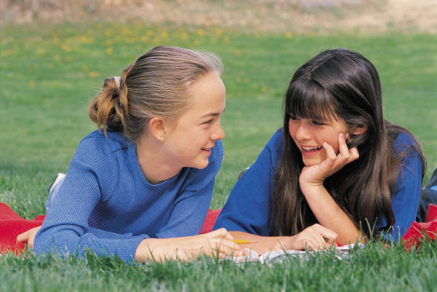
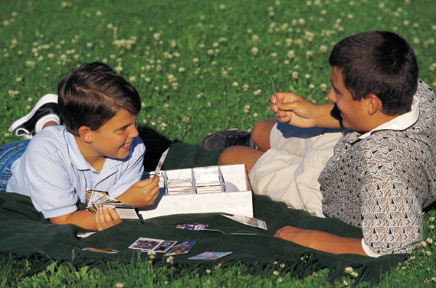
Notes:
To say:
Do any of you need help in meeting new friends when you are in situations where you don’t know people?
Let’s see what people recommend on how to meet new friends.

Slide 5
Making Friends in Six Easy Steps ☺
1
Listen to people.
Notes:
To say:
When you meet a new person, listen, listen, listen to what he/she is talking about. Is it sports, clothes, music, hobbies, pets? Most often people talk about things they are interested in, like to do, are good at, etc.

Slide 6
Making Friends in Six Easy Steps ☺
2
Ask questions about what they just said.
Notes:
To say:
Now that you know what they are interested in, you can ask questions related to what they just said.
What kind of dog do you have?
What movies do you like to go to?
Where do you like to shop?
What kind of skateboard do you have?
What is your favorite baseball team?
Who is your favorite singer?

Slide 7
Making Friends in Six Easy Steps ☺
3
Remember their name.
Notes:
To say:
Remember their name!
If you are not good at remembering names, think of ways to help you remember.
Do any of you have good ideas on how to help remember names?

Slide 8
Making Friends in Six Easy Steps ☺
4
Follow up.
Notes:
To say:
This is extremely, extremely important. When you meet someone you like, follow up! Send a text, email, call him/her or say “hi” the next time you see him/her at school.
If you don’t try to make new friends, then you probably won’t.

Slide 9
Making Friends in Six Easy Steps ☺
5
Be excited to
see them again.
Notes:
To say:
Train yourself to be excited to see people. You know how you feel when someone is excited to see you and he/she remembers your name. Smile, ask how things are going, what he/she has been doing, etc.

Slide 10
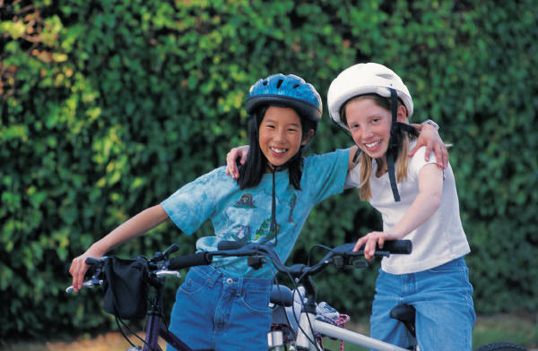
Making Friends in Six Easy Steps ☺
6
Suggest something to do.
Notes:
To say:
Don’t wait for the other person to make the first step. Suggest something to do that you know your parents will allow you to do.
Let’s think about activities that you could suggest to a new friend.

Slide 11
Let’s Practice
Listen to people.
Ask questions about what they just said.
Remember their name.
Follow up.
Be excited to see them again.
Suggest something to do.
Notes:
To say:
Let’s practice these six easy steps. Can I have two volunteers to role play?
To do:
Ask the volunteers to role play meeting someone new following these six steps. You might need to help steer the process a bit. If you have time, have two more students role play, or ask everyone to pair up and role play, then ask one team to share what it did.

Slide 12
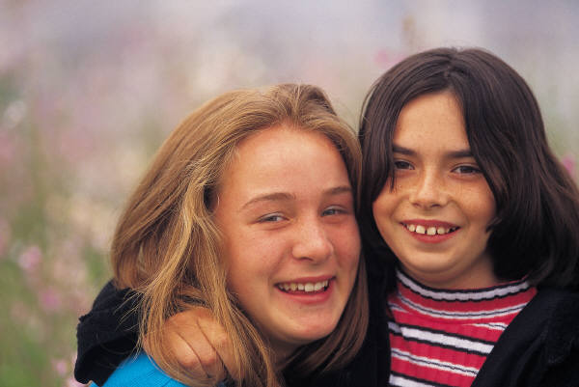
Challenge
Notes:
To say:
Your challenge this week is to meet one new friend using the six easy steps.

