Slide 1


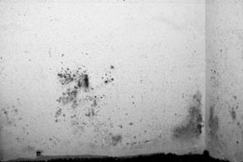
Mold: Health Effects
Kenneth Hellevang, Ph.D., P.E.
North Dakota State University
Fargo, ND

Slide 2
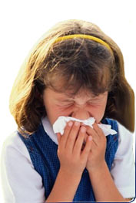
Health Effect
  Scientific evidence links mold and other factors related to damp conditions in buildings to:
  Asthma symptoms in those with the chronic disorder
  Coughing, wheezing, and upper respiratory symptoms in otherwise healthy individuals
  Hypersensitivity Pneumonitis in susceptible people
  Lower respiratory illness in children
  Institute of Medicine of the National Academies 2004
Notes:
Scientific evidence links mold and other factors related to damp conditions in homes and buildings to asthma symptoms in some people with the chronic disorder, as well as to coughing, wheezing, and upper respiratory tract symptoms in otherwise healthy people, says a report from the Institute of Medicine of the National Academies in 2004. An uncommon ailment known as hypersensitivity pneumonitis also is associated with indoor mold exposure in genetically susceptible people. Damp conditions and all they entail may be associated with the onset of asthma, as well as shortness of breath and lower respiratory illness in otherwise healthy children, although the evidence is less certain in these circumstances. Likewise, the presence of visible mold indoors may be linked to lower respiratory tract illness in children, but the evidence is not as strong in this case.
The study was sponsored by the Centers for Disease Control and Prevention. The Institute of Medicine is a private, nonprofit institution that provides health policy advice under a congressional charter granted to the National Academy of Sciences.

Slide 3

Health Effect
  Due to an inadequate number of studies, current evidence neither supports nor rules out an association of health symptoms sometimes attributed to fungal infestations that can include fatigue and neuropsychiatric disorders.
  Institute of Medicine of the National Academies 2004
Notes:
Very few studies have examined whether mold or other factors associated with indoor dampness are linked to fatigue, neuropsychiatric disorders, or other health problems that some people have attributed to fungal infestations of buildings. The little evidence that is available does not support an association, but because of the dearth of well-conducted studies and reliable data, the Institute of Medicine committee could not rule out the possibility.
The study was sponsored by the Centers for Disease Control and Prevention. The Institute of Medicine is a private, nonprofit institution that provides health policy advice under a congressional charter granted to the National Academy of Sciences.

Slide 4

Health Effect
Allergies
  20% allergic rhinitis
  14% allergy related sinusitus
  9% allergic dermatitis
  Allergy tests only identify selected antigens
  Harriet Ammann, Ph.D., Senior Toxicolist, Washington State Department of Health
Notes:
Allergic reactions occur due to exposure to many allergens. The Institute of Medicine (1993) estimates that about 20% of Americans suffer from allergic rhinitis (inflammation of the nasal mucous membrane), the most common chronic disease experienced by humans. About 14% of the population suffers from allergy related sinusitis (inflammation of the sinuses), while about 9% experience allergic dermatitis (inflammation of the skin). Molds are just one of several sources of indoor allergens. Other sources include dust mites, cockroaches, pets, and microorganisms. The general consensus is that the most common response to mold exposure is an allergic reaction.
An allergy test will only identify if there is a reaction to a specific allergen, such as an oak tree, which will be different than that of an elm tree. In testing for an allergic reaction to mold, just a few of the common types of fungi will be tested for, not all mold types.
Is Indoor Mold Contamination a Threat to Health?
Harriet Ammann, Senior Toxicologist with the Washington State Department of Health.

Slide 5
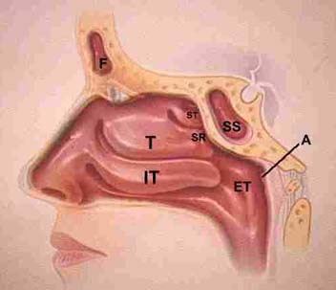
Health Effect
Respiratory Infection
  Not common except in immune compromised people
  Fungal sinusitis
Notes:
Infection from molds that grow in indoor environments is not a common occurrence,
except in certain susceptible populations, such as those with immune compromise from
disease or drug treatment.

Slide 6

Health Effects
Mucous Membrane Irritation
Trigeminal Nerve Irritation (Nasal)
VOCs irritate mucous membranes of eyes and respiratory system
Adverse reaction to odor
Studies are needed
Notes:
Volatile organic compounds (VOC) produced through fungal primary or secondary metabolism, and released into indoor air may produce health effects. VOCs are associated with the musty odor produced with fungi growth. Fungi may produce alcohols or aldehydes and acidic molecules. Such compounds in low, but sufficient aggregate concentration, can irritate the mucous membranes of the eyes and respiratory system.
Ability to perceive odors and respond to them is highly variable among people. Some individuals can detect extremely low concentrations of volatile compounds, while others require high levels for perception. Some people derive enjoyment from odors of all kinds. Others may respond with headache, nasal stuffiness, nausea or even vomiting to certain odors including various perfumes, cigarette smoke, diesel exhaust or moldy odors.
Further study of the link between volatile organic compounds produced by fungi and health symptoms is needed.
Is Indoor Mold Contamination a Threat to Health?
Harriet Ammann, Senior Toxicologist with the Washington State Department of Health.

Slide 7

Health Effects
Toxicity – Mycotoxins
  Penicillium – spores & vegetative portion
  Aspergillus
  Stachybotrys Chartarum (atra) (Black Mold)
    Wet spores sticky so are not easily aerosolized
    Symptoms: cough, rhinitis, burning sensation in mouth and nasal passages, fatigue
    Animal studies found pulmonary bleeding
Has not been adequately studied
Notes:
Some molds can produce mycotoxins. Toxigenic molds vary in their mycotoxin production depending on the substrate on which they grow and growing conditions. The spores, with which the toxins are primarily associated, are cast off in blooms that vary with the mold’s diurnal, seasonal and life cycle stage. Spores have the highest concentrations of mycotoxins, but it may also be in the vegetative portion of the mold, the mycelium. Viability of spores is not essential to toxicity, so the spore as a dead particle can still be a source of toxin. Some toxins are produced by Penicillium, Aspergillus, and Stachybotrys.
Stachybotrys is the mold which has received so much press coverage and is frequently referred to as the “Black Mold.” There are many molds which are black, so “Black Mold” freequently is not Stachybotrys. This organism has a high moisture requirement, so it grows vigorously where moisture has accumulated from roof or wall leaks, or chronically wet areas from plumbing leaks. Persons handling material heavily contaminated with this mold describe symptoms of cough, rhinitis, burning sensations of the mouth and nasal passages, and cutaneous irritation at the point of contact, especially in areas of heavy perspiration. Animal experiments in which rats and mice were exposed intranasally and intratracheally to toxic strains of S. chartarum, demonstrated acute pulmonary hemorrhage. While there are insufficient studies to establish cause and effect relationships between indoor Stachybotrys exposure and illness, including acute pulmonary bleeding in infants, toxic endpoints and potency for this mold are well described. What is less clear, and has been difficult to establish, is whether exposures indoors are of sufficient magnitude to elicit illness resulting from toxic exposure.
Is Indoor Mold Contamination a Threat to Health?
Harriet Ammann, Senior Toxicologist with the Washington State Department of Health.

Slide 8
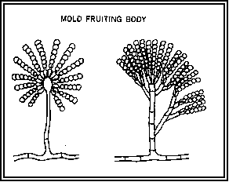
People React to:
Spores (concentration), Fragments, Proteins
Mycotoxins
Microbial Volatile Organic Compounds
People react if mold is living or dead
Mold “Must” Be Removed
Notes:
People can react to the protein in both mold spores and in fragments or pieces of the mold. They may also react to the microbial volatile organic compounds and mycotoxins produced by mold. People will react whether the mold is living or dead, therefore, mold must be removed. It cannot be just killed with a biocide such as bleach.

Slide 9

Symptoms Related to Biological Pollutants (mold, dust mites, animal dander, etc.)
Nasal & sinus congestion
Sore throat, coughing
Shortness of breath, chest tightness
Eye irritation
Headache
Fatigue
Rashes
Asthma attacks triggered
Notes:
The following symptoms can be related to biological pollutants including mold, dust mites, and animal dander. Many things in addition to mold can cause these symptoms. An elimination or reduction of these symptoms when the person is away from the building may indicate that the symptoms are related to the building environment.

Slide 10
Diagnosing Illness – Health Professional Involved
Asthma (Triggered by allergen)
Conjunctivitis: Inflammation of the membrane on the inner surface of the eyelid and eye.
Dermatitis: Inflammation of the skin
Hypersensitivity Disease (allergy)
Inhalation Fever (Flu-like illness following heavy exposure)
  Humidifier Fever (bacteria)
Rhinitis: inflammation of the nasal mucous membrane
Sinusitis: Inflammation of the sinuses
Sore Throat
Notes:
These are the types of illnesses that a medical professional may diagnose as being related to exposure to biological pollutants.

Slide 11


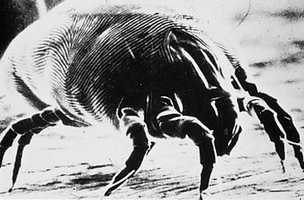
Other Indoor Air Pollutants
Environmental Tobacco Smoke
Combustion Products
Volatile Organics
Allergens: dust mites, animal & bird dander
Other illnesses
Notes:
Other indoor pollutants and illnesses can cause health symptoms similar to those experienced when exposed to biological pollutants or mold, so a medical professional should be consulted. It cannot be assumed that the symptoms are from exposure to mold.

Slide 12
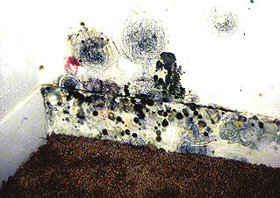
Mold: A Health Concern
Response Varies
  Young Children & Elderly more Susceptible
Cumulative Effect
If you can see it or smell it, there is a problem
Kansas City Hospital Experience
  Jay Portnoy, M.D.
Notes:
Young children and the elderly appear to be more susceptible to experiencing health symptoms when exposed to mold. Also, since most symptoms are due to an allergic reaction and only a percentage of the population has an allergic reaction to any allergen, only a percentage of the population will be allergic to mold. There may be four people in a home and only one person will be experiencing symptoms due to the exposure.
There appears to be a cumulative effect to exposure to mold. A person who has no symptoms today may become sensitized and have health symptoms later if they are exposed to a moldy environment for an extended period of time.
It is not healthy to live in a moldy environment, so if you can see mold or there is a musty smell associated with mold there is a problem that needs to be corrected.
Several children in Kansas City were experiencing such severe respiratory problems that they frequently needed to go to the emergency room, even though they were on the maximum medicine dosages allowed. An examination of the homes of these children found that all were living in environments with extensive mold infestation and water problems. The water problems were fixed and the mold was removed. Six months later these children were not experiencing severe respiratory problems, and they were either at minimum medicine dosage levels or no longer needed medicine to control their symptoms.

Slide 13
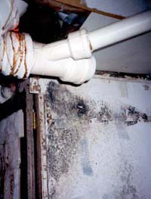
Black Toxic Mold
Many black molds
All mold infestation is a health concern
Current information is that Stachybotrys is similar to other molds
Notes:
There has been so much media attention given to “Black” mold or “toxic” mold that some people believe that there are harmful molds and other molds which are not a health concern. It is true that Stachybotrys can produce a toxin, but current information does not indicate that it is more of a health concern than other types of mold. It is not healthy to live in an environment with any type of mold, so all mold must be removed.

Slide 14
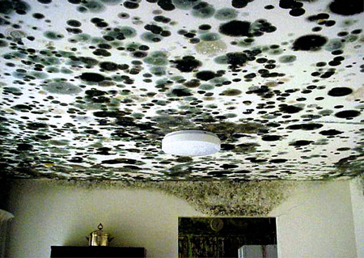
How is Effect Defined
Association
  Correlation
Causal
  Measured effect
Notes:
Scientific evidence links mold and other factors related to damp conditions in homes and buildings to asthma symptoms in some people with the chronic disorder, as well as to coughing, wheezing, and upper respiratory tract symptoms in otherwise healthy people, says a report from the Institute of Medicine of the National Academies in 2004. An uncommon ailment known as hypersensitivity pneumonitis also is associated with indoor mold exposure in genetically susceptible people. Damp conditions and all they entail may be associated with the onset of asthma, as well as shortness of breath and lower respiratory illness in otherwise healthy children, although the evidence is less certain in these circumstances. Likewise, the presence of visible mold indoors may be linked to lower respiratory tract illness in children, but the evidence is not as strong in this case.
The Center for Disease Control and Prevention, US Department of Health and Human Services, in a July 18, 2002 report to a US House of Representatives subcommittee reported that there were significant relationships between reports of work-related respiratory disease and visual assessment of water and mold-damage. They also reported that there were significant relationships between endotoxin and ultra-fine particles in air and work-related respiratory symptoms. And they reported that there were significant relationships between indicators of mold in chair and floor dust and work-related respiratory symptoms. This indicates an association between mold and health effects.
Studies have not shown that there is a measurable effect in the body to exposure to mold. This can mean that there is not a cause and effect relationship, or it may be that we have not done enough studies to document the effect, or that we have not used procedures that allow the effect to be shown.
Therefore, people will argue both sides of whether health symptoms are related mold exposure. Even though specific symptoms may not be able to be clearly proven to come from mold exposure, there is consensus that it is not healthy to live or work in a moldy environment.

