Slide 1
Agricultural Market Situation and Outlook
WELCOME!
August 20, 2020

Slide 2
Use the Q&A tool
to ask questions
After the webinar you’ll be invited
to complete a short survey

Slide 3

Macro Outlook and Ag. Lending Conditions
Bryon Parman
Cell – 701-261-5919
Bryon.Parman@ndsu.edu

Slide 4
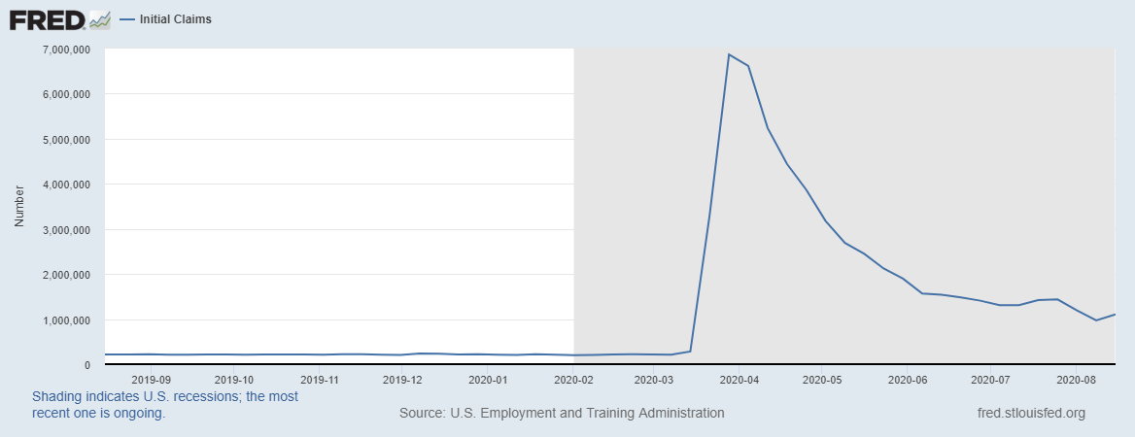
Weekly Initial Jobless Claims, St. Louis Federal Reserve: Claims Increase Back over 1 Million

Slide 5
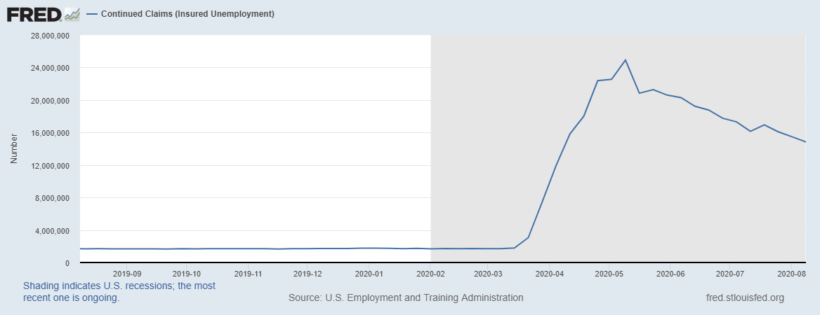
U.S. Continuous Jobless Claims
Continues Downward Trend

Slide 6
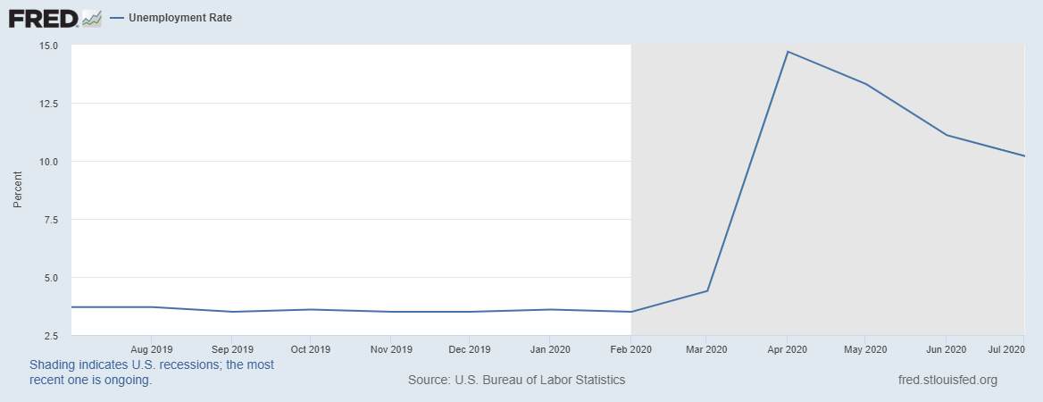
U.S. Unemployment Rate 10.2%

Slide 7
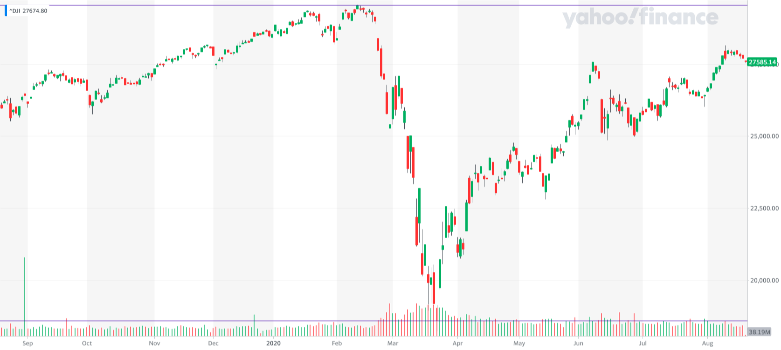
Stock Market within 5-6% of the Record High set in February
Low point 3/23/2020
18,592

Slide 8
Shape of the Recovery for the Equity Market:
A “V” Shaped Recovery?

Slide 9
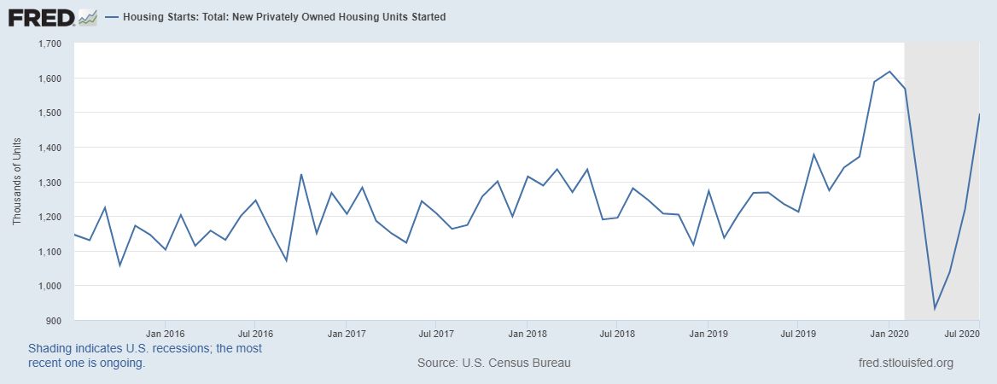
5 Year New Housing Starts

Slide 10
Median Home Prices
Median Home Prices up 6.8% (annualized) over the last 3 months
Regional
  9.9% Midwest (highest)
  4.3% Northeast (lowest)
  6.5-7.8% All other regions
Tighter supply
  Existing supply of homes down 18.2% from 2019

Slide 11
Home Prices not Increasing Everywhere though
Forbes, July 17 2020: “Manhattan Rents Drop to Record Lows as Demand Plummets”
“Home Sellers Slash Prices in San Francisco as Number of Houses for Sale Reach Recession-Era Level”…..”Not since 2010-2011 have so many homes in San Francisco been on the market at once, with almost 50% more single-family homes on the market….

Slide 12
Farm Loan Repayment Issues in the 10th District

Slide 13
It is possible CFAP and PPP loans diminished the expected growth in loan demand

Slide 14
Fund Availability and Deposits

Slide 15
Interest Rates in the 10th District

Slide 16

USDA Yield Updates and Impact of Derecho Storms
Frayne Olson
Crop Economist/ Marketing Specialist
frayne.olson@ndsu.edu
701-231-7377 (o)
701-715-3673 (c)

Slide 17
USDA August Yield Update
Yield updates for corn, soybeans, winter wheat, spring wheat and durum.
Operator Survey.
  20,346 farm operators.
  Survey conducted from July 30 – Aug. 6
Remote Sensing (satellite images).
  Time series of 250 meter MODIS Satellite Data.

Slide 18
U.S. Corn Supply & Demand Table
U.S. Corn | 2018/2019 | 2019/2020 (Est.) | 2020/2021 (Aug)
Planted A. | 88.9 Mill. A. | 89.7 Mill. A. | 92.0 Mill. A.
Harvested A. | 81.3 Mill. A. | 81.3 Mill. A. | 84.0 Mill. A.
Yield/Harvest A. | 176.4 bu. | 167.4 bu. | 181.5 bu.
Beginning Stocks | 2,140 Mill. Bu. | 2,221 Mill. Bu. | 2,228 Mill. Bu.
Production | 14,340 Mill. Bu. | 13,617 Mill. Bu. | 15,278 Mill. Bu.
Imports | 28 Mill. Bu. | 45 Mill. Bu. | 25 Mill. Bu.
Total Supply | 16,509 Mill. Bu. | 15,883 Mill. Bu. | 17,531 Mill. Bu.
Feed & Residual | 5,429 Mill. Bu. | 5,600 Mill. Bu. | 5,925 Mill. Bu.
Food, Seed, Ind. | 6,793 Mill. Bu. | 6,260 Mill. Bu. | 6,625 Mill. Bu.
Ethanol | 5,378 Mill. Bu. | 4,850 Mill. Bu. | 5,200 Mill. Bu.
Exports | 2,066 Mill. Bu. | 1,795 Mill. Bu. | 2,225 Mill. Bu.
Total Use | 14,288 Mill. Bu. | 13,655 Mill. Bu. | 14,775 Mill. Bu.
Ending Stocks | 2,221 Mill. Bu. | 2,228 Mill. Bu. | 2,756 Mill. Bu.
USDA WASDE – August 12, 2020

Slide 19
U.S. Corn Supply & Demand Table
U.S. Corn | 2018/2019 | 2019/2020 (Est.) | 2020/2021 (Aug)
Planted A. | 88.9 Mill. A. | 89.7 Mill. A. | 92.0 Mill. A.
Harvested A. | 81.3 Mill. A. | 81.3 Mill. A. | 84.0 Mill. A.
Yield/Harvest A. | 176.4 bu. | 167.4 bu. | 181.5 bu.
Beginning Stocks | 2,140 Mill. Bu. | 2,221 Mill. Bu. | 2,228 Mill. Bu.
Production | 14,340 Mill. Bu. | 13,617 Mill. Bu. | 15,278 Mill. Bu.
Imports | 28 Mill. Bu. | 45 Mill. Bu. | 25 Mill. Bu.
Total Supply | 16,509 Mill. Bu. | 15,883 Mill. Bu. | 17,531 Mill. Bu.
Feed & Residual | 5,429 Mill. Bu. | 5,600 Mill. Bu. | 5,925 Mill. Bu.
Food, Seed, Ind. | 6,793 Mill. Bu. | 6,260 Mill. Bu. | 6,625 Mill. Bu.
Ethanol | 5,378 Mill. Bu. | 4,850 Mill. Bu. | 5,200 Mill. Bu.
Exports | 2,066 Mill. Bu. | 1,795 Mill. Bu. | 2,225 Mill. Bu.
Total Use | 14,288 Mill. Bu. | 13,655 Mill. Bu. | 14,775 Mill. Bu.
Ending Stocks | 2,221 Mill. Bu. | 2,228 Mill. Bu. | 2,756 Mill. Bu.
National Average Yield was increased 1.7% from trend line of 178.5 bu./a.
USDA WASDE – August 12, 2020

Slide 20
USDA Secretary Production Report Briefing – 08-12-20

Slide 21
August 2020 Corn
NASA Terra MODIS Modeled Yield
USDA Secretary Production Report Briefing – 08-12-20

Slide 22
Derecho Storm Damage
Derecho is a widespread, long-lived, straight-line wind storm associated with a group of fast moving thunderstorms.
Storm hit Iowa and Eastern Illinois on August 10, 2020.
USDA Risk Management Agency is estimating 8.18 million acres of corn and 5.64 million acres of soybeans in Iowa were impacted.
  Reported by Iowa Soybean Association

Slide 23
Derecho Storm Damage
Total damage is still unknown.
  How many acres will be un-harvestable?
  What will yield drag be for lodged fields?
USDA National Agricultural Statistics Service (NASS) will resurvey farmers in Iowa to adjust corn and soybean yield estimates.
  Release date is not known.
Private estimates range from 200 – 500 million bushels of corn were lost.
Total soybean losses are not expected to be large.

Slide 24

Derecho Storm Damage in Iowa
National Weather Service – Des Moines, IA – 08-11-20

Slide 25
August 2020 Corn
NASA Terra MODIS Modeled Yield
USDA Secretary Production Report Briefing – 08-12-20

Slide 26
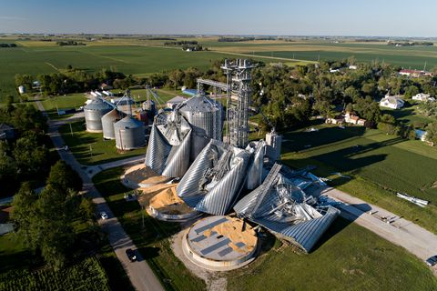
Derecho Storm Damage in Iowa
Heartland Cooperative grain elevator in Luther, Iowa

Slide 27
U.S. Soybean Supply & Demand Table
U.S. Soybean | 2018/2019 | 2019/2020 (Est.) | 2020/2021 (Aug)
Planted A. | 89.2 Mill. A. | 76.1 Mill. A. | 83.8 Mill. A.
Harvested A. | 87.6 Mill. A. | 75.0 Mill. A. | 83.0 Mill. A.
Yield/Harvest A. | 50.6 bu. | 47.4 bu. | 53.3 bu.
Beginning Stocks | 438 Mill. Bu. | 909 Mill. Bu. | 615 Mill. Bu.
Production | 4,428 Mill. Bu. | 3,552 Mill. Bu. | 4,425 Mill. Bu.
Imports | 14 Mill. Bu. | 15 Mill. Bu. | 15 Mill. Bu.
Total Supply | 4,880 Mill. Bu. | 4,476 Mill. Bu. | 5,055 Mill. Bu.
Crushings | 2,092 Mill. Bu. | 2,160 Mill. Bu. | 2,180 Mill. Bu.
Exports | 1,752 Mill. Bu. | 1,650 Mill. Bu. | 2,125 Mill. Bu.
Seed | 88 Mill. Bu. | 97 Mill. Bu. | 100 Mill. Bu.
Residual | 39 Mill. Bu. | -46 Mill. Bu. | 40 Mill. Bu.
Total Use | 3,971 Mill. Bu. | 3,862 Mill. Bu. | 4,445 Mill. Bu.
Ending Stocks | 909 Mill. Bu. | 615 Mill. Bu. | 610 Mill. Bu.
USDA WASDE – August 12, 2020

Slide 28
U.S. Soybean Supply & Demand Table
U.S. Soybean | 2018/2019 | 2019/2020 (Est.) | 2020/2021 (Aug)
Planted A. | 89.2 Mill. A. | 76.1 Mill. A. | 83.8 Mill. A.
Harvested A. | 87.6 Mill. A. | 75.0 Mill. A. | 83.0 Mill. A.
Yield/Harvest A. | 50.6 bu. | 47.4 bu. | 53.3 bu.
Beginning Stocks | 438 Mill. Bu. | 909 Mill. Bu. | 615 Mill. Bu.
Production | 4,428 Mill. Bu. | 3,552 Mill. Bu. | 4,425 Mill. Bu.
Imports | 14 Mill. Bu. | 15 Mill. Bu. | 15 Mill. Bu.
Total Supply | 4,880 Mill. Bu. | 4,476 Mill. Bu. | 5,055 Mill. Bu.
Crushings | 2,092 Mill. Bu. | 2,160 Mill. Bu. | 2,180 Mill. Bu.
Exports | 1,752 Mill. Bu. | 1,650 Mill. Bu. | 2,125 Mill. Bu.
Seed | 88 Mill. Bu. | 97 Mill. Bu. | 100 Mill. Bu.
Residual | 39 Mill. Bu. | -46 Mill. Bu. | 40 Mill. Bu.
Total Use | 3,971 Mill. Bu. | 3,862 Mill. Bu. | 4,445 Mill. Bu.
Ending Stocks | 909 Mill. Bu. | 615 Mill. Bu. | 610 Mill. Bu.
National Average Yield was increased 7.0% from trend line of 49.8 bu./a.
USDA WASDE – August 12, 2020

Slide 29
USDA Secretary Production Report Briefing – 08-12-20

Slide 30
August 2020 Corn
NASA Terra MODIS Modeled Yield
USDA Secretary Production Report Briefing – 08-12-20

Slide 31

Farm Program Enrollment
Ron Haugen
Extension Farm Management Specialist
701-231-8103
ronald.haugen@ndsu.edu

Slide 32
CFAP Signup
Only 63% of North Dakota Producers have signed up
More crops and livestock have been added to the eligible list
  Notable: eggs and all sheep (previously only sheep 2 years old or less)
Deadline has been extended from August 28, 2020 to September 11, 2020
The 20% of the payment that was held back will be paid

Slide 33
Applying for CFAP
Call to apply at local FSA office
Streamlined process online
May need to furnish documentation at a later date
Applications accepted though September 11,2020
Website: farmers.gov/cfap

Slide 34
Total US
2019-2020 ARC/PLC Enrollment
PLC 177M acres 70%
ARC-CO 65.5M acres 26%
ARC-IC 9.8M acres 4%

Slide 35
Corn US
2019-2020 ARC/PLC Enrollment
(2014 Farm Bill)
PLC 72.1M acres 75.5% (7%)
ARC-CO 17.6M acres 18.6% (92%)
ARC-IC 5.6M acres 5.9% (0.33%)

Slide 36
Soybean US
2019-2020 ARC/PLC Enrollment
(2014 Farm Bill)
PLC 7.6M acres 14.1% (4%)
ARC-CO 43M acres 79.7% (96%)
ARC-IC 3.4M acres 6.2% (0.35%)

Slide 37
Wheat US
2019-2020 ARC/PLC Enrollment
(2014 Farm Bill)
PLC 59.1M acres 93% (44%)
ARC-CO 3.8M acres 5.9% (54%)
ARC-IC 39K acres 1.9% (2%)

Slide 38

LIVESTOCK PRICE SITUATION AND OUTLOOK
Tim Petry
Extension Livestock Marketing Economist
Tim.Petry@ndsu.edu
www.ndsu.edu/livestockeconomics

Slide 39

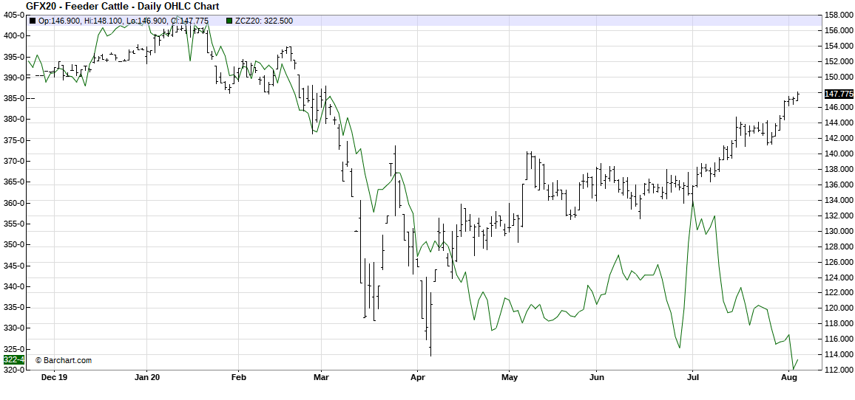

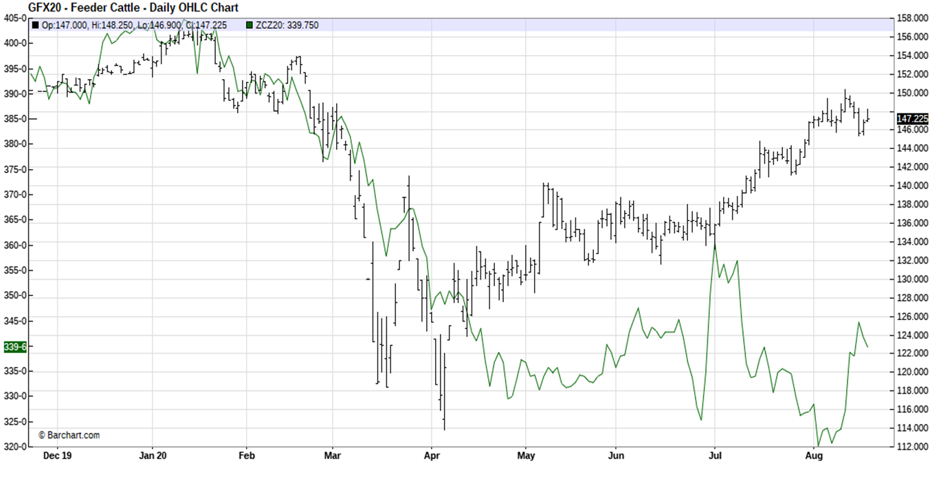


NOV FDR CAT VS. DEC CORN FUTURES

Slide 40
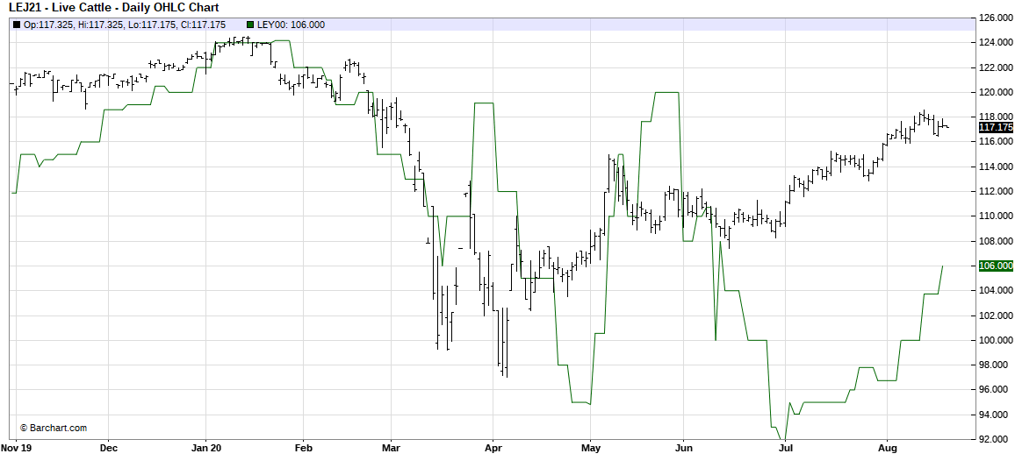


APR 2021 LV CAT FUT & 5-AREA FED CATTLE PRICE

Slide 42


Slide 43
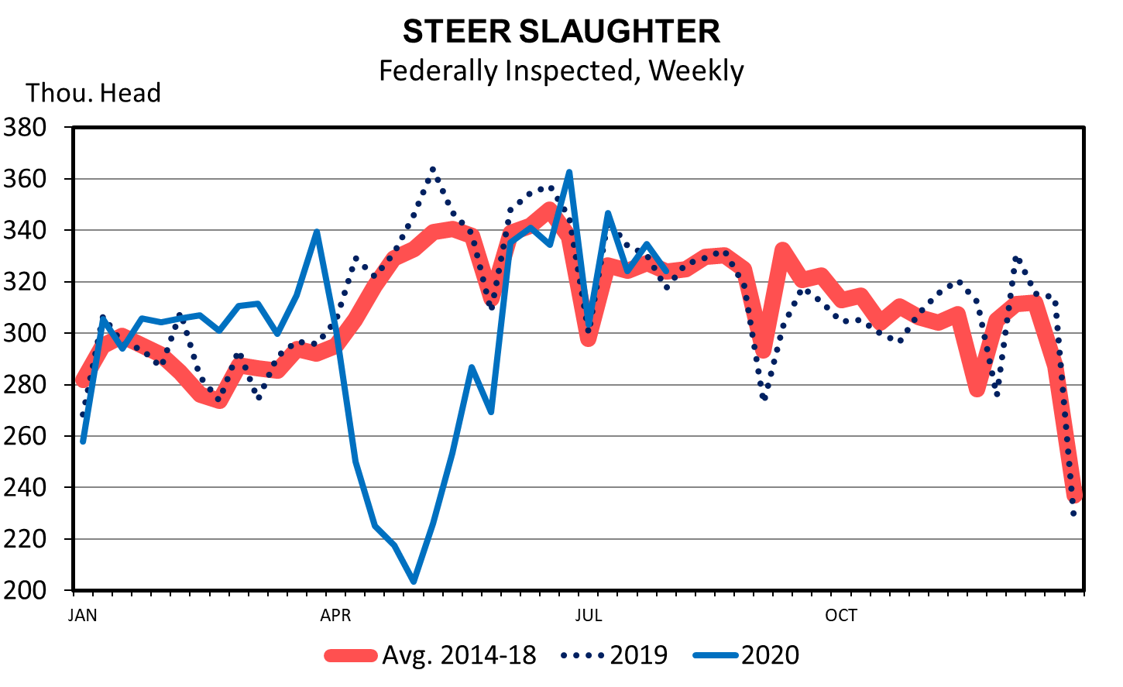
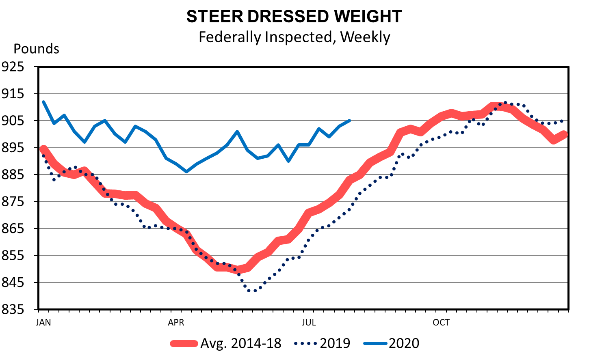

Slide 44

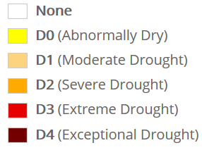
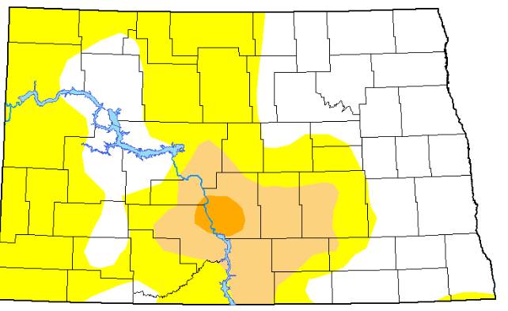

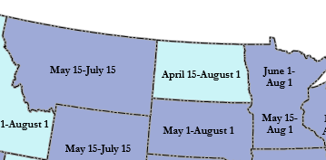

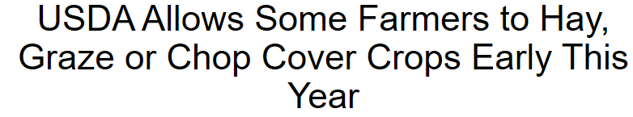
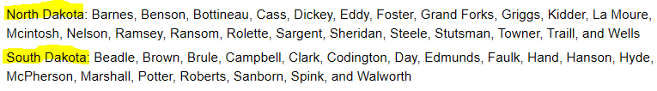

Slide 45


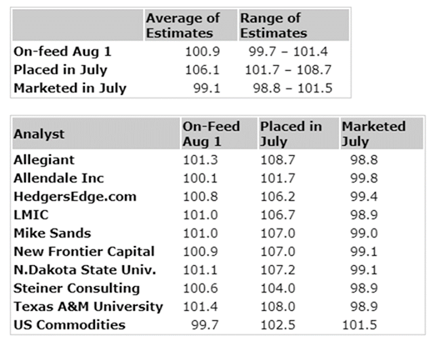

Slide 46
Last Agricultural Market and Situation Outlook Webinar of the ‘Summer’
Thursday September 3rd at 12:30

Slide 47
Recording and Additional Information
Use the Q&A tool
to ask questions
After the webinar you’ll be invited
to complete a short survey
www.ag.ndsu.edu/extension/economics
www.ag.ndsu.edu/alerts/coronavirus

