Slide 2
Energy Outlook
Marketing Facilitators Inservice
Minot, North Dakota
September 23, 2015
David Ripplinger

Slide 3
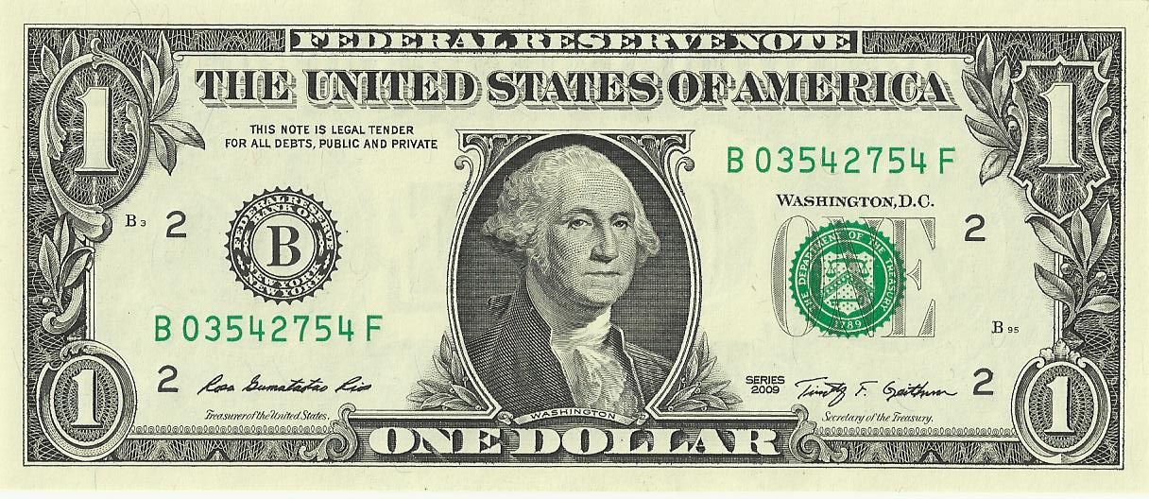
The Almighty Dollar
Capital is flowing to the United States

Slide 4
A strong dollar
Makes American goods more expensive and foreign goods less expensive
Good for American consumers
Bad for American farmers, especially those in North Dakota, given how much we export

Slide 5
An Example
In January 2012, the average price of Midwest spring wheat was $8.20 per bushel
At an exchange rate of 1.6 US$/R$ that same bushel was R$13.12
Today, that bushel is $5.13 and because a strong dollar and weak R$ (4.1 $/R$) R$21.06.

Slide 6
Oil
[SOMETHING ABOUT HISTORY REPEATING ITSELF…]

Slide 7
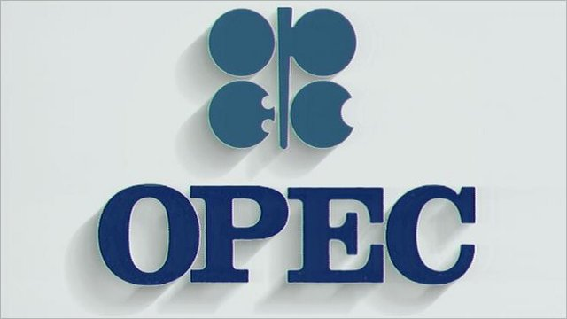
The Organization of Petroleum Exporting Countries (OPEC) looks to stabilize oil revenues.
Not only to keep prices high…
Notes:
OPEC was established in 1960 to stabilize oil revenues among member nations.
Traditionally we think of them as behaving as a cartel – limiting supplies to keep prices high, but that isn’t always the case.

Slide 8
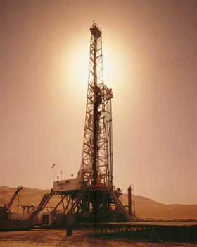
Late 70’s/early 80’s
OPEC limited production to keep prices high
Saudi Arabia cut production significantly
Notes:
For example in the late 1970’s and early 80’s OPEC wanted to limit production to some extent to drive up prices.
The problem with OPEC, like most cartels, is that there is an incentive for individual members to cheat.
What happened in this case was Saudi Arabia kept cutting production from nearly 10 mmbbl/day to 2.5 mmbbl/day.

Slide 9
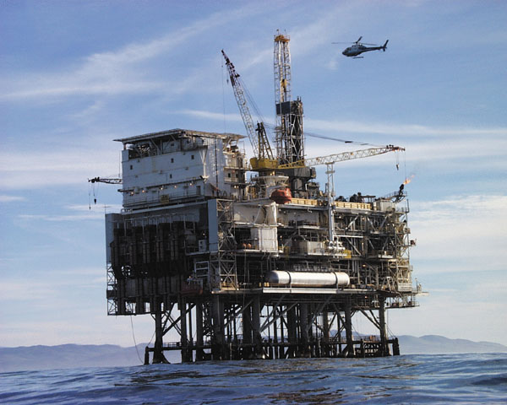
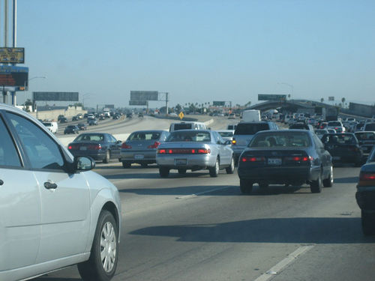
Late 70’s/Early 80’s
Production
Prices
Higher cost alternative sources
Less driving
Notes:
The effect of reduced oil production was an increase in global oil prices.
This led to the development of North Sea/off-shore oil development, and increased fuel economy of American vehicles.

Slide 10
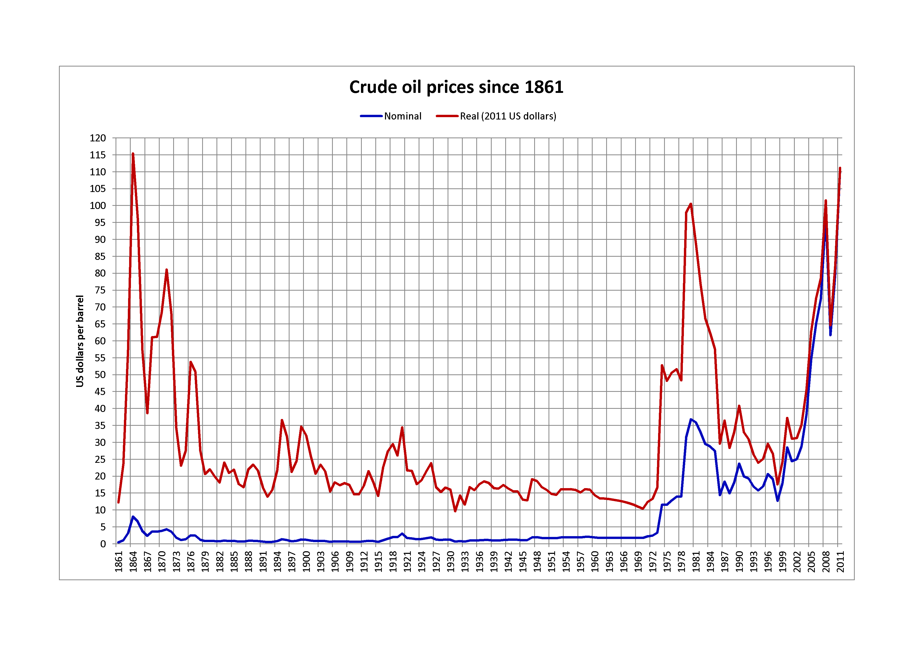
Saudi Response
Increase production to gain market share.
Oil prices fell 2/3^{rds}! in 1985-1986
Notes:
By 1985 Saudi Arabia had enough and decided that it increase production to gain market share.
This led oil prices to fall by 2/3rds from 1985 to 1986.
This led to a major disruption of a number of oil companies, many of which filed for bankruptcy.

Slide 11
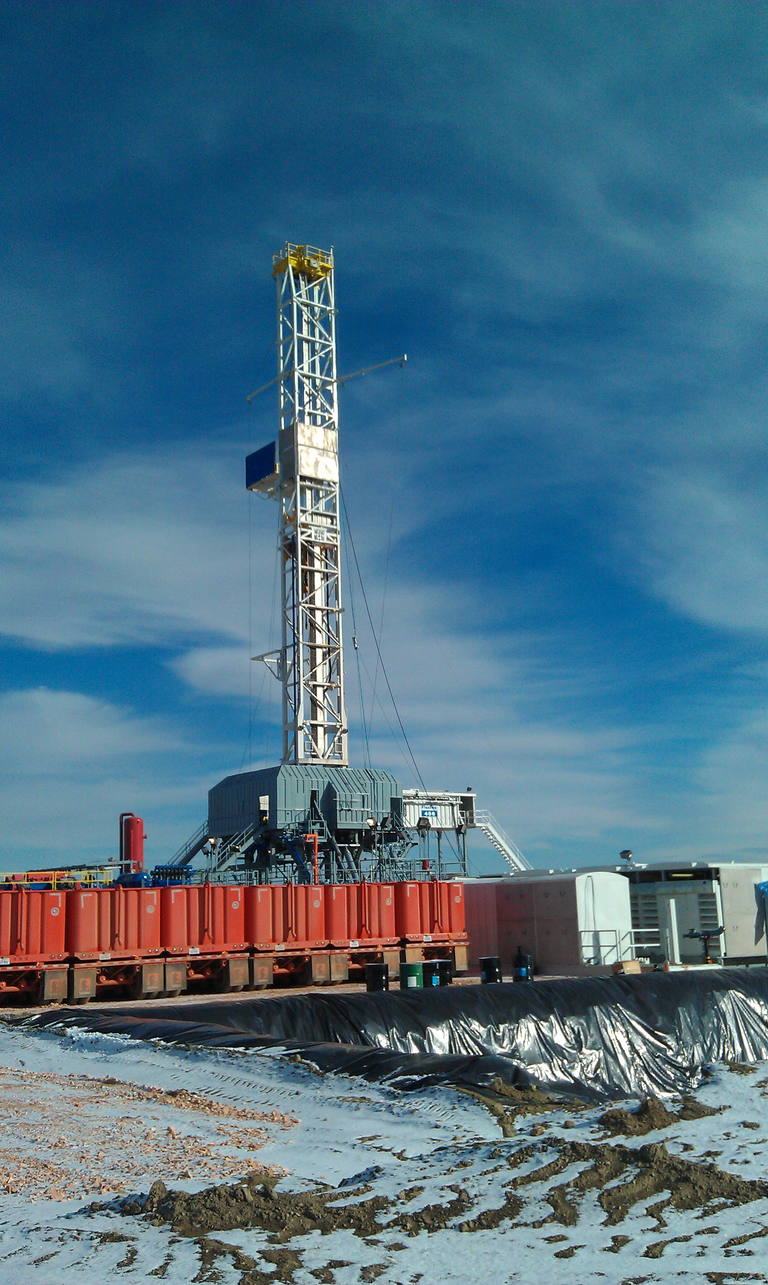
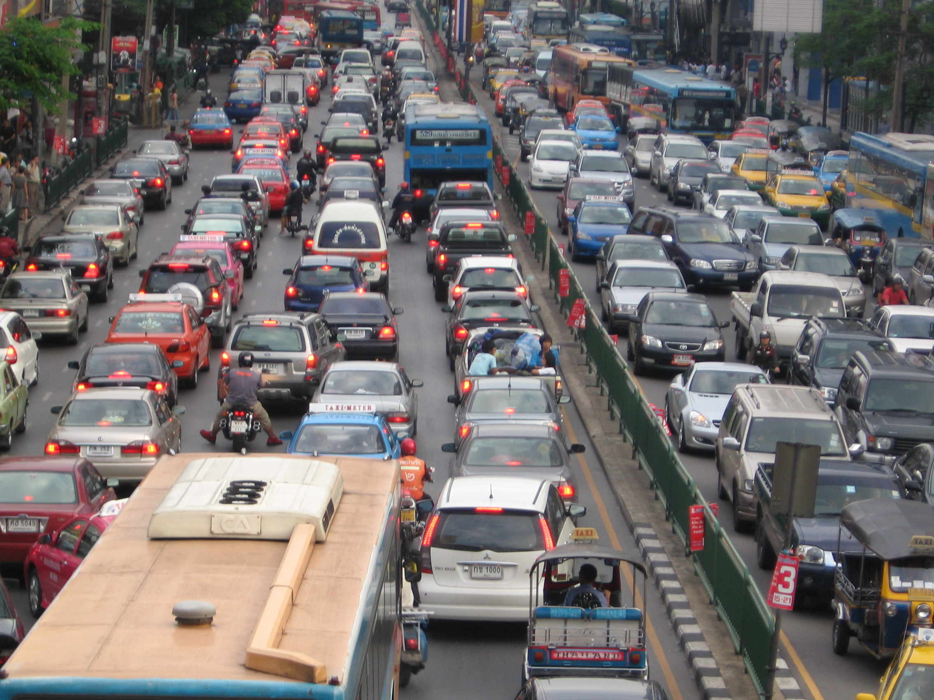
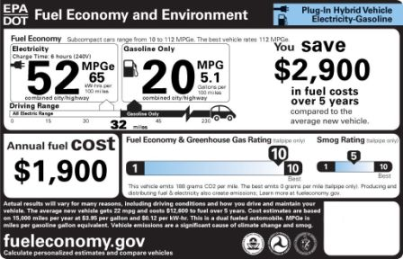
2014:History Repeats Itself (again)
OPEC members overproducing
Shale oil/renewables
Slumping demand in East Asia
Saudi Arabia goes for market share
Notes:
Today, history is repeating itself very closely.
OPEC members have been producing above their quotas, leading to a slow build up in global supplies.
High prices of oil led to the development of shale oil, including the Bakken Field in North Dakota.
Like in 1985, Saudi Arabia decided that it wanted its market share back, in this case continuing to produce oil above….
Something about 2 million gallons.
What to do with those gallons. We either need increased consumption or decreased production or both. Balance. Building pools/glut.

Slide 12
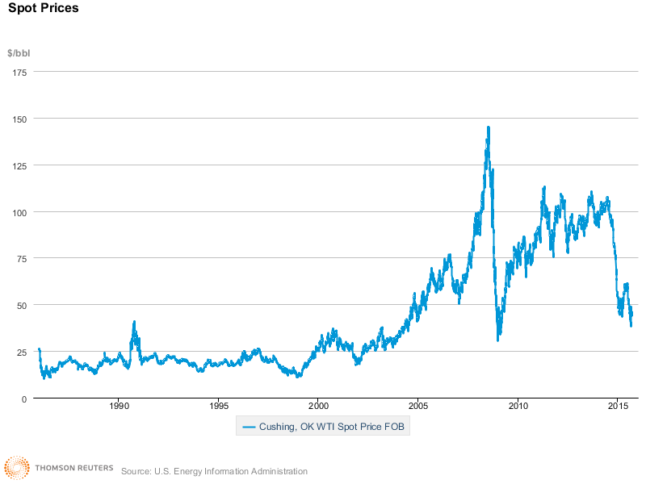
How low?
West Texas Intermediate is below $50 – half of its 2014 high of $101
Notes:
A question among investors and economists is how low with this go.
Doesn’t appear that we’ve found a price at which the market can clear.
They announced their plans to continue production on Thanksgiving, when price was $70/bbl. It has now fallen below $50.
We can look back to earlier in the year when their were signs of overproduction and growing supplies.
Saudi Arabia has given no clues as to how low they will tolerate oil to fall, making comments about willingness to see $30, $20, or lower prices.

Slide 13
How long?
A few months?
A year to 18 months?
Longer?
Notes:
When we hit the low. I don’t think we’re there yet. How long will it last.
Many believe that Saudi Arabia doesn’t have the appetite for this to last long. They have $750 billion in assets that make me think otherwise.
It took almost two decades for the real price to recover from the 1985 change.

Slide 14
What about the Bakken? ND Light Sweet: $30 9/22/15

Slide 15
 | 11/14 be | 11/14 Rigs | 8/15 be | 8/15 Rigs
Billings | $56 | 3 | $28 | 0
Bottineau-Renville | $61 | 5 | $85 | 2
Bowman-Slope | $75 | 1 | $85 | 2
Burke | $87 | 2 | $82 | 0
Divide | $104 | 6 | $81 | 3
Dunn | $29 | 27 | $24 | 11
Golden Valley | $87 | 0 | $64 | 0
McKenzie | $30 | 72 | $27 | 26
McLean | $73 | 0 | $25 | 0
Mountrail | $45 | 31 | $43 | 13
Stark | $38 | 2 | $41 | 1
Williams | $39 | 39 | $38 | 16

Slide 16
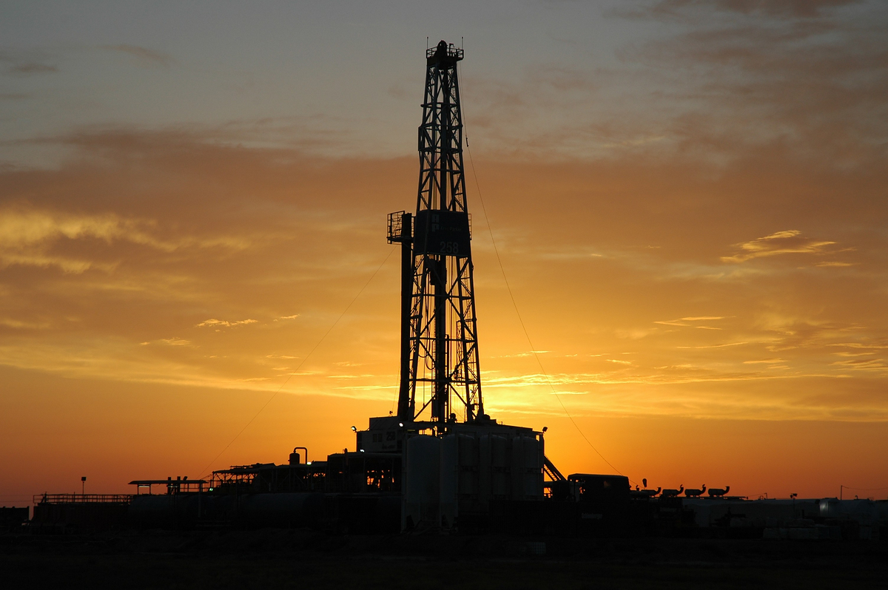
Rig Count
Now below 80 rigs
Down from 180 the last Friday of November
Oil production is steady around 1.2 million bbls/day

Slide 17
Outlook
Tremendous uncertainty regarding a short-term price, some saying WTI into the $20s.
Uncertainty of how long new low-price regime will last.

Slide 18
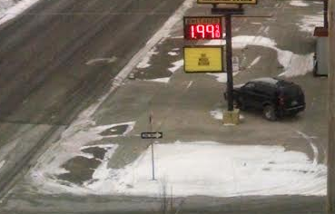
The Good news

Slide 19
Consumer Impacts
Regular gasoline (PADD 2, EIA)
$3.29 9/22/14 $2.21 9/21/15
12,000 miles per year, 24 mpg, 500 gallons
-> ‘savings’ of $535

Slide 21
Questions?

