Slide 2
The Economics of Alternative Biomass Collection Systems
David Ripplinger
Transportation Research Forum
March 14, 2014

Slide 3
Designing New Bioenergy Pathways
Biofuel policies
Bioenergy pathways defined
Design implications

Slide 4
Biofuel policies

Slide 5
The Renewable Fuel Standard (RFS)
A federal law enacted in 2005 and updated in 2007 that mandates the minimum use of various biofuels by type and year.
Provides support for the development and operation of biorefineries.

Slide 6
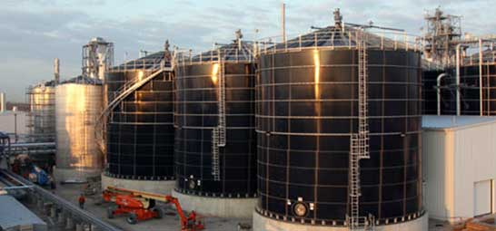
Motivation
Rural economic development
Energy security
Environmental benefits

Slide 7
Biofuels as defined by the RFS
The RFS defines biofuels by their feedstock and greenhouse gas (GHG) emissions relative to gasoline.
Conventional biofuel: reduction of ≥ 20%
Advanced biofuels: ≥ 50%
Cellulosic biofuel: cellulosic feedstock
(≥ 60% reduction)

Slide 8
Requires that California’s fuel mix meet declining GHG emission targets
Considers life cycle emissions, allows trade, and consequently prices emissions (CO₂)
Incentivizes incremental changes in GHG emissions

Slide 9
How do you measure this?
Life cycle assessment (LCA) measures energy use and GHG emissions associated with the production of goods and services
For biofuels the analysis goes from field to wheel

Slide 10
Bioenergy pathways

Slide 11
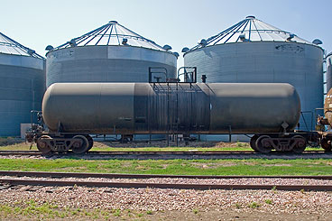
Bioenergy Pathways
Feedstock
Conversion Technology
Product
Notes:
It is helpful to think about bioenergy pathways which consist of a feedstock, or input; conversion technology, and product.
A common pathway is corn-based ethanol, where corn, the feedstock, is fermented into ethanol, the product.

Slide 12
More detail from field to consumer
Field
Feedstock Production
Harvest, Handling, Storage, Preprocessing
Conversion
Product Marketing/
Distribution
Consumer

Slide 13
The Role of Prices (Friedman)
Transmit information
Provide an incentive to users of resources to be guided by this information
Provide an incentive to owners of resources to follow this information

Slide 14
Decision makers Incentives Externalities
Field
Feedstock Production
Harvest, Handling, Storage, Preprocessing
Conversion
Product Marketing/
Distribution
Consumer

Slide 15
Designing Biomass Collection systems

Slide 16
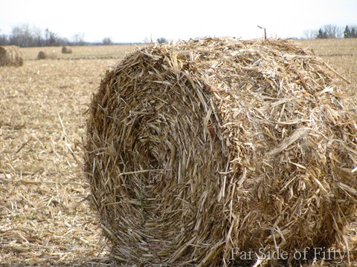
Many second generation bioenergy feedstocks (read – not corn) have low energy density
Consequently the energy required to transport them is considerable
This effects profitability and GHG emissions

Slide 17
Bioenergy system tradeoffs
So there are
Diseconomies of scale for collection
Economies of scale for processing (factory)
Constant returns to scale for feedstock production (farm)

Slide 18
A challenge presented by the RFS
A system with GHG reduction of just less than 50% is designated as a conventional biofuel
A system with GHG reductions just reaching 50% is an advanced biofuel
When designing a new system one is incented to reach the higher threshold

Slide 19
Another Problem
EPA is charged with making determinations on new biofuel pathways
They conduct the analysis using their own LCA model and others ILUC models – which aren’t known to petitioners

Slide 20
Implications for Cellulosic Biofuel
The theoretical GHG reductions for cellulosic biofuels far exceed the EPA threshold (90%+)
There is considerable slack in designing cellulosic biofuel pathways
The explicit financial parameters bind much sooner than GHG emissions

Slide 21
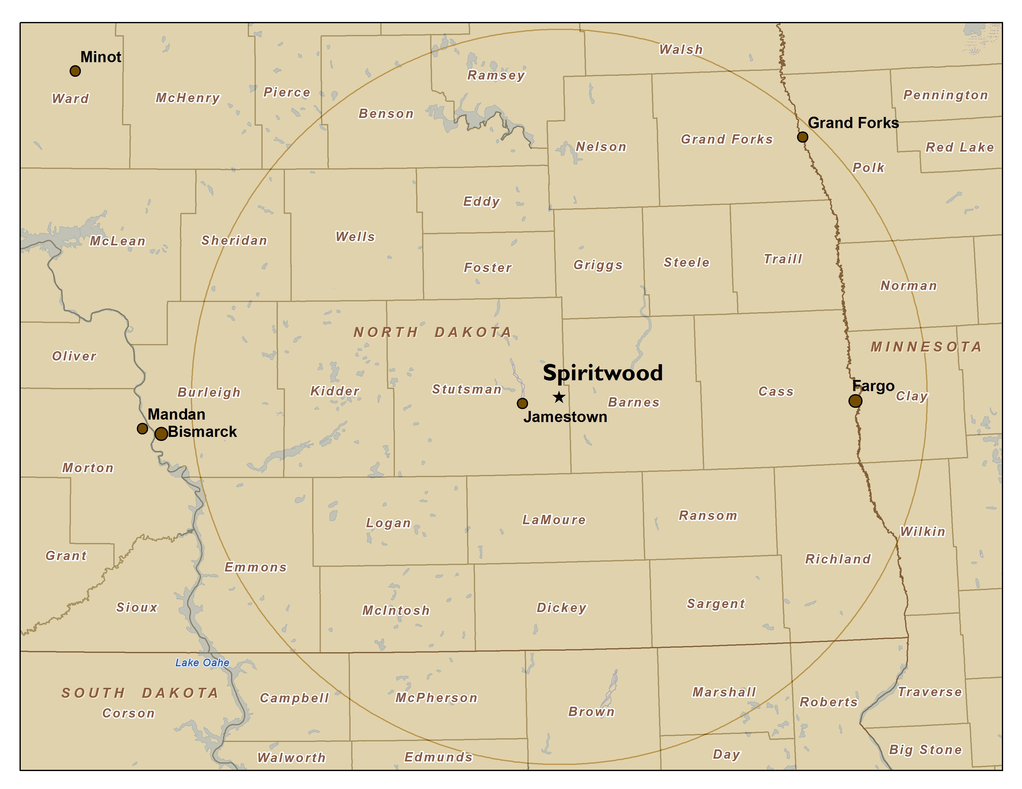

Slide 22
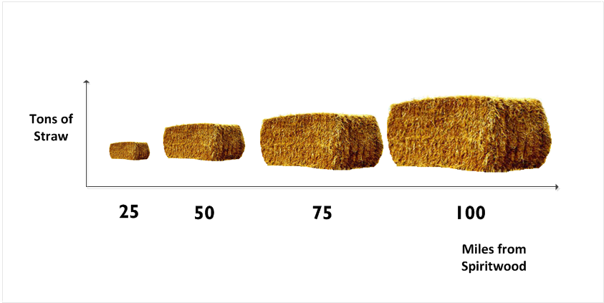
63 K
273 K
626 K
1.1 MM
Notes:
Being a distance from the facility. Need to have a very large catchment area

Slide 23
Implications for Advanced Biofuels
Don’t know what EPA’s models will estimate – especially land use change
Leave slack in the system (based on risk preference)

Slide 24
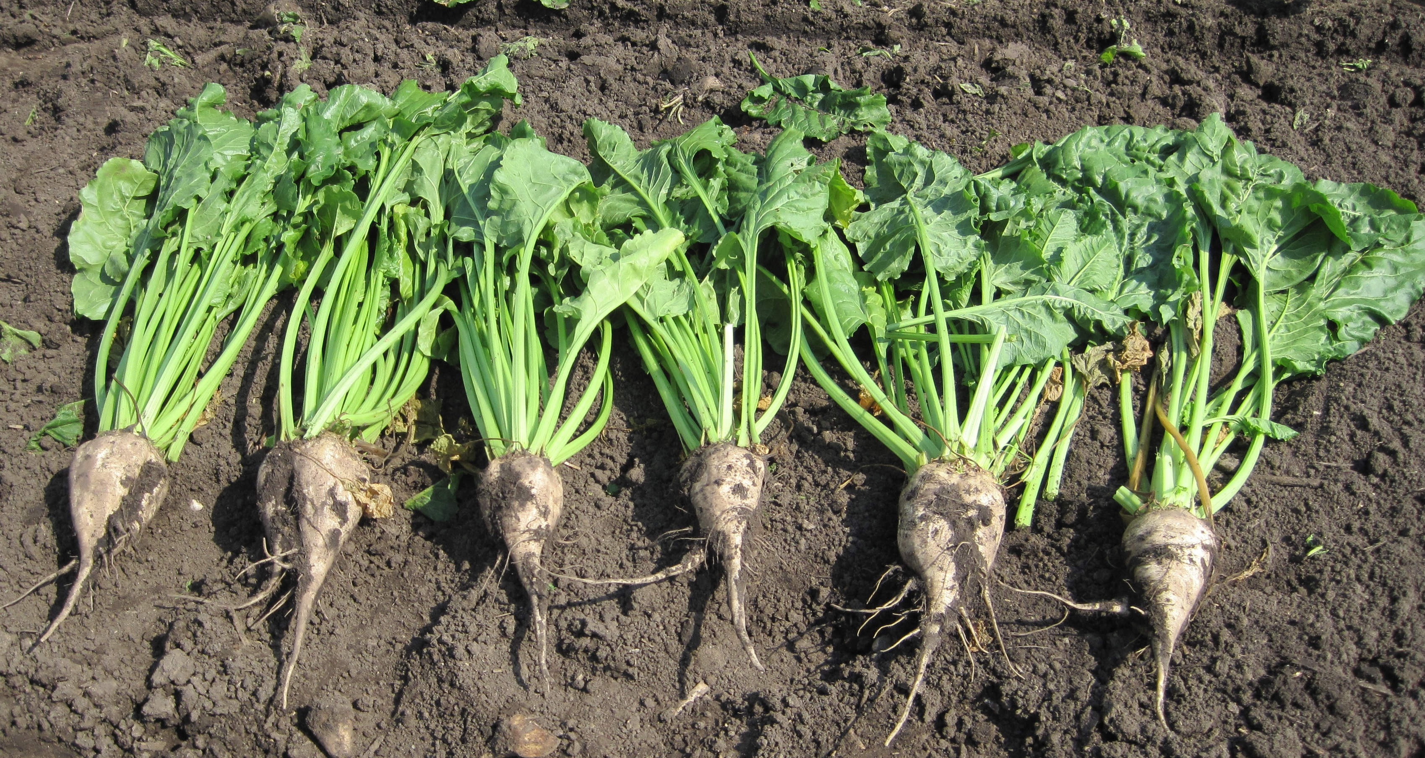
Industrial Beets
Non-cellulosic feedstock (sugar)

Slide 25
Industrial Beet Collection System
Designed with a 20 mile catchment area
20 MMGPY plant
‘Should’ attain the advanced biofuel threshold

Slide 26
LCFS
With a price for CO2 – LCFS better internalize the cost of GHG across the pathway
No steps/jumps. Less uncertainty.

Slide 27
Summary
RFS thresholds present challenges to biofuel system design
Much more significant for advanced biofuels (with lower GHG reductions)
Carbon-pricing standards are more efficient

