Slide 2
Energy Beets to Advanced Biofuels
David Ripplinger
September 11, 2013
Omaha, Nebraska

Slide 3
From Beet to Biofuel
Advantages of Beets
Region-Specific Supply Chains
Pathway Research and Development
Advanced Biofuel Petition Update

Slide 4
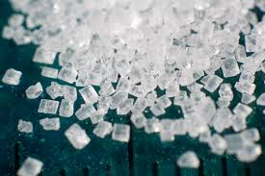
The Idea
Sugar is
Nature’s store of easily
accessible energy
Readily convertible into a number of fuels and products
Sugar beets are an economical way of producing sugar
Breed/engineer for sugar quantity not quality

Slide 5
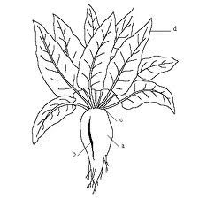
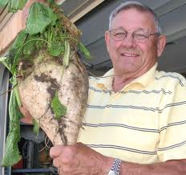
Energy Beets Defined
Varieties of beta vulgaris bred for sugar quantity
May not meet quality standards for food production (sugar beet)
Higher sugar yield than fodder beets

Slide 6
Energy BeetsTM
Only Betaseed has Energy BeetTM hybrids

Slide 7
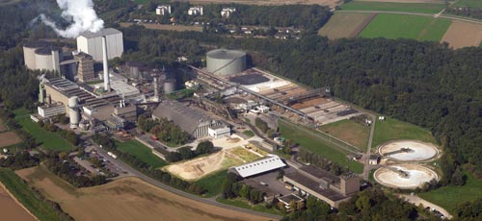
The European Experience

Slide 8
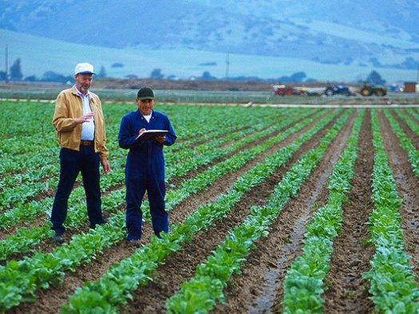
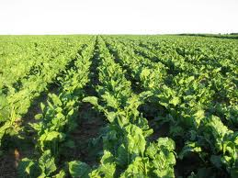
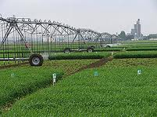
Region- Specific Energy Beet Supply Chains
Beets grow well in many agroecosystems
Supply chains will differ because of climate
Considerations
Economics
Energy use
Land use change
Environmental impacts

Slide 9
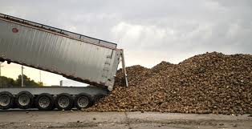
Spring Beets
-Planted in the Spring harvested in the Fall
-Dryland or irrigated production
-May be stored outdoors over winter in colder climates
Example: North Dakota
Rotation: Corn/Soybeans/Small Grain/Beets
Long days, cool nights put on sugar

Slide 10
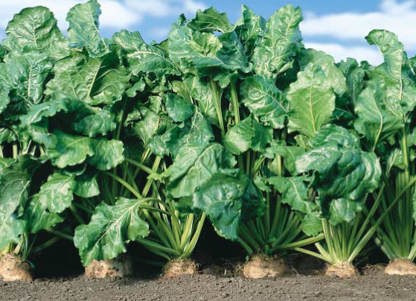
Winter Beets
Planted in the fall
harvested in the spring
Grown in areas where
hard freezes are unlikely
Dryland production
Example: Mississippi Delta
No land use impacts

Slide 11
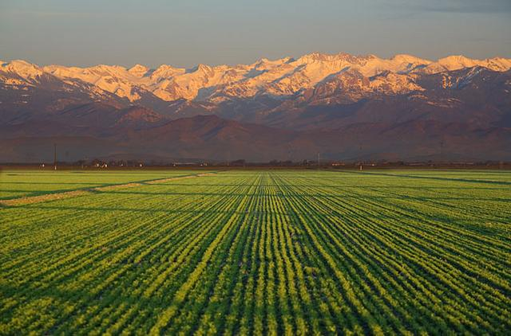
Just in Time Beets
Planted and harvested throughout the year
Irrigated
Example: San Joaquin Valley
Rotation: alfalfa/beans/sunflower/melons/wheat/beets

Slide 12
Comparative Summary
 | Spring Beets | Winter Beets | JIT Beets
Locale | North Dakota | Mississippi Delta | San Joaquin Valley
Production | Dryland/Irrigated | Dryland | Irrigated
Land Use |  | None
Availability | Sept-May | Feb-Apr | Mar-Dec

Slide 13
NDSU Research
“Phase II”
Front-end
Whole beet
Juice
Field trials
Crop insurance
Economic and environmental

Slide 14
Green Vision Group
Heartland Renewable Energy
Department of Agribusiness & Applied Economics

Slide 15
Front-End Processing
Pulp for pellets
Beets
Hammer mill
Modified ribbon mixer with hot water spray
Chamber filter press
+
Juice for biofuel
Beet to juice and pulp

Slide 16
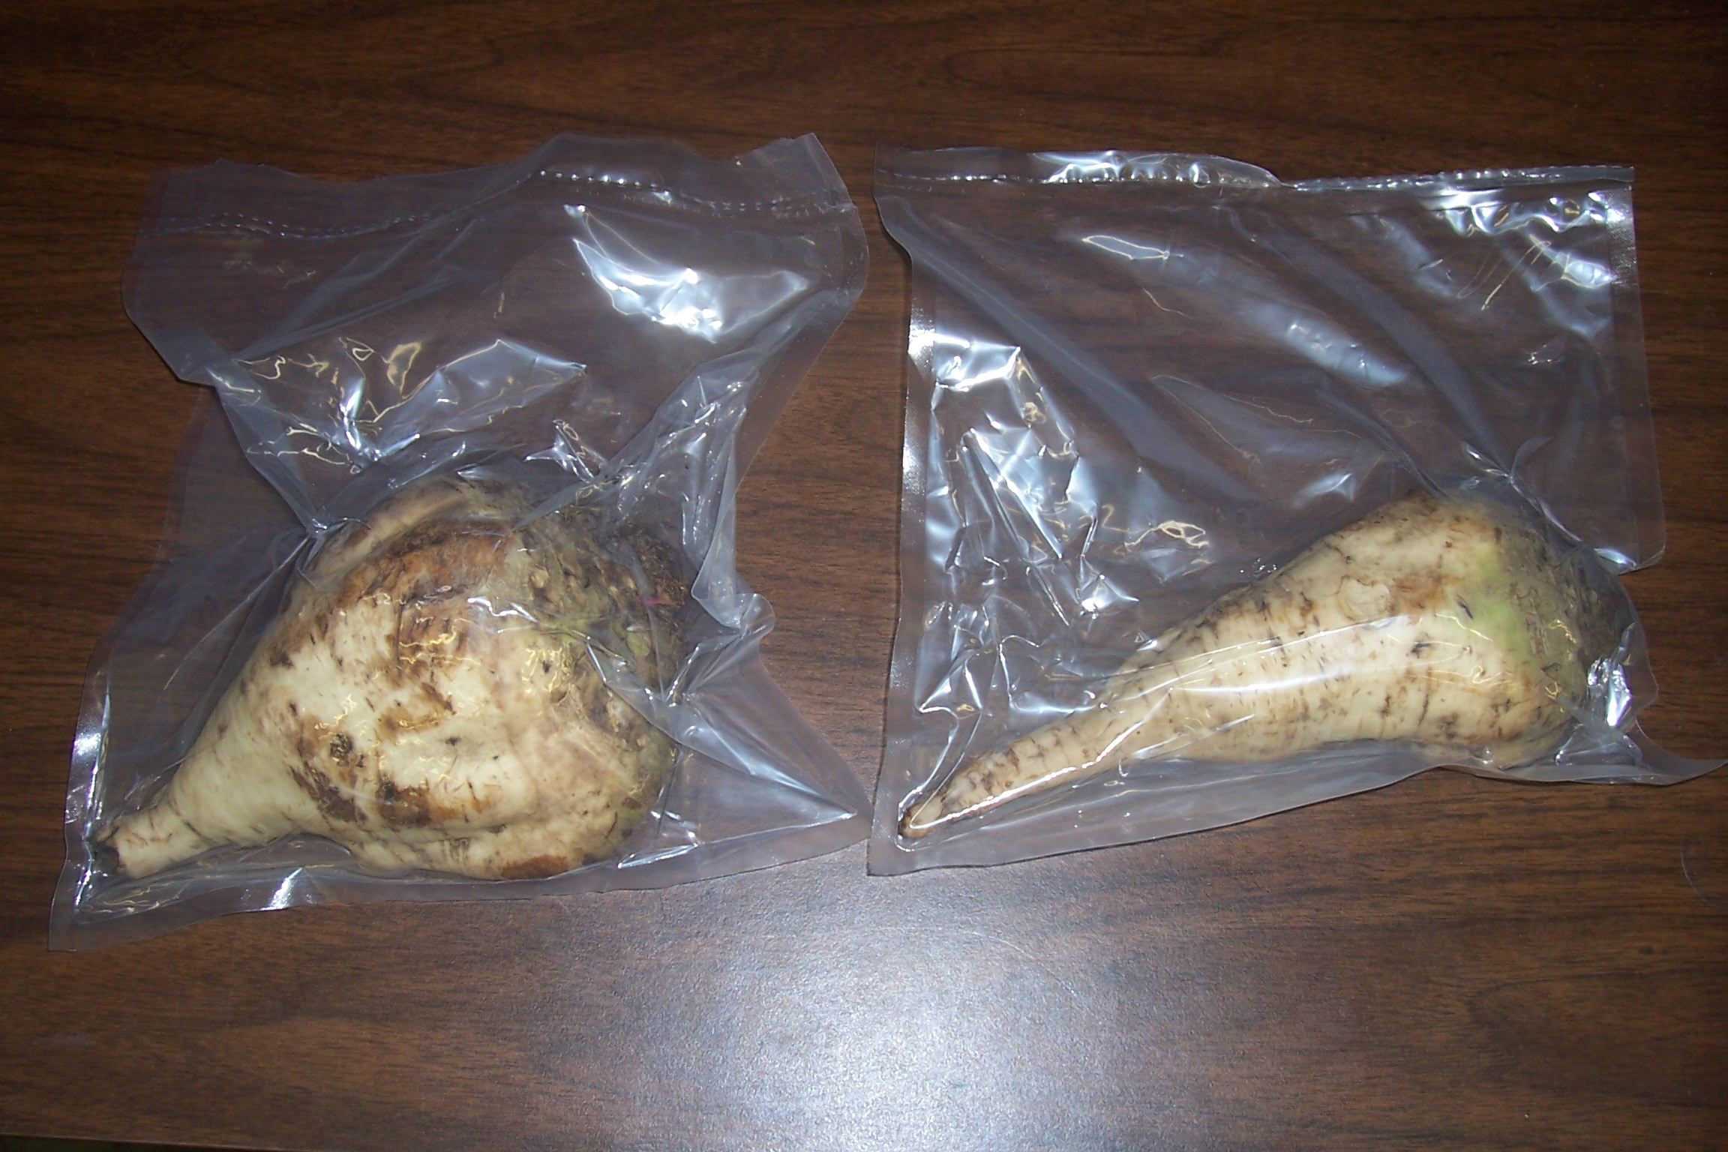
Beet/Juice Storage

Slide 17
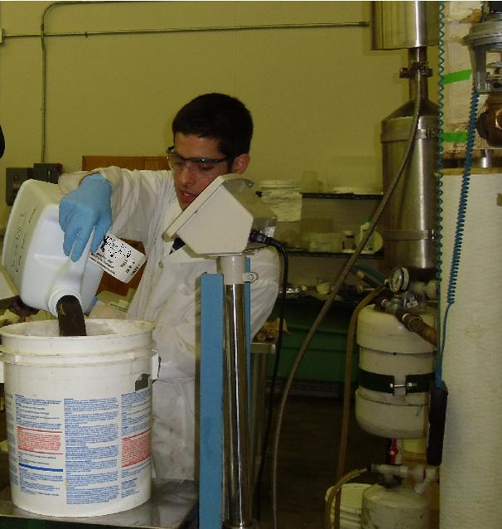

Slide 18
Field Trials

Slide 20
Sugar Yield Per Acre

Slide 21
Ethanol Yield Per Acre

Slide 22
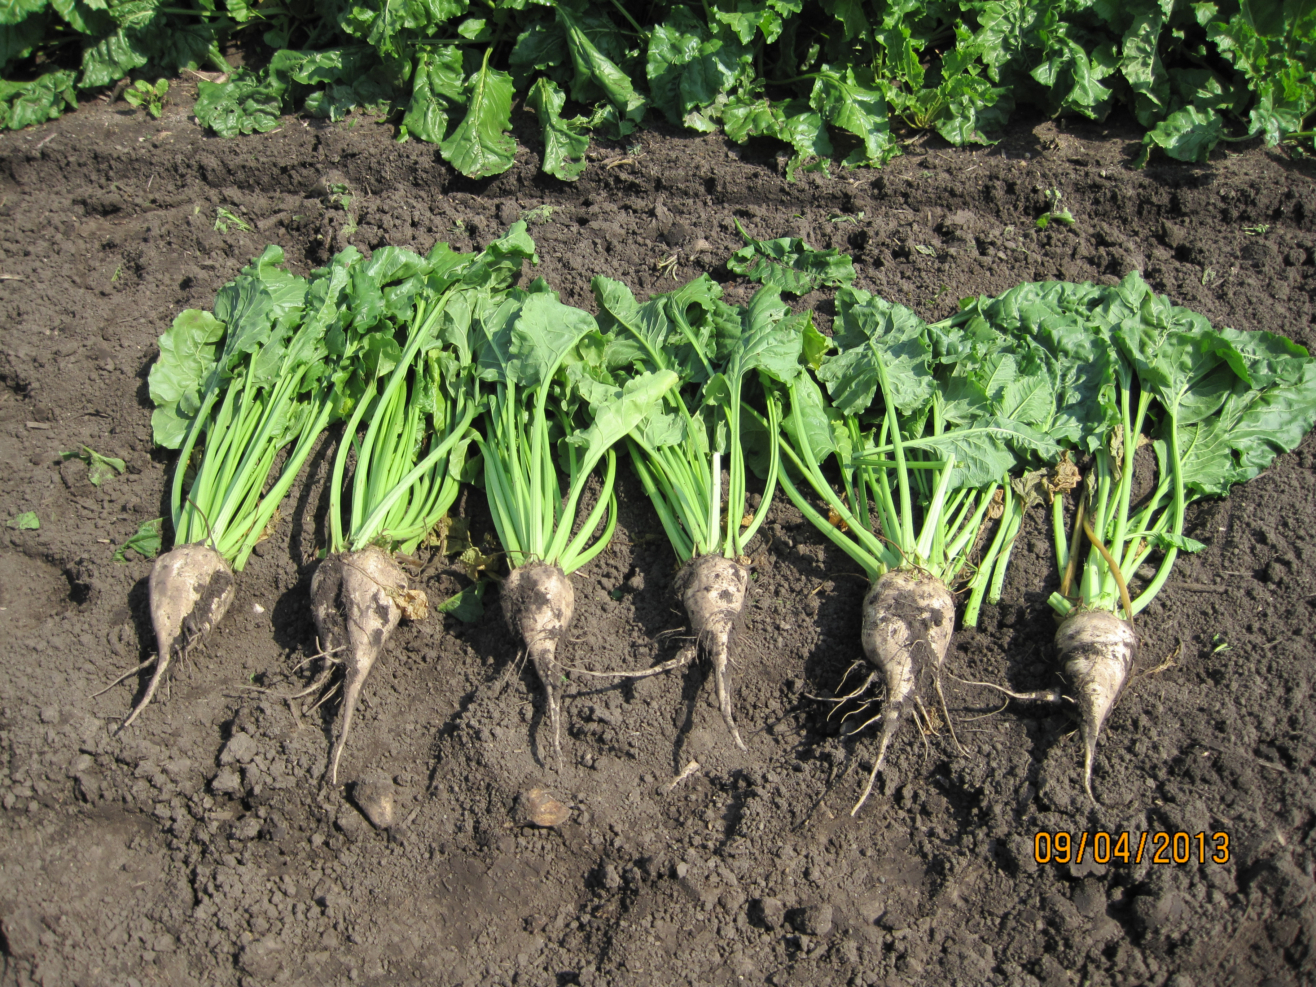

Slide 23
Economic and Environmental Analysis
Feedstock production and conversion
Considering ND-based systems (ND Industrial Commission, ARPA-E) and CA and MS-based systems (ARPA-E)
Currently finalizing TEA and the price of industrial sugar

Slide 24
…you had me at industrial sugar.

Slide 25
Advanced Biofuel Petition
Petition submitted to EPA in October 2011 (710 days and counting)
Green Vision Group & Heartland Renewable Energy
Critical determination
Sugar determination made about a month ago (designated as a renewable fuel)

Slide 26
Summary
Use of beets has real, obvious advantages
Differences exist among region-specific pathways
NDSU research is helping optimize the pathway
EPA biofuel petition

