Slide 2
NDSU Extension
Farm Stress Program
NDBA Ag Credit Conference
Fargo, ND
David Ripplinger
September 27, 2018

Slide 3
Some Statistics
-Farm workers have the highest suicide rate of any occupation: https://www.cdc.gov/mmwr/volumes/65/wr/mm6525a1.htm
-Suicide is the number one cause of death of North Dakota males age 15-54. http://www.worldlifeexpectancy.com/north-dakota-cause-of-death-by-age-and-gender
-North Dakota's suicide rate increased 58% between 1999 and 2016, the greatest increase of any state (https://www.cdc.gov/media/releases/2018/p0607-suicide-prevention.html).
-anecdotally we know that many farmer/rancher suicides are masked as accidents.

Slide 4
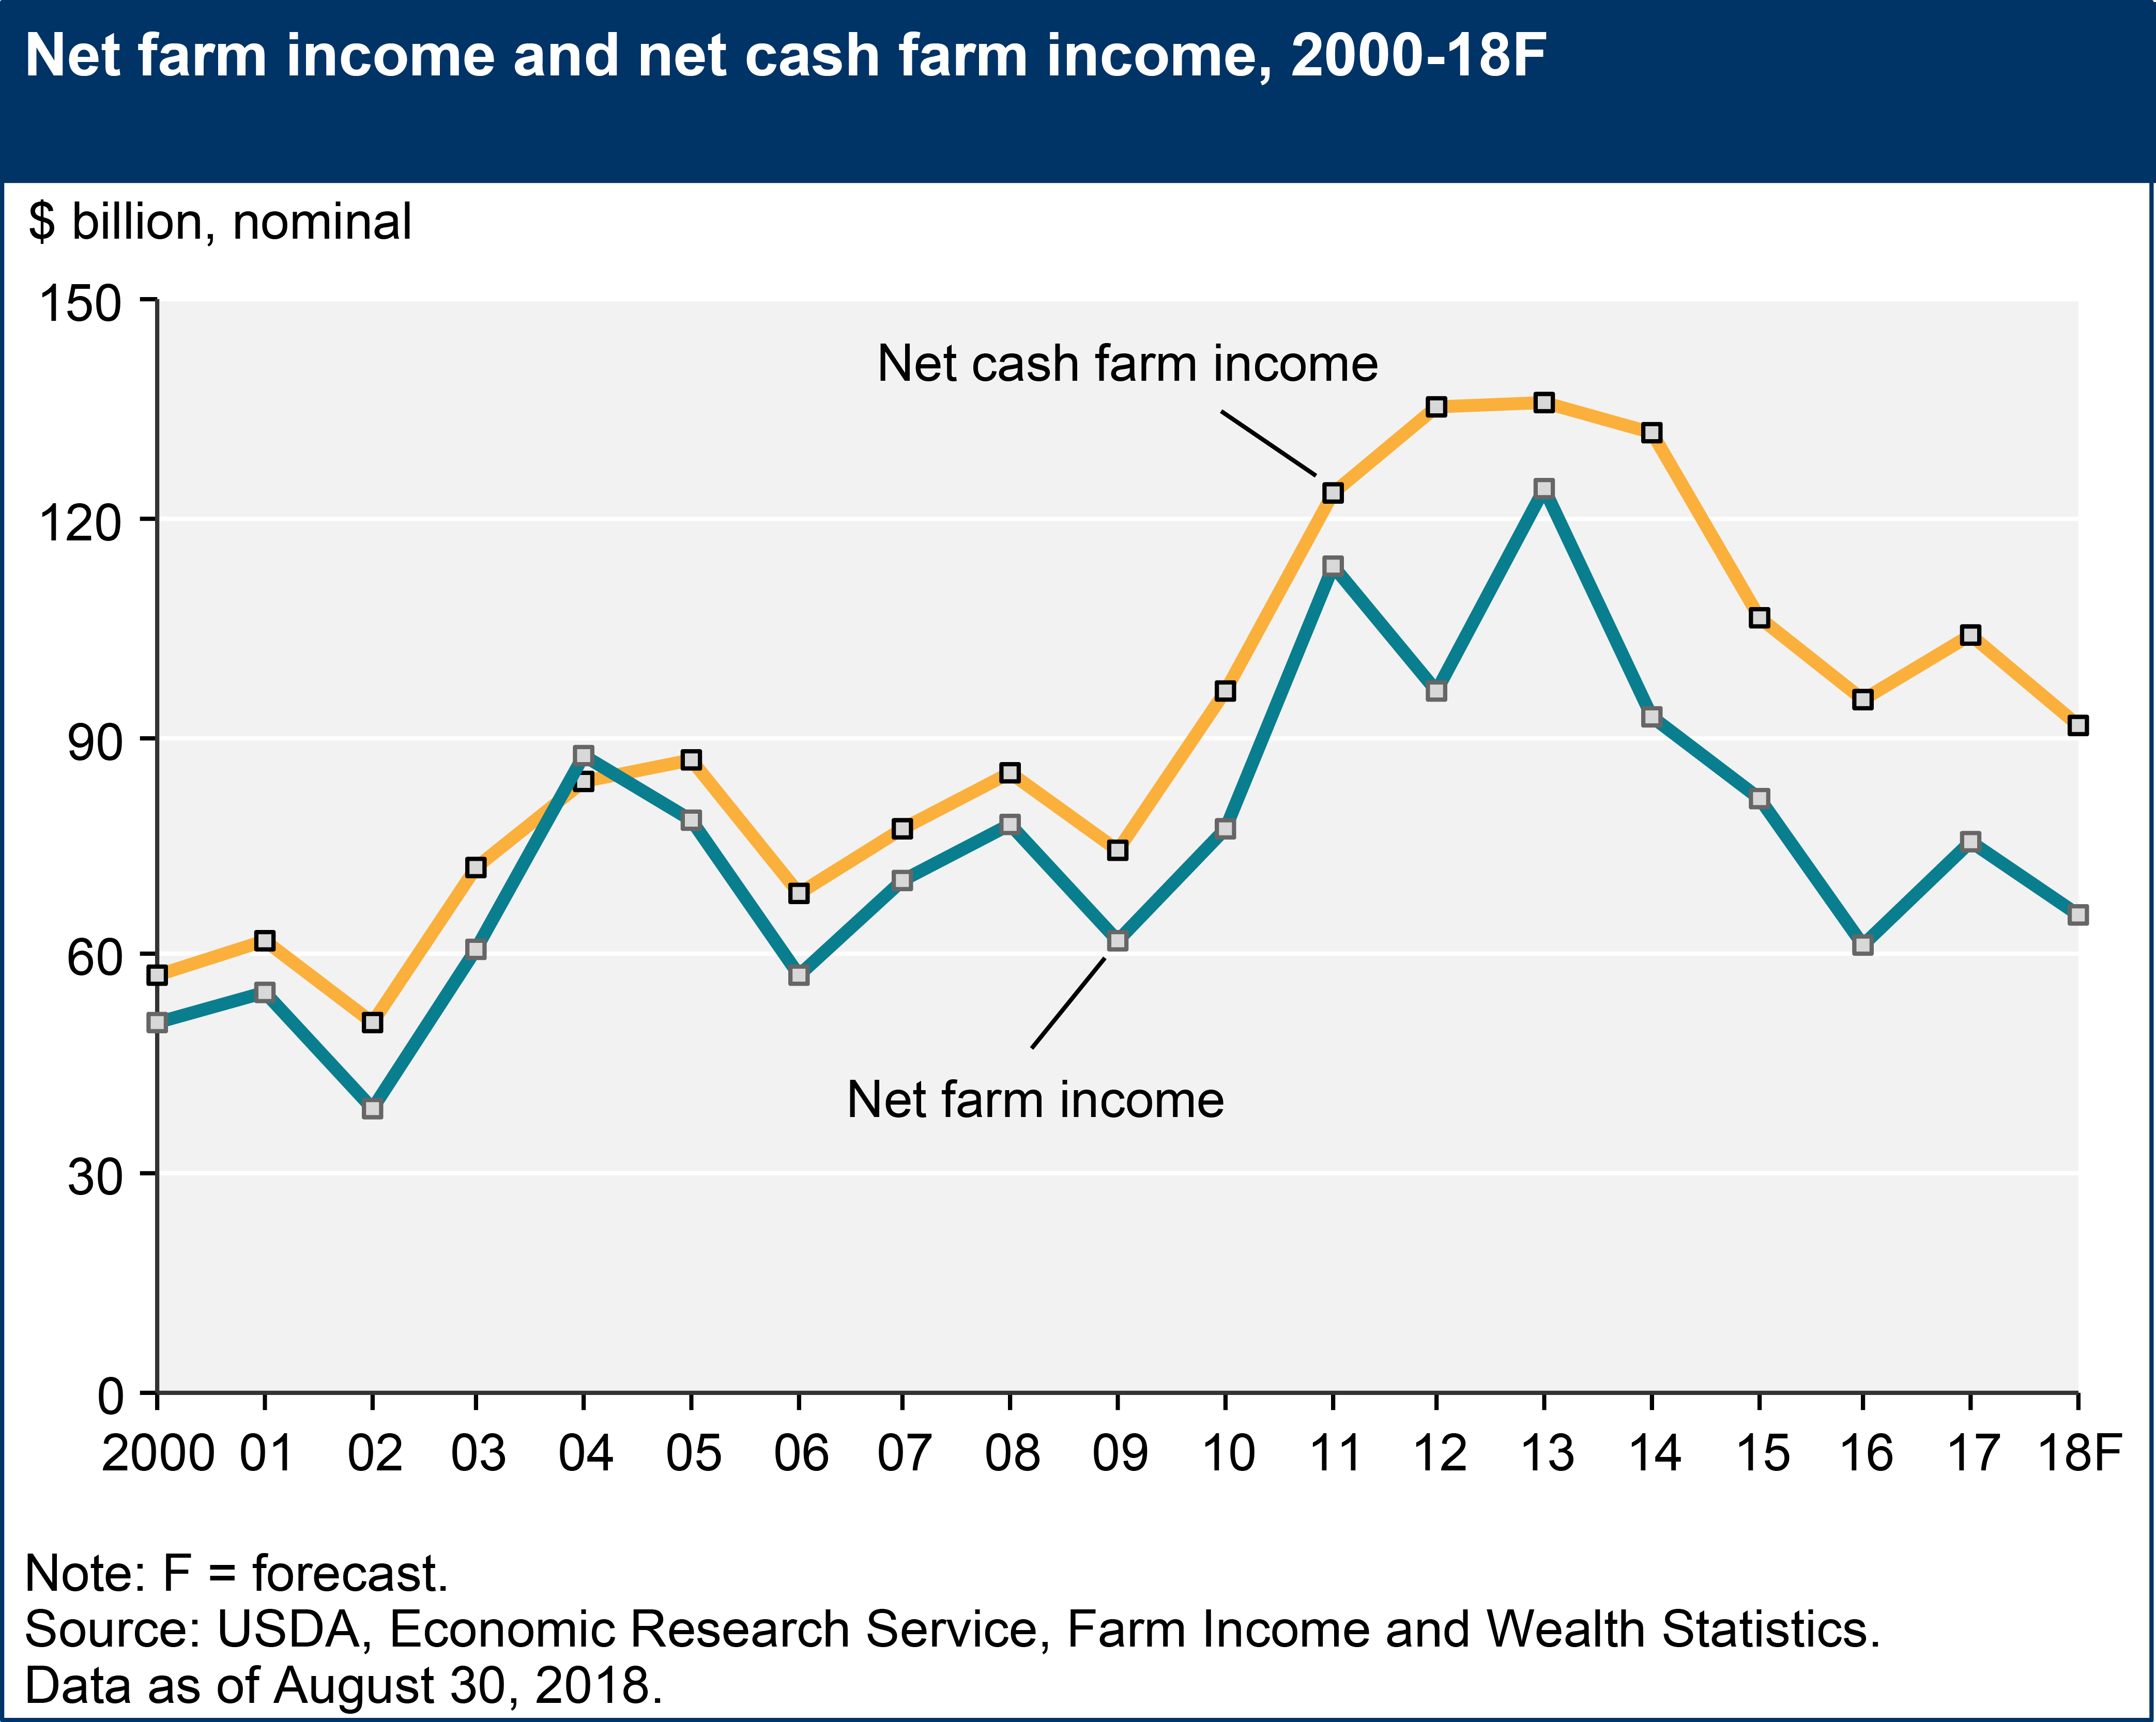


Slide 5
Some thoughts about the economics
This isn’t the 1980’s
- many farmers are doing well, with strong balance sheets
and profitable farms
- some are not, for a variety of reasons
Things may be getting a whole lot worse, before they get better
- trade dispute (could last a long time)
- interest rates (land values, operating costs)

Slide 6
Are you prepared to deal with a client
who is suffering from a mental health crisis?
Can you recognize signs of distress?
Can you immediately respond to manage a crisis at hand?
Do you know who to refer the individual to for more help?

Slide 7
If you’re not ready, do you think you should be?
If you need and want to be ready,
how are you going to prepare yourself and your bank?

Slide 8
Urgent Resources
911
211 connects callers with ND First Link, which provides mental health, including suicide response
National Suicide Prevention Hotline: 1-800-273-TALK (8255)
Crisis text line: Text “GO” to 741741

Slide 9


Slide 10
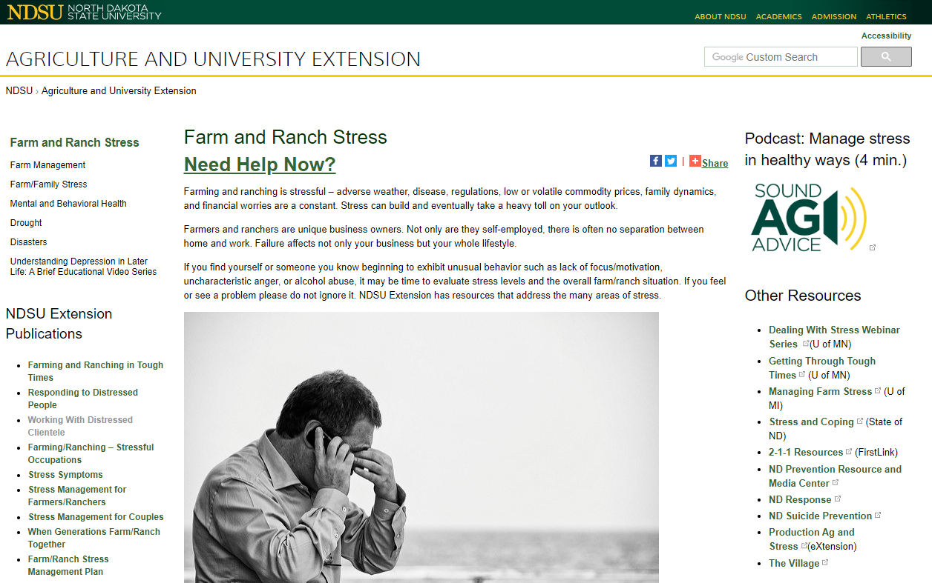
https://www.ag.ndsu.edu/farmranchstress

Slide 11
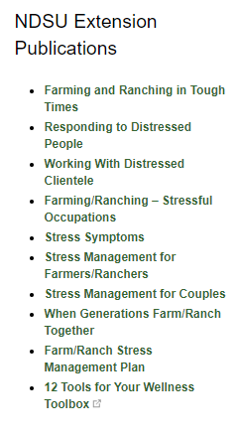
NDSU Extension Publications
NDSU Extension has a number of stress-related publications that address different issues and different people.
These publications are all available online in electronic form. If you’d like a hard-copy(ies) for your own use or to share with others let us know and we’ll get them to you through your county agent.

Slide 12


Slide 13
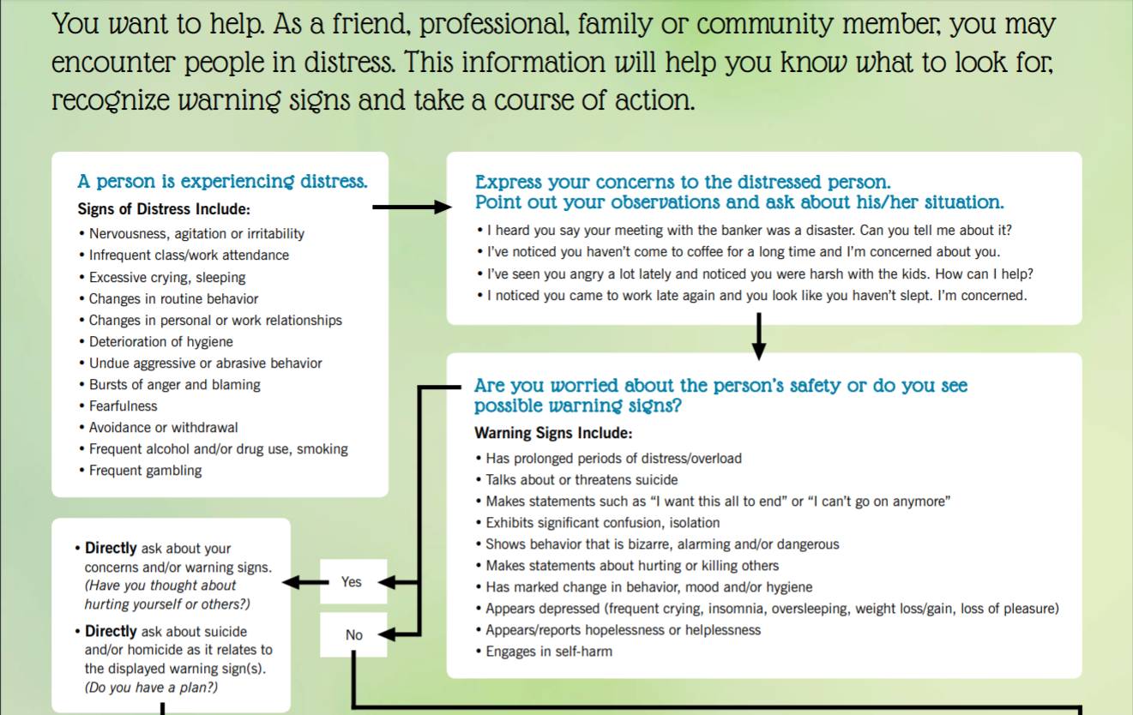

Slide 14
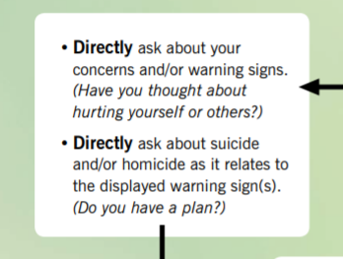

Slide 15
The Financial Side of Things
Many farmers are suffering stress and anxiety because of a weak and deteriorating financial position.
NDSU Extension
Farm Business Management Instructors
Ag Mediators

Slide 16
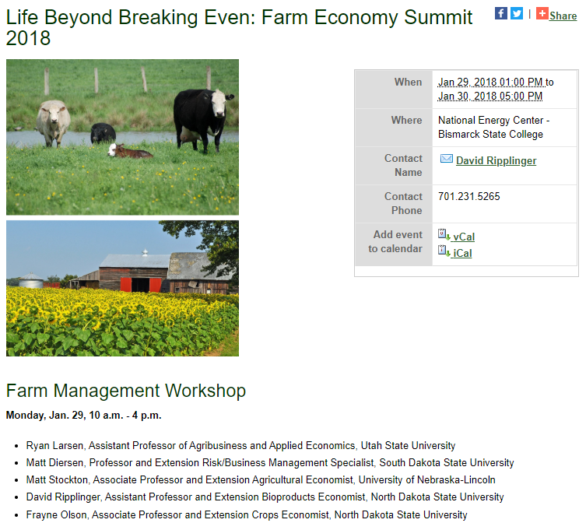
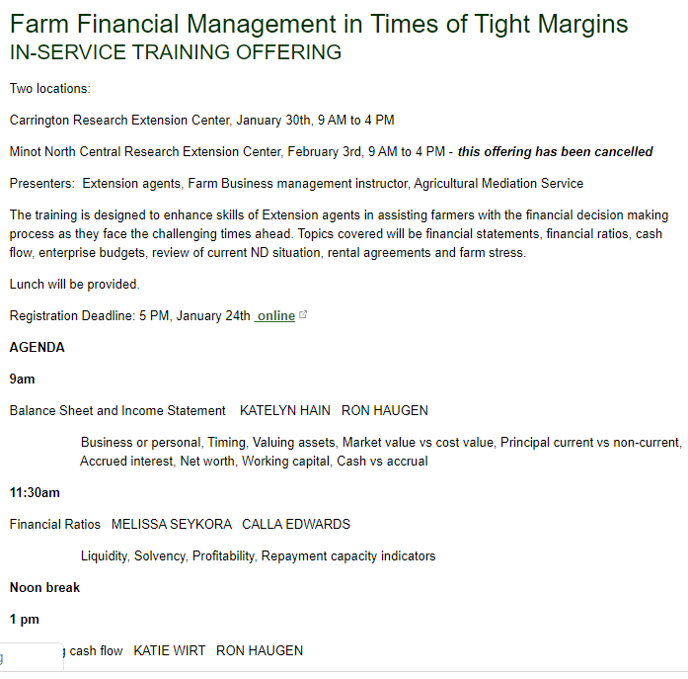

Slide 17
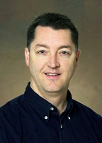
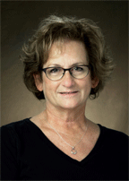
NDSU Extension Specialists
Sean Brotherson, Co-Chair Farm Stress Team
Extension Family Science Specialist
Kim Bushaw,
Extension Family Science Specialist

Slide 18
NDSU Extension Programs
Is there more that NDSU Extension can do?
For example, an educational program delivered across the state?
On what subject matter? For what audience? With what type of delivery?

Slide 19
Are you prepared to deal with a client
who is suffering from a mental health crisis?

