Slide 2
Bioenergy Update
Lake Region Roundup
David Ripplinger
January 9, 2019

Slide 3
Corn Ethanol Key Factors
Glut in energy markets – ethanol , gasoline, and oil
Expanding US Corn Ethanol Capacity (16.3 billion gallons)
Near Record US Corn Ethanol Production
Relatively stable US Corn Ethanol Exports
Policy Uncertainty E15 and RFS

Slide 4
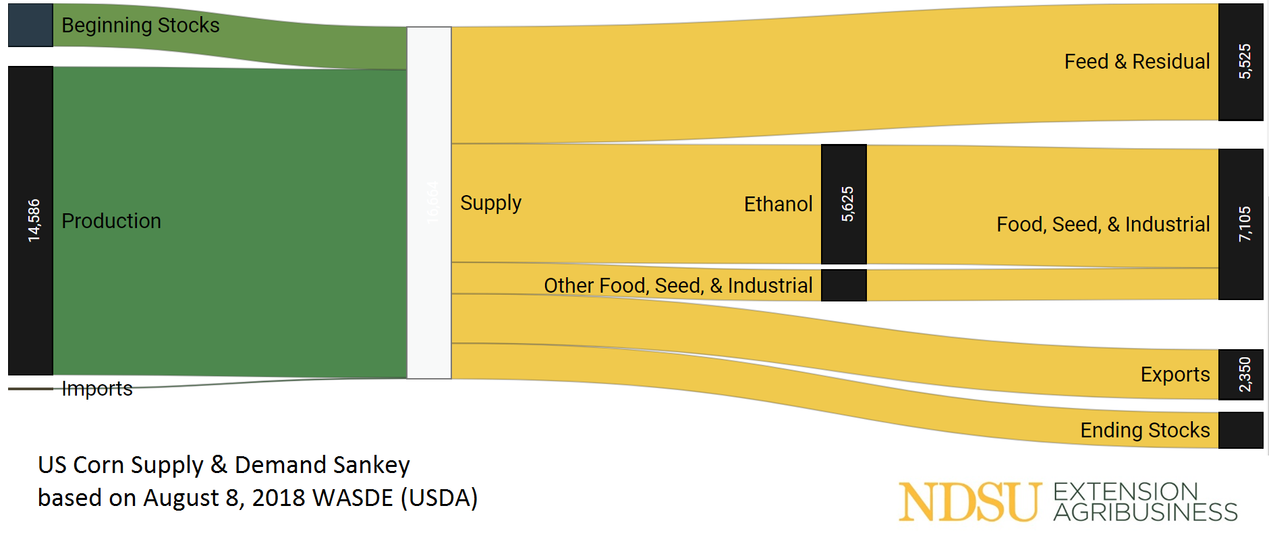
US Corn Ethanol Use>>Feed & Residual

Slide 5
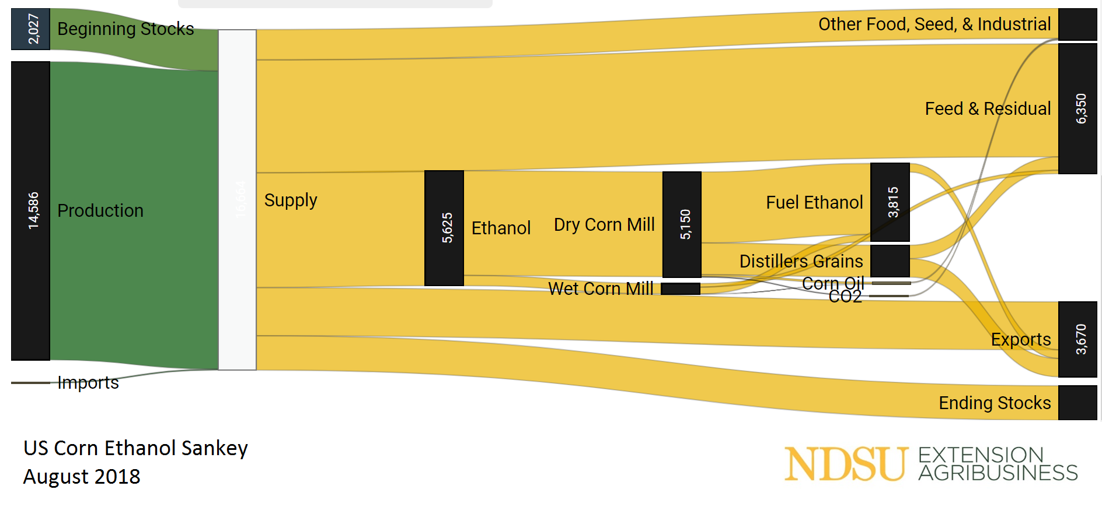
Accounting for ‘Feedback’
Data: WASDE, Grain Crushing and Co-Products Production Report

Slide 6
Ethanol Crush Margins
(Bushel-Basis South Dakota)
2.8 gallons ethanol
17 pounds distillers grains
.75 pounds corn oil
From
1 bushel of corn
2.8 x 1.20 $3.37 etoh
17 x .075 $1.27 ddgs
.75 x .245 $ .18 oil
-3.39 $3.39 corn
$1.43/bu
Capital & Other Operating Expenses
($1.40)
Data: USDA/AMS

Slide 7
Corn Ethanol-US Production & Use
15 billion gallon mandate
Data: EIA

Slide 8
Record Corn Ethanol Exports
– 2 billion gallons est. 2018
Data: EIA

Slide 9
What are the five largest
US ethanol destinations (1H 2018)?
Brazil (40%)
Canada (16%)
China (6%)
India (6%)
South Korea (5%)

Slide 10
Hardship Waivers
The Renewable Fuel Standard (RFS) allows the EPA to waive the Renewable Volume Obligation (RVO) of small refiners (<75,000 bbls/day) enduring severe hardship due to the policy.
The EPA under Scott Pruitt waived
19 of 20, 2016 waivers – 790 million gallons
29 of 33, 2017 waivers – 1.46 billion gallons
Equivalent of 800 million bushels
Should waived gallons be reallocated?

Slide 11
D6 RIN Prices (cents)
Hardship Waivers Known
Data: Thomson Reuters

Slide 12
Market Expansion
Domestic: The administration has announced that it has begun working on new regulations to allow the use of E15.
Foreign: Much of the ag industry sees corn ethanol as the best opportunity for trade growth.
China: Hasn’t done much to show they will be able to achieve their stated E10 by 2020 goal.

Slide 13
Carbon Pricing
California has created a carbon market for biofuels.
Its Low Carbon Fuel Standard (LCFS) has set annual carbon intensity standards for fuels (CAP).
Regulated parties (blenders and refiners) are required to supply fuels with increasingly smaller carbon footprints over time. They can do by blending ever higher levels of biofuels or trading for permits from other parties that do (TRADE).

Slide 14
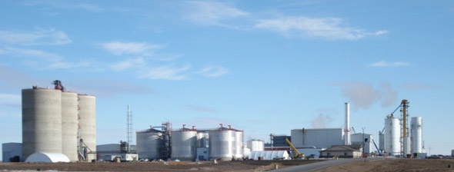
An example pathway
Fuel Producer: Red Trail Energy LLC
Facility Name: Red Trail Energy LLC
Midwest Corn, Ethanol, Dry Mill, 100% MDGS, NG
76.46

Slide 15
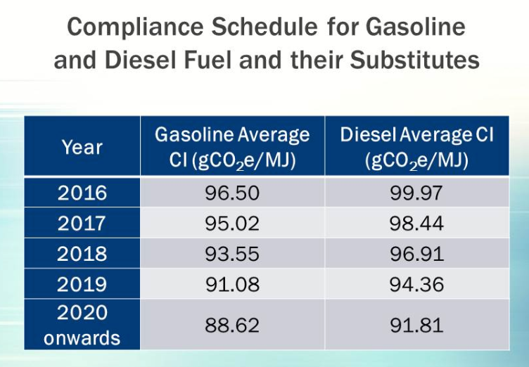

Slide 16
An Example
Company X has the ability to easily blend ND corn ethanol with a carbon intensity of 76 g co2 e/MJ with gasoline that has a carbon intensity of 96.
The resulting blend has a carbon intensity of 94, this is above the 2018 standard so the refinery needs to trade for carbon credits.

Slide 17
California Carbon Prices

Slide 18
Importance/Impacts
There is a mechanism that rewards incremental improvements in carbon reductions.
$180/MT is real money.
-> corn-ethanol refinery investments.
-> corn production practices. For example, no till.
-> new biofuel pathways.

Slide 19
 | Emissions
Process | gCO2-eq/ wet short ton | gCO2-eq/ MJ beet ethanol | gCO2-eq/ MJ corn-ethanol
Feedstock Production | 21,615 | 10.1 | 15
Domestic Land Use Change | −882 | -0.4 | -
Land Use Change | 15,556 | 7.1 | 28
Feedstock Transport | 8,183 | 3.8 | 4
Total Upstream Emissions, Mean | 44,954 | 21.0 | 47
*24 gallons/short ton; 89 MJ/gallon ethanol
https://www.federalregister.gov/documents/2017/07/26/2017-15721/notice-of-opportunity-to-comment-on-an-analysis-of-the-greenhouse-gas-emissions-attributable-to

Slide 20
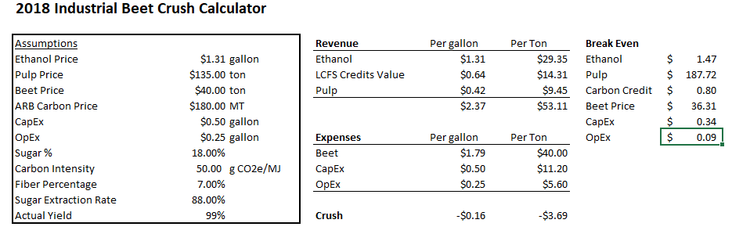
Energy Beet Economics

Slide 21
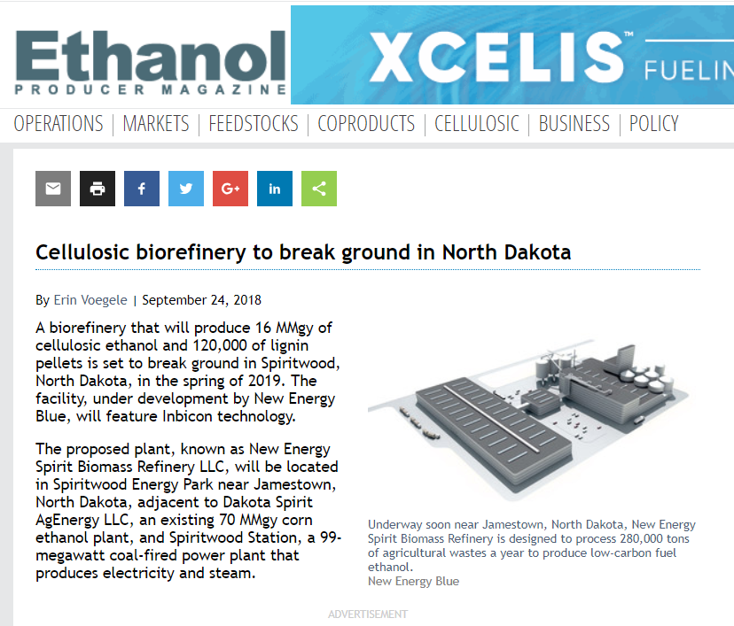
Spiritwood
Cellulosic
16 million gallon
280,000 tons of straw
120,000 tons of lignin
Danish Technology
~$60/ton straw

Slide 22
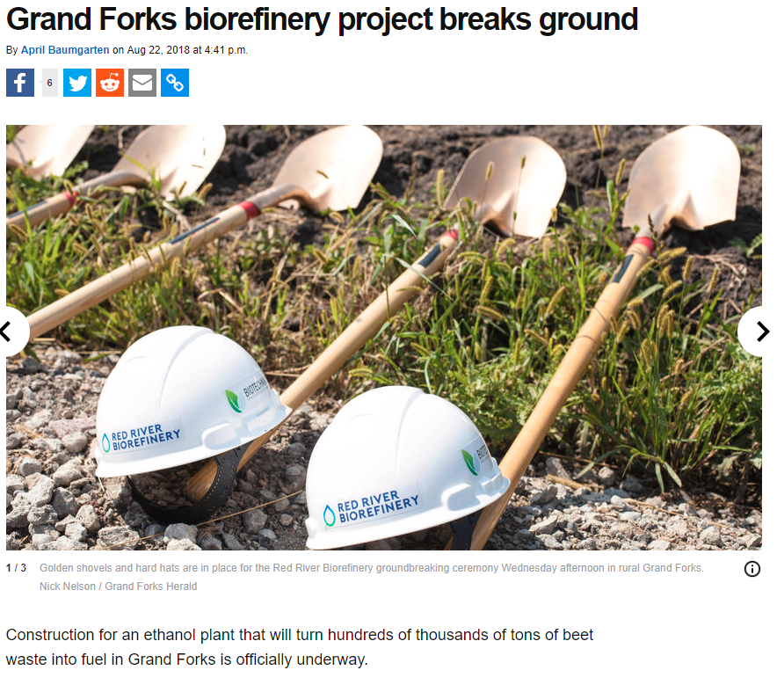
Grand Forks Cellulosic
Co-located at Simplot
18.8 million gallons
500,000 tons of waste
(especially beet tailings, potato scraps)

Slide 23
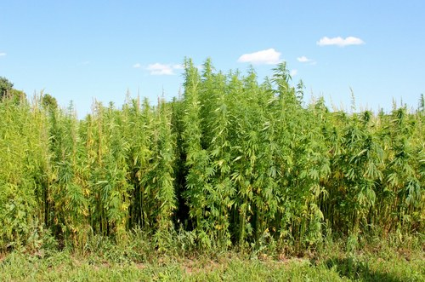
Industrial Hemp
The recently passed Farm Bill opens the way for production of industrial hemp.
There is a lot of work to be done to build markets.

Slide 24
Oil!
WTI has $30 fallen since October 2018. ND Light Sweet traded at $63 in Oct. $16.50 12/26.
Record ND production to end 2018
ND Rig Count
10/14 - 192
10/17 - 54
10/18 - 71
1/19 -63

