Slide 2
Goal for the Day
Prepare for farm and refinery tours
Make the most of the farm and refinery tours
-have questions ready*

Slide 3
Agenda
8.30 am Preparation for Today’s Tour
Noon Lunch
1 pm Farm Tour
2.30 pm Ethanol Refinery Tour

Slide 4
Introductions
NDSU Extension
My Position
My Work

Slide 5
Economics
‘The study of the allocation of scare resources among alternative ends to satisfy insatiable human wants.’

Slide 6
Unicorn Fuel
There is no perfect fuel, there never will be.
There will always be costs, alternatives, choices.
Technology, consumer preferences, and resource availability is always changing.

Slide 7
Energy Transition
Civilization is currently undergoing a major energy transition
Rise of renewables and storage
Decline of fossil fuels
But hasn’t it been doing this since the development of steam power 400 years ago?

Slide 8
Dimensions of Sustainability
Social
(People)
Environmental
(Planet)
Economic
(Profit)

Slide 9
Corn production

Slide 10
So what do you know
about modern corn production?

Slide 11
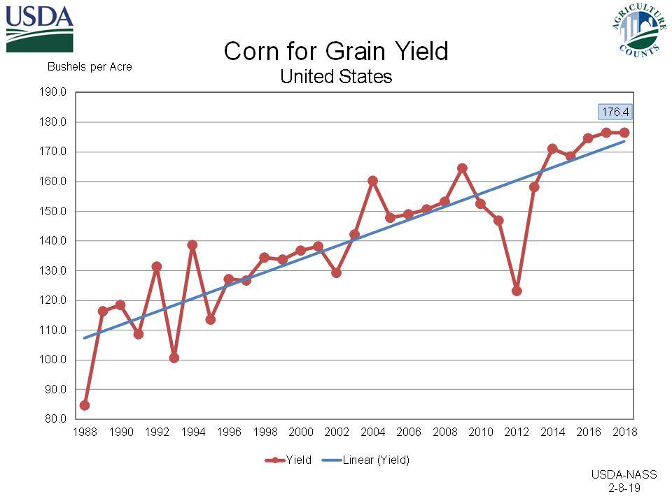

Slide 12
Corn Advantages
C4 crop
Relatively energy dense
Storable/transportable
Hybrid – naturally protects intellectual property
Most well-understood organism on the planet
Industries invested in improving production and processing/existing markets for the crop

Slide 13
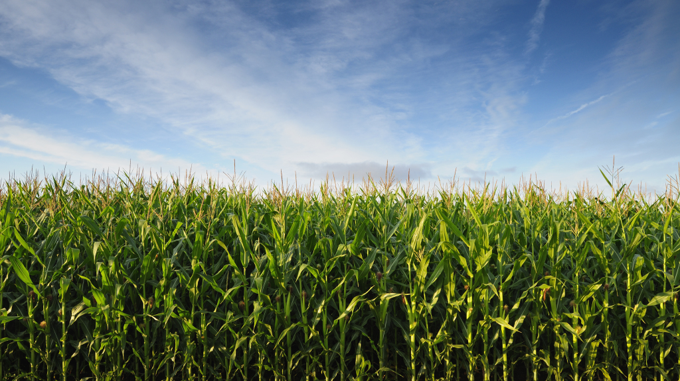
C4 Plants
C4 plants (eg corn and sugarcane) are very photosynthetically efficient,
that is they convert solar energy from the sun into chemical energy than other plants
Energy is stored as starch in corn

Slide 14
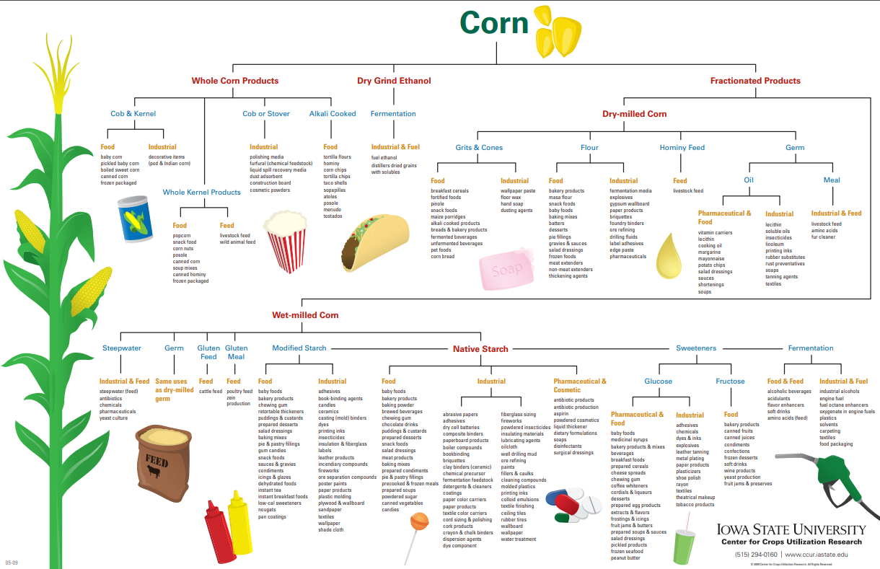

Slide 15
North Dakota Corn
Shorter growing season and fewer growing degree days than the central corn belt.
More recently:
New, shorter season varieties
Change in climate – wetter, longer, warmer growing seasons
Higher prices

Slide 16
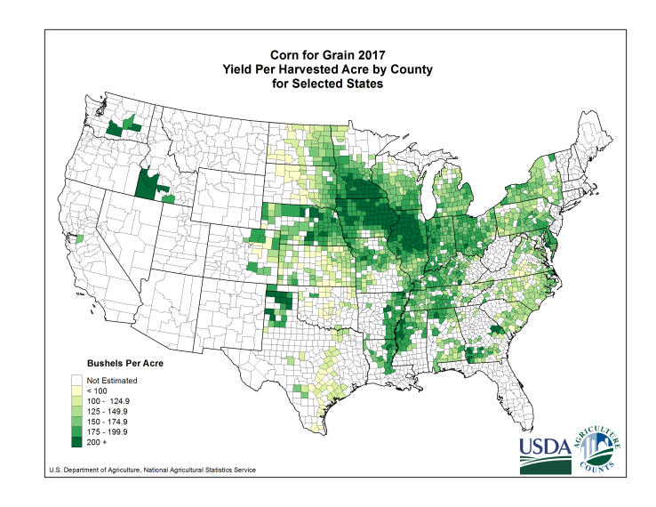

Slide 17
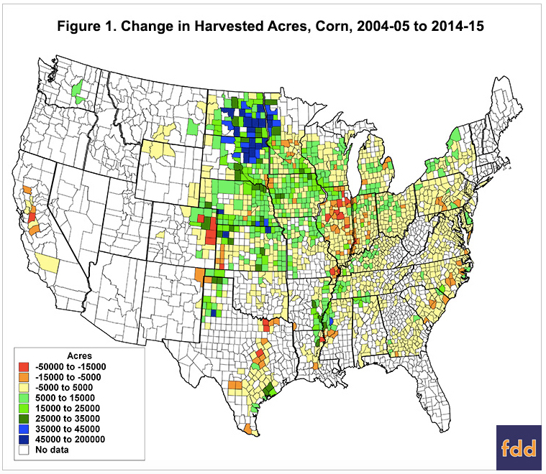
Source:Farmdoc Daily

Slide 18
Genetic Potential
Seeds are often framed as having genetic potential of achieving certain yields and that less than optimal management and environmental conditions slowly whittle away on it over the growing season.

Slide 19
Input Use Efficiency
Most corn breeding now looks to reduce losses to stress and take better advantage of resources
Nitrogen Use
Water Use/Drought Resistance

Slide 20
Corn is a resource hog
Few other crops have the per acre input requirements of corn – especially when it comes to fertilizer.
However, it is very efficient when measured per unit of output.

Slide 21
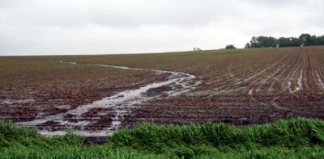
Erosion
Conventional tillage and other practices can lead to significant losses of topsoil to wind and water erosion.
Can use alternative tillage methods and cover crops.

Slide 22
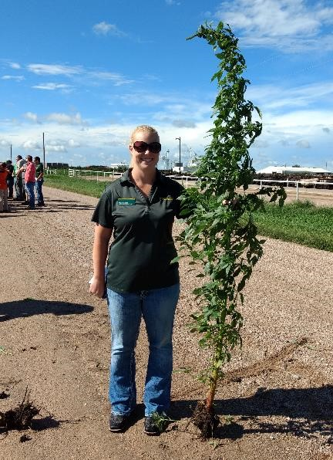
Monocultures
Depletes soil of nutrients, which must be replaced
Requires weed, pest, and weed control
Development of herbicide tolerant “superweeds”
There are fields in the Midwest that have been planted to corn every year for decades.

Slide 23
Field Operations
Field preparation
Planting
Fertilizer application
Weed, insect, disease management
Harvest
Drying and transportation

Slide 24
Production Economics
Handout

Slide 25
North Dakota Agriculture
Handout

Slide 26
Jobs
Research and development
Input sales and marketing
Technical assistance/services
Production (barriers to entry)
Marketing
There is tremendous need for more workers, especially skilled workers in agriculture in the next decade. Various levels of education.

Slide 27
What questions do you
have about corn production?
For me?
For the family farm we’re going to visit?

Slide 28
Break!

Slide 29
Corn-ethanol refining

Slide 31
Humans have used fermentation for millennia
Use of yeast to convert sugars to alcohol
Preserving food: sausage, beer, cheese, bread

Slide 33
Need to break starch down into sugar first
An enzyme, alpha amylase, is used to convert starch to sugar (glucose) so it can be fermented.
This is typically purchased, but more recently a gm corn variety (Enogen) that produces alpha amylase in the kernel has been released.

Slide 35
Corn Ethanol Balance
A bushel (56 pounds) of corn yields
-2.8 gallons of ethanol (fuel)
-17.5 pounds of distillers grains (animal feed)
-1 pound of corn oil (biodiesel production)
Some refineries also market CO₂

Slide 36
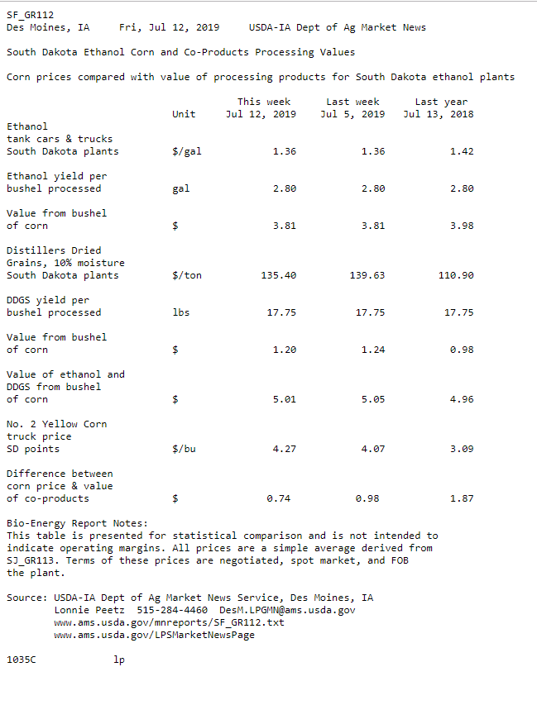

Slide 37
Why are margins negative?
Demand is weaker than expected
-domestically
-internationally
Corn is expensive
-there is fear of a crop shortage due to a wet spring

Slide 38
Tharaldson Ethanol
Dry Mill
180 million gallons (2nd largest in the United States?)
Uses 60 million bushels of corn annually, most from within 60 miles of the refinery
Gets its water from Fargo

Slide 39
ND Ethanol
Five refineries
470 million gallon capacity – how much is that?

Slide 40
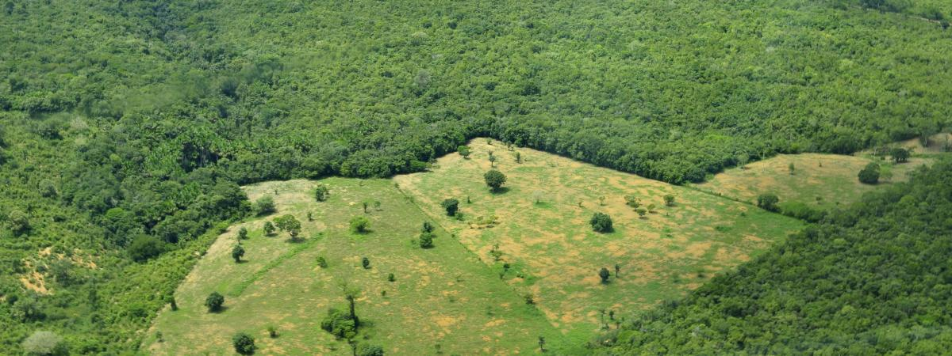
Land Use Change
Increased crop and land prices will result in deforestation and other negative environmental impacts.

Slide 41
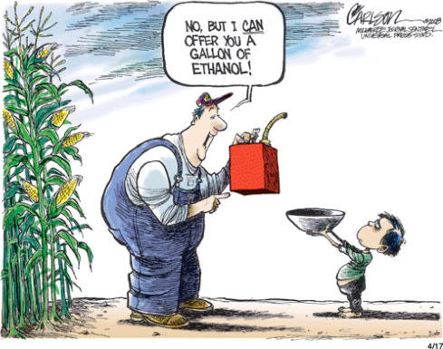
Food vs Fuel
There is only so much current and potential cropland. Cropland used for bioenergy production diverts it from food production

Slide 42
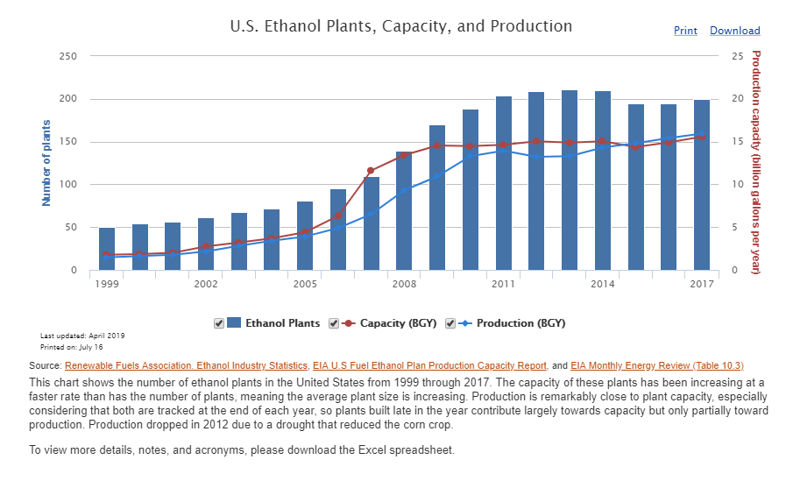

Slide 43
US Corn Ethanol Use>>Feed & Residual

Slide 44
Accounting for ‘Feedback’
Data: WASDE, Grain Crushing and Co-Products Production Report

Slide 45
What questions do you
have about ethanol refining?
For me?
For the tour?

Slide 46
Break

Slide 47
Climate change

Slide 48
Is climate change
a point of contention for you?
For your family and friends?
For your students?

Slide 49
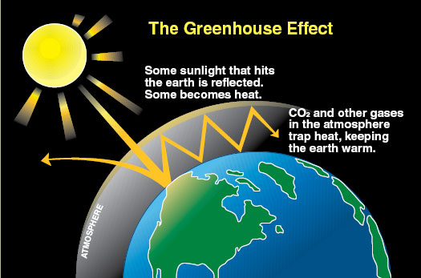

Slide 51
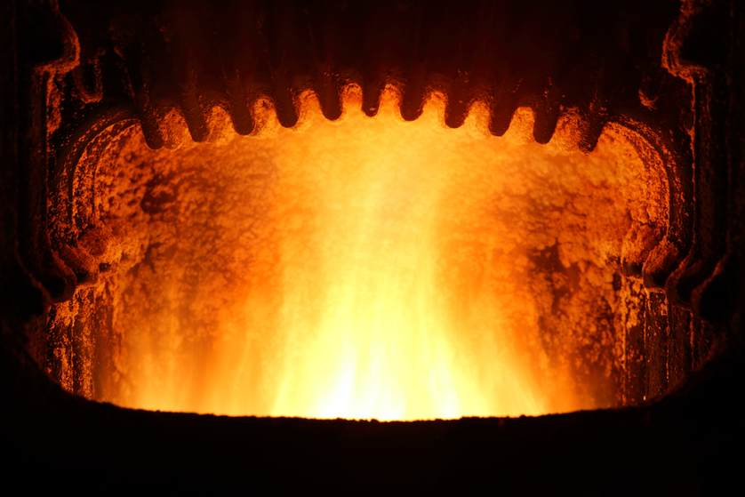
Unburnable carbon
-- fossil fuel energy sources which cannot be burnt if the world is to limit global warming to 2 degrees C.

Slide 52
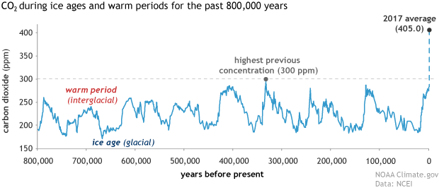

Slide 53
Framing as Climate Variation

Slide 54
Environmental life cycle assessment

Slide 55
Remember that GHGs (CO₂) are Pollutants!

Slide 56
Environmental Life Cycle Assessment (LCA) Defined
An objective process to evaluate the environmental burdens associated with a product, process, or activity by identifying energy and materials used and wastes released to the environment, and to evaluate and implement opportunities to affect environmental improvements.

Slide 57
The Process
Goal and Scope Definition
What are we trying to learn?
Life Cycle Inventory
What’s embedded in the product?
Life Cycle Impact Assessment
What effect does it have?
Data Interpretation
What does it all mean?

Slide 58
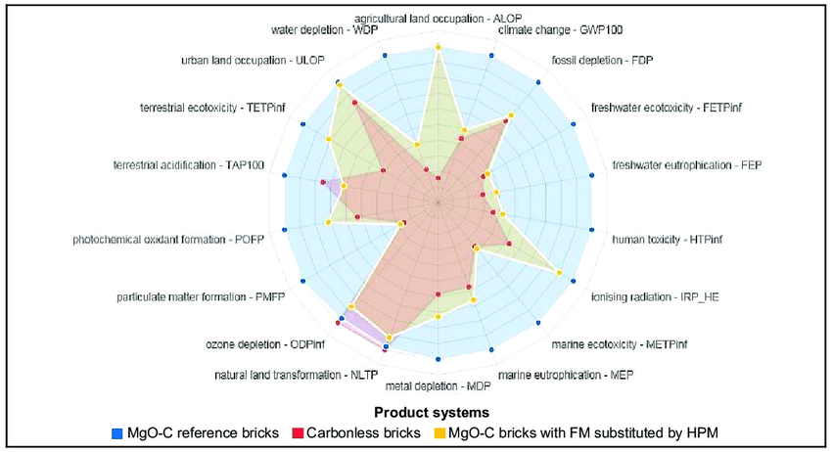
Corn-ethanol environmental concerns are dominated by GHG emissions

Slide 60
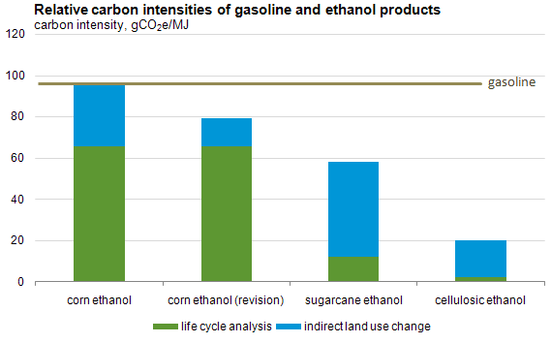
Source: EIA
Source:USDA

Slide 61
Does the use of environmental life cycle assessment impact your thoughts about the ‘greenness’ of ethanol relative to gasoline?

Slide 62
Results of life cycle assessments guide regulatory processes in many states and the federal government, for example the US Environmental Protection Agency’s enforcement of the Renewable Fuel Standard and California’s Low Carbon Fuel Standard.

Slide 63
We almost completely ignore social impacts of biofuels.
What does it actually mean to farmers, rural communities, workers, consumers.
Especially those that are socially disadvantaged.

Slide 64
Energy balance

Slide 65
Definition
Net energy = energy delivered-energy used to deliver
Energy returned on energy invested (EROEI) =
energy delivered/energy used to deliver

Slide 66
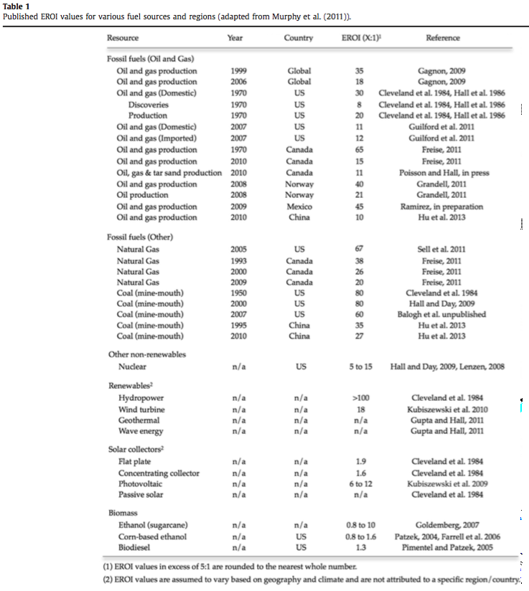
Hall et al 2014

Slide 67
Why the variation?
It all depends on model assumptions and the data used.
Estimates for corn-ethanol less than 1 usually considered distillers grains waste, as opposed to a co-product

Slide 68
There has been a lot of criticism of corn-ethanol due to its low energy balance.
But does it matter if it’s lower cost and more environmentally friendly?
How can it be lower cost if it doesn’t have a larger EROEI?

Slide 69
Do you have your question(s)?

Slide 70
Break and then Lunch!

