Slide 2
Industrial Sugar: Understanding the Opportunity
David Ripplinger

Slide 3
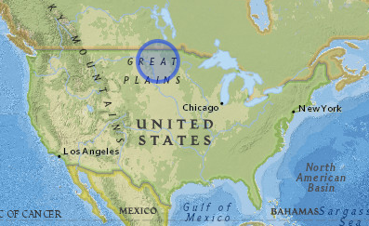
Siting
A project developer is looking to site its first industrial sugar refinery in North Dakota
Five communities under consideration
May produce industrial sugar or a finished product like ethanol
Notes:
Locations may produce industrial sugar feedstock or a finished product.
Processing facilities may produce:
Industrial sugar feedstock (for third party)
Ethanol
Advanced chemicals

Slide 4
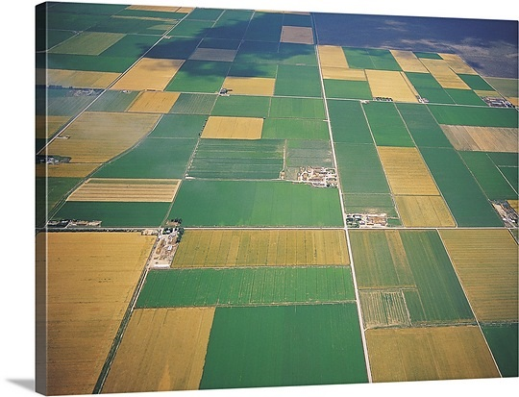
Requirements
20 MMGPY Refinery
Requires about 750,000 tons of beets
30,000 dryland acres (@25t/AC)
120,000 acres with a four-year rotation
Most feedstock sourced within 20 miles of plant
Fewer irrigated acres are needed
4

Slide 5
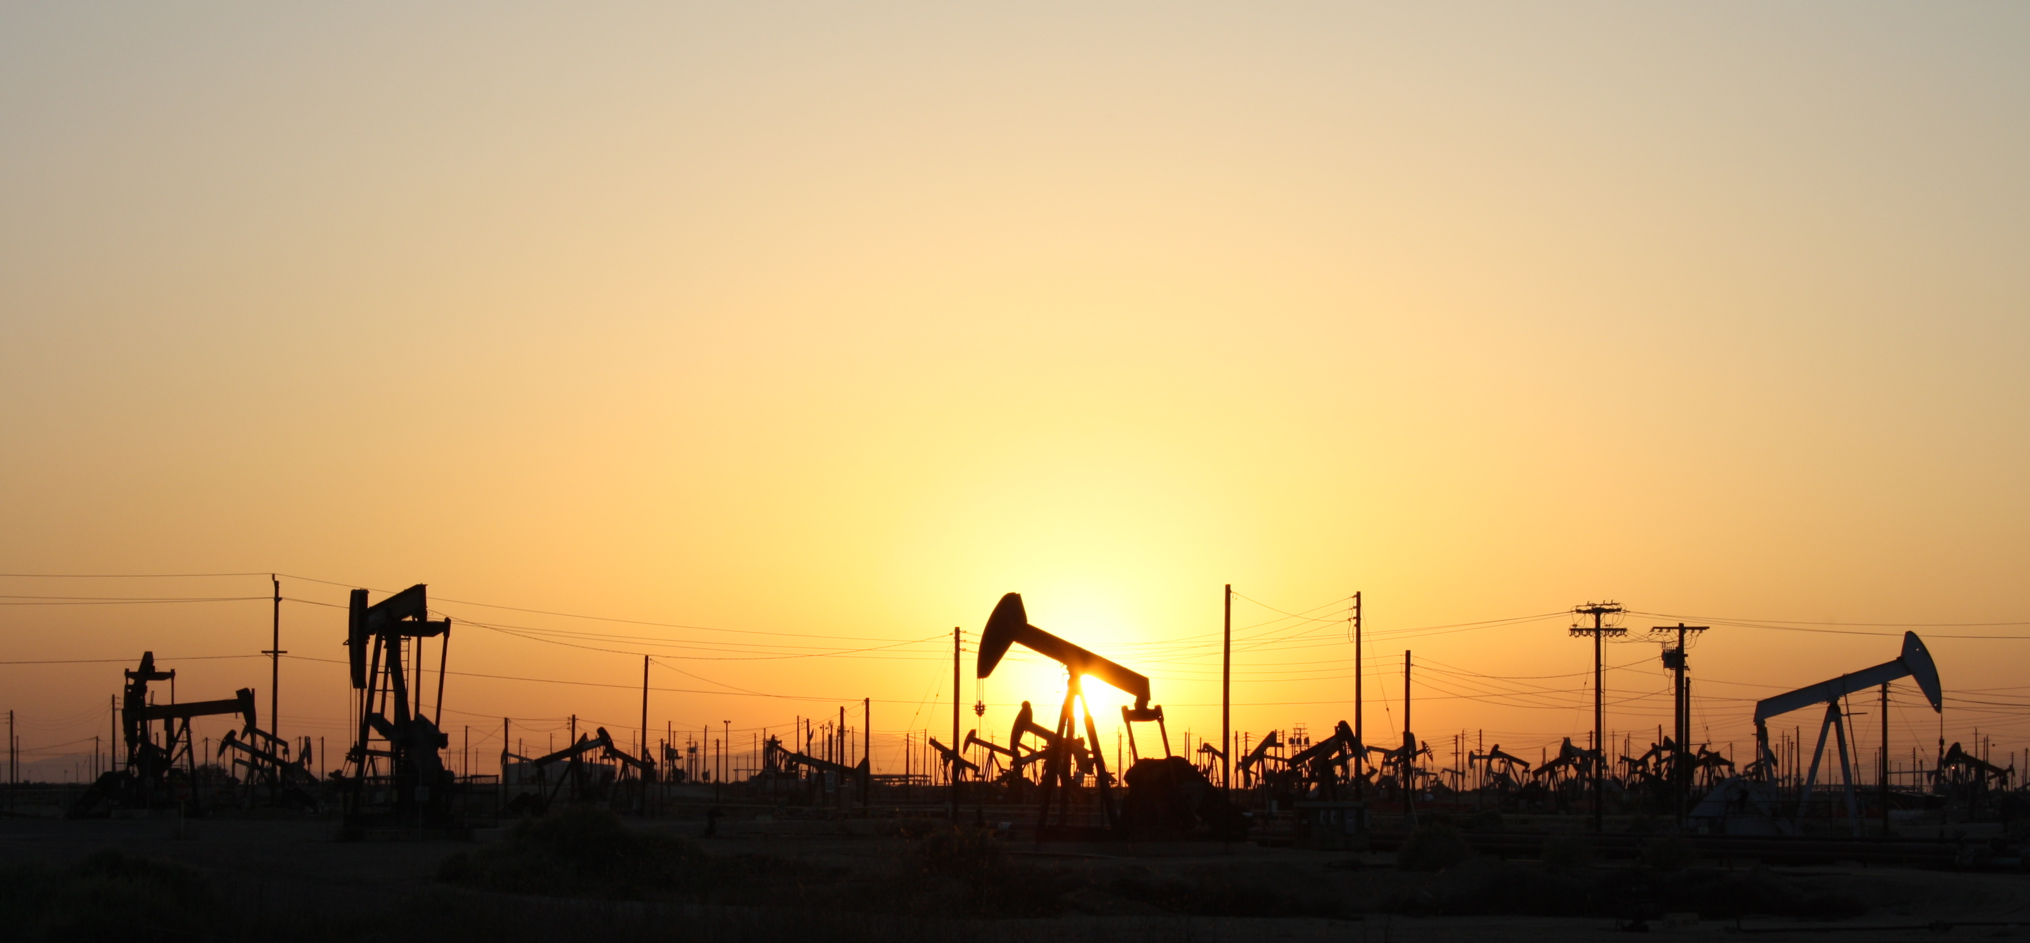
The Play
Low-cost, low- carbon fuel and chemicals

Slide 6
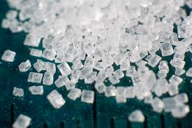
Why Sugar?
Sugar is nature’s energy source
It can be readily converted to a wide range of chemicals and fuels

Slide 7
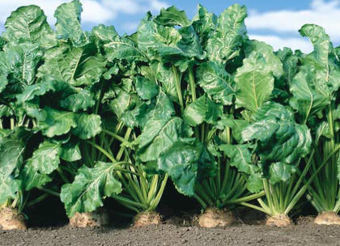
Why Beets?
A sugar crop:
Higher sugar production
Less processing

Slide 8
Why North Dakota?
Beets are a cool season crop
Fall conditions are ideal for sugar production
Long days
Cool nights

Slide 9
Other US Projects

Slide 10
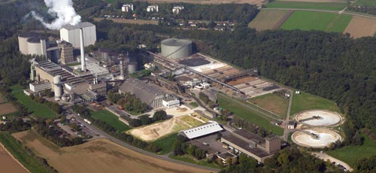
The European Experience

Slide 11
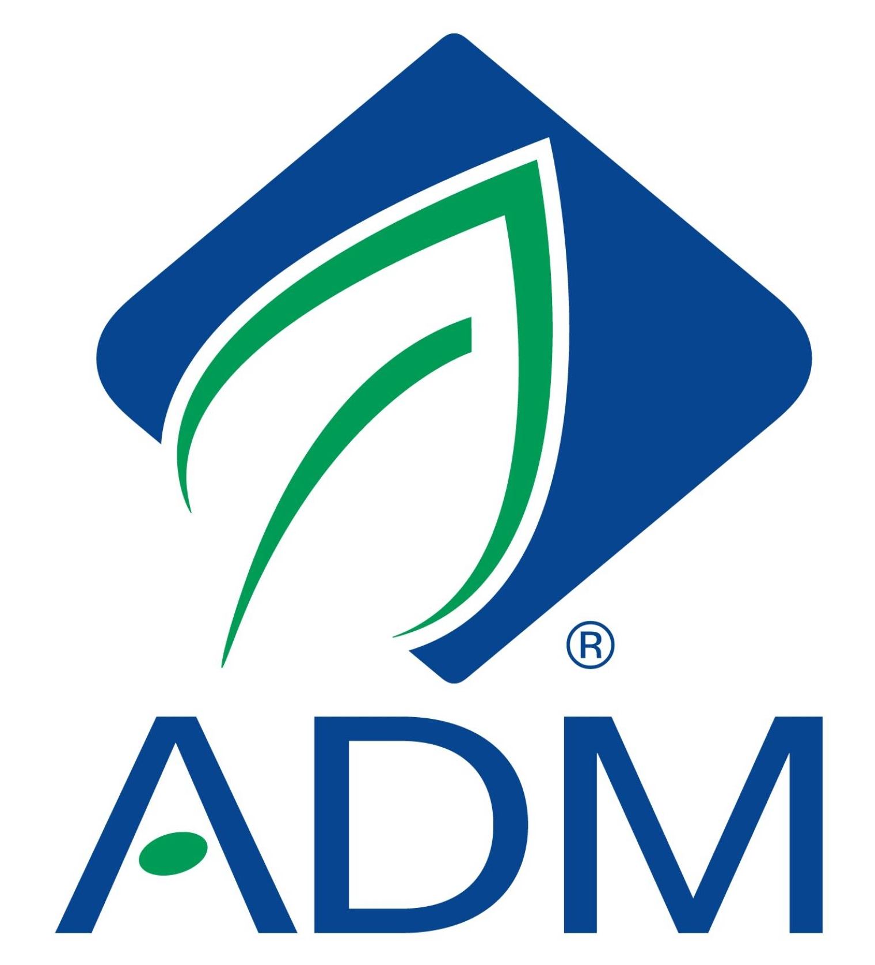
A non-beet sugar project
Solazyme has partnered with ADM to develop a commercial scale facility next to ADM’s Clinton Corn Wet Mill
The search is for low-cost, low-carbon sugar

