Slide 2
When does a new technology have value?
David Ripplinger
North Central Cropping Systems Academy
Fargo, North Dakota
March 20, 2015

Slide 3
Who is this guy?

Slide 4
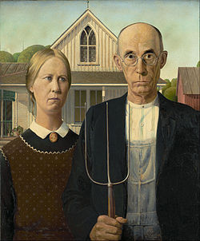
The Roles of a Farmer

Slide 5
The Wow Factor

Slide 6
The Role of Extension

Slide 7
A Crash Course in Systems Engineering

Slide 8
Definition
an interdisciplinary approach and means to enable the realization of successful systems.

Slide 9
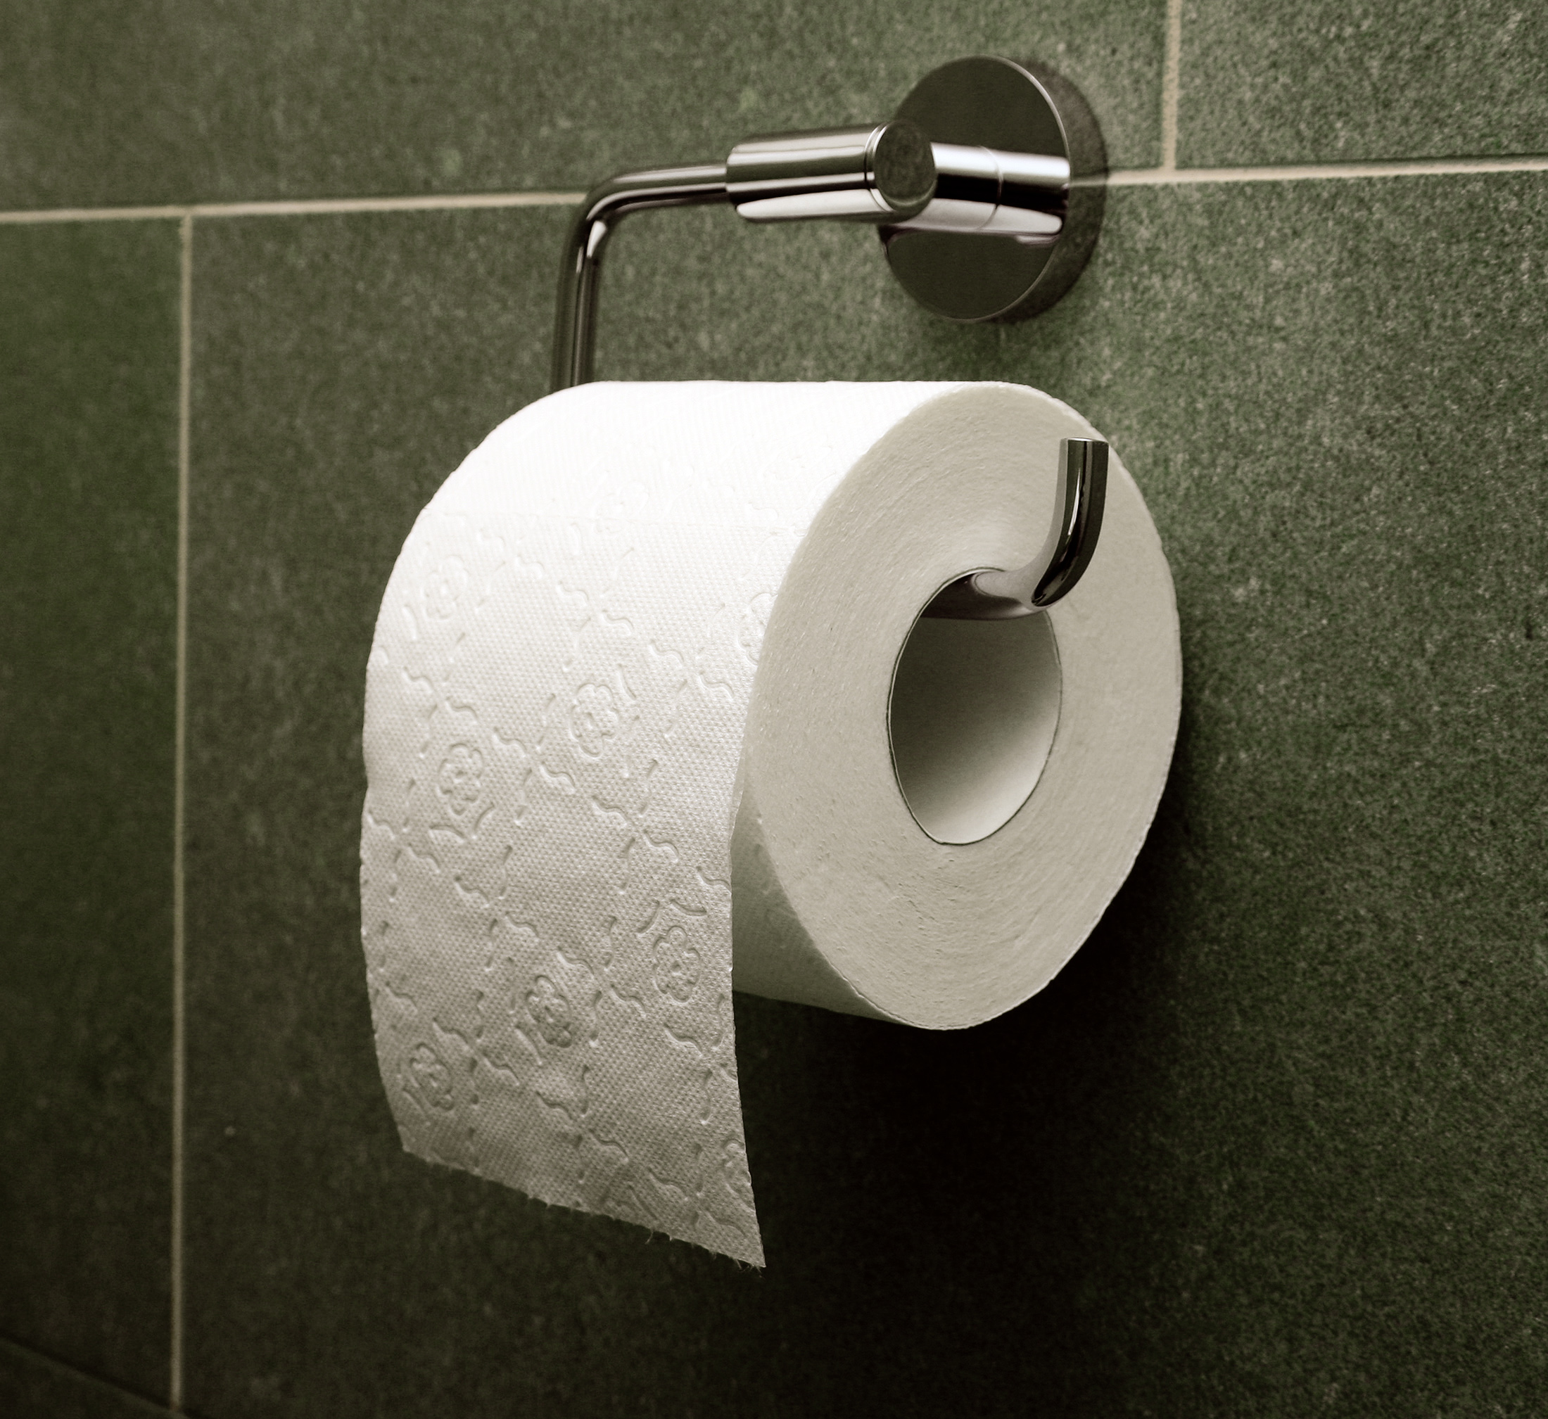
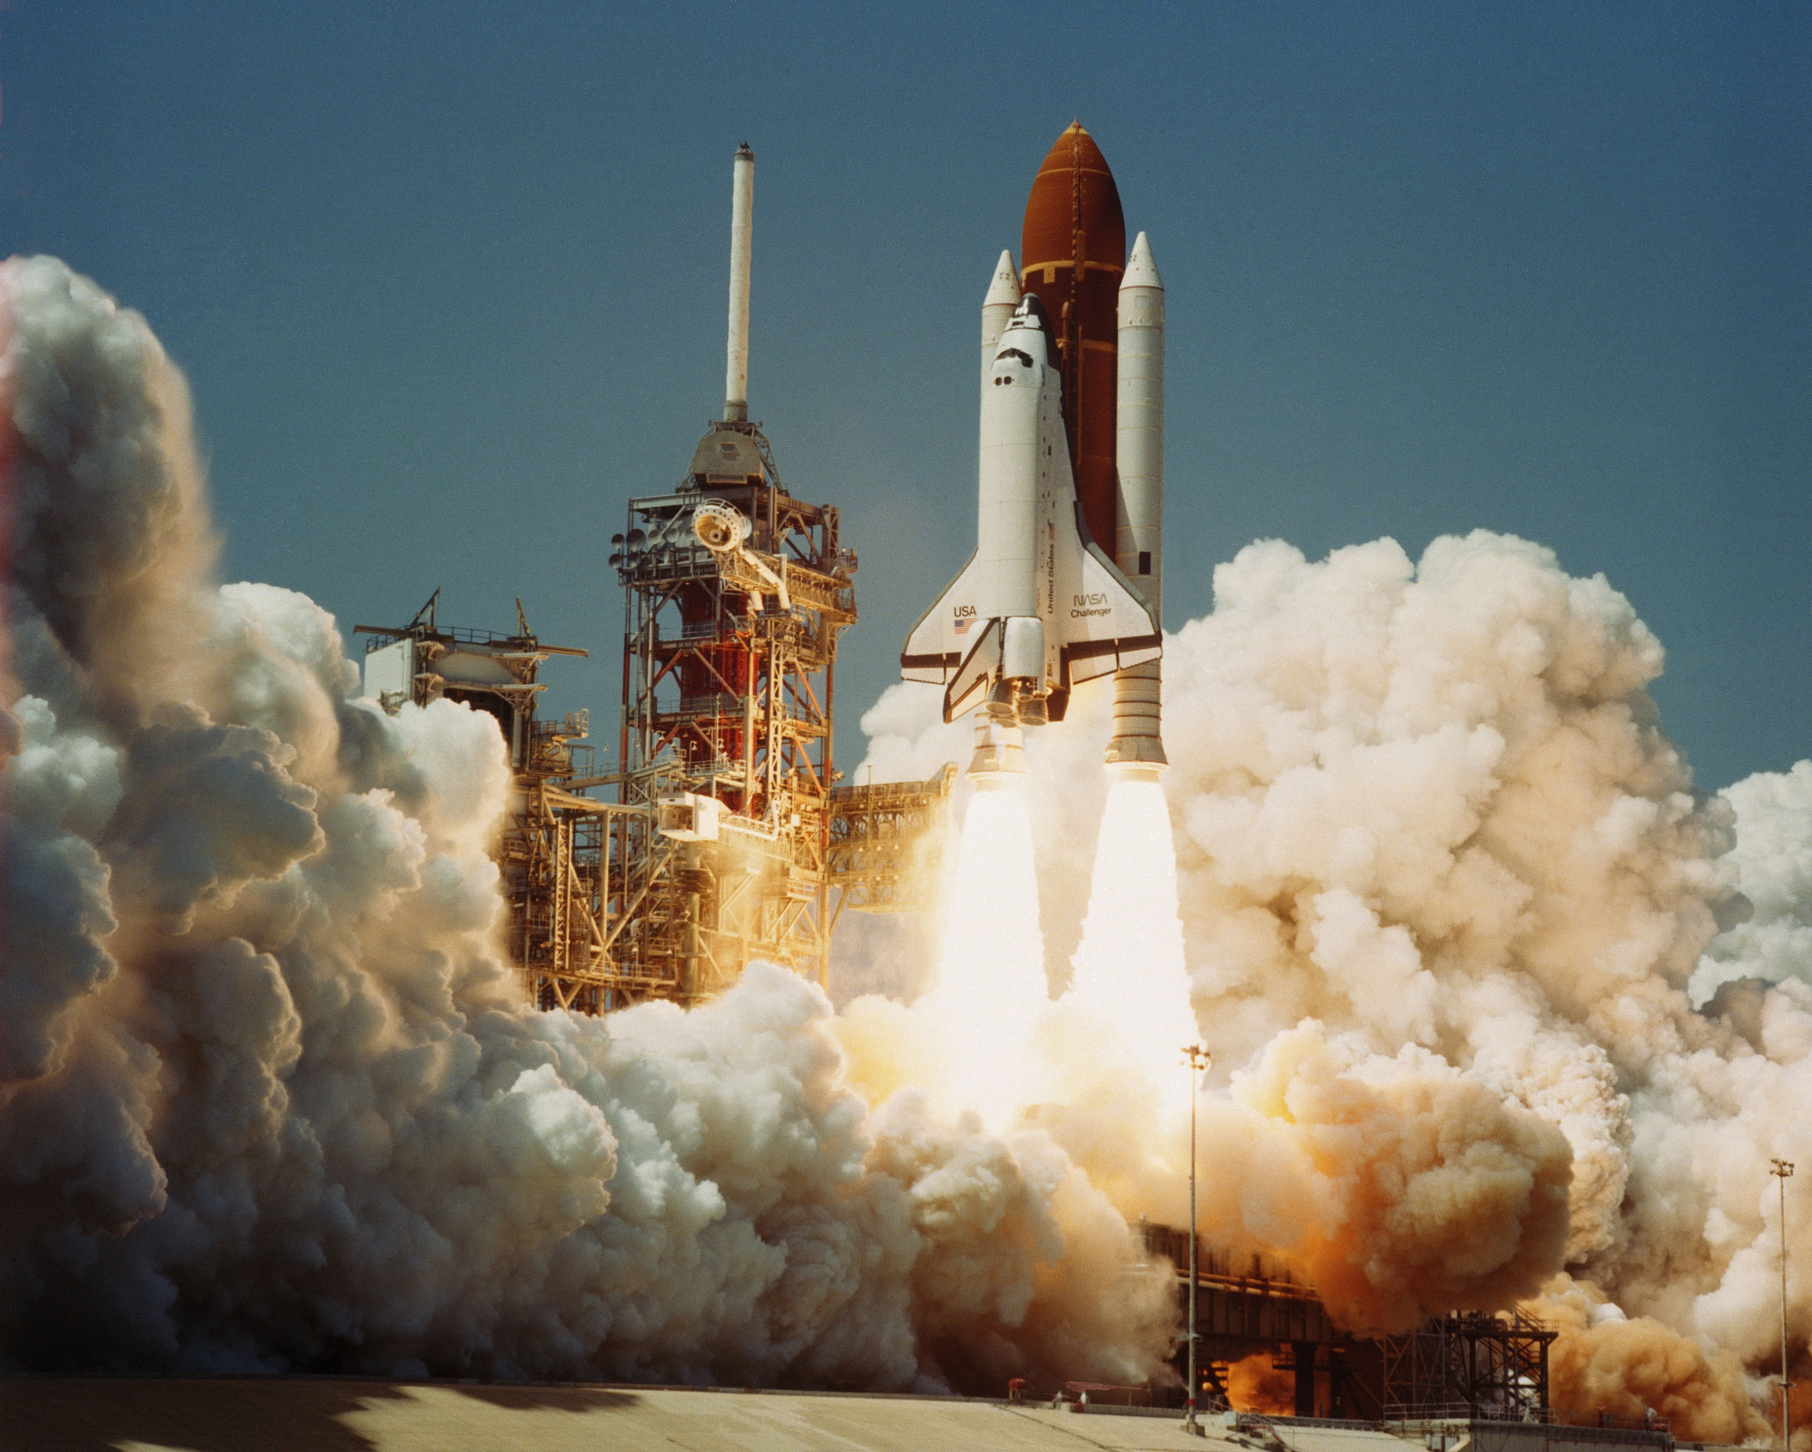
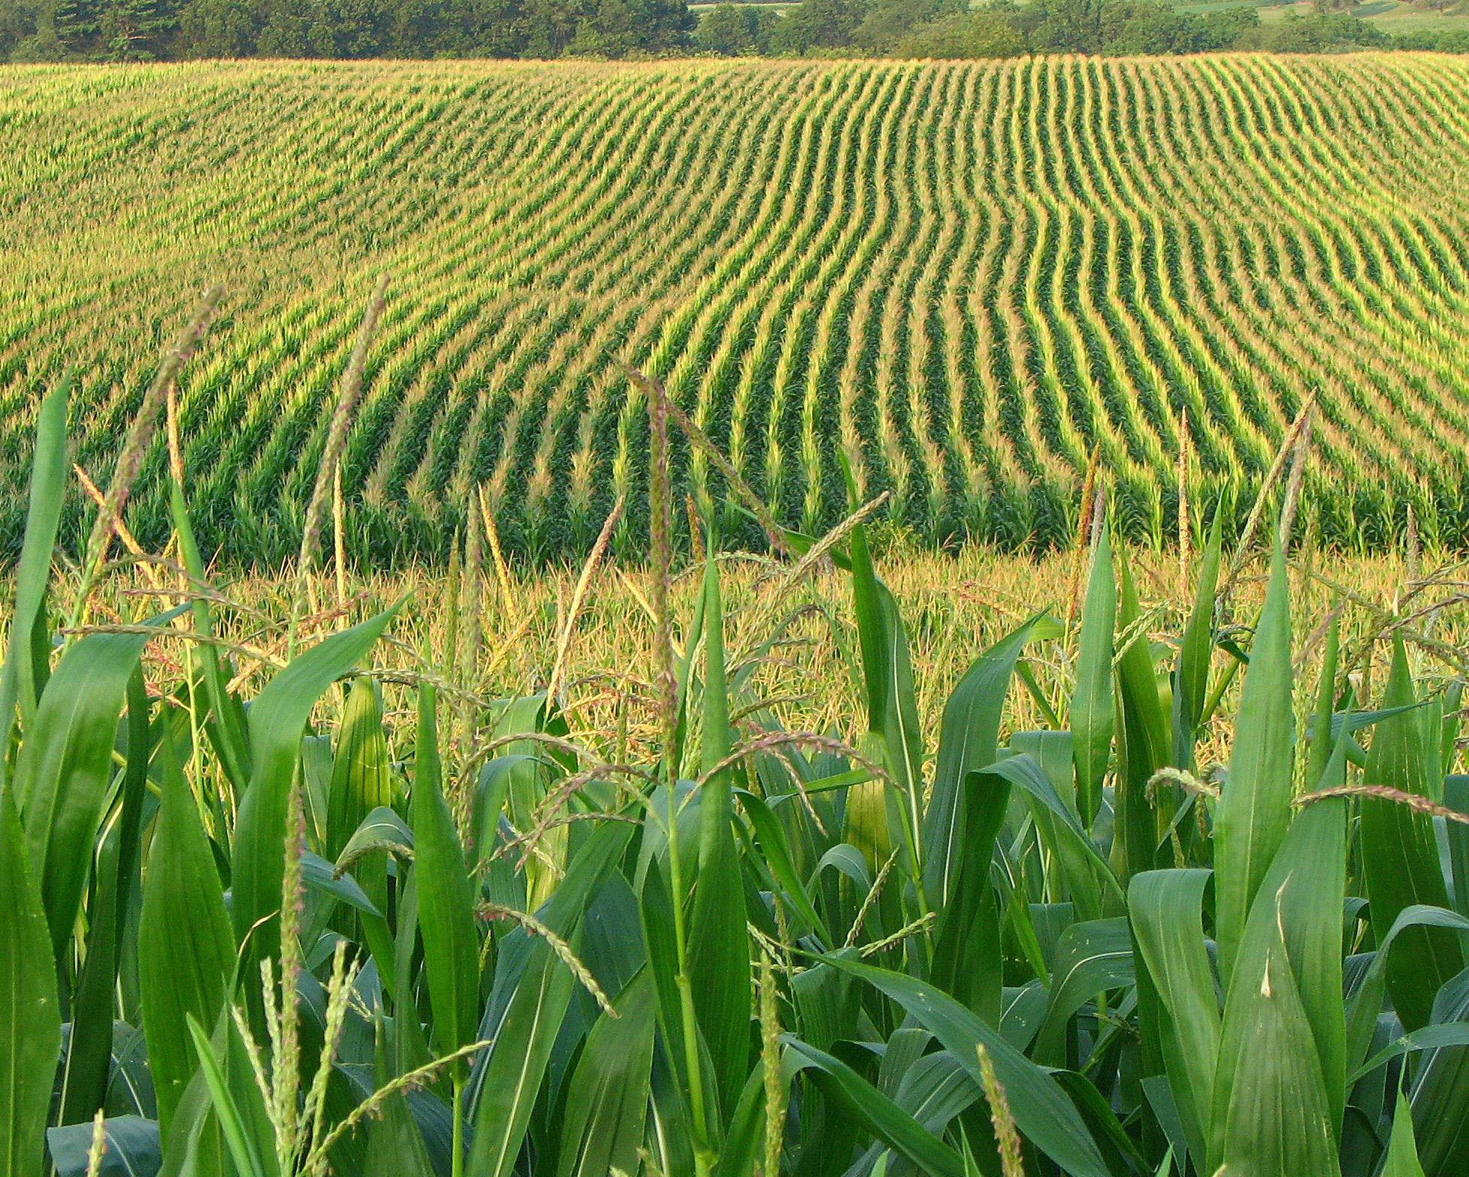
Applications
Building space shuttles
Optimizing cropping systems
Buying toilet paper

Slide 10
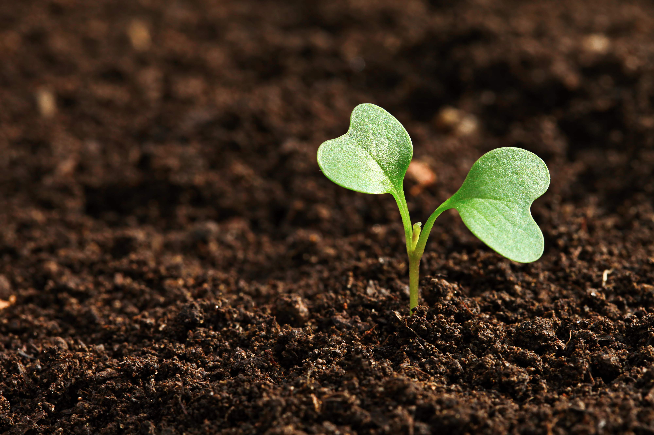
What is technology?
A very broad definition:
Not just information technology/hardware and software
Collection of techniques used to achieve a goal.
Often embedded in machines or in our case plants…

Slide 11
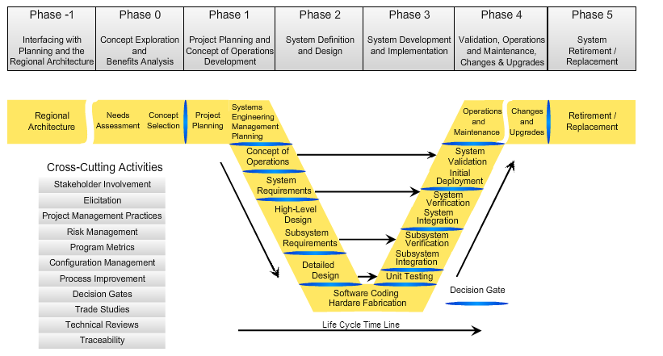
Process

Slide 12
1. Identify Needs
Do this first
Do this first
Do this first
Do this first
Do this first
Do this first
Do this first
Do this first

Slide 13
1. Identify Needs
Known
Understood
Prioritized

Slide 14
Exercise 1. The Top 10 Needs of Midwestern Farmers

Slide 15
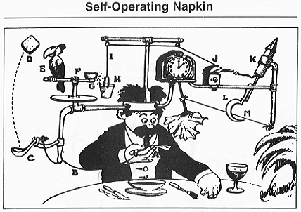
2. Identify Possible Solutions

Slide 16
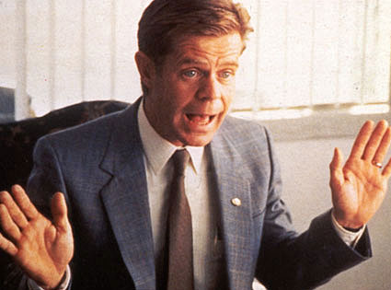
You may have noticed
I’ve yet to refer to sales…

Slide 17
2. Identify Possible Solutions
What is promising?
What is feasible? – Much more than financial. What can the farm handle?
Assess the possibilities using a cost-benefit analysis.

Slide 18
2. Identify Possible Solutions
Cost benefit analysis
Consider financial and non-financial costs and benefits.
Easier in agriculture as there are market prices for many inputs and outputs. Harder because there are many considerations.

Slide 19
Exercise 2. Technological Solutions

Slide 20
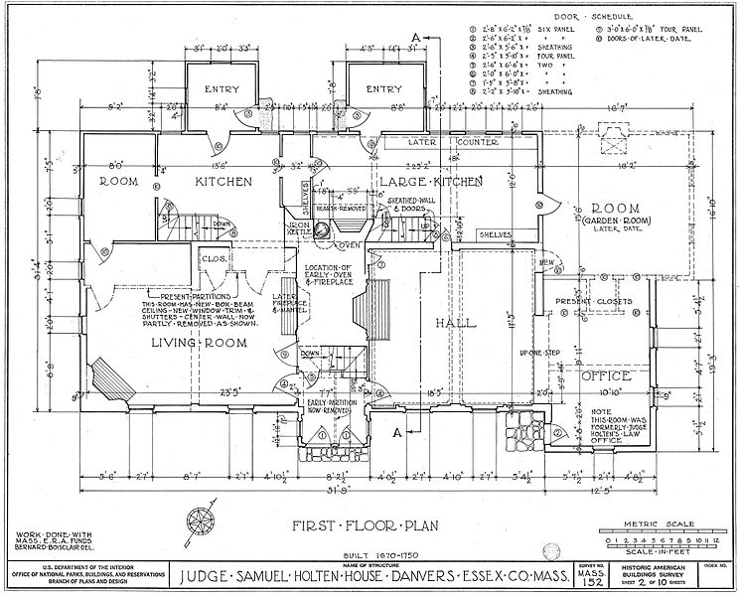
3. Develop a Plan
Make a budget
Identify resources
Make procurement decisions
Develop a schedule

Slide 21
4. Create a Concept of Operations
How exactly do you plan on using this stuff?

Slide 22
4. Create a Concept of Operations
Buy technology.
?????
Profit.

Slide 23
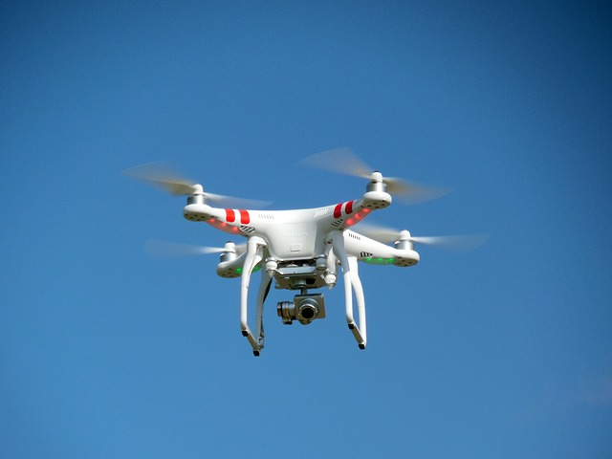
4. Create a Concept of Operations
The story of how a technology will be used from the perspective of its users.
Example:

Slide 24
Exercise 3. Concept of Operations

Slide 25
..a bunch of technical steps…
Nearly all farmers are going to buy off-the-shelf technology or turn key solutions.
This is the preferred strategy if those technologies and strategies meet needs.
We get to skip a bunch of steps…

Slide 26
Considerations
What can be done automatically or by others?
Who owns the data? Do you have access? Do others?
Liability?
What if the system fails?
How well does the system integrate with others?

Slide 27
Integration
Does the system work with existing technology?
Should it?
Will it be able to work with future technology?

Slide 28
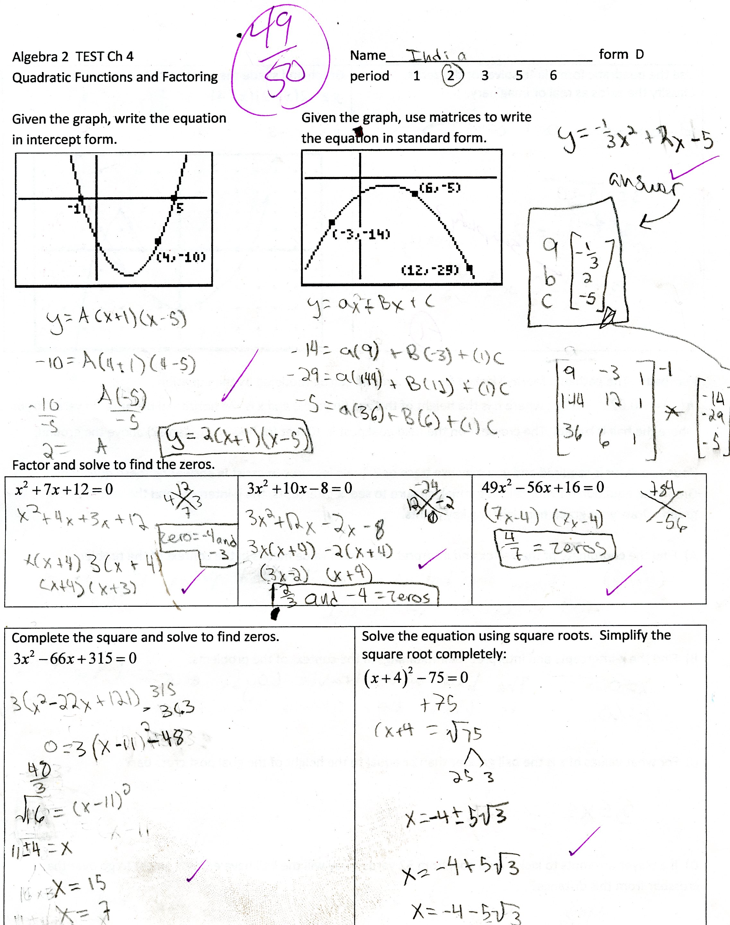
Evaluation
This step is often overlooked or given inadequate attention.
‘The system works well.’
‘It saves me money.’
The effort needs to be deliberate.

Slide 29
Evaluation
Review against original needs.
It the technology being used as planned.
Were cost and benefit estimates accurate?
Are there changes in operations that can decrease costs and/or improve benefits?

Slide 30
Changes and Upgrades
Needs and technology change over time.
It may become necessary to update the technology or make incremental changes.

Slide 31
Retirement and Replacement
Rarely considered. So much energy and enthusiasm at the beginning, little thought about the rest of the life cycle.
What happens to the data?

Slide 32
Extension Materials for Farmers?
An overview of systems engineering (non-technical).
A farmer’s guide to managing technology?
Cost-benefit analysis model.

Slide 33
A Review
Start with needs
Identify possibilities
Develop a plan
Create a concept of operations
Think about the entire life cycle

