Slide 1
Age Old Wisdom Applied to Succession Planning
David Ripplinger
Mayville, ND
November 10, 2015

Slide 2
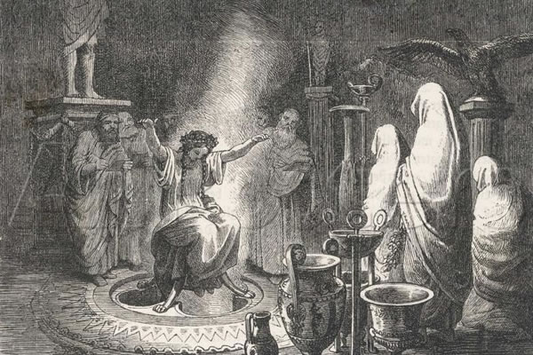

Slide 3
γνῶθι σεαυτόν
(Know Thyself)

Slide 4
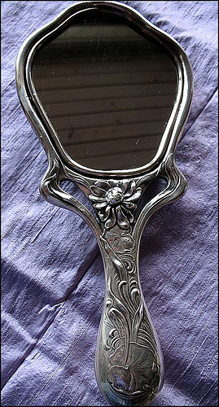
Have you thoughtfully considered what you want? Have you written it down?
Succession planning considers many issues, nearly all of which require personal judgements.

Slide 5
Νεωτερον διδασκε
(Teach a Youngster)

Slide 6
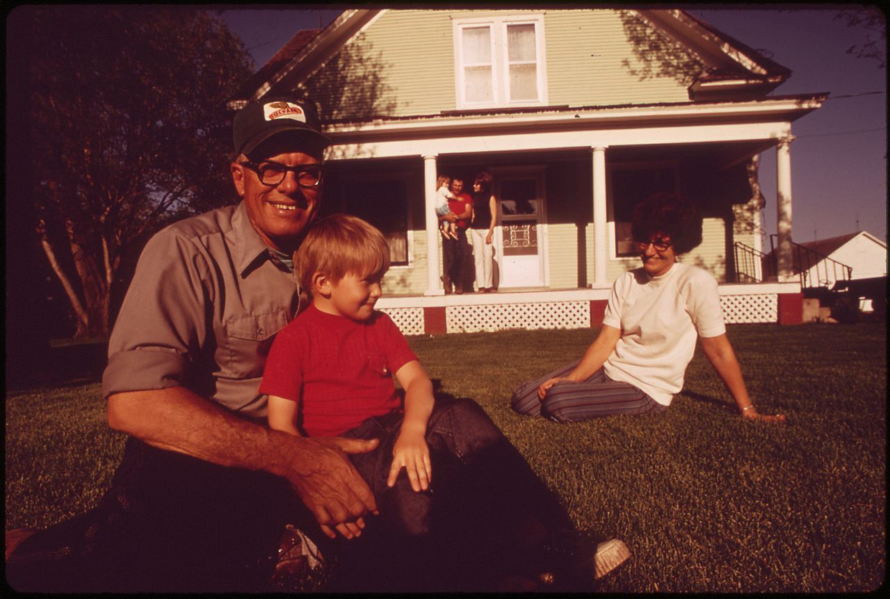
Good farmers aren’t created overnight.
To keep a family farm operating you need a person that is actively involved in many facets of the operation.

Slide 7
Τυχη μη πιστευε
(Do Not Trust Fortune)

Slide 8
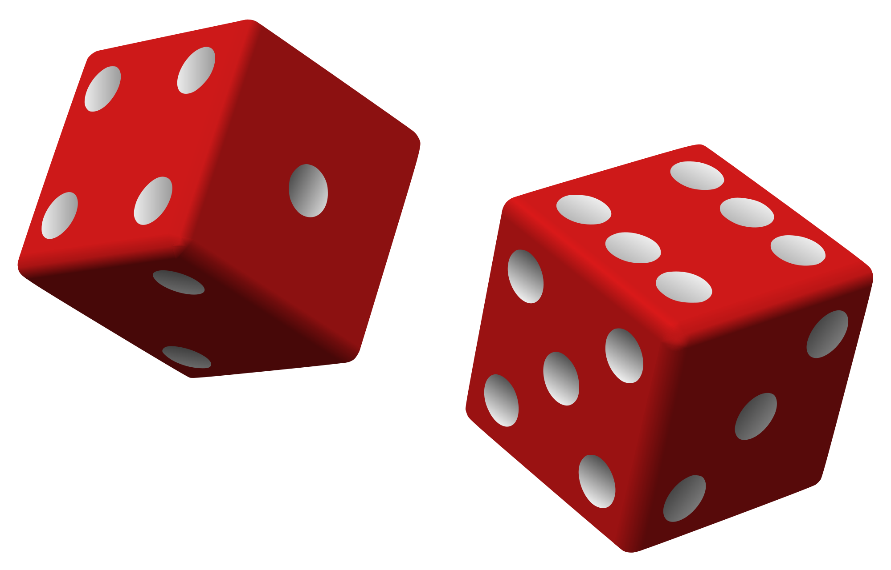
Things often do not go according to plan.
You need to be flexible and have a plan that’s flexible too. If things change – you may need to update the plan!

Slide 9
Ορα το μελλον
(Foresee the Future)

Slide 10
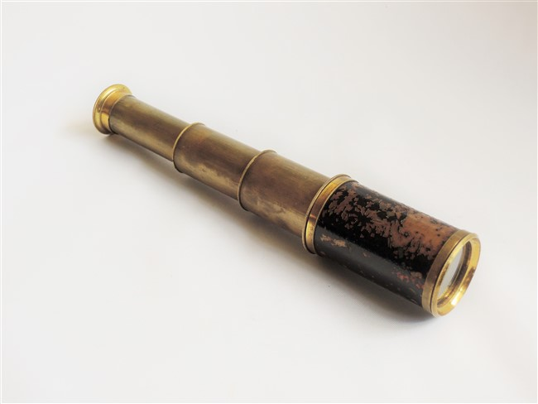
A vision statement tells the reader about the desired future. The future that the business, in this case farmer and farm, wants to make.
What future do you want to create?

Slide 11
Προγονους στεφανου
(Crown Your Ancestors)

Slide 12
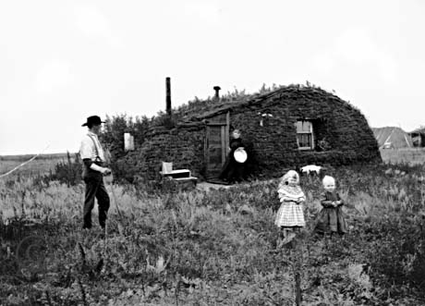
Most ND family farms are multigenerational.
You may see yourself as the steward of something that is bigger than you are.
How does this impact how you think about the farm and its future?

Slide 13
Γνους πραττε
(Act When You Know)

Slide 14
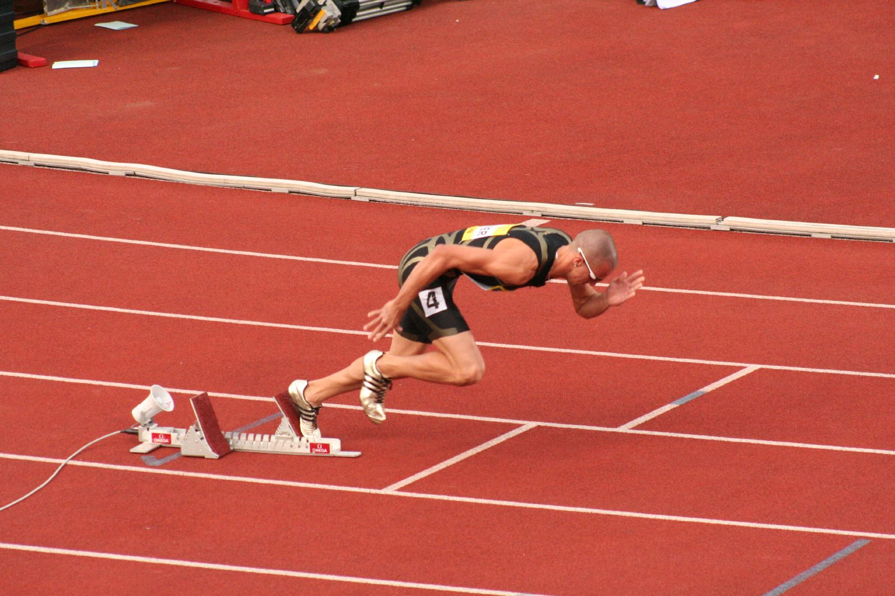
Some experts recommend starting work on a succession plan 5 to 10 years before the transition is made.
That’s too late.
What if you are injured or killed? What if the original plan in your head doesn’t work for others!

Slide 15
Φρονει θνητα
(Think as a Mortal)

Slide 16
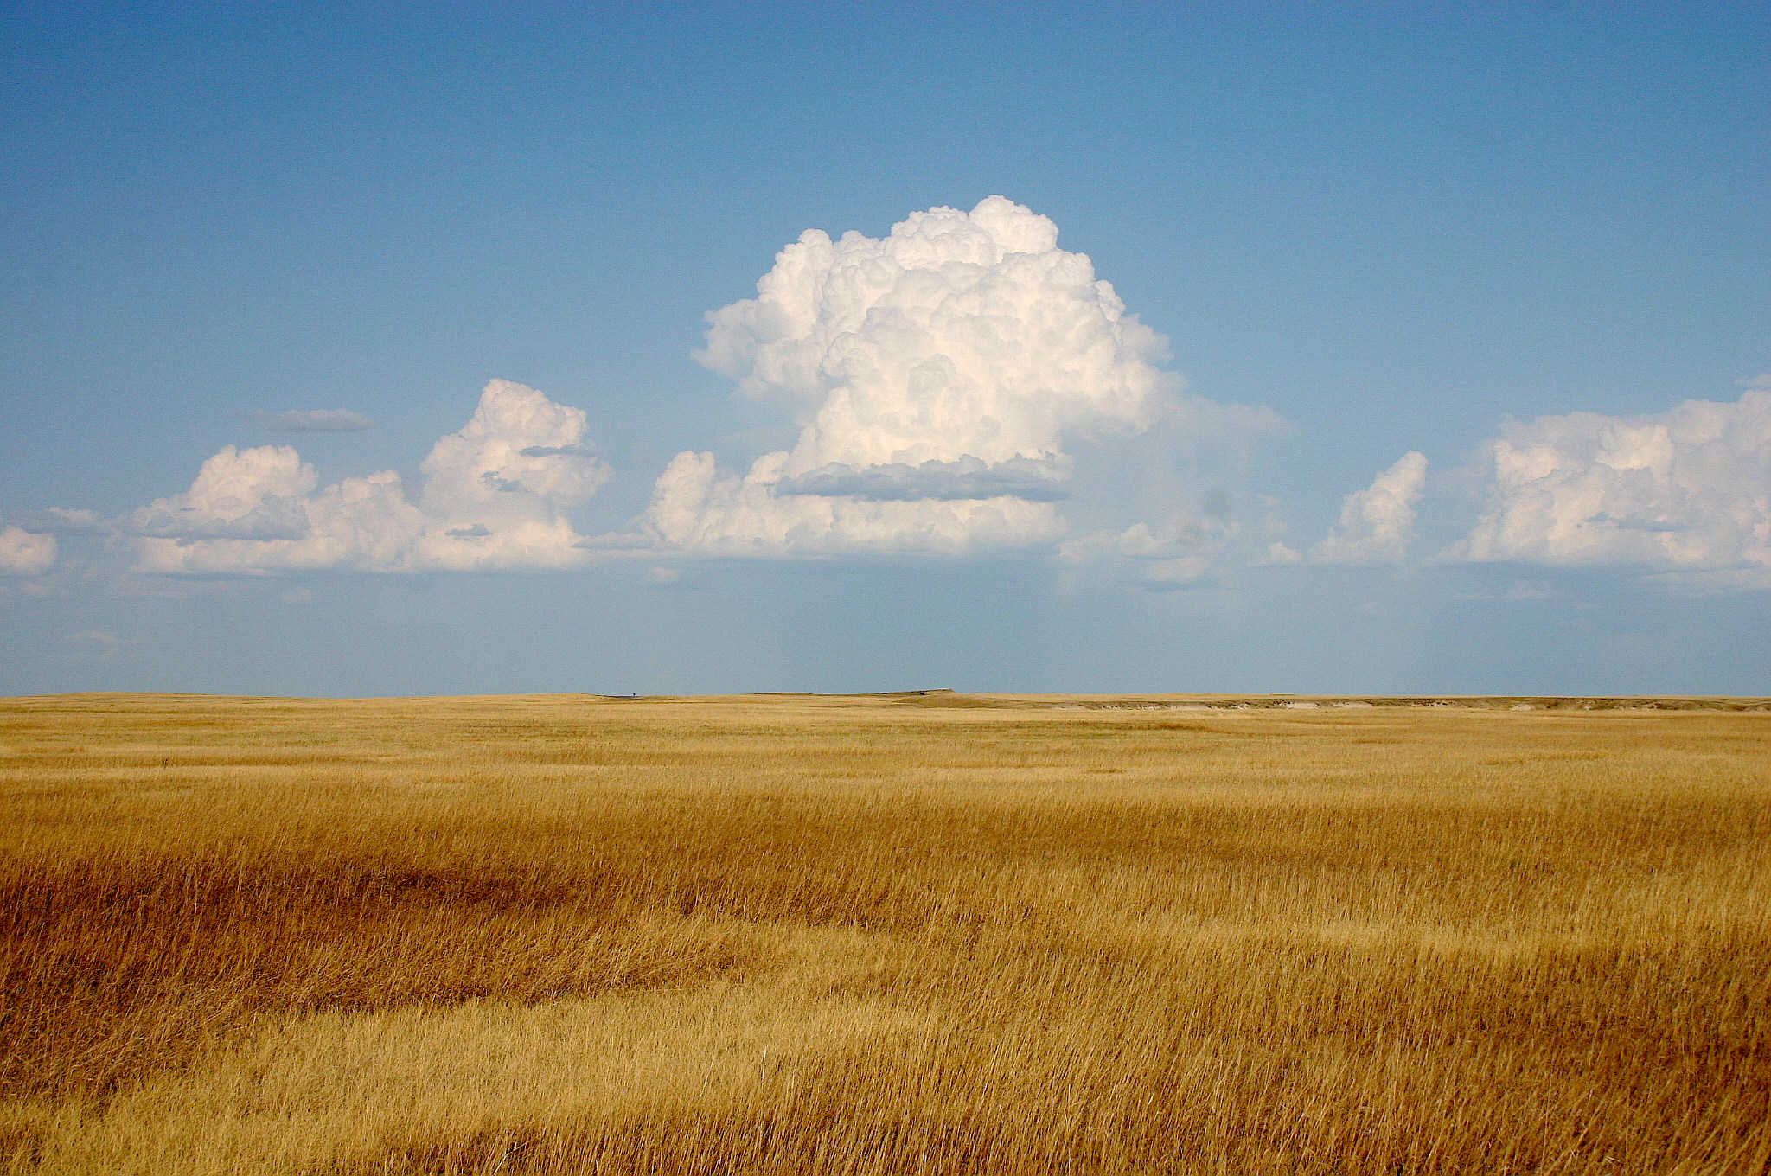
Things change. Death is certain.
You need to consider these eventualities and prepare for them.

Slide 17
Σοφοις χρω
(Consult the Wise)

Slide 18
Accountants, lawyers, and other financial experts can help.
Think about what you want and when ready seek them out.
Many want to see you do this well.

Slide 19
Ους τρεφεις αγαπα
(Love Whom you Rear)

Slide 20
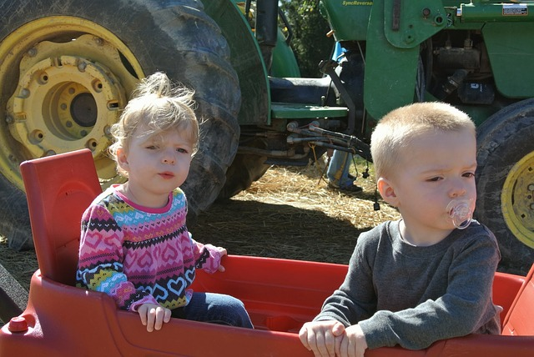
Your family will always be your family.
Although they might not want to talk to you if you handle succession planning poorly.
Be just and loving, but know that you may ruffle some feathers.

Slide 21
Πραττε δικαια
(Practice What is Just)

Slide 22
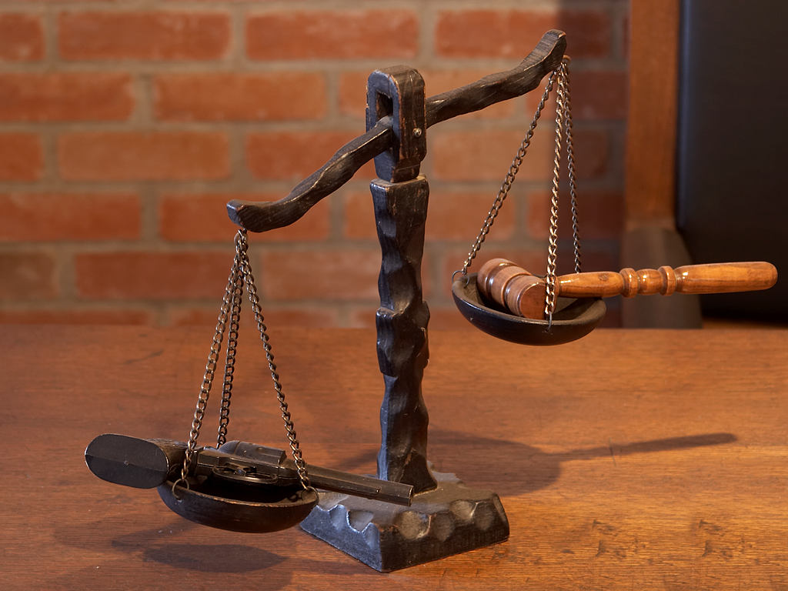
Life isn’t fair
Trying to keep things equal may be the surest way to lose the farm.
If equality is fundamental to you, know the sacrifice that may have to be made.

Slide 23
About that Oracle…

Slide 24
Homework!
Start today.
Write it down.
Work on it. Share it. Revise it.
Engage professionals.

