Slide 2
Managing Energy Crop Risk

Slide 3
Types of Risk
Production
Marketing
- Price
- Offtake

Slide 4
Production Risk - Causes
Weather
Pests
Human error
Misuse of technology

Slide 5
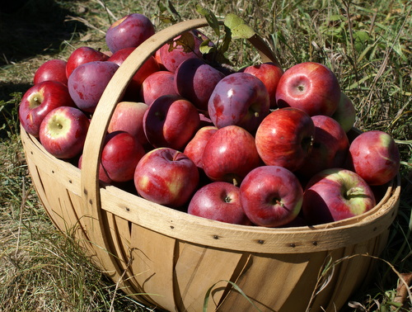
Production Risk - Protection
Diversification
Crop Insurance
Not currently available for ‘energy beets’
Is available for sugar beets.

Slide 6
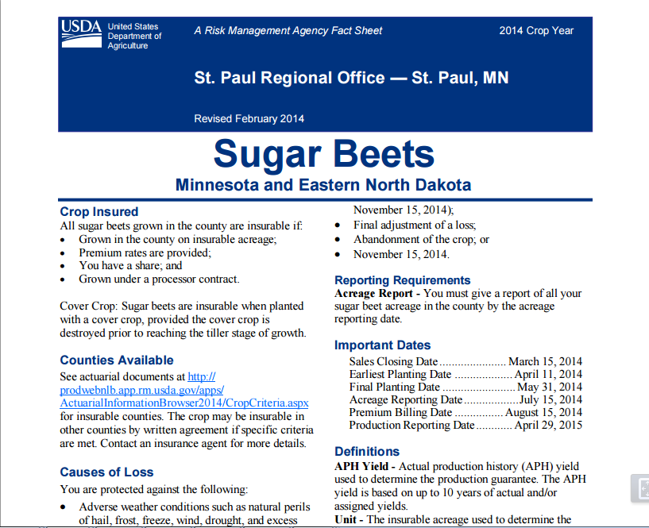

Slide 7
Contracting
A commitment to deliver at a future time
May set the price or a formula to calculate the price.

Slide 8
Contract Types
Fixed price – set price for the duration of the contract.
Formula price – price varies according to an agreed plan.
Ex. 8x corn futures.

Slide 9
Formula Contracts
Could have a minimum price (floor) to limit farmers downside risk
Or maximum price (ceiling) to limit the processors downside risk

Slide 10
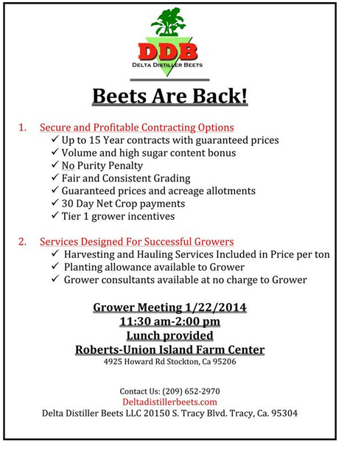

Slide 11
Offtake/Counter Party Risk
What happens if refinery goes bankrupt?

Slide 12
New Generation Co-op
Farmers provide equity to build plant.
Have a right and an obligation to deliver.

Slide 13
Risk Management Review
Production risk – can be protected with diversification and insurance
Crop insurance is not yet available, but trial data is available, but a pricing mechanism is needed
Crop could be priced using fixed price or formula contract
A new generation would address price risk and offtake risk, but would require additional capital

