Slide 1
Fertilizer: Buy Now or Buy Later
Central ND Ag Day
Carrington
December 17, 2015
David Ripplinger

Slide 2
A caveat

Slide 3
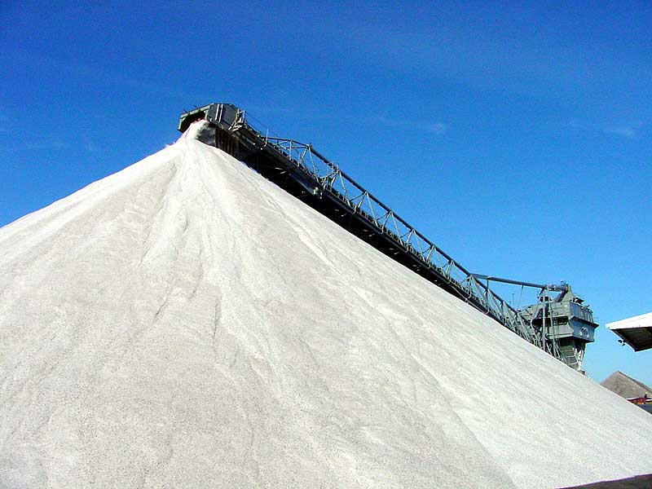
Dakota Gas
Urea Expansion
Beulah, ND
375,000 tons urea

Slide 4
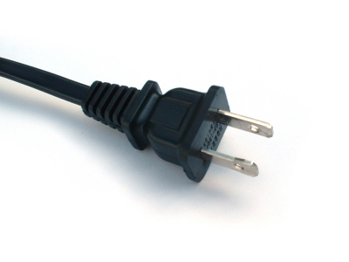
CHS/Spiritwood

Slide 5
Grand Forks Project

Slide 6
Response to West Fertilizer Explosion in TX, 15 dead
OSHA is increasing the regulation of ammonia retailers, increasing costs
Smaller retail locations (as many as 1/3) are expected to close

Slide 7
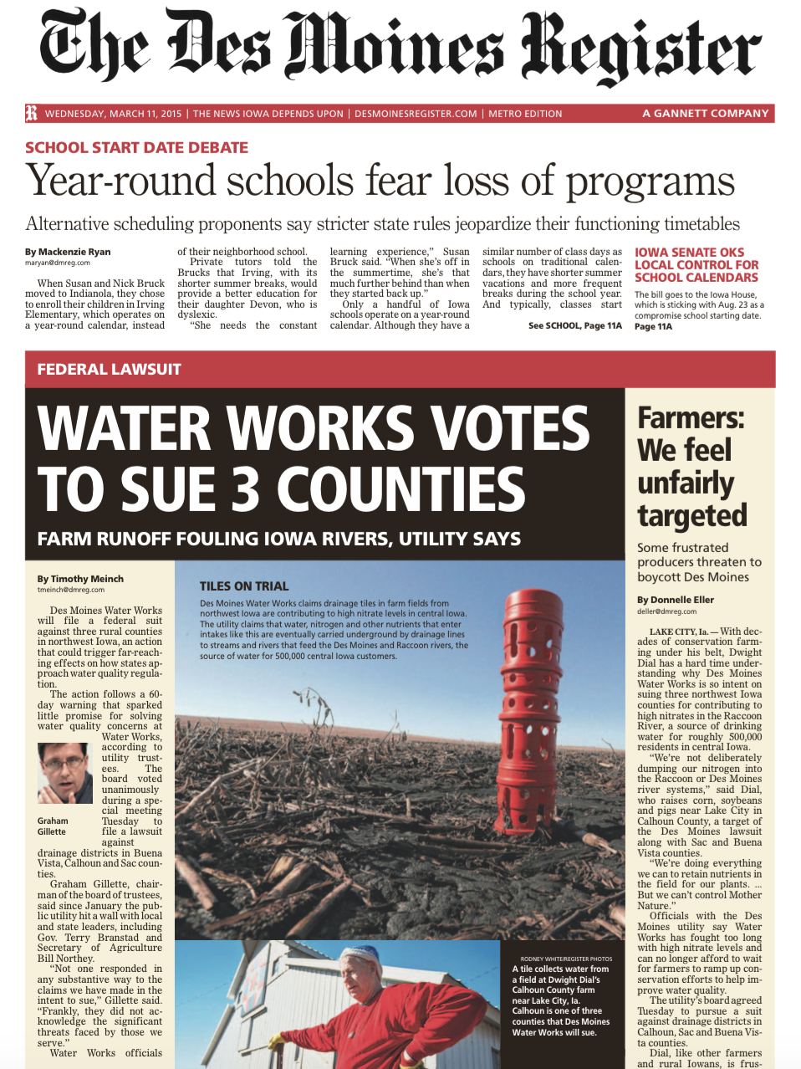

Slide 8
Consolidation
CHS invested $2.8 billion in CF Industries
CF industries had made an offer for OCI
CVF has purchased Rentech

Slide 9
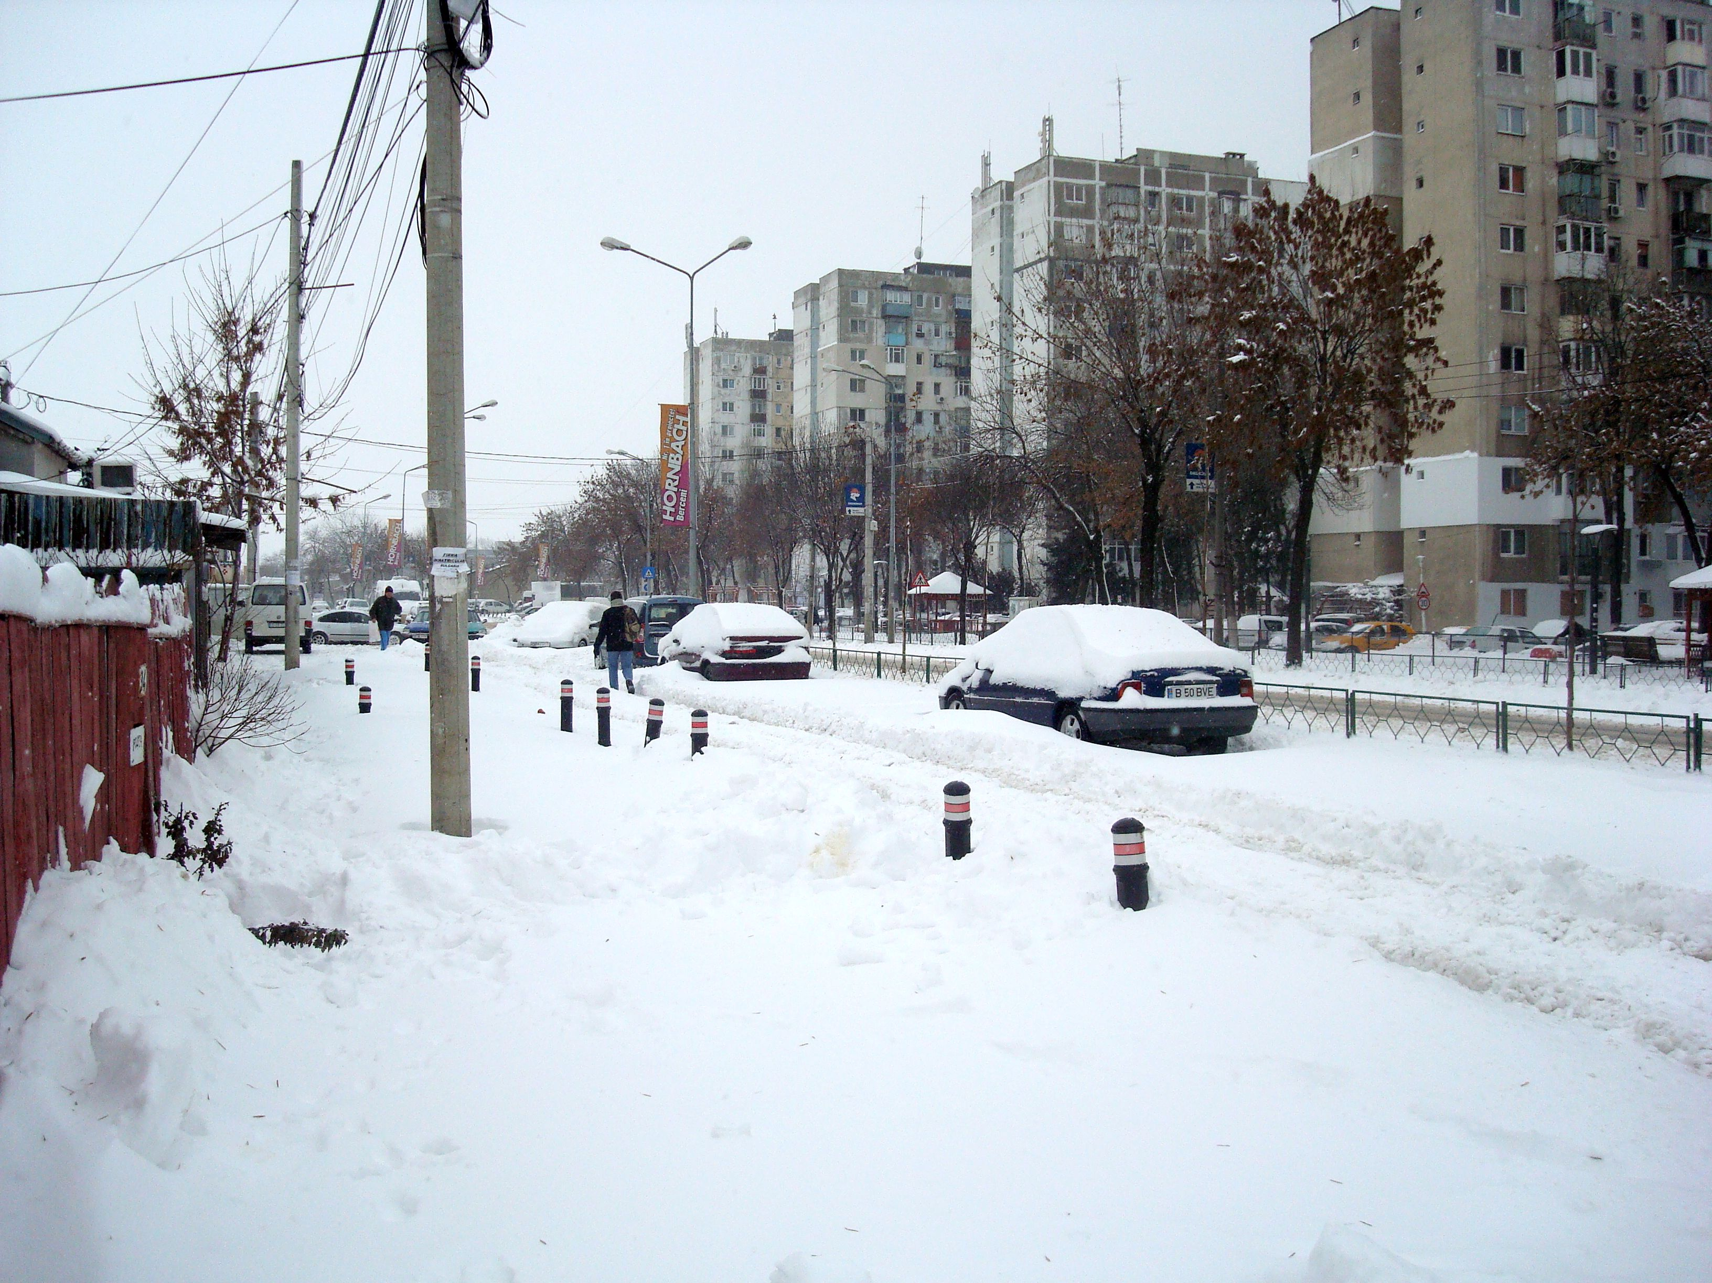
Logistics

Slide 10
Fertilizer OUtlook

Slide 11
Bang for your Buck
Lower crop prices have changed the economics of crop production and fertilizer use
-Shift to lower input crops
-Application of less fertilizer

Slide 12
Farmers are not booking fertilizer
--waiting for lower prices
--don’t have cash
--don’t have income to offset
--might have difficulty with their credit
Driving prices lower

Slide 13
Ammonia

Slide 14
Urea

Slide 15
Fertilizer Wrap Up
Market is under transition
Environmental/health issues
Lower returns to farming
Farmer delay in pricing
Increased capacity

