Slide 2
Energy Outlook
David Ripplinger
Valley City
January 21, 2015

Slide 3
Outline
Global Economy
Oil!
Ethanol
Corn

Slide 4
The Big Picture

Slide 5
A Weak Global Economy
Most economies in the world are struggling
Today, the ECB will likely announce a major stimulus package
In China, it is expected that the lowest growth in 24 years will be reported

Slide 6
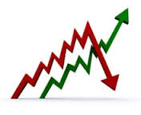
Deflation
There are signs that deflation may rear its head in many places
(NZ yesterday…)
This means regularly falling prices – which can be just as bad (if not worse) than inflation

Slide 7
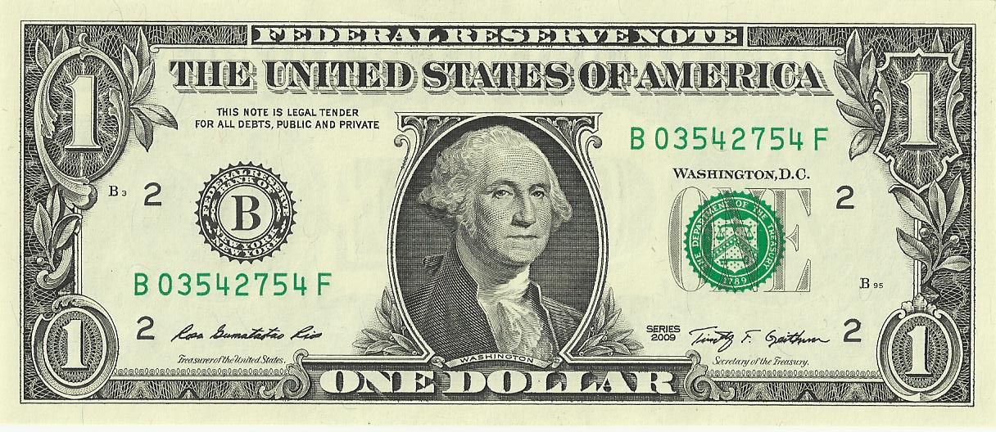
The Search for Strength
Be happy you live in the United States…
Capital is flowing to the United States strengthening the dollar

Slide 8
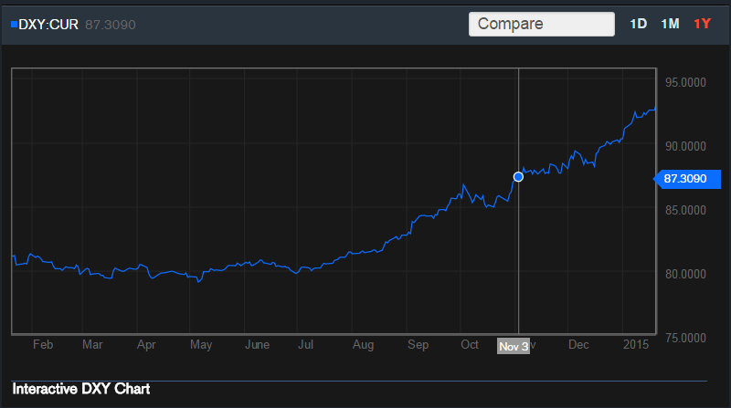

Slide 9
A strong dollar
Makes American goods more expensive and foreign goods less expensive
Is good for American consumers
But not so good for American farmers, especially those in North Dakota, given how much we export

Slide 10
Oil History

Slide 11
The Organization of Petroleum Exporting Countries (OPEC) looks to stabilize oil revenues.
Not only to keep prices high…
Notes:
OPEC was established in 1960 to stabilize oil revenues among member nations.
Traditionally we think of them as behaving as a cartel – limiting supplies to keep prices high, but that isn’t always the case.

Slide 12
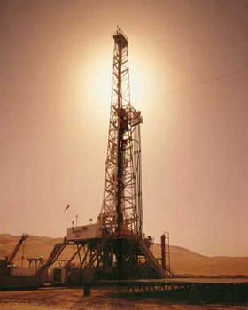
Late 70’s/early 80’s
OPEC limited production to keep prices high
Saudi Arabia cut production significantly
Notes:
For example in the late 1970’s and early 80’s OPEC wanted to limit production to some extent to drive up prices.
The problem with OPEC, like most cartels, is that there is an incentive for individual members to cheat.
What happened in this case was Saudi Arabia kept cutting production from nearly 10 mmbbl/day to 2.5 mmbbl/day.

Slide 13
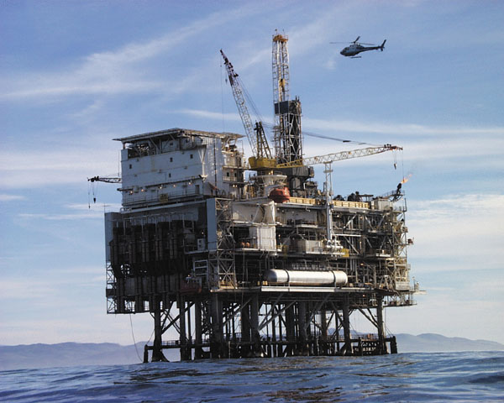
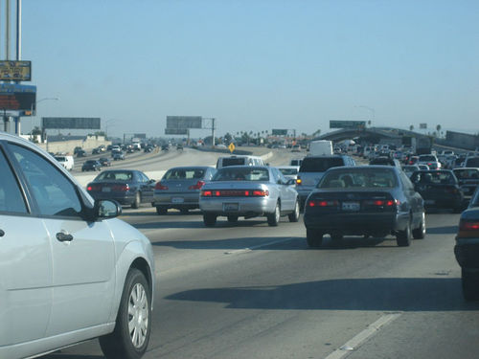
Late 70’s/Early 80’s
Production
Prices
Higher cost alternative sources
Less driving
Notes:
The effect of reduced oil production was an increase in global oil prices.
This led to the development of North Sea/off-shore oil development, and increased fuel economy of American vehicles.

Slide 14
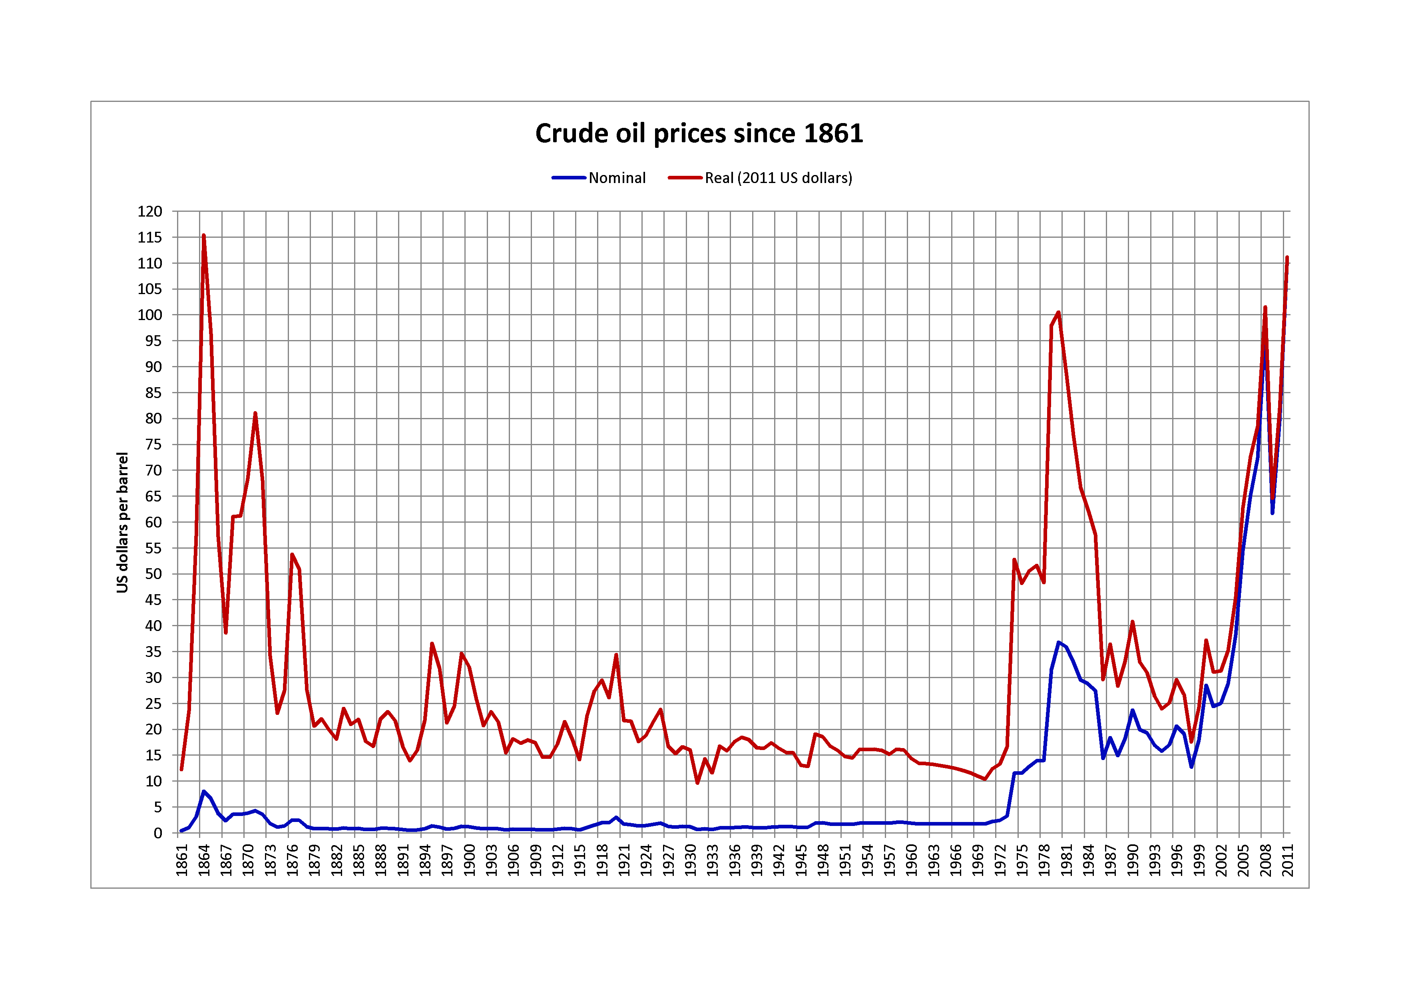
Saudi Response
Increase production to gain market share.
Oil prices fell 2/3^{rds}! in 1985-1986
Notes:
By 1985 Saudi Arabia had enough and decided that it increase production to gain market share.
This led oil prices to fall by 2/3rds from 1985 to 1986.
This led to a major disruption of a number of oil companies, many of which filed for bankruptcy.

Slide 15
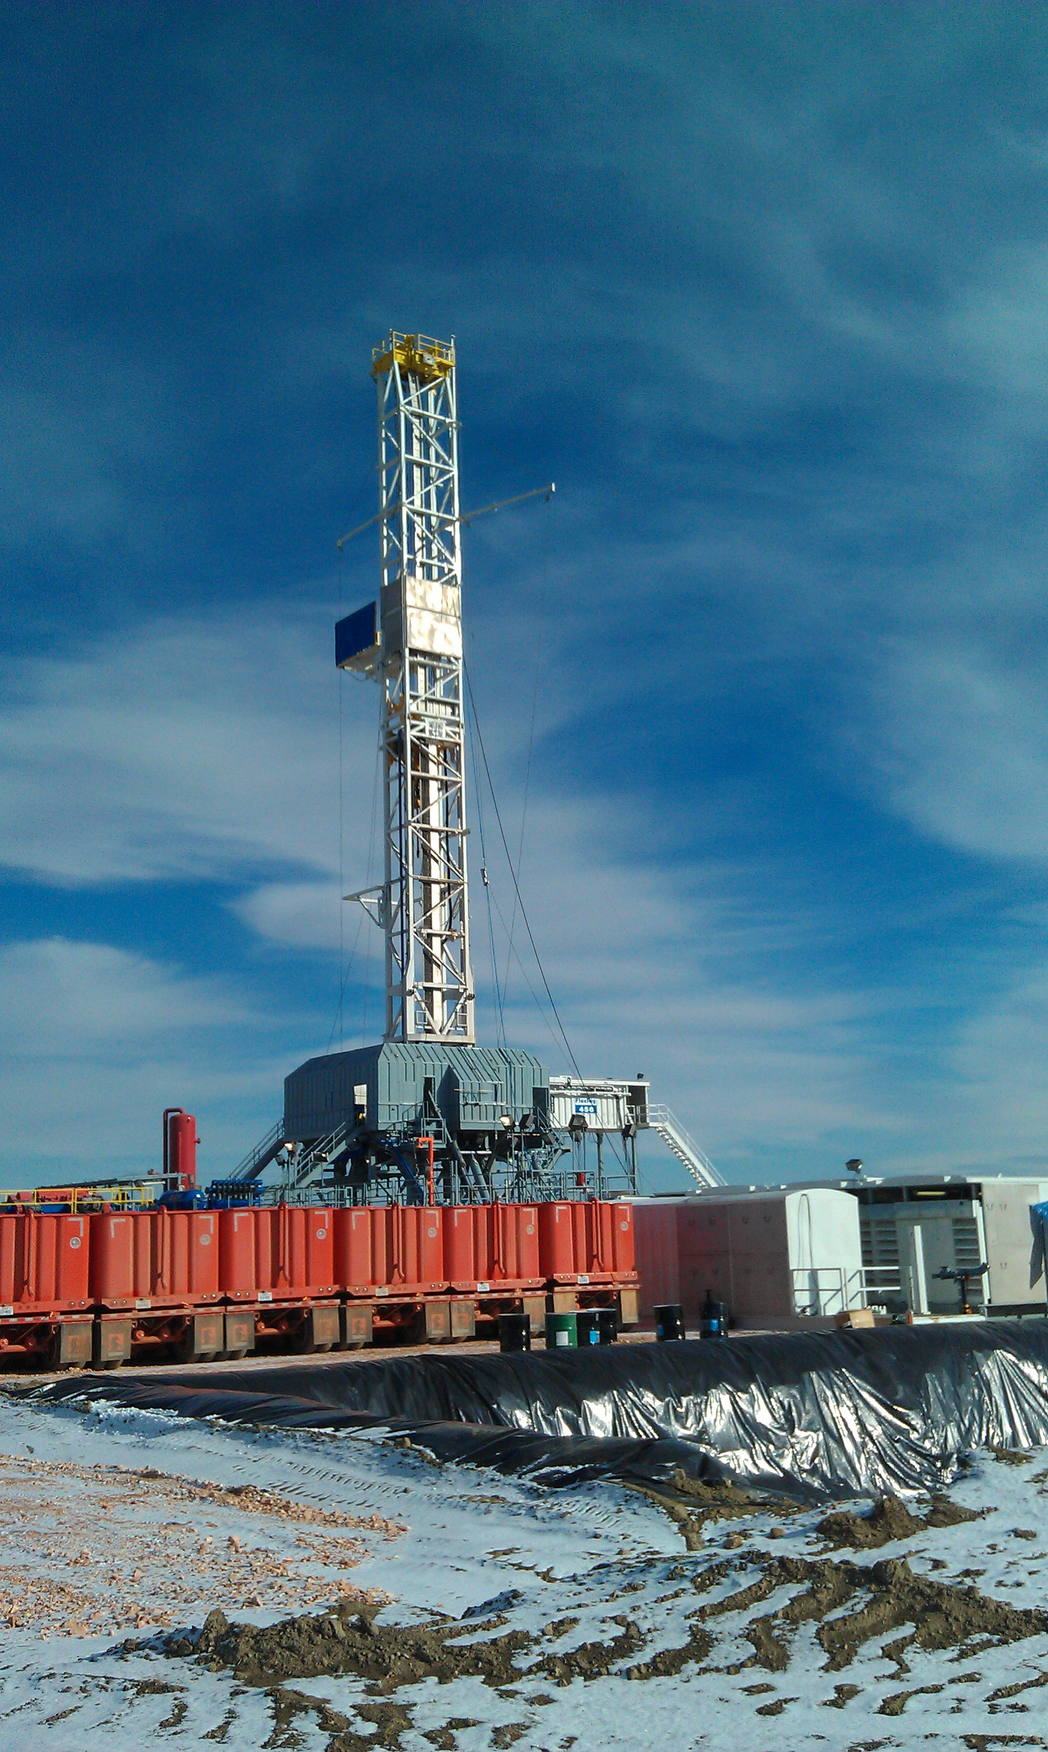
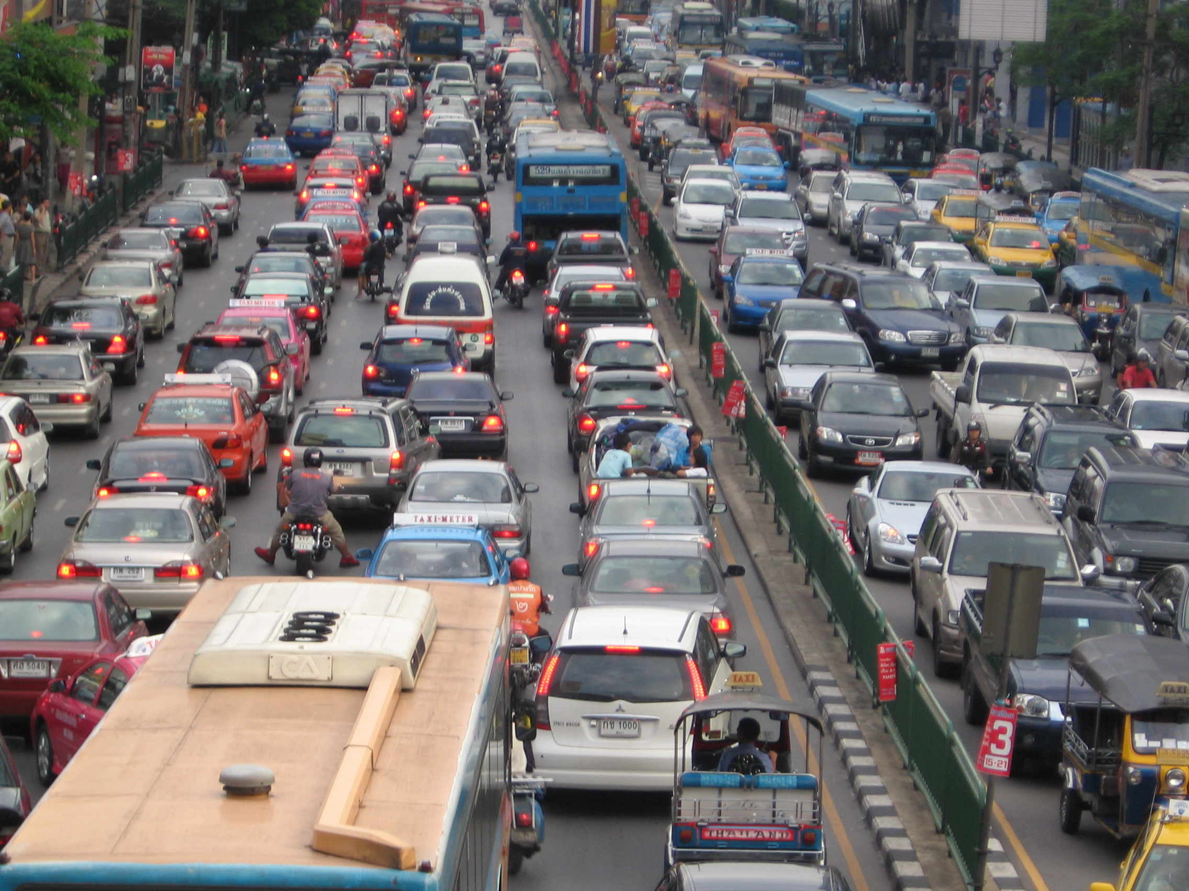
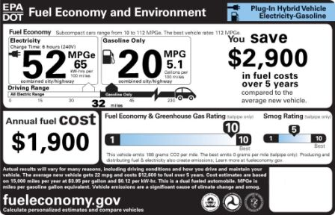
2014:History Repeats Itself (again)
OPEC members overproducing
Shale oil/renewables
Slumping demand in East Asia
Saudi Arabia goes for market share
Notes:
Today, history is repeating itself very closely.
OPEC members have been producing above their quotas, leading to a slow build up in global supplies.
High prices of oil led to the development of shale oil, including the Bakken Field in North Dakota.
Like in 1985, Saudi Arabia decided that it wanted its market share back, in this case continuing to produce oil above….
Something about 2 million gallons.
What to do with those gallons. We either need increased consumption or decreased production or both. Balance. Building pools/glut.

Slide 16
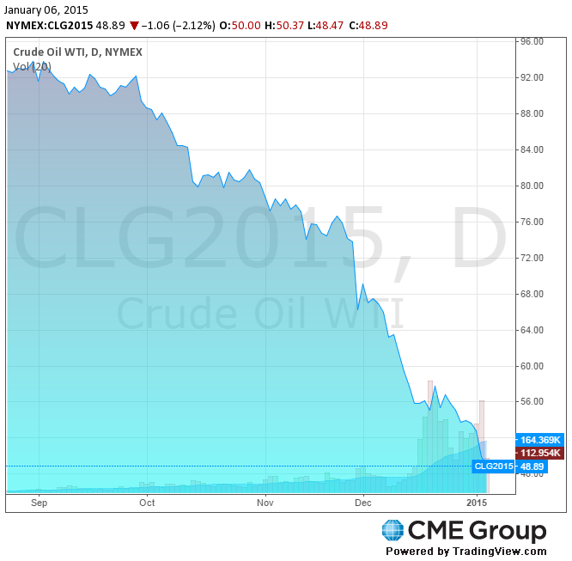
How low?
West Texas Intermediate is now below $50 – half of its 52-week high of $101
Notes:
A question among investors and economists is how low with this go.
Doesn’t appear that we’ve found a price at which the market can clear.
They announced their plans to continue production on Thanksgiving, when price was $70/bbl. It has now fallen below $50.
We can look back to earlier in the year when their were signs of overproduction and growing supplies.
Saudi Arabia has given no clues as to how low they will tolerate oil to fall, making comments about willingness to see $30, $20, or lower prices.

Slide 17
How long?
A few months?
A year to 18 months?
Longer?
Notes:
When we hit the low. I don’t think we’re there yet. How long will it last.
Many believe that Saudi Arabia doesn’t have the appetite for this to last long. They have $750 billion in assets that make me think otherwise.
It took almost two decades for the real price to recover from the 1985 change.

Slide 18
What about the Bakken? ND Light Sweet: $33.37 1/20/15

Slide 19
 | Breakeven/bbl
Billings | $53
Bottineau-Renville | $51
Bowman-Slope | $75
Burke | $81
Divide | $85
Dunn | $29
Golden Valley | $77
McKenzie | $28
McLean | $73
Mountrail | $42
Stark | $36
Williams | $37
Source: ND DMR

Slide 20
Potential State Fiscal Impact
Lower investment (impact sales/income tax)
Lower production (bbls to tax)
Lower extraction tax revenue – exemption if average monthly WTI price is below $52.59 for five consecutive months.

Slide 22
Review of Last Year’s Outlook
Last year – predicted ~ 180 rigs
Above that level through December 5th
Down to 169 as of January 2nd. 156 as of the 16th…

Slide 23
Outlook
Tremendous uncertainty regarding a short-term price, some saying WTI into the $20s.
Uncertainty of how long new low-price regime will last.
Rig count down substantially ~120 rigs.
-Helms expected 40 to 50 rig decline when WTI was $58 and total count was 180.

Slide 24
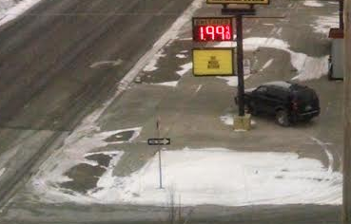
The Good news

Slide 25
Consumer Impacts
Regular gasoline (PADD 2, EIA)
11/19/15 - $1.92
12/30/13 - $3.26
12,000 miles per year, 24 mpg, 500 gallons
-> ‘savings’ of $670

Slide 27
Should I buy diesel now…

Slide 29
Ethanol & low oil Prices

Slide 30
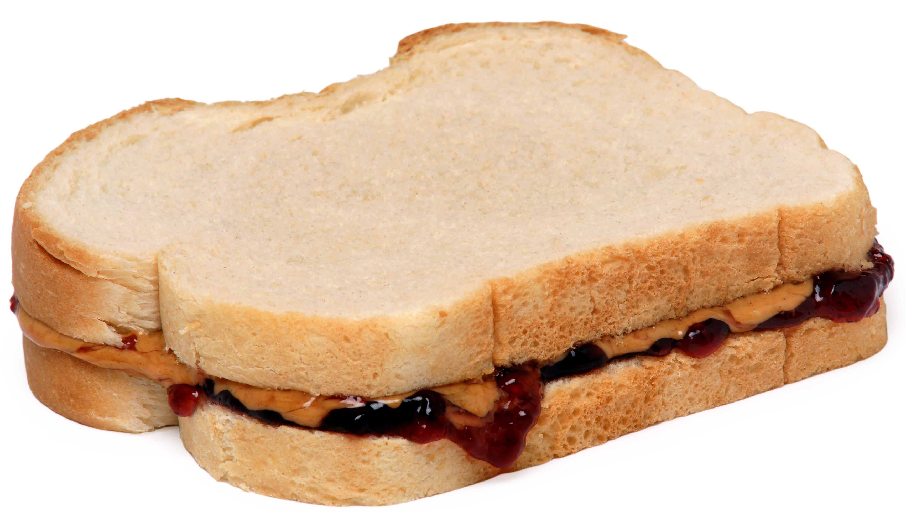
E10 - complement
Good news for ethanol as a blend stock for gasoline
Lower oil and consequently gas prices will result in increased consumption, including ethanol.

Slide 31
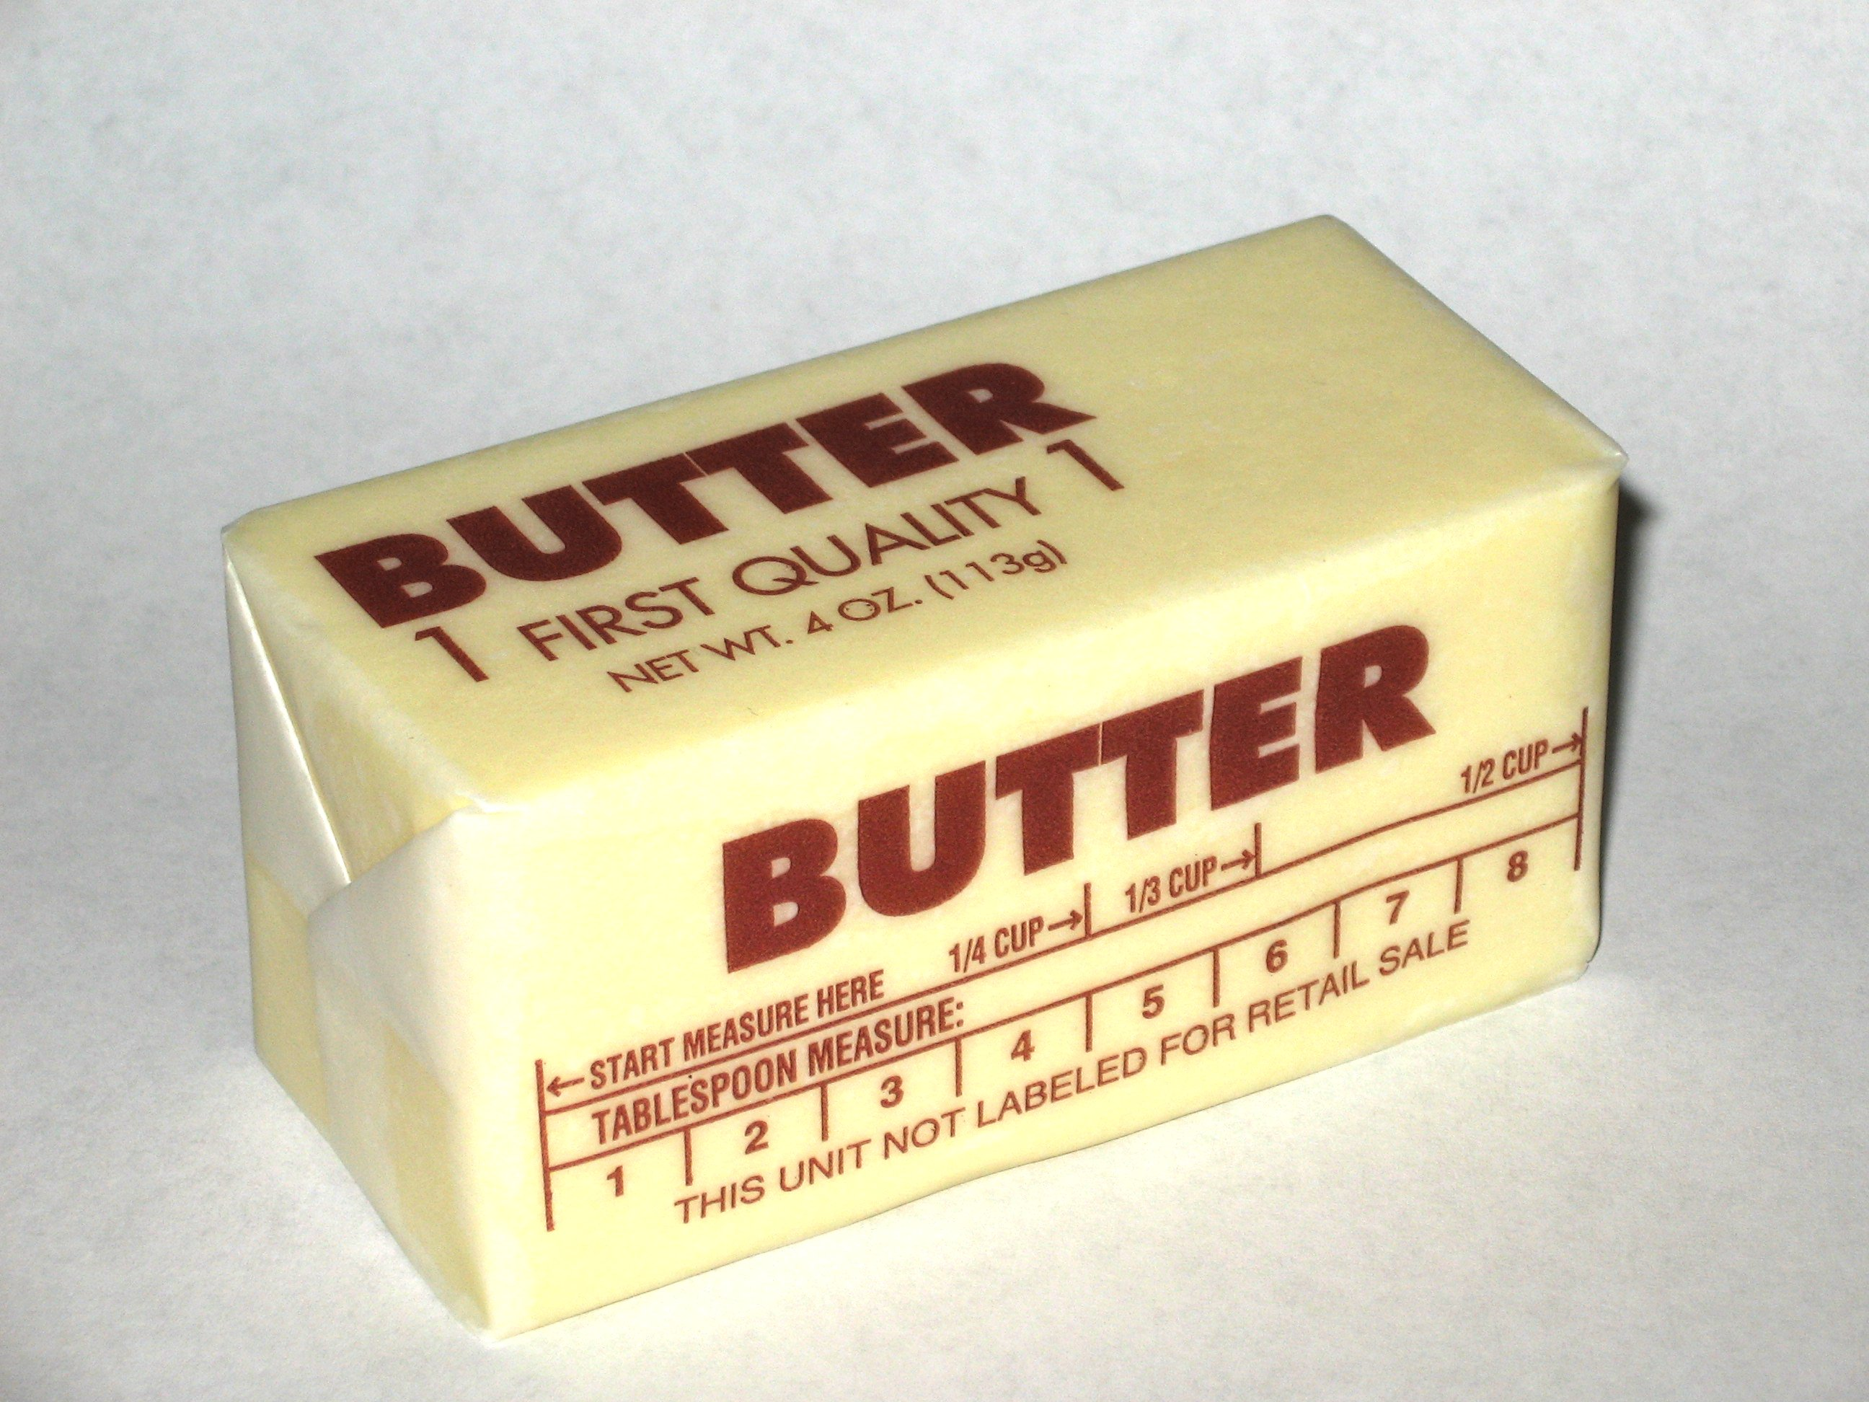
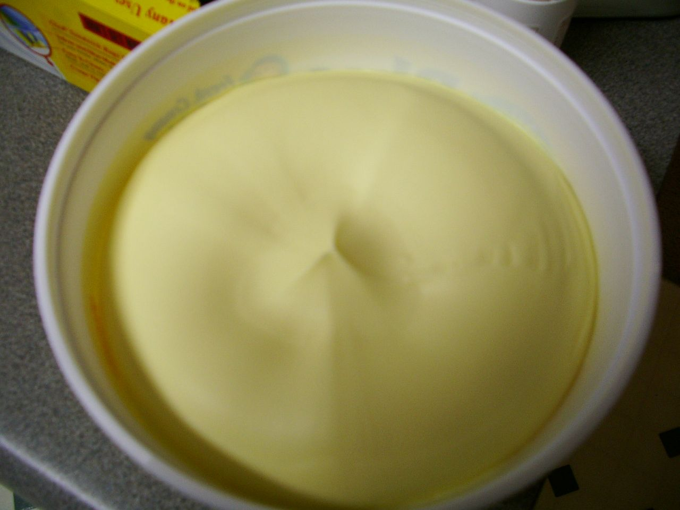
E85 - substitute
E85 will have a more difficult time competing against gasoline on an energy-price equivalent basis

Slide 32
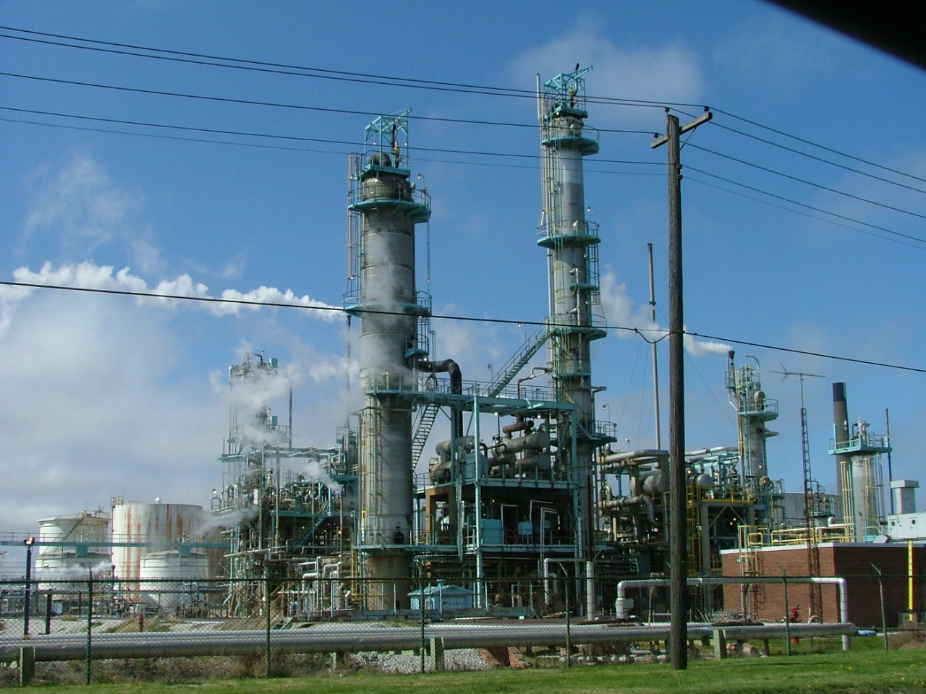
If low oil prices persist
Refiners may produce higher octane gasoline, displacing ethanol as an oxygenate

Slide 33
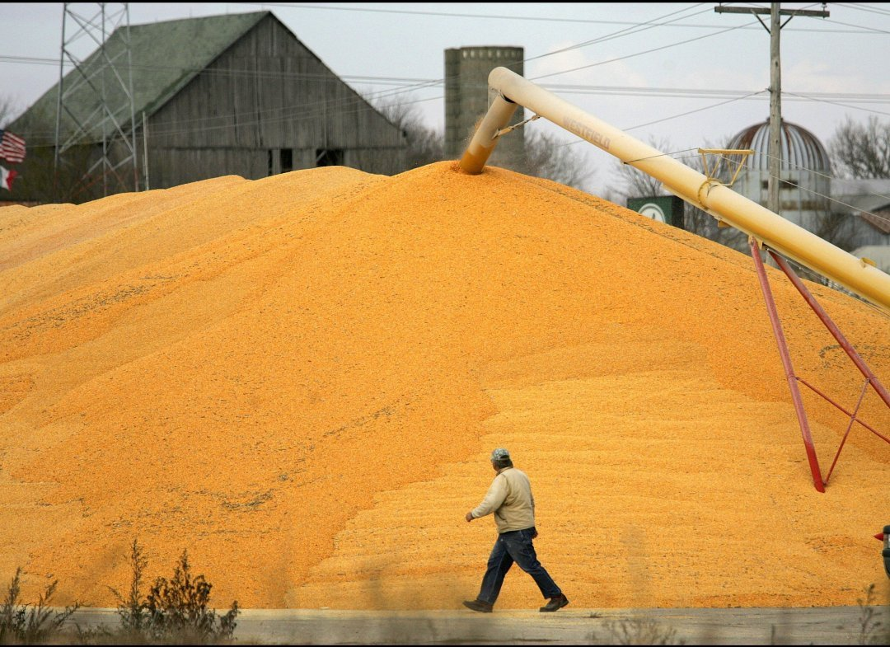

Slide 34
RFS
The Renewable Fuel Standard mandates minimum use of biofuels by type and year.
EPA can change the mandate for the next year in the case of
- economic harm
- inadequate supply
Obligated parties (blenders and others) are required to blend or purchase RINs to show compliance with the law.

Slide 35
2014 Proposed Rule November 2013
 | Original Mandate | 2014 Proposed
Cellulosic | 1.75 | .017
Biomass-based diesel | 1/1.28 | 1.28
Other advanced | 1 | .263
Total advanced | 3.75 | 2.2
Corn-starch ethanol | 14.4 | 13.01
Total renewable | 18.15 | 15.21
Limited production
‘Blend wall’

Slide 36
Final Rule - Implications
For corn ethanol: ‘adjust the net’
For advanced biofuel and cellulosic:
- slow or stop ethanol activity
- support drop-in fuels activity
It’s all about the reasoning.
Is the ‘blend wall’ justification?

Slide 37
RFS Outlook
Mandate | Original Mandate | 2014 Proposed | Outlook
Cellulosic | 1.75 | .017 | .017
Biomass-based diesel | 1/1.28 | 1.28 | 1.28
Other Adv. | 1 | .263 | .263
Total | 3.75 | 2.2 | 2.2
Corn-starch | 14.4 | 13.01 | 13.8
Total renewable | 18.15 | 15.21 | 16
Guarantee – The EPA will be sued by the biofuels industry, the oil and gas industry, or both
billion gallons

Slide 38
Key Factors
Falling energy (oil) prices
Large corn crop
Exports

Slide 39
Brazil may increase its gasoline blend from 25 to 27.5%
Corn-ethanol is/was… an affordable source of octane

Slide 40
The New Normal?
Corn ethanol – unsubsidized, weakly supported by the RFS
Economics driven by global oil and US corn prices, exports

Slide 41
Corn Ethanol Outlook
Production | 14.5 billion gallons
Capacity Use | 97.5 %
Corn Use | 5,175 billion bushels
DDGs | 43.9 million tons
Consumption | 13.25 billion gallons
Exports | 1.25 billion gallons

Slide 42
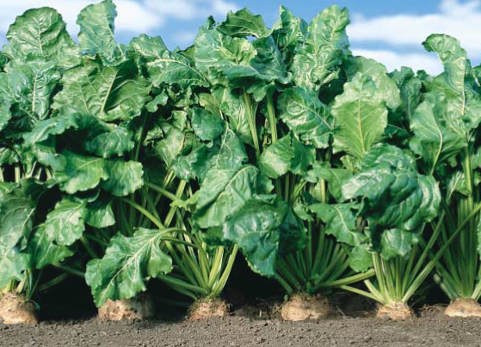
Energy Beet-Ethanol
Langdon, Cando, Carrington, Jamestown, and Valley City under consideration for first 20 MMGPY biorefinery
Require 750,000 tons of beets
30,000 dryland acres (@25t/AC)
Most feedstock sourced within 20 miles of plant
Grower meetings held last winter – chemical carryover

Slide 43
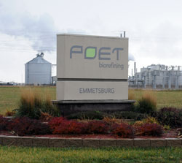
Cellulosic Biofuel
POET’s Project Liberty had its grand opening in September
Abengoa had its grand opening in October
Dupont’s refinery in Nevada, IA is under commission

Slide 44
Summary
The global economy is in crisis
Oil prices have fallen
Ethanol benefits and suffers from low gasoline prices

