Slide 2
Oil & Gas Outlook
David Ripplinger
Lake Region Extension Round-up
Devils Lake
January 7, 2015

Slide 3
A little History

Slide 4
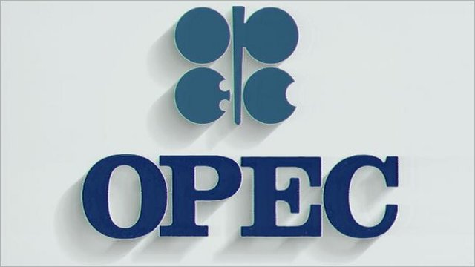
The Organization of Petroleum Exporting Countries (OPEC) looks to stabilize oil revenues.
Not only to keep prices high…
Notes:
OPEC was established in 1960 to stabilize oil revenues among member nations.
Traditionally we think of them as behaving as a cartel – limiting supplies to keep prices high, but that isn’t always the case.

Slide 5
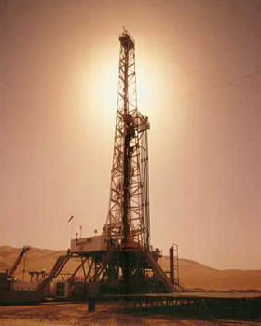
Late 70’s/early 80’s
OPEC limited production to keep prices high
Saudi Arabia cut production significantly
Notes:
For example in the late 1970’s and early 80’s OPEC wanted to limit production to some extent to drive up prices.
The problem with OPEC, like most cartels, is that there is an incentive for individual members to cheat.
What happened in this case was Saudi Arabia kept cutting production from nearly 10 mmbbl/day to 2.5 mmbbl/day.

Slide 6
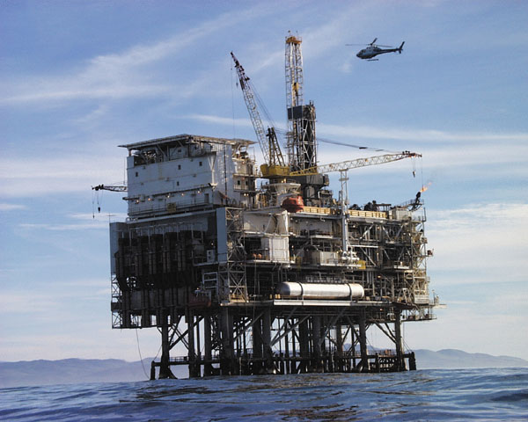
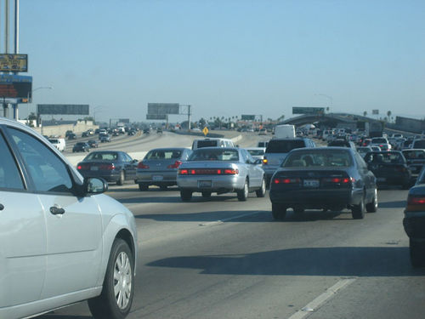
Late 70’s/Early 80’s
Production
Prices
Notes:
The effect of reduced oil production was an increase in global oil prices.
This led to the development of North Sea/off-shore oil development, and increased fuel economy of American vehicles.

Slide 7
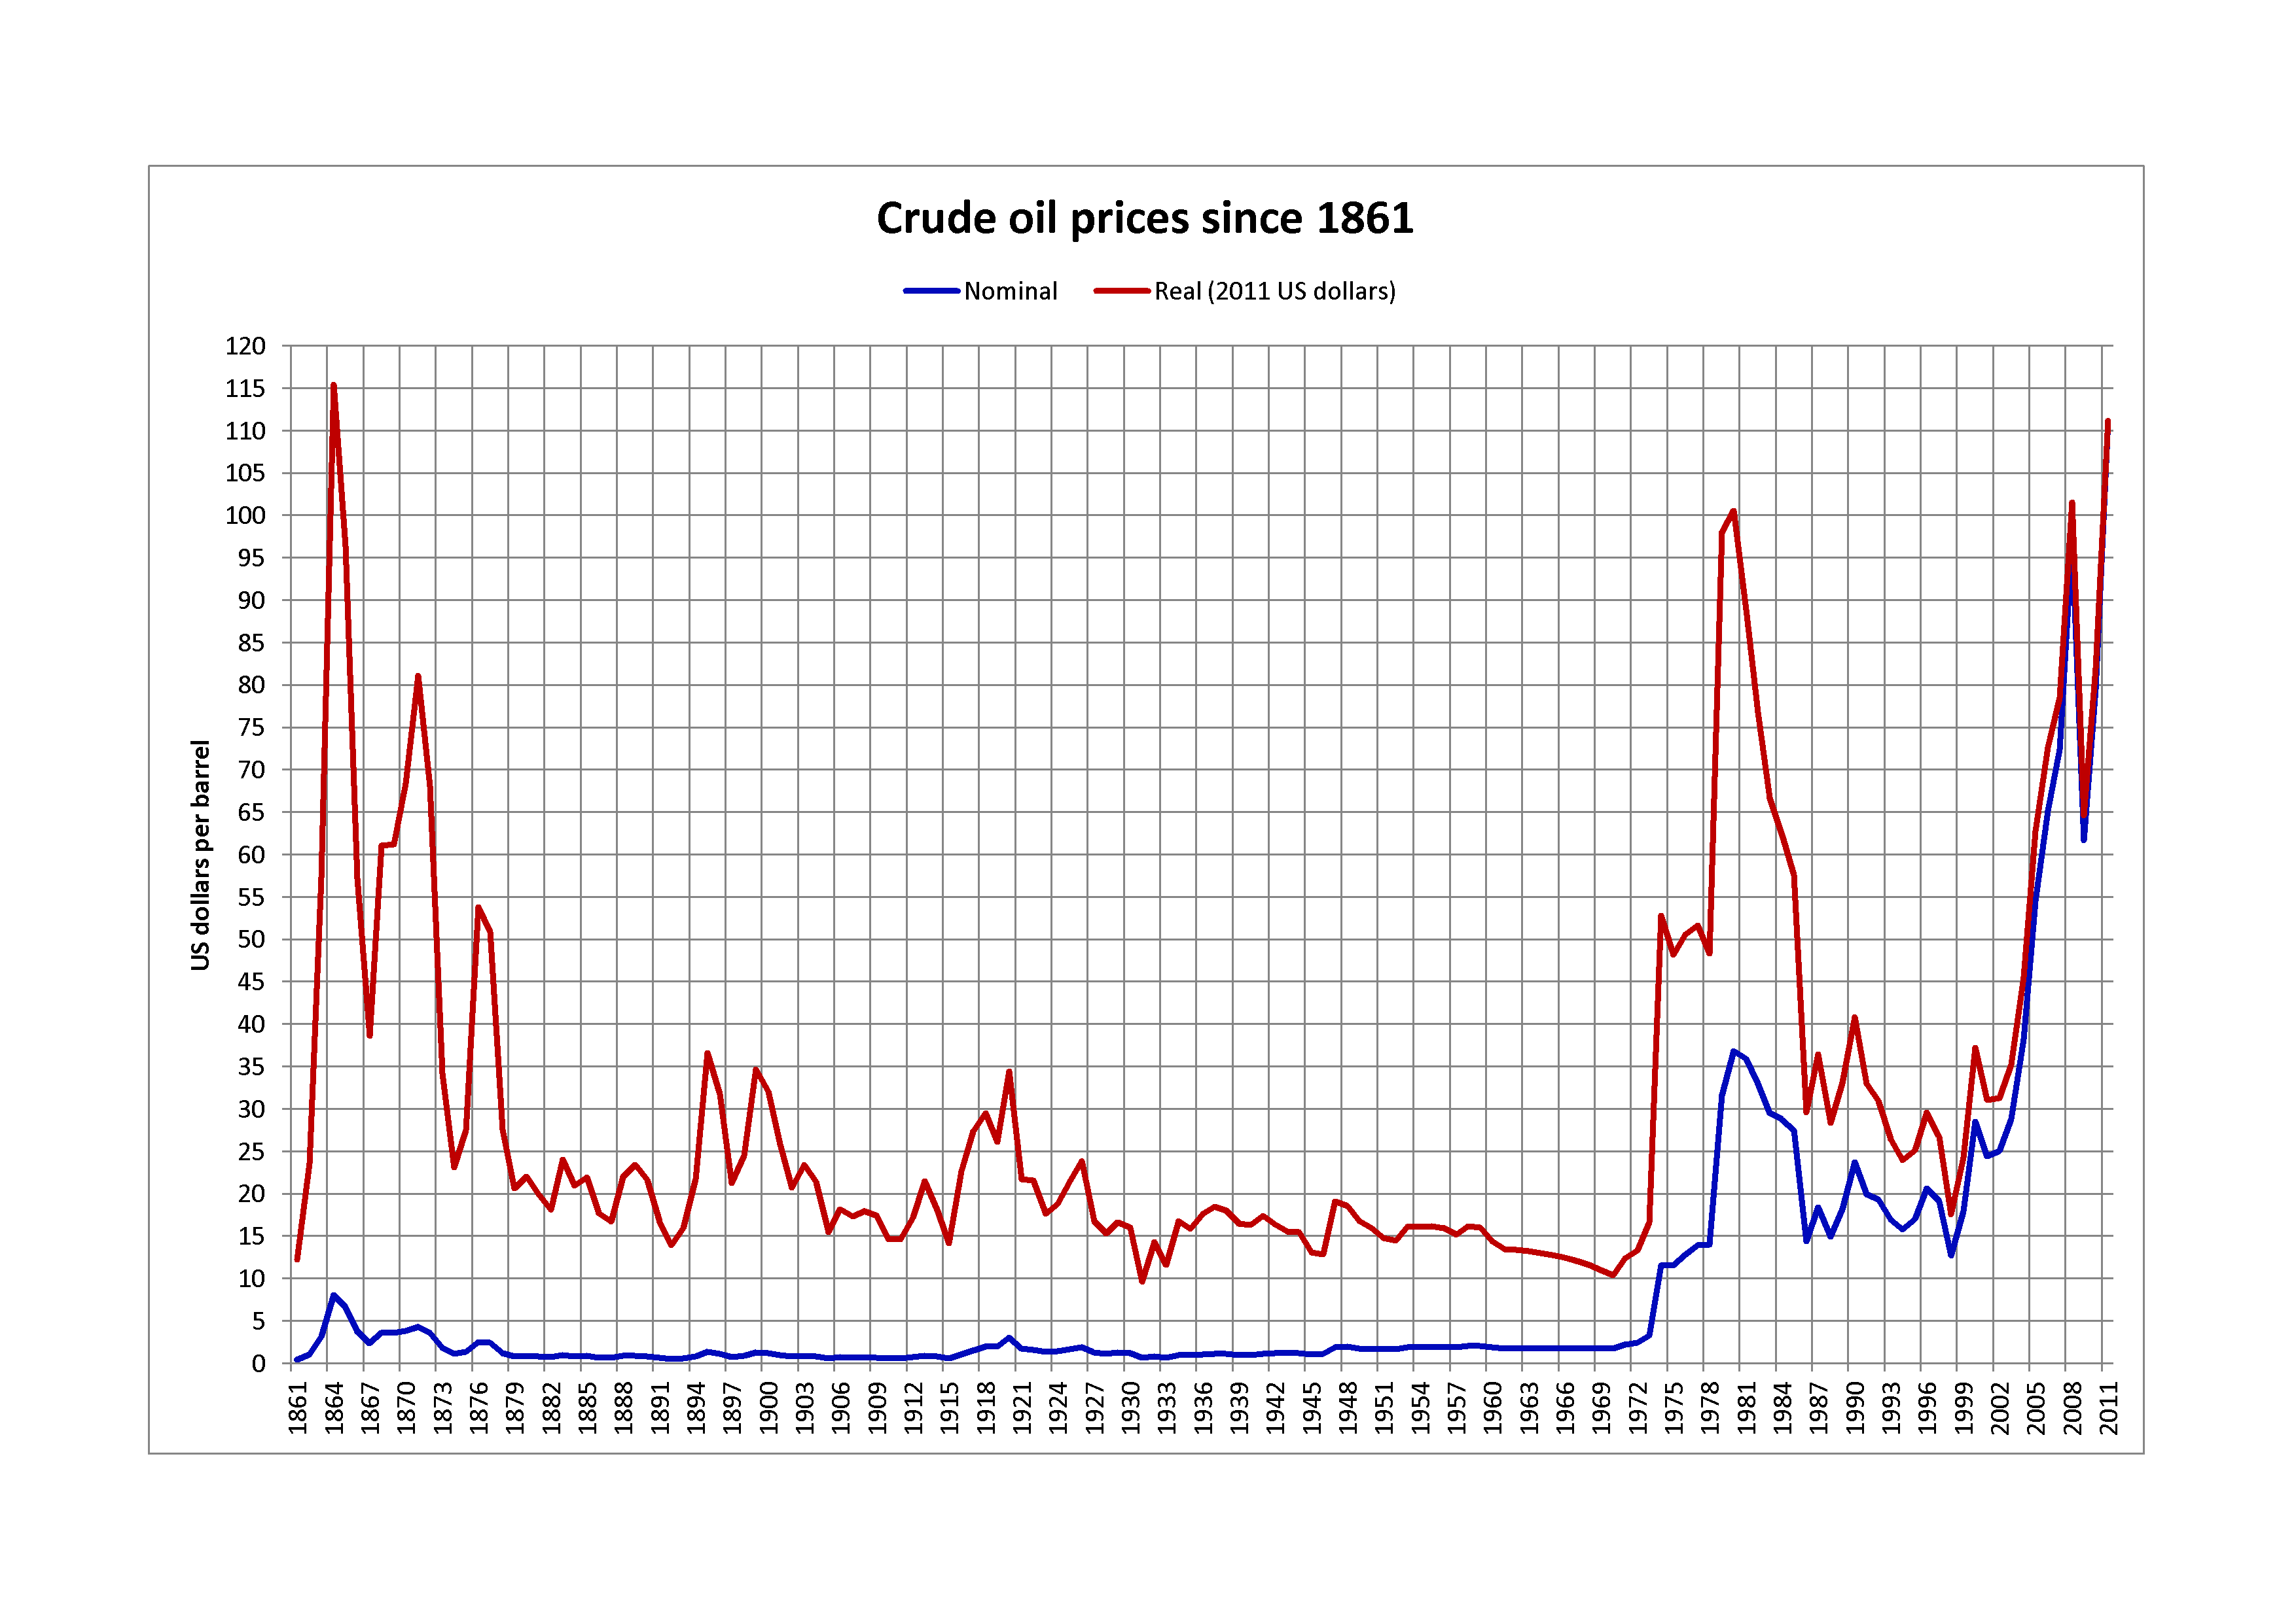
Saudi Response
Increase production to gain market share.
Oil prices fell 2/3^{rds}! in 1985-1986
Notes:
By 1985 Saudi Arabia had enough and decided that it increase production to gain market share.
This led oil prices to fall by 2/3rds from 1985 to 1986.
This led to a major disruption of a number of oil companies, many of which filed for bankruptcy.

Slide 8
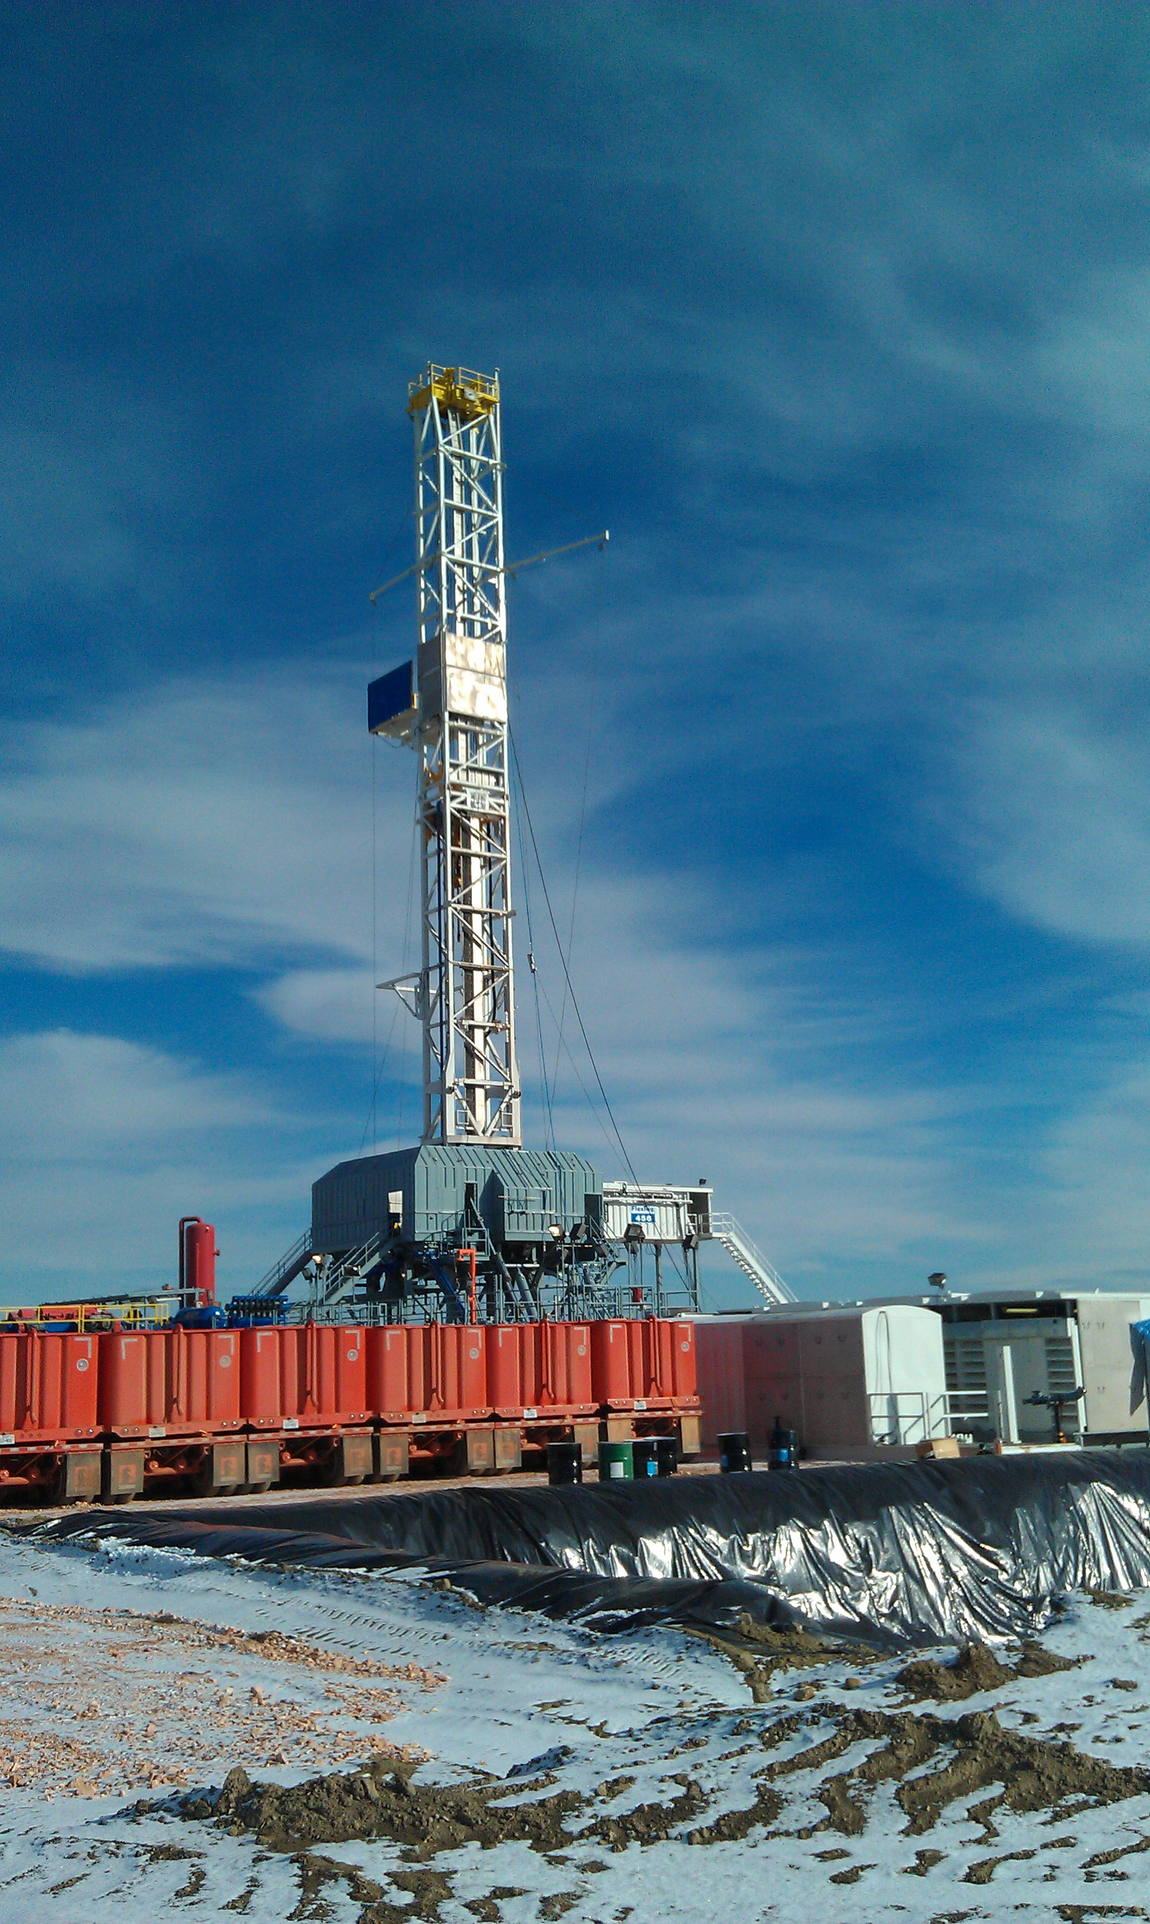
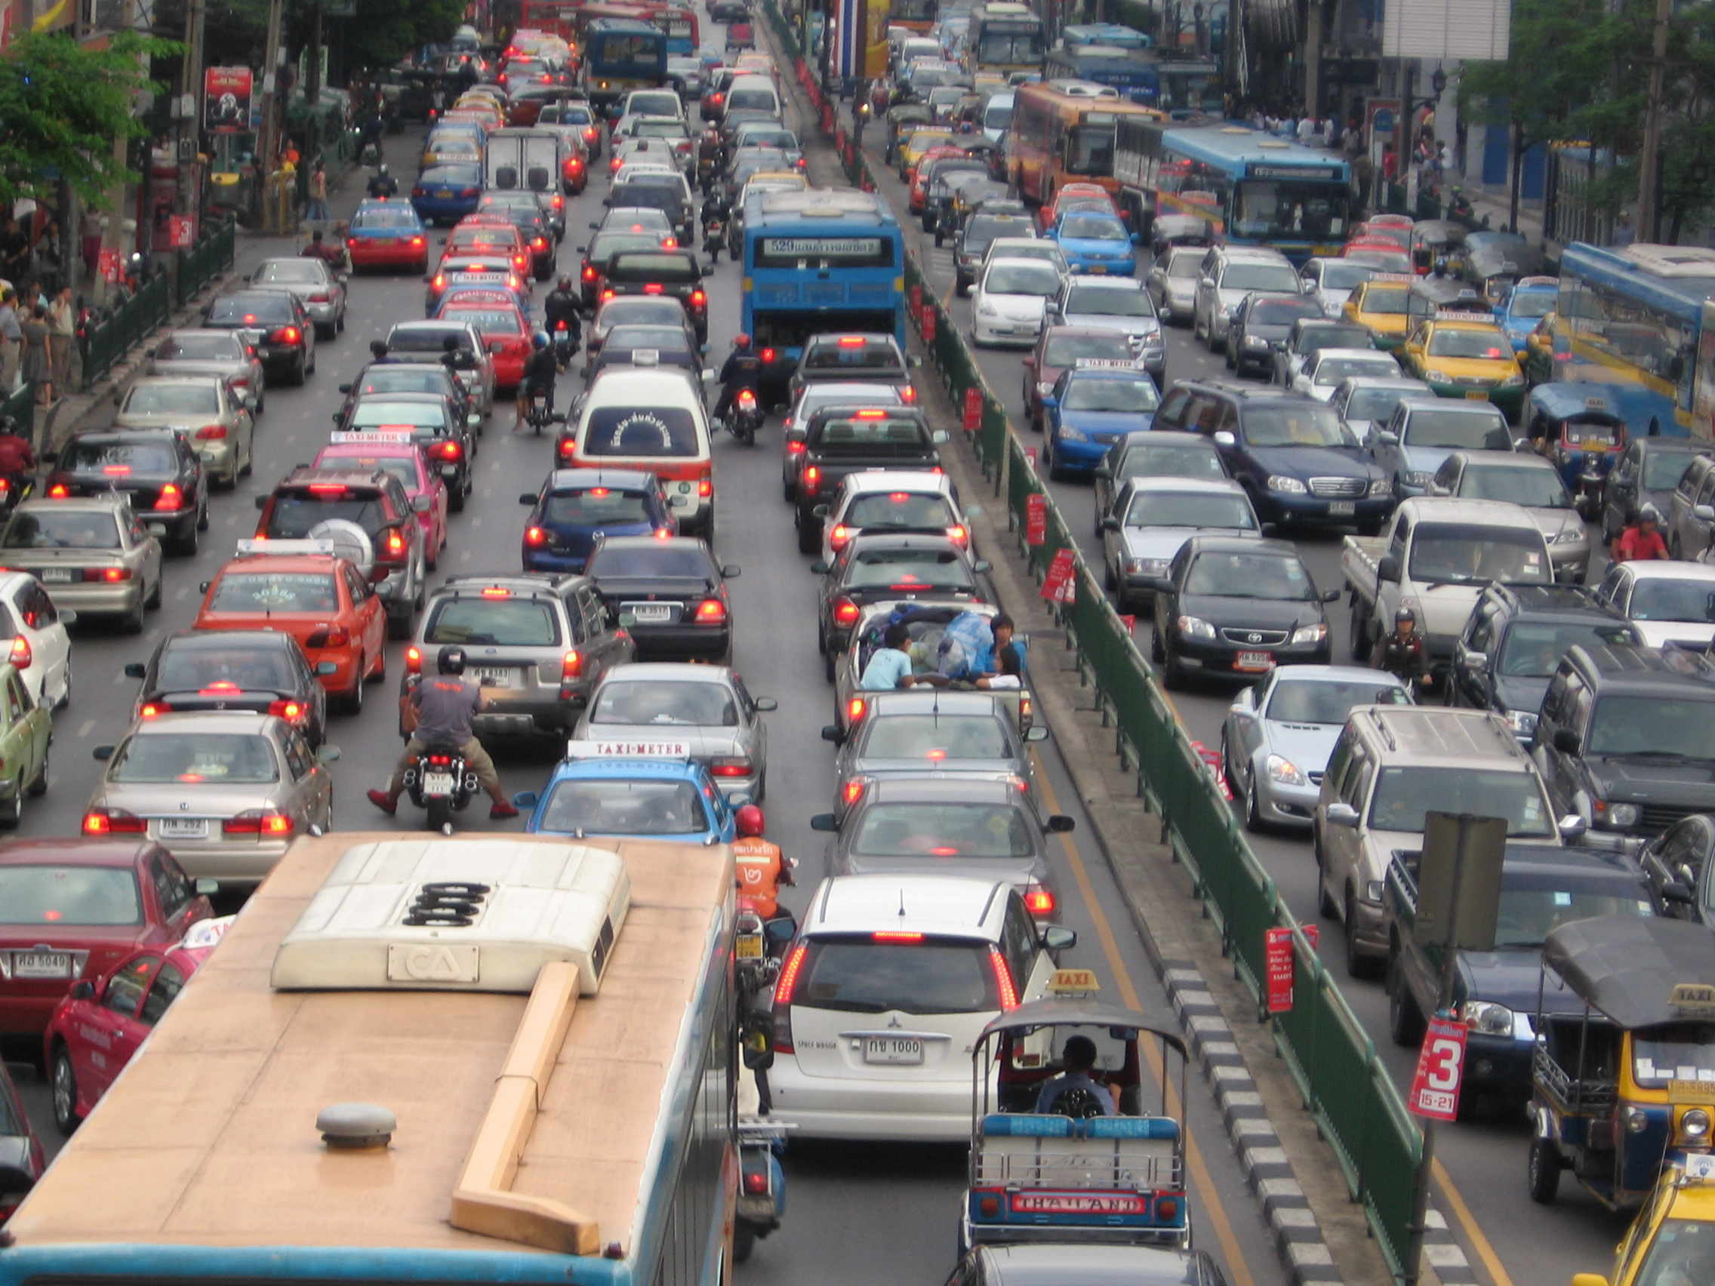
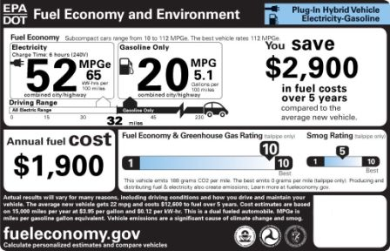
2014:History Repeats Itself (again)
OPEC members overproducing
Shale oil/renewables
Slumping demand in East Asia
Saudi Arabia goes for market share
Notes:
Today, history is repeating itself very closely.
OPEC members have been producing above their quotas, leading to a slow build up in global supplies.
High prices of oil led to the development of shale oil, including the Bakken Field in North Dakota.
Like in 1985, Saudi Arabia decided that it wanted its market share back, in this case continuing to produce oil above….
Something about 2 million gallons.
What to do with those gallons. We either need increased consumption or decreased production or both. Balance. Building pools/glut.

Slide 9
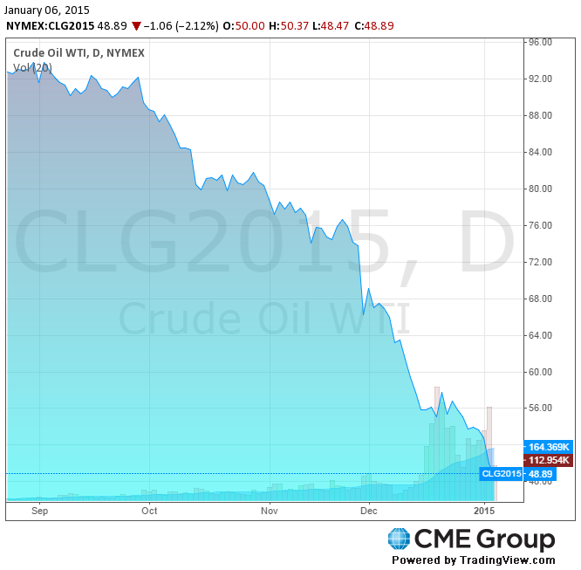
How low?
West Texas Intermediate is now below $50 – half of its 52-week high of $101
Notes:
A question among investors and economists is how low with this go.
Doesn’t appear that we’ve found a price at which the market can clear.
They announced their plans to continue production on Thanksgiving, when price was $70/bbl. It has now fallen below $50.
We can look back to earlier in the year when their were signs of overproduction and growing supplies.
Saudi Arabia has given no clues as to how low they will tolerate oil to fall, making comments about willingness to see $30, $20, or lower prices.

Slide 10
How long?
A few months?
A year to 18 months?
Longer?
Notes:
When we hit the low. I don’t think we’re there yet. How long will it last.
Many believe that Saudi Arabia doesn’t have the appetite for this to last long. They have $750 billion in assets that make me think otherwise.
It took almost two decades for the real price to recover from the 1985 change.

Slide 11
What about the Bakken? ND Light Sweet: $34.91 1/6/15

Slide 12
 | Breakeven/bbl
Billings | $53
Bottineau-Renville | $51
Bowman-Slope | $75
Burke | $81
Divide | $85
Dunn | $29
Golden Valley | $77
McKenzie | $28
McLean | $73
Mountrail | $42
Stark | $36
Williams | $37

Slide 13
Potential State Fiscal Impact
Lower investment (impact sales/income tax)
Lower production (bbls to tax)
Lower extraction tax revenue – exemption if average monthly WTI price is below $52.59 for five consecutive months.

Slide 15
Review of Last Year’s Outlook
Last year – predicted ~ 180 rigs
Above that level through December 5th
Down to 169 as of January 2nd.

Slide 16
Outlook
Tremendous uncertainty regarding a short-term price, some saying WTI into the $20s.
Uncertainty of how long new low-price regime will last.
Rig count down substantially ~120 rigs.
-Helms expected 40 to 50 rig decline when WTI was $58 and total count was 180.

Slide 17
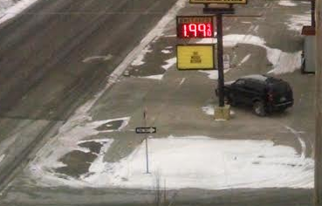
The Good news

Slide 18
Consumer Impacts
Regular gasoline (PADD 2, EIA)
12/29/14 - $2.09
12/30/13 - $3.26
12,000 miles per year, 24 mpg, 500 gallons
-> ‘savings’ of $585

Slide 20
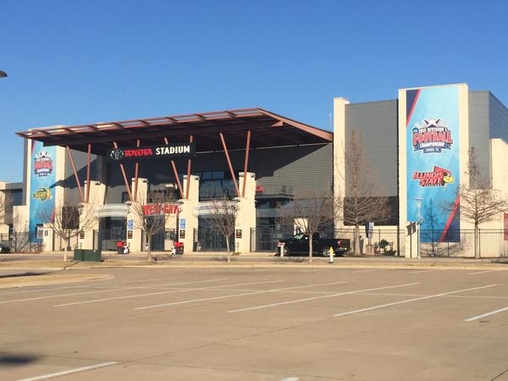
Take a road trip soon. Someone needs to use this fuel.

Slide 21
What does this mean for ethanol?

Slide 22
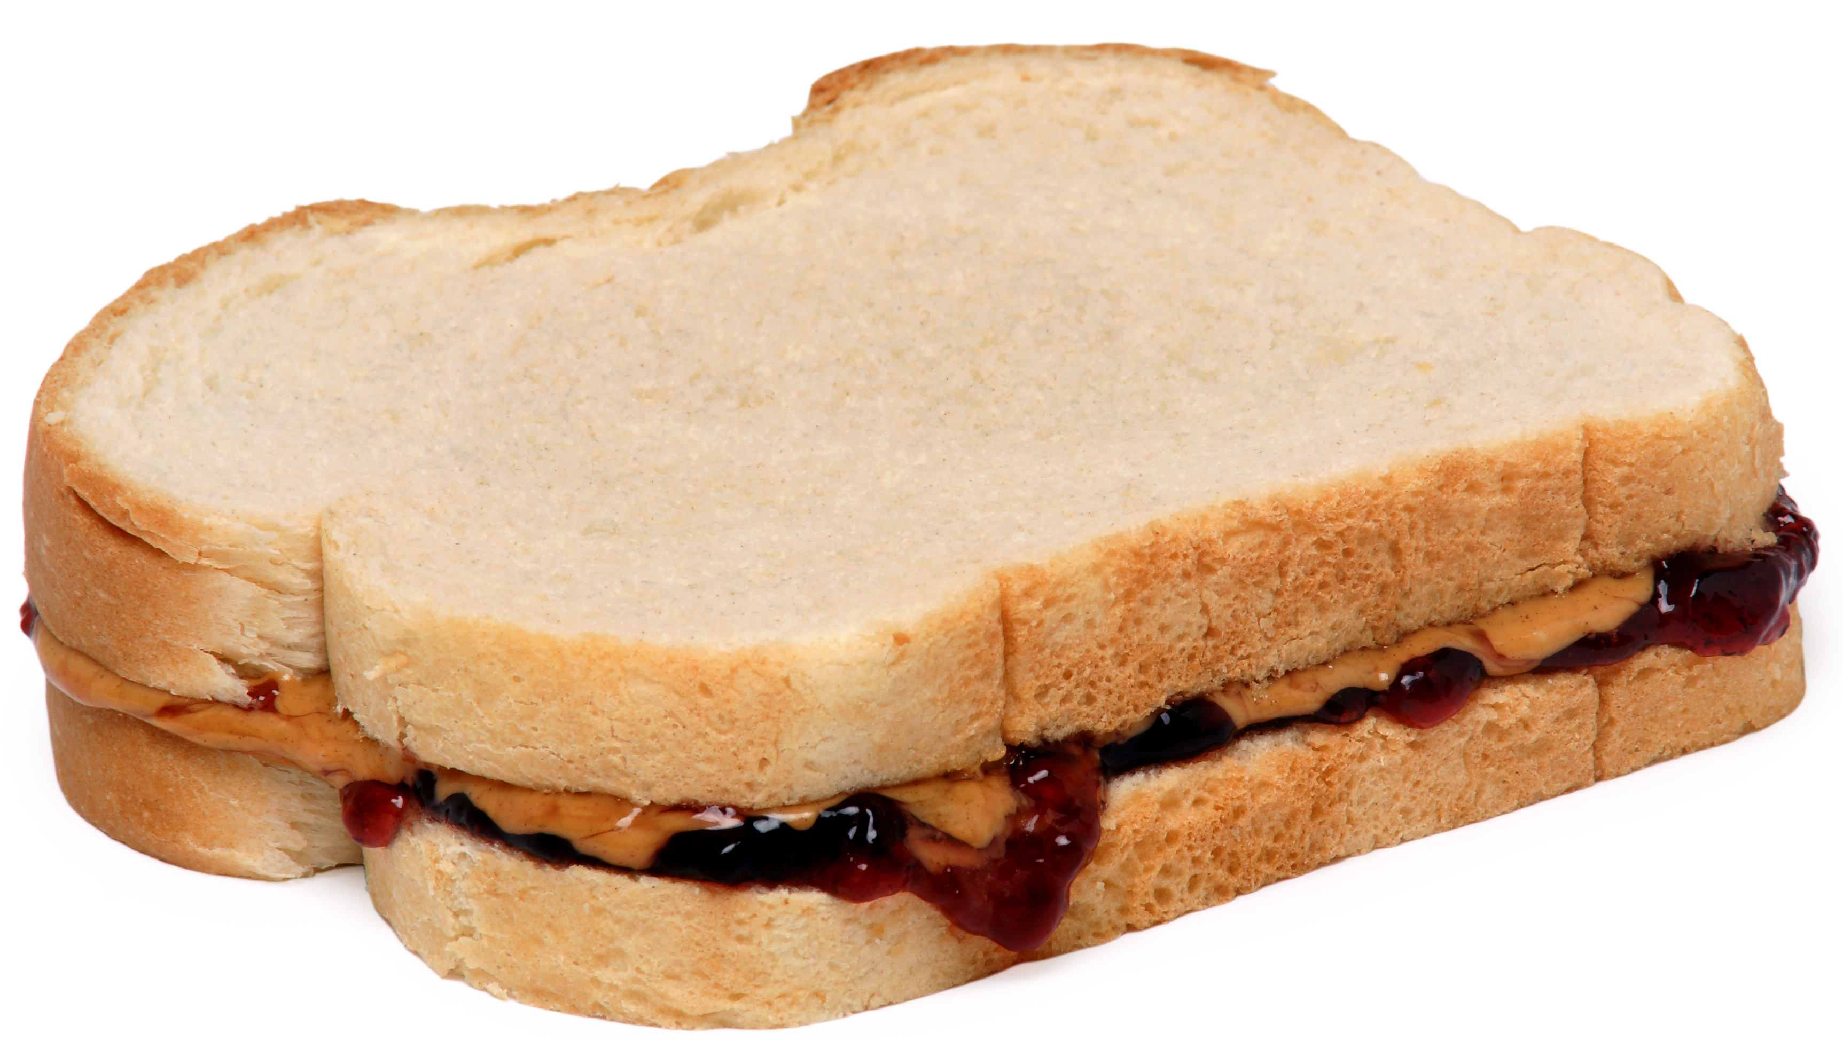
E10
Good news for ethanol as a blend stock for gasoline
Lower oil and consequently gas prices will result in increased consumption, including ethanol.

Slide 23
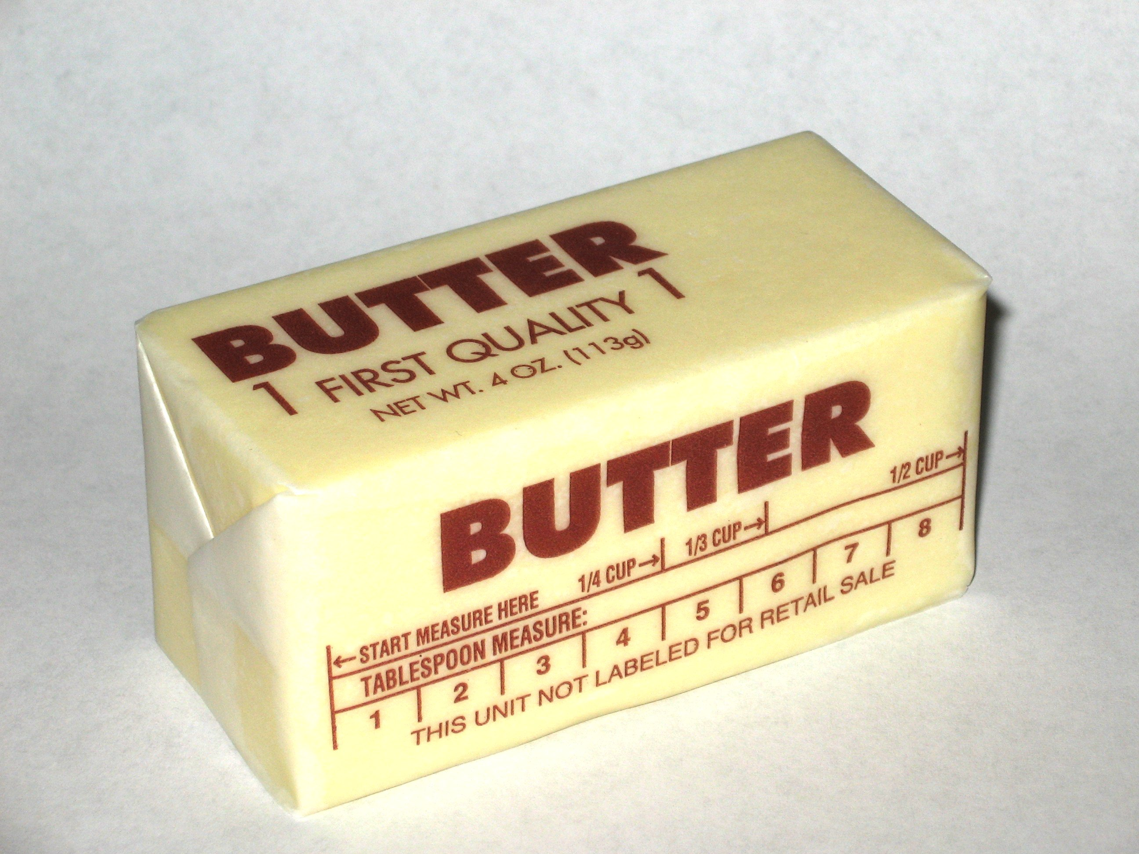
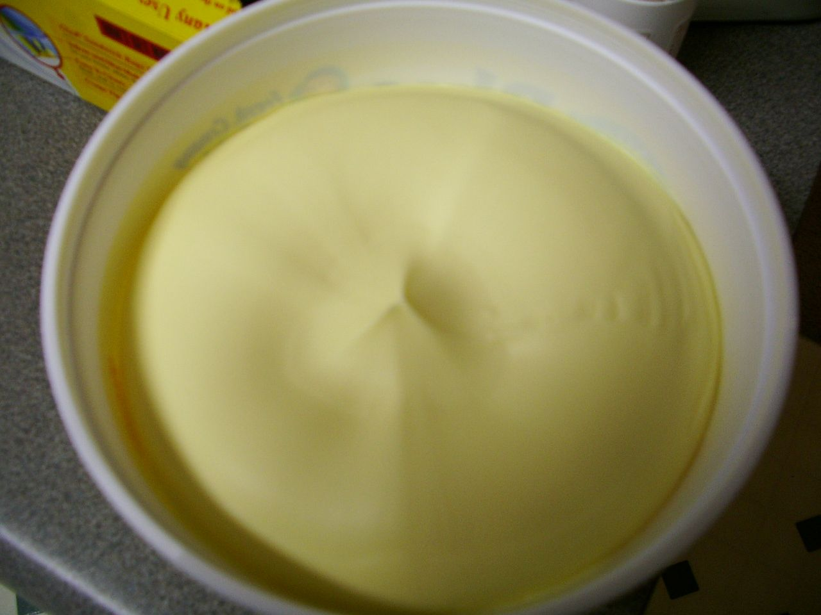
E85
E85 will have a more difficult time competing against gasoline on an energy-price equivalent basis

Slide 24
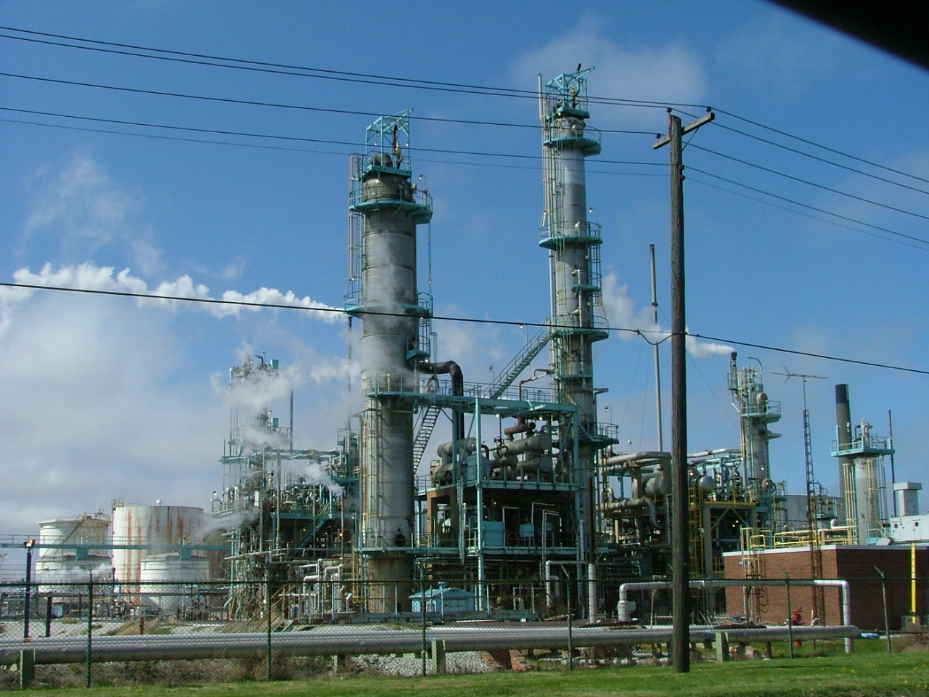
If low oil prices persist
Refiners may produce higher octane gasoline, displacing ethanol as an oxygenate

Slide 25
Should I buy diesel now…

Slide 27
Summary
The Saudis have started a price war
This is good for consumers
It has mixed impacts on biofuels
It is not good for the state’s oil industry or coffers

