Slide 2
Energy Beets
David Ripplinger
Lake Region Extension Round-Up
Devils Lake
January 7, 2015

Slide 3
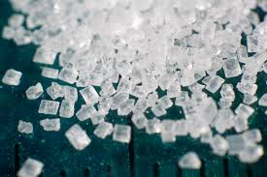
Why sugar?
Nature’s store of easily
accessible energy
Readily convertible into a number of fuels and products

Slide 4
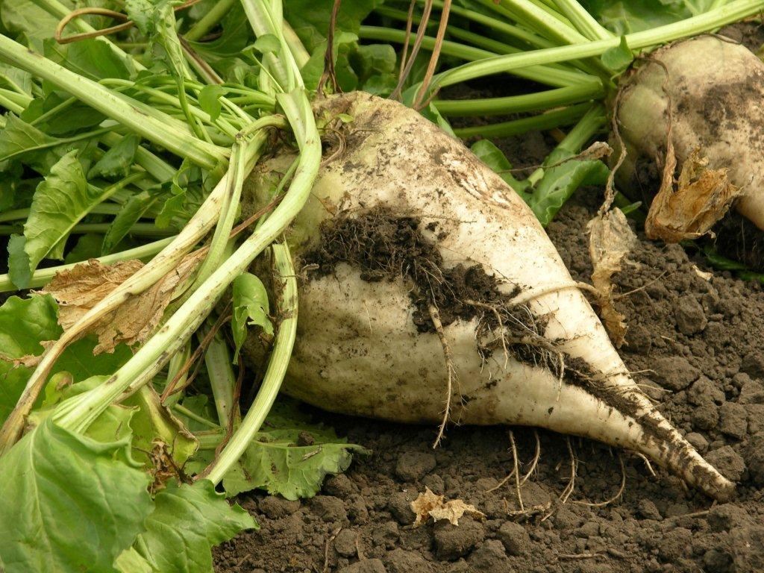
Why beets?
Northern crop
Sugar crop

Slide 5
Why the Northern Plains?
The climate is ideal - sugar yield and quality
- Daytime temps: 60 to 80 degrees
- Night time temps: 40 to 60 degrees
Free cold storage

Slide 6
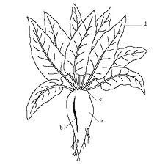
Industrial Beets Defined
Aka energy beets
Varieties of beta vulgaris bred to maximize fermentable sugar
May not meet quality standards for food production (sugar beet)

Slide 7
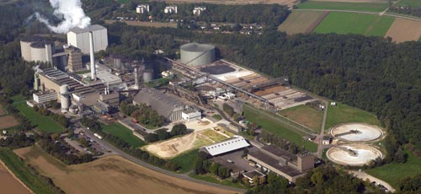
The European Experience

Slide 8
Can you grow beets outside the Red River Valley?

Slide 9
2011-2014 North Dakota Trials

Slide 10
2011-2014 North Dakota Trials

Slide 11
How much sugar is this?

Slide 12
Can you grow beets outside the RRV?

Slide 13
Herbicide Carryover
Growers must plan ahead on herbicides two to four years due to potential of carry-over damage to beets
(Similar to canola)

Slide 14
Crop Rotation
Four years to break disease cycle
Does well following wheat and barley (better emergence)
Does poorly following soybeans and dry beans (too much nitrogen)

Slide 15
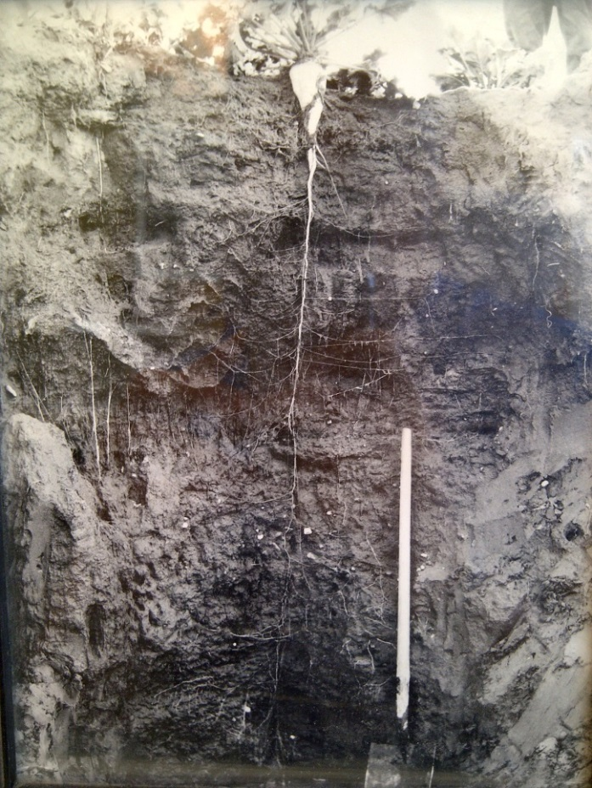
Benefits
Deep tap root can improve soil health
Allow beet to endure drought conditions
Provide access to nutrients far below the surface

Slide 16
Some Answers
You can grow no-till beets
You can grow in rocky soil (lifter, facility)
Efforts to develop crop insurance policies are underway

Slide 17
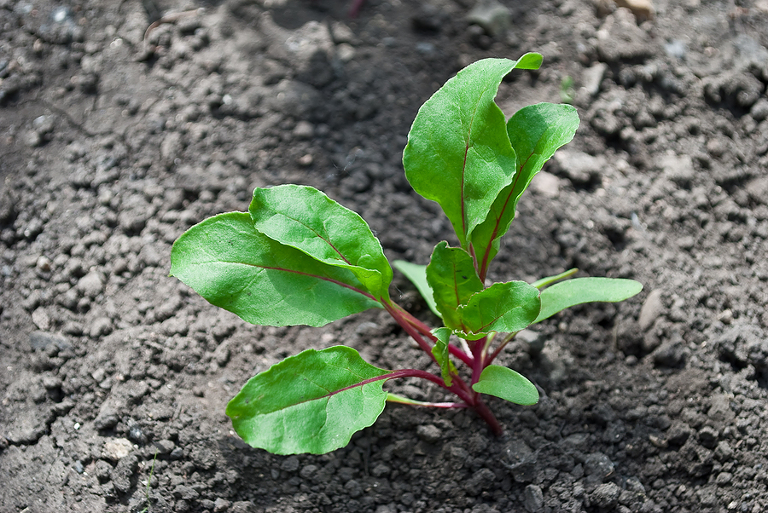
Some Concerns
Beet emergence
Soil compaction
Harvest weather
& labor needs

Slide 18
Siting
Five communities under consideration: Valley City, Jamestown, Carrington, Cando, Langdon
Facilities may produce industrial sugar or a finished product like ethanol
Notes:
Locations may produce industrial sugar feedstock or a finished product.
Processing facilities may produce:
Industrial sugar feedstock (for third party)
Ethanol
Advanced chemicals

Slide 19
Feedstock Requirements
20 MMGPY Refinery
Requires about 750,000 tons of beets
30,000 dryland acres (@25t/AC)
120,000 acres with a four-year rotation
Most feedstock sourced within 20 miles of plant
Fewer irrigated acres are needed
19

Slide 20
Growers are critical Without growers there is no plant

Slide 21
Summary
Beets show significant promise as an industrial crop
Efforts to commercialize are underway
Growers need to be ready

