Slide 2
Emerging Opportunities
AGEC 420
February 24, 2015
David Ripplinger

Slide 4
Do what you can,
with what you have,
where you are.
-Theodore Roosevelt

Slide 5
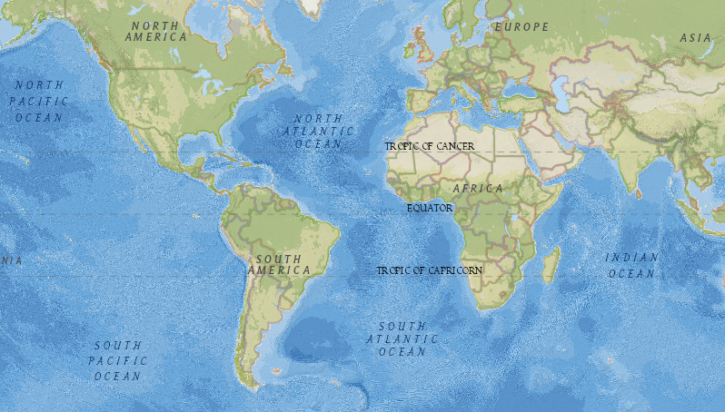
You are here

Slide 6
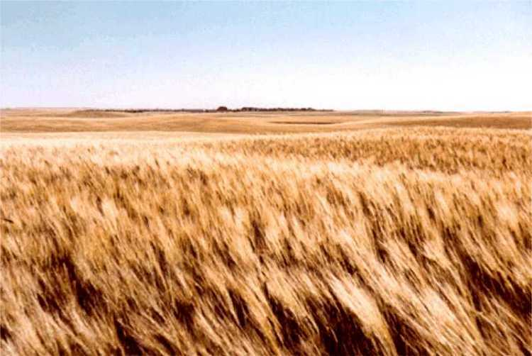
What have we got?
Arable land and pasture
Relatively short, cool, semi-arid growing season
Cold winters
Distant markets

Slide 7
When I was a kid…

Slide 8
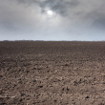

Slide 9
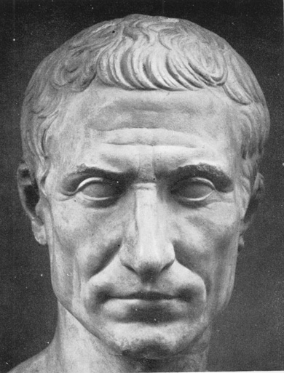
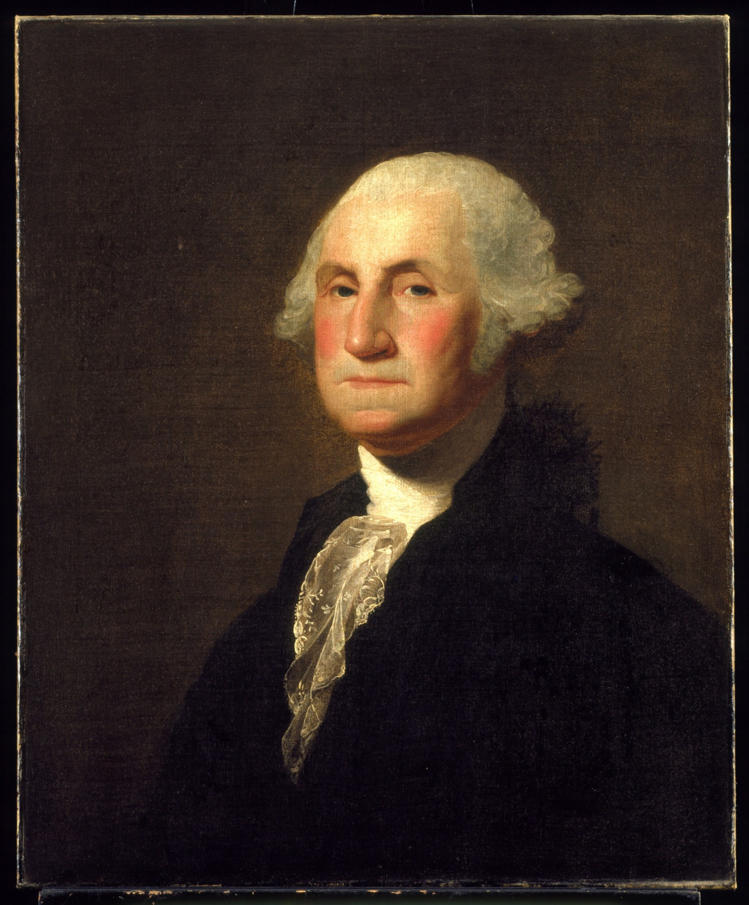

Slide 10
Question 1. When was I a kid?
1940’s
1960’s
1980’s

Slide 11
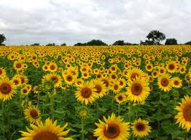
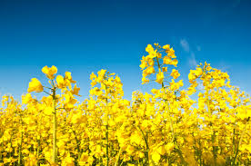
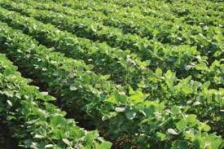

Slide 12
1982 Census of Ag-ND
Crop | Acres
Corn-grain | 500,000
Wheat | 9,800,000
Barley | 1,800,000
Oats | 900,000
Flax | 400,000
Sunflower | 3,100,000
Soybeans | 400,000
Summer Fallow | 4,900,000

Slide 13
Do you guys even know what durum is?
North Dakota planted
4.4 million acres in 1980.

Slide 15
Census of Ag-ND
Crop | Acres-1982 | Acres-2012
Corn-grain | 500,000 | 3,500,000
Wheat | 9,800,000 | 7,700,000
Barley | 1,800,000 | 1,000,000
Oats | 900,000 | 100,000
Flax | 400,000 | 300,000
Sunflower | 3,100,000 | 849,000
Soybeans | 400,000 | 4,700,000
Summer Fallow | 4,900,000 | 300,000

Slide 16
North Dakota as the swing producer

Slide 17
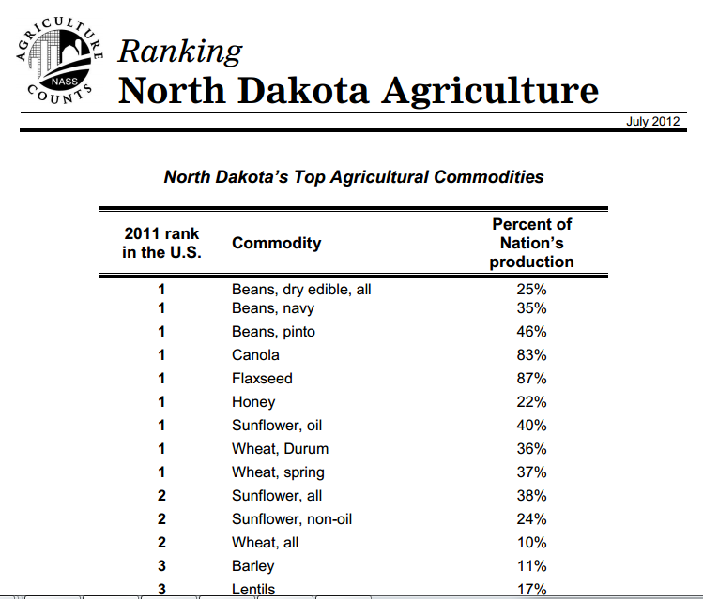

Slide 18
Question 2. A market where no participant is large enough to have the market power to set the price of a homogenous product:
Monopoly
Perfect Competition
Oligopoly

Slide 19
Question 3. It is possible for a firm to earn financial profits in a perfectly competitive firm in the long run.
True or False

Slide 20
What would you plant this year? Why?

Slide 21
What would you want or require to know
to plant a new crop?

Slide 22
Industrial/energy beets

Slide 23
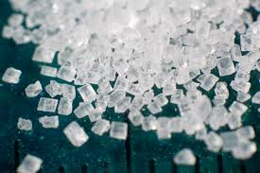
The General Idea
Sugar is
Nature’s store of easily
accessible energy
Readily convertible into a number of fuels and products
Beets are an economical way of producing sugar
Breed/engineer for sugar quantity not quality

Slide 24
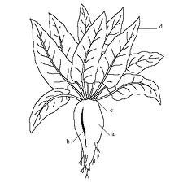
Industrial Beets Defined
Aka energy beets
Varieties of beta vulgaris bred to maximize fermentable sugar
May not meet quality standards for food production (sugar beet)

Slide 25
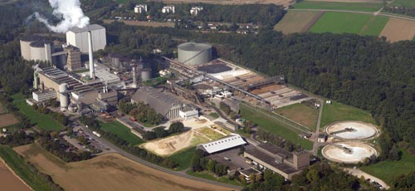
The European Experience

Slide 26
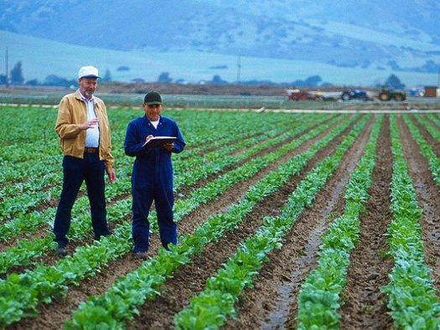
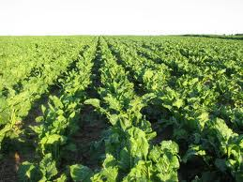
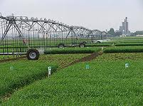
Region- Specific Energy Beet Supply Chains
Beets grow well in many agroecosystems
Supply chains will differ because of climate
Considerations
Economics
Energy use
Land use change
Environmental impacts

Slide 27
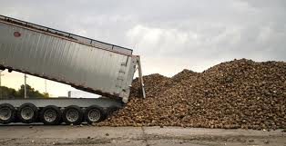
Spring Beets
-Planted in the Spring harvested in the Fall
-Dryland or irrigated production
-May be stored outdoors over winter in colder climates
Example: North Dakota
Rotation: Corn/Soybeans/Small Grain/Beets
Long days, cool nights put on sugar

Slide 28
Crop Rotation
Four years to break disease cycle
Does well following wheat and barley
Does poorly following soybeans and dry beans (too much nitrogen)

Slide 29
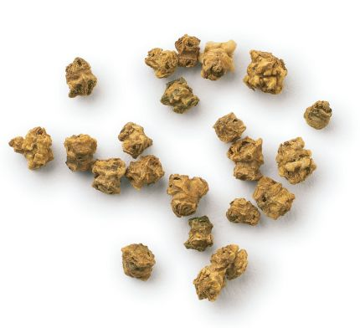
Planting
Late April - May
Small coated seeds
Newer corn & bean planters work - 22” & 30”

Slide 30
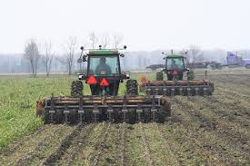
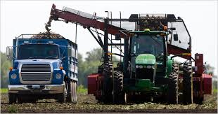
Harvest, Transport, Storage
Late September and October
Labor intense and requires specialized equipment
Topper mechanically removes foliage
Lifters pull beets from the soil
- piled at field edge
- delivered to larger pile

Slide 31
Harvest, Transport, Storage
Fall work is labor intense -
Grower managed or custom managed?
Harvest? Transportation?
Harvester rule of thumb: 100 A/row for 10-day harvest window
Example: 8-row harvester = 800 acres

Slide 32
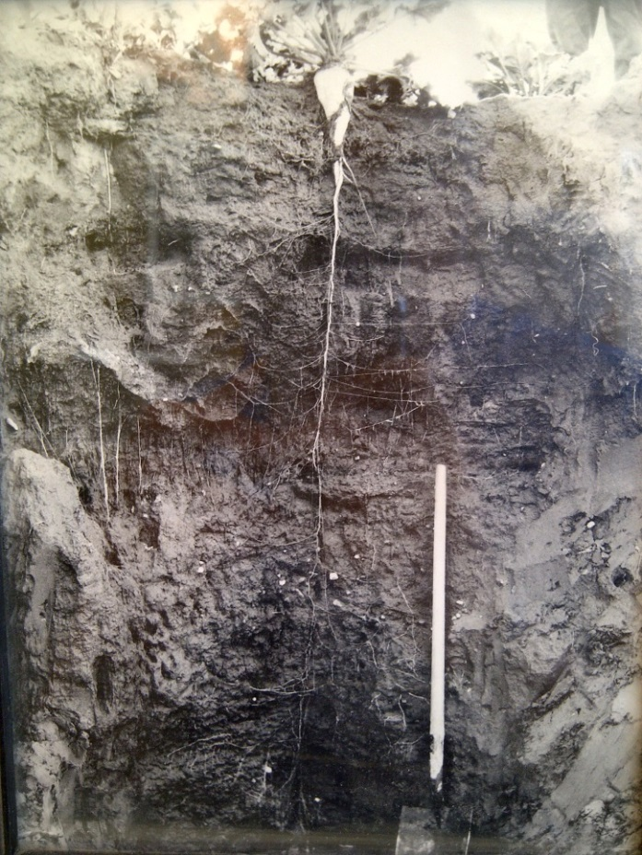
Benefits
Deep tap root can improve soil health
Allow beet to endure drought conditions
Provide access to nutrients far below the surface

Slide 33
Some Answers
You can grow no-till beets
You can grow in rocky soil (lifter, facility)
Efforts to develop crop insurance policies are underway

Slide 34
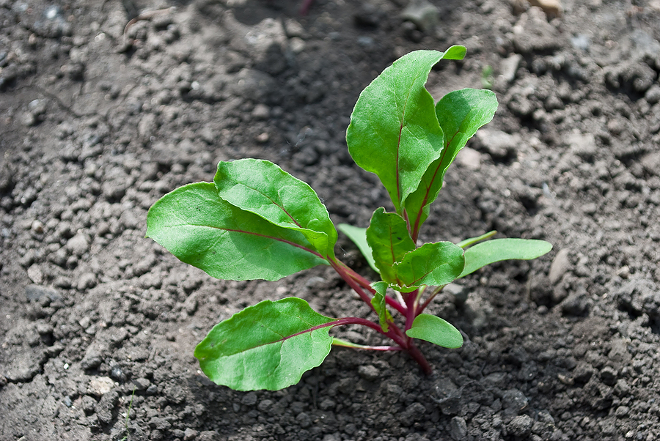
Some Concerns
Beet emergence
Soil compaction
Harvest weather

Slide 35
production economics

Slide 36
Enterprise Budget
Estimate economic profitability for individual farm/ranch enterprises.
Consider expected production costs and revenue.

Slide 37
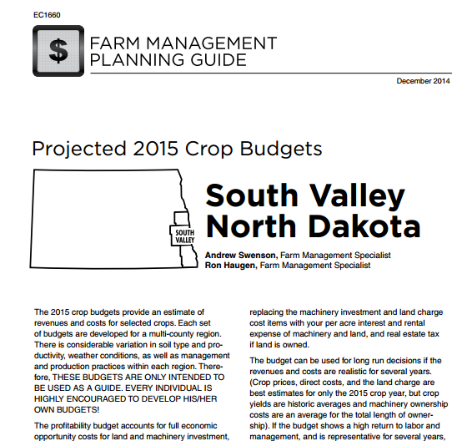
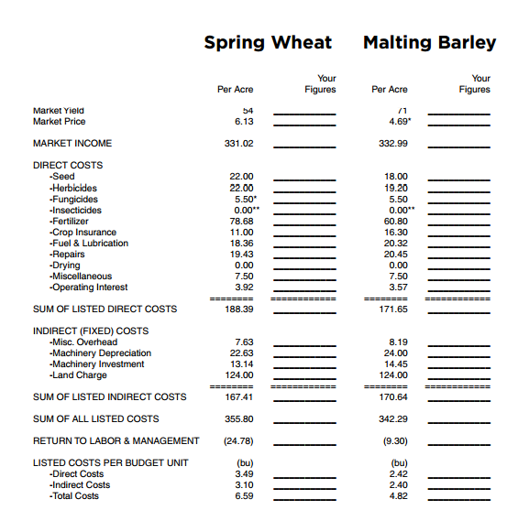

Slide 38
Industrial Beet Enterprise Budget Langdon
 | Per Acre |  | Your Numbers | Notes:
Market Yield | 25 |  | 29 | Based on yield trials & historical records
Market Price | 33.00 |  | 33.00 | 8x Corn
Market Revenue | 825.00
DIRECT COSTS
-Seed | 150.00 |  | 150.00
-Crop Chemicals | 75.00 |  | 75.00
-Fertilizer | 100.00 |  | 80.00 | Fertilizer credit
-Crop Insurance | 25.00 |  | 25.00
-Fuel & Lubrication | 65.00 |  | 65.00
-Repairs | 90.00 |  | 90.00
-Miscellaneous | 45.00 |  | 45.00
-Operating Interest | 15.00 |  | 15.00
SUM OF LISTED DIRECT COSTS | 565.00 |  | 545.00
INDIRECT (FIXED) COSTS
-Misc. Overhead | 60.00 |  | 60.00
-Machinery Int. & Dep. | 75.00 |  | 60.00 | Some used equipment
-Land Charge | 55.50 |  | 60.00
SUM OF LISTED INDIRECT COSTS | 229.00 |  | 180.00
SUM OF ALL LISTED COSTS | 55.50 |  | 725.00
RETURN TO LABOR & MGMT | 69.50 |  | 232.00
LISTED COSTS PER BUDGET UNIT | (t) :
-Direct Costs | 22.60
-Indirect Costs | 9.16
-Total Listed Costs | 31.76

Slide 39
Partial Budgets
Used to compare costs and benefits of alternatives faced by farm business.
Focuses only on changes.
For example, growing a new crop…
http://pubs.cas.psu.edu/freepubs/pdfs/ua366.pdf

Slide 40
Steps.
State the proposed change
List the added returns
List the reduced costs
List the added costs
List the reduced returns
Summarize the net effect
Consider non-financial factors.

Slide 41
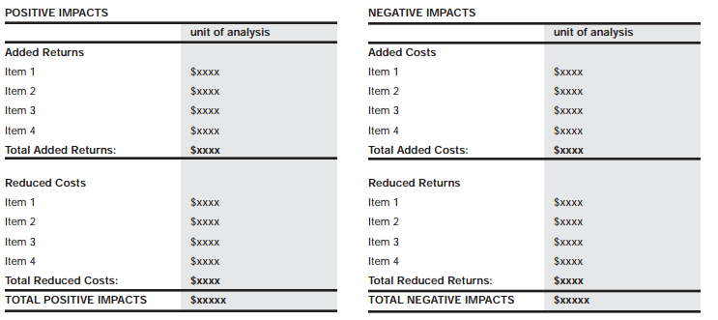
PROS
CONS

Slide 42
Example
Proposed change:
Added returns:
Reduced costs:
Added costs:
Reduced returns:
Marriage
Love and affection
Household chores
Mother-in-law
Must grow up

Slide 43
Partial Budget
Partial Budget Langdon
Scale | 160 |  | acres
A. Added Income |  |  |  |  | C. Added Costs
Yield | 25 |  |  |  |  | 700
Price | 33
Revenue | 132000 |  |  |  |  | 112000
B. Reduced Costs |  |  |  |  | D. Reduced Income
 |  | 244 |  |  | Yield | 1720
 |  |  |  |  | Price | .2
 |  | 38960 |  |  | Revenue | 55040
Net Change
A+B-C-D |  | 3920 |  |  | Per Acre | 24.50

Slide 44
Partial Budget Langdon
Scale | 160 | acres
Added Income |  |  |  | Added Costs
Yield | 29 |  |  |  | 665
Price | 33
Revenue | 153120 |  |  |  | 106400
Reduced Costs |  |  |  | Reduced Income
 | 244 |  |  | Yield | 1720
 |  |  |  | Price | 0.20
 | 38960 |  |  | Revenue | 55040
Net Change | 30640 |  |  | Per Acre | 191.50

Slide 45
Remember to consider non-financial factors!

Slide 46
Wrap-up
Change and adaptation are part of production agriculture, especially in the northern plains

