Slide 2
The Economics of Biomass Combined Heat & Power
David Ripplinger
Bioenergy Specialist
NDSU Extension
Minnesota Renewable Energy Roundtable
Rochester, MN
July 17, 2015

Slide 3
CHP Basics
Generating electric power and useful energy from a single fuel source
35% Efficient
80% Efficient
70% Efficient
Notes:
Recover otherwise wasted thermal energy to produce useful thermal energy or electric power.

Slide 4
Source: ICF CHP Database

Slide 5
CHP Benefits: Economic
Lower cost Less price variability
Source: Energy Information Administration

Slide 6
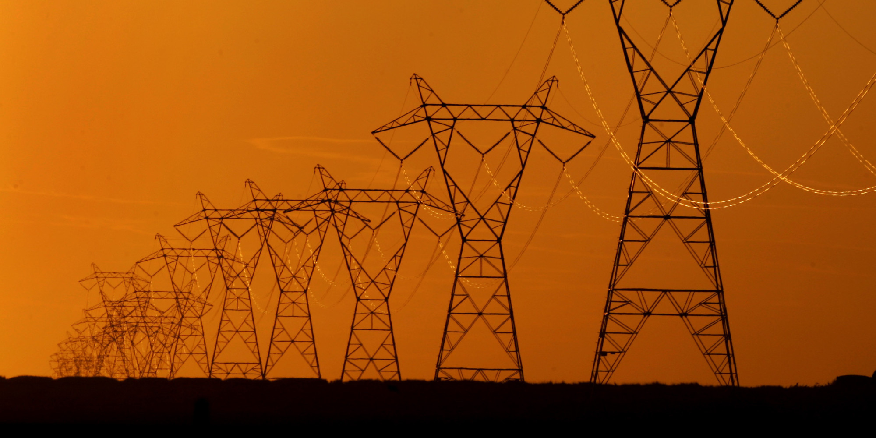
CHP Benefits: Efficiency
Recover otherwise wasted thermal energy
Takes place closer to energy consumer- lower losses to transmission & distribution

Slide 7
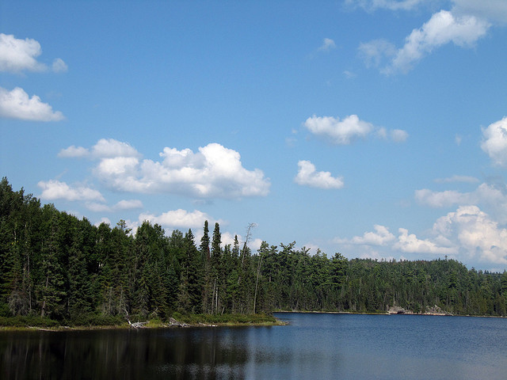
CHP Benefits: Environmental
More efficient energy use
Lower carbon fuels
→Lower greenhouse gas
emissions!

Slide 8
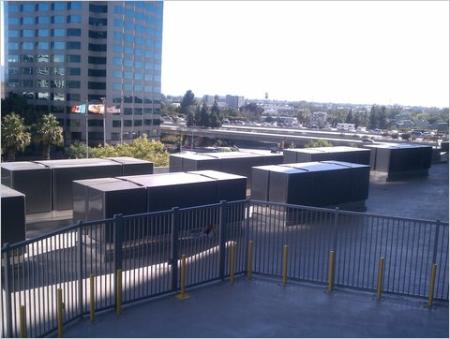
CHP Benefits: Resiliency
For those businesses whose operations depend on reliable power
-Adobe Biogas Fuel Cells

Slide 9
Why Biomass?
Energy cost savings
Greenhouse gas reductions
Local economic development
Reduced supply risk

Slide 10
When does CHP work best?
High electricity prices
Deregulated electricity markets
Firms with
-Regular operations
-Regular thermal loads
-Existing central plant
-Central plant equipment replacement or major construction planned
-Reliability concerns
-Environment

Slide 11
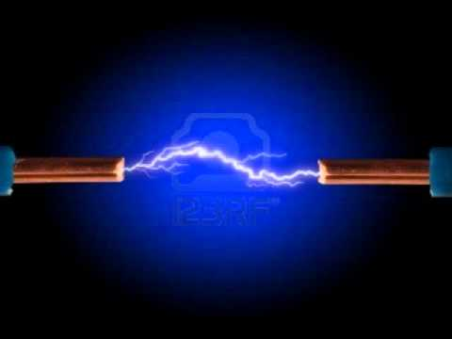
Determining Feasibility: The Spark Spread

Slide 12
Spark Spread
=
+
-

Slide 13
Spark Spread
=
+
-
Avoided cost of power ($/kWh)
Avoided cost of thermal fuel ($/MMBtu)
CHP fuel price ($/MMBtu)
÷
x
Boiler efficiency (%)
CHP heat rate (MMBtu/kWh)
÷
.1
Power-to-heat ratio
÷
3,413 MMBtu/kWh

Slide 14
Spark Spread
=
+
-
$.08/kWh
$6/MMBtu
$5/MMBtu
÷
x
80%
.0141 MMBtu/kWh
÷
.1
÷
3,413 MMBtu/kWh
$.03/kWh =
$.08/kWh
$.02/kWh
$.0705/kWh

Slide 15
You may have a CHP project if
the spark spread is positive
…we didn’t account for
capital costs and O&M.

Slide 16
Adding the Cost of Capital
Assumptions
Electric Capacity (MW) 3
Annual Operating Hours 8,000
Capital Cost $18,000,000
Cost of Capital 8%
Calculations
Cost per kW $6,000
Cost per kWh $.06
+ O&M from $.02 to $.10+/kWh

Slide 17
Sensitivity Analysis
Prices: electricity, boiler fuel, CHP fuel, capital, O&M
Technology: boiler efficiency, power to heat ratio, CHP heat rate
Project scale and scope
Alternative fuels

Slide 18
What about risk?
Price risk
Supply risk
Policy risk
Operating risk

Slide 19
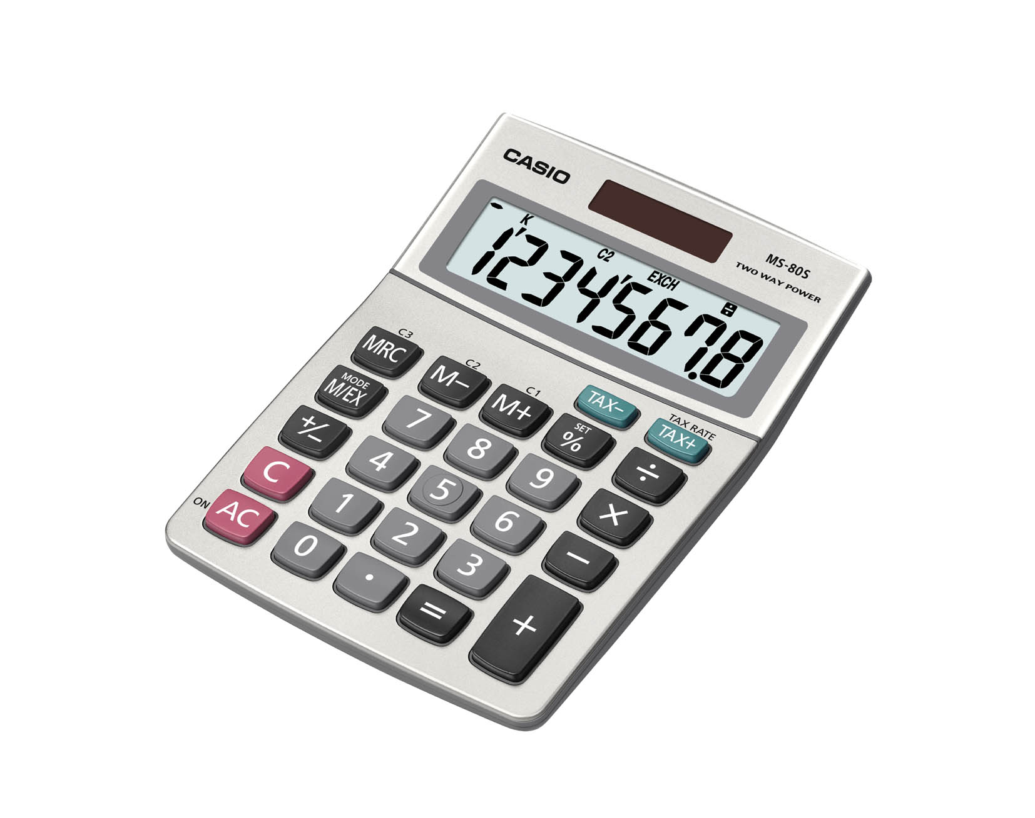
What about emissions?
Calculate the spark spread using carbon instead of financial accounting
Price using a carbon price (eg $20 MT/CO₂e)

Slide 20
Green
Spark Spread
=
+
-
Avoided GHG emissions of power
(g CO_{2 e}/kWh)
Avoided GHG emissions of thermal fuel
(g CO_{2 e}/MMBtu)
CHP GHG emissions
(g CO_{2 e}/MMBtu)
x
÷
CHP heat rate (MMBtu/kWh)
Boiler efficiency (%)
÷
Power-to-heat ratio
÷
3,413 MMBtu/kWh

Slide 21
!
Someone needs to get EPA better biomass carbon emissions values for their CHP emissions calculator ASAP!

Slide 22
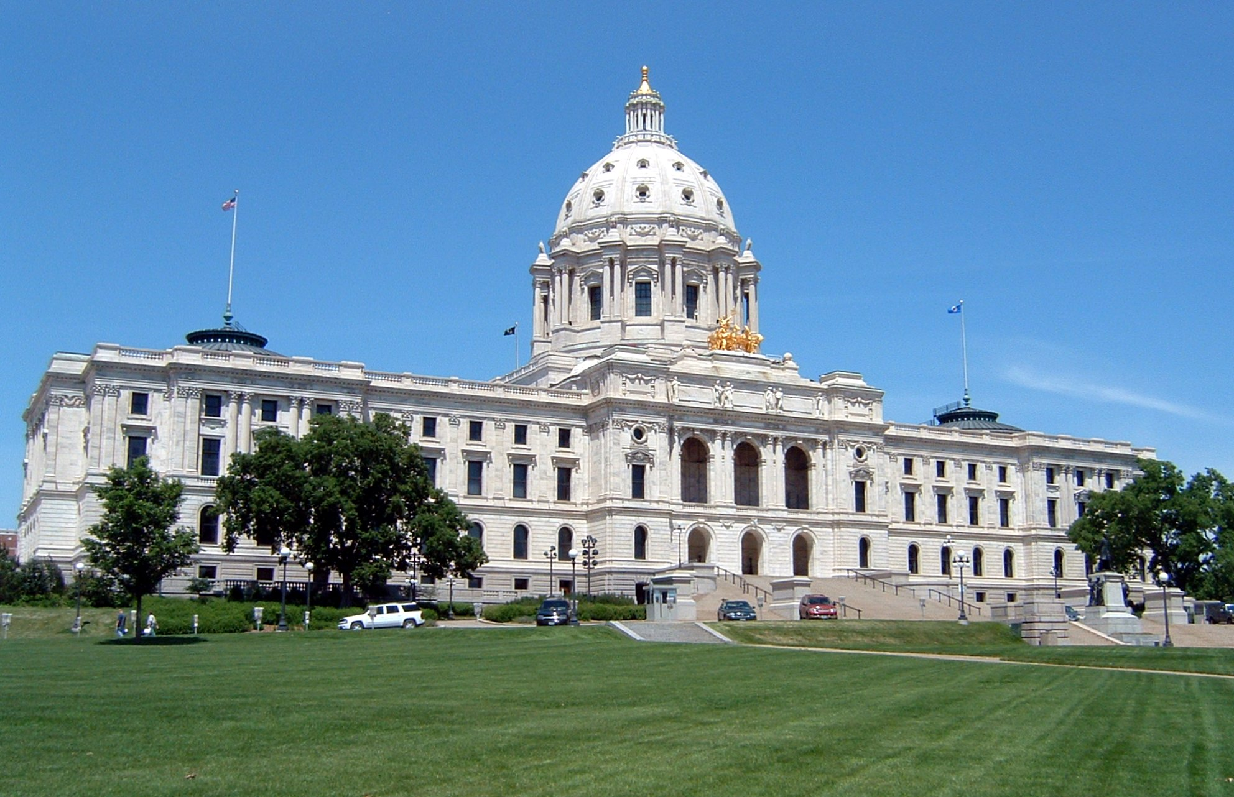
CHP Policy
Federal
Tax Incentives
Financing (§1703)
Boiler MACT
§111(d)
State
Next Generation Energy Act (MN)
RPS
CIP
Net metering
Standby
Incentives/financing

Slide 23
Summary
Know the basics
Calculate the spark
Follow policy developments

Slide 24
David Ripplinger
Bioenergy Specialist
david.ripplinger@ndsu.edu
701.231.5265

