Slide 2
Energy Outlook
Ag Lenders Conference
October 2015
David Ripplinger

Slide 3
Corn ethanol

Slide 4
Corn Ethanol Key Factors
Low energy prices
Large corn stocks
Increasing motor gasoline consumption
Positive margins
High production

Slide 5
Source: Energy Information Administration

Slide 7
Source: Energy Information Administration

Slide 8
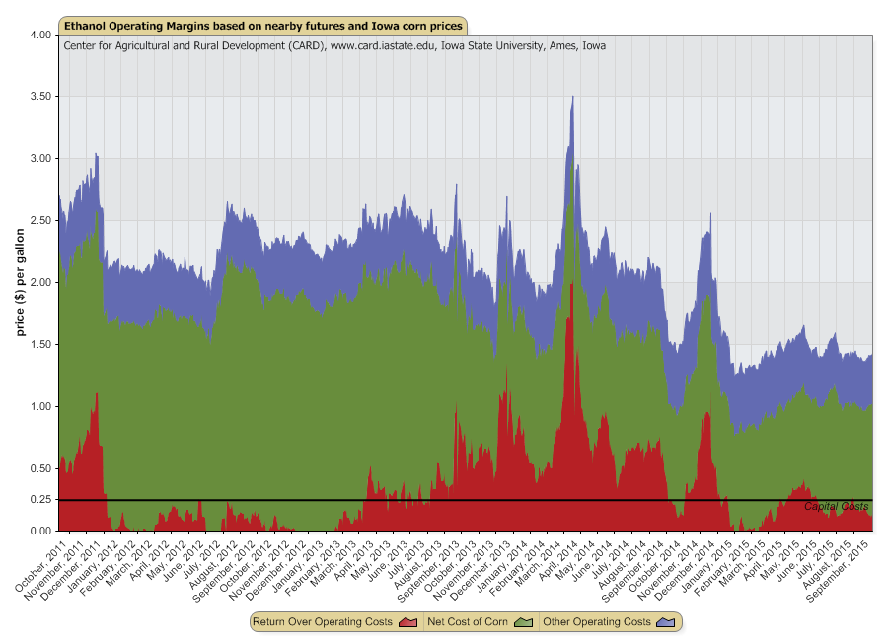

Slide 9
Source: Energy Information Administration

Slide 10
RFS
-EPA announced 2014, 2015, and 2016 mandated volumes in late May
-Used blend wall as justification
2014-2016 Mandated Levels, billions of gallons
 | 2014 | 2015 | 2016
Statute | 14.4 | 15 | 15
Revised | 13.25 | 13.4 | 14

Slide 11
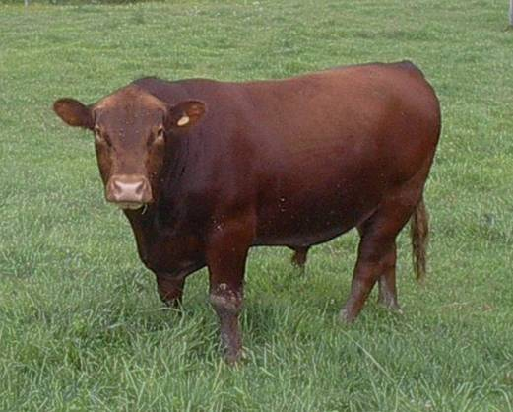
An Analogy

Slide 12
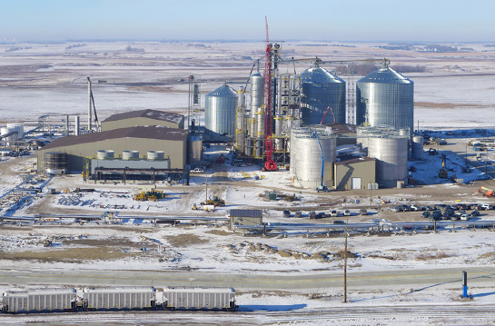
Spiritwood, North Dakota
-65 mmgpy corn ethanol refinery
-co-located with coal-fired power plant
-began accepting corn early spring
-operating this summer

Slide 13
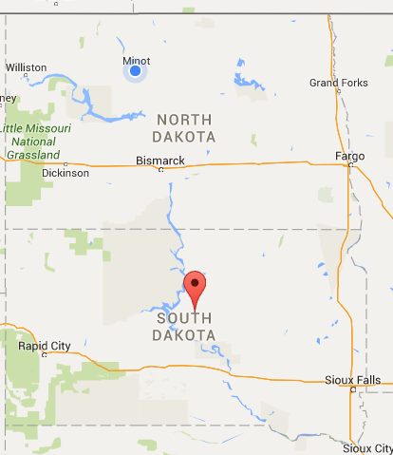
Onida, South Dakota
-Proposed 70 mmgpy corn ethanol plant
-A corn-basis play
-Currently raising funds

Slide 14
Corn Ethanol Short-Term Outlook
14.5 billion gallons ethanol produced
(record/near record)
800 million gallons exported
5.2 billion bushels of corn used
45 million short tons of DGs

Slide 15
Corn Ethanol Long Term Outlook
RFS is non-binding
Gasoline use continues to grow
Corn continues to be ‘low-cost’
Corn-ethanol refineries can make 20% reduction in greenhouse gas emissions
1% increase in ethanol production
-> one new refinery on average each year

Slide 16
Biodiesel Roller Coaster Continues
It appears that the biodiesel tax credit will be re-enacted…

Slide 17
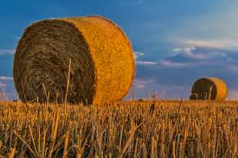
Cellulosic Ethanol
Three plants built
None operating at full capacity

Slide 18
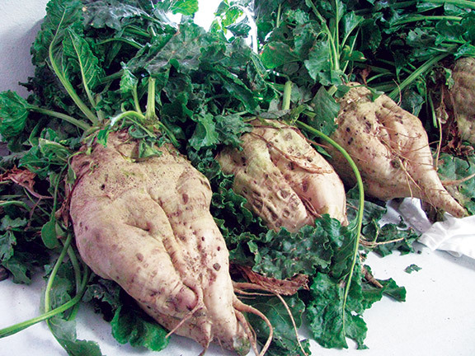
Diving in Feed First
Interest in energy beet development remains
Activities in ND and CA have slowed; Projects in the SE have advanced
What about feed?

Slide 19
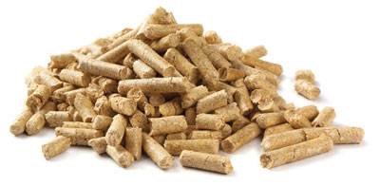
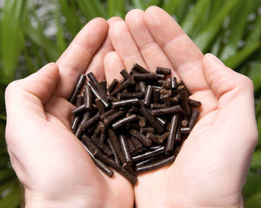
Solid Biofuel/Biomaterials
High solid biofuel fuel prices persist
Use of crop residue a possibility
Use of torrefied biomass as a fuel (co-fired at coal power plant) or plastics

Slide 20
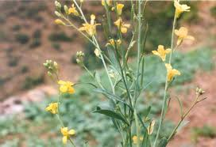
Carinata-Jet Fuel
Being grown under contract in western North Dakota
Target is ‘marginal’ land
Used for green jet fuel

Slide 21
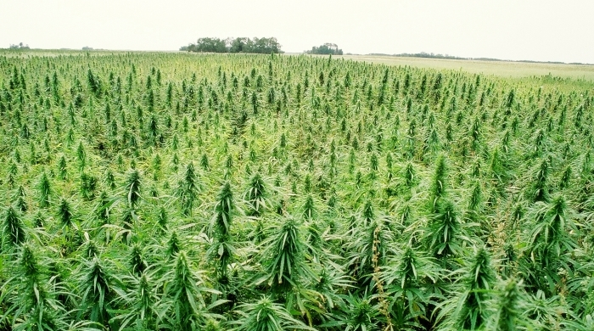
Hemp
Farm Bill has opened door for production
Currently part of research
NDSU had a plot in Langdon
Many uses
Commercial viability?

Slide 22
Cattails
Interest in harvest – water impoundments, wetlands
How can it be used?
solid biofuel, material…

Slide 23
Oil
[SOMETHING ABOUT HISTORY REPEATING ITSELF…]

Slide 24
The Organization of Petroleum Exporting Countries (OPEC) looks to stabilize oil revenues.
Not only to keep prices high…
Notes:
OPEC was established in 1960 to stabilize oil revenues among member nations.
Traditionally we think of them as behaving as a cartel – limiting supplies to keep prices high, but that isn’t always the case.

Slide 25
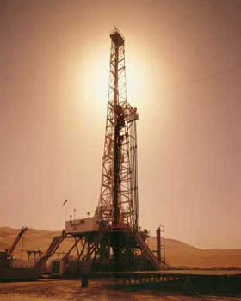
Late 70’s/early 80’s
OPEC limited production to keep prices high
Saudi Arabia cut production significantly
Notes:
For example in the late 1970’s and early 80’s OPEC wanted to limit production to some extent to drive up prices.
The problem with OPEC, like most cartels, is that there is an incentive for individual members to cheat.
What happened in this case was Saudi Arabia kept cutting production from nearly 10 mmbbl/day to 2.5 mmbbl/day.

Slide 26
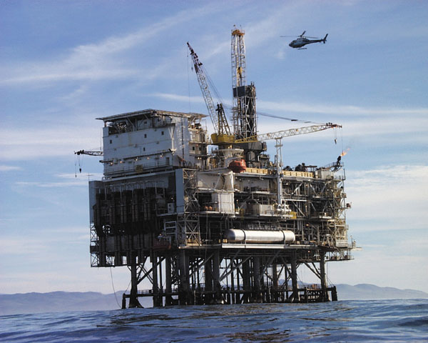
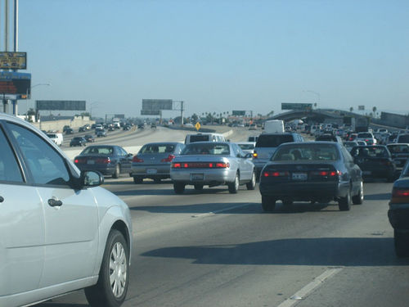
High Prices
Higher cost alternative sources
Less driving
Notes:
The effect of reduced oil production was an increase in global oil prices.
This led to the development of North Sea/off-shore oil development, and increased fuel economy of American vehicles.

Slide 27
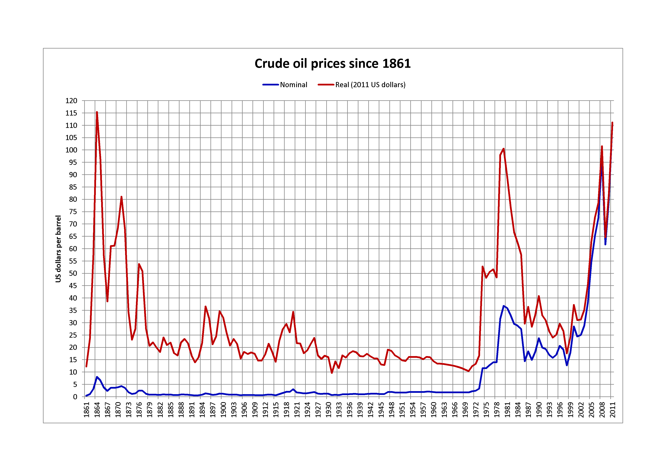
Saudi Response
Increase production to gain market share.
Oil prices fell 2/3^{rds}! in 1985-1986
Notes:
By 1985 Saudi Arabia had enough and decided that it increase production to gain market share.
This led oil prices to fall by 2/3rds from 1985 to 1986.
This led to a major disruption of a number of oil companies, many of which filed for bankruptcy.

Slide 28
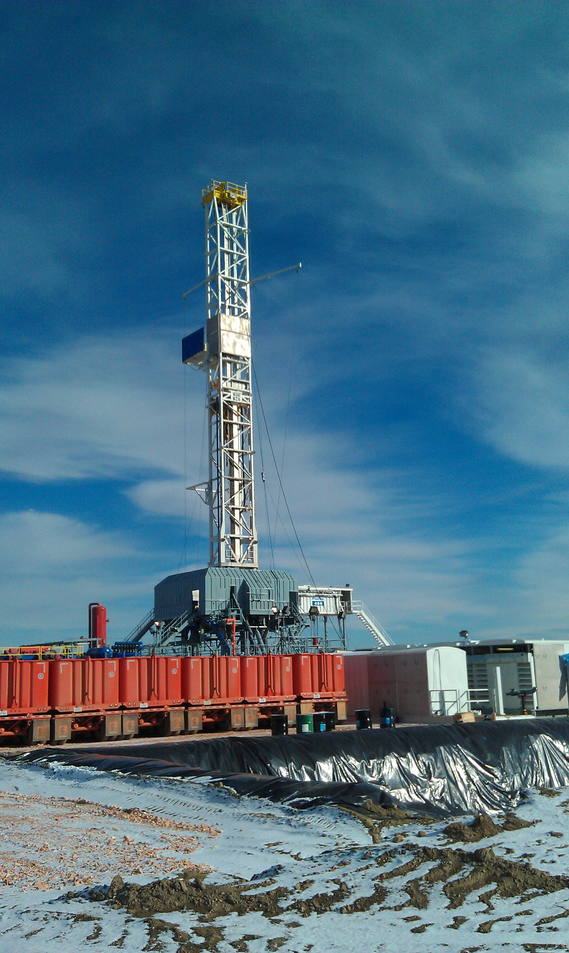
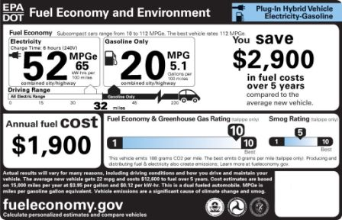
2014:History Repeats Itself (again)
OPEC members overproducing
Shale oil/renewables
Slumping demand in East Asia
Saudi Arabia goes for market share
Notes:
Today, history is repeating itself very closely.
OPEC members have been producing above their quotas, leading to a slow build up in global supplies.
High prices of oil led to the development of shale oil, including the Bakken Field in North Dakota.
Like in 1985, Saudi Arabia decided that it wanted its market share back, in this case continuing to produce oil above….
Something about 2 million gallons.
What to do with those gallons. We either need increased consumption or decreased production or both. Balance. Building pools/glut.

Slide 29
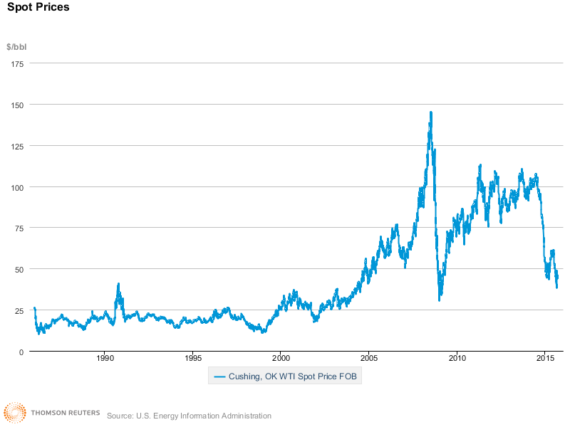
How low?
West Texas Intermediate is below $50 – half of its 2014 high of $101
Notes:
A question among investors and economists is how low with this go.
Doesn’t appear that we’ve found a price at which the market can clear.
They announced their plans to continue production on Thanksgiving, when price was $70/bbl. It has now fallen below $50.
We can look back to earlier in the year when their were signs of overproduction and growing supplies.
Saudi Arabia has given no clues as to how low they will tolerate oil to fall, making comments about willingness to see $30, $20, or lower prices.

Slide 30
How long?
A few months?
A year to 18 months?
Longer?
Notes:
When we hit the low. I don’t think we’re there yet. How long will it last.
Many believe that Saudi Arabia doesn’t have the appetite for this to last long. They have $750 billion in assets that make me think otherwise.
It took almost two decades for the real price to recover from the 1985 change.

Slide 31
What about the Bakken? ND Light Sweet: $34.5 10/14/15

Slide 32
 | 11/14 be | 11/14 Rigs | 8/15 be | 8/15 Rigs
Billings | $56 | 3 | $28 | 0
Bottineau-Renville | $61 | 5 | $85 | 2
Bowman-Slope | $75 | 1 | $85 | 2
Burke | $87 | 2 | $82 | 0
Divide | $104 | 6 | $81 | 3
Dunn | $29 | 27 | $24 | 11
Golden Valley | $87 | 0 | $64 | 0
McKenzie | $30 | 72 | $27 | 26
McLean | $73 | 0 | $25 | 0
Mountrail | $45 | 31 | $43 | 13
Stark | $38 | 2 | $41 | 1
Williams | $39 | 39 | $38 | 16

Slide 33
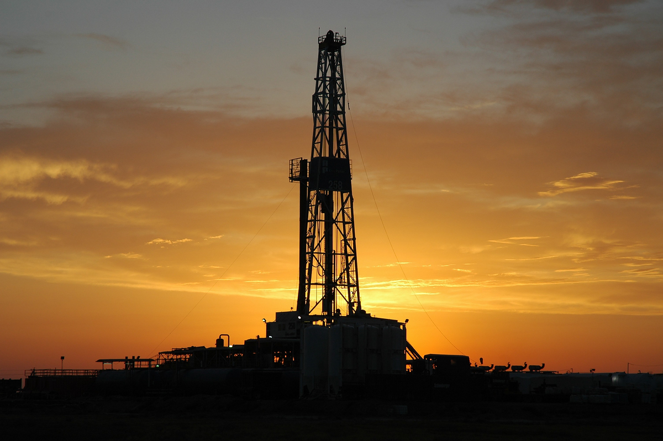
Rig Count
Now below 70 rigs
Down from 180 the last Friday of November
Oil production down slightly around 1.2 million bbls/day

Slide 34
Outlook
Tremendous uncertainty regarding a short-term price, some saying WTI into the $20s.
Uncertainty of how long new low-price regime will last.

Slide 35
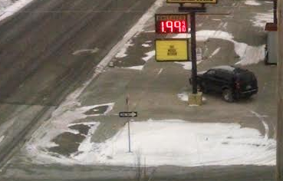
The Good news

Slide 36
Consumer Impacts
Regular gasoline (PADD 2, EIA)
$3.29 9/22/14 $2.21 9/21/15
12,000 miles per year, 24 mpg, 500 gallons
-> ‘savings’ of $535

Slide 38
Questions?

