Slide 2
Sugar Beets as an Industrial Feedstock
David Ripplinger
May 3, 2014
Fargo, ND
Notes:
Good morning.
My name is David Ripplinger.
I am North Dakota’s bioenergy economist. My job is to work with farmers and business to identify new opportunities in bioenergy and to keep existing bioenergy businesses profitable.
Today I’m going to talk about using sugar from sugar beets as an ingredient to produce fuel and other chemicals. These ‘industrial’ uses of sugar are in high demand today.

Slide 3
Agenda
Industrial Sugar Defined
The European Experience
A Global Opportunity
North American Projects
Considerations
Notes:
I’ll begin by explaining some basics about the use of sugar as an ingredient to make fuels and chemicals.
Next, I’ll describe Europe, which has long produced sugar beets, and its transition from using beets for making food only to making food and fuel.
Then I’ll discuss the new global opportunity for low-cost, ‘green’ sugar and what it means for sugar beets.
After that I’ll discuss what we are doing in the United States to develop an industrial sugar system that is separate from that used to make food.
I’ll conclude with consideration of issues associated with using sugar beets to produce fuels and chemicals.

Slide 4
Industrial sugar

Slide 5
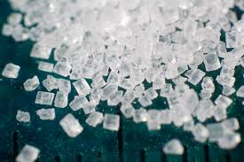
The Idea
Sugar is
Nature’s store of easily
accessible energy
- Plant
- Food
Notes:
The idea behind using sugar as an ingredient for producing fuel and chemicals is the same chemistry for why plant’s produce it and humans consume it.
Sucrose is a readily accessible source of energy. Plants and animals can easily use it as energy.

Slide 6
The Idea
Sugar is
readily convertible into a number of fuels and products
‘industrial sugar’
Notes:
Just as plants and animals can readily access sucrose for energy, yeast and other organisms and easily convert it to fuel and other, more valuable chemicals.
The obvious example is the production of alcohol (ethanol) using yeast, but there are many other opportunities. There are a number of biotechnology companies, especially in the United States that have technology to convert sugar to renewable fuel and chemicals.

Slide 7
The Idea
Sugar beets are an economical way of producing sugar
Especially in northern/cool weather regions
Notes:
Sugar beets are very efficient producers of sugar. We see this from sugar beet production around the world.
Sugar beets are a cool season crop and produce high yields in northern areas around the globe.

Slide 8
The Idea
Sugar beets are an energy efficient producer of sugar
Notes:
One of the advantages of sugar beet is that is an energy efficient producer of sugar.
Farmers and others may not always think of it this way, instead they see it as a profitable crop.

Slide 9
What Makes a Product ‘Green’
Has a lower negative environmental impact than related products
Energy use and greenhouse gas emissions associated with its production
Notes:
I’ll speak occasionally about ‘green’ products. Green is defined as products or services that have smaller negative environmental impacts that competing products.
Greenhouse gas emissions are usually the primary consideration.
We can measure the greenness of product. Many consumers are willing to pay more for green products.

Slide 10
The European Experience

Slide 11
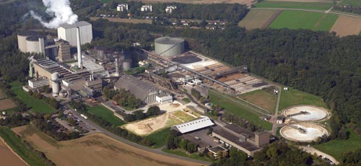
The European Experience

Slide 12
Europe has long had a domestic sugar beet industry
Notes:
Europe is the home of the global sugar beet industry.
They were the first to identify and develop beets as a sugar crop.
A large system of farms, factories, and supporting industries developed there from about the mid 1850’s to today.

Slide 13
Change in policy
Farmers wanted to keep growing beets
Sugar mills were already there
Notes:
About a decade, European agricultural policy changed removing much of the support for sugar beet production.
However, farmers wanted to continue to grow beets, in part because of its rotational benefits as well as because they had experience with the crop.
Also, the sugar factories were already built, they too wanted to continue to operate.

Slide 14
The reaction
Add a fermentation unit to the mill
Flexible system allowing production of food or fuel depending on profitability
Notes:
In response, fermentation units were added to many factories.
This provided those factories with the ability to produce ethanol OR sugar human consumption depending on profitability.
This system of food/fuel producing factories remains in place today.

Slide 15
A Global search

Slide 16
The Global Search
Search for low-cost, environmentally friendly products
High energy prices
Concerns about the environment – especially climate change
Notes:
At about the same time that European agricultural policy changed, a number of other events occurred..
First, energy prices, especially oil rose dramatically.
Second, concerns about the environment, especially climate change led many voters and consumers in wealthy countries to reconsider the impacts of the use of fossil fuels and look to cleaner, renewable sources.

Slide 17
The Global Search
Renewable energy policies
Consumer demand
Notes:
In response, a number of nation’s created policies that supported the use of renewable energy.
Many consumers began showing even stronger preferences for products that were environmentally sustainable.
To meet the demands of consumers and renewable energy policies, the search for low-cost, ‘green’ fuels and chemicals began.

Slide 18
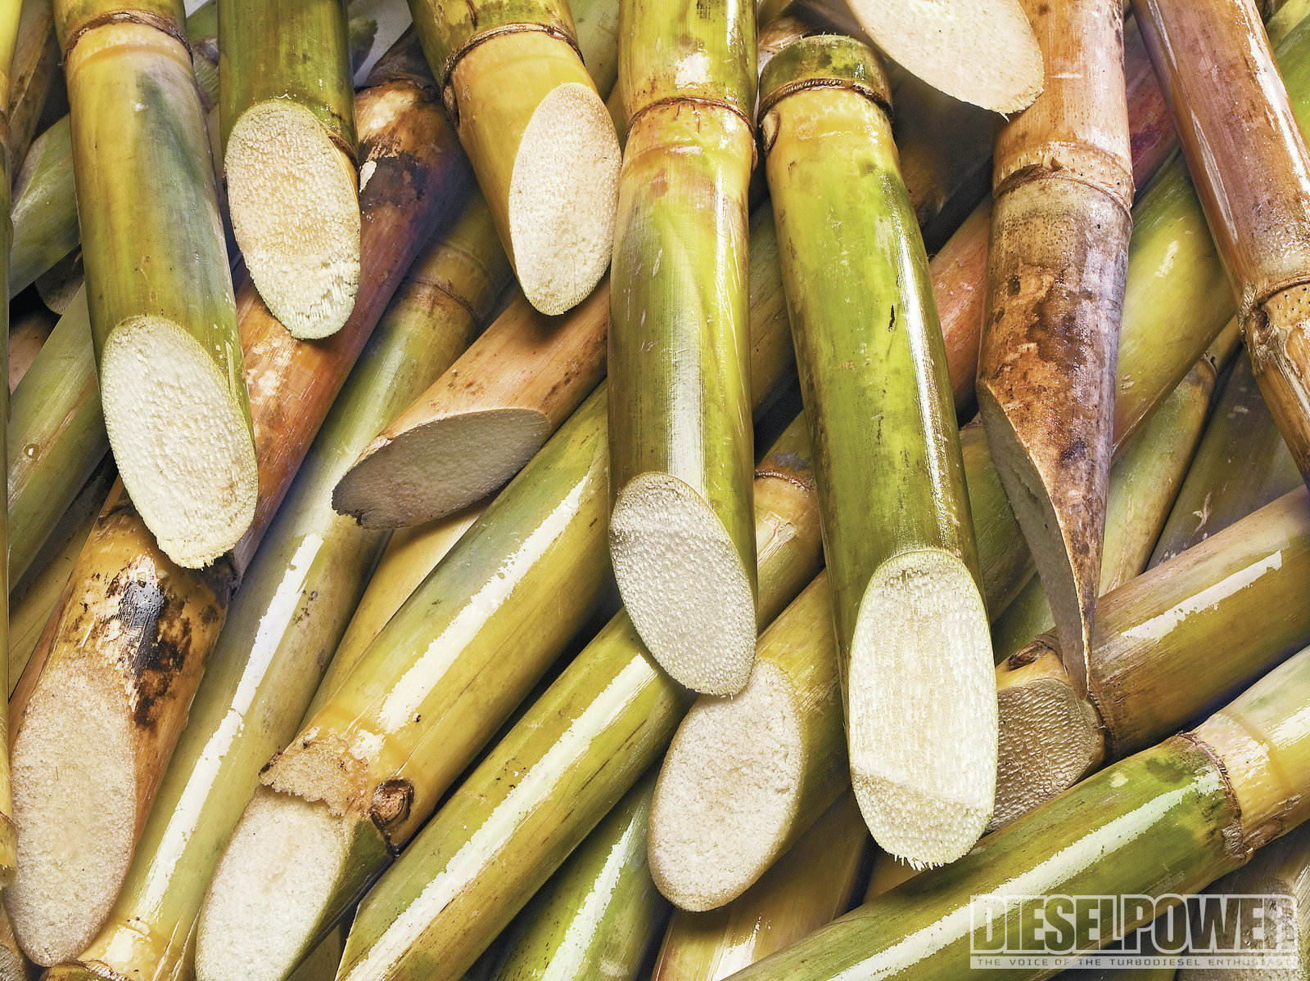
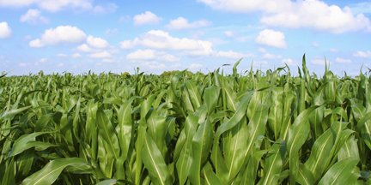
What we found
Brazilian sugar cane
North American corn
Notes:
The first place most businesses looked was Brazil as it had long been a low-cost producer of sugar for human consumption.
However, the cost of sugar production in Brazil was rising taking away its advantage.
The next best alternative to Brazilian sugar cane is US corn. However, it has some disadvantages. One it is used for food and feed, which many consumers and voters do not like. Also, corn is a starch crop. This starch must be converted to sugar which is costly and requires considerable energy, making the resulting sugar less ‘green’.

Slide 19
US Plans

Slide 20
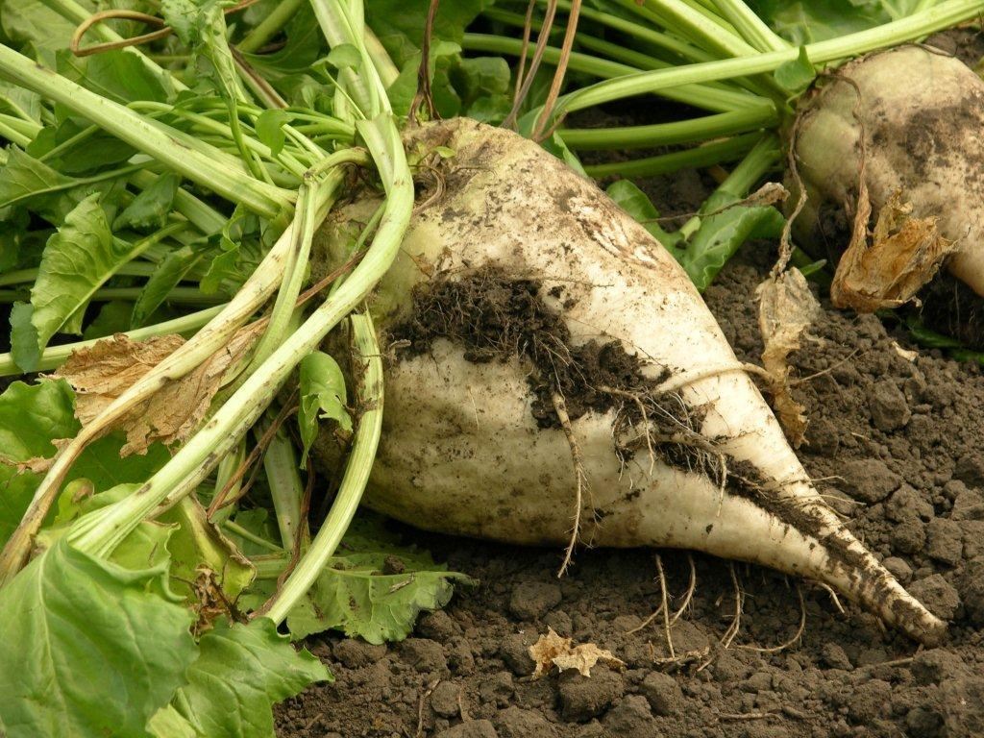
US Plans
Develop beet-industrial sugar systems that are separate from food sugar systems.
Food versus Fuel
Notes:
In response to the global need for low cost, green energy, US project developers have taken a unique approach.
They are working to develop separate systems that convert beets into industrial sugars. Unlike the European model, there will be no overlap with food sugar production.
One reason for this is the issue of food versus fuel. This issue relates to concerns of consumers and voters in that food crops should not be used to produce fuel as it will impact the diets of low-income individuals

Slide 21
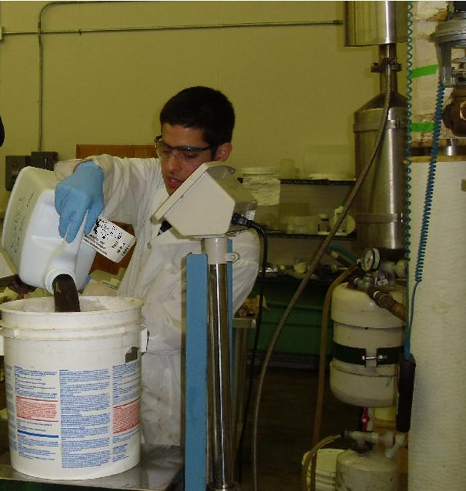
Research
Re-engineering the traditional sugar beet to food process
Profitably produce industrial, not food grade sugar
Breeding
Harvesting and Storage
Processing and Juice Storage
Notes:
A number of research projects are underway across the United States to design a beet to industrial sugar system that is profitable and energy efficient.
This includes breeding/seed selection for varieties of beets, changing harvesting and whole beet storage, as well as processing the storing the resulting juice.
There are many potential opportunities to improve the system, as industrial grade sugar has lower standards than food grade sugar.

Slide 22
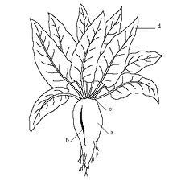
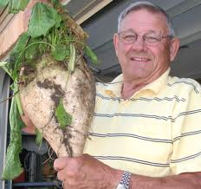
Industrial Beets
Varieties of beta vulgaris bred for sugar quantity
May not meet quality standards for food production (sugar beet)
Higher sugar yield than fodder beets
Notes:
Selection of varieties of beets with high levels of sugar has occurred and been planted in yield trials across the united states.
High levels of impurities are acceptable as the beet will be used to produce industrial sugar.

Slide 23
Front-End Processing
Pulp for pellets
Beets
Hammer mill
Modified ribbon mixer with hot water spray
Chamber filter press
+
Juice for biofuel
Beet to juice and pulp
Notes:
One area of research is front-end processing – those activities that extract sugar from the beet.
The tradition food sugar processes are very complex, costly, and energy intense as care has to be taken to prevent sucrose loss.
For an industrial sugar system, processes can be much more brutal, less expensive and energy intense as the product is fermentable sugars, not sucrose alone.

Slide 24
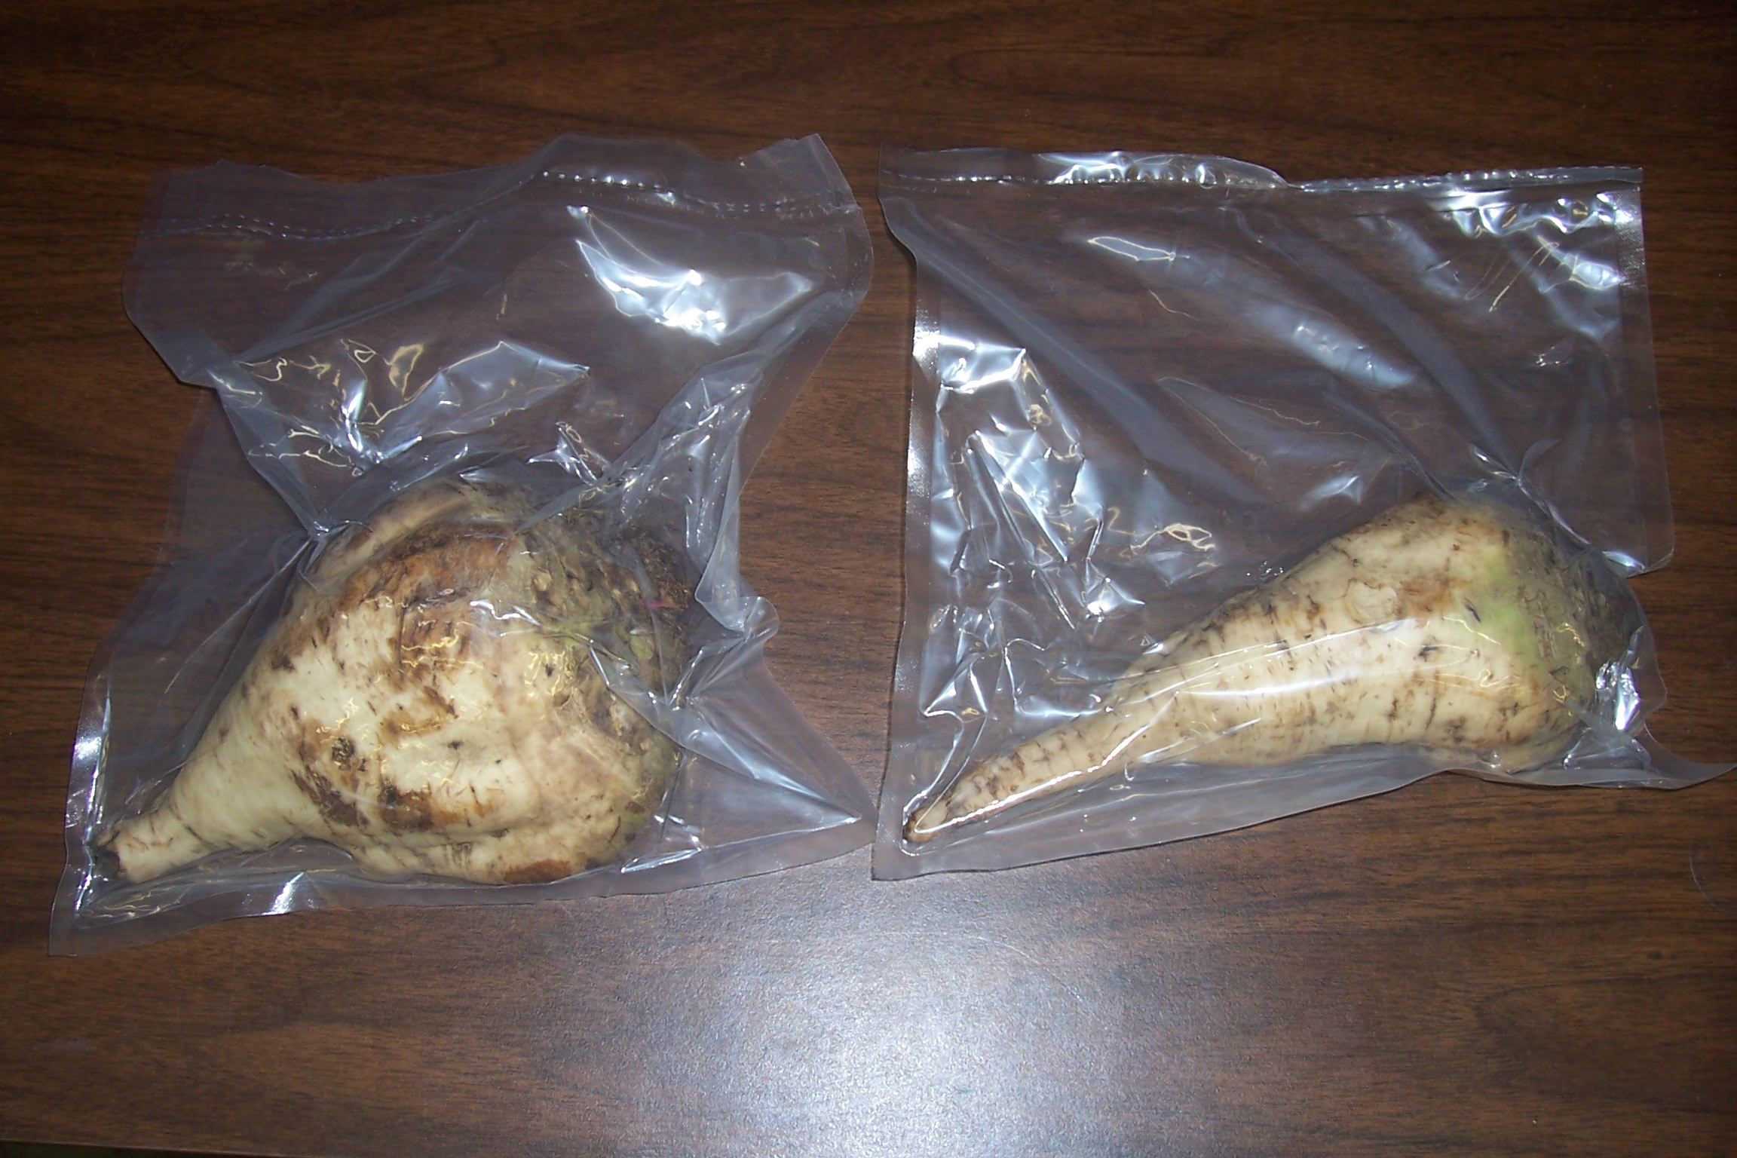
Beet/Juice Storage
Notes:
A number of private and publicly funded research projects have looked at whole beet storage.
In the picture on the slide, beets are being stored in oxygen free bags. Other research has looked at applying chemical to increase whole beet shelf life as well as identifying ways to extend the storage of sugar juice.

Slide 25
considerations
Notes:
While I’ve provided an overview of the current beet and industrial sugar landscape there are many important considerations that I haven’t yet discussed or considered fully.

Slide 26
Food Security
when all people at all times have access to sufficient, safe, nutritious food to maintain a healthy and active life
Should land be used to grow industrial crops?
Notes:
The first is food security.
Most Americans take food security for granted. We are not generally concerned with the availability or price of food. This is not the case in most other parts of the world.
Using land to produce industrial crops or using food crops to produce fuel and biochemicals may reduce a nation’s food security. This is not acceptable in most/many parts of the world.

Slide 27
Energy Security
the uninterrupted availability of energy sources at an affordable price
Notes:
Related is the issue of energy security.
The question here is does a nation have access to reasonable priced energy. Again, most nation’s struggle with energy security as they must import energy oftentimes from less-then-friendly trade partners or from long distances.
While the use of farmland to produce industrial crops or food crops to produce fuel may increase energy security – it needs to be weighed against food security.

Slide 28
Overproduction
Notes:
One of the biggest challenges facing commercial farmers is low prices.
These prices are often brought upon by overproduction.
Diversion of excess supply can stabilize prices and farmer income.

Slide 29
Flexible Sugar Program
USDA sells extra sugar for use by ethanol refiners
Used for the first time in 2013
Notes:
Management of agricultural prices by controlling supply has typically been done by the government.
In the United States, the Flexible Feedstock Program was created in 2006 to find a home for surplus sugar by selling excess sugar to ethanol refiners.
The program was first used in 2013.

Slide 30
Economic Opportunity
Notes:
As discussed earlier, there is an opportunity for business development as biotechnology companies look globally for low-cost ‘green’ ingredients to make fuel and chemicals.

Slide 31
Environmental Sustainability
Notes:
The issue of environmental sustainability varies in importance from person to person and region to region.
The issue will continue to be a major driver of global business opportunities.

Slide 32
Europe Revisited
Relatively food and energy secure
Consumers and voters are concerned about the environment
Had existing farmers who wanted to continue to grow sugar beets
Notes:
Europe is relatively food and energy secure.
It’s consumers and voters are concerned about the environment.
The biggest driver was historical experience with the crop and existing capabilities.

Slide 33
The US Experience
Extremely food and energy secure
Consumers and voters are somewhat concerned about the environment
Development is driven by economics
Notes:
The United States is extremely food and energy secure.
Its consumers and voters are somewhat concerned about the environment.
Development is based on economic opportunity.

Slide 34
Concluding Questions
Think about sugar beets as an industrial as well as a food crop
How food secure is Kyrgyzstan?
How energy secure is Kyrgyzstan?
How stable are agriculture markets?
How concerned are your citizens about the environment?
Notes:
I’ll begin by explaining some basics about the use of sugar as an ingredient to make fuels and chemicals.
Next, I’ll describe Europe, which has long produced sugar beets, and its transition from using beets for making food only to making food and fuel.
Then I’ll discuss the new global opportunity for low-cost, ‘green’ sugar and what it means for sugar beets.
After that I’ll discuss what we are doing in the United States to develop an industrial sugar system that is separate from that used to make food.
I’ll conclude with consideration of issues associated with using sugar beets to produce fuels and chemicals.

Slide 35
Questions?

