Slide 2
Industrial Beet Grower Discussion
David Ripplinger
January 2014

Slide 3
Growers are critical Without growers there is no plant

Slide 4
Are you willing and able to grow industrial beets?

Slide 5
Can beets be grown outside the RRV?

Slide 6
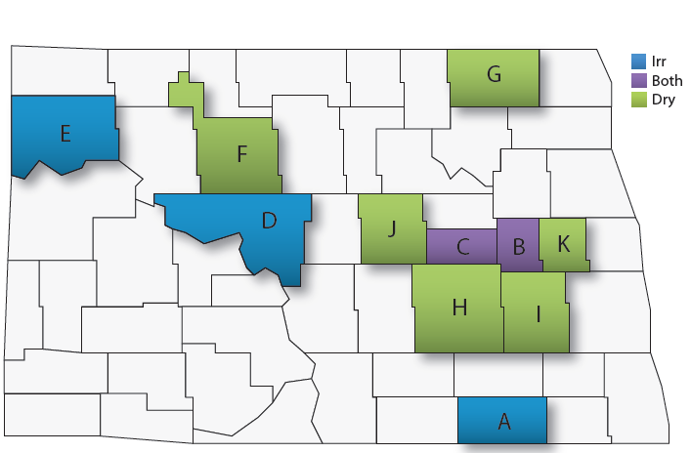
2009-2013 North Dakota Industrial Beet Trials
2013 notes: Dazey dryland trial had severe herbicide carryover injury. Litchville trial was placed on saline site.

Slide 7
2009-2013 North Dakota Industrial Beet Trials

Slide 8
Why the Northern Plains?
The climate is ideal - sugar yield and quality
- Daytime temps: 60 to 80 degrees
- Night time temps: 40 to 60 degrees
Free cold storage

Slide 9
Can you grow beets outside the RRV?

Slide 10
Herbicide Carryover
Growers must plan ahead on herbicides two to four years due to potential of carry-over damage to beets
ALS-inhibiting Group 2 herbicides have rotational restrictions of up to 40 months
Spartan & products containing sulfentrazone (Atrazine, Sonalan, Treflan, Prowl) have rotational restrictions of 24 months or longer
Pay attention to pre-mixture herbicides. For example, Extreme contains imazethapyr (Pursuit) so it has 40-month rotational restriction

Slide 11
How do you grow beets?
Notes:
I am an economist!

Slide 12
Crop Rotation
Four years to break disease cycle
Does well following wheat and barley
Does poorly following soybeans and dry beans (too much nitrogen)

Slide 13
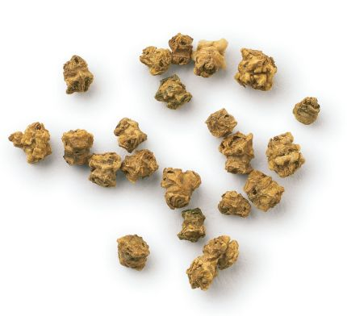
Planting
Late April - May
Small coated seeds
Newer corn & bean planters work - 22” & 30”

Slide 14
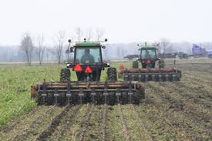
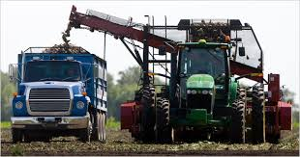
Harvest, Transport, Storage
Late September and October
Labor intense and requires specialized equipment
Topper mechanically removes foliage
Lifters pull beets from the soil
- piled at field edge
- delivered to larger pile

Slide 15
Harvest, Transport, Storage
Fall work is labor intense -
Grower managed or custom managed?
Harvest? Transportation?
Harvester rule of thumb: 100 A/row for 10-day harvest window
Example: 8-row harvester = 800 acres

Slide 16
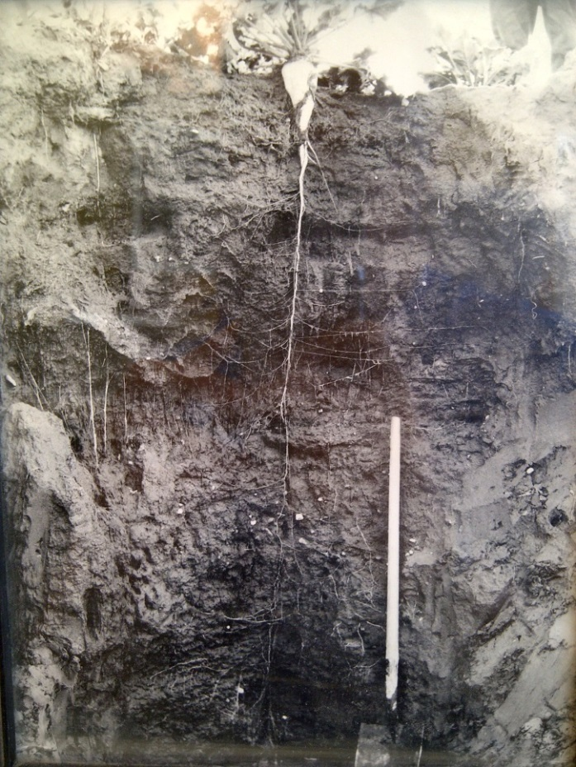
Benefits
Deep tap root can improve soil health
Allow beet to endure drought conditions
Provide access to nutrients far below the surface

Slide 17
Some Answers
You can grow no-till beets
You can grow in rocky soil (lifter, facility)
Efforts to develop crop insurance policies are underway

Slide 18
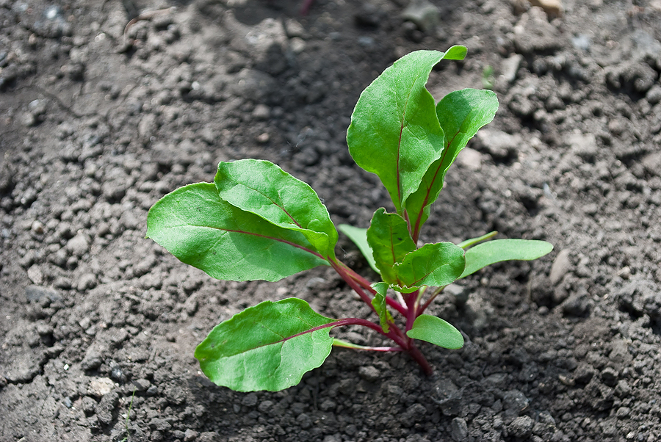
Some Concerns
Beet emergence
Soil compaction
Harvest weather

Slide 19
What factors would impact your willingness to grow beets?

Slide 20
To move forward, the project developers need an idea of how much beets will cost
Price/pricing mechanism
Contract period
When does ownership exchange hands?
Do you want to grow and invest in the plant?

Slide 21
To move forward, the project developers need an idea of how much beets will cost
Harvest
Transportation
Storage type/location

Slide 22
What questions do you have? How can NDSU answer them?
Notes:
What information would you like when making the decision to grow?
What are your biggest concerns?

Slide 23
Agronomic
Engineering
Economic
Beet production
Herbicide resistance
Salinity
Trial results
Equipment
Harvesting
Transportation
Storage
Expenses
Returns
Insurance
Labor
Contracting
Counterparty risk

Slide 24
Growers are critical Without growers there is no plant

