Slide 1
Economic Impact of Irrigation Along the McClusky Canal
David Ripplinger
Department of Agribusiness
& Applied Economics

Slide 2
Outline
Background
Traditional Crop Budgets
Stochastic Budgets
Relative Returns

Slide 3
McClusky Canal
Garrison Dam 1950’s
Irrigation along the McClusky Canal
51,700 acres authorized for development under the Dakota Water Resources Act (2000)

Slide 4
Study Purpose
Estimate the returns of irrigated crop production along the McClusky Canal, while considering the impact of production risk
A second study considers the economic impacts of irrigation development

Slide 5
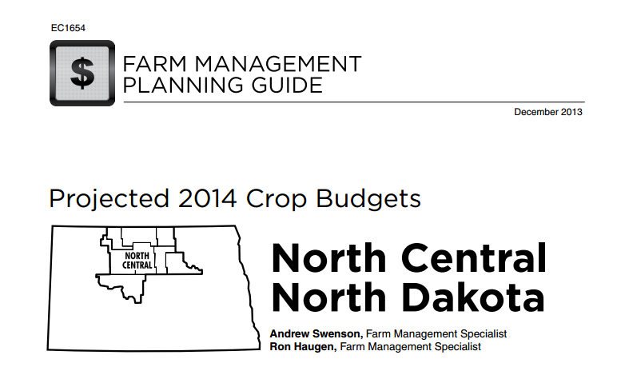
Traditional Budgets
Yield is a single number

Slide 6
Baseline Dryland Rotations
 | HRS/Canola/HRS/ Soybean | Corn/ Soybean/HRS | Corn/Dry Bean/ HRS
Revenue | $284.92 | $315.17 | 358.05
Direct Costs | 160.81 | 187.13 | 207.25
Indirect Costs | 88.67 | 94.32 | 98.37
Total Cost | 249.48 | 281.45 | 305.62
Return to Labor and Mgmt | $35.44 | $33.72 | $52.53
Based on Swenson and Haugen (2013)

Slide 7
Irrigated Budget
 | Corn | Corn/Corn/ Dry Bean/Wheat | Corn/Dry Bean/ Barley/ Beets | Corn/Dry Bean/ Barley/ Potatoes
Revenue | $640.00 | $608.45 | $715.25 | $1,449.25
Direct Costs | $331.12 | $283.27 | $342.74 | $608.57
Indir. Costs | $216.73 | $209.90 | $236.53 | $229.82
Total Cost | $547.85 | $493.17 | $579.27 | $838.39
Return to Lab. & mgmt. | $92.15 | $115.28 | $135.98 | $610.86
Based on Aakre (2013), Swenson and Haugen,
uses GDCD irrigation cost data

Slide 8
Stochastic Budgets
Yield is a distribution
Same crop price and input costs as traditional budgets
Use trial data from Carrington and Minot Research Extension Centers (2003-2013)

Slide 10
Corn was unique as it was the only crop that showed increasing yields

Slide 11
Expected Crop Yields
 | Dryland |  |  |  | Irrigated
 | Spring Wheat | Canola | Soybean |  | Corn | Dry Bean | Spring Wheat
 | (bu.) | (lbs) | (bu) |  | (bu) | (lbs) | (bu)
Best Year in 20 | 89 | 3,112 | 48 |  | 228 | 2846 | 95
Best Year in 10 | 82 | 2,946 | 44 |  | 215 | 2659 | 92
Average Year | 58 | 2,316 | 31 |  | 171 | 1998 | 81
Worst Year in 10 | 34 | 1,687 | 18 |  | 127 | 1338 | 70
Worst Year in 20 | 28 | 1,514 | 14 |  | 114 | 1151 | 67
This analysis simulates 2014 yields

Slide 12
Stochastic Dryland Returns
 | Spring Wheat | Canola | Soybean | Dryland Rotation
Best Year in 20 | $353 | $380 | $283 | $272
Best Year in 10 | $310 | $345 | $244 | $246
Average Year | $148 | $213 | $101 | $153
Worst Year in 10 | -$13 | $81 | -$43 | $60
Worst Year in 20 | -$60 | $44 | -$83 | $33
Returns are higher as yields are higher

Slide 13
Stochastic Irrigated Returns
 | Dryland Rotation | Irrigated Corn | Irrigated Corn/ Dry Bean/HRS
Best Year in 20 | $272 | $365 | $276
Best Year in 10 | $246 | $313 | $244
Average Year | $153 | $137 | $140
Worst Year in 10 | $60 | -$39 | $36
Worst Year in 20 | $33 | -$91 | $15
This includes simulated 2014 yields.

Slide 14
Differences in Returns
 | Dryland-Irrigated Corn Difference | Dryland –Irrigated Corn/Dry Bean/HRS Difference
Best Year in 20 | $240 | $186
Best Year in 10 | $183 | $144
Average Year | -$16 | $4
Worst Year in 10 | -$215 | -$138
Worst Year in 20 | -$280 | -$171
This includes simulated 2014 yields.

Slide 15
Impact of Increasing Corn Yield
Corn yields increased 2.9 bushels per year
Yields can be expected to increase 29 bushels by 2024.
Keeping corn price ($4/bu) and input prices constant, corn rotation will return $100 more than the dryland rotation in 2024.

Slide 16
Impact of Increasing Corn Yield
If we assume that seed companies capture half of the increased returns ($2/bu x 29 bushels) the farmer would still see returns that are $58/acre higher.
We can capitalize this in the price of land*.
If the change in returns are capitalized into the price of land, a discount rate of 4%, the price of irrigated land increases $1,450.

Slide 17
Summary
Used economic budgets
Modeled with traditional and stochastic budgets
Irrigated specialty crops and corn show promise of profitability
Farmers should do their own budgeting

