Slide 2
Commercializing the Industrial Beet-Sugar Pathway in the Northern Plains
David Ripplinger
January 31, 2014
Notes:
Good afternoon.
My name is David Ripplinger.
I’m a bioenergy economist at NDSU.
My primary job is to work with industry and farmers to develop new bioenergy projects and ensure the viability of existing ones.
My background is in agriculture, but in my job I’ve had to become acquainted with energy. In many ways energy dominates my work. It is very big industry and changes in energy markets move ag markets.
The issue of energy is important to my work in two ways. First, many bioenergy projects require a lot of energy – so I need to be concerned with energy as an input. At the same time, many of the products produced compete directly with existing ones made using petroleum. This includes motor fuels, heating fuels, and plastics.

Slide 3
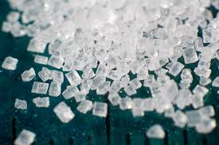
The General Idea
Sugar is
Nature’s store of easily
accessible energy
Readily convertible into a number of fuels and products
Beets are an economical way of producing sugar
Breed/engineer for sugar quantity not quality

Slide 4
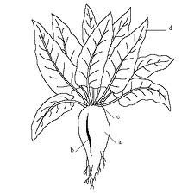
Industrial Beets Defined
Aka energy beets
Varieties of beta vulgaris bred to maximize fermentable sugar
May not meet quality standards for food production (sugar beet)

Slide 5
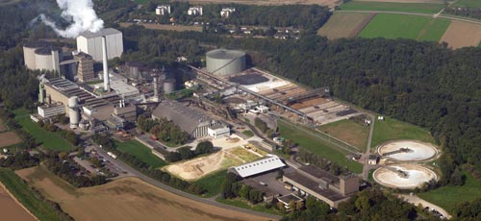
The European Experience

Slide 6
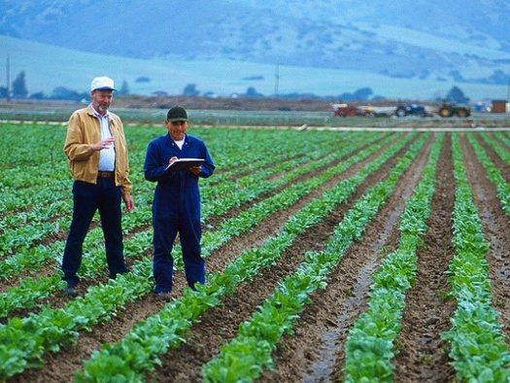
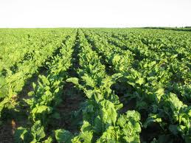
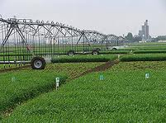
Region- Specific Energy Beet Supply Chains
Beets grow well in many agroecosystems
Supply chains will differ because of climate
Considerations
Economics
Energy use
Land use change
Environmental impacts

Slide 7
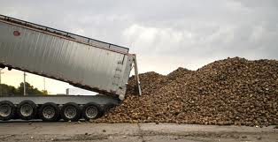
Spring Beets
-Planted in the Spring harvested in the Fall
-Dryland or irrigated production
-May be stored outdoors over winter in colder climates
Example: North Dakota
Rotation: Corn/Soybeans/Small Grain/Beets
Long days, cool nights put on sugar

Slide 8
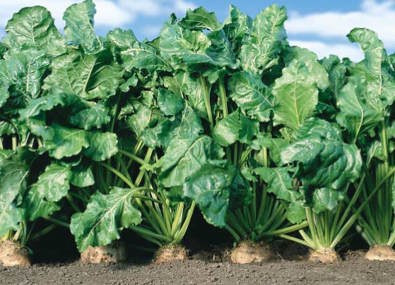
Winter Beets
Planted in the fall
harvested in the spring
Grown in areas where
hard freezes are unlikely
Dryland production
Example: Mississippi Delta
No land use impacts

Slide 9
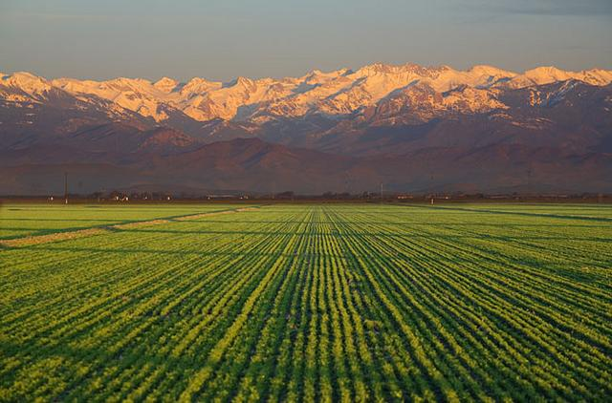
Just in Time Beets
Planted and harvested throughout the year
Irrigated
Example: San Joaquin Valley
Rotation: alfalfa/beans/sunflower/melons/wheat/beets

Slide 10
Designing a northern Industrial beet-sugar system

Slide 11
Phase 1
Initial Research
Phase 2
Current Research
Phase 3
Commercialization
Initial feasibility
Research: yield trials, burn tests and juice storage
Research: yield trials, front-end processing, juice storage
Developing federal crop insurance program
Advanced biofuel petition with EPA
2014-2016: finalize processing & commercialization strategies – including feedstock commitments and capitalization
2015 or 2016: First crop grown and facility built

Slide 12
Project Partners
Department of Agriculture and Biosystems Engineering
Department of Agribusiness & Applied Economics
Plus support from many North Dakota communities and grant funding from APUC and ND Renewable Energy Council
5

Slide 13
NDSU Research
“Phase II”
Front-end
Whole beet
Juice
Field trials
Crop insurance
Economic and environmental

Slide 14
Front-End Processing
Pulp for pellets
Beets
Hammer mill
Modified ribbon mixer with hot water spray
Chamber filter press
+
Juice for biofuel
Beet to juice and pulp

Slide 15
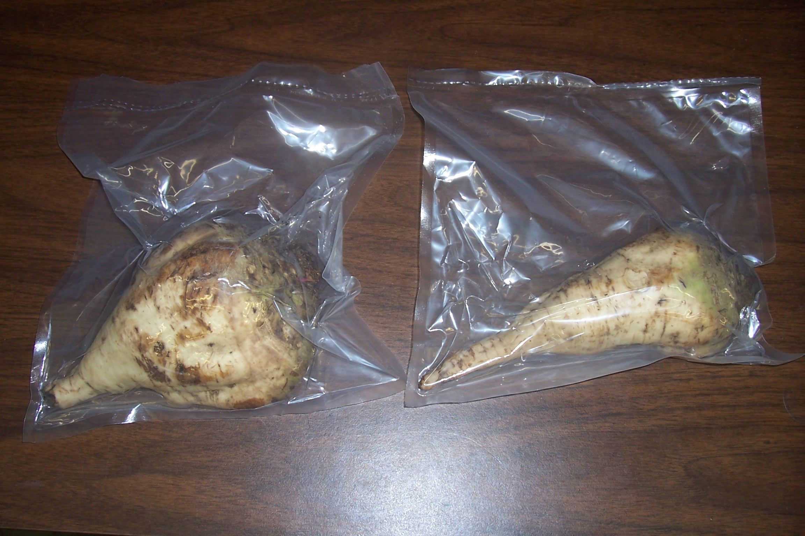
Beet/Juice Storage

Slide 16
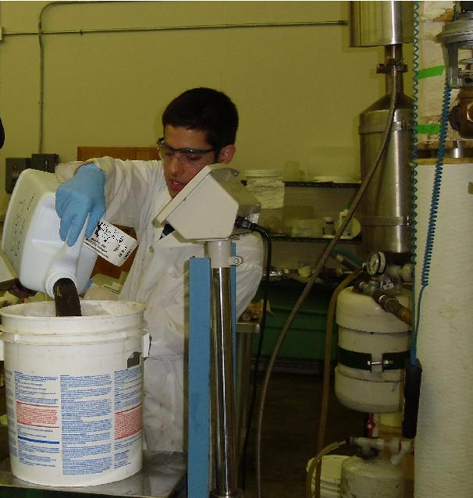

Slide 17
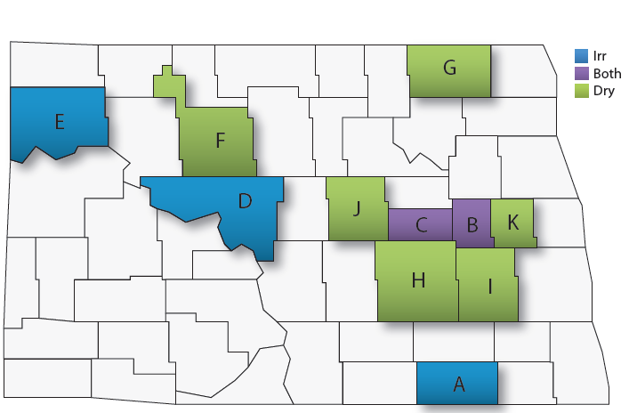
2009-2013 North Dakota Industrial Beet Trials
2013 notes: Dazey dryland trial had severe herbicide carryover injury. Litchville trial was placed on saline site.

Slide 18
2009-2013 North Dakota Industrial Beet Trials

Slide 19
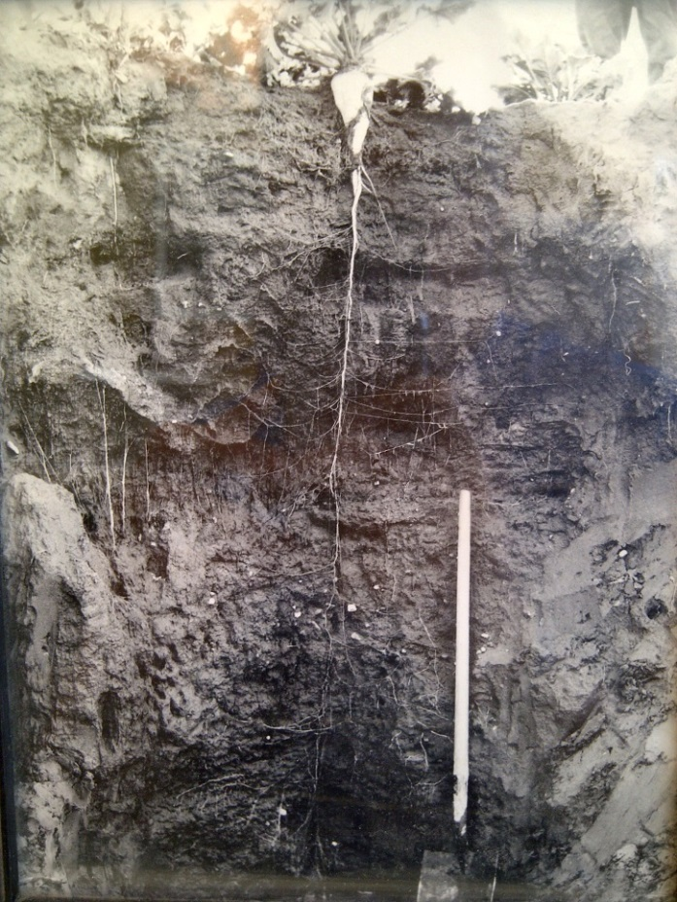
Agronomic Benefits
Deep tap root can improve soil health
Allow beet to endure drought conditions
Provide access to nutrients far below the surface

Slide 20
Herbicide Carryover
Growers must plan ahead on herbicides two to four years due to potential of carry-over damage to beets
ALS-inhibiting Group 2 herbicides have rotational restrictions of up to 40 months
Spartan & products containing sulfentrazone (Atrazine, Sonalan, Treflan, Prowl) have rotational restrictions of 24 months or longer
Pay attention to pre-mixture herbicides. For example, Extreme contains imazethapyr (Pursuit) so it has 40-month rotational restriction

Slide 21
Retrospective Returns Per Acre
Source: FINBIN, NDSU

Slide 22
EPA Petition
Federal policy (RFS) mandates the use of different biofuels by type.
Advanced biofuels, have an environmental footprint half the size of gasoline, and less than corn-ethanol
EPA is charged with verifying new fuels footprints
Notes:
Make a comment about the RFS.

Slide 23
Life cycle assessment completed in 2011 to quantify energy use and greenhouse gas emissions associated with the production of ethanol using beets
A petition for an advanced biofuel designation was submitted by Green Vision Group to EPA in October 2011
Provided supplemental data and documentation in spring 2012

Slide 24
Siting
Five communities under consideration
Facilities may produce industrial sugar or a finished product like ethanol
Notes:
Locations may produce industrial sugar feedstock or a finished product.
Processing facilities may produce:
Industrial sugar feedstock (for third party)
Ethanol
Advanced chemicals

Slide 25
Feedstock Requirements
20 MMGPY Refinery
Requires about 750,000 tons of beets
30,000 dryland acres (@25t/AC)
120,000 acres with a four-year rotation
Most feedstock sourced within 20 miles of plant
Fewer irrigated acres are needed
25

Slide 26
Growers are critical Without growers there is no plant

Slide 27
Summary
Beets show significant promise as an industrial crop
Efforts to commercialize are underway
Growers need to be ready

