Slide 1
Regional Re-launch
by: Monique Snelgrove & Dave Ripplinger

Slide 2
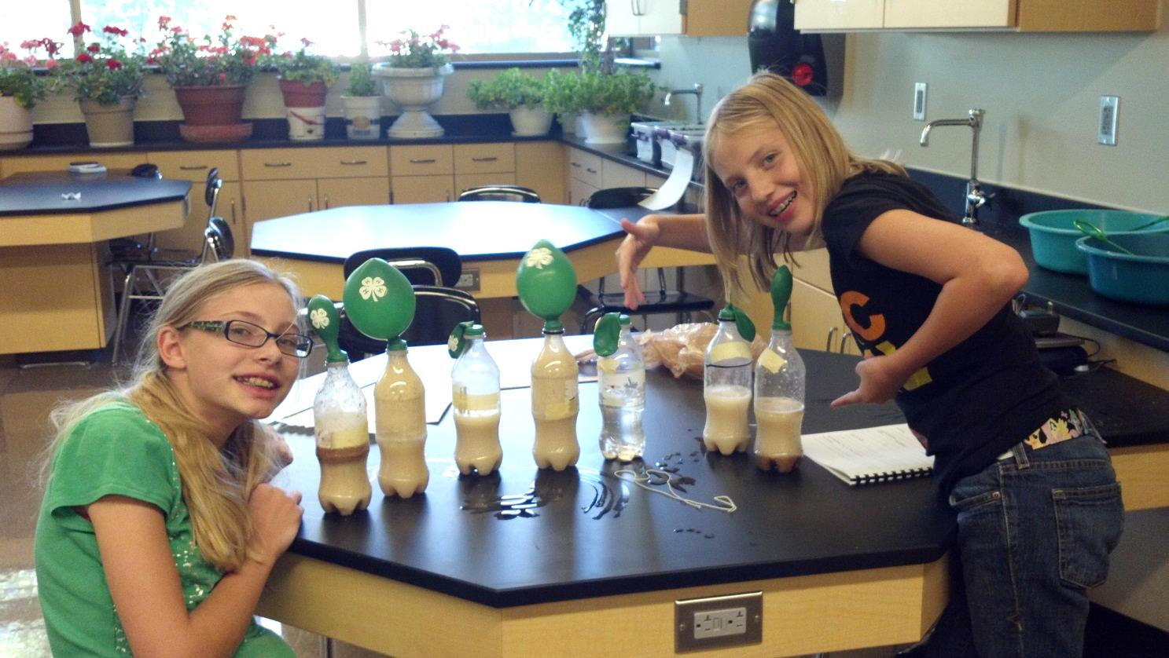
For the past 5 years… Biofuel Blast has blasted its way across ND!
But, HOW can we make this experiment RELEVANT to the youth of NORTH DAKOTA??

Slide 3
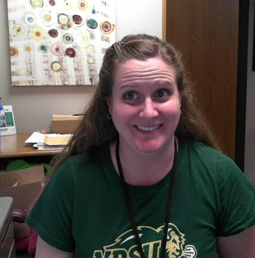
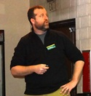
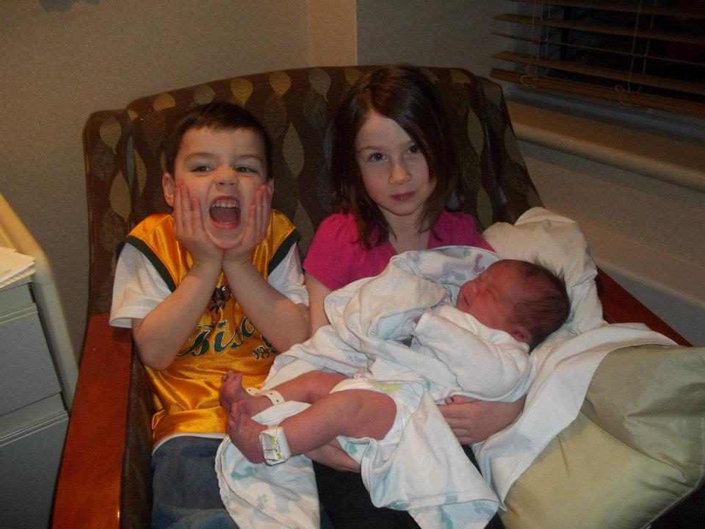
I’m gonna need someone smarter than me…
I need someone who’s better working with youth…

Slide 4
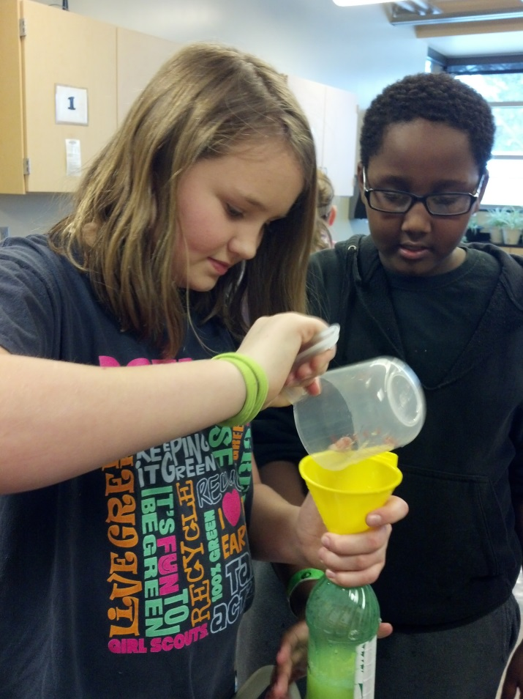
We’ve got the right people working together…. NOW WHAT?
Invite Dave as a “guest expert” to 4-H Science Club. What could be more fun than an afterschool science club with middle school students, right?!

Slide 5
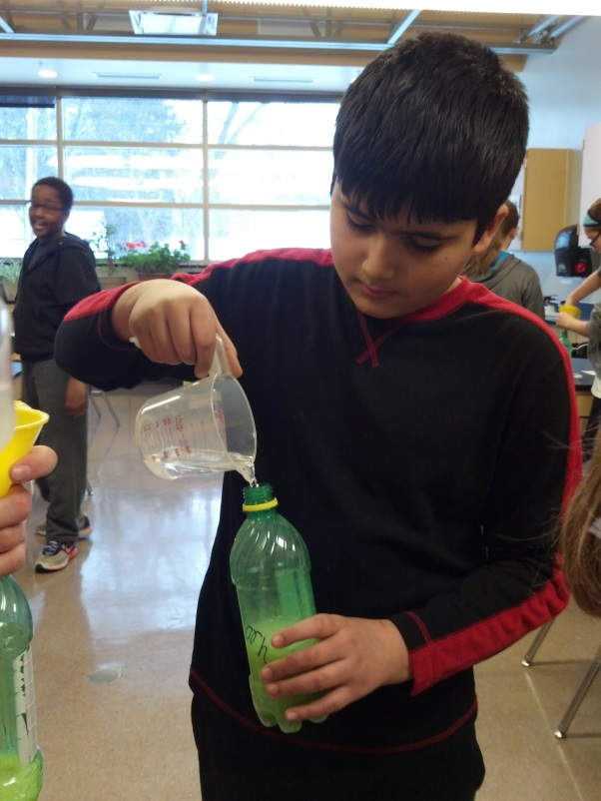
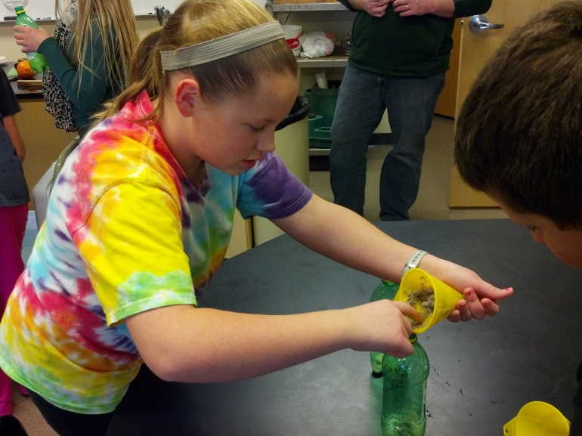
DO…. The Experiment
Modification: Let’s use ND Crops!
Using a blender, puree samples of Sugar Beets, Sweet Corn, and Oranges.

Slide 6
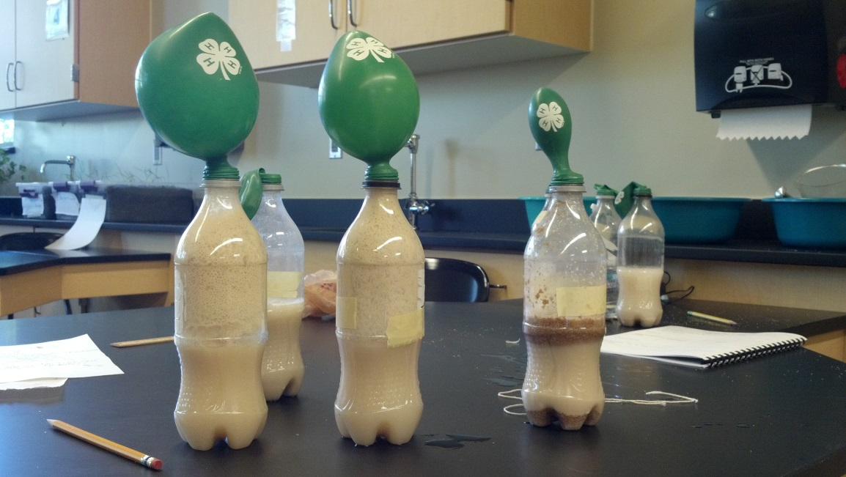
REFLECT…. on The Experiment
Guiding Question: Which crop holds the most potential as a biofuel source?
Discuss with youth… How does Agricultural Economics play into our choice? (Dave is our expert, let’s ask him!)

Slide 7
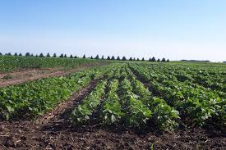
REFLECT…. on The Experiment
Guiding Question: Which crop holds the most potential as a biofuel source?
Discuss with youth… How does Agricultural Economics play into our choice? (Dave is our expert, let’s ask him!)
How should we use cropland?
How should crops be used?
Give students a chance to think about choices, tradeoffs, and their own preferences

Slide 8
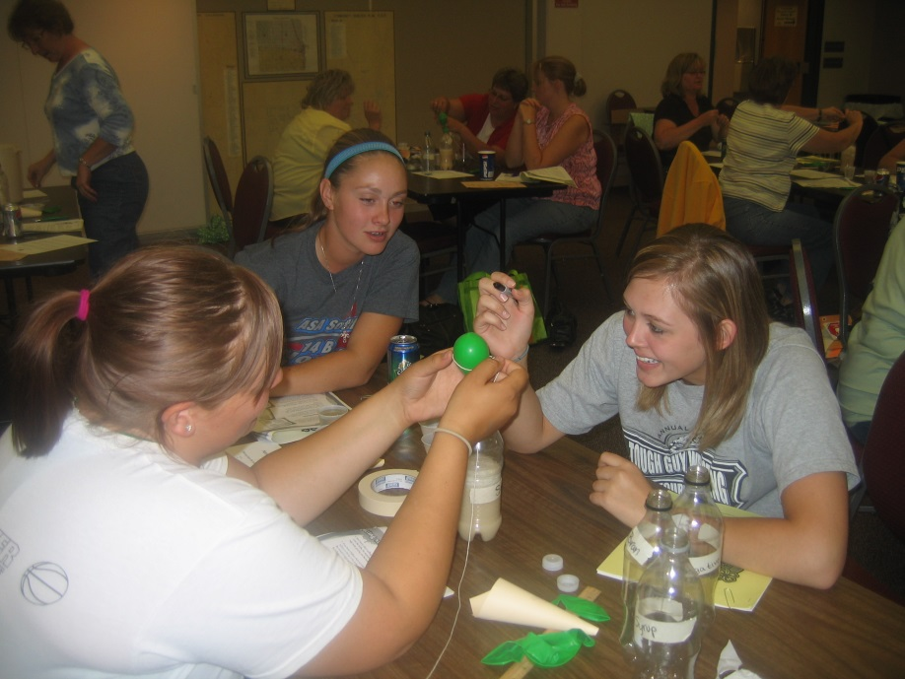
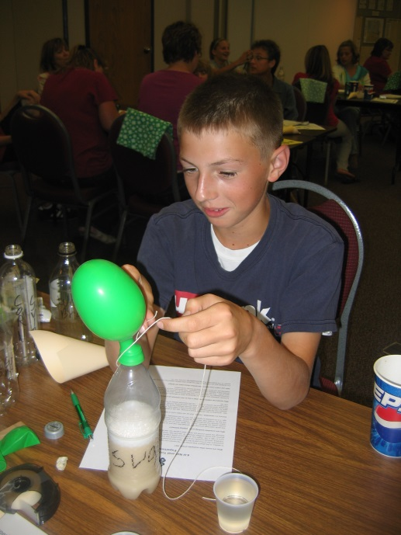
REFLECT…. Life Skills modeled in The Experiment
OH NO, it’s flawed!
Guiding Question: Did we follow the scientific method? Can we trust our results?
Discuss with youth… Did we really measure how much gas was produced, or are we measuring something else?

Slide 9
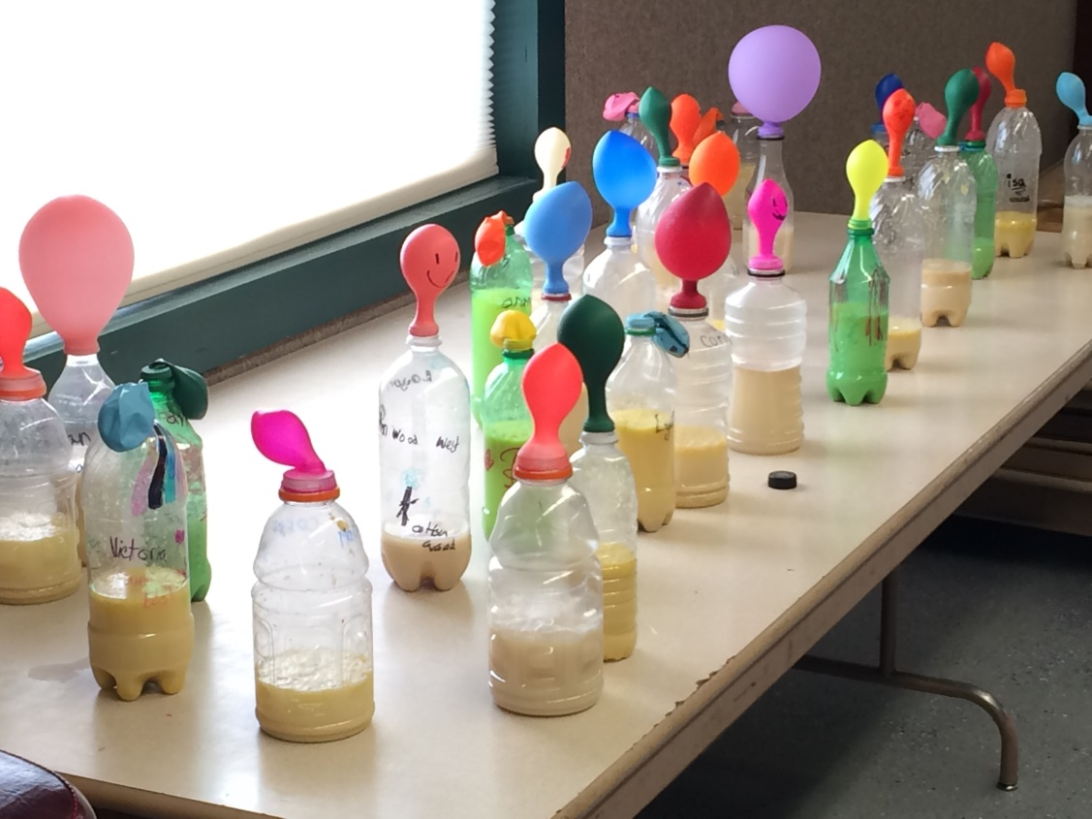
THE FLAW… what is it, and how do we adjust?
Guiding Question: Did we really measure how much gas was produced?
If not…
Then, what did we measure? And how can we adjust the experiment to measure volume of gas produced?

Slide 10
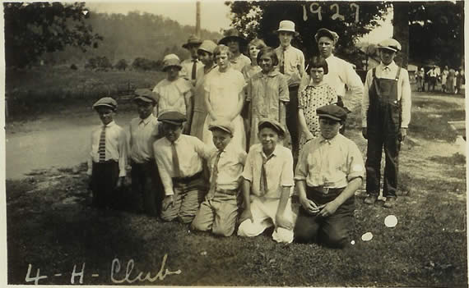
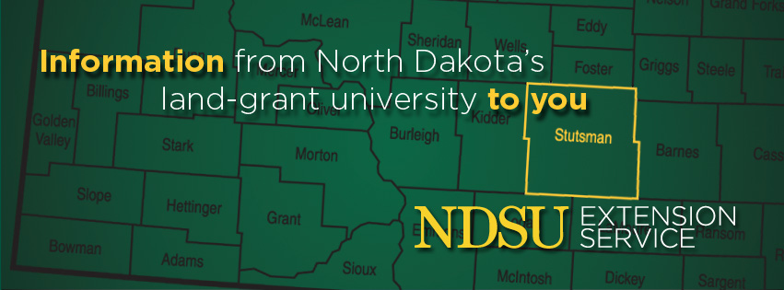
APPLY… bringing this back to your county, by living a legacy in 4-H.
Experiment Modifications:
ND Crops
Gas collection system
GOING BEYOND… with resources.
Programming extension: Biodiesel 4-H Trunk
Take-homes from this workshop.

