Slide 2
Ag-Energy Outlook
David Ripplinger
1.21.14
Center, ND

Slide 3
Agriculture
Bioenergy
Energy
Farm Energy

Slide 4
Corn Ethanol

Slide 5
Source: Federal Highway Administration

Slide 6
Source: University of Michigan Transportation Research Institute

Slide 7
Source: Energy Information Administration

Slide 8
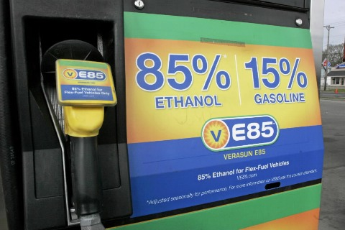
The Blend Wall
Our nation’s fueling infrastructure and fleet have a limited capability to utilize ethanol.

Slide 9
The Renewable Fuel Standard (RFS)
A federal law enacted in 2005 and updated in 2007 that mandates the minimum use of various biofuels by type and year.
Provides support for the development and operation of biorefineries.

Slide 10
How does it work?
Each year blenders are told the amount of each type of fuel they need to blend based on the amount of fuel they used the previous year

Slide 11
2014 Initial
14.4 billion
18.15 billion
% of Motor Gas
9.8
9.33
Corn-ethanol
Total
Proposed
13 billion
15.21billion

Slide 12
WASDE
CORN |  |  | 2013/14 | 2013/14
 | 2011/12 | 2012/13 Est. | Proj. Dec | Proj. Jan
 |  |  | MM Acres
Area Planted | 91.9 | 97.2 | 95.3 | 95.4
Area Harvested | 84 | 87.4 | 87.2 | 87.7
 |  |  | Bushels
Yield per Harvested Acre | 147.2 | 123.4 | 160.4 | 158.8
 |  |  | MM Bu.
Beginning Stocks | 1128 | 989 | 824 | 821
Production | 12360 | 10780 | 13989 | 13925
Imports | 29 | 162 | 30 | 35
Supply, Total | 13517 | 11932 | 14842 | 14781
Feed and Residual | 4557 | 4335 | 5200 | 5300
Food, Seed & Industrial | 6428 | 6044 | 6400 | 6400
Ethanol & by-products | 5000 | 4648 | 4950 | 5000
Domestic, Total | 10985 | 10379 | 11600 | 11700
Exports | 1543 | 731 | 1450 | 1450
Use, Total | 12528 | 11111 | 13050 | 13150
Ending Stocks | 989 | 821 | 1792 | 1631
CCC Inventory | 0 | 0 | 0 | 0
Free Stocks | 989 | 821 | 1792 | 1631
Outstanding Loans | 41 | 32 | 50 | 50
Avg. Farm Price ($/bu) | 6.22 | 6.89 | 4.05 - 4.75 | 4.10 - 4.70
USDA WASDE 1/14

Slide 13
Source: Iowa State University

Slide 14
Source: Energy Information Administration

Slide 15
65 million gallon per year
corn-ethanol refinery
Located near Spiritwood
Uses heat and power from co-located coal-fired power plant

Slide 16
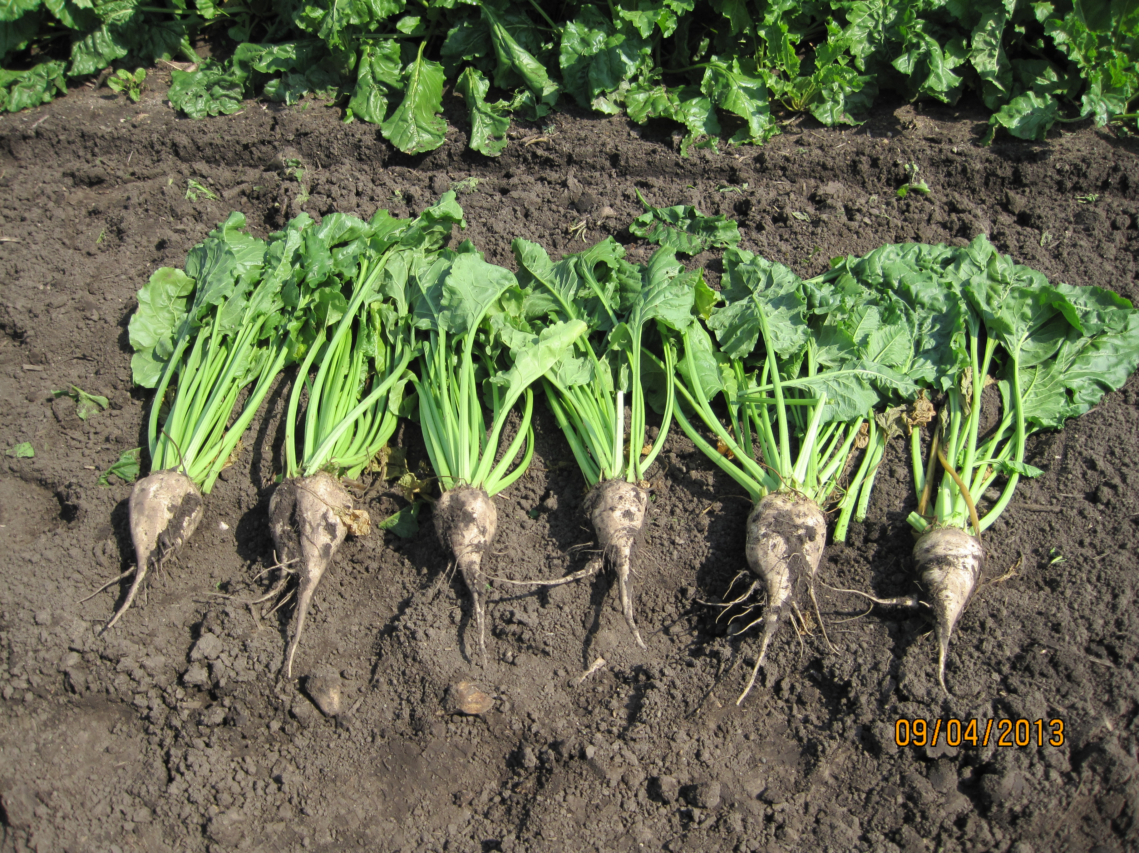
Notes:
Varieties of beta vulgaris bred for sugar quantity
May not meet quality standards for food production (sugar beet)
Higher sugar yield than fodder beets
Sugar is
Nature’s store of easily
accessible energy
Readily convertible into a number of fuels and products
Sugar beets are an economical way of producing sugar
Breed/engineer for sugar quantity not quality

Slide 17
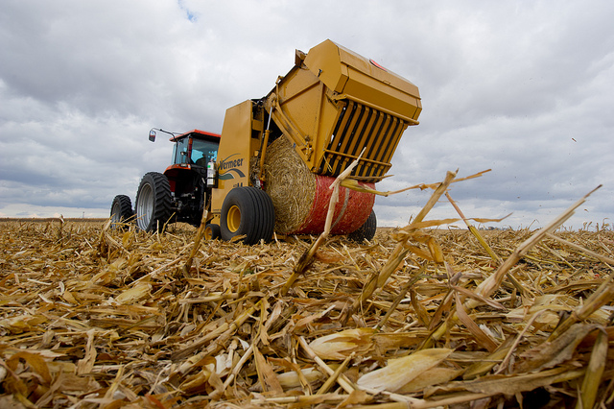
Domestic cellulosic projects
Poet-DSM in Emmitsburg, IA, 25 mmgpy
Dupont-Danisco in Nevada, IA, 27.5 mmgpy
Abengoa in Hugoton, KS, 25 mmgpy

Slide 18
Ethanol Wrapup
EPA’s ‘blend wall’ ruling if maintained will significantly affect the ethanol industry and the demand for corn
Profits and exports are keeping ethanol refineries running at high capacity
Advanced and cellulosic biofuel projects are underway

Slide 19
Biodiesel

Slide 20
Biodiesel
Blend wall is much lower
Tax credit expired at the end of 2013
2014 Initial
1 billion+
18.15 billion
Biodiesel
Total
Proposed
1.28 billion
15.21billion

Slide 21
Source: Energy Information Administration

Slide 22
SOYBEAN OIL |  |  | 2013/14 | 2013/14
 | 2011/12 | 2012/13 Est. | Proj. Dec | Proj. Jan
 |  |  | Million Pounds
Beginning Stocks | 2425 | 2540 | 1705 | 1705
Production | 19740 | 19820 | 19435 | 19840
Imports | 149 | 196 | 250 | 200
Supply, Total | 22314 | 22556 | 21390 | 21745
Domestic Disappearance | 18310 | 18686 | 18550 | 18550
Biodiesel | 4874 | 4617 | 5200 | 5200
Food, Feed & other Industrial | 13436 | 14069 | 13350 | 13350
Exports | 1464 | 2164 | 1150 | 1450
Use, Total | 19774 | 20851 | 19700 | 20000
Ending stocks | 2540 | 1705 | 1690 | 1745
Avg. Price (c/lb) | 51.9 | 47.13 | 38.00 - 42.00 | 35.50 - 39.50
TotalSouSouS a
Source: United States Department of Agriculture

Slide 23
SOYBEAN |  |  | 2011/12 | 2012/13 Est | 2013/2014 Proj. Dec | 2013/2014 Proj. Jan
 |  |  |  |  | MM Acres
Area Planted |  |  | 75 | 77.2 | 76.5 | 76.5
Area Harvested |  |  | 73.8 | 76.2 | 75.7 | 75.9
Filler |  |  |  |  | Bushels
Yield per Harvested Acre |  |  | 41.9 | 39.8 | 43 | 43.3
 |  |  |  |  | Million Bu.
Beginning Stocks |  |  | 215 | 169 | 141 | 141
Production |  |  | 3094 | 3034 | 3258 | 3289
Imports |  |  | 16 | 36 | 25 | 25
Supply, Total |  |  | 3325 | 3239 | 3423 | 3454
Crushings |  |  | 1703 | 1689 | 1690 | 1700
Exports |  |  | 1365 | 1320 | 1475 | 1495
Seed |  |  | 90 | 89 | 87 | 87
Residual |  |  | -2 | 1 | 22 | 22
Use, Total |  |  | 3155 | 3099 | 3274 | 3304
Ending Stocks |  |  | 169 | 141 | 150 | 150
Avg. Farm Price ($/bu) 2/ |  |  | 12.5 | 14.4 | 11.50 - 13.50 | 11.75 - 13.25
Source: United States Department of Agriculture

Slide 24
Source: Iowa State University

Slide 25
13/14 RVO 105 MM gals
Source: Energy Information Administration

Slide 26
Biodiesel Wrapup
Blend wall is not an issue, but EPA did not increase the biodiesel RVO from 2013
Margins have declined significantly

Slide 27
Farm energy

Slide 28
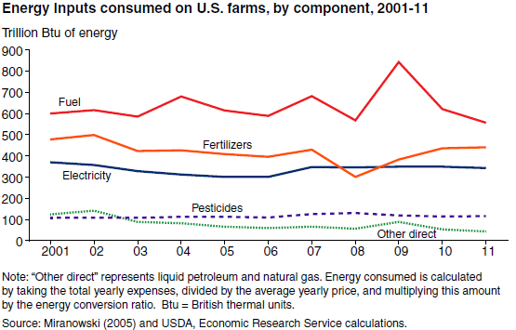
General Slide

Slide 29
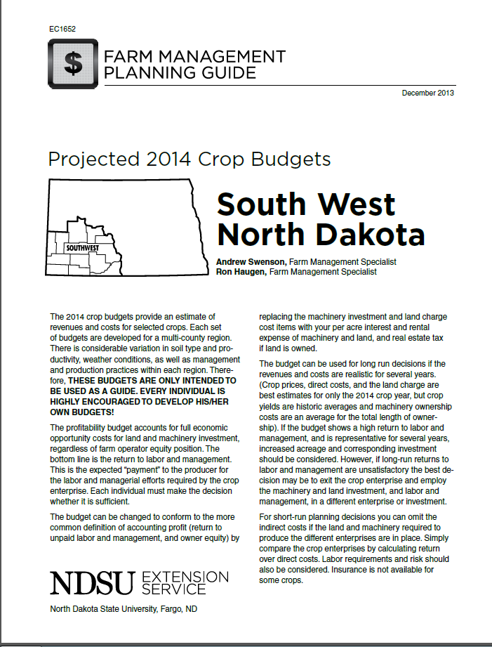
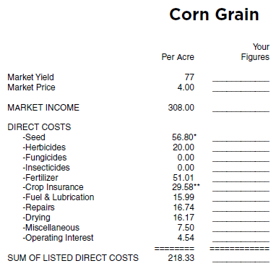

Slide 30
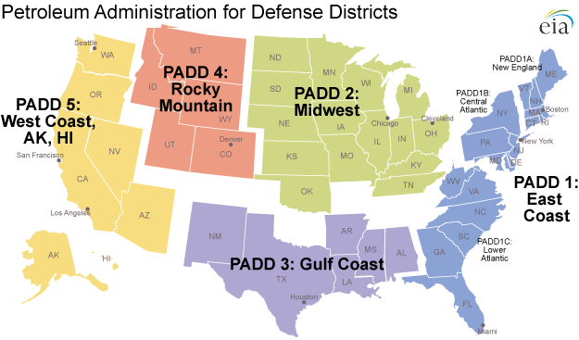

Slide 31
Diesel OUtlook

Slide 32
First Things First
Crude Oil – Production is up
Refining activity is up
Diesel and gas exports are up (a lot)

Slide 33
Super Field
Sometime in 2014, the Bakken is expected to begin producing more than 1 million barrels of oil per day qualifying it as a ‘super field’.
In the history of the world, how many super fields have been developed?

Slide 34
Diesel Outlook
Short term (winter) is bullish with cold weather across the northern US
Medium term is bearish with prices >$.10 less for 2014 and 2015 (EIA). Depends on the price of crude.
KS farm diesel is expected to be 8.5% lower than 2013 (Dhuyvetter)

Slide 35
Projects
Great Falls, MT Expansion +20,500 bbls/d
Dakota Prairie (Dickinson) 20,000 bbls/d
Dakota Oil (Trenton) + 20,000 bbls/d
Thunder Butte Refinery +20,000 bbl/d (30,000?)

Slide 36
Source: Energy Information Administration

Slide 37
Nitrogen Fertilizer

Slide 38
ND Nitrogen
Ammonia $565 st FOB $585 prepay (780 year ago)
Urea – tons are short in western ND - $450 FOB/$495 prepay (510 year ago)
Much higher than the region average - $410
UAN - $315 prepay

Slide 39
Outlook
Fertilizer Outlook & Technology Conference
Doug Hoadley, CFI
Total Nitrogen use flat 13.8 million tons –fertilizer. NH3 and UAN flat, Urea down, others up
DEF less than 400M tons will grow to 1.2 million tons in 2018

Slide 40
Projects/Expansion
CHS – Spiritwood (2017)
- 2,000 st/d
- commissioned $25 million FEED study
- final decision to build made in early 2014
Northern Plains Nitrogen – Grand Forks (2017)
- 2,400 st/d
- purchasing land
- ground breaking early 2015
Koch – Brandon, MB; CF – Port Neal, IA

Slide 41
Natural Gas/Propane

Slide 42
Supply issues persist in Northern plains
PADD2 propane stocks were low to start the season
Cold weather bullish in the near term (stocks are less than 60% of last years level)
Increased domestic production
Cochin reversal
CHS – Hannaford Terminal

Slide 43
Farm Energy Outlook Summary
Diesel prices down in 2014
Nitrogen prices down significantly
Natural gas/propane

