Slide 2
Unconventional
David Ripplinger
November 13, 2013
Notes:
Good afternoon.
My name is David Ripplinger.
I’m a bioenergy economist at NDSU.
My primary job is to work with industry and farmers to develop new bioenergy projects and ensure the viability of existing ones.
My background is in agriculture, but in my job I’ve had to become acquainted with energy. In many ways energy dominates my work. It is very big industry and changes in energy markets move ag markets.
The issue of energy is important to my work in two ways. First, many bioenergy projects require a lot of energy – so I need to be concerned with energy as an input. At the same time, many of the products produced compete directly with existing ones made using petroleum. This includes motor fuels, heating fuels, and plastics.

Slide 3
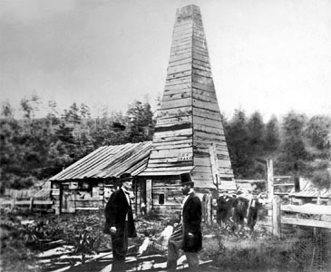
Titusville
Notes:
It’s always best to start a story at the beginning.
And here’s the beginning of it all.
Does anyone know where this picture was taken and when?
It’s titusville pennsylvania. 1859.
That’s first commercially succesful oil well ever. Anywhere.
Edwin Drake, the man on right, who oversaw the drilling took the title ‘governor’.
Things have changed in the past 154 years.
New fields, new players, new technologies.

Slide 4
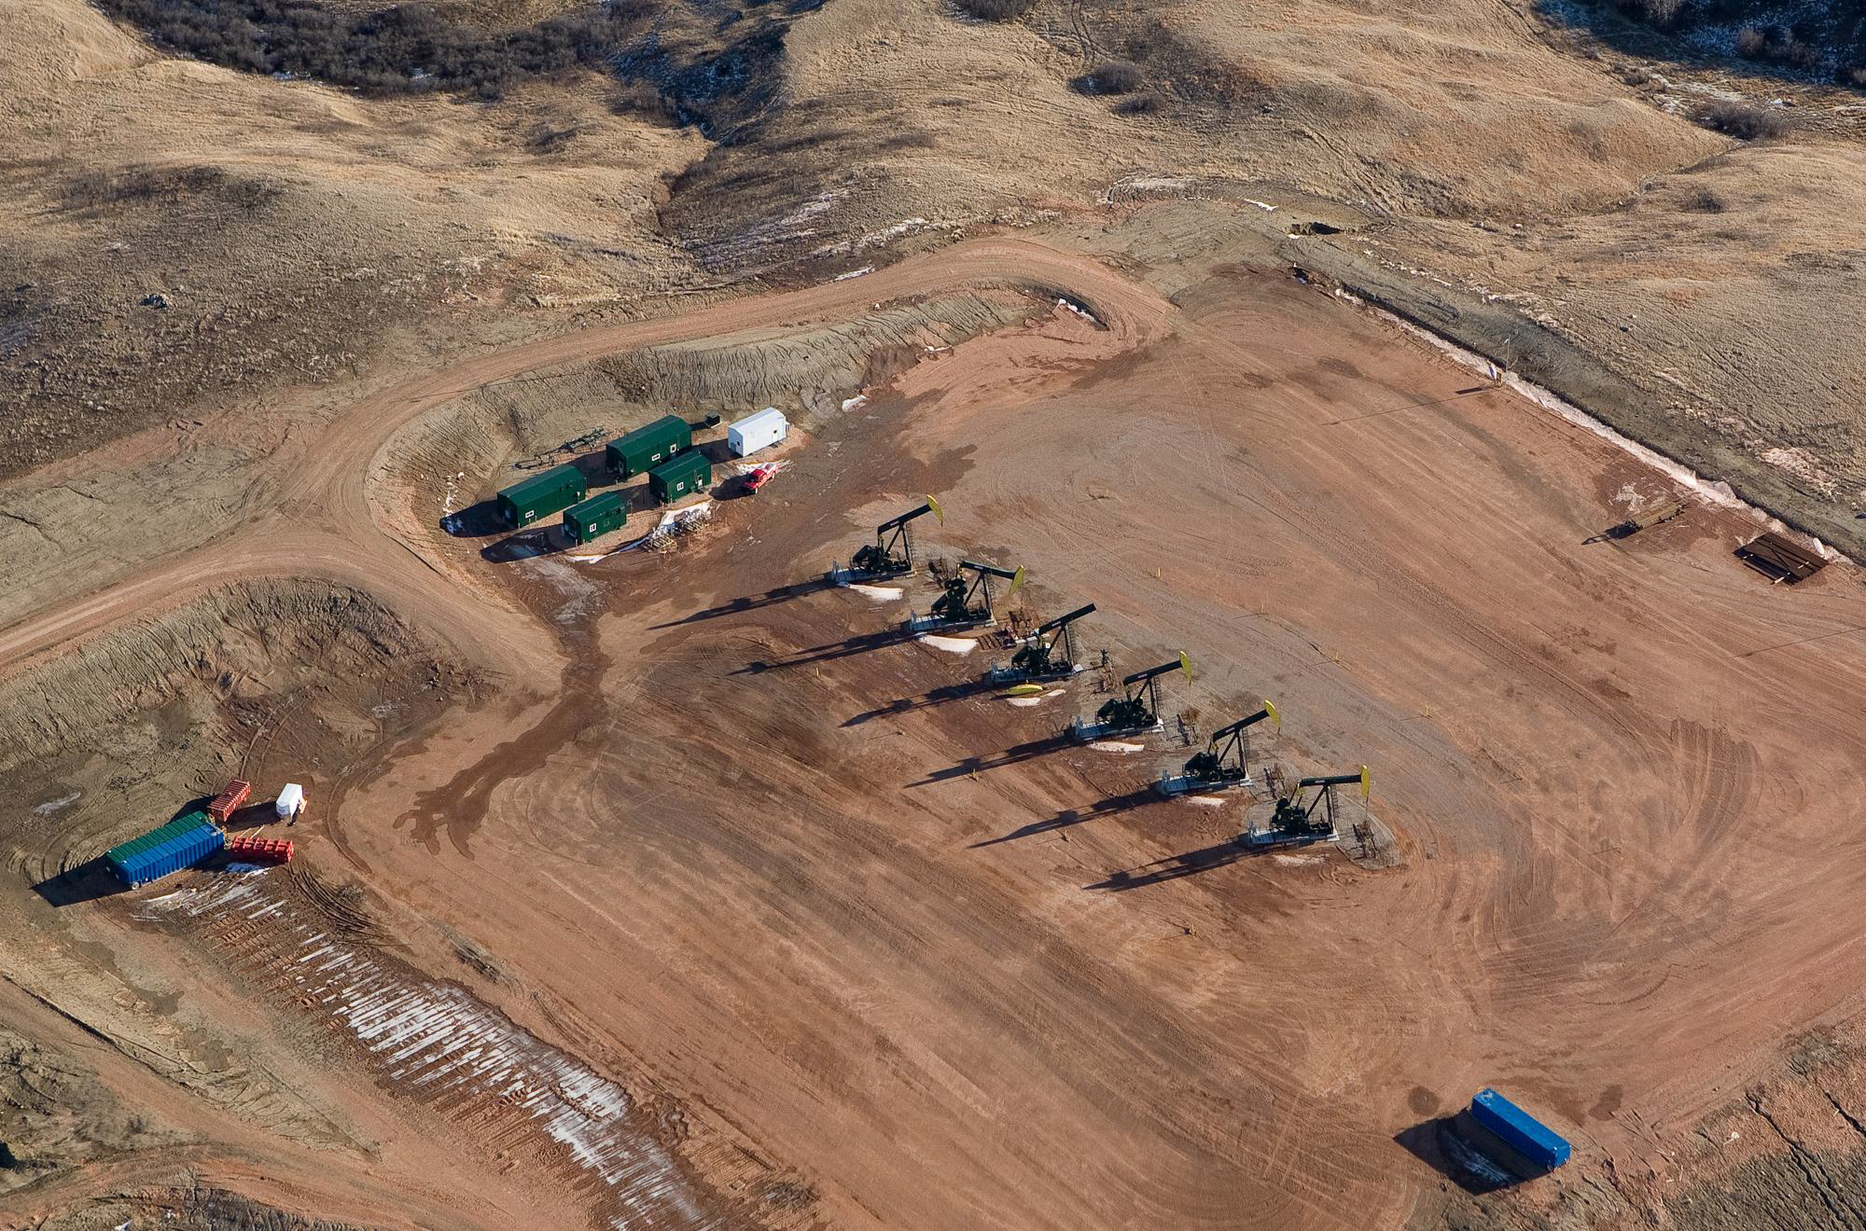
ND PAD
Notes:
My goal is eventually get to this.
The Bakken. A tight oil field located in western North Dakota, Montana, and Saskatchewan.
The Bakken and other tight oil and gas formation in the united states are a major piece of America’s energy industry.
But there’s a lot more there that you might now.

Slide 5
A quick intro to oil

Slide 6
Barrels, Horses, and Men
1 barrel of oil (5.8 million btus)
= 22 bushels of oats
= 5 thousand bowls of Wheaties
Notes:
http://articles.mcall.com/2011-05-24/opinion/mc-barrel-oil-explainit-20110524_1_actual-barrels-oil-and-oil-products-btu

Slide 7
A quiz
Which three nation’s
currently lead the world
in oil production?

Slide 8
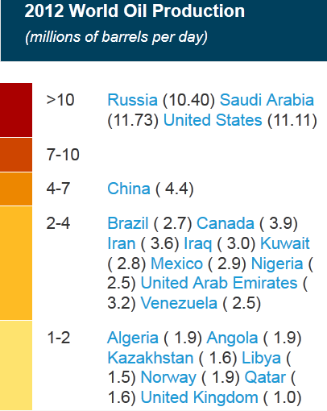
Source: Energy Information Administration

Slide 9
Who’s using it?

Slide 10
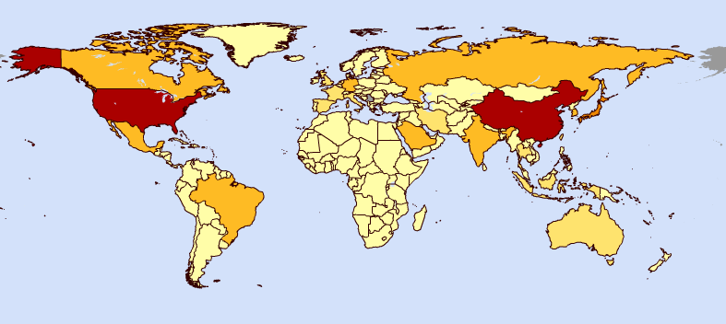
Consumers
2012
United States 18 billion bbls
China 10 billion bbls
Japan 5 billion bbls
Source: Energy Information Administration

Slide 11
Energy Security
the relative security of nation resulting from access to energy resources

Slide 13
Where does the US get its oil?

Slide 14
Canada is by far the largest source of US oil imports (~25% in 2012)

Slide 15
Energy Independence
A nation that produces all the energy it consumes.
Is the United States energy independent?

Slide 16
Energy Independence
The US is not energy independent today, but the consensus is will be in the future.

Slide 17
ND tight oil development

Slide 18
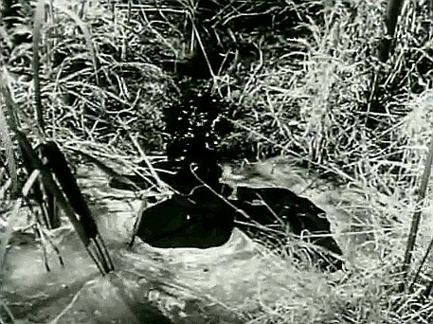

Slide 19
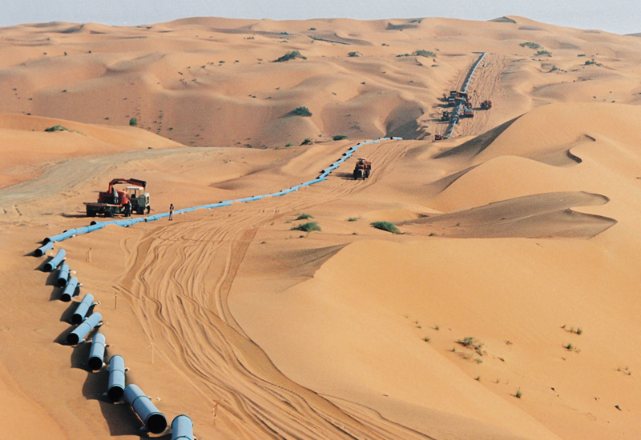
The Ghawar

Slide 20
WTI Spot Price

Slide 21
The cure for high prices…

Slide 22
innovation
and
utilization of less profitable resources

Slide 23
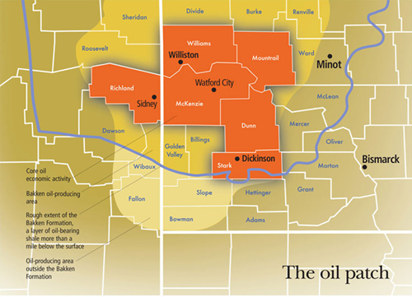

Slide 24
Pickens Comments

Slide 25
Innovations
What are they?

Slide 26
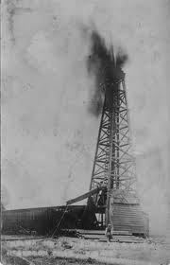
Horizontal drilling
Fracking

Slide 27
Horizontal drilling
Fracking
Imaging technology
Computer modeling

Slide 28
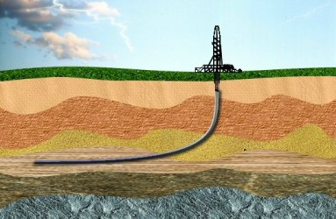
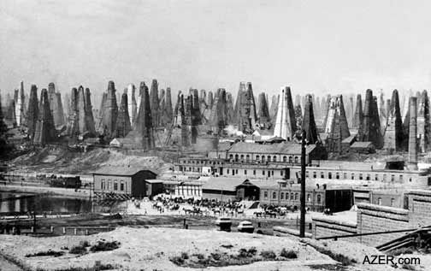
Horizontal Drilling

Slide 29
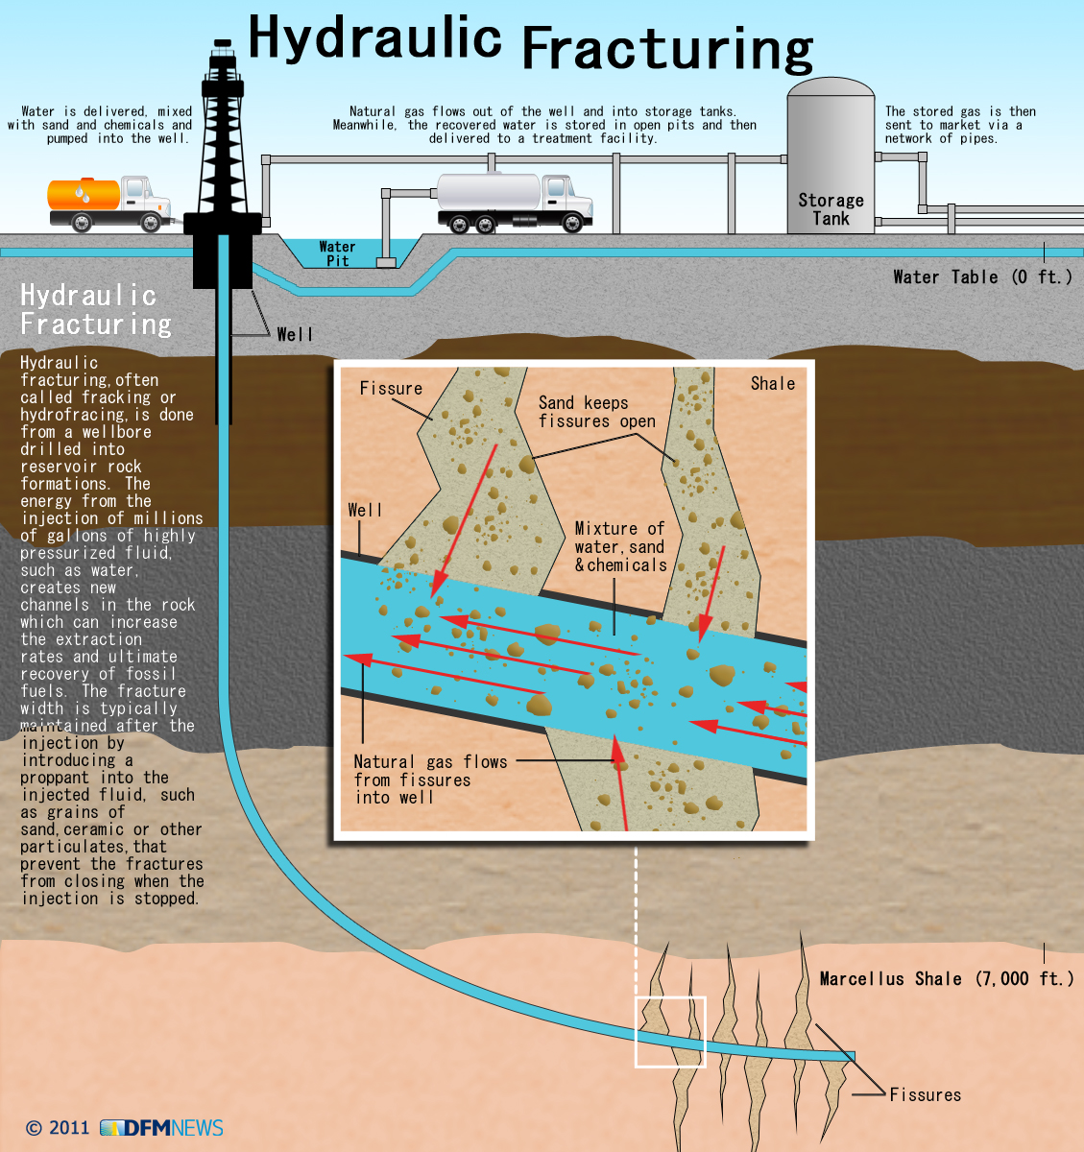
Fracking

Slide 30
Recent Activity

Slide 31
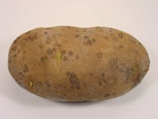

Slide 32
Rigs Down, Spuds Up
 | 1Q 12 | 3Q 13
Rigs | ~200 | 180
Spuds | 507 | 747
Spuds/Rig | 2.5 | 4.1
Spud to spud | 36 days | 22 days
Source: Baker Hughes Investor Relations

Slide 33
Source: KLJ Power Report 2012

Slide 34
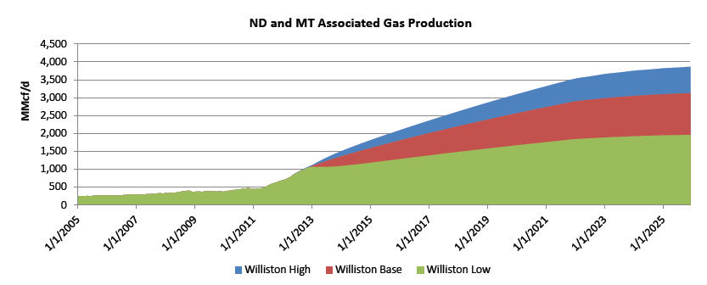
Source: Bentek, Williston Basin Study 2012

Slide 35
North Dakota
Oil
Gas

Slide 36
Break Even
$55-70?
$80 to $90?

Slide 37
How much?
An April 30 USGS Report estimated
7.4 billion barrels of oil
6.7 trillion cubic feet of associated gas
.53 billion barrels of NGL
In the Bakken and Three Forks (not just ND)
Technically recoverable
This is double the previous estimate from 2008

Slide 38
How much?
Harold Hamm, 2011
Bakken only
24 billion oil barrel equivalents
Technically recoverable

Slide 39
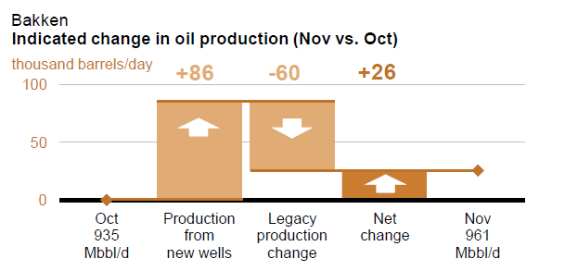
Source: EIA Drilling Productivity Report

Slide 40
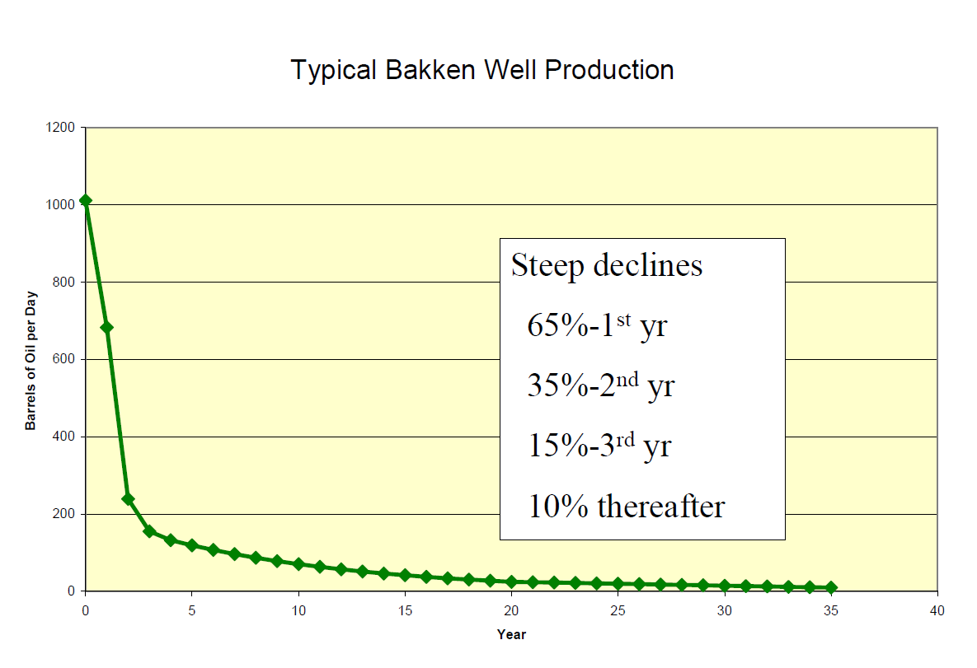
Source: ND DMR

Slide 41
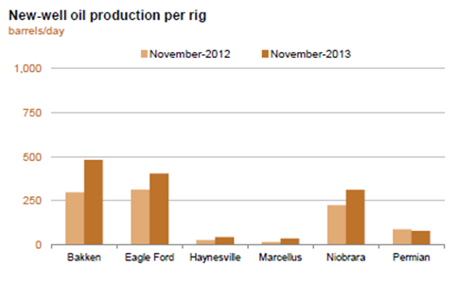
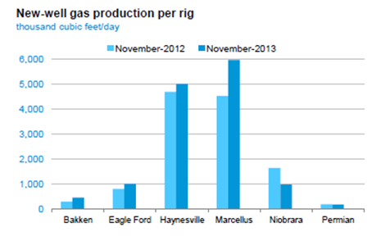
Source: EIA Drilling Productivity Report

Slide 42
The Impacts

Slide 43
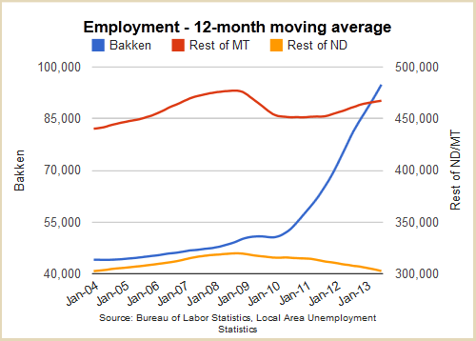
From the Minneapolis Fed

Slide 44
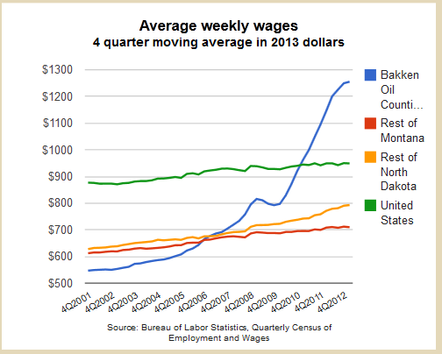
From the Minneapolis Fed

Slide 45
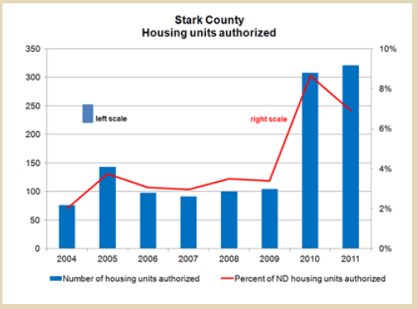
1,486 in 2012
From the Minneapolis Fed

Slide 46
outlook

Slide 47
ND wells are profitable at current and nearby prices
Don’t expect drastic change in the number of rigs (~180) over the next year

Slide 48
Watchlist
Drop in oil prices (world peace?)
Increase in natural gas prices
Fracking regulation/taxation
Persistent regional factors

Slide 49
Wrap up
Most ND oil resources being developed are unconventional
That are only economic when prices are high
The expectation is that activity will continue for at least 10-15 years at the current pace

