Slide 2
Nitrogen Fertilizer Manufacturing on the Northern Plains: Alternatives & Opportunities
David Ripplinger
CornVention 2013
Fargo, North Dakota
February 20, 2013

Slide 3
The Cure for High Prices…
Anhydrous Ammonia Retail Price Paid, Northern Plains
Source: USDA, Agricultural Prices Paid

Slide 4
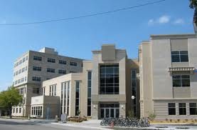
The Response
The North Dakota Corn Utilization Council initiated a series of studies to address high nitrogen fertilizer projects, including two with the Department of Agribusiness and Applied Economics.

Slide 5
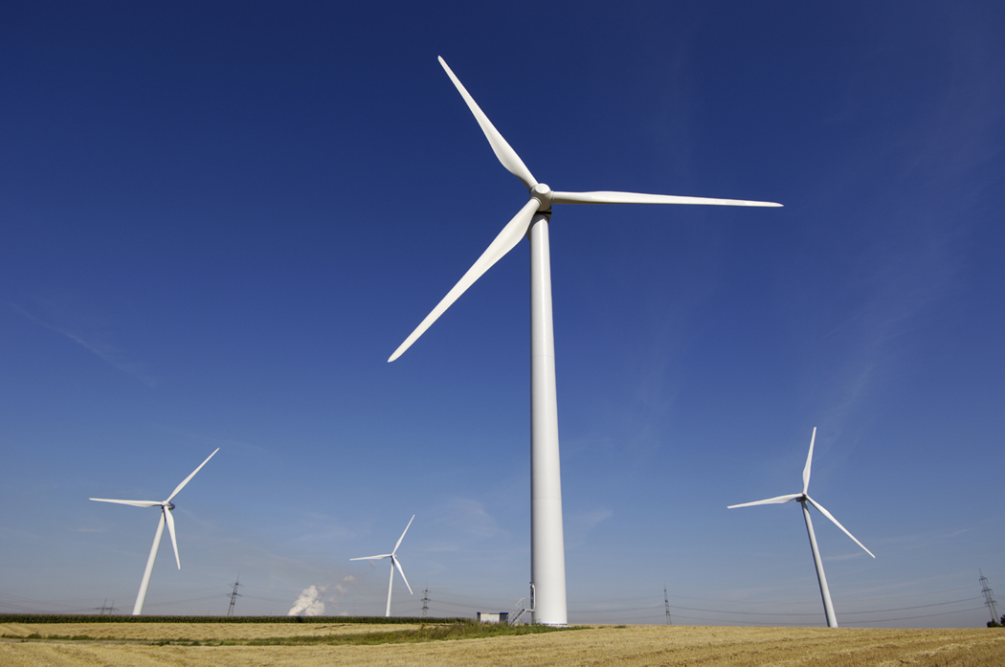
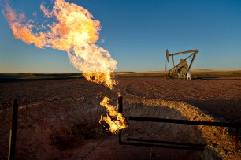
The Projects
Green fertilizer
Flare gas utilization

Slide 6
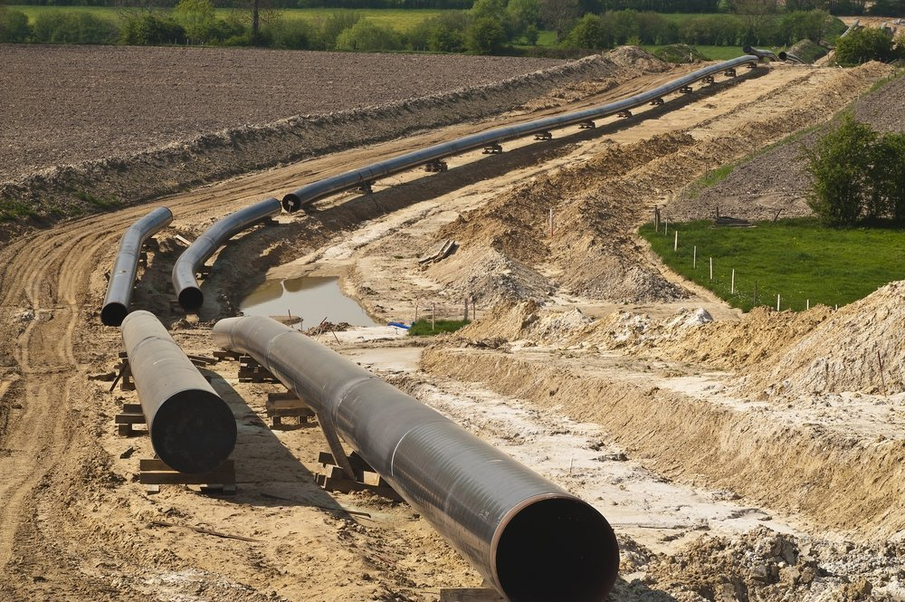
The Findings
Green fertilizer
- Expensive
- Unreliable
Flare gas utilization
- Economies of scale
- Expensive to collect
- Especially at large scale

Slide 7
…in the meantime…

Slide 8
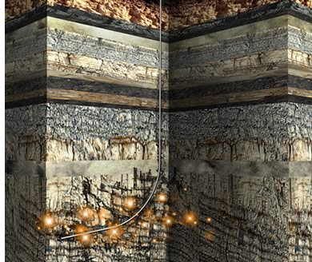
New Technology was Commercialized

Slide 9
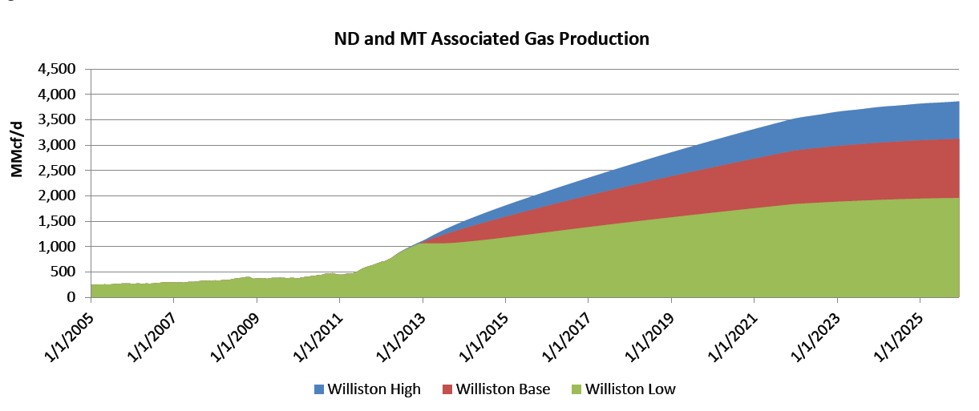
Causing Production to Increase (especially in North Dakota)
Source: Bentek, HPDI

Slide 10
And Prices to Fall
Historical NYMEX Henry Hub Natural Gas Futures Prices (Nearby)
Source: EIA, 2012

Slide 11
The feasibility analysis that ruled out collecting flare gas demonstrated the merits of traditional nitrogen manufacturing.
Why not build a world-scale
nitrogen fertilizer plant?
Buy natural gas ‘off the pipe’?

Slide 12
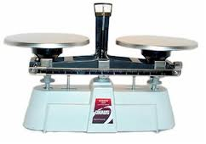
Provide a Natural Hedge for Farmers
Input
Costs
Investment Returns

Slide 13
Reframing the opportunity

Slide 14
North America is a Low-Cost Supplier of Natural Gas/Products
Low cost production
High demand in market
Low/no transportation costs

Slide 15
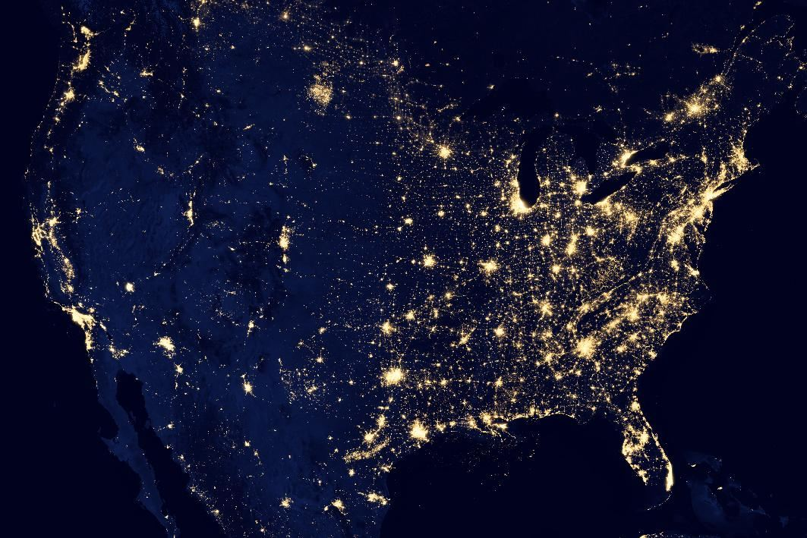
And North Dakota is at the Center of It

Slide 16
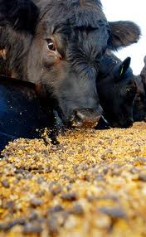
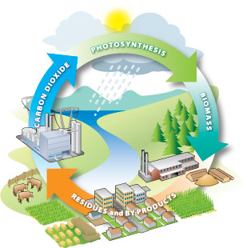
Growing Global Demand for Nitrogen Fertilizer
Rising global incomes and demand for protein-rich diets
High energy costs, environmental, rural development and energy security concerns -> bioenergy
High ag commodity prices
Seeking higher production (yields and acres)

Slide 17
And North Dakota is at the Center of It
Regional corn acres increased 28% in the Dakotas and Minnesota between 2010 and 2012 (USDA)
Increased demand/use of nitrogen fertilizer
Nitrogen Use in Tons (corn)
Source: USDA

Slide 18
The feasibility analysis that ruled out collecting flare gas showed the merits of a world-scale nitrogen fertilizer manufacturing facility.
Can you build a business on it?

