Slide 1

Midwest Residential
Heating Fuel Use Assessment
Heating the Midwest Conference & Expo
Apr. 24-26, 2013 • Carlton, MN
Fred Iutzi¹, Xiaolan Liu¹, & David Ripplinger²
1. Illinois Institute for Rural Affairs at Western Illinois University
2. Dept. of Agribusiness & Appl. Economics, North Dakota State University

Slide 2




HTM Biomass Resources & Demographics Action Team
Pete Aube, Potlatch Corp.
Steve Bertjens, USDA
Stuart Birrell, ISU
Cara Carper, SW Badger RC&D
Mike Curci, Andritz Inc.
Al Doering, AURI
Nate Dorr, NWMF
Mary Eaton, Idea Circle
Lindberg Ekoka, MFRC
Rod Enberg, Enberg Logging Sup.
Jill Euken, ISU
Cam Fanfulik, NWRDC
Dave Fiebelkorn, Woodshed Ren.
Joel Haskard, UMN
Steve Hubbard, State of WI
Scott Hull, State of WI
Fred Iutzi, IIRA
Steve John, AWI
Bill Johnson, BCS
Kevin Kephart, SDSU
Kimberly Korbecki, State of MI
Joe Kramer, Energy Ctr. of WI
Nan Larson, AURI
Gail Leverson, Cass Co., MN
Mark Lindquist, State of MN
Xiaolan Liu, IIRA
Thein Maung, NDSU
Amanda Mott, State of WI
Steve Olson, Fond du Lac Res.
Lissa Pawlisch, UMN
Don Peterson, Ren. Res. Solutions
Becky Philipp, AURI
Mike Polzin, MN Power
Gary Radloff, UW
Chris Reynolds, Phoenix Recycling
Steve Richter, TNC
Dave Ripplinger, NDSU
Scott Robinson, CVAE
Dean Sedgwick, Itasca Power
Wade Stomgren, RMS
Doug Tiffany, UMN
Kevin Triemstra, MN Biomass Exch.
Mike Troge, Oneida Nation
Bruno Zagar, Fond du Lac Res.
Diomedes Zamora, UMN
Team leadership
Becky Philipp &
Al Doering
Study authors
Fred Iutzi, Xiaolan Liu,
& David Ripplinger

Slide 3

Residential heating: The low-hanging fruit of biomass development
Strauss, 2013
Iutzi et al., 2013

Slide 4

Problem statement
Developing residential biomass markets involves displacing existing heating fuels.
Therefore existing heating fuel use is one of the bases for assessing local and regional biomass market potential.
…but fuel use statistics are usually only reported at the state level.

Slide 5

Data
[State-level map of RECS
data goes here.]
Residential Energy Consumption Survey (RECS) provides estimates of energy used for residential heating broken down by fuel.
Used 2009 data. (Most recent available.)
Iutzi et al., 2013

Slide 6
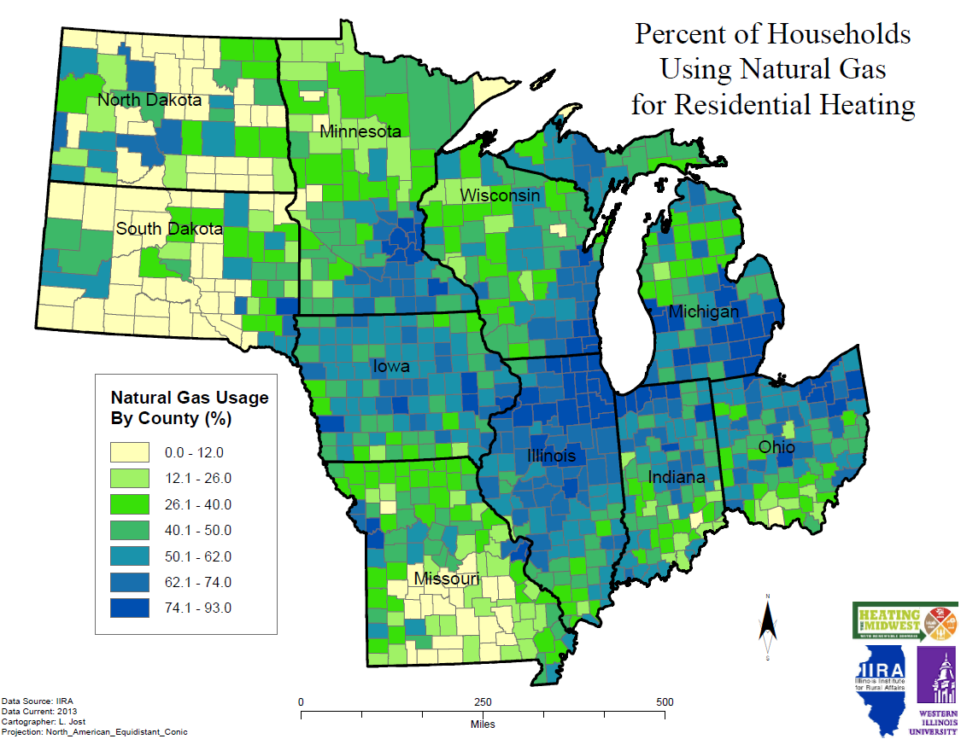

Data
County-level estimates of number of households using each heating fuel.
Used five-year average, 2007-2011.
Iutzi et al., 2013

Slide 7
Data
Natural gas
Iutzi et al., 2013

Slide 8
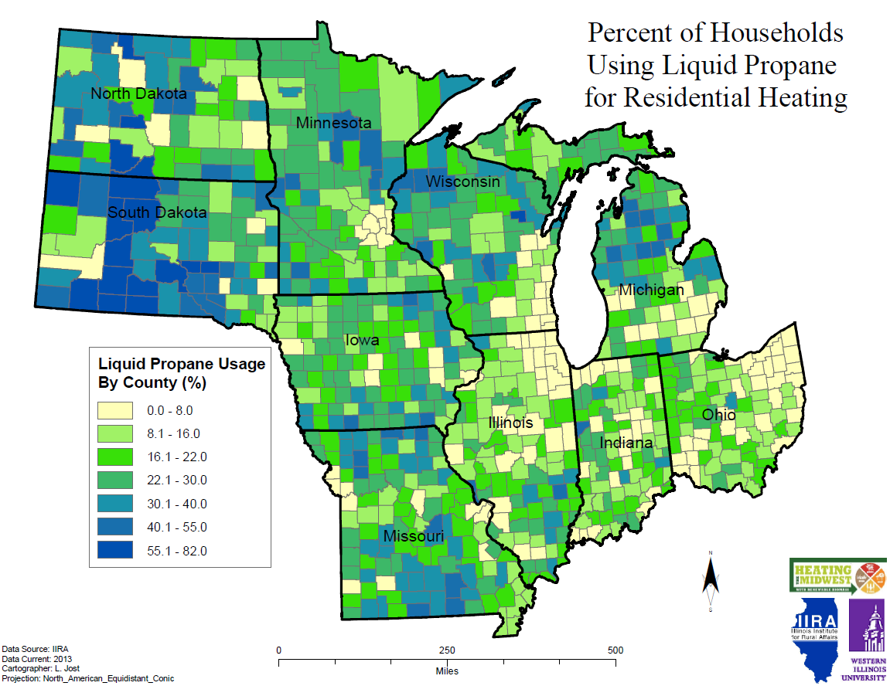
Data
LP
Iutzi et al., 2013

Slide 9
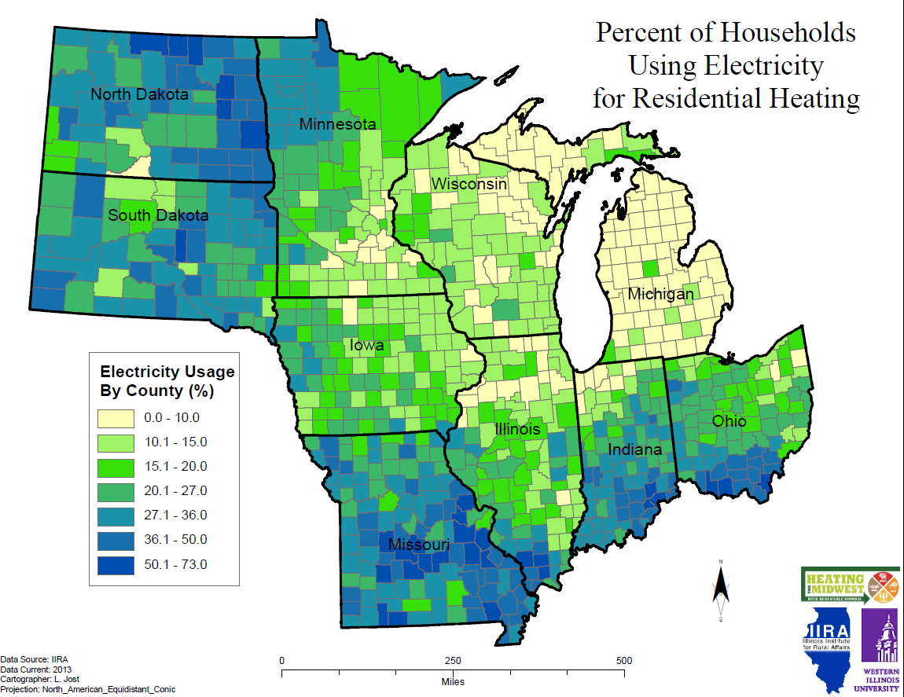
Data
Electricity
Iutzi et al., 2013

Slide 10
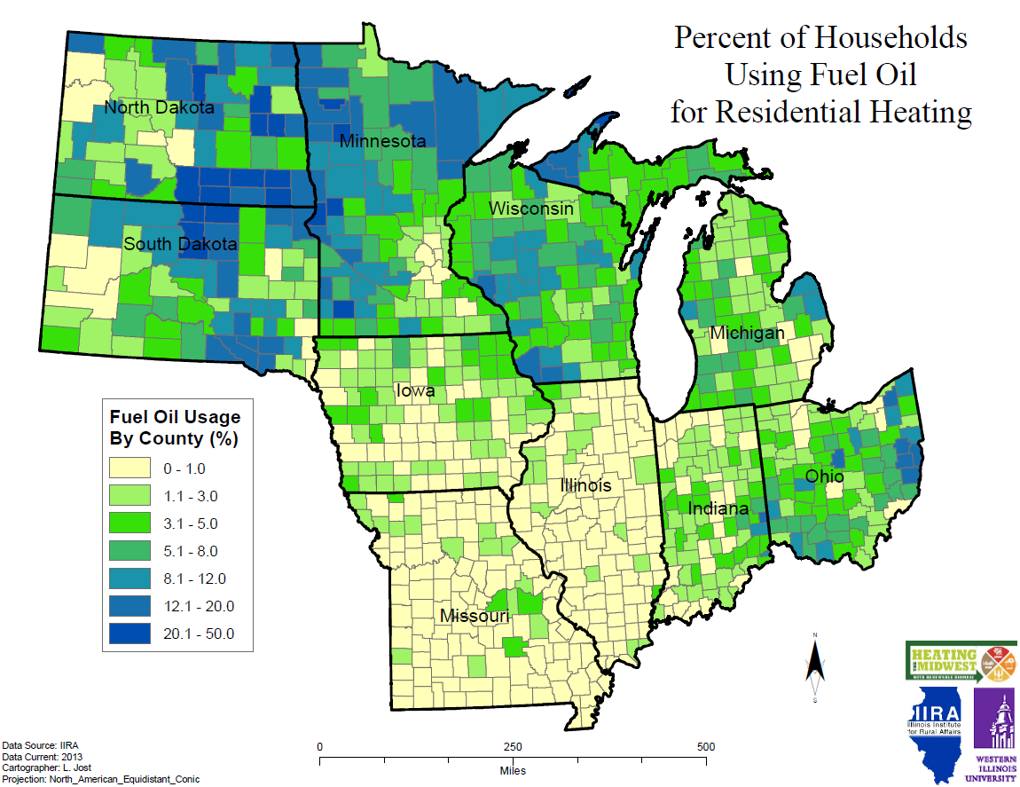
Data
Fuel Oil
Iutzi et al., 2013

Slide 11
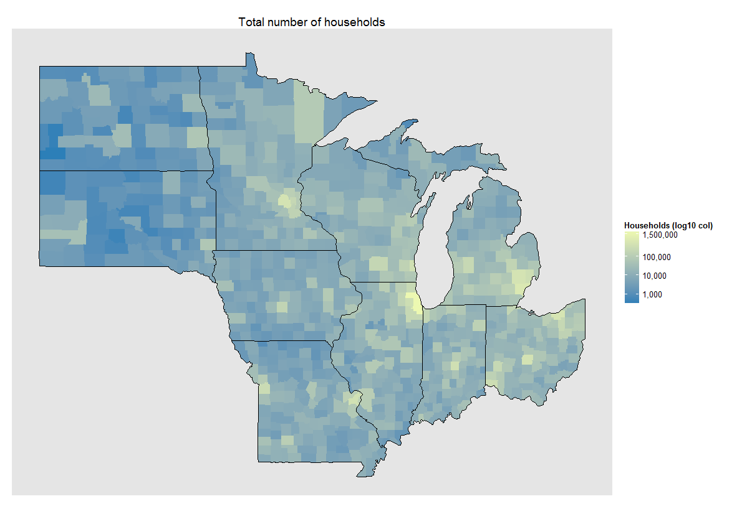
Data
Total Households
Iutzi et al., 2013

Slide 12
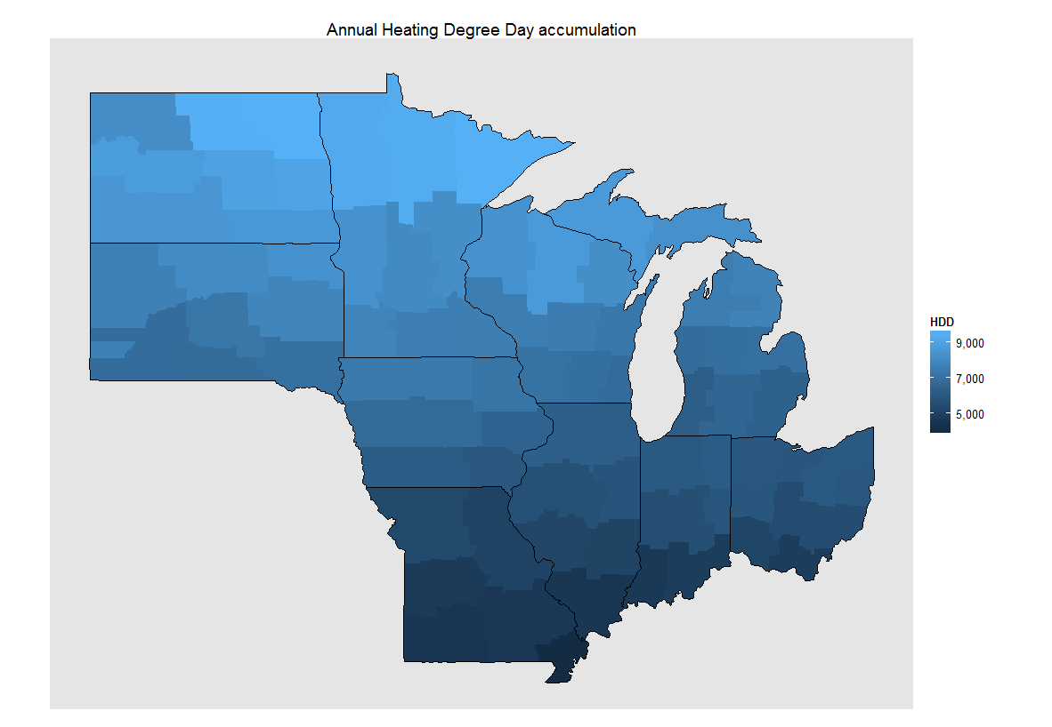


Data
NOAA National Climatic Data Center (NCDC) data set TR-9640 provides annual heating degree day accumulation by climate division.
Calculated a ten-year average, 2001-2010. Imputed division averages to counties. Calculated statewide averages.
Iutzi et al., 2013

Slide 13
Data
HDD
Iutzi et al., 2013

Slide 14
Methods
IA - MN - ND - SD
IL
IN - OH
MI
MO
WI
For each state or multi-state grouping, calculated fuel consumption in MMBTU per household per HDD. Repeated for each fuel.
For each county, multiplied corresponding state consumption factor by total households and annual HDD. Repeated for each fuel.
For each county, calculated hypothetical biomass demand under scenarios of 10% & 25% displacement of LP + electricity.
MMBTU / household / HDD
=
consumption factor
NG
LP
Elec.
consumption factor
x
total households
x
annual HDDs
=
fuel consumption MMBTU
Each of:
305 co.
102 co.
180 co.
83 co.
115 co.
72 co.
NG
LP
Elec.
(LP MMBTU + Elec. MMBTU)
x
% displacement
/
16 MMBTU / t DM
Each of:
857 co.
10%
25%
Iutzi et al., 2013

Slide 15
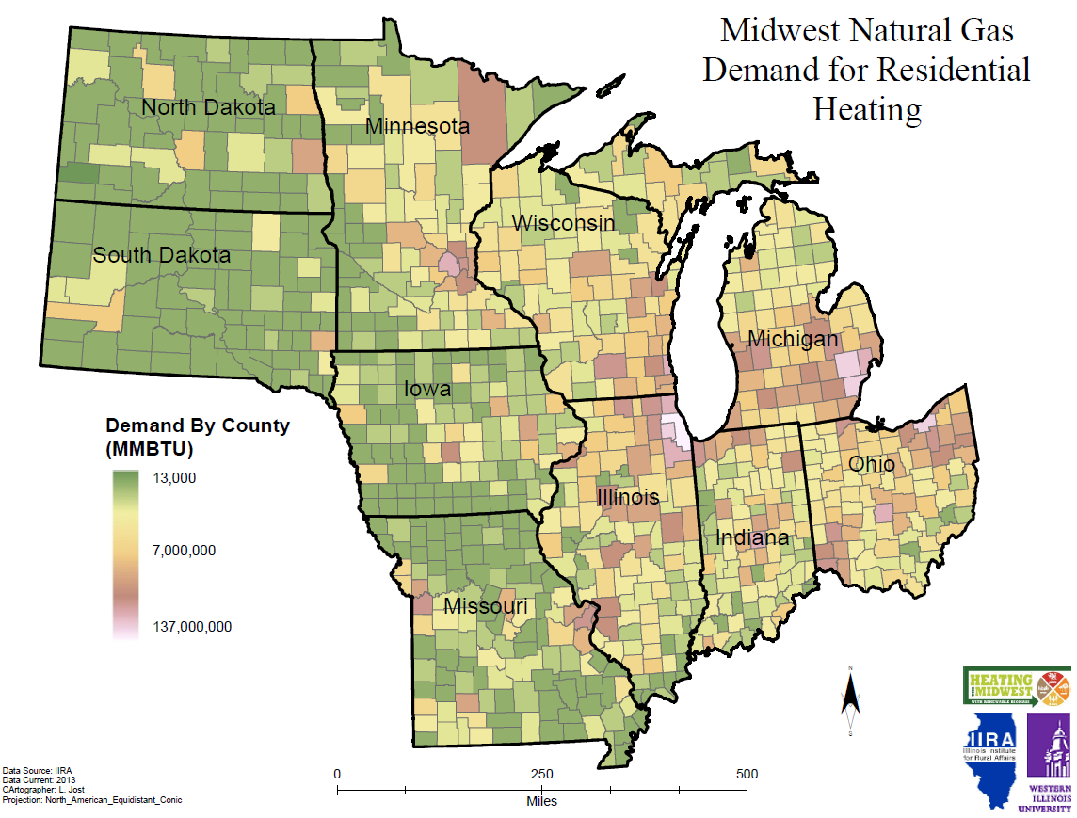
Results
Natural gas
Iutzi et al., 2013

Slide 16
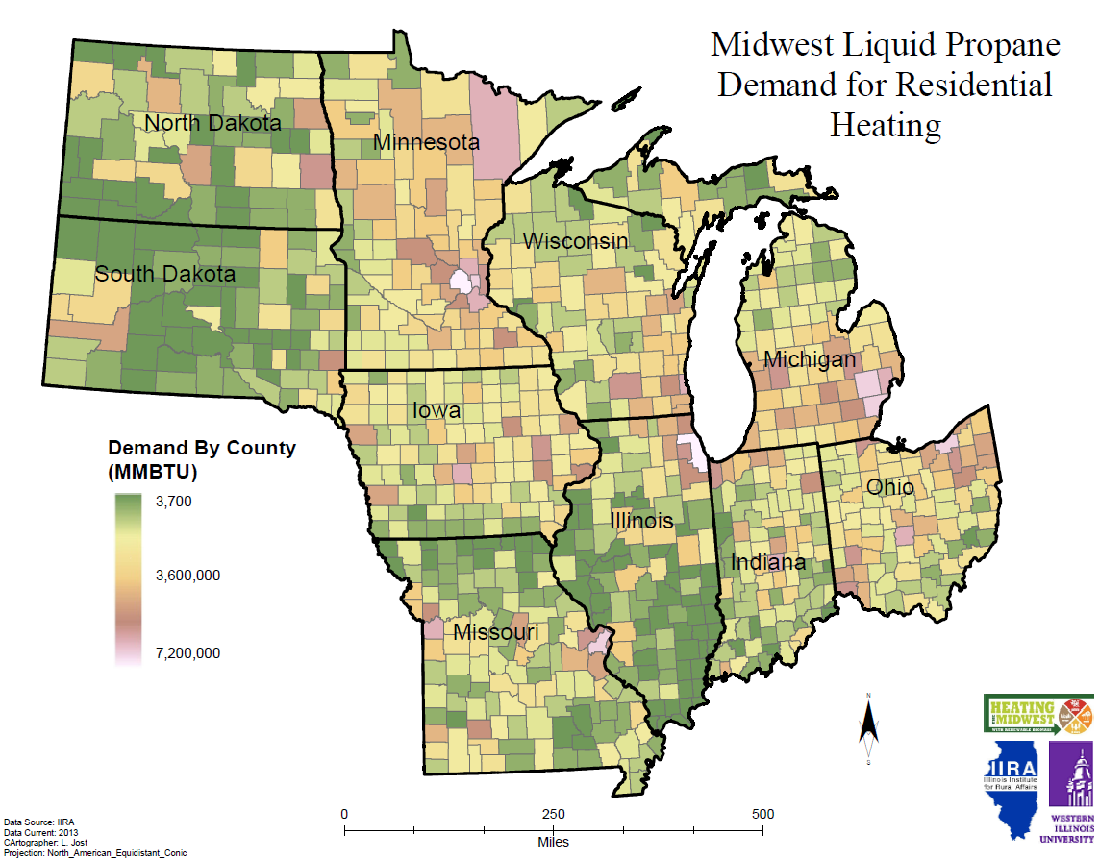
Results
LP
Iutzi et al., 2013

Slide 17
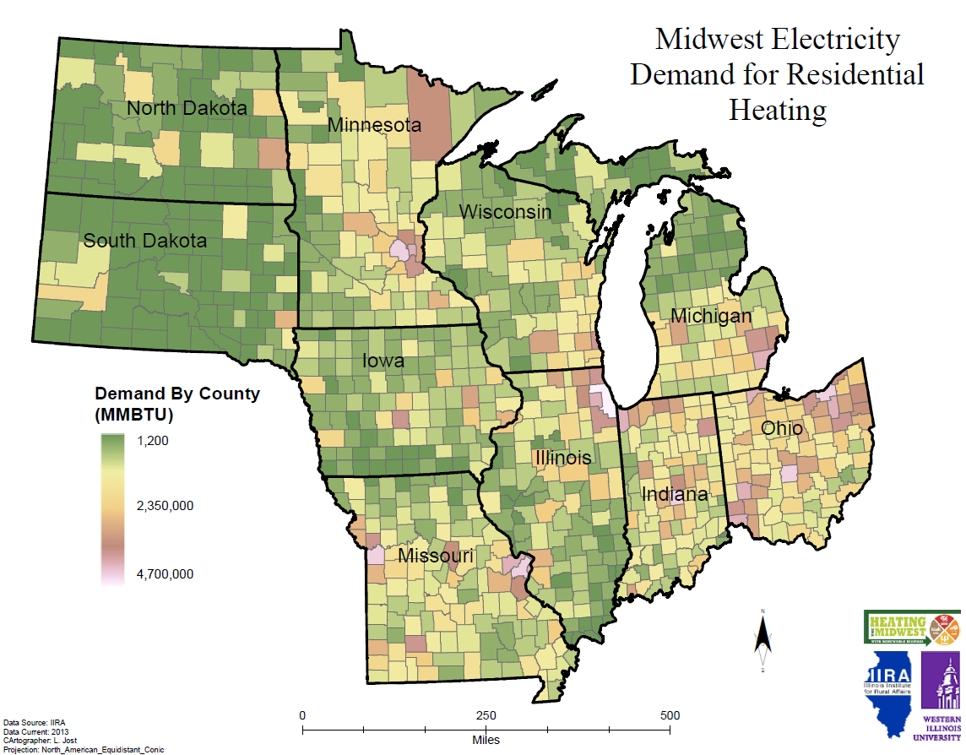
Results
Electricity
Iutzi et al., 2013

Slide 18
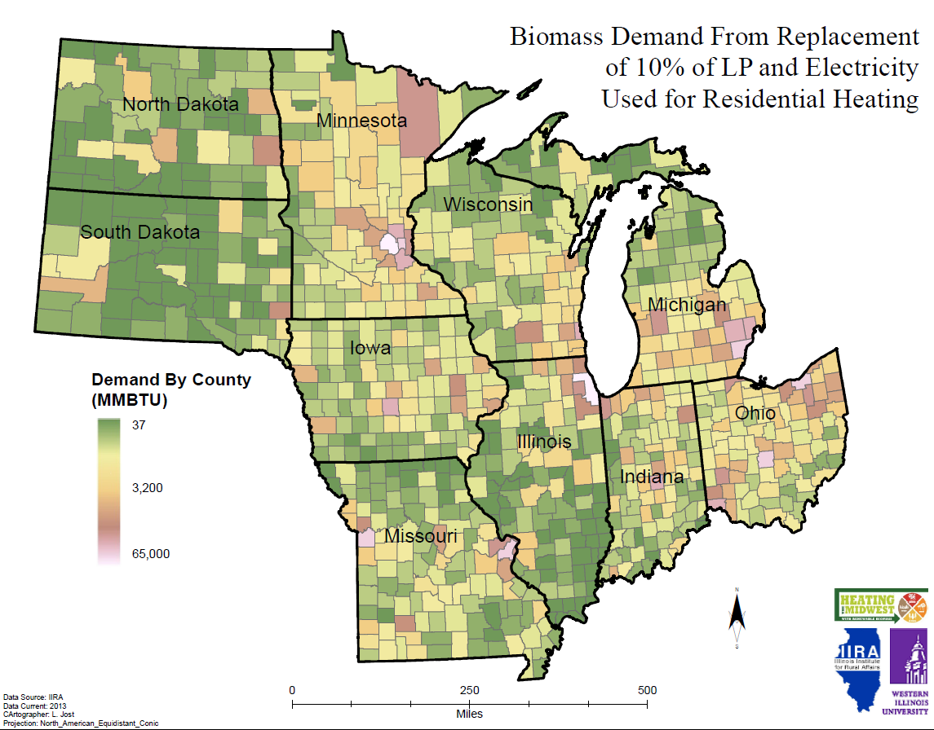
Results
Biomass Demand From Replacement of 10% of LP and Electricity Used for
Residential Heating
10% Biomass
Iutzi et al., 2013

Slide 19
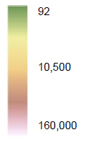
Results
Biomass Demand From Replacement of 25% of LP and Electricity Used for
Residential Heating
25% Biomass
Iutzi et al., 2013

Slide 20
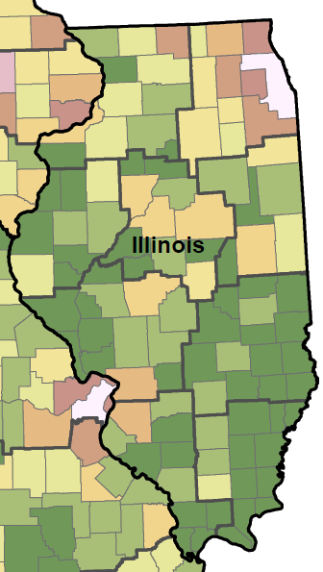
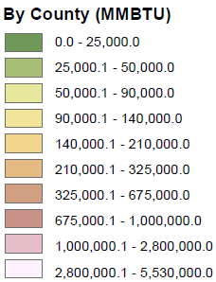
Use of results: Example 1
LP usage
IL Climate Division 4
County | LP (MMBTU) | Electricity (MMBTU)
DeWitt | 17,439 | 14,864
Logan | 28,492 | 24,284
Macon | 115,523 | 98,462
Marshall | 13,118 | 11,181
Mason | 16,657 | 14,197
McLean | 164,417 | 140,136
Menard | 12,854 | 10,956
Peoria | 195,483 | 166,614
Stark | 6,146 | 5,238
Tazewell | 140,344 | 119,618
Woodford | 36,504 | 31,113
TOTAL | 746,977 | 636,664
Iutzi et al., 2013

Slide 21
Use of results: Example 1
Fuel consumed | MMBTU
Propane | 747,000
Electricity | 637,000
Total high- price fuels | 1,380,000
10% scenario | 138,000
15% scenario | 207,000
Biomass demand | t DM / yr*
10% scenario | 8,620
25% scenario | 12,900
11 counties of IL Climate Division 4
* Assuming 16 MMBTU / t DM.
Iutzi et al., 2013

Slide 22
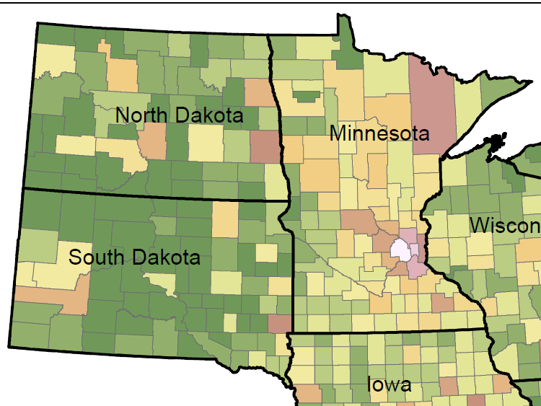
Use of results: Example 2
Wahpeton, ND
Iutzi et al., 2013

Slide 23
Use of results: Example 2
Fuel consumed | MMBTU
Propane | 2,160,000
Electricity | 950,000
Total high-price fuels | 2,710,000
10% scenario | 270,000
25% scenario | 680,000
Biomass demand* | t DM / yr
10% scenario | 17,000
25% scenario | 42,500
Wahpeton, ND region
Clay, MN
Grant, MN
Otter Tail, MN
Traverse, MN
Wilkin, MN
Cass, ND
Ransom, ND
Richland, ND
Sargent, ND
Marshall, SD
Roberts, SD
* Assuming 16 MMBTU / t DM.
Iutzi et al., 2013

Slide 24
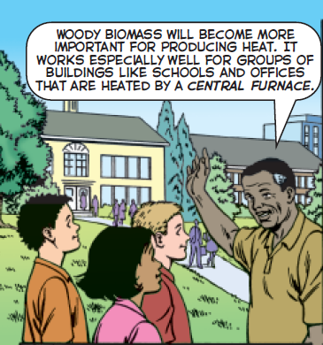


Accessing the results
Spreadsheet of county-level results to be posted with slides on HTM website.
Report will be published later in 2013.
www.heatingthemidwest.org
Deschaine (NACD), 2007
Iutzi et al., 2013

Slide 25
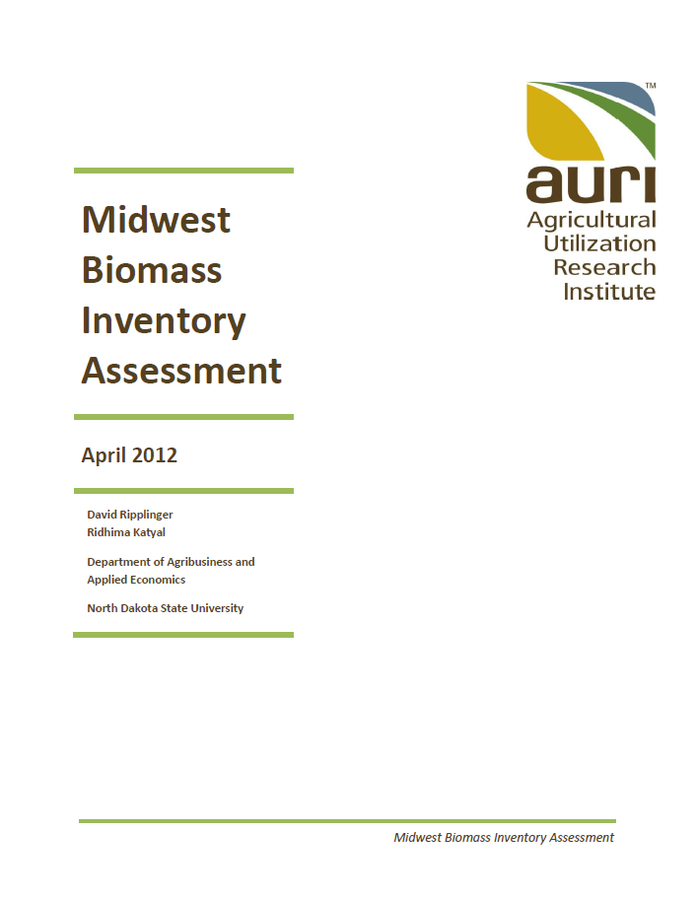
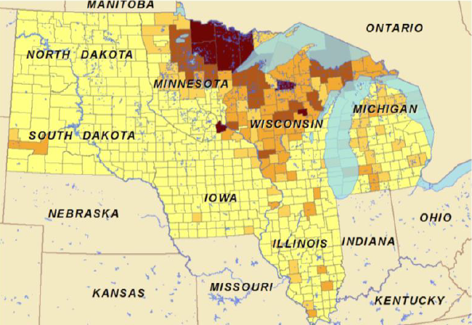
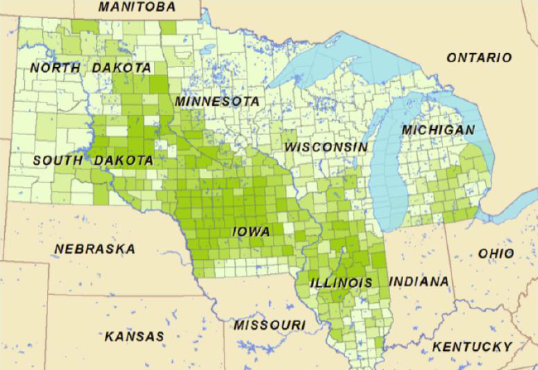
2012 Biomass Inventory
www.auri.org/2012/04/midwest-biomass-inventory/
Iutzi et al., 2013

Slide 26
Next directions
Expand assessment to commercial & ag sectors
Link consumer demographics to market behavior
Integrate natural gas distribution infrastructure and price information into assessment
Other directions?

Slide 27


HTM Biomass Resources & Demographics Action Team
www.heatingthemidwest.org
Team contact
Becky Philipp, AURI
218-280-8575
bphilipp@auri.org
Author contacts
Fred Iutzi, MS, IIRA at WIU
f-iutzi@wiu.edu, 309-298-1453
Xiaolan Liu, PhD, IIRA at WIU
x-liu@wiu.edu, 309-298-2526
David Ripplinger, PhD, NDSU
david.ripplinger@ndsu.edu, 701-231-5265

