Slide 2
Bioenergy Outlook Fall 2013
David Ripplinger
Ag Lender Conferences
October-November 2013

Slide 3
All Roads Lead to Washington

Slide 4
The Renewable Fuel Standard

Slide 5
The Renewable Fuel Standard (RFS)
A federal law enacted in 2005 and updated in 2007 that mandates the minimum use of various biofuels by type and year.
Provides support for the development and operation of biorefineries.

Slide 6
US ethanol production and capacity

Slide 7
What types of fuels?
Renewable Fuels
Advanced Biofuels
Biodiesel
Cellulosic

Slide 8
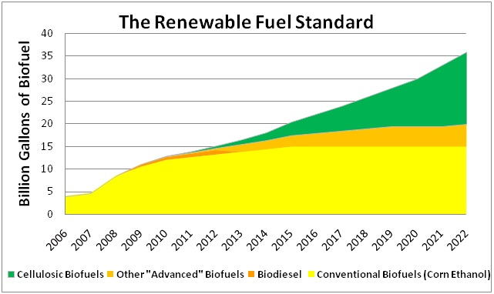
How much?
Changes each year
Can be modified by EPA

Slide 9
How does it work?
Each year blenders are told the amount of each type of fuel they need to blend based on the amount of fuel they used the previous year

Slide 10
Two snags
Phantom Fuel
The Blend Wall

Slide 11
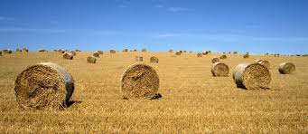
Two reasons to change mandates
- Economic harm
- Inadequate domestic supply
Case in point: cellulosic ethanol

Slide 12
2012 Drought
In 2012, blenders requested a waiver.
EPA denied the request.

Slide 13
RFS 2013 Levels
 | 2013 Initial
Corn-ethanol | 13.8 billion
Cellulosic | 1 billion
Biodiesel | 1 billion
Other Advanced | .75 billion
Total | 16.55 billion
2013 Actual
13.8 billion
6 million
1.28 billion
1.46 billion
16.55 billion

Slide 14
Breaking down the blend wall
Increased biodiesel production, but feedstocks (soybean oil) are expensive
Use of higher blends E15 and E85, but we barely have the infrastructure or fleet to do it

Slide 15
Biodiesel
There is significant excess capacity
$1 per gallon biodiesel tax credit is set to expire in Dec

Slide 16
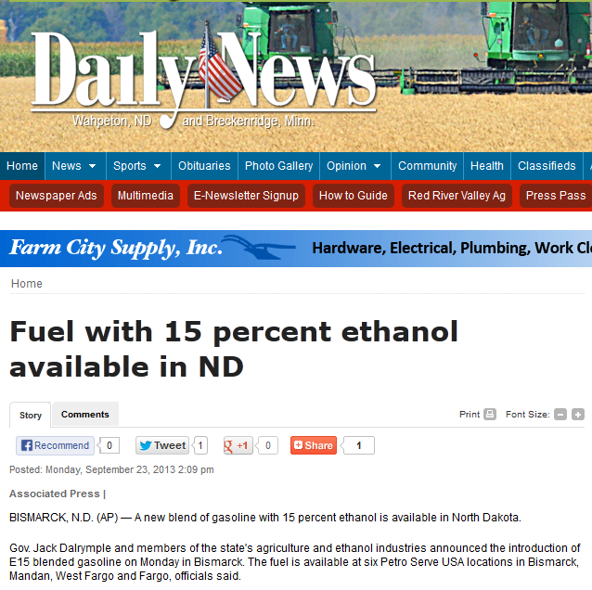
EPA Certification

Slide 17
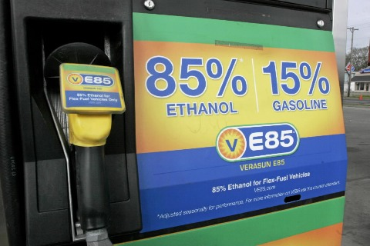
E85
There are about 10 million flex fuel vehicles.
1 million of these use E85 (as of 2011).
There are about 2,300 E85 stations.
500 gallons per vehicle-year
→ 5 billion gallons…
That’s a lot of fuel that would move if priced right.

Slide 18
Renewable Identification numbers

Slide 19
RINS defined
Renewable Identification Numbers (RINS) are a mechanism to track the production or import and use of biofuels.
They can be traded, banked, and eventually reported to EPA to verify compliance

Slide 20
The value of RINS
RINS have value when a blender would rather buy a RIN then blend a gallon of biofuel.
This occurs when the cost of a gallon of biofuel exceeds its value.

Slide 22
Renewable Fuel RIN prices

Slide 23
Economics 101/Speculators
NY Times September 14, 2013

Slide 24
Corn-based ethanol

Slide 26
Chicago corn nearby futures

Slide 27
Ethanol Forward Price Curve

Slide 28
Ethanol Nearby Futures

Slide 29
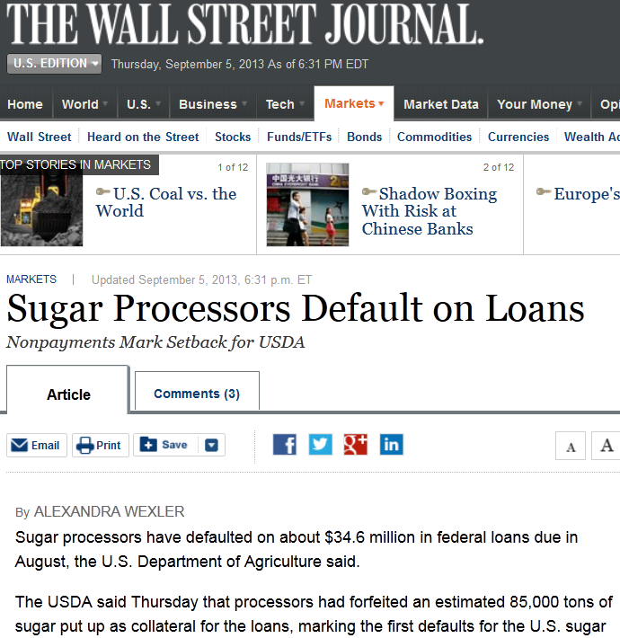

Slide 30
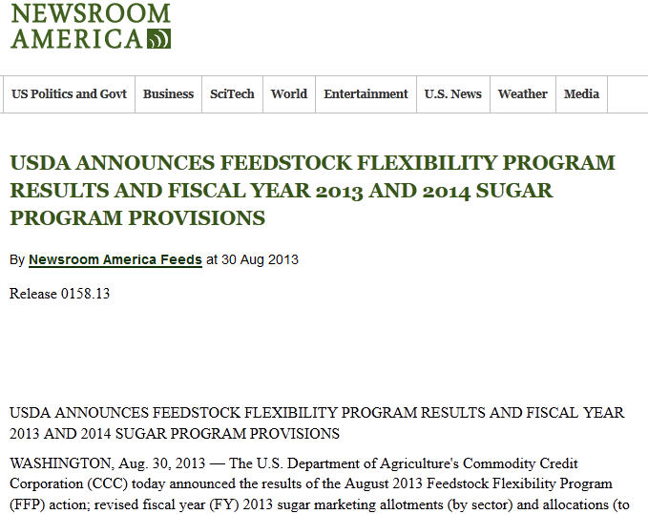

Slide 31
Sugar forfeitures & ethanol
Impacts
14 lbs of sugar/gallon of ethanol
1 billion pounds of sugar -> 70 million gallons of ethanol
~.5% of corn-ethanol production

Slide 32
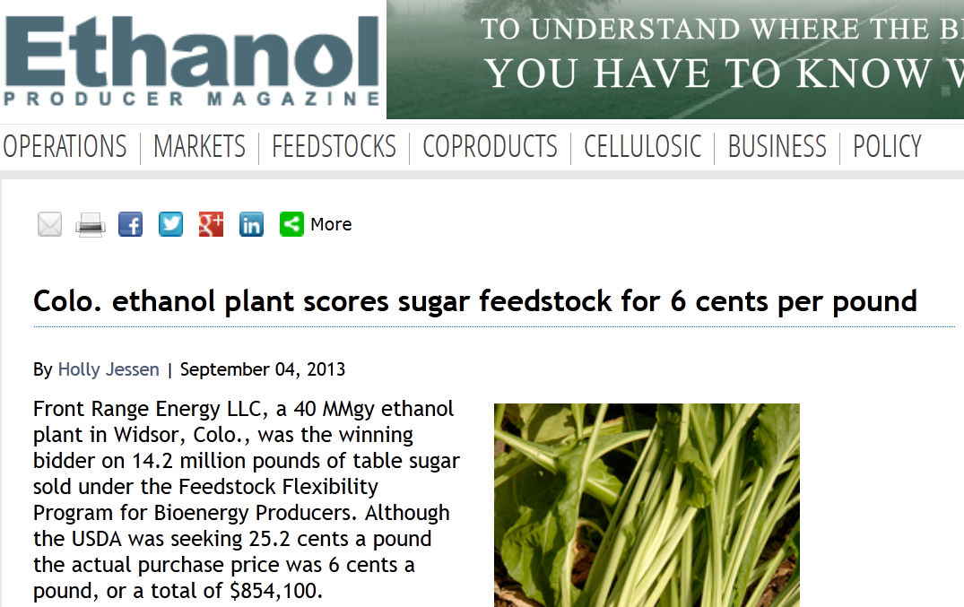

Slide 33
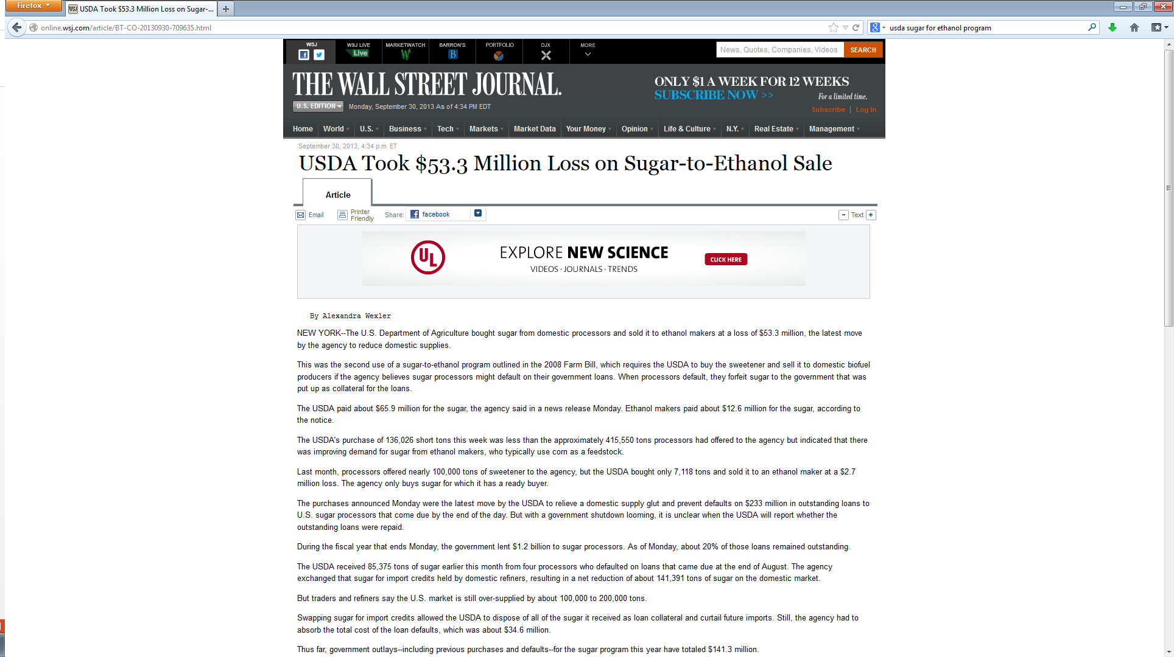

Slide 34
Cellulosic Ethanol Nearing commercialization

Slide 35
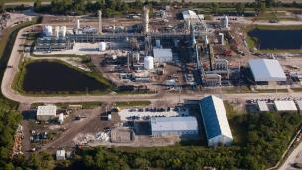
Ineos Bio (FL) gasifies waste wood to produce 8 mm gpy of ethanol been operating since July

Slide 36
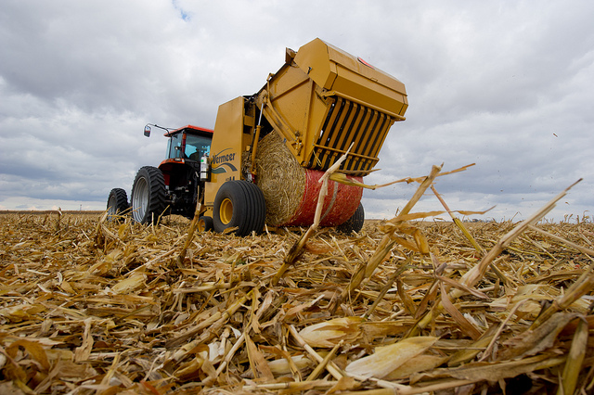
Domestic cellulosic projects
Poet-DSM in Emmitsburg, IA, 25 mmgpy
Dupont-Danisco in Nevada, IA, 27.5 mmgpy
Abengoa in Hugoton, KS, 25 mmgpy

Slide 37
An old one to remember
Range Fuels of Soperton Georgia, $300 million biorefinery produced one batch of cellulosic ethanol and then was dismantled

Slide 38
North Dakota Projects

Slide 39
65 million gallon per year
corn-ethanol refinery
Located near Spiritwood
Uses heat and power from co-located coal-fired power plant

Slide 40
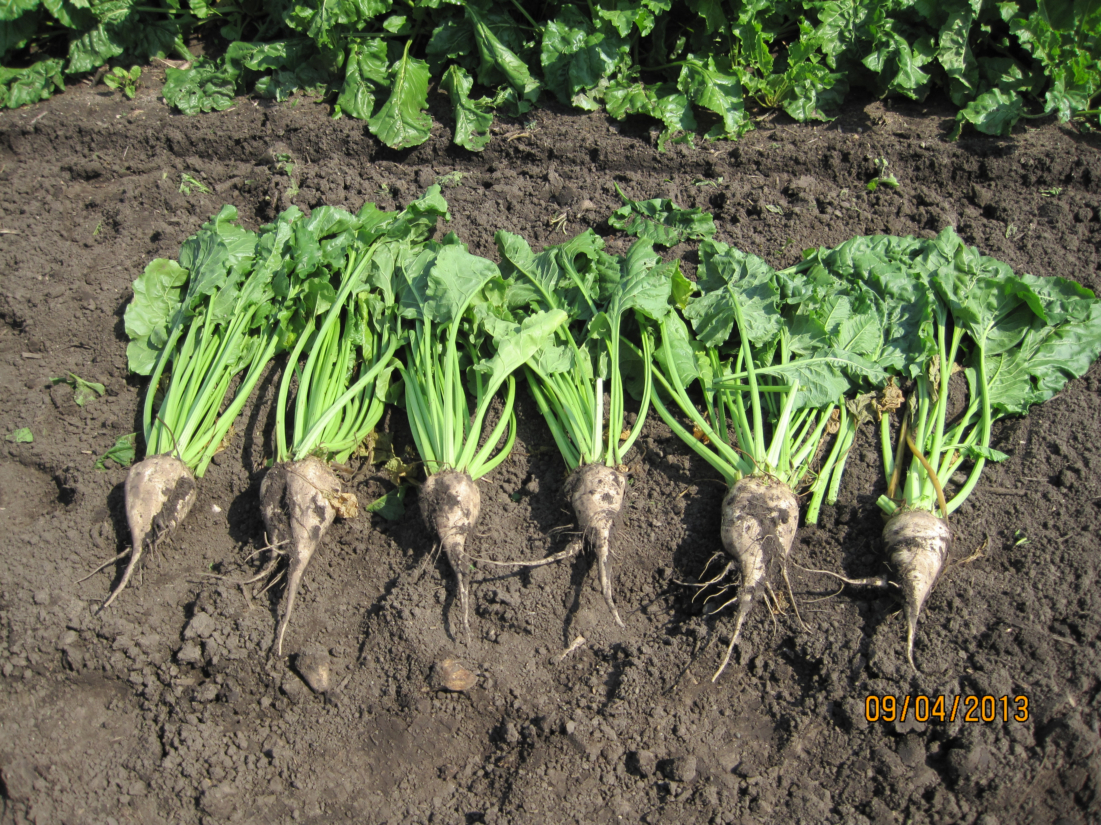
NDSU Research

Slide 42
OUTLOOK

Slide 43
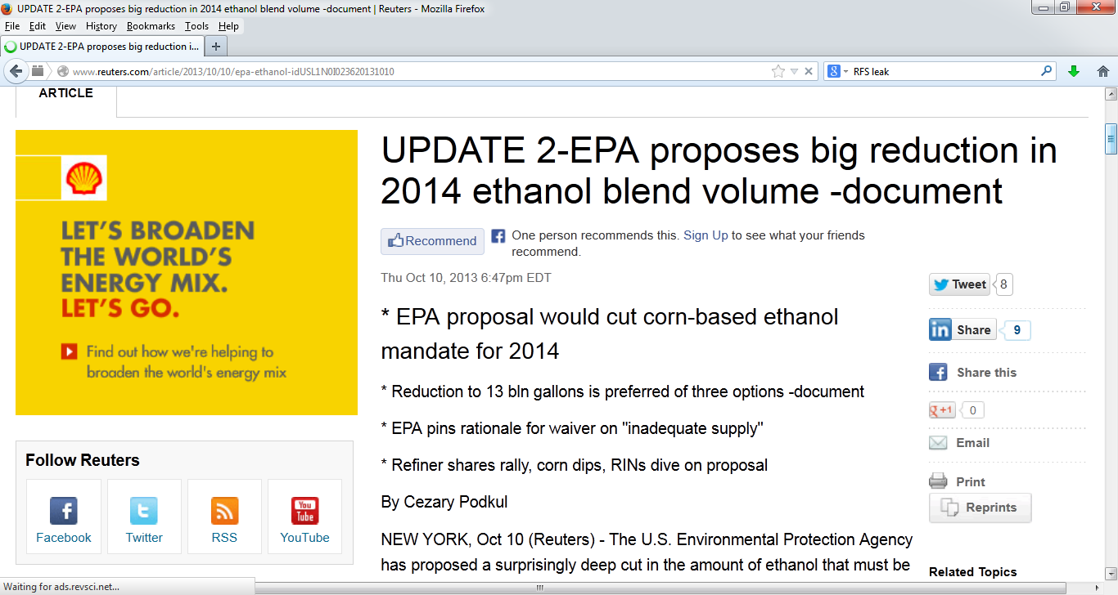

Slide 44
 | 2 013 Initial
Corn-ethanol | 13.8 billion
Cellulosic | 1 billion
Biodiesel | 1 billion
Other Advanced | .75 billion
Total | 16.55 billion
2014 Rumor
13 billion
23 million
1.28 billion
2.21 billion
15.21 billion
% of Motor Fuels
9.8
.017
1.16
1.36
9.33
2014 Initial
14.4 billion
1.75 billion
>1 billion
1 billion
18.15 billion

Slide 46
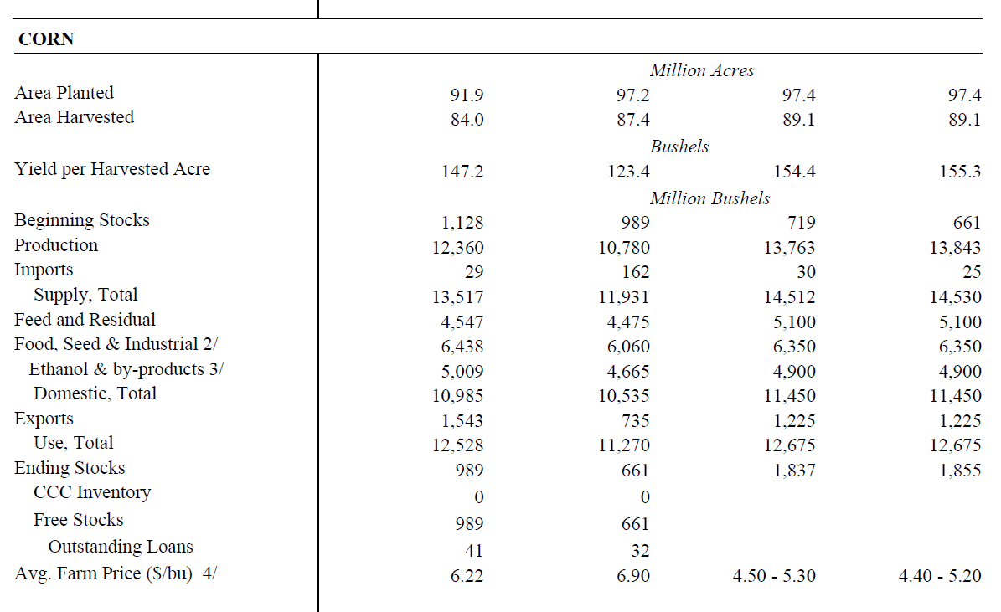
Source: WASDE, USDA

Slide 47
What would this mean to corn growers?
Especially those in North Dakota?
Other producers/land owners?
What does it mean to you as a lender?

Slide 48
Soybeans/Biodiesel
Loss of the biodiesel tax credit
The mandate will likely bind
Production will fall from 1.7 to 1.28 billion gallons.
Similar impacts as corn, but on a much smaller scale

Slide 49
Summary
EPA’s decision on the 2014 mandate which is required by November 31 may move the corn market significantly
This could affect profitability in 2014 and have significant longer-term implications as well.

