Slide 2
Recent Issues in Domestic Renewable Energy Policy
David Ripplinger
January 30th, 2013

Slide 3
Today’s Topics
Wind Energy
Renewable Fuel Standard
Volumetric Excise Tax Credit

Slide 4
Wind and roller coasters

Slide 5
Wind Production Tax Credit (PTC)
Provides a 2.2 cent tax break per kwH for the first ten years of a facility

Slide 6
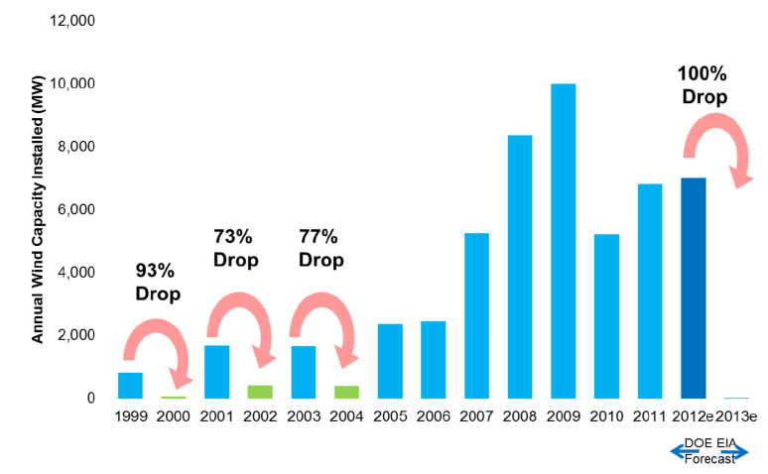
The Roller Coaster
Source: AWEA, EIA

Slide 7
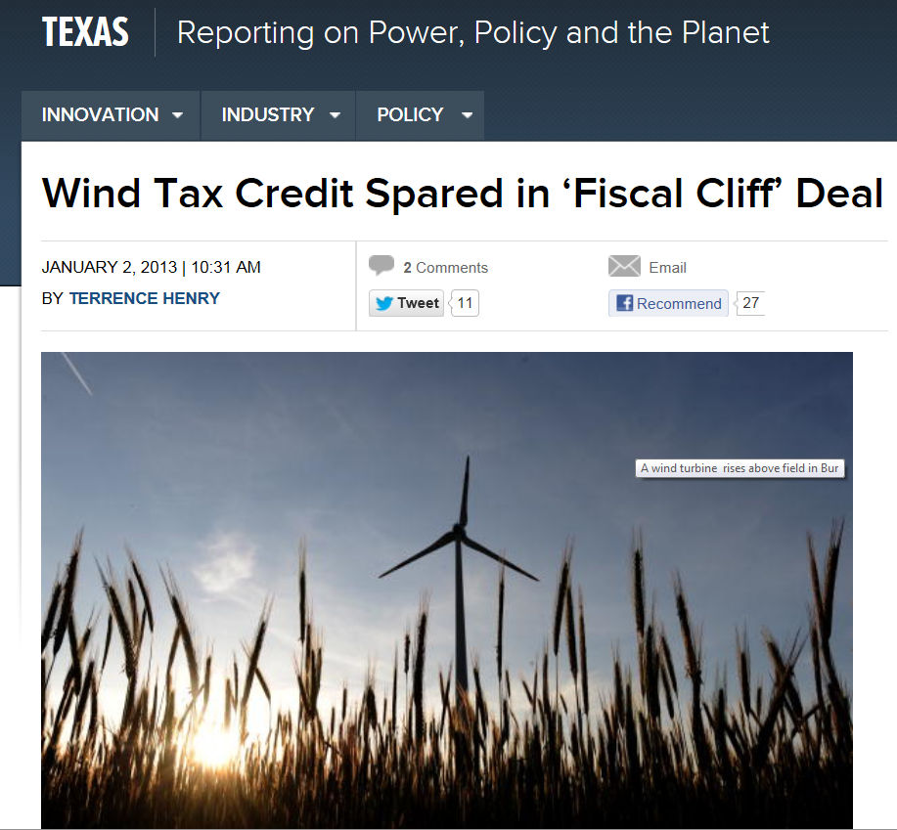
http://www.denverpost.com/breakingnews/ci_22296411/wind-energy-tax-credit-extended-one-year

Slide 8
The effects

Slide 9
RIN Primer

Slide 10
The Renewable Fuel Standard
The expanded Renewable Fuel Standard (RFS2) is a federal law that mandates increasing use of biofuels.

Slide 11
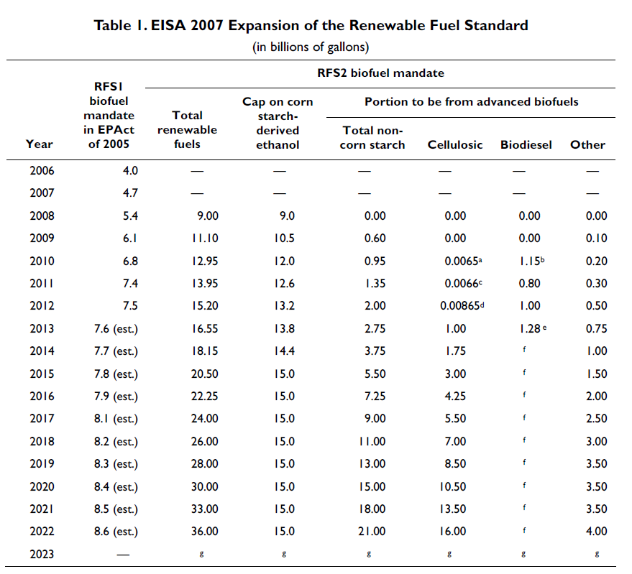
Congressional Research Service

Slide 12
Source: EIA

Slide 13
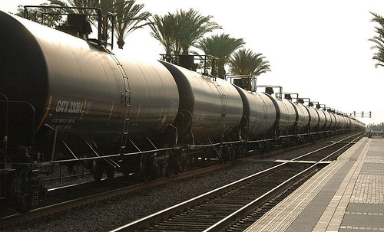
How the policy is enforced
Each gallon of renewable fuel produced in or imported into the United States is assigned a 38 digit Renewable Identification Number (RIN). The RIN is attached to the physical commodity until it is purchased by a blender.

Slide 14
How the policy is enforced
Blenders must acquire a sufficient number of RINs, their Renewable Volume Obligation (RVO), for each of the four fuel types based on their blending activities in the previous year. Failure to demonstrate compliance is subject to severe penalty by the EPA.

Slide 15
How the policy is enforced
RINs, once detached from the physical fuel to which it was assigned, can be traded or banked by a blender to meet their RVO.
Arbitrage will force the value of a RIN (ignoring speculation and transaction costs) to the difference between the biorefinery’s and consumer’s prices.

Slide 16
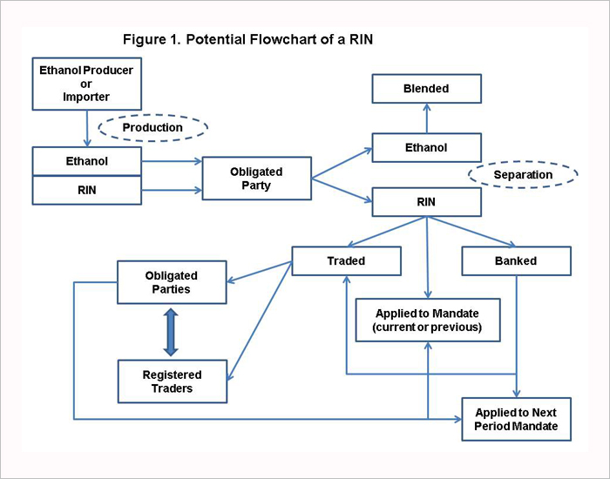
University of Illinois

Slide 17
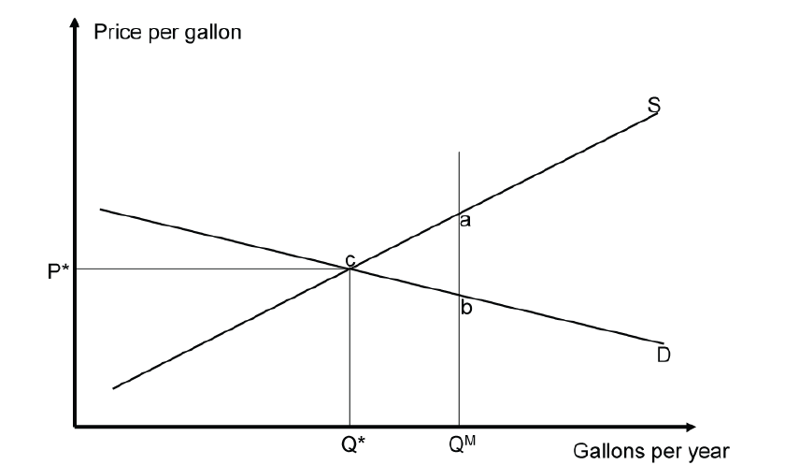

Slide 18
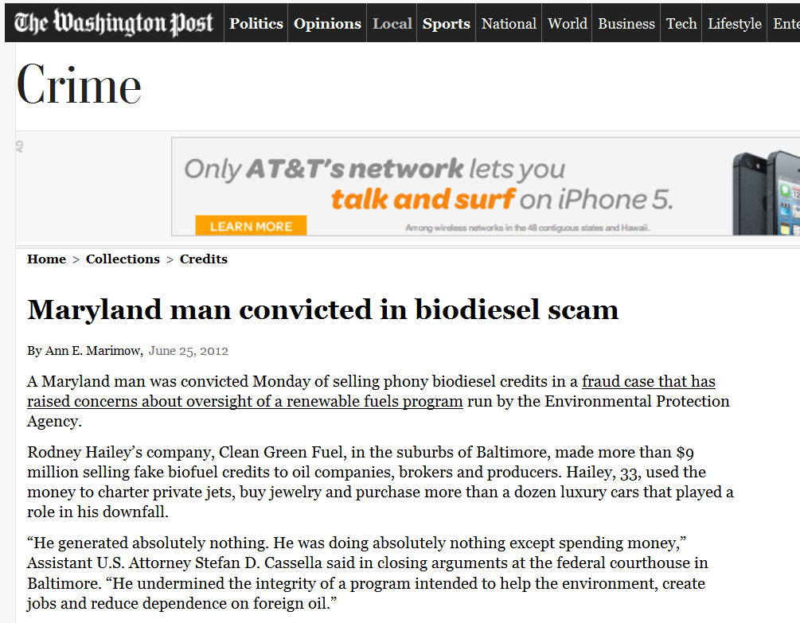

Slide 20
Splash and dash

Slide 21
VETC
The Volumetric Excise Tax Credit (VETC) was established in 1978 for ethanol and in 2004 for biodiesel.
In 2008, the credit was $.51 per gallon of ethanol and $1.00 per gallon of biodiesel blended in the United States

Slide 22
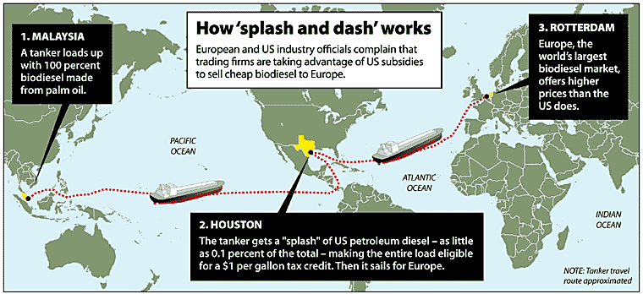
Splashing and Dashing

Slide 23
With Numbers
A company that shipped a tanker with 2.5 million gallons of biodiesel that was splashed with 2,500 gallons of diesel in New Orleans would be able to collect a $2.5 million tax credit.
Iowa State estimated that the biodiesel tax credit cost tax payers about $1.28 billion between January 2007 and August 2008.
Phased out in 2008.

Slide 24
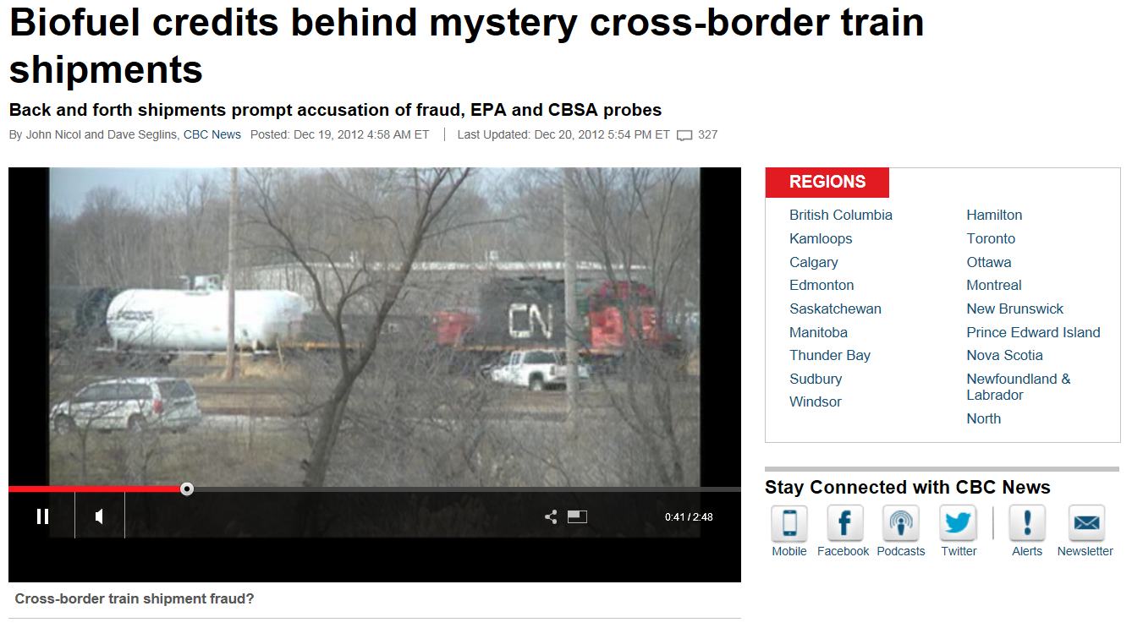
Policy Abuse Revisited
http://www.cbc.ca/news/canada/story/2012/12/19/mystery-biodiesel-train-credits.html

Slide 25
A review
Wind Energy – there is considerable instability in nearly all domestic energy policy
Renewable Fuel Standard – well designed mechanism* to ensure minimum levels of biofuels are used
Volumetric Excise Tax Credit – wow.

