Slide 1
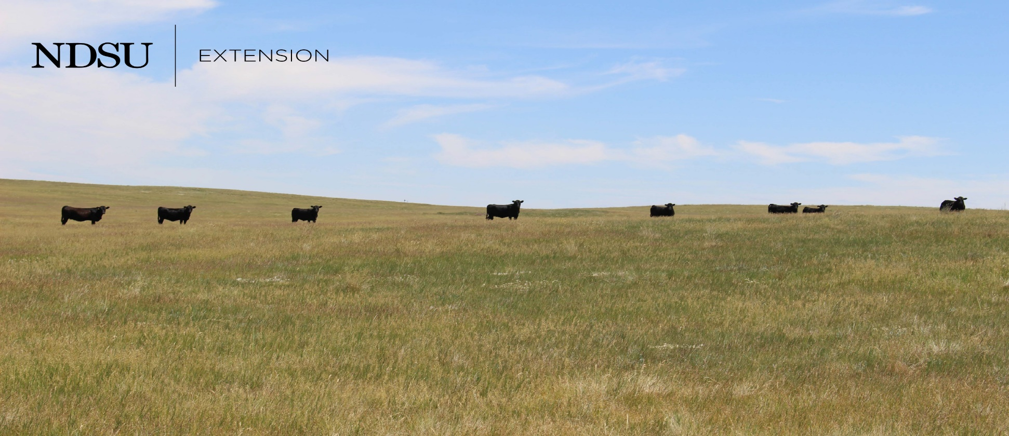
Summer Grazing Outlook - 2021
Tim Petry
Livestock Marketing Economist
www.ndsu.edu/livestockeconomics
4/27/2021

Slide 2
Will summer grazing be profitable in 2021?
Economics are favorable, but drought conditions and corn prices a concern
Carefully compute expected costs and returns!
Price risk management suggested

Slide 3
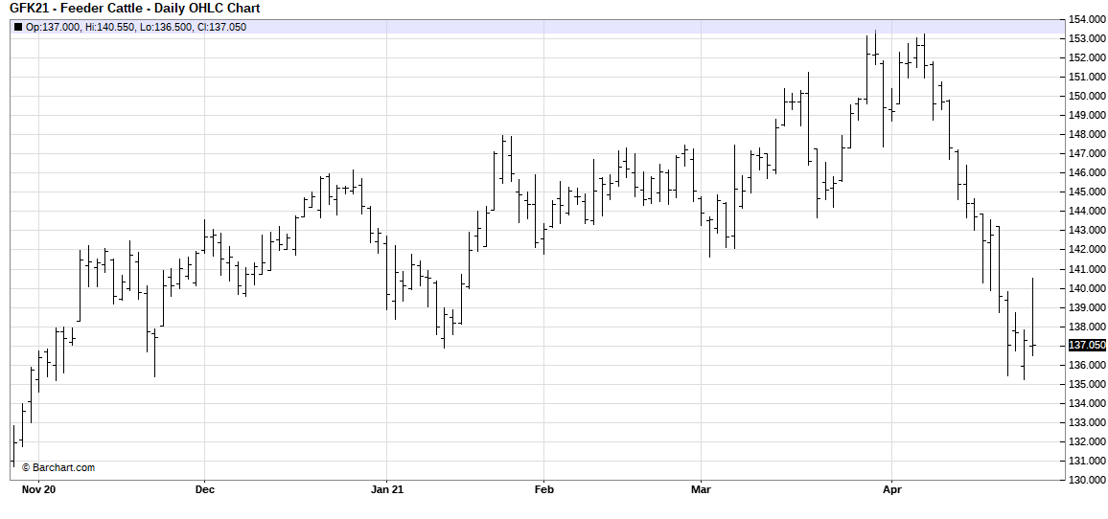
Situation
Beef cow herd declined with declining feeder cattle supplies supportive to prices, BUT?
Calf prices volatile with COVID-19 , Corn$ , Drought
Severe drought in Northern Plains and West
High corn price-feedlots prefer to purchase heavier (800 lb.) cattle
Futures prices volatile

Slide 4
Possible Price Risk
Fed cattle prices volatile COVID-19, demand?
Record beef production
Record pork, chicken and total meat production
Corn price outlook?
Prices have increased $3.50/bu. since August
Continued price volatility-planted acres? crop development? Exports?

Slide 6
HINDSIGHT IS 2020 BUT 2021?

Slide 7
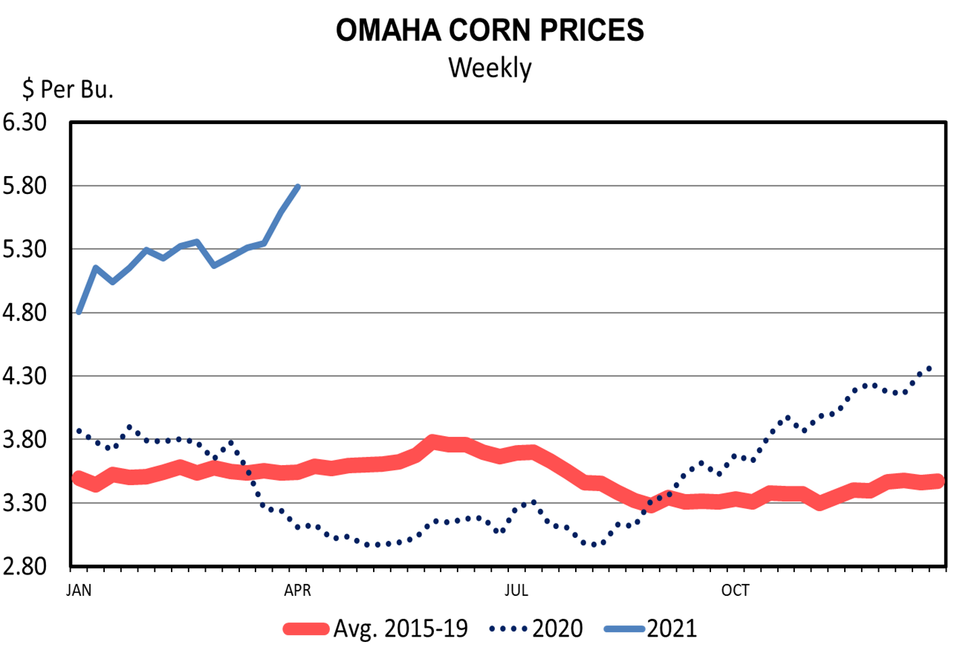

Slide 8
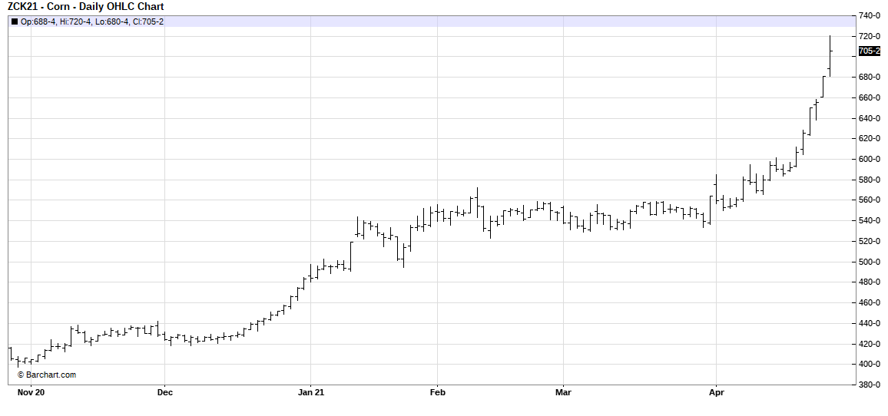
Volatile Prices Will Continue

Slide 9
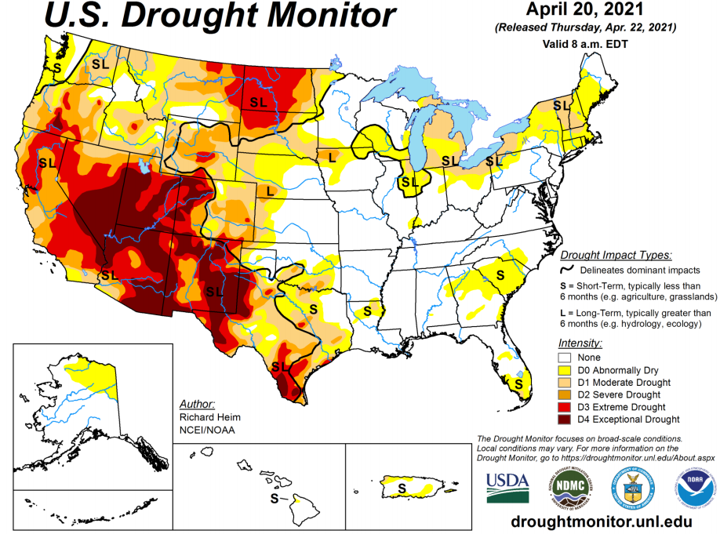

Slide 10
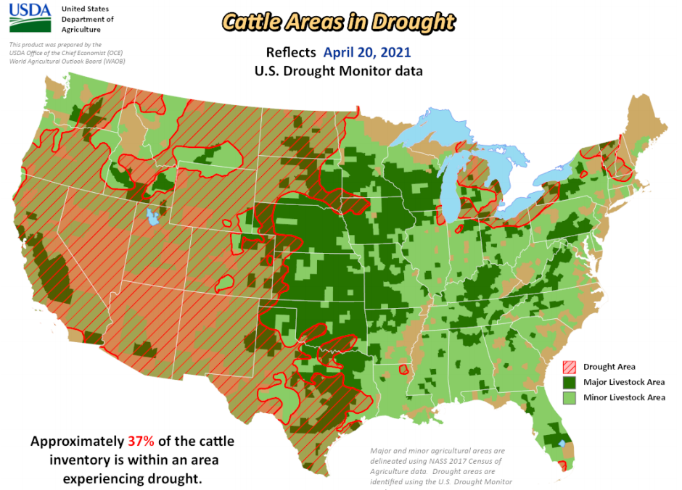

Slide 11
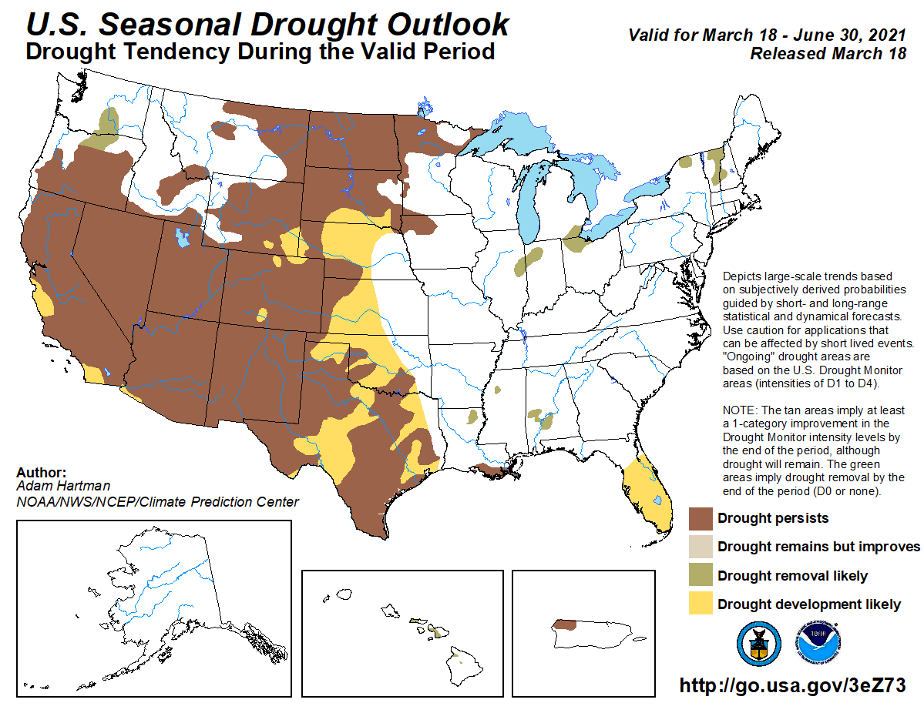
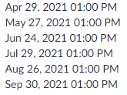

Slide 12
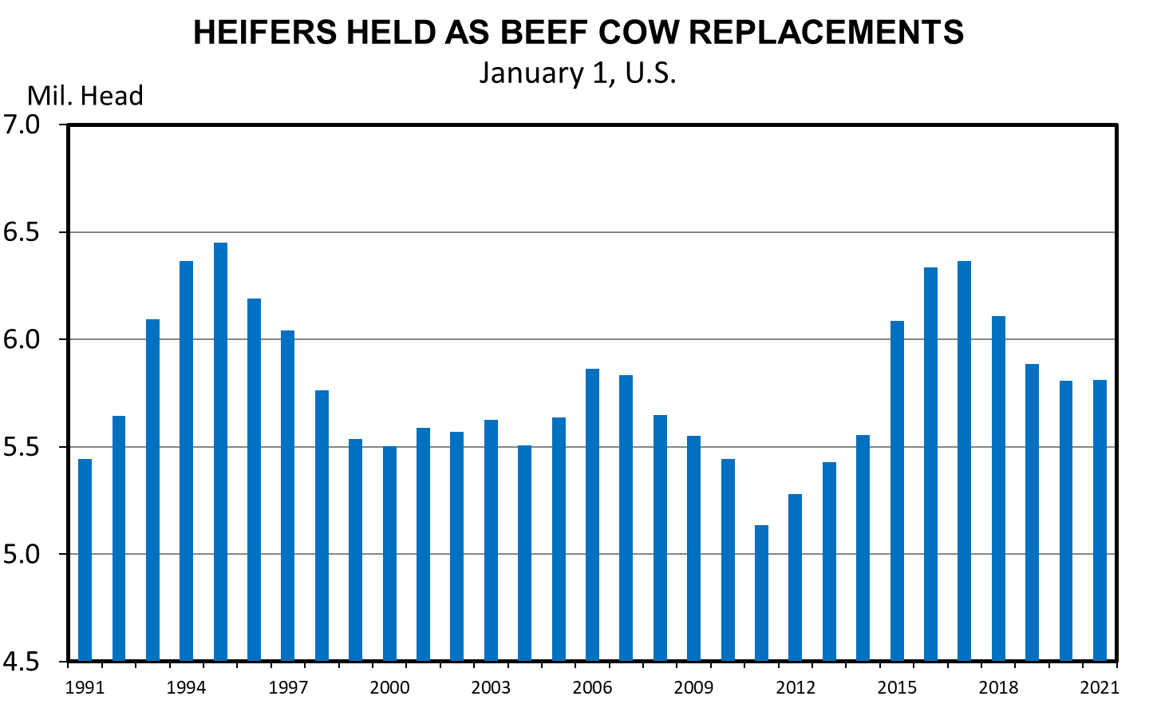
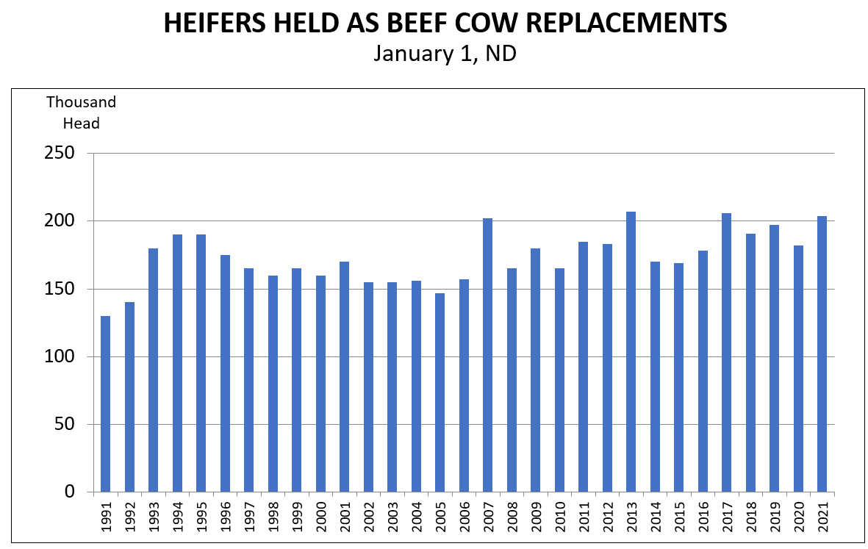

Slide 13
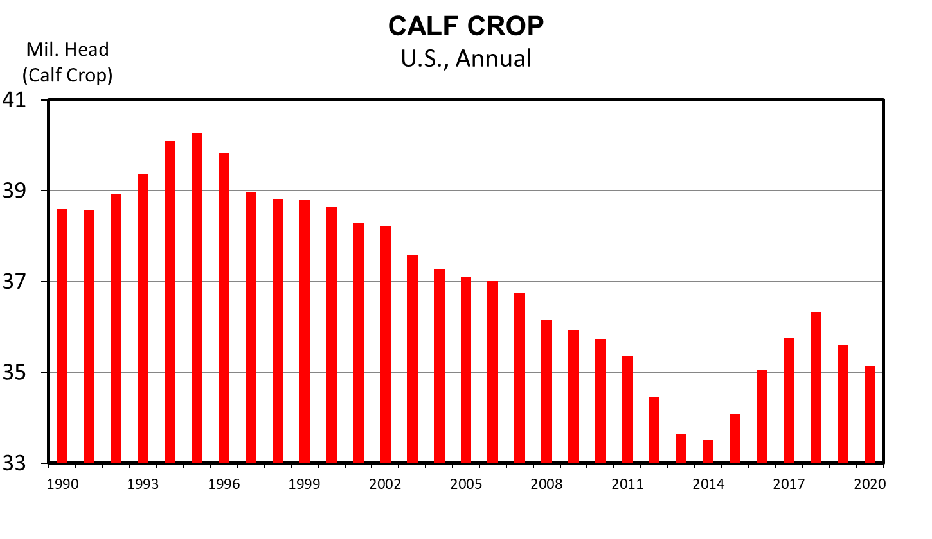
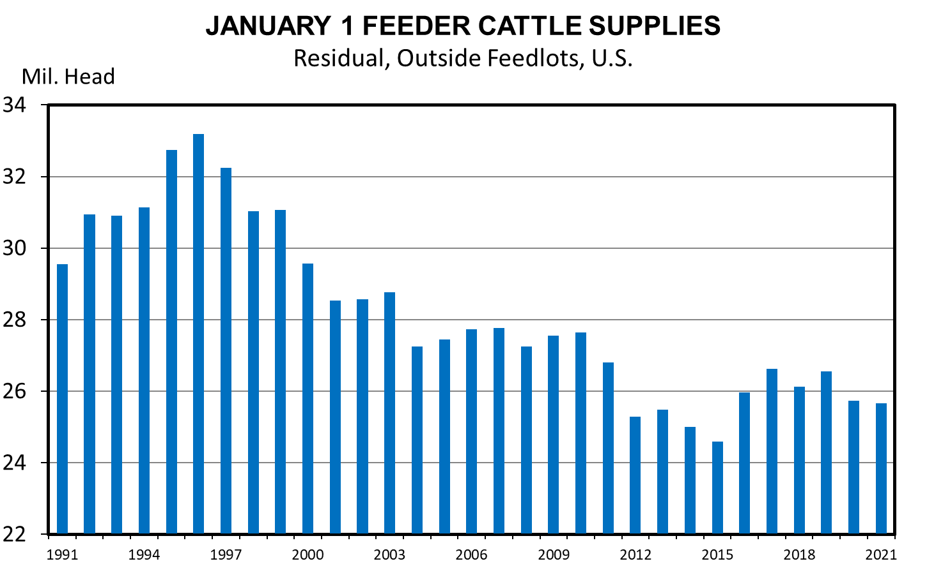
Data Source: USDA-NASS Livestock Marketing Information Center

Slide 14
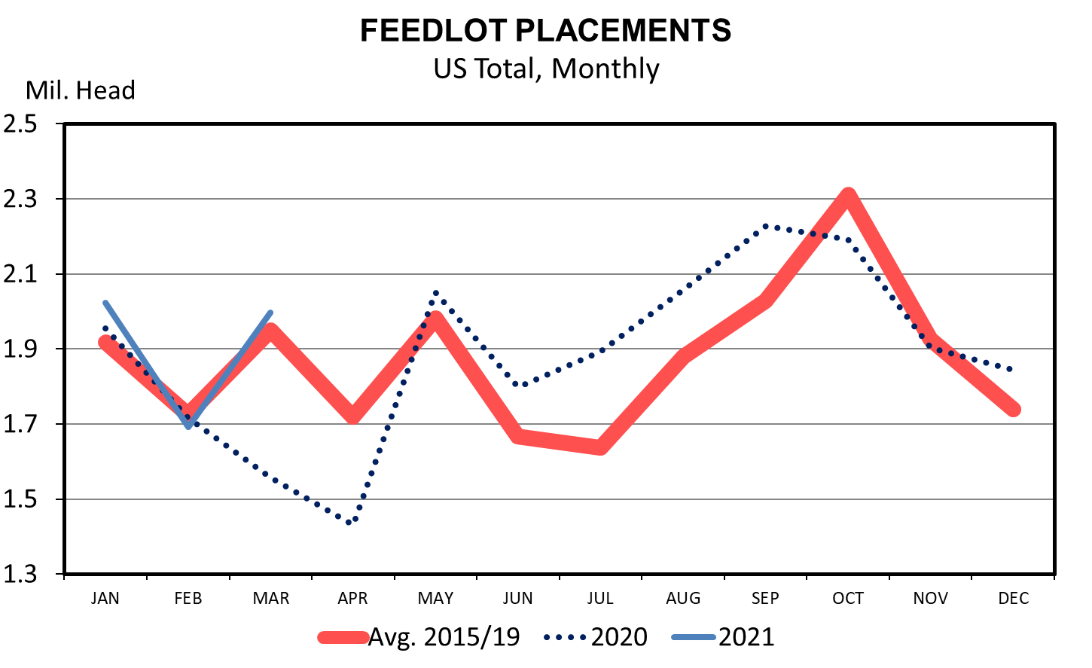
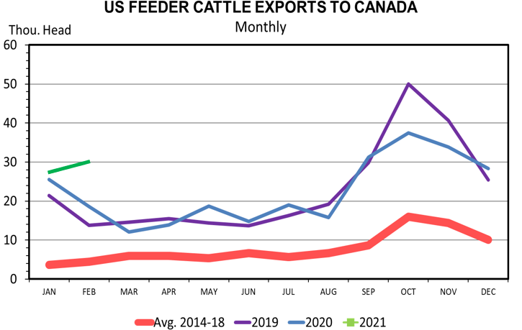
Data Source: USDA-ERS & USDA-FAS - Livestock Marketing Information Center

Slide 15
MED. FRAME #1 STEER CALF PRICES 550-600 Pounds, N.D., Weekly

Slide 17
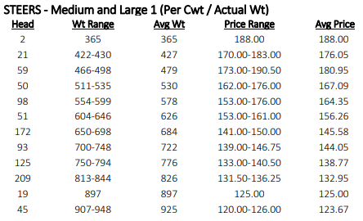
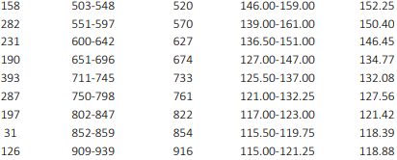

Slide 18
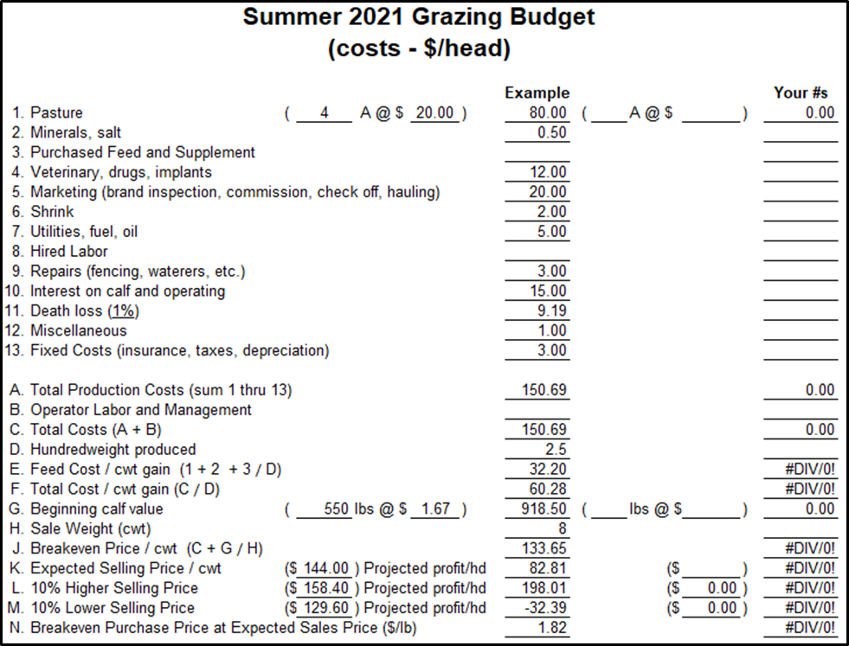

Slide 19
Price Risk Management Tools
Cash forward contract
Video and internet auctions
CME futures
CME options
Livestock Risk Protection (LRP)
Which one or combination fits your marketing plan?
“If you don’t manage risk, risk will manage you”

Slide 20
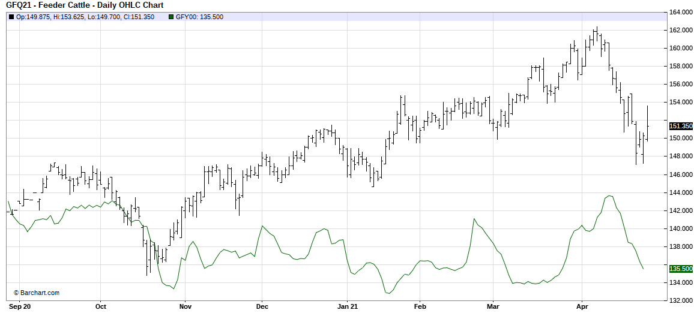
AUG 2021 FDR CAT/CME FDR CAT INDEX

Slide 21
N.D. Feeder Cattle Basis “Rule of Thumb”
E to W along I-94
800 lb. M&L 1 steers par with FC futures
($0 Basis, but wide range in prices)
Highway 2 deduct $2-$4

Slide 22
NEW LRP Premium Subsidy Rates
Coverage Level % Subsidy Rate %
95-100 35
90-94.99 40
85-89.99 45
80-84.99 50
70-79.99 55
Effective 9-14-2020/Retroactive to 7-1-2020
(13% Subsidy for many years)

Slide 24
LRP – Feeder Cattle 4/27/21
 | Price | Cost/cwt | End Date | Current LRP Cash Price
800 lb. steer | 150.00 | 4.69 | 8/24/21 | 135.22
 | 134.00 | 1.03
 | 151.86 | 5.26 | 9/21/21
 | 135.86 | 1.25
750 lb. heifer | 135.00 | 4.22 | 8/24/21 | 121.17
 | 133.20 | 3.64
 | 136.67 | 4.73 | 9/21/21
 | 134.87 | 4.11

Slide 25
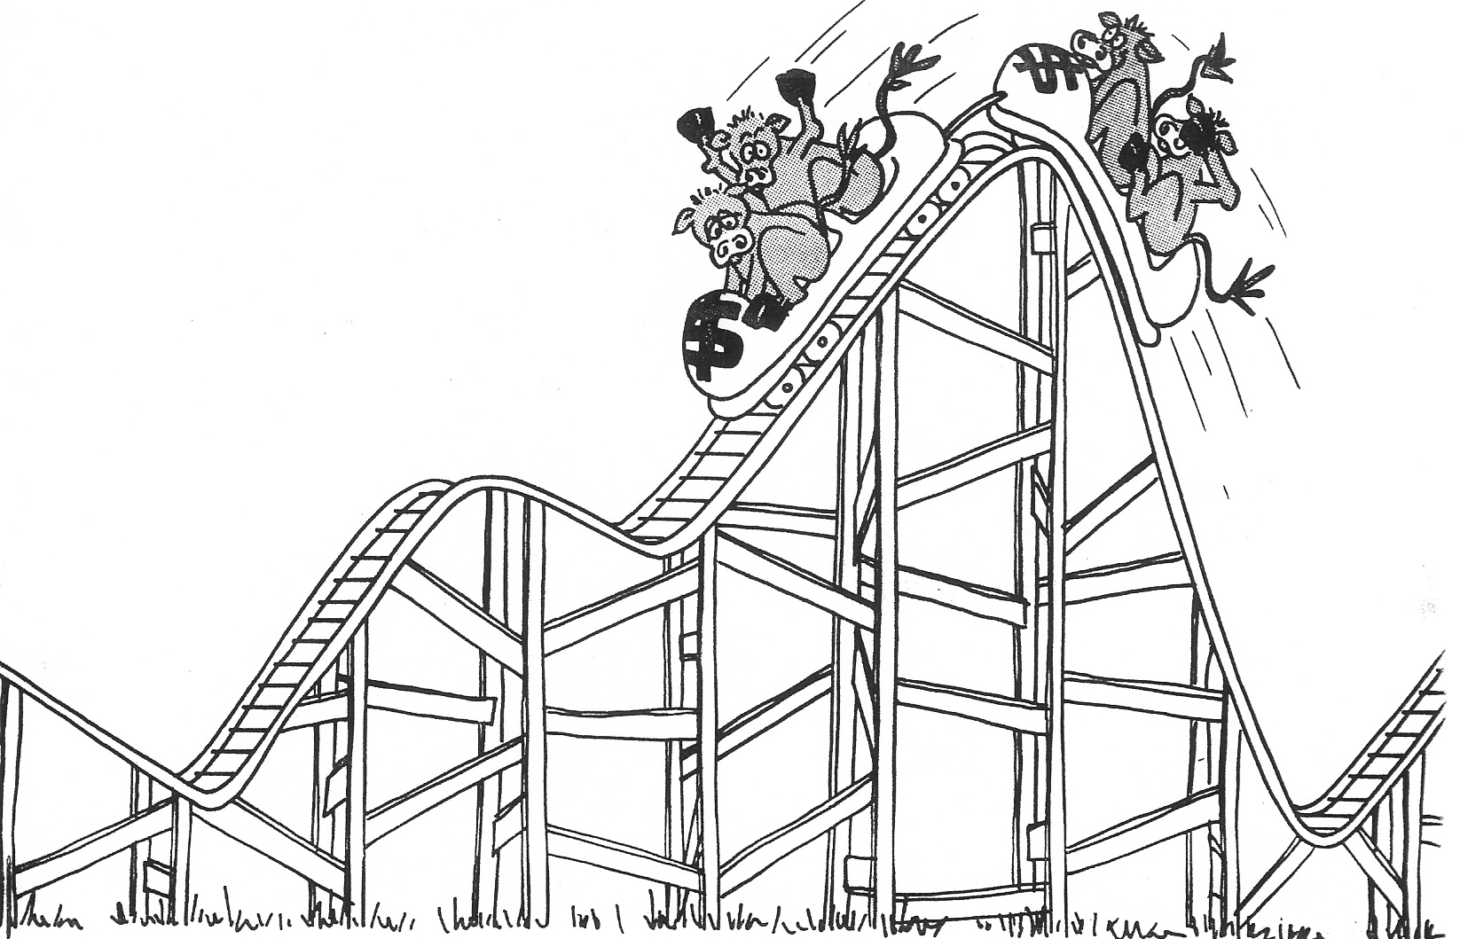
2021: COVID-19, Corn$, Drought Issues? Causing Volatility and Risk , especially on seasonal basis. Flexible marketing plans should include risk management tools

