Slide 1
ND State Climate Office Bi-Weekly Drought Update
Adnan Akyuz, Ph.D.
NDSU, AES
State Climatologist
Last Update: 6/17/2021

Slide 2
US Drought Monitor
Current
4-week change

Slide 3
State-wide Precipitation and Temperature Rankings Last Month
May Precipitation in ND:
50th Driest Month
May Temperature in ND:
53rd Coldest Month
NOAA National Centers for Environmental information, Climate at a Glance: Divisional Mapping from https://www.ncdc.noaa.gov/cag/

Slide 4
County-wide Precipitation and Temperature Rankings Last Month
May Precipitation
May Temperature
NOAA National Centers for Environmental information, Climate at a Glance: Divisional Mapping from https://www.ncdc.noaa.gov/cag/

Slide 5
State-wide Precipitation and Temperature Rankings Last 3 Months
Mar-May Precipitation in ND:
14th Driest Season
Mar-May Temperature in ND:
22nd Warmest Season
NOAA National Centers for Environmental information, Climate at a Glance: Divisional Mapping from https://www.ncdc.noaa.gov/cag/

Slide 6
County-wide Precipitation and Temperature Rankings Last 3 Months
Mar-May Precipitation
Mar-May Temperature
NOAA National Centers for Environmental information, Climate at a Glance: Divisional Mapping from https://www.ncdc.noaa.gov/cag/

Slide 7
State-wide Precipitation and Temperature Rankings Last 8 Months
Oct-May Precipitation in ND:
3rd Period on Record
Oct-May Temperature in ND:
14th Warmest Season on Record
NOAA National Centers for Environmental information, Climate at a Glance: Divisional Mapping from https://www.ncdc.noaa.gov/cag/

Slide 8
County-wide Precipitation and Temperature Rankings Last 7 Months
Oct-May Precipitation
Oct-May Temperature
NOAA National Centers for Environmental information, Climate at a Glance: Divisional Mapping from https://www.ncdc.noaa.gov/cag/

Slide 9
Select City Precipitation Accumulation Deficits
Bismarck (Water-year Accumulation)
Williston (Water-year Accumulation)
 | Accumulation (in)
Oct 1 to date (Departure from normal; Ranking) | 4.42 (-5.83; 4th Driest since 1873)
1981-2010 Average | 10.25
The lowest on record for the period (year) | 3.91 (1987-88)
 | Accumulation (in)
Oct 1 to date (Departure from normal; Rank) | 3.93 (-3.19; 13th Driest since 1893)
1981-2010 Average | 8.52
The lowest on record for the period (year) | 3.29 (1979-80)

Slide 10
Select City Precipitation Accumulation Deficits
Fargo (Water-year Accumulation)
Grand Forks (Water-year Accumulation)
 | Accumulation (in)
Oct 1 to date (Departure from normal; Ranking) | 7.15 (-6.5; 6th Driest since 1881)
1981-2010 Average | 13.65
The lowest on record for the period (year) | 6.21 (1912-13)
 | Accumulation (in)
Oct 1 to date (Departure from normal; Rank) | 6.36 (-5.03; 7th Driest since 1892)
1981-2010 Average | 11.39
The lowest on record for the period (year) | 5.09 (1962-63)

Slide 11
Last 30-Day Precipitation
Total Accumulation
% of Normal
NDAWN Center: https://ndawn.ndsu.nodak.edu/

Slide 12
Long Term Precipitation % of Normal
Last 60 Days
Last 90 Days
NDAWN Center: https://ndawn.ndsu.nodak.edu/
AHPS: https://water.weather.gov/ahps/

Slide 13
6-Month Precipitation % of Normal
AHPS: https://water.weather.gov/ahps/

Slide 14
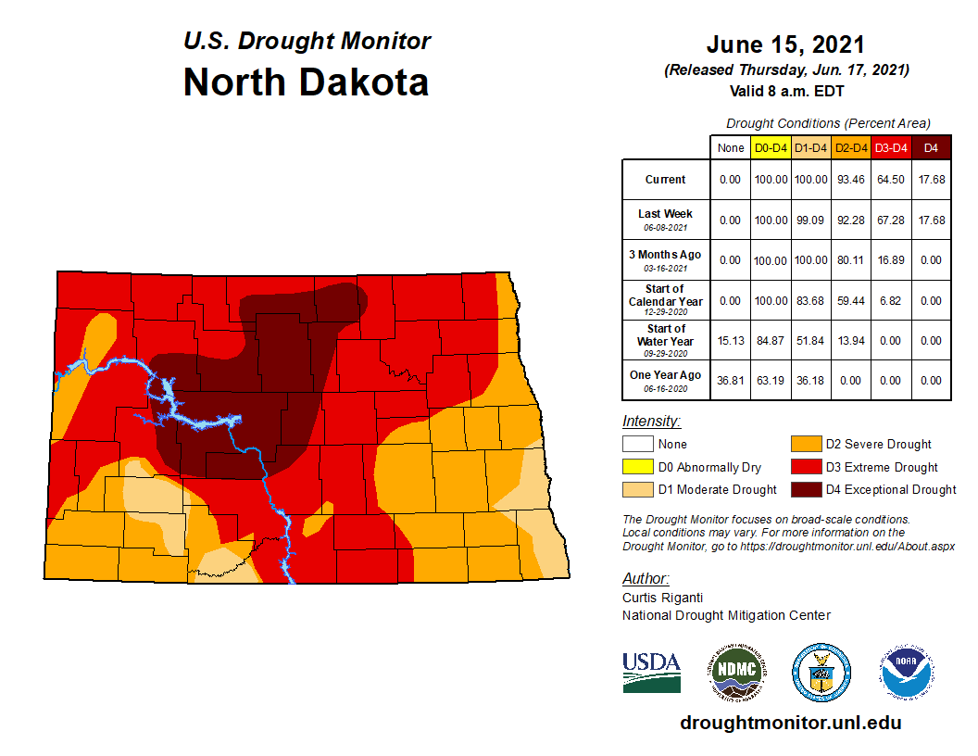
Cumulative % area
(% Weekly Change)
D4
18%
(0%)
D2
93%
(+1%)
D3
64%
(-3%)
D1
100%
(1%)
Estimated Population in Drought Areas: 672,591 (+9,112)
(Weekly change)

Slide 15
Drought Change
4-week Change
6-monthChange

Slide 16
Drought Severity and Coverage Index (Statewide)
Highest DSCI this season: 393 (5/18/2021)
Current DSCI: 376 (-10)
2nd Highest DSCI : 329
(Aug 8, 2006)
295
8/8/2017
Drought Severity and Coverage Index = A_{DO} + 2A_{D1} + 3A_{D2} + 4A_{D3} + 5A_{D4} (Akyüz, 2007)
Where: A is a % of the state covered under the corresponding D-severity

Slide 17
Statewide Accumulated Drought Severity and Coverage
ADSCI for the Current Season: 12,126
57-week Accumulation since 5/19/2020
28,894
10,642
9,653
2116
11,991
12,126
Numbers indicate the area under the DSCI Curve (Accumulated DSCI*) which is directly correlated with the accumulated drought impact in the state.
*DSCI values are accumulated since the first week the drought category is at last D1 anywhere in the state.
Akyuz (2017)

Slide 18
ND Drought Economic Impact
*NOAA Billion-Dollar Weather and Climate Disasters Database
Event | Economic Impact Rank | CPI Adjusted Estimated Cost (in Billions)* | Total Cost (if Multi-year Drought)
1980 | 2 | $5-10
1988 | 1 | $5-10
1989 | 5 | $0.5-1 | $5.5-11 (1988-89 Drought)
2002 | 8 | $0.25-0.5
2003 | 11 | $0.25-0.5 | $0.5-1
2006 | 6 | $0.5-1
2008 | 4 | $0.5-1
2012 | 10 | $0.25-0.5
2013 | 7 | $0.5-1 | $0.75-1.5
2017 | 3 | $1-2
2020 | 9 | $0.25-0.5
2021 |  | $ | $

Slide 19
Soil Moisture Ranking Percentile
Short-term Prediction Research and Transition Center: Real-time 3km Land Information System
0-10 cm (Surface to 4”)
0 to 100 cm (Surface to 3’)
https://weather.msfc.nasa.gov/sport/case_studies/lis_CONUS.html

Slide 20
Other Drought Indices
90-Day SPI (Standard Precipitation Index)
30-Day EDDI (Evaporative Demand Drought Index)

Slide 21
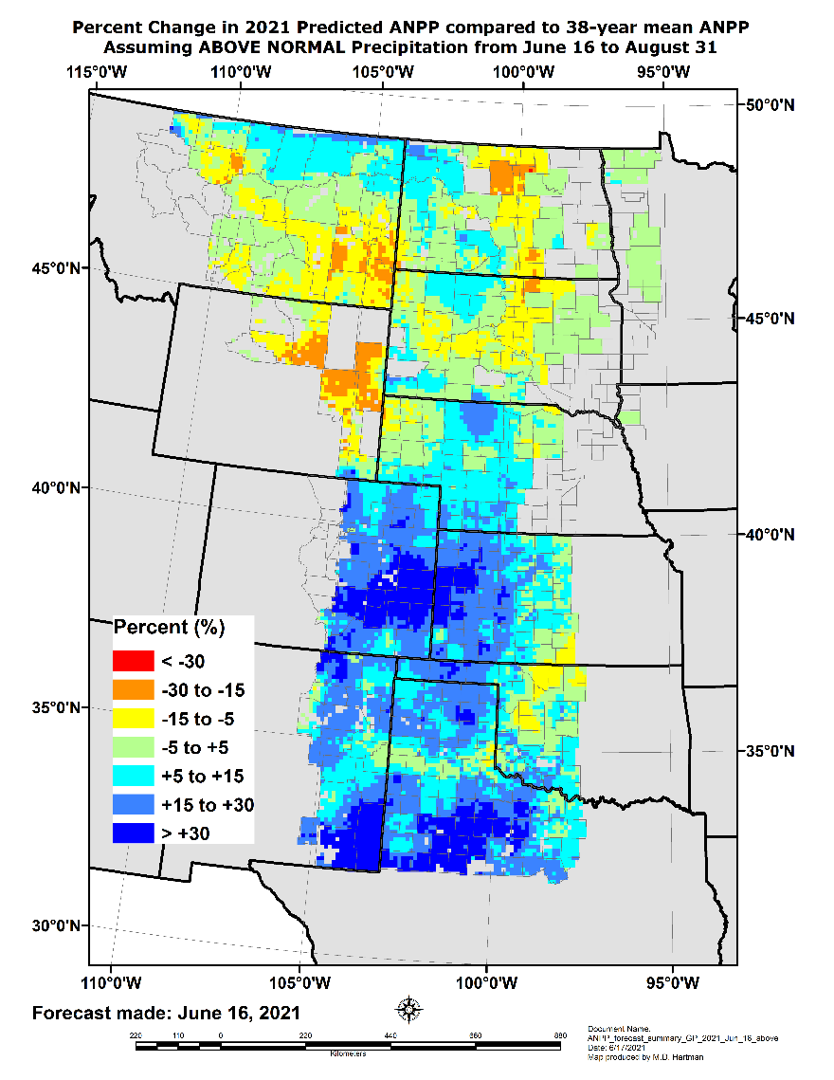
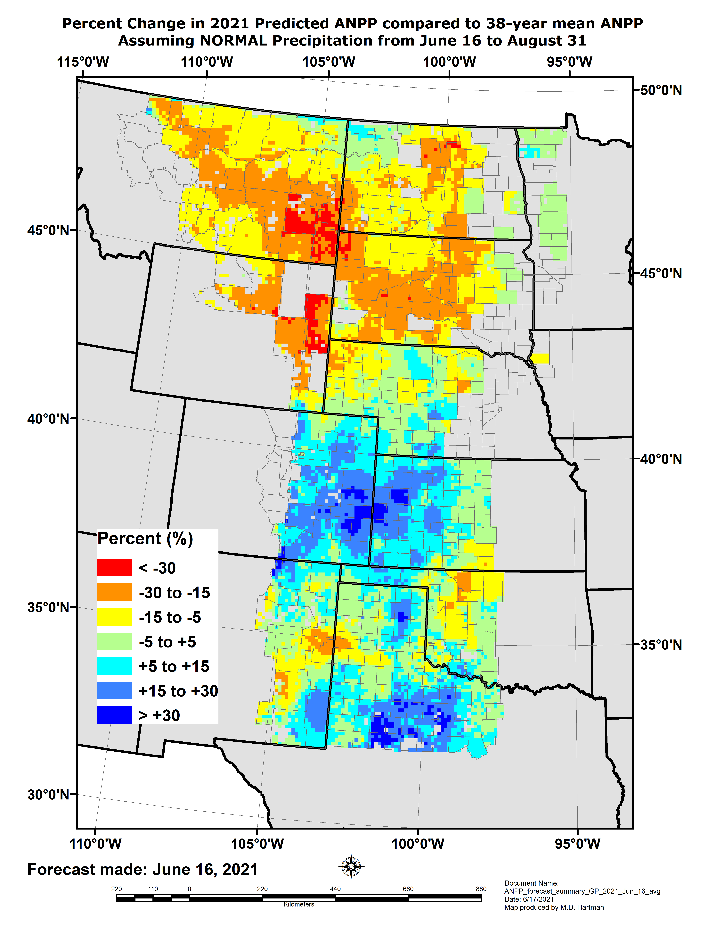
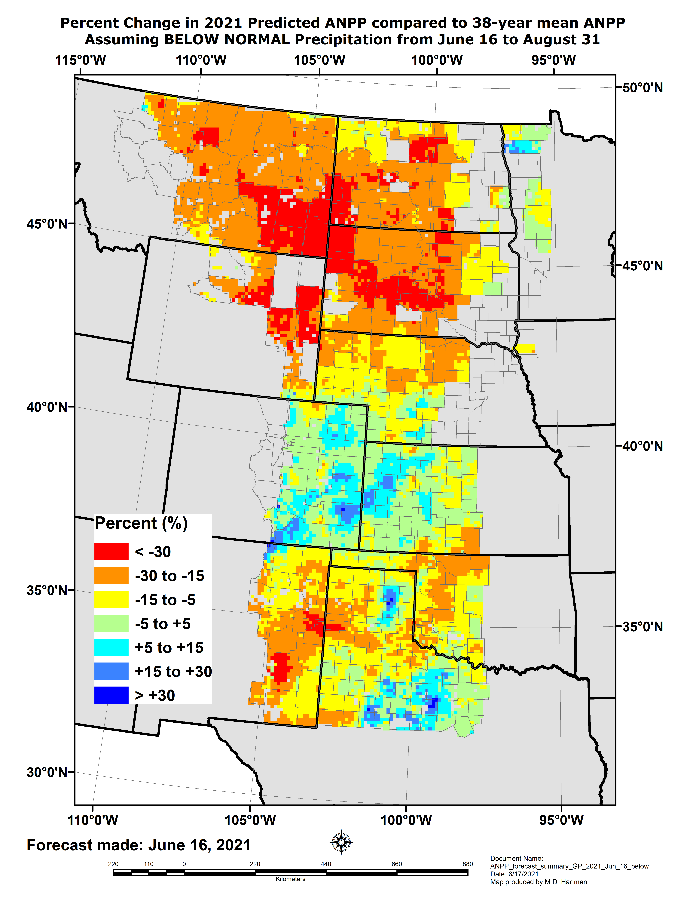
Grass-Cast: Made: June 16, 2021 % Change in Grassland Production for Your Area this Summer Compared to Its 38-yr Average - Forecast

Slide 22
Countywide Impacts
CD1 (Divide): Conditions continue to be very dry across the county. The recent heat has actually been good for our crops & grass as it warmed the ground up enough to get things growing. Our temperatures have fluctuated a lot from daytime highs to nighttime lows resulting in plants not growing as good as they should. However the high temperatures & wind will continue to dry out the top soil. Fields are looking alright. Germination was slow this year & crops have not come up as even as farmers would like. However they are growing. Ranchers are still concerned with forage availability in rangeland. Native ranges just haven't grown this year. After the rain and heat they have grown a little bit and greened up a touch. However they are at a significant loss when it comes to plant height, density, and regrowth. Within the past week along roadsides, grass is heading out already that's maybe 6-12in tall. Hopefully this isn't an indicator on how early, stressed crops like wheat and durum will head out too.
CD1 (Williams): The conditions in western North Dakota have improved quite a bit from previous weeks with heavy rainfall on Thursday, June 10th. The storms brought heavy hail, high winds and large amounts of moisture to some areas of Williams County. The rainfall ranged from just over an inch up to five inches. Much of this ran off though as the precipitation was so heavy in a short period of time that it caused localized flooding, rather than soaking in. High temperatures and winds following the rain event have really dried things up the past few days. A benefit of the runoff from the large storm is that most dugouts and ponds have water now whereas before the event, were mostly dry or completely dry. This should bring some relief to ranchers that have been hauling water to livestock for the past couple months. The pasture areas are finally greening up after being brown all spring. The precipitation arrived too late for alfalfa as it was already in bloom.

Slide 23
Countywide Impacts
CD2 (McHenry): The northern part of the county has received 2" of rain on Friday last week. Unfortunately there hasn't been much growth in the crops yet, weeds have started to germinate. Most farmers have moved to spraying now that moisture is present. The overall picture still doesn't look good for the area. There have been a lot of dispersions of herds and general selling down of cattle, the local sale barn has been selling 1000 cow/calf pairs for 3 weeks and have that many consigned for the next 3 weeks.
CD2 (Pierce): Conditions for Pierce county continue to be county wide. Southern Pierce county has caught a little more rain but still remains severely dry. Areas East and west of rugby still haven’t caught significant rain. Right now Pierce County can’t catch a substantial rain amount. Seems like it is a half inch at a time but that is not making up for hot and windy conditions. People are spraying minimal herbicides on small grains to conserve money. Some canola crops are being abandoned due to flea beetles. Some soybean and corn crops have about half emergence. A lot of stress on producers. Water quality in livestock pastures is slowly getting worse. Livestock barn is maxed out every week for sales now. They’re trying their best to get resources to ranchers. Wells can’t be dug until September. A lot of cattle yet to be sold.

Slide 24
Countywide Impacts
CD3 (Towner): The recent rains were not consistent throughout the county. Over the past week one NDAWN site got just over 2 inches and the other just over 1 inch and reports of less than an inch in other areas. It is hard to tell what the immediate recovery will be, however, it won't change the fact that the dugouts are still very low and crops were still impacted by the recent high temperatures.
CD3 (Cavalier): Last weeks rains helped the drought situation and crops are looking better.
CD3 (Pembina): These coniditions are widespread throughout the county. The county has received an approximately an inch to an inch and a half of rain over the last week which has helped late planted crops to emerge. Approximately 3000 acres of sugar beets had to be replanted due to insuffcient moisture to sustain germinated seedlings causing around 25% stand loss in affected fields. Some producers have replanted acres of poor stands of hard red spring wheat. Hotter than average temperatures combined with warm high winds have resulted in conditions of low humdity creating both increased fire risk and dessiacting conditions espcially for young crop plants. The recent rain will help sustain crop plants but more is needed to maintain growth. Many trees in the area are showing signs of drought stress. Home gardeners are having to water plants at a much higher frequency and turf which is receiving no irrigation is dying.

Slide 25
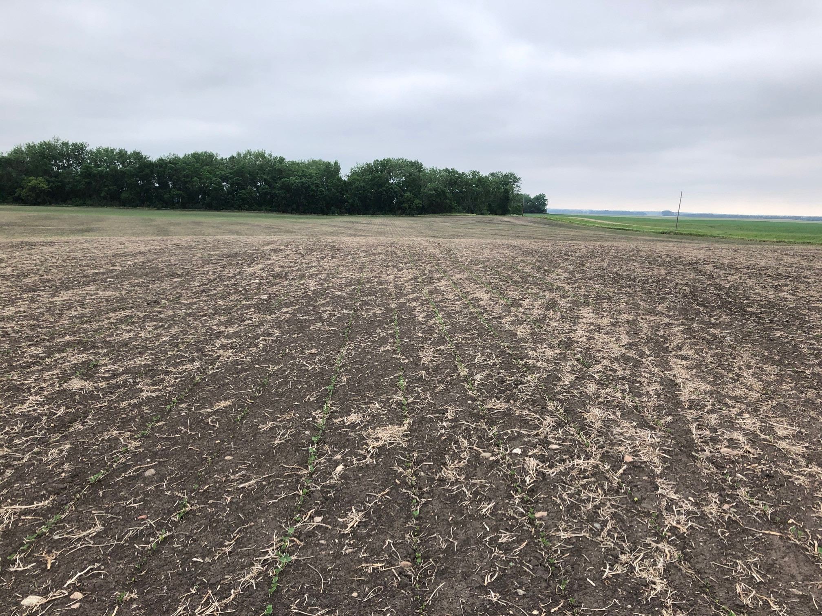
Countywide Impacts
CD3 (Grand Forks): Widespread. 1st cutting alfalfa very short. Reports of less than a bale to the acre. Crops are stalled. Very uneven emergence. Spring wheat has been pushed and is heading out early and also Very short. Anticipating shortage of straw. Spider mites in soybean. Livestock forage concerns continue. Animals being sold. Beans picture is taken from a hilltop. You can see very poor emergence/crop growth/small leaves. In low area by trees, crop is progressing much faster than rest of the field and has reached almost V2. Spider mites are moving into the field and can be observed along with spider mite damage on leaves along edges of fields (spider mite picture). Grasshoppers are also increasing. Ditches being mowed are very brown underneath. Wheat picture, just showing unevenness of crop. There is wheat heading out at 12 inches tall, and is very thin.

Slide 26
Countywide Impacts
CD4 (Golden Valley): For the most part county wide including western Billings county. The very northern tip of Golden Valley did get rain last week in a series of storms, but it came hard and fast, may have helped to refresh stock ponds, but not much help to the grass and crops. Central pat of the county crops are going backward fast and will continue to decline this week with the predicted heat and wind. Pastures and hay crops are in much the same place. Pastures are quickly drying up, and guys are in a hurry to get first cutting alfalfa put up prior to it "burning up“.

Slide 27
Countywide Impacts
CD5 (Kidder): Some of the county received over 5 inches of rain last week over the span of a few short hours. While stock ponds were replenished, excessive flash flooding and hail damage was seen with storm. Crop ground was washed out or hailed out along with many gardens along I-94. Other areas of the county are still extremely dry and did not receive any rain. For some farmers, they will be forced to replant fields for the 3rd time this year. Buildings and grain bins were lost from excessive winds from storm.

Slide 28
Countywide Impacts
CD7 (Stark/Billings): This report is for Stark and Billings counties. We have received some moisture but is very spotty. The eastern 1/3 of Stark County is a little better. Northern part of Billings county has also received a little more moisture recently.

Slide 29
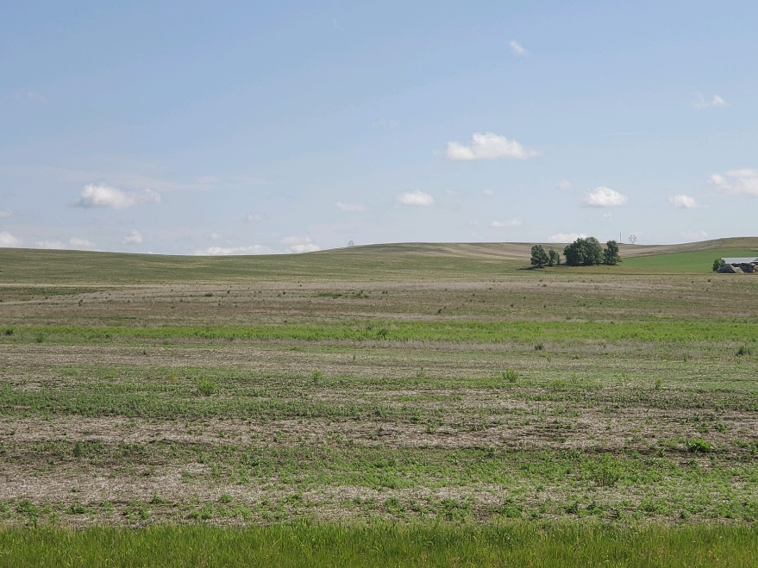
Countywide Impacts
CD8 (Morton): Very hot weather with minimal to no rain in some areas of the county. Poor emergence in some fields
Poor Germination, in Morton Co.

Slide 30
Outlooks

Slide 31
7-day: Through Thu. 7 AM (CDT), June 17
Precipitation:
Through Fri 7am, June 25
Temperature Departure from Normal:
Through Fri 7pm, June 25
https://www.wpc.ncep.noaa.gov/#page=qpf

Slide 32
8-14 Day: June 25- July 1
Precipitation
Temperature
https://www.cpc.ncep.noaa.gov/products/predictions/814day/

Slide 33
Week 3 and 4: June 26-July 9
Precipitation
Temperature
https://www.cpc.ncep.noaa.gov/products/predictions/814day/

Slide 34
One-Month Outlook (Updated June 17)
Precipitation
Temperature
Climate Prediction Center

Slide 35
Jul-Sep 2021 Outlook (Updated June 17)
Precipitation
Temperature
Climate Prediction Center

